Slide 1


Demographic Trends, Characteristics, and Population Projections for Texas and Tarrant County
Women’s Policy Forum of Tarrant County
May 6, 2020
@TexasDemography

Slide 2
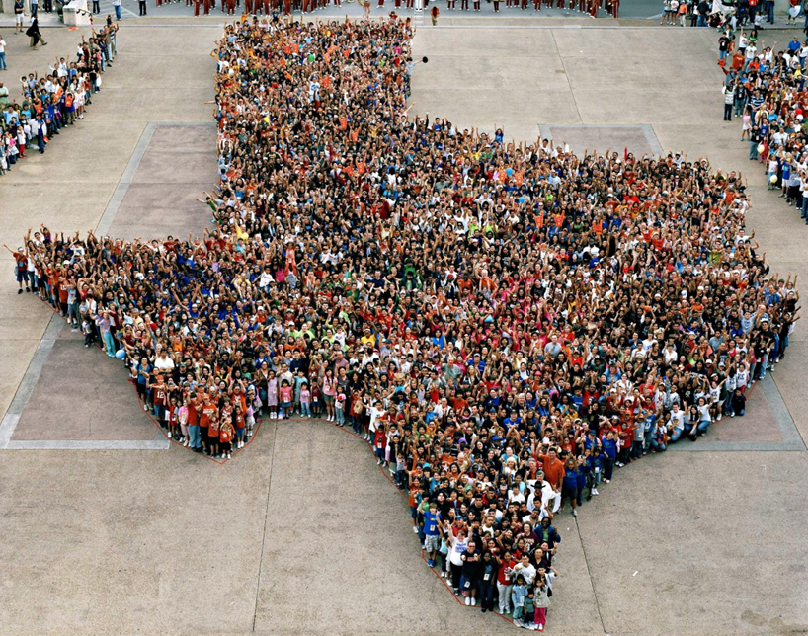
A complete and accurate count is essential for Texas.

Slide 3
CENSUS 2020
Every ten years, the country conducts a census to count every person in the United States.
The next count will take place April 1, 2020.
Census counts used to reapportion the U.S. House of Representatives, determining how many seats each state gets.
Census counts also used to determine the number of electoral college votes a state gets.
Census counts used by state officials to redraw congressional and state legislative boundaries to account for population shifts.
Census derived data are used to allocate over $1.5 trillion in federal funds to support healthcare, education, transportation, or other service programs.

Slide 4
CENSUS 2020
Businesses rely on Census data for market research, locations, and economic development.
Census derived data are used to allocate over $1.5 trillion in federal funds to support healthcare, education, transportation, or other service programs.

Slide 5
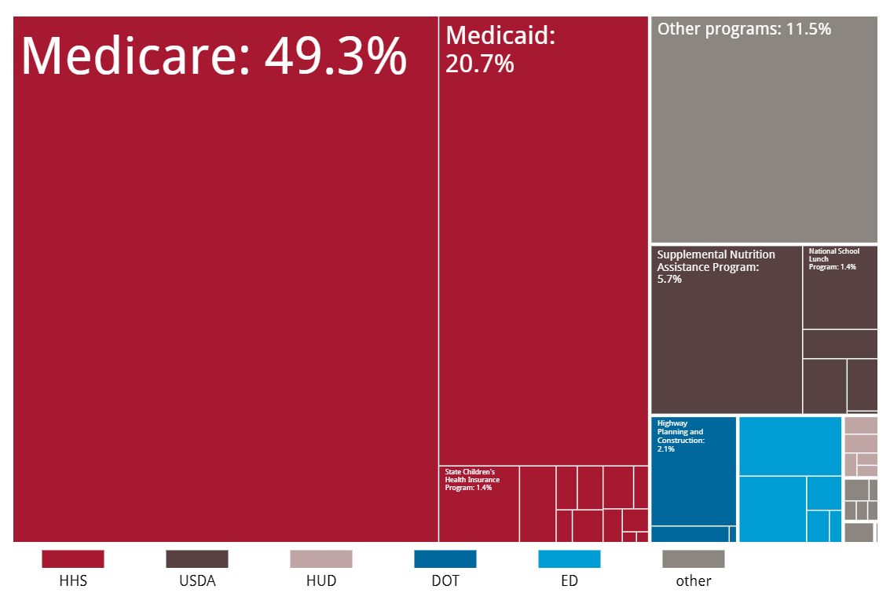
Census Derived Funding in Texas
In FY 2017, Texas received $101 billion in federal funding for programs that use Census derived data.
Source: Reamer, Andrew; George Washington Institute of Public Policy, Counting for Dollars

Slide 6
Census Derived Funding in Texas, FY 2017
Program | FY2017 Funding
Medicare | $ 50,065,391,000
Medicaid | $ 21,078,511,000
Other programs | $ 11,665,742,000
Supplemental Nutrition Assistance Program | $ 5,805,152,000
Highway Planning and Construction | $ 2,172,810,000
National School Lunch Program | $ 1,433,344,000
Title I Grants to Local Education Agencies | $ 1,415,074,000
State Children's Health Insurance Program | $ 1,382,120,000
Special Education Grants | $ 1,037,782,000
Head Start | $ 626,118,000
School Breakfast Program | $ 558,932,000
Supplemental Nutrition Program for Women, Infants, and Children | $ 501,349,000
Child and Adult Care Food Program | $ 367,326,000
Federal Transit Formula Grants | $ 299,620,000
Child Care and Development Block Grant | $ 292,750,000
Vocational Rehabilitation Grants to the States | $ 278,589,000
Health Care Centers | $ 252,786,000
Child Care Mandatory and Matching Funds | $ 224,538,000
Title IV-E Foster Care | $ 207,520,000
Supporting Effective Instruction State Grants | $ 169,159,000

Slide 7
Census Derived Funding in Texas, FY 2107
Program | FY2017 Funding
Community Development Block Grants/Entitlement Grants | $ 156,133,000
Crime Victim Assistance | $ 155,567,000
Public Housing Capital Fund | $ 145,820,000
Block Grants for the Prevention and Treatment of Substance Abuse | $ 144,710,000
Adoption Assistance | $ 143,120,000
Unemployment Insurance Administration | $ 134,772,000
Social Services Block Grant | $ 134,505,000
Low Income Home Energy Assistance | $ 118,304,000
Career and Technical Education - Basic Grants to States | $ 93,666,000
Public Housing Operating Fund | $ 73,562,000
Home Investment Partnerships Program | $ 63,974,000
State Community Development Block Grant | $ 59,551,000
WIOA Youth Activities | $ 58,290,000
WIOA Adult Activities | $ 55,508,000
Employment Service/Wagner-Peyser Funded Activities | $ 50,422,000
WIOA Dislocated Worker Formula Grants | $ 49,097,000
Community Services Block Grant | $ 33,936,000
Special Programs for the Aging, Title III, Part C, Nutrition Services | $ 28,861,000
Federal Transit - Capital Investment Grants | $ 28,160,000
Cooperative Extension Service | $ 22,443,000
Homeland Security Grant Program | $ 21,481,000

Slide 8
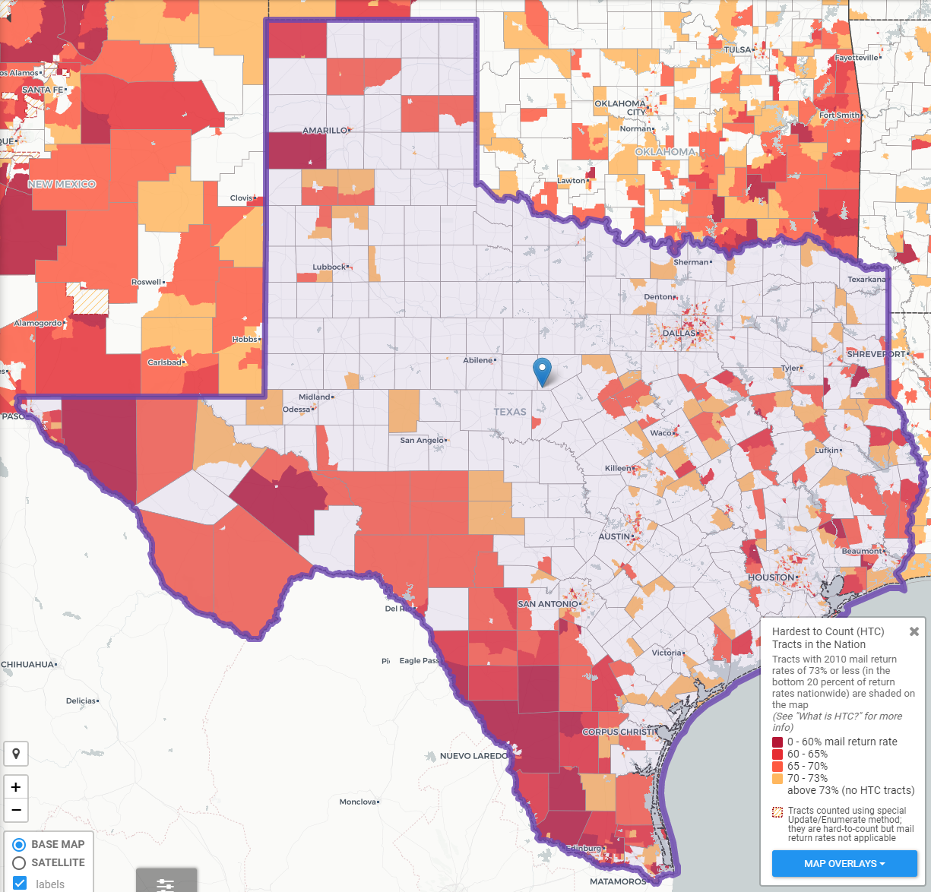

Texas Hard to Count Populations
In 2010, an estimated 240,000 Texans were undercounted in the Census.
An estimated 7 million, or nearly 25%, of Texans live in hard to count neighborhoods.
Some projections indicate up to 500,000 Texans could be undercounted in 2020.
Source: Center for Urban Research of the City University of New York (CUNY) Graduate Center.
Notes:
It has never been easy to count a place as diverse and large as Texas. Our population growth has continued to add to some of the very hard to count populations historically missed from Census surveys. So we face a significant challenge today.

Slide 9
Texas Hard to Count Populations
Census research has identified populations that are more difficult for the Census Bureau to count. These include:
People of Color
  Texas has the second largest number of Hispanics and African Americans and third largest number of Asian populations of all states in the U.S.
Immigrants
  An estimated 4.85 million foreign born reside in Texas.
Children under 5
  An estimated 5 percent, or about 2.2 million, of kids under the age of 5 were not counted in the 2010 Census, including about 75,000 Texas children. Children who are not biologically related, Hispanic, live in complex households, live in rented housing, and who have very young parents are even more likely not to be counted.

Slide 10
Texas Hard to Count Populations
Single-Parent Households
  An estimated 1.2 million Texas households are single-parent households, and all of these households are households with children under 18 years of age.
People with Limited English Proficiency
  Approximately 8% of Texas households are limited English speaking households, with 85% of these households speaking Spanish, 9% speaking an Asian or Pacific Islander language, 4% speaking Indo-European languages, and 2% speaking other languages.
People living in Multi-Family Housing
  Nearly 1 in 4 Texas housing units are in buildings with 2 or more units and 15% of Texas housing units are in buildings with 10 or more units.

Slide 11
Texas Hard to Count Populations
Renters
  Over 1 in 3 Texas households are renter occupied.
Larger Households
  Approximately 5% of Texas households are considered crowded households, where more than 1 person per room is living in the household.
Low Income Populations
  Approximately 16% (or 4.2 million) of the Texas population lives below the poverty level.

Slide 12
Gender and Race/Ethnicity Pay Gap*, Texas, 2018
 | Male Earnings | Pay Gap for Males | Female Earnings | Pay Gap for Females
NH White | $65,965 | * | $50,045 | $0.76
Hispanic | $37,315 | $0.57 | $30,580 | $0.46
Black | $42,477 | $0.64 | $38,195 | $0.58
Asian | $72,029 | $1.09 | $51,871 | $0.79
*pay gap derived using median earnings of NH White males as reference; all earnings are for full-time, year-round workers.
Source: U.S. Census Bureau, 2018 American Community Survey 1-Year Estimates

Slide 13
Educational Attainment by Race/Ethnicity and by Sex, Texas, 2018
 | Total | Male | Female
Educational Attainment
HS and above | 84.0% | 83.4% | 84.5%
NH White | 94.3% | 94.1% | 94.4%
Black | 90.0% | 89.0% | 90.9%
Asian | 87.9% | 90.4% | 85.8%
Hispanic | 67.0% | 65.8% | 68.1%
BA and above | 30.3% | 29.8% | 30.8%
NH White | 39.3% | 39.9% | 38.7%
Black | 25.0% | 22.8% | 27.0%
Asian | 59.9% | 62.9% | 57.3%
Hispanic | 15.2% | 13.7% | 16.7%
Source: U.S. Census Bureau, 2018 American Community Survey 1-Year Estimates

Slide 14
Select Demographic and Social Characteristics by Sex, Texas, 2018
 | Total | Male | Female
Labor Force Participation Rate | 64.5% | 83.6% | 70.1%
Unemployment Rate | 4.9% | 4.4% | 4.6%
Percent below poverty level | 14.9% | 13.4% | 16.3%
Without Health Insurance | 17.7% | 18.5% | 17.0%
Source: U.S. Census Bureau, 2018 American Community Survey 1-Year Estimates

Slide 15
Population Growth and Projected Congressional Seats of Select States
 | 2010 Population | 2019 Population | Numeric Change 2010-2019 | Percent Change 2010-2019 | Projected Congressional Seats Added
United States | 308,745,538 | 328,239,523 | 19,481,418 | 6.3%
Texas | 25,145,561 | 28,995,881 | 3,849,790 | 15.3% | 3
Florida | 18,801,310 | 21,477,737 | 2,673,173 | 14.2% | 2
North Carolina | 9,535,483 | 10,488,084 | 952,333 | 10.0% | 1
Arizona | 6,392,017 | 7,278,717 | 886,429 | 13.9% | 1
Colorado | 5,029,196 | 5,758,736 | 729,417 | 14.5% | 1
Oregon | 3,831,074 | 4,217,737 | 386,658 | 10.1% | 1
Montana | 989,415 | 1,068,778 | 79,371 | 8.0% | 1
California | 37,253,956 | 39,512,223 | 2,257,704 | 6.1% | -1
Minnesota | 5,303,925 | 5,639,632 | 335,705 | 6.3% | -1
Source: U.S. Census Bureau. 2000 and 2010 Census Count, 2019 Population Estimates; Brookings Institute.
Notes:
Texas is the second largest state in terms of population (2nd to CA) and area (2nd to AK). In terms of number of people, Texas’ growth exceeds that of all other states between 2010 and 2018. Texas has added over 3.5 million people between April 1, 2010 and July 1, 2018. This puts Texas on track to meet or surpass the number of people added in the last census when Texas gained 4 congressional seats. Projections from multiple sources anticipate Texas will gain 3 congressional districts after the 2020 census.

Slide 16
Linear Forecast of Census Bureau Population Estimates 2010-2019 and TDC Population Projections
Ideal House District Size = 195,734 to 197,851
Ideal Senate District Size = 947,099 to 957,345
Source: Texas Demographic Center 2018 Population Projections; linear forecast derived by the Texas Demographic Center from Census Bureau Population Estimates
Notes:
The Texas Demographic Center produces population projections for the state. In comparing these projections, to a linear forecast of the Census Bureau’s population estimates since 2010, we see the Texas Demographic Center is closely aligned with the Census Bureau estimates trend. TDC projections indicate Texas will grow to just under 29.7 million by 2020.

Slide 17
Texas added 367,215 people between July 1, 2018 and July 1, 2019.
About 1,006 people per day added to our population.
  About 483 persons per day from natural increase (more births than deaths)
  About 523 per day from net migration (178 international and 345 domestic migrants per day).
Source: U.S. Census Bureau, 2018 Population Estimates.
Notes:
The Austin Metro area added about 53 thousand people during the same time period (2017 to 2018). Seventy percent (or about 37 thousand) were added through migration and the remaining 30% through natural increase. About 145 people are added to the Austin metro population every day. That’s about 100 people per day add through net migration and about 43 people per day added through natural increase.

Slide 18
Estimates of Components of Population Change, Texas, 2011-2019
Source: U.S. Census Bureau, 2019 Vintage population estimates
Notes:
Natural increase has been in the range of half of population change since the last Census in Texas. Thus Texas is growing quickly and substantially from having more births than deaths over time. In the last year, the number and percent of immigrants has declined and the number and percent of domestic migrants from other states has increased.

Slide 19

Total Estimated Population by County, Texas, 2019
Source: U.S. Census Bureau, 2019 Population Estimates
Notes:
When we look at the geographic distribution of the population of Texas over time we see continually increasing population in the counties along the I-35 corridor, the Houston area, and the lower Rio Grand Valley. Urbanized areas out west have grown but most counties in the west have experienced limited growth and some population decline. Approximately 86% of the population is along I-35 and east. This area with the 3 major metropolitan areas at the points is often described as the Texas population triangle.

Slide 20
Estimated Population Change, Texas Counties,
2010 to 2019
104 counties lost population over the 9 year period.
Source: U.S. Census Bureau, 2019 Population Estimates
Notes:
Population change over the decade has been greatest in the urban and suburban population triangle counties. Counties in the lower Rio Grande Valley also had significant growth as did El Paso. Overall, 150 counties gained population while 104 (41%) lost population over the decade.

Slide 21
Estimated Percent Change of the Total Population by County, Texas, 2010 to 2019
Source: U.S. Census Bureau, 2019 Population Estimates
Notes:
Percent change is an indicator of the speed of population change void of information about the volume of population change. Percent change in the population over the past few years has been greatest in the suburban population triangle counties, notably among counties between San Antonio and Austin. In the early part of the decade, counties in the Eagle Ford Shale area (south east of San Antonio) had been growing quickly. This is less so the case today. The Cline Shale area (Midland and Odessa area) continues to grow and in some cases even growing faster than the State.
The growth rate in the metro counties (82 counties) is 1.7 and in non-metro, or rural, counties it is .3. This means the metro county growth rate is 5.6 times that of the growth rate in non-metro, or rural, counties. At this rate, nearly 95% of the state’s population growth out to 2050 will occur in metro counties and less than 5% will occur in rural areas.

Slide 22
Largest U.S. Cities, 2018
Rank | Place | Census 2010 | 2011 | 2012 | 2013 | 2014 | 2015 | 2016 | 2017 | 2018
1 | New York , NY | 8,175,133 | 8,272,963 | 8,348,032 | 8,398,739 | 8,437,387 | 8,468,181 | 8,475,976 | 8,438,271 | 8,398,748
2 | Los Angeles , CA | 3,792,621 | 3,821,136 | 3,852,532 | 3,883,916 | 3,913,260 | 3,943,215 | 3,969,262 | 3,982,002 | 3,990,456
3 | Chicago , IL | 2,695,598 | 2,708,209 | 2,719,735 | 2,726,772 | 2,728,524 | 2,726,215 | 2,718,946 | 2,713,067 | 2,705,994
4 | Houston , TX | 2,099,451 | 2,124,143 | 2,160,086 | 2,198,280 | 2,240,982 | 2,286,630 | 2,309,752 | 2,317,445 | 2,325,502
5 | Phoenix , AZ | 1,445,632 | 1,470,052 | 1,499,839 | 1,527,336 | 1,556,552 | 1,584,927 | 1,613,581 | 1,634,984 | 1,660,272
6 | Philadelphia , PN | 1,526,006 | 1,540,322 | 1,551,797 | 1,558,371 | 1,565,604 | 1,571,258 | 1,576,390 | 1,580,221 | 1,584,138
7 | San Antonio , TX | 1,327,407 | 1,357,536 | 1,383,608 | 1,408,787 | 1,435,839 | 1,464,531 | 1,488,512 | 1,511,409 | 1,532,233
8 | San Diego , CA | 1,307,402 | 1,319,697 | 1,337,149 | 1,355,951 | 1,376,725 | 1,388,674 | 1,403,865 | 1,414,427 | 1,425,976
9 | Dallas , TX | 1,197,816 | 1,218,320 | 1,242,344 | 1,259,239 | 1,279,679 | 1,301,794 | 1,324,477 | 1,343,087 | 1,345,047
10 | San Jose , CA | 945,942 | 969,948 | 983,322 | 1,001,253 | 1,014,418 | 1,026,099 | 1,030,359 | 1,032,136 | 1,030,119
11 | Austin , TX | 790,390 | 828,694 | 854,841 | 875,463 | 901,734 | 921,545 | 939,768 | 951,750 | 964,254
12 | Jacksonville , FL | 821,784 | 829,554 | 836,997 | 842,762 | 852,560 | 865,835 | 880,495 | 891,736 | 903,889
13 | Fort Worth , TX | 741,206 | 764,034 | 781,059 | 796,175 | 815,135 | 835,950 | 856,902 | 875,456 | 895,008
14 | Columbus , OH | 787,033 | 800,522 | 812,711 | 827,824 | 841,740 | 855,012 | 866,918 | 881,763 | 892,533
15 | San Francisco , CA | 805,235 | 815,677 | 829,027 | 839,841 | 851,116 | 863,836 | 872,795 | 879,166 | 883,305
Source: U.S. Census Bureau, 2018 Vintage Population Estimates
Notes:
The City of Austin is the 11th largest U.S. city. Already larger than San Francisco, CA and soon to be larger than San Jose, CA.

Slide 23
Top Counties for Numeric Growth in Texas, 2018-2019
County | U.S. Rank | 2019 Population Estimate | Population Change 2018-2019 | Percent of Change from Natural Increase | Percent of Change from Domestic Migration | Percent of Change from International Migration
Harris | 3 | 4,713,325 | 33,280 | 116.5% | -91.5% | 74.8%
Collin | 4 | 1,034,730 | 30,423 | 20.8% | 65.6% | 13.5%
Denton | 5 | 887,207 | 28,466 | 19.8% | 74.0% | 5.8%
Travis | 6 | 1,273954 | 27,382 | 32.7% | 51.0% | 15.7%
Williamson | 9 | 590,551 | 24,088 | 15.3% | 81.0% | 3.3%
Fort Bend | 10 | 811,688 | 23,607 | 24.4% | 57.1% | 18.5%
Bexar | 11 | 2,003,554 | 22,367 | 56.0% | 33.5% | 10.5%
Tarrant | 12 | 2,102,515 | 21,069 | 65.1% | 12.1% | 23.0%
Montgomery | 16 | 607,391 | 17,621 | 18.3% | 76.2% | 5.3%
Comal | 46 | 156,209 | 8,068 | 4.3% | 94.2% | 1.1%
Kaufman | 49 | 136,154 | 7,875 | 9.4% | 90.5% | -0.1%
Bell | 53 | 362,924 | 7,527 | 48.3% | 49.8% | 1.5%
Hays | 54 | 230,191 | 7,485 | 19.9% | 76.8% | 2.8%
Hidalgo | 74 | 868,707 | 6,409 | 147.6% | -47.4% | -0.3%
Dallas | 77 | 2,635,516 | 6,166 | 345.9% | -395.5% | 149.9%
Harris, Dallas, and Hidalgo Counties had negative net migration.
Source: U.S. Census Bureau, 2018 Population Estimates

Slide 24
Top Counties for Percent Growth* in Texas, 2018-2019
County100 | U.S. Rank | 2019 Population Estimate | Population Change 2018-2019 | Percent Population Change 2018-2019 | Percent of Population Change from Natural Increase | Percent of Population Change from Domestic Migration | Percent of Population Change from International Migration
Kaufman | 2 | 136,154 | 7,875 | 6.1% | 9.4% | 90.5% | -0.1%
Comal | 4 | 156,209 | 8,068 | 5.4% | 4.3% | 94.2% | 1.1%
Rockwall | 6 | 104,915 | 4,369 | 4.3% | 9.8% | 88.6% | 1.5%
Williamson | 9 | 590,551 | 24,088 | 4.3% | 15.3% | 81.0% | 3.3%
Kendall | 14 | 47,431 | 1,828 | 4.0% | 0.6% | 97.9% | 1.5%
Andrews | 18 | 18,705 | 694 | 3.9% | 14.0% | 84.0% | 2.0%
Chambers | 20 | 43,837 | 1,610 | 3.8% | 17.8% | 80.1% | 2.2%
Parker | 25 | 142,878 | 4,808 | 3.5% | 8.2% | 90.9% | 0.7%
Hays | 28 | 230,191 | 7,485 | 3.4% | 19.9% | 76.8% | 2.8%
Denton | 32 | 887,207 | 28,466 | 3.3% | 19.8% | 74.0% | 5.8%
Ellis | 34 | 184,826 | 5,820 | 3.3% | 16.0% | 83.2% | 0.7%
Waller | 36 | 55,246 | 1,734 | 3.2% | 20.0% | 78.4% | 1.4%
Gaines | 37 | 21,492 | 672 | 3.2% | 46.0% | 43.9% | 10.0%
Collin | 49 | 1,034,730 | 30,423 | 3.0% | 20.8% | 65.6% | 13.5%
Source: U.S. Census Bureau, 2019 Population Estimates
*Among counties with populations of 10,000 or more in 2018.

Slide 25

As Texas grows, it becomes older and increasingly diverse.

Slide 26
Texas Racial and Ethnic Composition,
2010 and 2018
11
Source: U.S. Census Bureau. 2018 Population Estimates
Notes:
As of the 2000 Census, about 53% of Texas’ population was non-Hispanic White, about 32% where of Hispanic descent, about 11% where non-Hispanic African American, and about 3% NH Asian, and 1% non-Hispanic Other.
In 2010, the Texas population was made up of 45% non-Hispanic Whites, 38% of Hispanic descent, 11% non-Hispanic Black or African American, 4% non-Hispanic Asian, and 2% non-Hispanic Other. In 2017, Texas continues to diversify with increases in the proportion of the population identifying as Hispanic and NH Asian and a decrease in the proportion identifying as White, NH.
Hispanics are a major driver of growth in Texas. Between 2000 and 2010, of every 10 people added to the Texas population, 6 were Hispanic. In 2010, Hispanics made up 32% of the total Texas population. Currently, Hispanics make up 39% of the total population. This represents an annual growth rate of over 2.5%, higher than the state growth rate. Over half (53.7%) of the growth add to the Texas population between 2010 and 2017 can be attributed to growth among Hispanics.

Slide 27
Race-Ethnicity Composition by Age Group, 2010 to 2018, Texas
Source: U.S. Census Bureau. 2018 Population Estimates
Notes:
Texas added over 3.55 million people between 2010 and 2018. However, growth is not evenly distributed across age and race/ethnicity groups. This chart shows that between 2010 and 2018, the 65 plus age category had the greatest increase (slightly more than one million) and grew at the fastest rate compared to the younger age groups. During this same period, all race/ethnicity groups saw increases in every age group, except for NH Whites. Specifically, NH Whites experienced population declines in the under 18 years and 45-64 years age groups, but had the most significant growth in the 65 years plus age group.

Slide 28
Place of Birth for the Foreign Born Population, Texas, 2018
Total Foreign Born Population |  | 4,928,025
Latin America |  | 3,276,400
Mexico |  | 2,505,720
Central America | Belize, Costa Rica, El Salvador,¹ Guatemala,³ Honduras,² Nicaragua, Panama | 474,967
South America | Argentina, Bolivia, Brazil, Chile, Colombia,¹ Ecuador, Guyana, Peru, Uruguay, Venezuela² | 182,179
Caribbean | Bahamas, Barbados, Cuba,¹ Dominica, Dominican Republic, Grenada, Haiti, Jamaica, St. Vincent & the Grenadines, Trinidad and Tobago, West Indies | 113,534
Asia |  | 1,129,111
South Central Asia | Afghanistan, Bangladesh, India,¹ Iran, Kazakhstan, Nepal, Pakistan, Sri Lanka, Uzbekistan | 440,731
South Eastern Asia | Cambodia, Indonesia, Laos, Malaysia, Burma, Philippines,² Singapore, Thailand, Vietnam¹ | 357,359
Eastern Asia | China,¹ Hong Kong, Taiwan,³ Japan, Korea² | 233,578
Western Asia | Iraq,¹ Israel, Jordan, Kuwait, Lebanon,² Saudi Arabia, Syria, Yemen, Turkey,³ Armenia | 92,090
Source: U.S. Census Bureau, 2018 American Community Survey 1-Year Estimates
Notes:
Hispanics, mostly from Mexico, make up the majority of the foreign born population in Texas.

Slide 29
Annual Shares of Recent Non-Citizen Immigrants to Texas by World Area of Birth, 2005-2015
Estimated number of international migrants to Texas
101,588
77,702
98,194
Source: U.S. Census Bureau, American Community Survey, 1-Year PUMS
Notes:
Recent trends indicate the face of the Texas immigrant is changing with increasingly larger shares of recent migrants coming from Asian countries and fewer and smaller shares coming from Latin American countries.

Slide 30
Race/Ethnicity Composition, DFW Metro Area and Its Counties, 2018
 | Hispanic | NH White | NH Black | NH Asian | NH Other
Collin County | 15.4% | 55.9% | 10.1% | 15.7% | 2.8%
Dallas County | 40.5% | 28.6% | 22.6% | 6.6% | 1.7%
Denton County | 19.5% | 58.3% | 10.1% | 9.4% | 2.7%
Ellis County | 26.6% | 59.9% | 10.8% | 0.7% | 1.9%
Hunt County | 17.0% | 71.0% | 7.9% | 1.5% | 2.6%
Johnson County | 22.0% | 71.2% | 3.4% | 0.9% | 2.6%
Kaufman County | 22.4% | 62.2% | 12.0% | 1.2% | 2.2%
Parker County | 12.8% | 82.9% | 1.4% | 0.6% | 2.3%
Rockwall County | 18.0% | 70.3% | 6.5% | 3.0% | 2.3%
Tarrant County | 29.2% | 45.9% | 16.7% | 5.7% | 2.5%
Wise County | 19.7% | 76.3% | 1.3% | 0.6% | 2.1%
DFW Metro Area
Source: U.S. Census Bureau, 2018 American Community Survey 1-Year
Estimates
Source: U.S. Census Bureau, 2018 Population Estimates

Slide 31
Percent of Total Population Change Contributed by Race/Ethnicity, 2010 to 2018
 | Hispanic | NH White | NH Black | NH Asian | NH Other
Collin | 17.8% | 30.3% | 16.3% | 31.4% | 4.2%
Dallas | 60.2% | -11.7% | 27.9% | 19.8% | 3.8%
Delta | 139.0% | -66.1% | -32.2% | 4.2% | 55.1%
Denton | 23.9% | 37.2% | 16.5% | 18.6% | 3.8%
Ellis | 42.4% | 31.1% | 20.8% | 1.6% | 4.1%
Hunt | 44.8% | 38.9% | 5.9% | 5.6% | 4.8%
Johnson | 51.0% | 30.3% | 9.8% | 2.5% | 6.5%
Kaufman | 44.5% | 29.9% | 19.1% | 2.8% | 3.8%
Parker | 24.6% | 69.8% | 0.6% | 1.0% | 4.0%
Rockwall | 25.4% | 56.2% | 9.3% | 5.1% | 4.0%
Tarrant | 45.8% | 6.5% | 30.6% | 12.2% | 4.8%
Wise | 36.5% | 54.1% | 3.4% | 1.7% | 4.4%
Source: U.S. Census Bureau, 2018 Population Estimates

Slide 32

Population Projections

Slide 33
Projected Population, 2010-2030, Texas
Source: Texas Demographic Center, 2014 and 2018 Population Projections

Slide 34
Projected Population by Race and Ethnicity,
Texas 2010-2030
Source: Texas Demographic Center 2018 Population Projections
Notes:
Population projections by race and ethnicity suggest that Latino’s are and will increasingly be the largest race/ethnic group. The number and percent who are non-Hispanic white are likely to decline. Non-Hispanic other are largely of Asian descent and they appear to be increasing rapidly, although the base number is small.

Slide 35
Population Projections, DFW Metro Largest Counties, 2010-2030
Source: Texas Demographic Center, 2018 Population Projections

Slide 36
Projected Population by Race/Ethnicity, Tarrant County, 2010 to 2030
Source: Texas Demographic Center, 2018 Population Projections

Slide 37
Redistricting Dates
Apportionment File sent to POTUS on 12/31/2020 April 30, 2021*
Redistricting Data File (Public Law 94-171 File) received by the Governor no later than April 1, 2021 July 31, 2021*
PL 94-171 released to states in groups of 8 states per week, with one week prior notice
PL 94-171 File to include:
  Race, Ethnicity, 18 plus, Occupancy Status, Group Quarters by Type
Data available at WWW.CENSUS.GOV/RDO
*pending Congressional approval

Slide 38
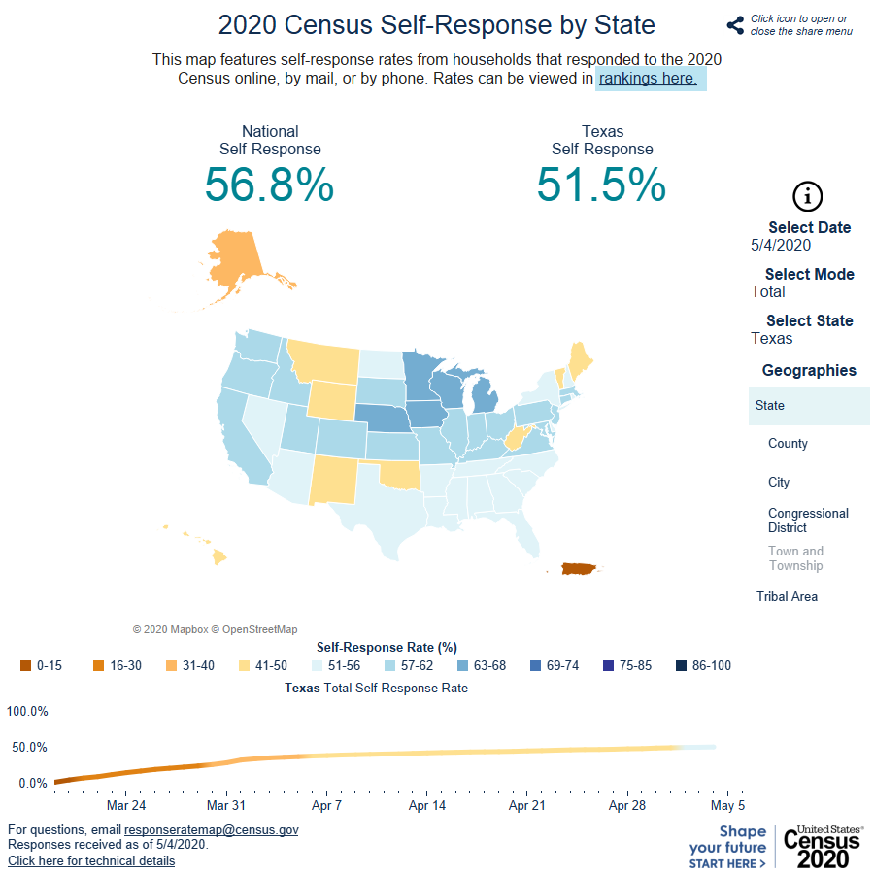
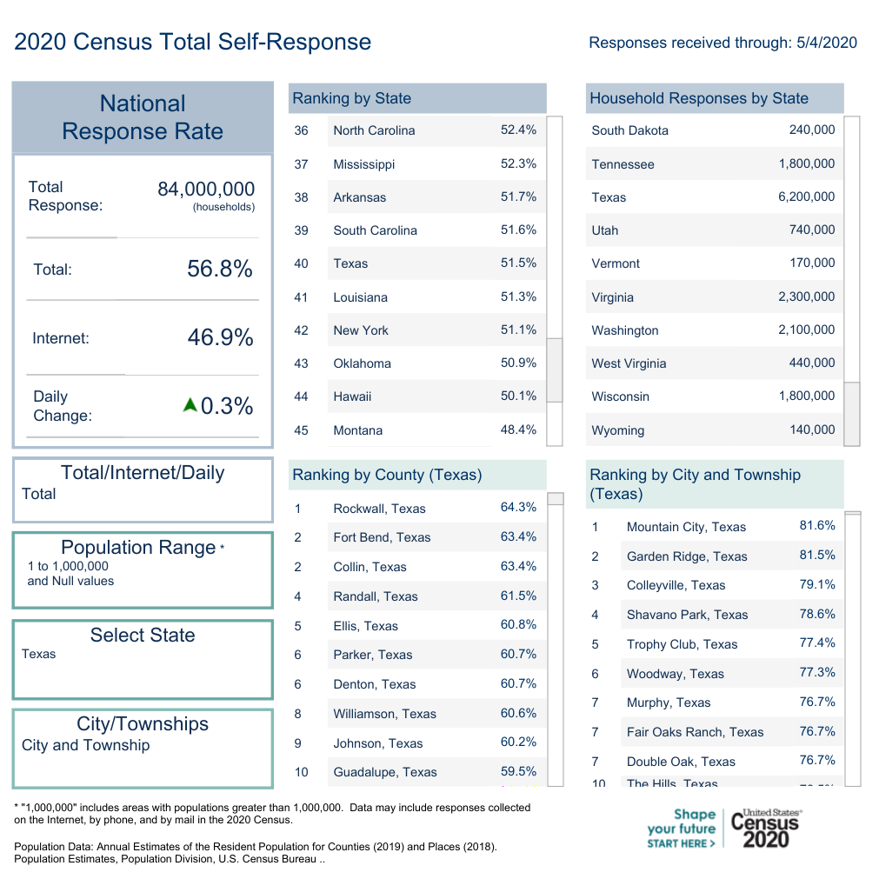
2020 Census Self-Response Rates, 5/4/2020
Tarrant County
Source: U.S. Census Bureau. 2020 Self Response Rates, https://2020census.gov/en/response-rates.html
Notes:
Tarrant County ranks 12th among Texas counties; Fort Worth ranks third among Texas cities over 500,000. https://2020census.gov/en/response-rates.html

Slide 39


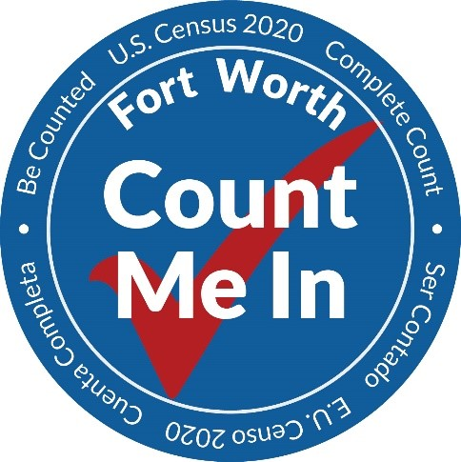
TexasCounts.org

Slide 40

Notes:
https://2020census.gov/en/how-to-help.html

Slide 41

Notes:
https://2020census.gov/content/dam/2020census/materials/partners/2019-11/Half_Page_Handout_Ways_to_Respond.pdf
By now, many of you should have already received an invitation from the Census Bureau to complete our 2020 Census form. Please do so promptly. It’s safe, easy, and important for the future of Texas.

Slide 42



Lila Valencia, Ph.D.
(512) 936-3542
Lila.Valencia@utsa.edu
demographics.texas.gov
@TexasDemography

