Slide 1
Census 2020: The Good, the Bad, the Ugly
ARDA
April 16, 2021
@TexasDemography

Slide 2
What is the Census?
Every ten years, the country conducts a census to count every person in the United States.
April 1, 2020 is the official Census date.
Census counts used to reapportion the U.S. House of Representatives, determining how many seats each state gets.
Census counts also used to determine the number of electoral college votes a state gets.
Census counts used by state and local officials to redraw congressional, legislative, and local boundaries to account for population shifts.
Businesses rely on Census data for market research, locations, and economic development.
Census derived data are used to allocate over $1.5 trillion in federal funds to support healthcare, education, transportation, or other service programs.*
Census data form the foundation for nearly all demographic and socio-economic statistics, including population estimates & projections, for the next 10 years.
*Source: Reamer, Andrew; George Washington Institute of Public Policy, Counting for Dollars

Slide 3
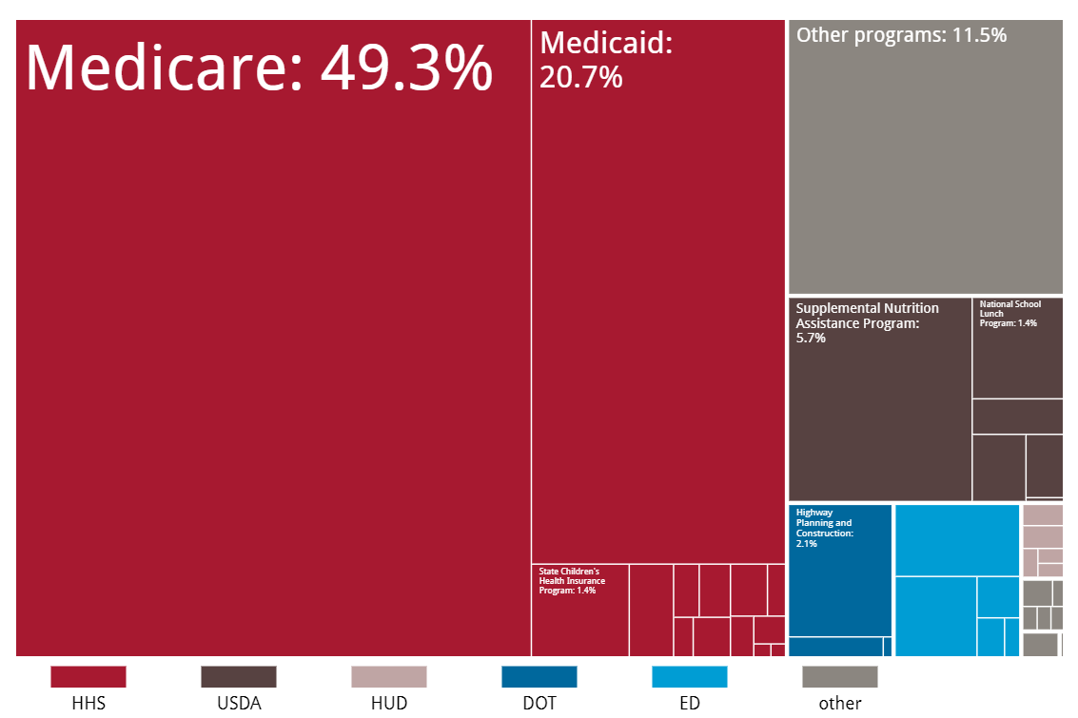
Census Derived Funding in Texas
In FY 2017, Texas received $101 billion in federal funding for programs that use Census derived data.
$50 billion for Medicare
$21 billion for Medicaid
$30 billion for other programs.
Source: Reamer, Andrew; George Washington Institute of Public Policy, Counting for Dollars

Slide 4
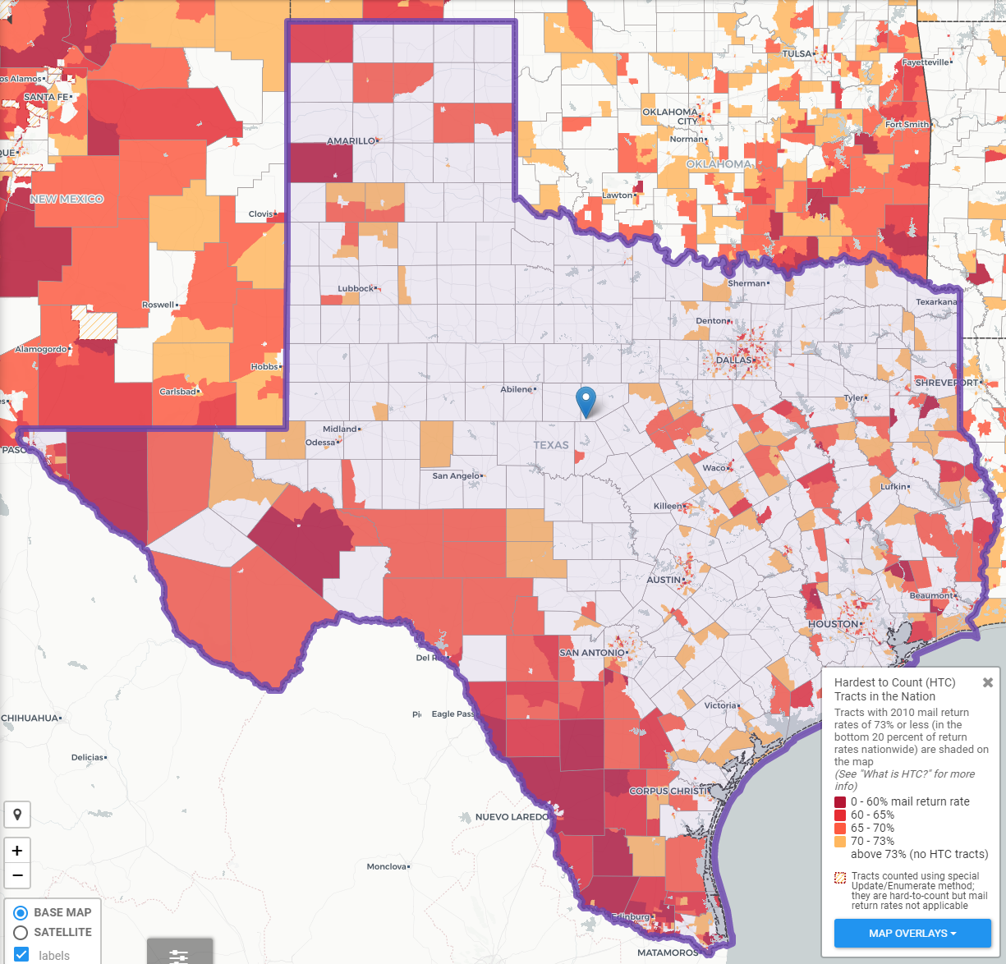
Texas Hard to Count Populations
An estimated 7 million, or nearly 25% of Texans live in HTC areas.
People of color
Children under 5 years
Populations in/near poverty
Single-parent households
Immigrants & those with limited English proficiency
Complex households: renters, multi-family, mixed status, multi-generation, larger households
Source: Center for Urban Research of the City University of New York (CUNY) Graduate Center. https://www.censushardtocountmaps2020.us
Notes:
In 2010, an estimated 240,000 Texans were undercounted in the Census.
An estimated 7 million, or nearly 25%, of Texans live in hard to count neighborhoods.
Some projections indicate more than 500,000 Texans could be undercounted in 2020.

Slide 5
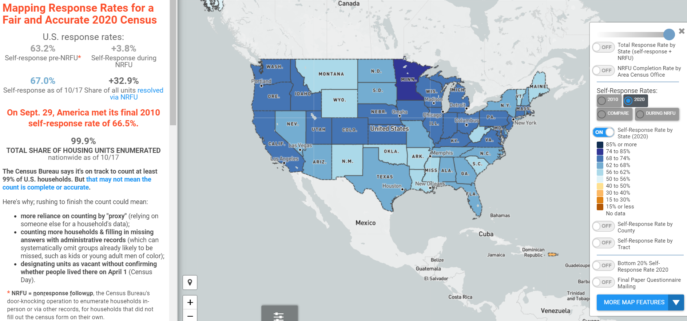
U.S. Response Rates to the 2020 Census
Total Response Rate
=
Self-Response Rate
+
NRFU Enumerated Rate
Source: Center for Urban Research of the City University of New York (CUNY) Graduate Center. https://www.censushardtocountmaps2020.us
Notes:
An estimated 99.1 million households self-responded to the 2020 Census.

Slide 6
U.S. Response Rates to the 2020 Census
99.98% of all housing units and addresses nationwide were enumerated.
2020 Self-Response Rate of 67.0% surpassed 2010 Self-Response Rate of 66.5%.
32.9% housing units enumerated through Non-Response Follow-Up (NRFU).
24.1% of NRFU workload enumerated through proxy (landlord, neighbor, etc.).
5.6% of address nationwide (13.9% of NRFU workload) resolved using administrative records

Slide 7
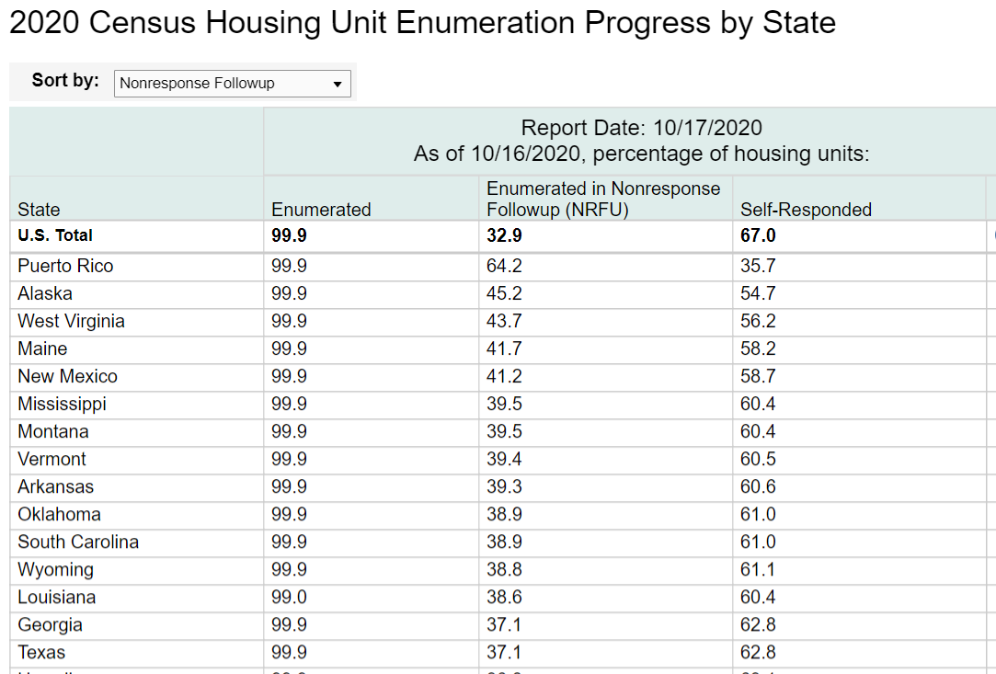
2020 Census Total Response in Texas
Total Response Rate
=
Self-Response Rate
+
NRFU Enumerated Rate
Texas Response Rate:
99.9% = 62.8% + 37.1%
Notes:
About 7.6 million Texas households self-responded.
Texas tied with GA for 38th in self-response. Texas ranked 14th in NRFU response.

Slide 8
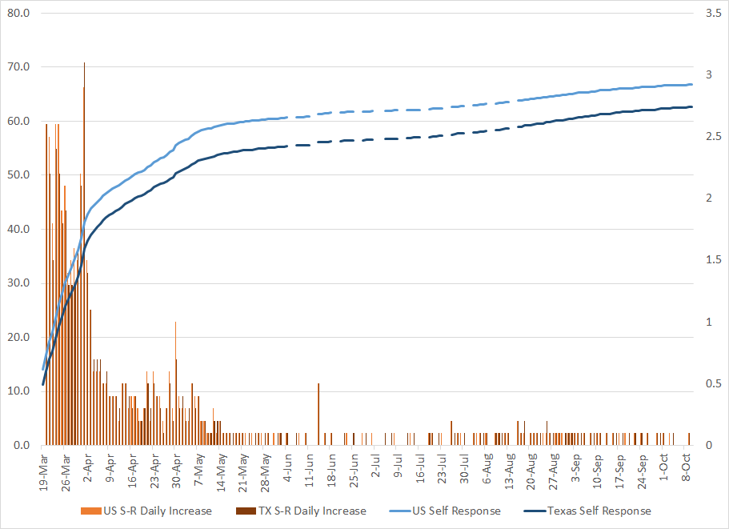
TDC Analysis of Daily Self-Response Rates (SRR) as of 10/12/20
Total increase in SRR pre-NRFU (July 1st to August 8th) = 1.6
Total increase in SRR post-NRFU (August 9th to present) = 4.4
In last two weeks, Total Response Rates in Texas have come to a standstill.
Zero change in SRR in 7 of the last 10 days.
Notes:
About 7.6 million Texas households self-responded.
Texas tied with GA for 38th in self-response. Texas ranked 14th in NRFU response.

Slide 9
Not all rates are created equal.
Self response rates, total response rates, enumeration rate, NRFU completion rates
What we do know:
Texas self-response rate lags 2010 rate: 62.0% vs. 64.4%
Self-response rates vary across the state.
Enumeration does not mean count.
Self-response yields the most accurate census data.

Slide 10
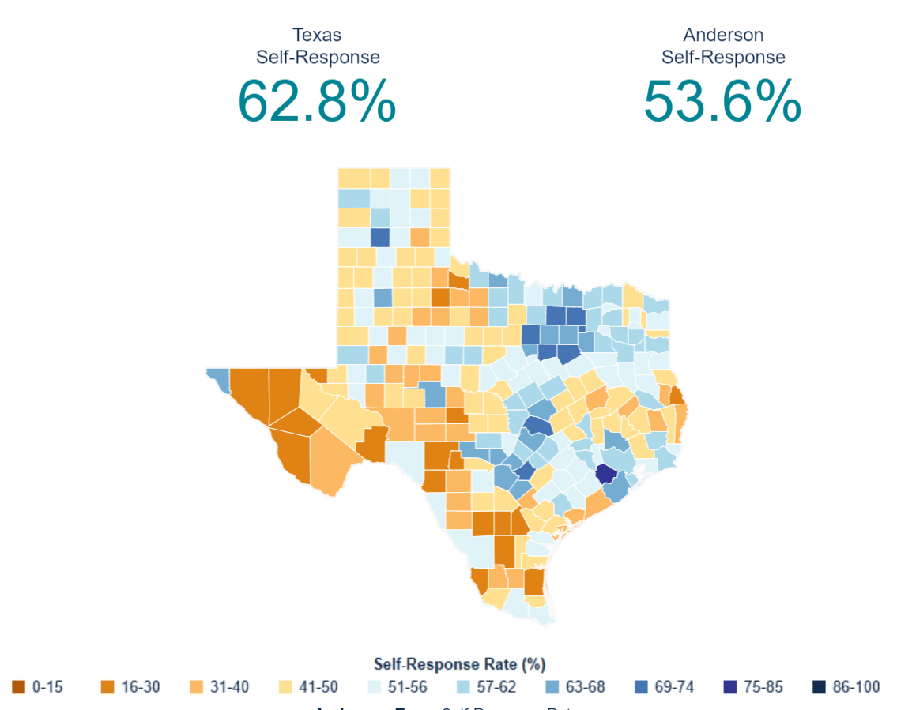
2020 Census Response Across Texas
Self-Response Rates among Texas Counties ranged from 75.8% in Fort Bend County to 18.6% in Edwards County.
29/254 (11%) Counties met or surpassed their 2010 SRR.
283/1221 (23%) Places/Cities met or surpassed their 2010 SRR.

Slide 11
TDC Analysis of Census Tracts with Self-Response Rates in Bottom 20% as of 9/28/20
Texas has 1347 census tracts with self-response rates below 50% (bottom 20% of self-response rates across all Texas census tracts)
These lower responding CTs are distributed across the state, in 231 of 254 counties. However, there are more census tracts in the lower NRFU completion ACOs, specifically Laredo, Fort Bend, Lubbock, and El Paso.
47.9% of these CTs have majority (>50%) Hispanic populations and 55.9% have a greater share of Hispanics than their state share (>40%).
5% of these CTs have majority (>50%) African American populations and 35.3% have a greater share of Blacks than their state share (>12%).
77.1% of these CTs greater shares than the Texas share of Hispanic and/or Black populations.

Slide 12
Census Bureau Data Quality Measures
Census Coverage Measures: provide undercount by demographic groups, geography, and method
Post-Enumeration Survey: interview a small sample of HHs who to check accuracy of data collected on 2020 census forms (November 2021-February 2022)
Demographic Analysis: produce population estimates using vital statistics, estimates of international migration and administrative records (December 2020)
For more info: https://www.census.gov/newsroom/press-releases/2020/2020-census-metrics-data-quality-measures.html
https://www.census.gov/programs-surveys/decennial-census/about/coverage-measurement.html (2010 Census)

Slide 13
Areas of Concern
Communities of color
Under-represented groups in administrative records
Areas with low internet access
Off-campus college students
Public perception of the Census Bureau and its data

Slide 14
The Privacy Challenge
Every time you release any statistic calculated from a confidential data source you “leak” a small amount of private information.
If you release too many statistics, too accurately, you will eventually reveal the entire underlying confidential data source.
14
2020CENSUS.GOV

Slide 15
The Census Bureau’s Privacy Protections Over Time
Throughout its history, the Census Bureau has been at the forefront of the design and implementation of statistical methods to safeguard respondent data.
Over the decades, as we have increased the number and detail of the data products we release, so too have we improved the statistical techniques we use to protect those data.
Stopped publishing small area data
Whole-table suppression
Data swapping
Formal Privacy
1930
1970
1990
2020

Slide 16
Privacy and Data Usability
Every disclosure avoidance method reduces the accuracy and usability of the data.
Traditional methods for protecting privacy (suppression,
coarsening, and perturbation) can have significant impacts on the usability of the resulting data products, but data users are often not aware of the magnitude of those effects.

Slide 17
The Growing Privacy Threat
More Data and Faster Computers!
In today’s digital age, there has been a proliferation of databases that could potentially be used to attempt to undermine the privacy protections of our statistical data products.
Similarly, today’s computers are able to perform complex, large-scale calculations with increasing ease.
These parallel trends represent new threats to our ability to safeguard respondents’ data.

Slide 18
Reconstruction
The recreation of individual-level data from tabular or aggregate data.
If you release enough tables or statistics, eventually there will be a unique solution for what the underlying individual- level data were.
Computer algorithms can do this very easily.

Slide 19
Reconstruction: An Example
Age | Sex | Race | Relationship
66 | Female | Black | Married
84 | Male | Black | Married
30 | Male | White | Married
36 | Female | Black | Married
8 | Female | Black | Single
18 | Male | White | Single
24 | Female | White | Single
This table can be expressed by 164 equations. Solving those equations takes 0.2 seconds on a 2013 MacBook Pro.
13

Slide 20
Re-identification
Linking public data to external data sources to re-identify specific individuals within the data.
Dataset A
External Dataset B
Joe Smith
A
B
C
Jane Doe
X
Y
Z
Person 1 | Person 2
A | X
B | Y
C | Z
Joe Smith | Jane Doe
C | Z
2020CENSUS.GOV

Slide 21
Differential Privacy
aka “Formal Privacy”
-quantifies the precise amount of privacy risk…
-for all calculations/tables/data products produced…
-no matter what external data is available…
-now, or at any point in the future!
20

Slide 22
Assessing Privacy Risk
Traditional Disclosure Avoidance Considers Absolute Privacy Risk
Can an individual be re-identified in the data, and can some sensitive attribute about them be inferred?
Evaluates risk given a particular, defined mode of attack, asking: What is the likelihood, at this precise moment in time, of re-identification and inferential disclosure by a particular type of attacker with a defined set of available external information?
Formal Privacy is about Relative Privacy Risk
Does not directly measure re-identification risk (which requires specification of an attacker model).
Instead, it defines the maximum privacy “leakage” of each release of information compared to some counterfactual benchmark (e.g., compared to a world in which a respondent does not participate, or provides incorrect information).
21

Slide 23
Precise amounts of noise
Differential privacy allows us to inject a precisely calibrated
amount of noise into the data to control the privacy risk of any calculation or statistic.
23

Slide 24
Privacy vs. Accuracy
Differential Privacy also allows policymakers to precisely calibrate where on the
privacy/accuracy spectrum the resulting data will be.
24

Slide 25
Redistricting Dates
Apportionment File sent to POTUS on 12/31/2020- now by April 30, 2021
Redistricting Data File (Public Law 94-171 File) received by the Governor no later than April 1, 2021 - now by September 30, 2021
PL 94-171 released to states in groups of 8 states per week, with one week prior notice
PL 94-171 File to include:
Race, Hispanic origin, 18 and older, occupancy status, and group quarters by type.
Data available at WWW.CENSUS.GOV/RDO

Slide 26
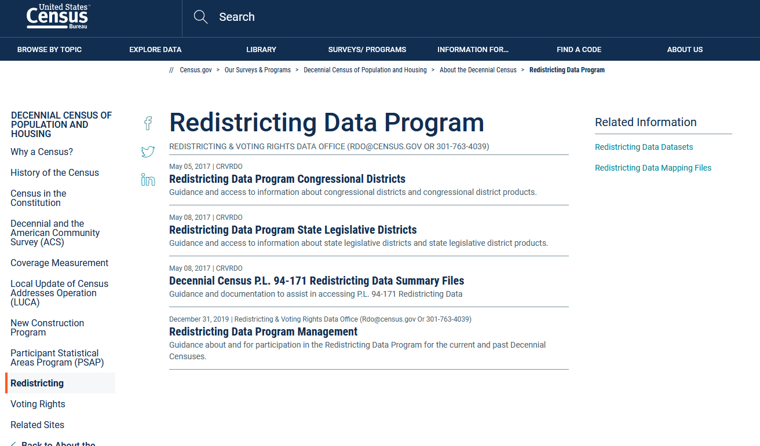
https://www.census.gov/programs-surveys/decennial-census/about/rdo.html

Slide 27
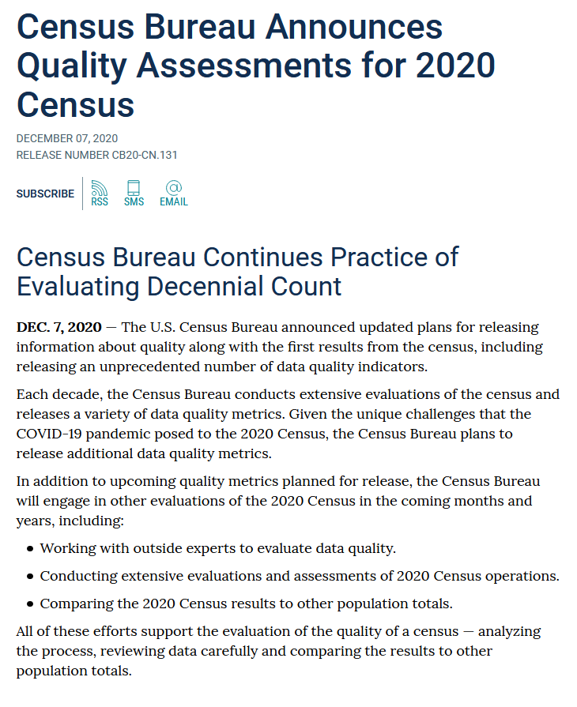
https://www.census.gov/newsroom/press-releases/2020/2020-census-quality-assessments.html

Slide 28
https://www.census.gov/programs-surveys/decennial-census/2020-census/planning-management/planning-docs/CQR-detailed-op-plan.html
Information on 2010 CQR process:
https://www.census.gov/programs-surveys/decennial-census/decade/2010/program-management/cqr.html

Slide 29
Lloyd Potter
(210) 458-6530
Lloyd.Potter@utsa.edu
demographics.texas.gov
@TexasDemography

