Slide 1
ACS in Action: Using ACS Data at the Texas Demographic Center
May 21, 2026
Austin, Texas

Slide 2
Using the ACS to Respond to Data Requests
Comprehensive Demographic Profiles
Grant Writing
Assist with Annual Budgets and Audits
Inform State Legislation
Comply with State and Federal Laws
Economic Development and Planning

Slide 3
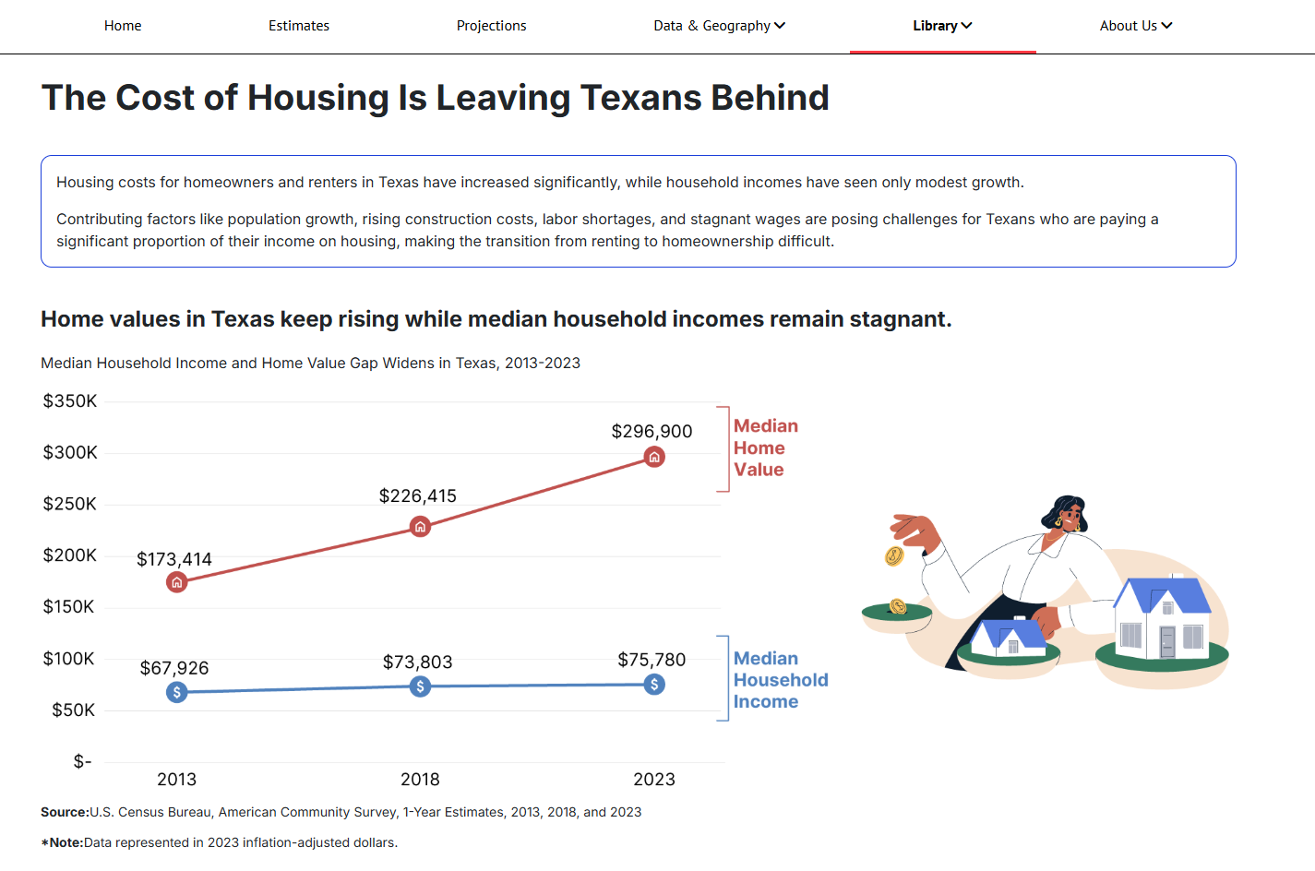
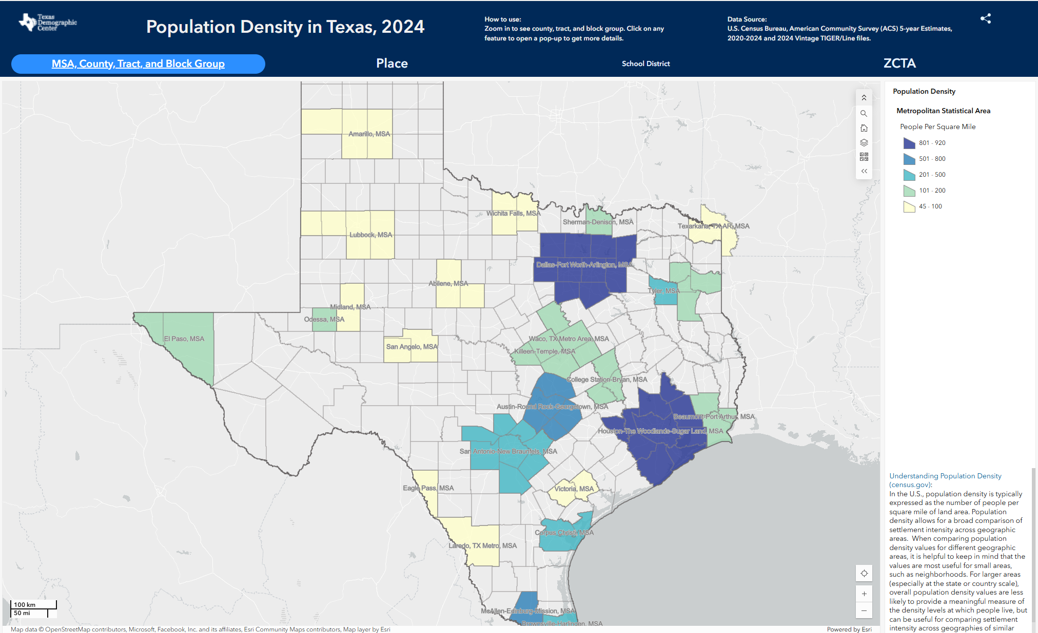
ACS in TDC Products and Tools
Visualizations
Interactive Maps

Slide 4
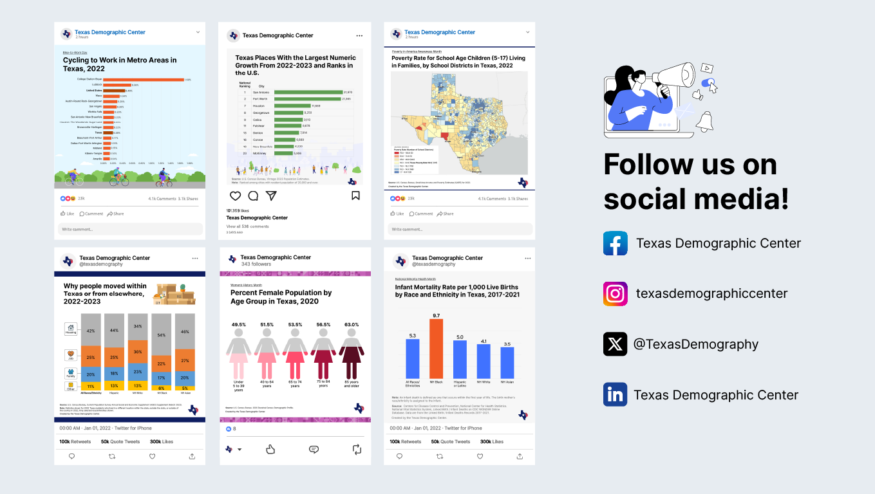
ACS in TDC Products and Tools: Social Media

Slide 5
Any Questions?

Slide 6
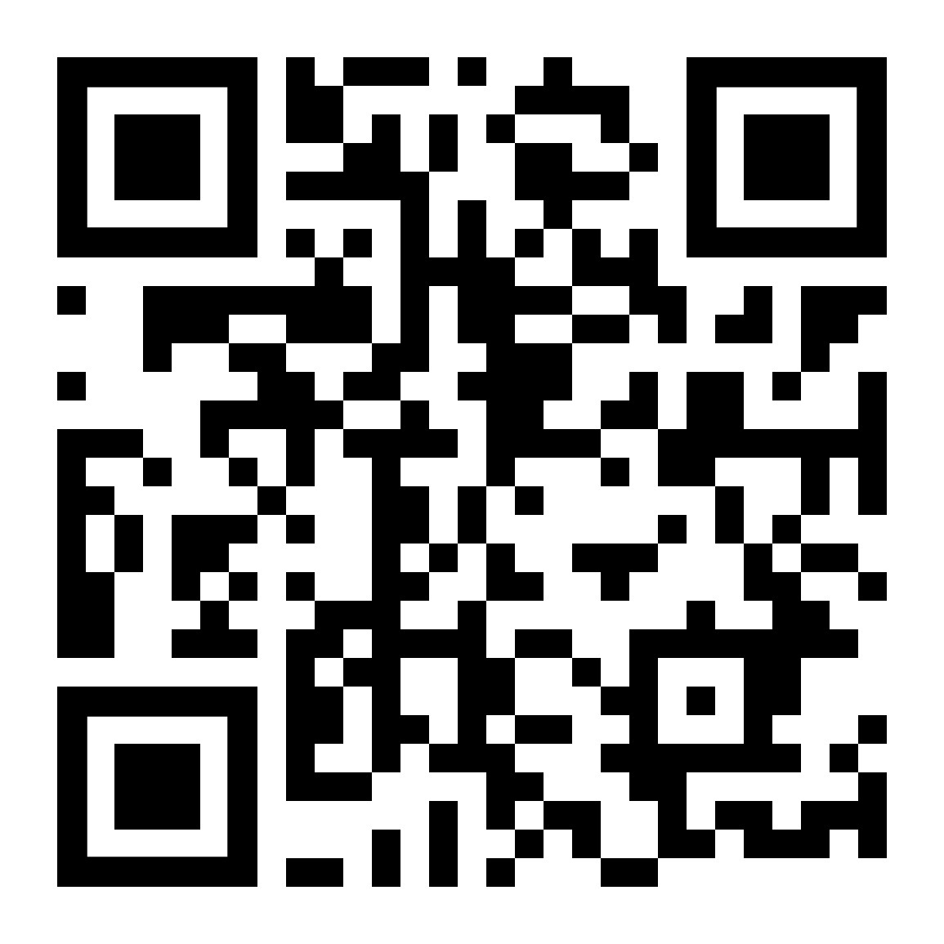



Visit our website
Sign up for our newsletter
Follow us on social media

Slide 7
Valeria Alvarez, MPP
(210) 458-6543
TDC@UTSA.edu
demographics.texas.gov/
@TexasDemography

