Slide 1
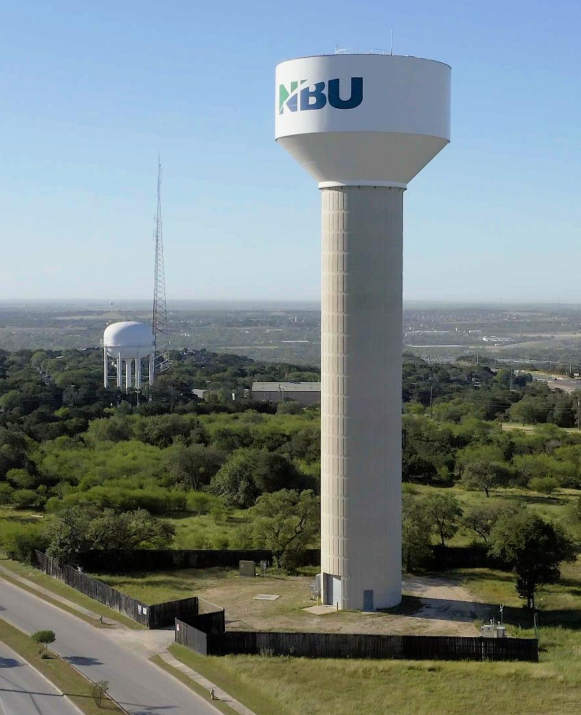


Water Supply and Planning
DEMO
Robin Gary, One Water Program Manager
Notes:
One Water New Braunfels is a collaboration between NBU, the City, and GBRA to optimize water management.

Slide 2
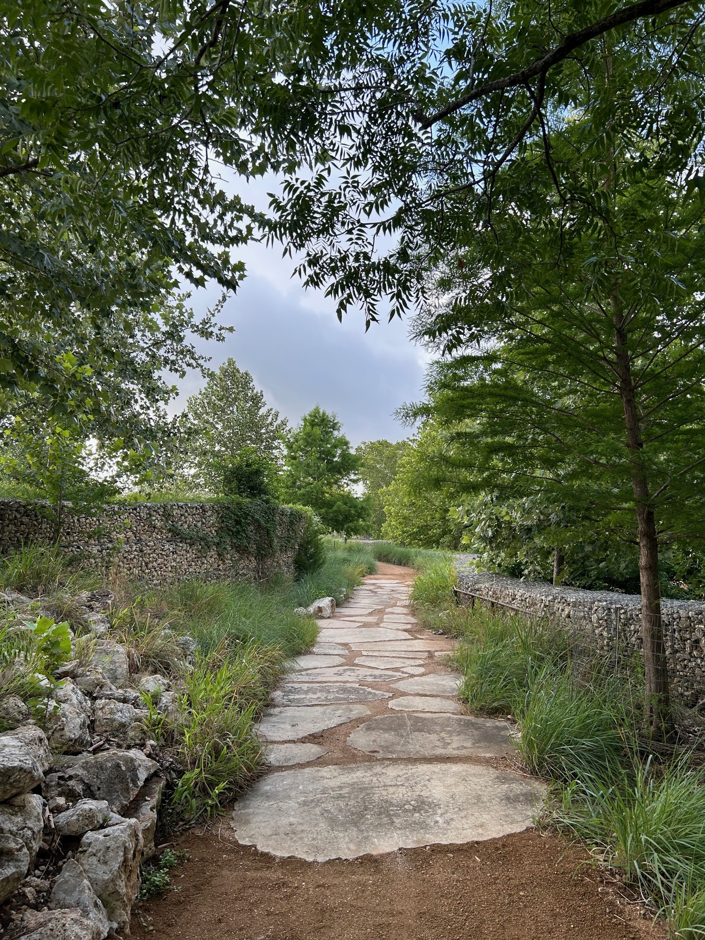
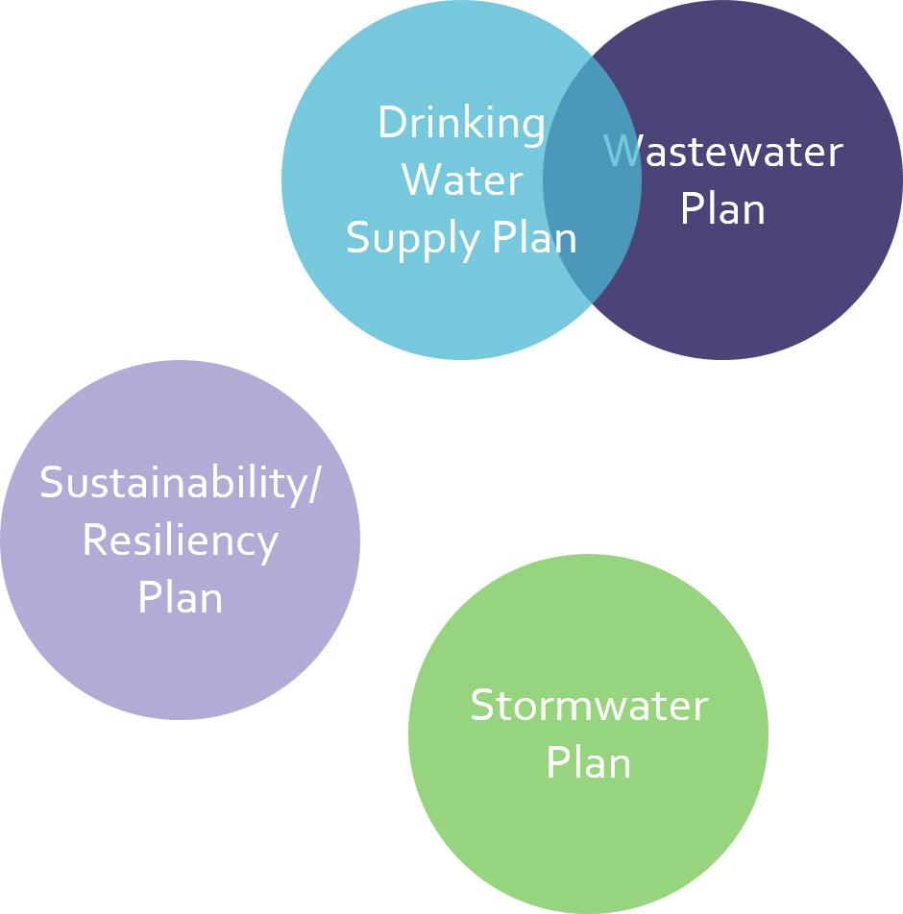
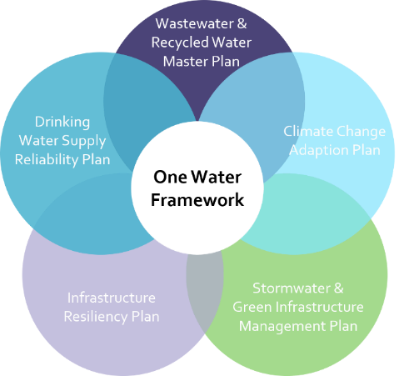
One Water
One Water is an integrated PLANNING and IMPLEMENTATION approach to managing finite water resources for long-term resilience and reliability, meeting both community and ecosystem needs.
Water Research Foundation (WRF)
Traditional Approach
One Water Approach
Notes:
One Water is a strategy and a mindset that is changing the way we manage water. We’re moving from a siloed approach to a collaborative approach to plan and build differently here in New Braunfels. The better we manage water, the better we can protect our local economy, community, and environment.

Slide 3
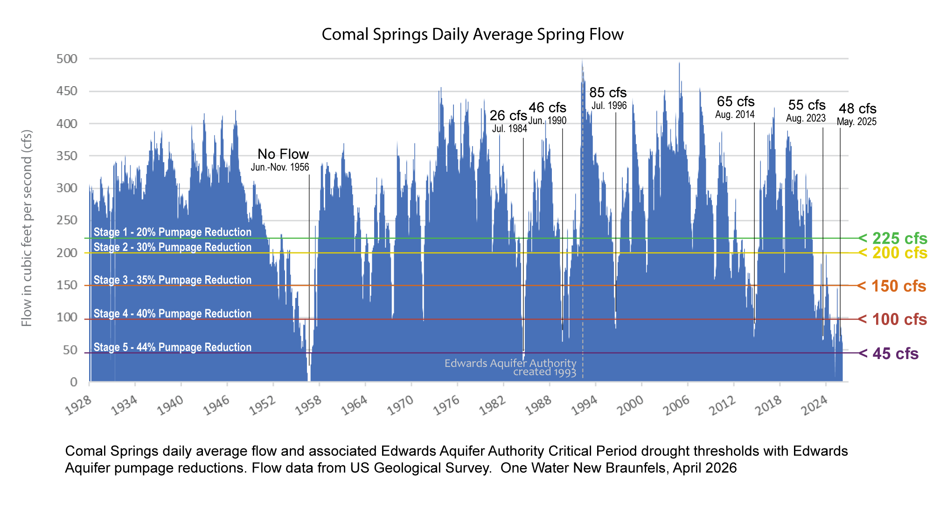
Historic Droughts
Central Texas is no stranger to drought.
We have to plan for it.
Notes:
Drought shouldn’t be surprising. This hydrograph shows Comal Springs flow since 1928 to now. Drought is no stranger, and we have to plan for it. It impacts our businesses, our quality of life, and our natural resources. We hear a lot about drought restrictions and how that limits the amount of water we can use, but did you know that the wading pool in Landa Park stops flowing at 75 cfs? Floating the Comal River takes 30-45 minutes at 300 cfs (average flow), but 3-4 hours below 100 cfs (what we’ve seen recently).

Slide 4
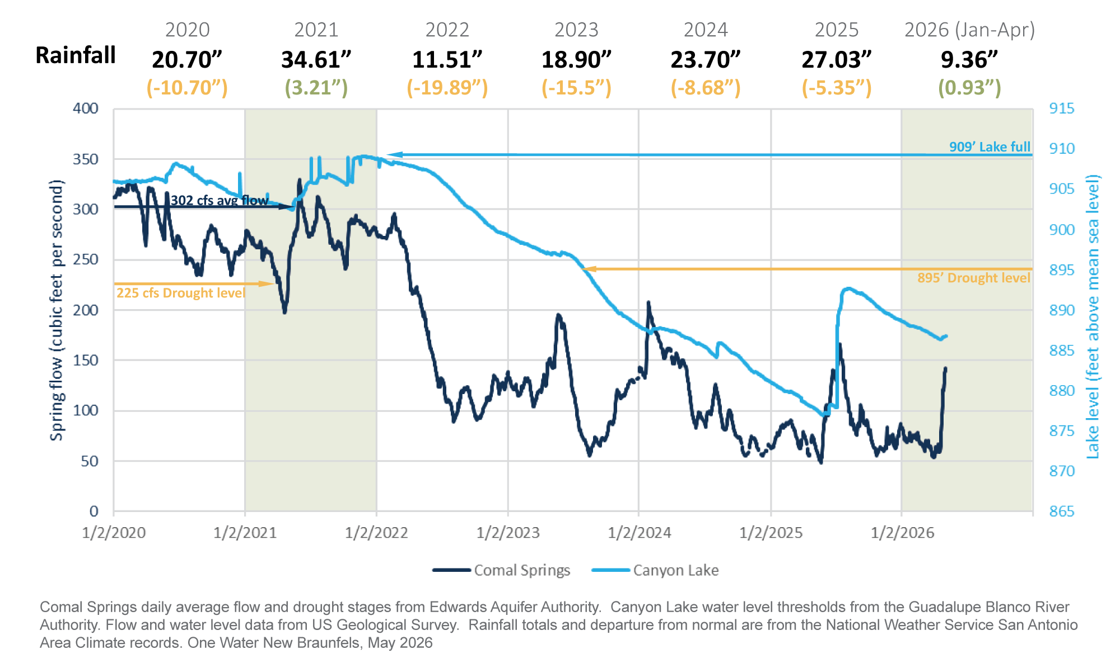
Recent Drought
Canyon Lake Water Level
5/4/26: 886.78’ msl
GBRA Stage 2 Moderate Shortage
Comal Springs Flow
5/5/26: 133 cfs (10-day avg)
EAA Stage 3: 35% Reduction

Slide 5
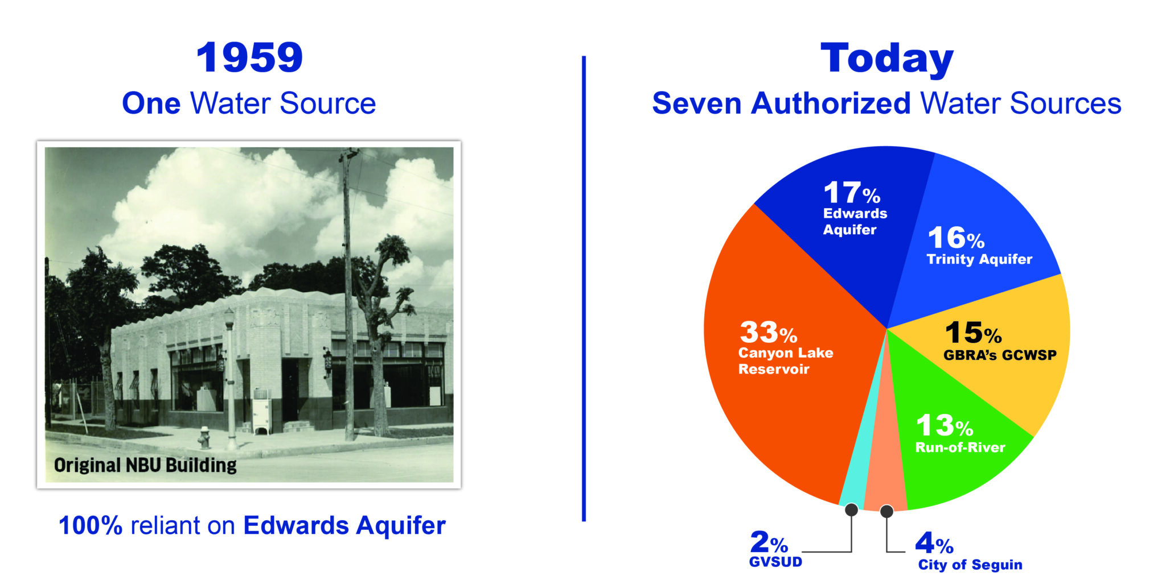
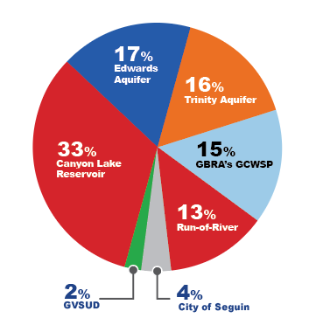
Decades of Water Supply Planning
New Braunfels Herald-Zeitung, 5/1/2026: Supply & Demand

Slide 6
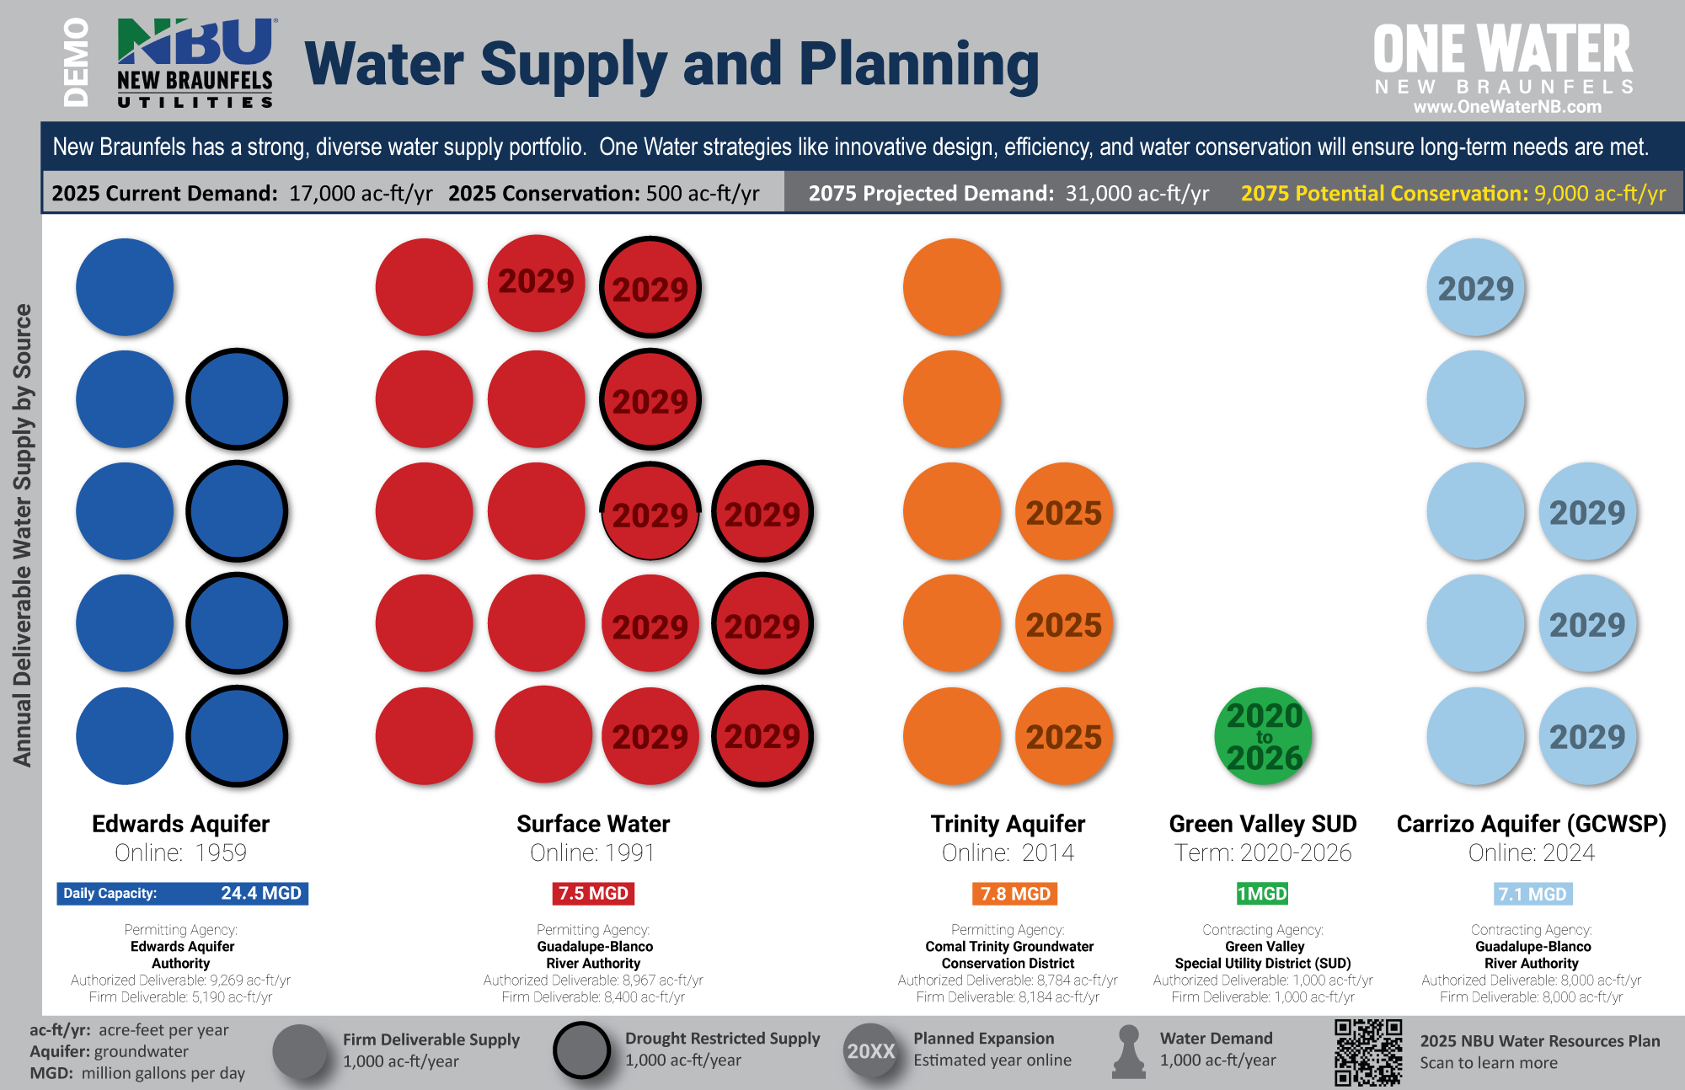
One Water Demo: NBU’s Water Supply Portfolio
NBU’s 5 different water sources
Units:
  Acre-feet (ac-ft): 325,851 gallons
  Typical NB Household: 6,000 gal/month
  1,000 ac-ft = Circle & Pawn
Drought Restrictions
Planned Expansions
Activities:
Annual Current and Projected Future Demand
Daily Capacity and Seasonal Demand

Slide 7
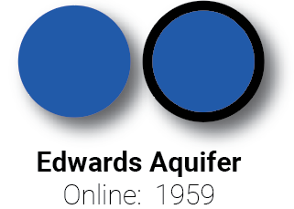
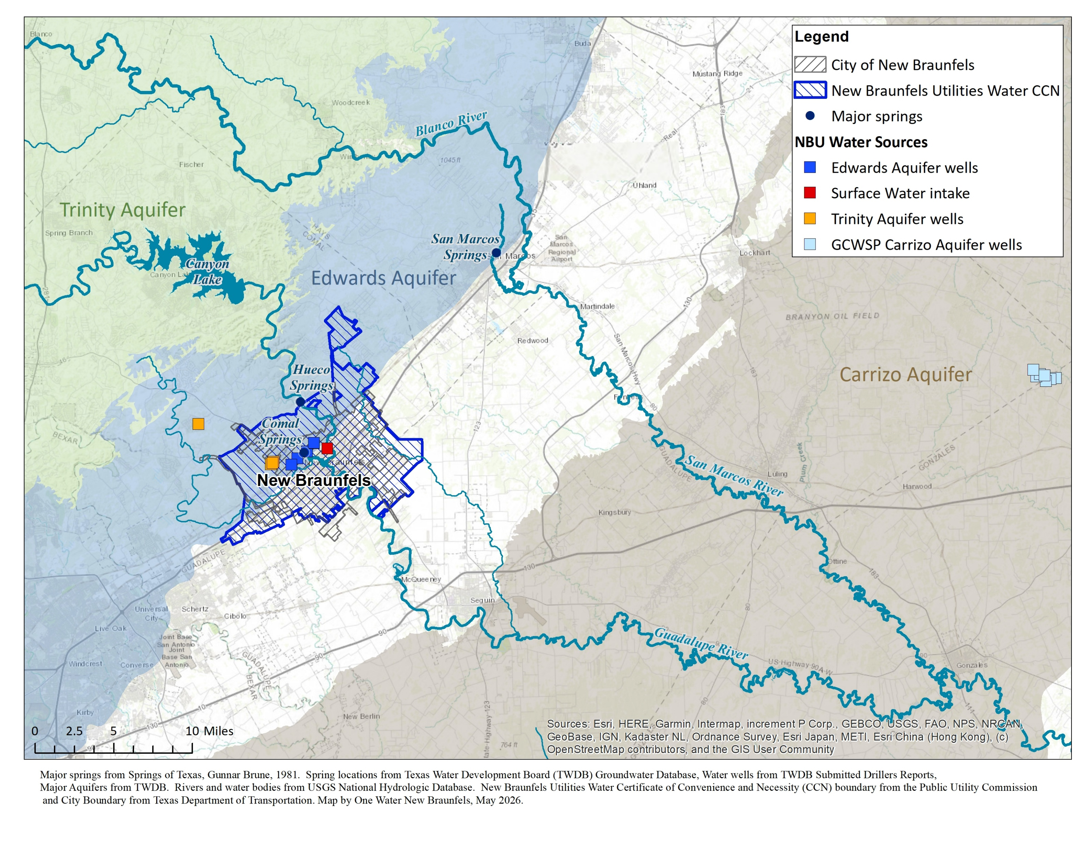

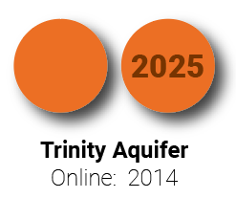

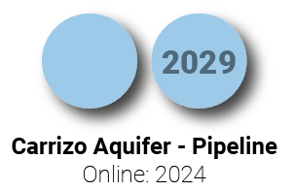
Water Supply Timeline & Locations

Slide 8
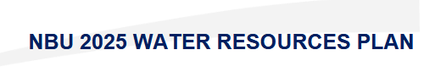
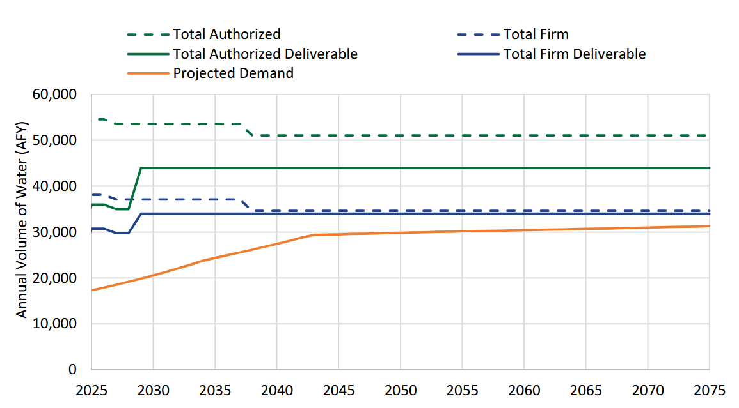
Projected 50-year Supply and Demand
https://www.nbutexas.com/planning-for-the-future-of-new-braunfels/
Notes:
Total Authorized: all our permitted water, which includes 7 different ‘sources’
Total Authorized Deliverable: what we can actually treat and distribute in no drought conditions
Total Firm: all permitted water but under worst-case drought restrictions
Total Firm Deliverable: what we can treat and distribute during worst-case drought restrictions.
We’ll be talking about the solid lines during today’s demo—and how supplies relate to projected demand.

Slide 9
17

Slide 10
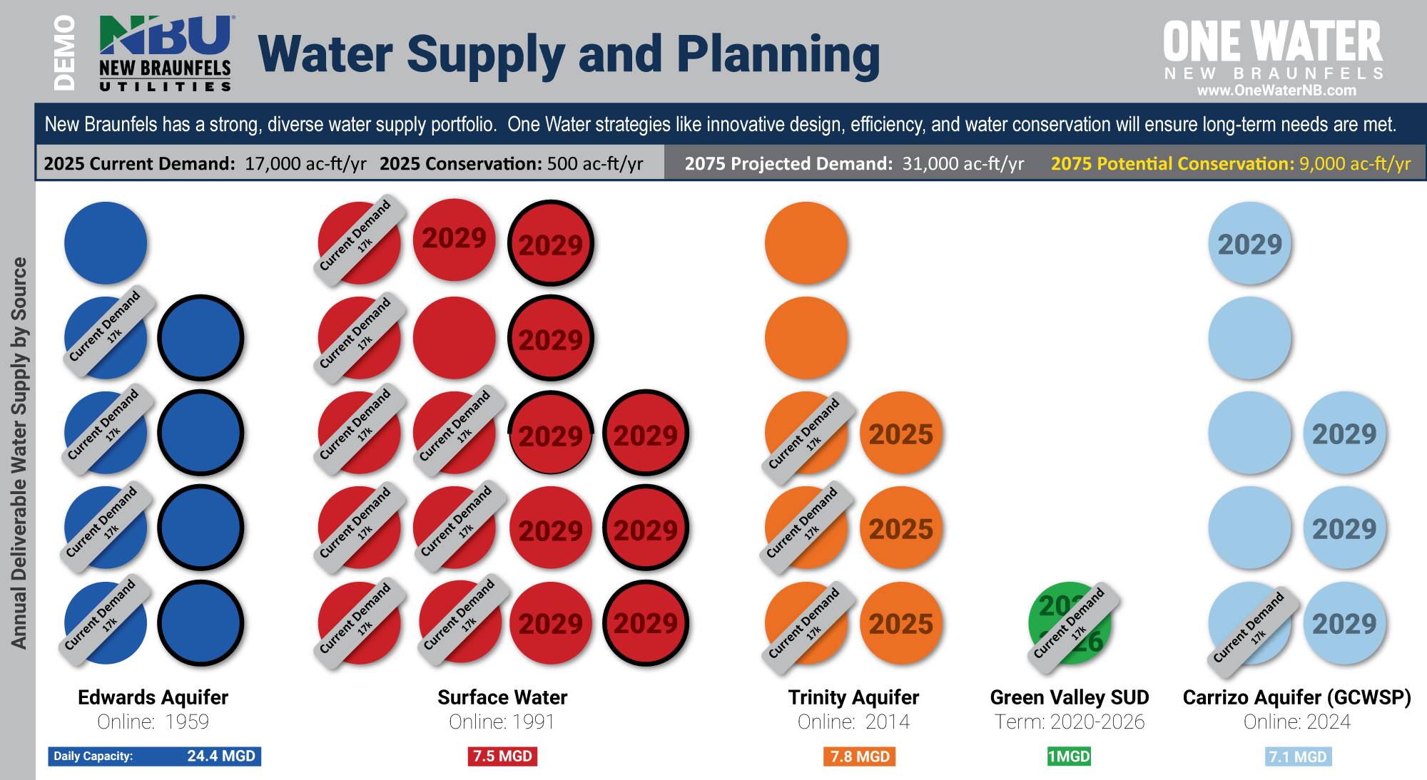
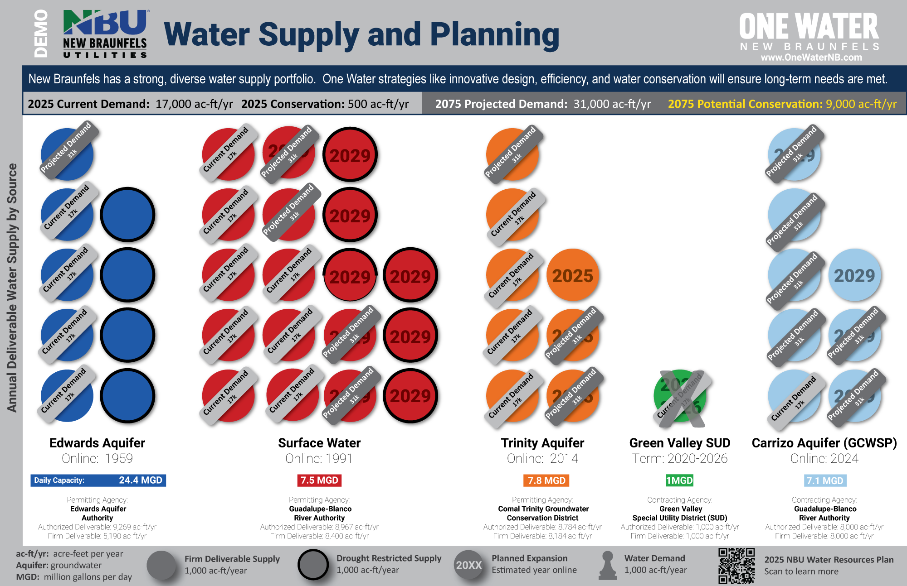
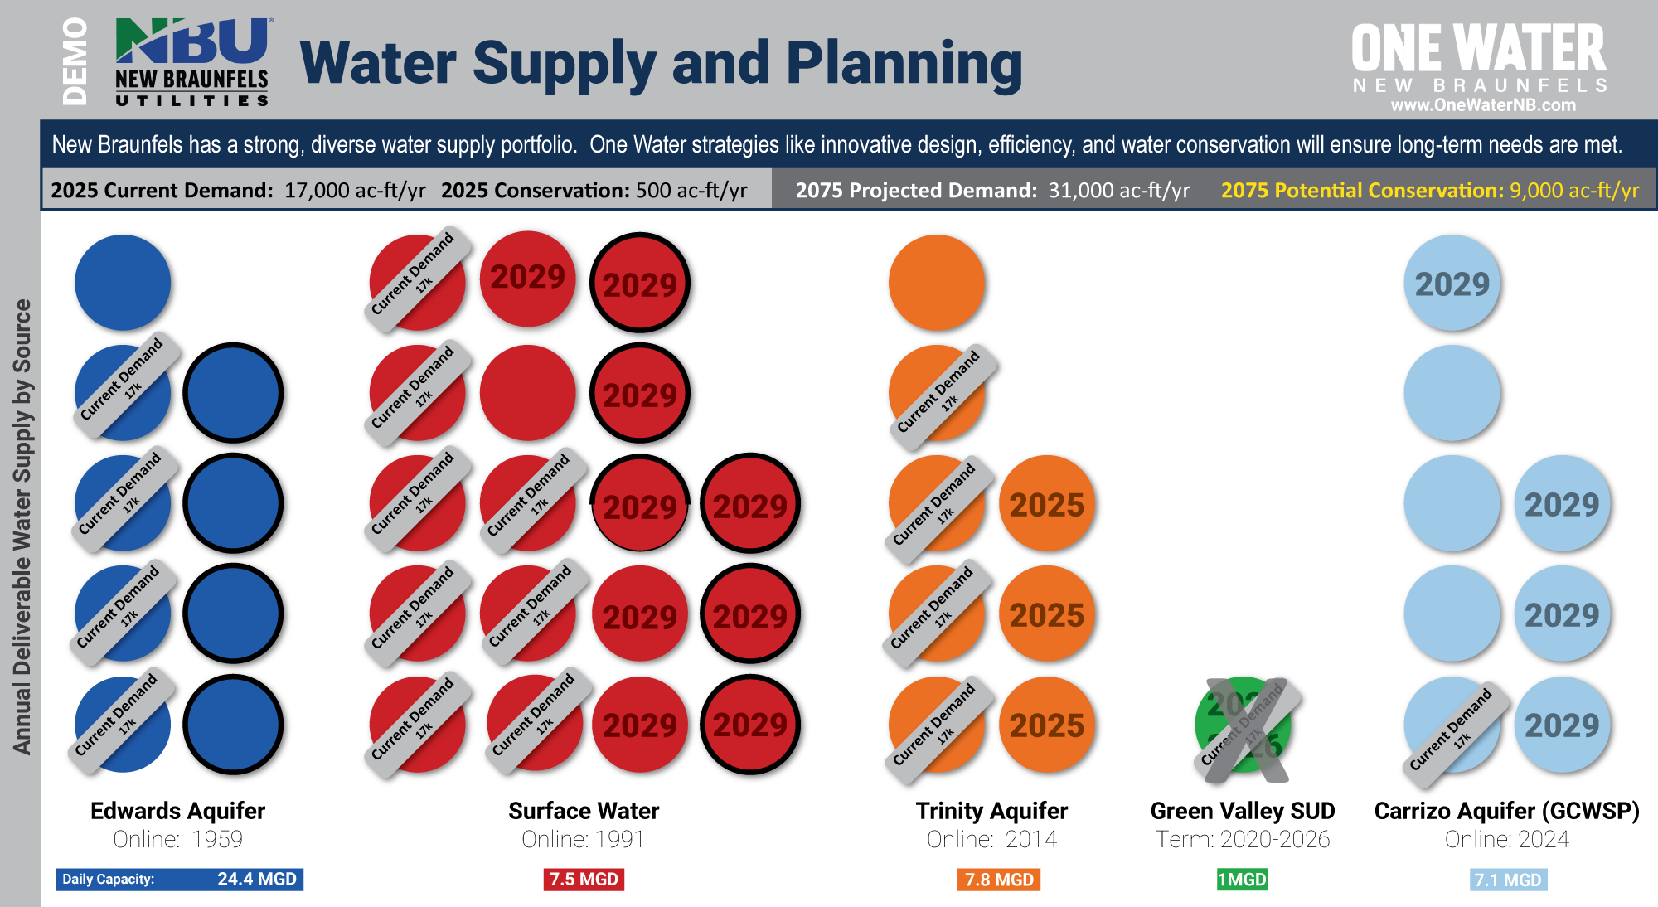
+14
= 31

Slide 11
What about the unexpected?

Slide 12
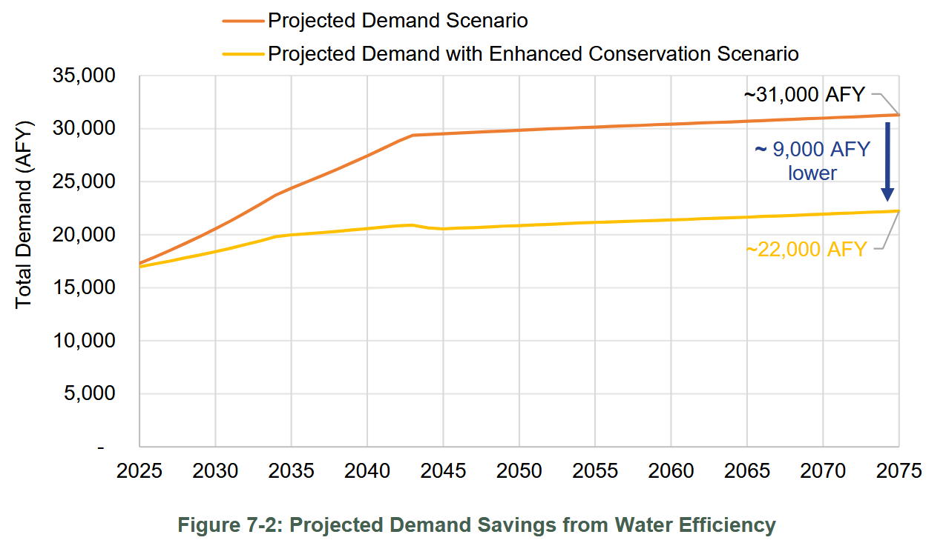
Good News: Innovative design, efficiency, conservation

Slide 13


Slide 14

Future
So Bright!

Slide 15
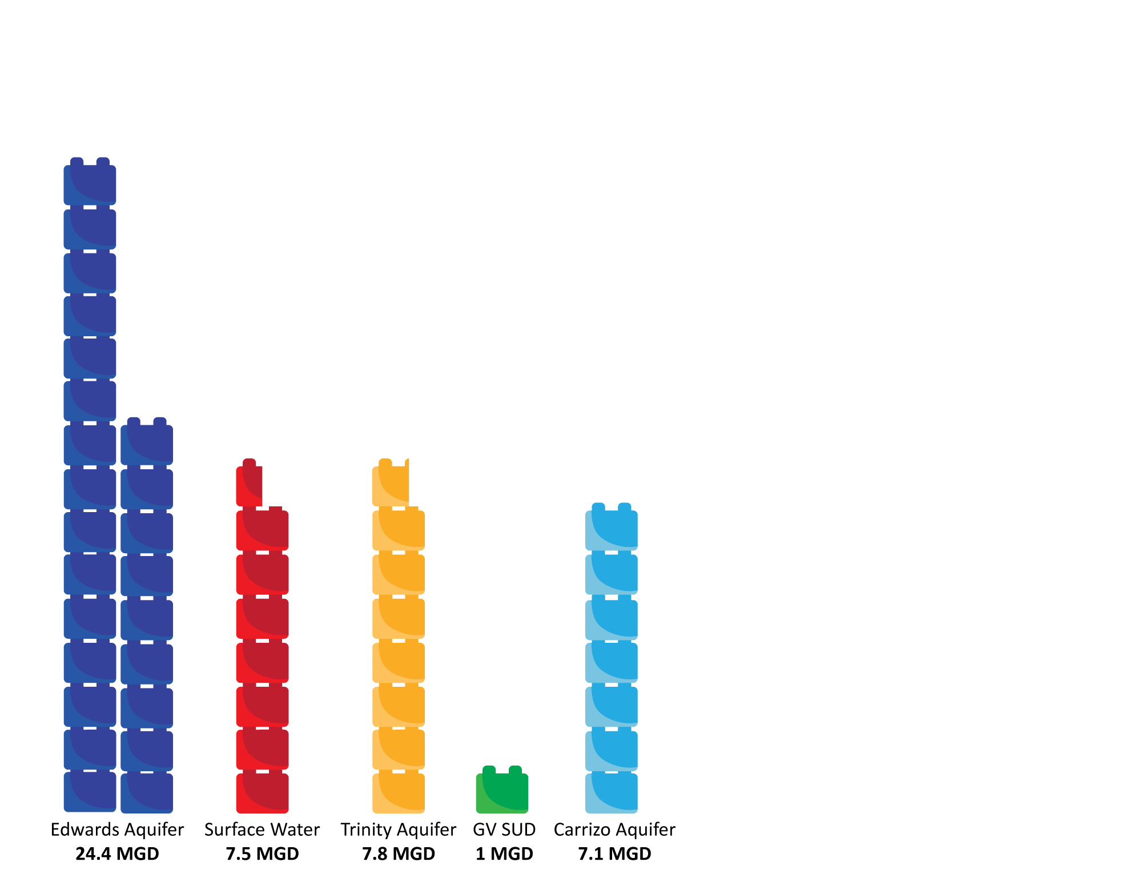
Daily Capacity
MGD: Million gallons per day

Slide 16
Seasonal Demand in New Braunfels
= MGD: Million gallons per day
Winter Average
10-12 MGD

Slide 17
Seasonal Demand in New Braunfels
= MGD: Million gallons per day
Summer Average
18-20 MGD
Winter Average
10-12 MGD

Slide 18
Seasonal Demand in New Braunfels
Summer Irrigation Peak
24-26 MGD
= MGD: Million gallons per day
Outdoor
water use.
(Irrigation)
Summer Average
18-20 MGD
Winter Average
10-12 MGD
Indoor
water use.
(Health and safety)

Slide 19
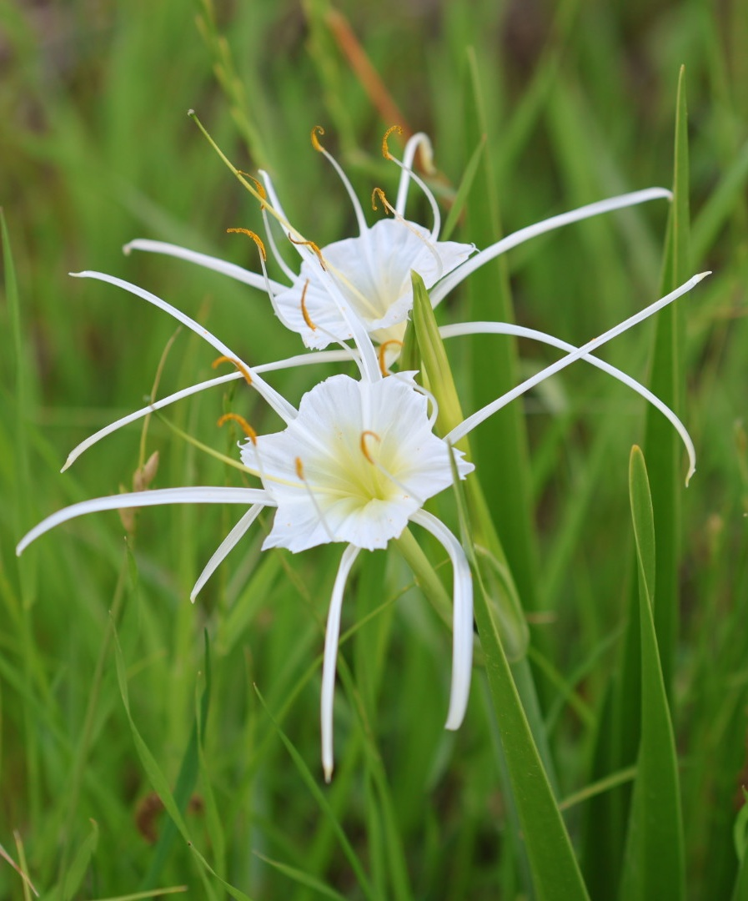
Key Takeaways
New Braunfels has a strong, diverse water supply portfolio.
Droughts happen. We plan for them.
One Water strategies like innovative design, efficiency, and water conservation will ensure long-term needs are met.
Texas Native: Spider Lilly

Slide 20
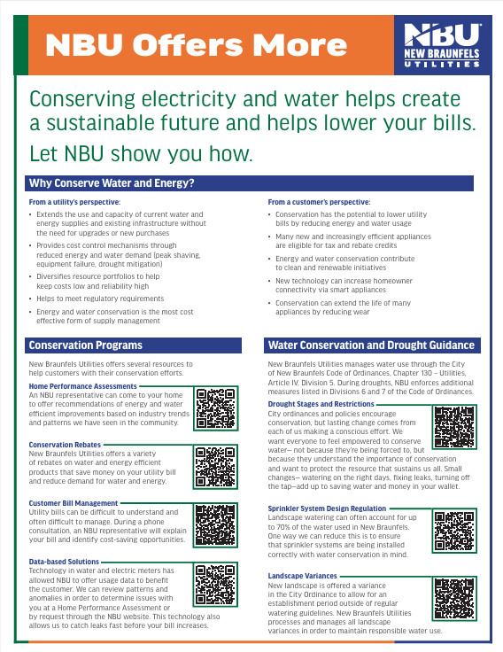
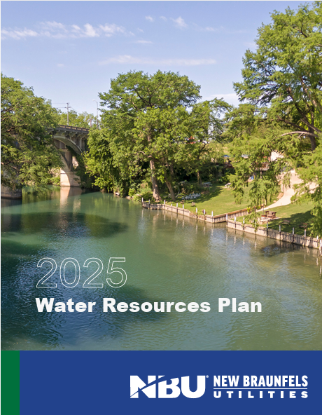
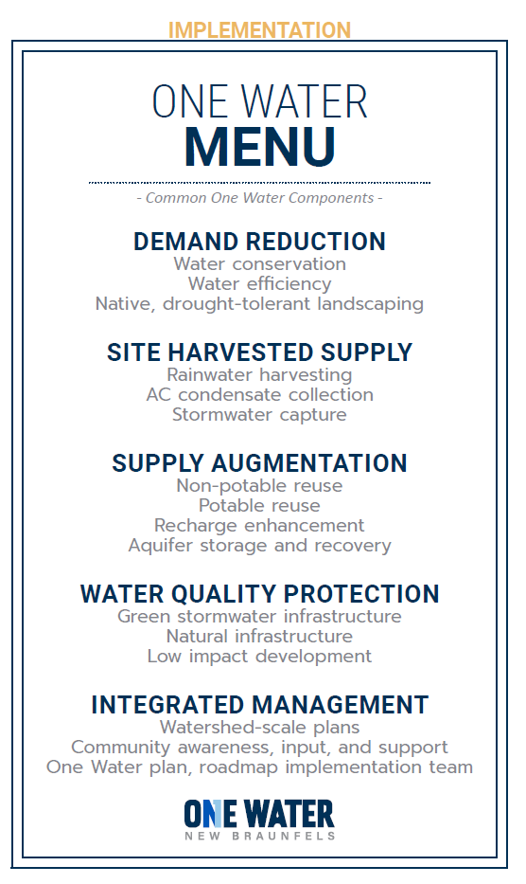
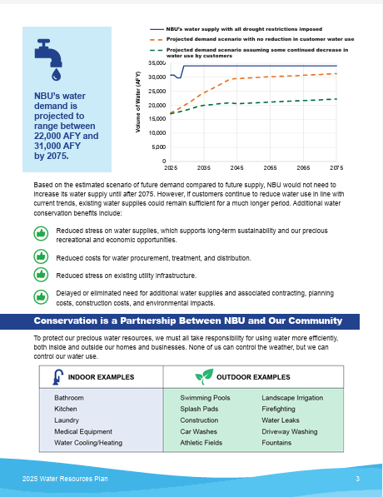
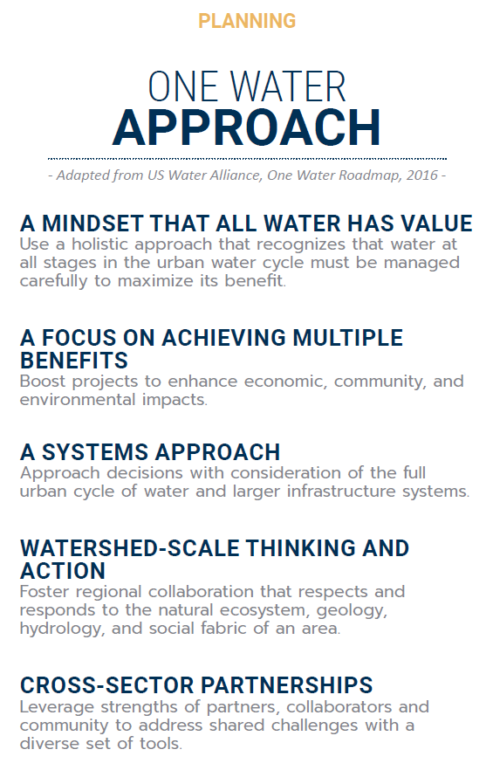
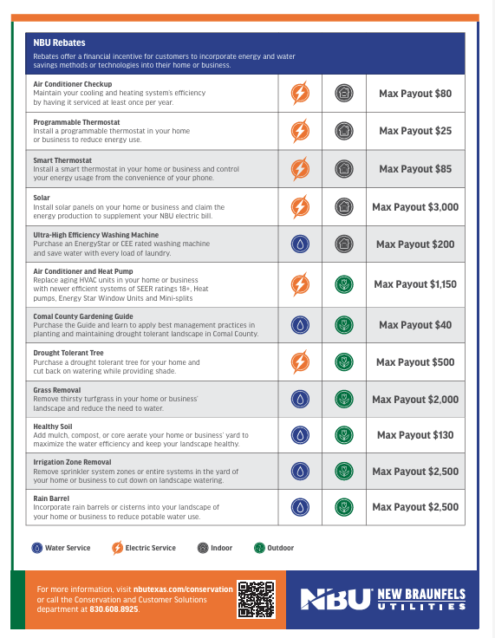
Resources
One Water New Braunfels:
www.OneWaterNB.com
Headwaters at the Comal, Community Programs:
https://headwatersatthecomal.com/visit/programs/

Slide 21
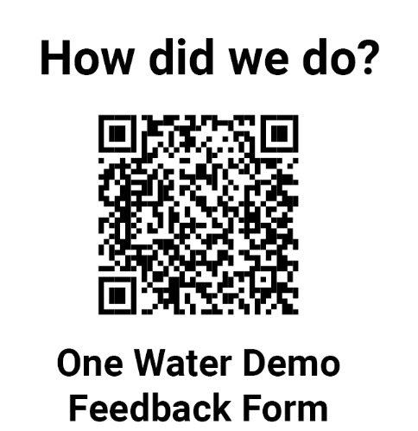
Thank you!

