Slide 1
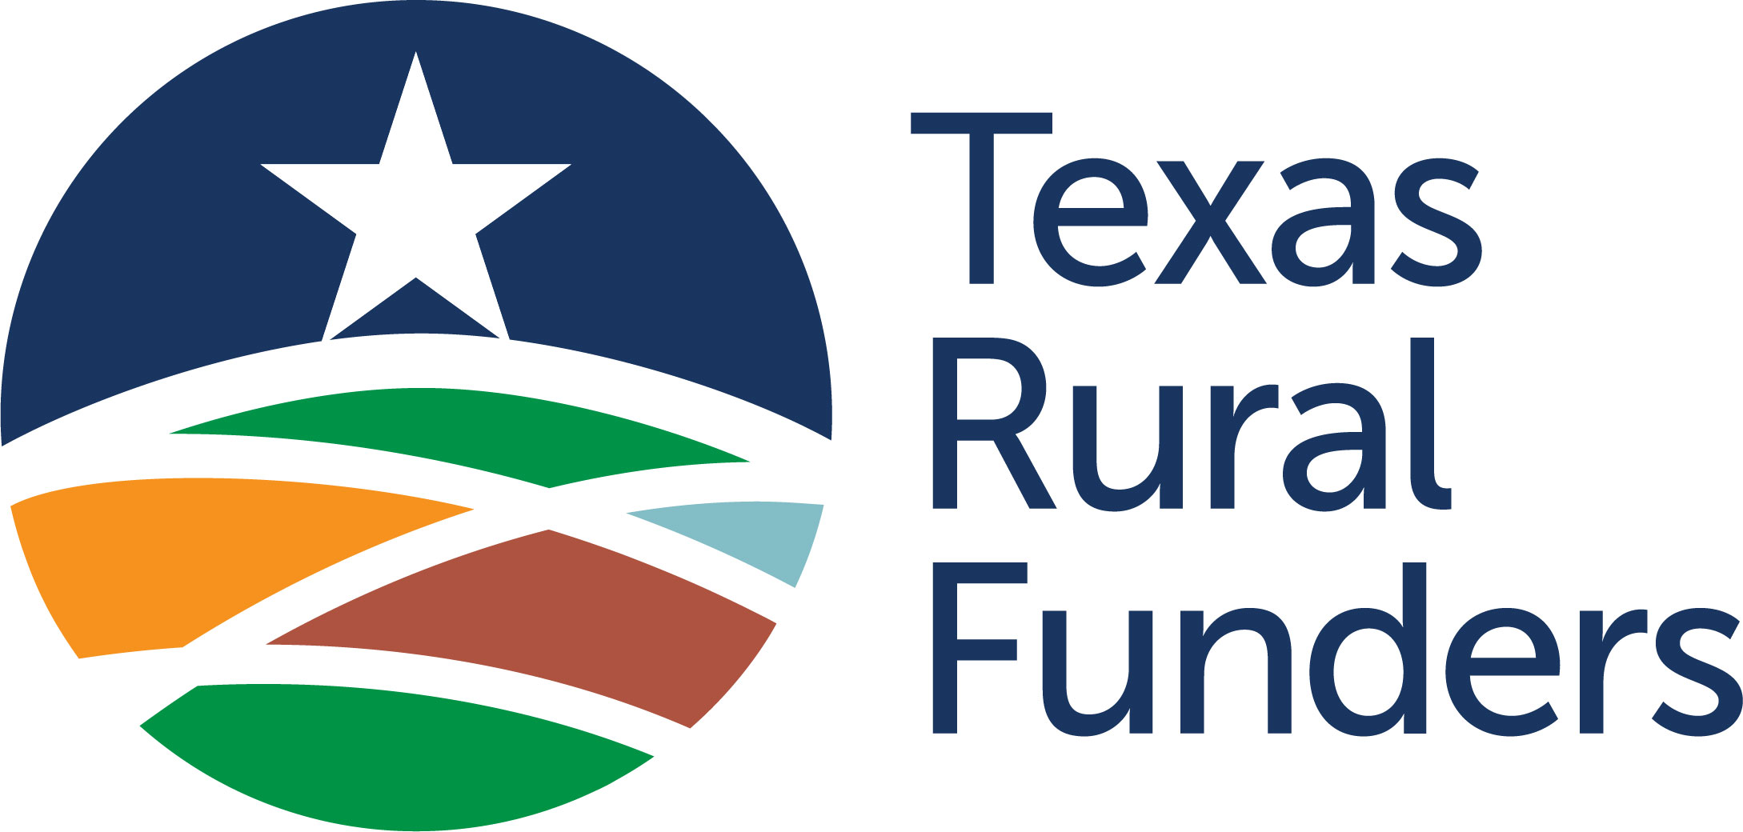
Rural Texas Reimagined
Data and Tools to Build Rural Assets and Capacity
May 21, 2026
Notes:
KELTY

Slide 2
What is Texas Rural Funders?
What Does Texas Rural Funders Do?
The leading membership organization for philanthropy dedicated to rural Texas
For Communities
Share resources including monthly newsletter, Grants Hub, webinars, and more
Mission
To mobilize the power of philanthropy to strengthen rural Texas
For Funders
Provide a learning network along with tools and information to serve rural communities
A trusted partner and connector for rural communities.
Notes:
EVAN
For Communities: monthly newsletter, Grants Hub, webinars, and informational resources
For Funders: membership organization providing funders with tools and information to serve rural communities

Slide 3
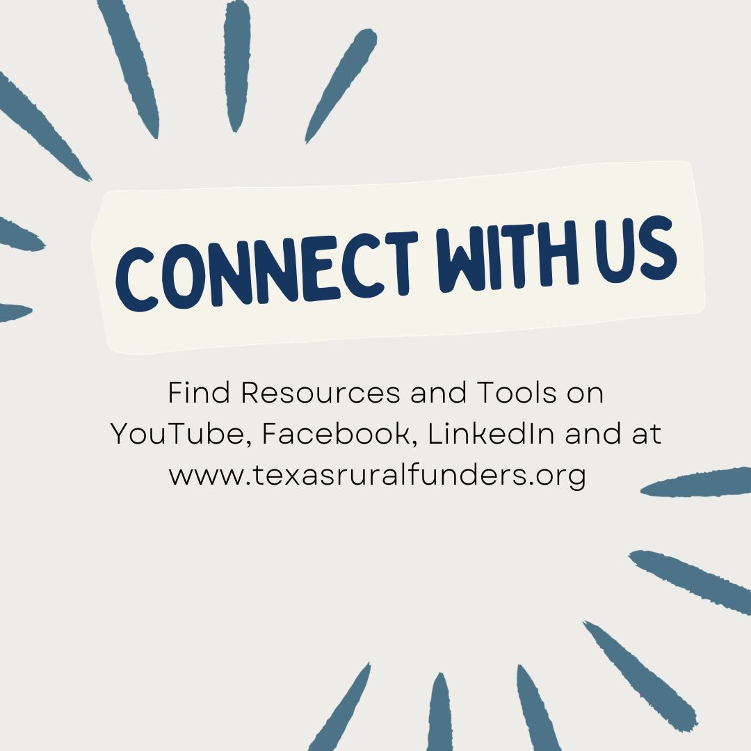
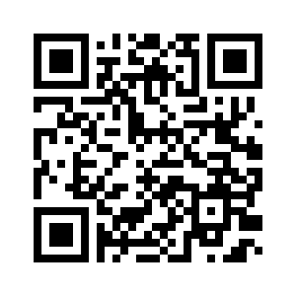
Stay Connected with
Texas Rural Funders
Sign up for The Round-Up, a monthly newsletter spotlighting all things rural that matter to Texas.
Notes:
EVAN

Slide 4
SESSION GUIDE
1.
Why Funding Rural Matters
Insights from Philanthropy & Nonprofits
2.
What We Learned from USDA
New Data on Rural Funding Patterns
3.
What We Learned from Rural Texas Surveying Impacts of Changes to Federal Funding
4.
How We Can Respond
Strategies that Support Rural Capacity
Notes:
EVAN

Slide 5
1.
Why Funding Rural Matters
Insights from Philanthropy & Nonprofits
Notes:
KELTY

Slide 6
Rural & Urban are interconnected
20%
of the U.S. population is rural
70%
of funding to rural communities comes from urban areas
$3.5
billion in grants per year to rural organizations
Source: Federal Reserve Bank of Richmond (December 2024)
Notes:
KELTY
Remember: your food isn’t grown in the HEB parking lot!

Slide 7
But Resources To Rural Are More Limited
3%
of all grants go to rural communities
15:1
ratio of loans to grants in rural communities
Source: Federal Reserve Bank of Richmond (December 2024)
Notes:
KELTY

Slide 8
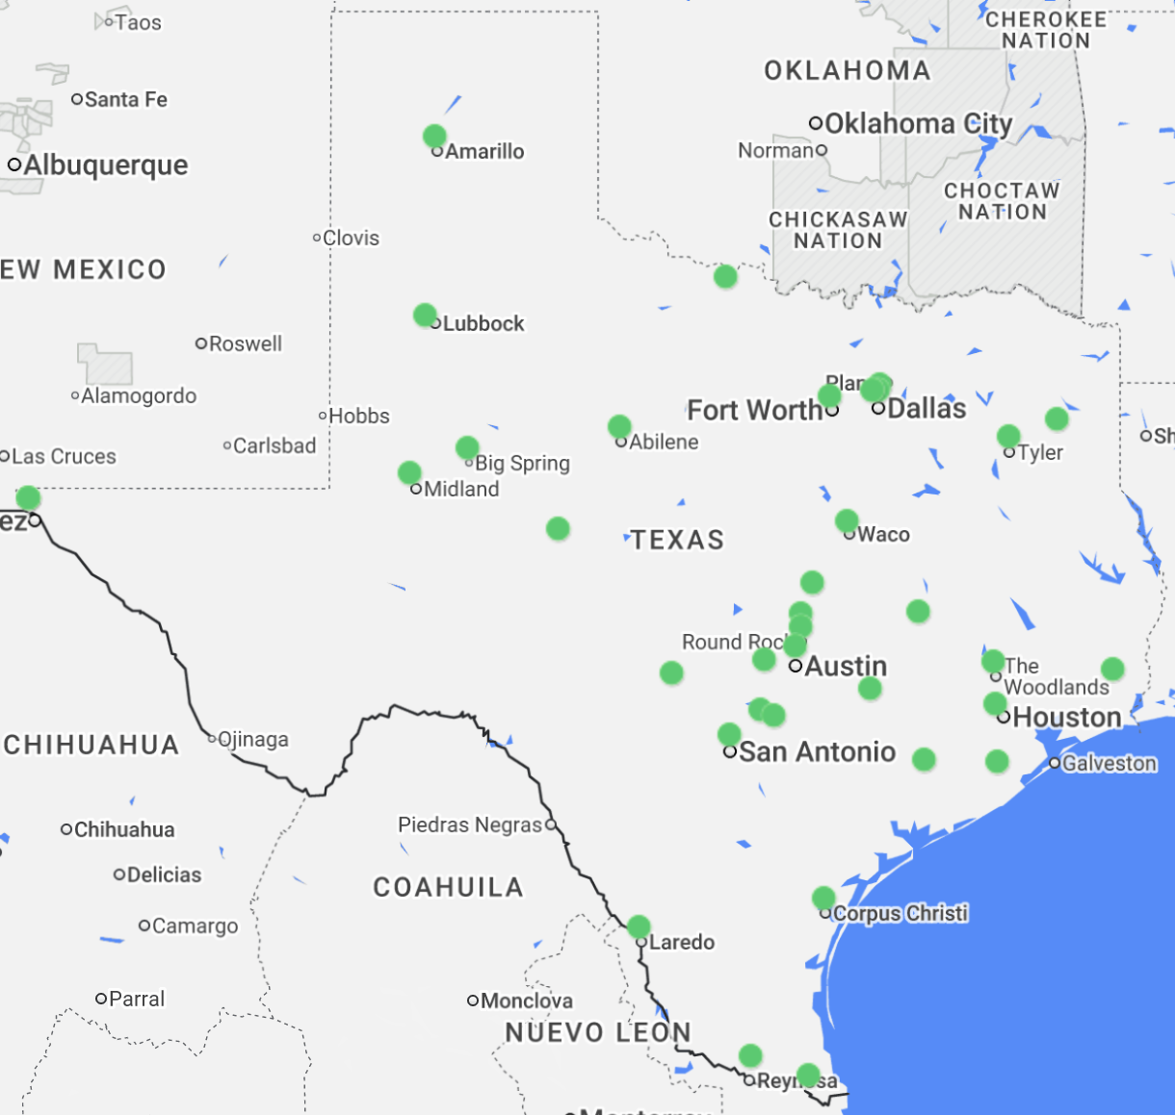
Community Foundations in Texas, May 2026
And …
Crucial Funding Partners Aren’t Always in Rural Areas
71%
of Community Foundation grants go to local recipients within the same metro area or county
Source: Federal Reserve Bank of Philadelphia (May 2022)
Map: Council on Foundations (May 2026)
Notes:
KELTY
What we know from the Philly Fed study is that community foundations are really good at investing money hyper-locally, but many rural areas don’t have a community foundation.
Fun fact: there are 36 community foundations in Texas.

Slide 9
PHILANTHROPY’S RURAL BLIND SPOT
Invisible
Visible & Funded
Visible & Unfunded
Source: Stanford Social Innovation Review (Spring 2021)
Notes:
KELTY
Rural organizations are working hard, usually with fewer staff and smaller budgets.
As a result, many fall into the invisible category. That’s not where you want to be.
BE VISIBLE: Funders can’t support you if they don’t know who you are.
Building partnerships, applying for grants, participating in technical assistance are ways to increase your visibility.
And doing these things create opportunities to support your mission.
It gives people an opportunity to say YES I want to work with you.

Slide 10
RURAL PHILANTHROPY (MIS)PERCEPTIONS
Mindset
Shift
“Capacity is low”
Rural leaders are multi-talented
and self-sufficient
Rural communities get
fewer resources
“Balance sheets are too small”
“No innovative projects
to support”
Where and how are we
sourcing projects?
“The impact is too small because most people live in urban”
Rural communities provide
resources that urban needs
Notes:
KELTY

Slide 11
2.
What We Learned from USDA
New Data on Rural Funding Patterns
Notes:
EVAN

Slide 12
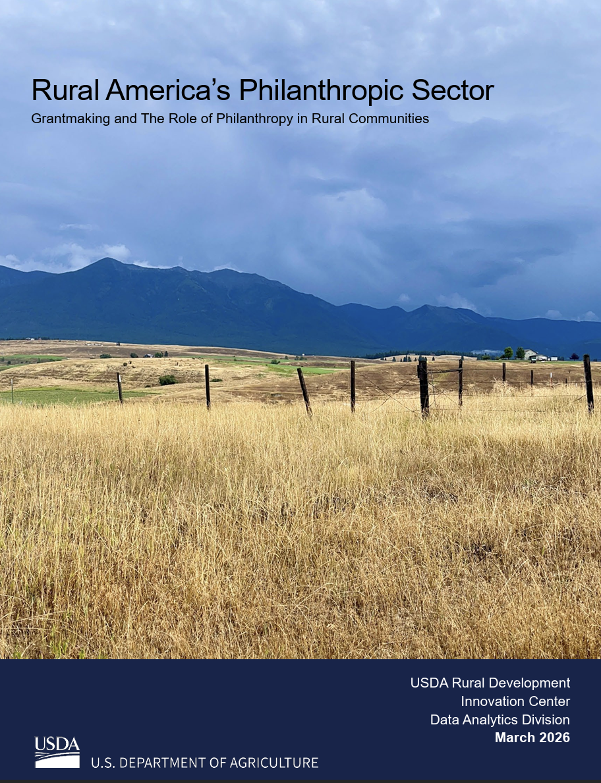
New Analysis from USDA
Rural America’s Philanthropic Sector
Focus To identify potential gaps in the availability of tax-exempt grantmaking organizations in rural America.
Key Findings Between 2014-2021: Only 8% of the ~75K grantmakers active in the U.S. were based in a rural community 1 in 3 rural counties nationwide had no locally-based grantmaking organizations Rural-based funders issued only 3% of all grant dollars (totaling $3.5 billion per year)
Notes:
EVAN
Released March 2026.
Takeaways
Fewer funders located in rural communities
2. 97% of the philanthropy pie is coming from urban funders and 3% from rural (remember that rural makes up 20% of the US population)
Other key factoids from the report:
75,242 grantmaking orgs active in any year from 2014-2021
$116 billion in grants or $1.5 million per organization
Grantmaking was on a steady upward trajectory
Increase from 2019 to 2021 – some increase as a result of COVID
Private foundations (62% of all orgs in the US) more common than grantmaking public charities (but public charities are a larger presence in rural area than private foundations)

Slide 13
USDA’s Key Definitions
Philanthropic Grantmaking Organization
Tax-exempt public charity or private foundation
involved in broadly accessible, routine, meaningful, and relevant domestic grantmaking as part of their regular operations.
Public Charity examples: United Ways or Community Foundations
Private Foundation example: The Meadows Foundation
Rural Community
Any county located outside of a metropolitan statistical area.
Source: U.S. Department of Agriculture (March 2026)
Notes:
EVAN
What is the difference between a public charity and a private foundation?
Public charities fundraise from multiple sources and can run their own programs (e.g., United Ways, Community Foundations)
Private foundations are funded from a single source of wealth and their only function is grantmaking (e.g., The Meadows Foundation)

Slide 14
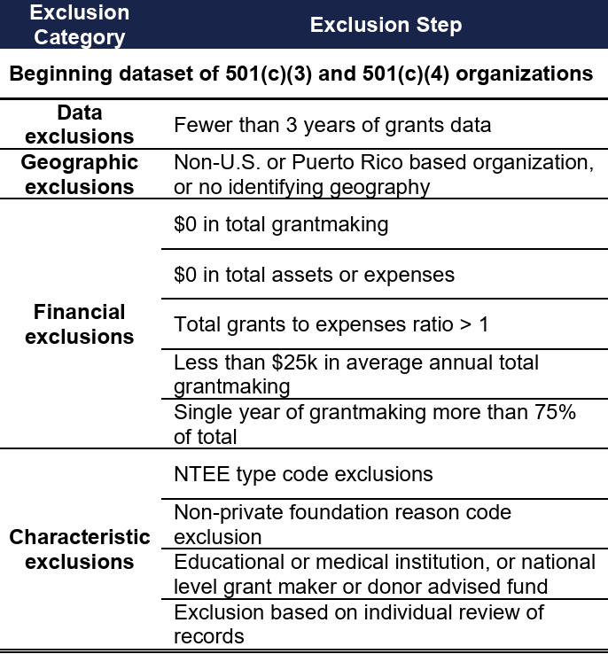
USDA’s Data Methodology
To study grantmaking organizations in rural communities, USDA Rural Development’s research team used IRS Form 990/990 PF filings.
Using the following exclusion criteria, they built a dataset of 84,161 unique tax-exempt grantmaking organizations.
Source: U.S. Department of Agriculture (March 2026)
Notes:
EVAN
Things we need to acknowledge based on this criteria:
There is meaningful grant activity that falls below threshold - $25,000 may seem small, but can go a long way in rural communities!
Later we will share an example of small, rural grants that have had a big impact.
There are active, thoughtful funders that may not meet these criteria.
We know from our network that there are small funders in rural Texas.
Additionally, new funders incorporate every year that won’t have 3 years of grants data yet!

Slide 15
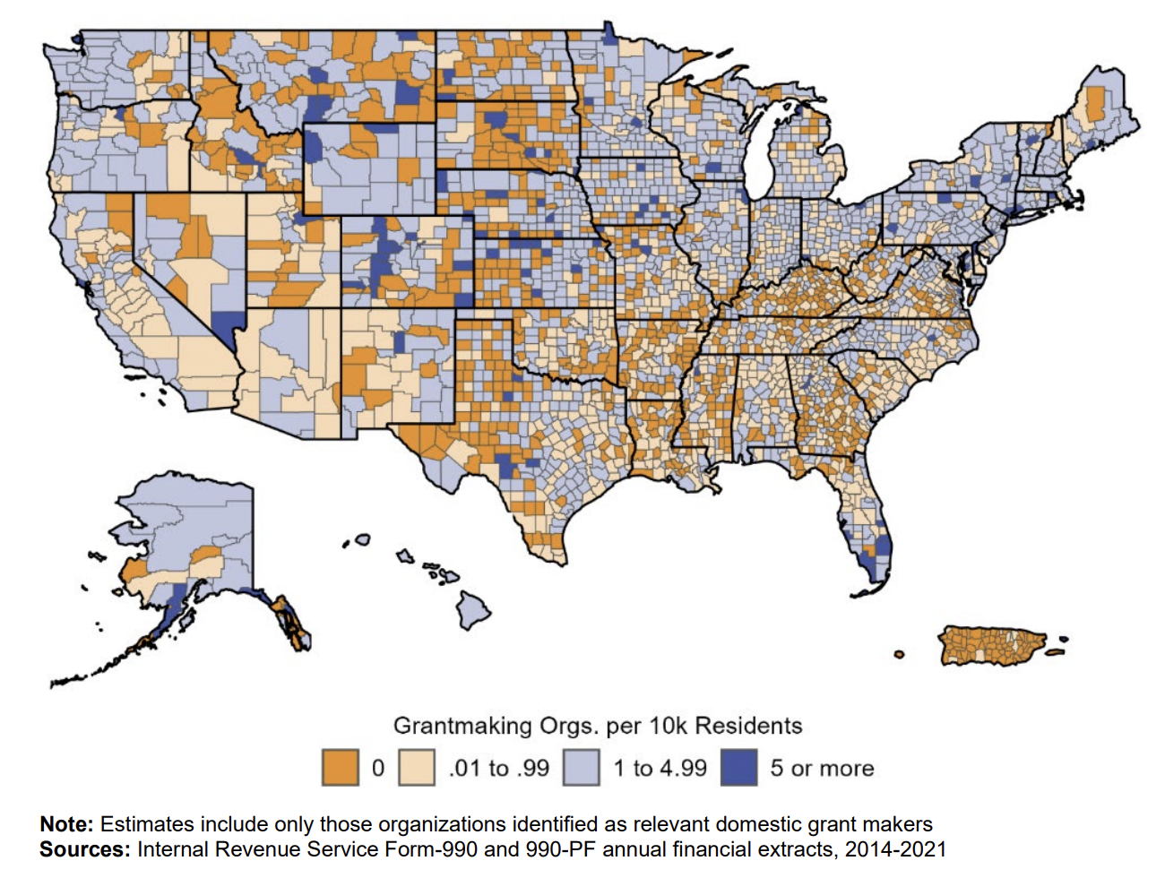
Geography of rural giving
Average Number of Grant Makers per 10,000 People
By County, 2014-2021
Key Insight
Even when accounting for population, rural communities have few or no funders.
Source: U.S. Department of Agriculture (March 2026)
Notes:
KELTY
You might think “of course a big metro area like Dallas or Houston has more funders, more people live there.”
But this map shows that, even when we account for population, urban areas have more funders per person.
Many rural communities have few or no funders – far below the share that the average city has access to.
Walk folks through the map:
What does blue vs. orange mean? Blue = funders, orange = no funders
Ratio based on funders per capita – 10,000 or more people
Texas county examples pulled from the map:
Far West Texas
El Paso: 875,822
Hudspeth: 3,416
Culberson: 2,261
Reeves: 12,151
Jeff Davis: 1,647
Presidio: 5,240 (Marfa)
Brewster: 9,458 (Alpine)
Dark blue counties on USDA-RD Map (5 or more grant orgs per 10K resident):
Population estimate from TAC (https://www.county.org/county-information-map)
Foard (pop. 1,095)
Stonewall County (pop. 1,245)
Sutton County (pop. 3,372)
Edwards County (pop. 1,422)
Gillespie (pop. 26,725)
Compare: Dallas County (1-4.99 grantmakers per 10K) - pop 2,613,539

Slide 16


Geography of rural giving
Average Number of Grant Makers per 10,000 People
By County, 2014-2021
Culberson
2,261
El Paso
875,822
Hudspeth
3,416
Jeff Davis
1,647
Presidio
5,240
Reeves
12,151
Brewster
9,458
West TX Rural Philanthropy Days
Rio Grande COG
Nonprofit Management Center
Source: U.S. Department of Agriculture (March 2026)
Notes:
KELTY
Texas county examples pulled from the map:
Far West Texas
El Paso: 875,822
Hudspeth: 3,416
Culberson: 2,261
Reeves: 12,151
Jeff Davis: 1,647
Presidio: 5,240 (Marfa)
Brewster: 9,458 (Alpine)
Dark blue counties on USDA-RD Map (5 or more grant orgs per 10K resident):
Population estimate from TAC (https://www.county.org/county-information-map)
Foard (pop. 1,095)
Stonewall County (pop. 1,245)
Sutton County (pop. 3,372)
Edwards County (pop. 1,422)
Gillespie (pop. 26,725)
Compare: Dallas County (1-4.99 grantmakers per 10K) - pop 2,613,539

Slide 17
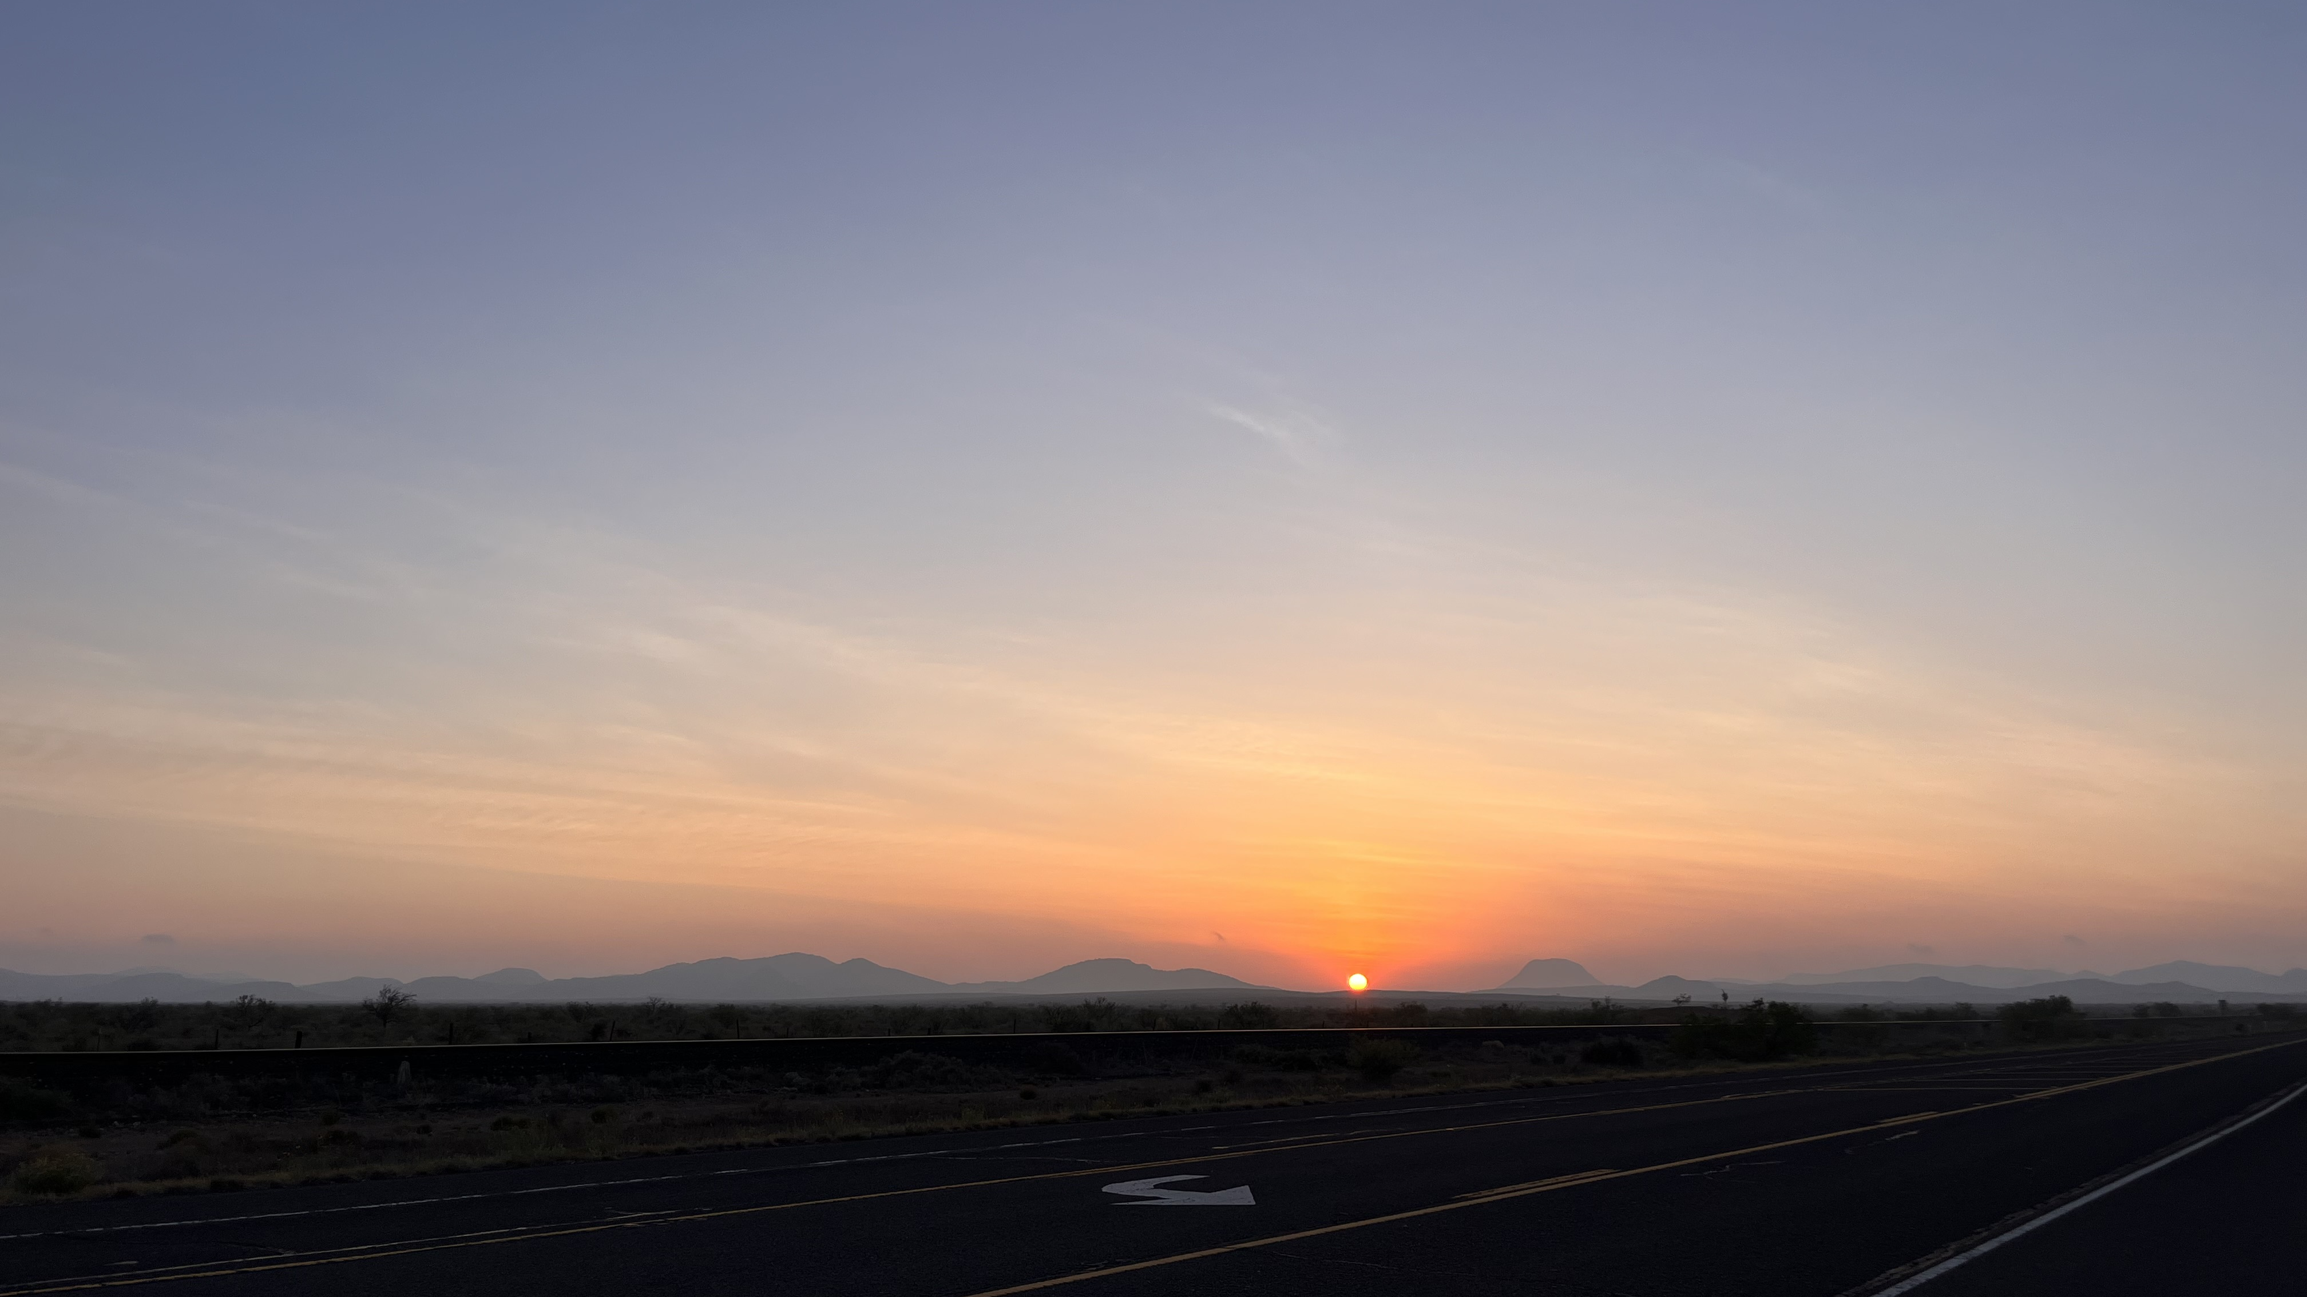
Frontier Philanthropy
What is the Trans-Pecos?
What is the Trans Pecos?
Sunrise outside Alpine, Texas

Slide 18
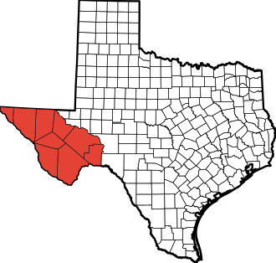
What is the Trans-Pecos?
9 counties (out of 254)
31,479 sq. miles (covering 12% of Texas)
94% of the population lives in El Paso
Population density is 27 people per sq. mile
Notes:
9 counties that cover over 31,000 square miles.
Of these 9 counties, 5 are also the largest counties in the state by area.
Most recognized city in this region is El Paso
856,187 people live in the Trans Pecos
And 93% of them live in El Paso!
Population density is 27 people per square mile.

Slide 19
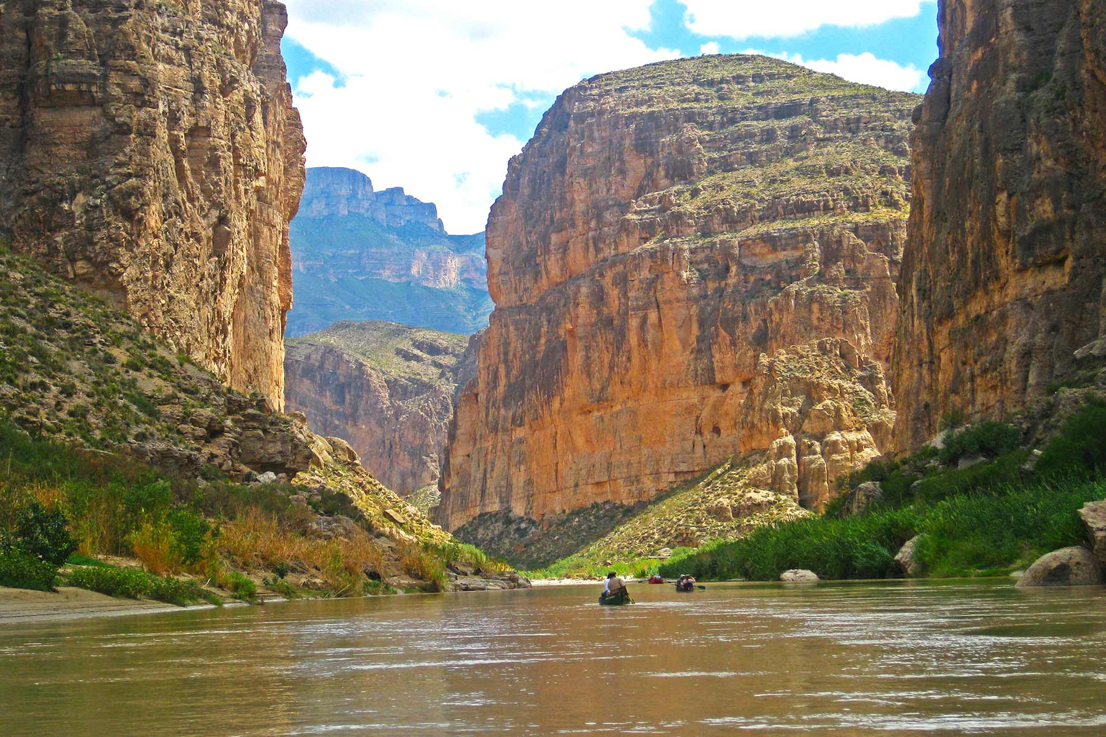
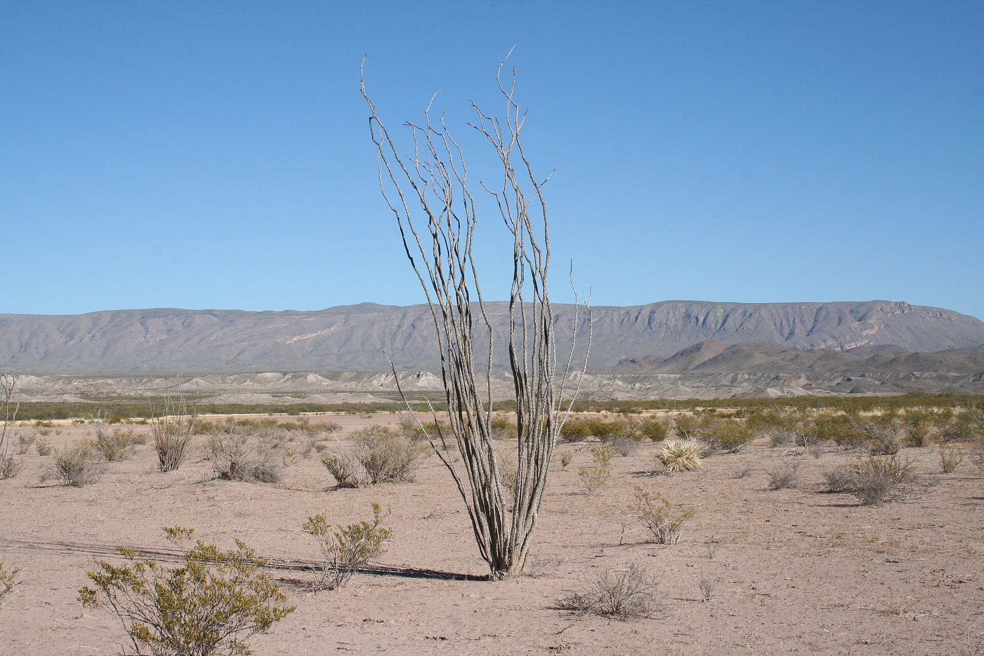
About
Far West Texas
Big Bend National Park
Chihuahuan Desert
Notes:
It is home to the largest desert in North America
Home to the only 2 national parks in Texas (Big Bend and Guadalupe Mountains)
When you get outside of El Paso, you see desert, large, open spaces, and amazing sunsets.
The Trans Pecos is the home of Big Bend National Park, one of the least visited parks in the national park system because it is so remote.

Slide 20
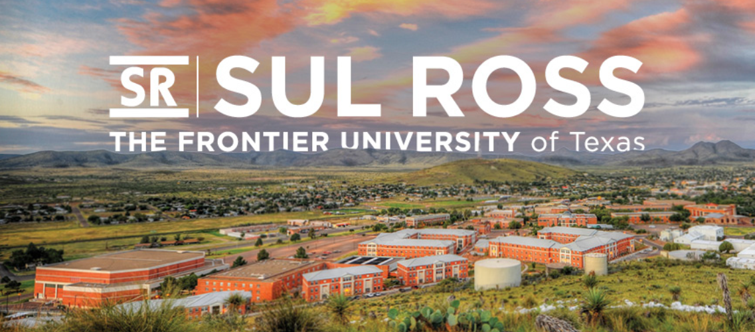
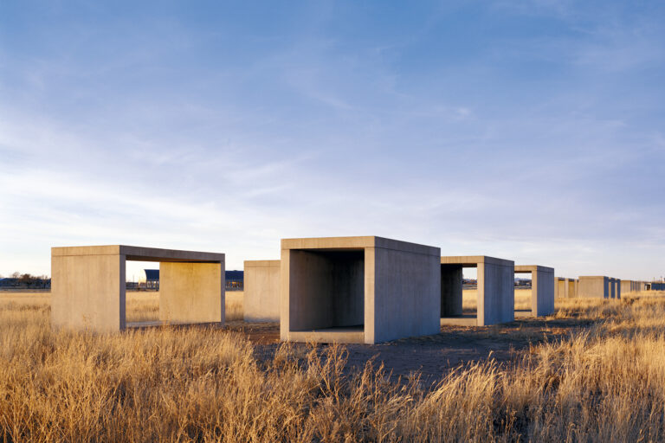
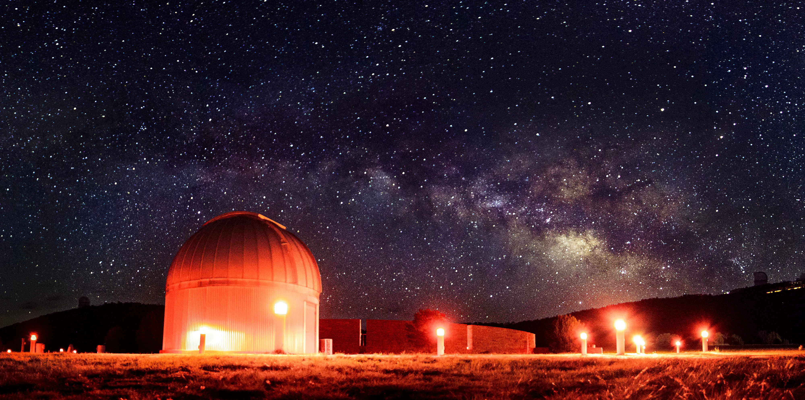
About
Far West Texas
Chinati Foundation
McDonald Observatory
Notes:
But it’s also where artist Donald Judd established the Chinati Foundation in Marfa, which brings visitors from around the world to view permanent, site specific modern art
If you have ever listened to the astronomy program Star Date on NPR, it comes from McDonald Observatory in Fort Davis.
It’s where Sul Ross State University is located (in Alpine) which has a beautiful art museum and
This part of the state is known for art, astronomy, geology, national parks, dark skies,
The vast majority of communities in the region have populations under 5,000 people.

Slide 21
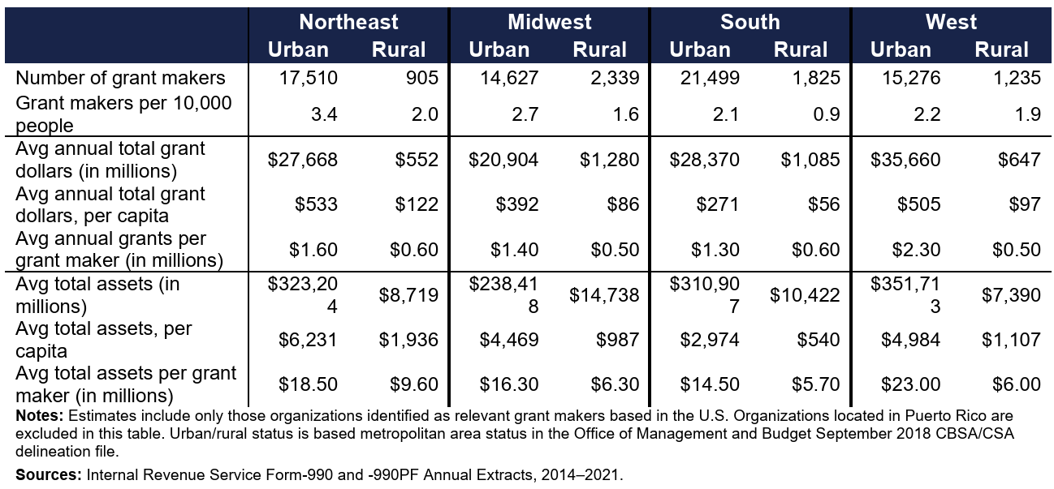
Regional Trends
Statistics on Grantmaking Organizations,
by Census Region and Urban/Rural Status, 2014-2021
Key Insight
Philanthropy in the rural South (Texas) is lower than every other urban and rural region in the U.S.
Source: U.S. Department of Agriculture (March 2026)
Notes:
EVAN
Upshot: urban philanthropy is always bigger, but rural grantmaking organizations aren’t evenly distributed across the country, either.
Largest rural grantmaking sector per capita AND most rural grants per capita: Northeast
The rural South (where Texas is located) runs behind every other urban AND rural region in the U.S. Between 2014-2021, when you account for population, the rural South had:
The lowest number of grantmaking organizations,
With the least assets, and
The lowest amount of grantmaking activity.

Slide 22
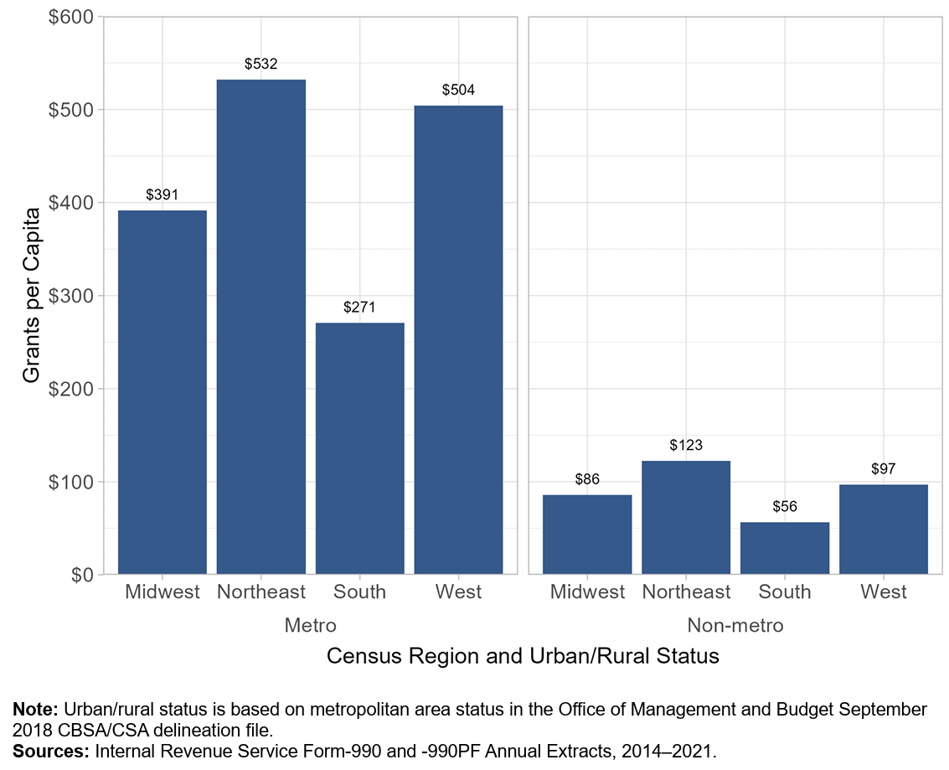
Urban-Rural Funding Gap
Per Capita Grants by Region and Rural/Urban Status, 2014-2021
Key Insight
Explosive population growth in the South has not been enough to close the funding gap with other regions of the U.S.
Source: U.S. Department of Agriculture (March 2026)
Notes:
EVAN
Despite the fact that the South has led the nation in population growth, our philanthropic sector is still smaller than any region in the country.
After the 2020 Census, the South gained seats in Congress (Texas, Florida, North Carolina).
Our voice in national policy is larger than ever but our grantmaking sector hasn’t kept pace.

Slide 23
3.
What We Learned from Rural Texas
Surveying Impacts of Changes to
Federal Funding
Notes:
EVAN

Slide 24
Background: 2025 Brought Big Changes to Federal Grants
Initial Funding Freeze
Survey Deployed
Government Shutdown
Notes:
EVAN – Voiceover how we pull info for Grants Hub and that is demonstrates the decrease in funding opportunities
General freeze, then program-by-program pauses, reviews, and court proceedings that are still ongoing.
Federal reduction in force (RIF), and staff furloughs the October 2025 government shutdown, also effectively paused grant programs across this timeline.
Takeaway: the federal government’s traditional role in supporting the nonprofit sector is evolving – changes to the funding ecosystem are not just an isolated event but a trend we’re going to see into the near future.
This will continue into the near future, so how can we help nonprofits cultivate resilient resource strategies?

Slide 25
Adaptive Survey, Powered by A.I.
Depending on how respondents answered, our survey’s A.I. had three different ‘banks’ of questions it could ask them.
Key information collected across all respondents include:
Types of funding received
Annual budget size
Percentage breakdown of funding sources
Reductions in government funding at time of survey
How nonprofits are responding to funding changes
What nonprofits will do if funding cuts continue
Response Period:
April 25 – May 12, 2025
Total Responses:
245
Notes:
KELTY
Read whole list of key info!

Slide 26
most Respondents Receive A Mix of
Funding – Not Just Federal grants
Percent of Respondents that Receive Government Funding, by Funding Source
Please Indicate:
Which types of government funding does your organization receive?
Select all that apply.
n = 245
Notes:
KELTY
75% and 73% are almost equal. People getting federal are also getting state grants.
At least half get local govt contracts
These other levels of government are also experiencing funding cuts.
Takeaway: small share of non-govt. revenue in these budgets, so we can expect (and have seen) more pressure on private sources to make up public sector cuts.

Slide 27
2/3 of Nonprofits Had Federal Funding Cut
n = 236
Notes:
KELTY

Slide 28
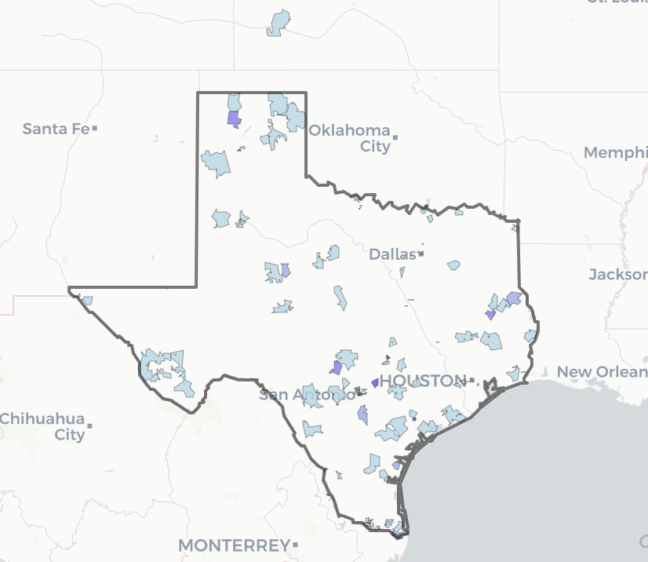
Regional Trends
Number of Responses by ZIP Code
n = 245
Notes:
EVAN
Darker = more responses
Segmented by general zip code and counties.

Slide 29
Most Organizations Started Looking for Alternative Funding
n = 245
n = 78
Yes or No:
Has your organization sought alternative funding sources?
n = 31
n = 14
n = 34
n = 34
n = 34
n = 20
Notes:
EVAN
Voiceover this is a binary

Slide 30
Some Organizations Turned to Seeking External Partnerships
n = 245
n = 78
Yes or No:
Has your organization partnered with another nonprofit in response to federal funding cuts?
n = 31
n = 14
n = 34
n = 34
n = 34
n = 20
Notes:
EVAN

Slide 31
4.
How We Can Respond
Strategies that Support Rural Capacity
Notes:
KELTY

Slide 32
Data Informs Capacity Building
Rural communities face steep, systemic challenges when seeking funding:
Limited time and resources to identify funding opportunities
Few (if any) available staff or volunteers to write applications
Finite range of organizations within the community to partner with
Grant applications usually written with urban in mind and rural as the “younger sibling or mini-urban”
Strategy: capacity building tools that leverage rural assets already in the community
Notes:
EVAN

Slide 33
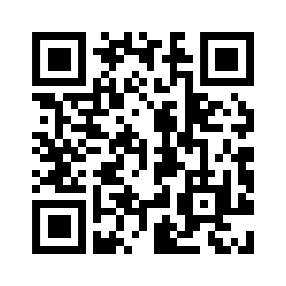
Access the Grants Hub here.
Grants Hub on the Texas Rural Funders Website
Built for | Community leaders Nonprofits
Key features | Free, downloadable database of grant opportunities for rural communities Roster of vetted grantwriters with subject-matter expertise
Notes:
EVAN

Slide 34
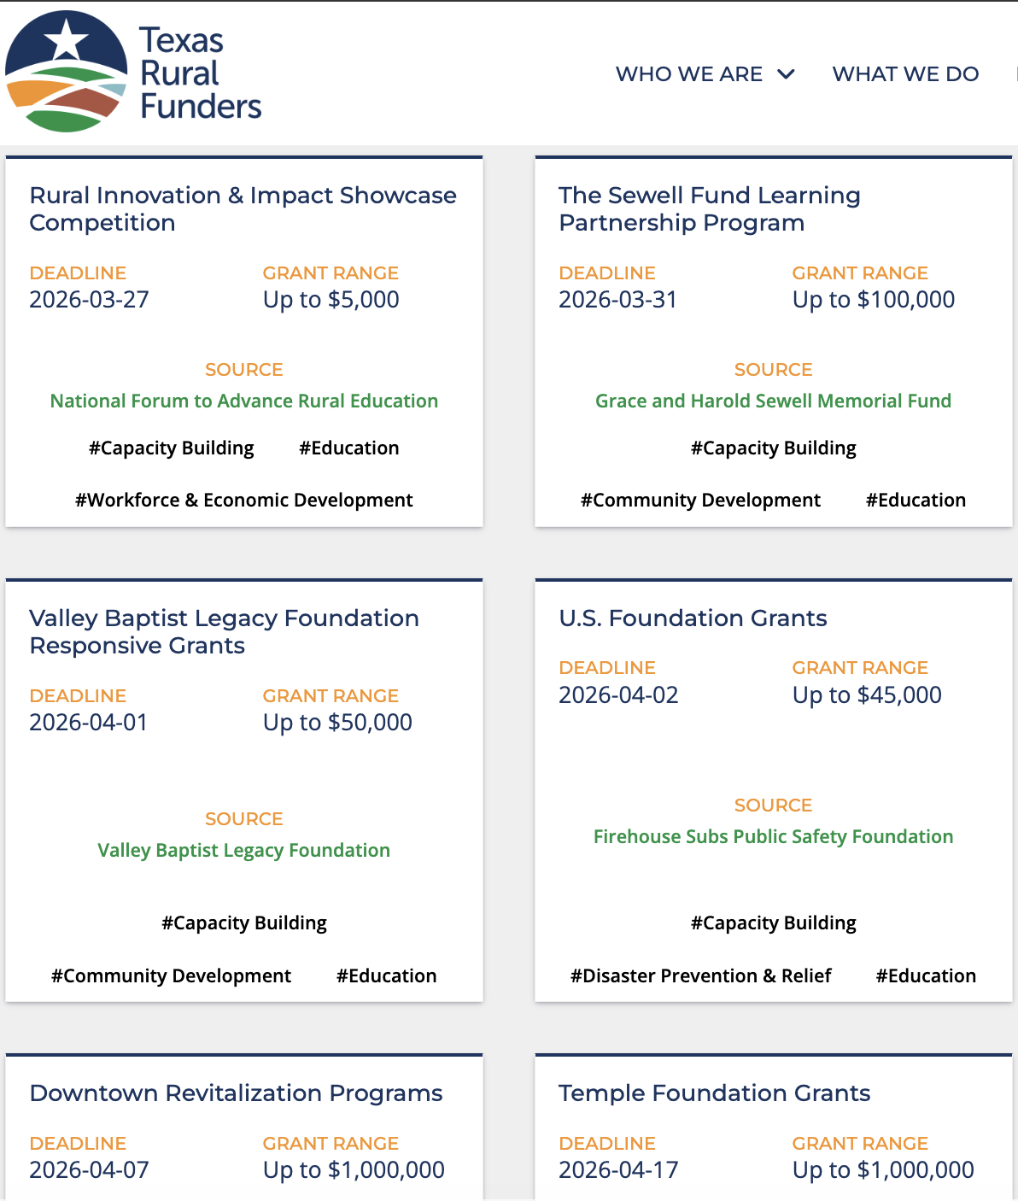
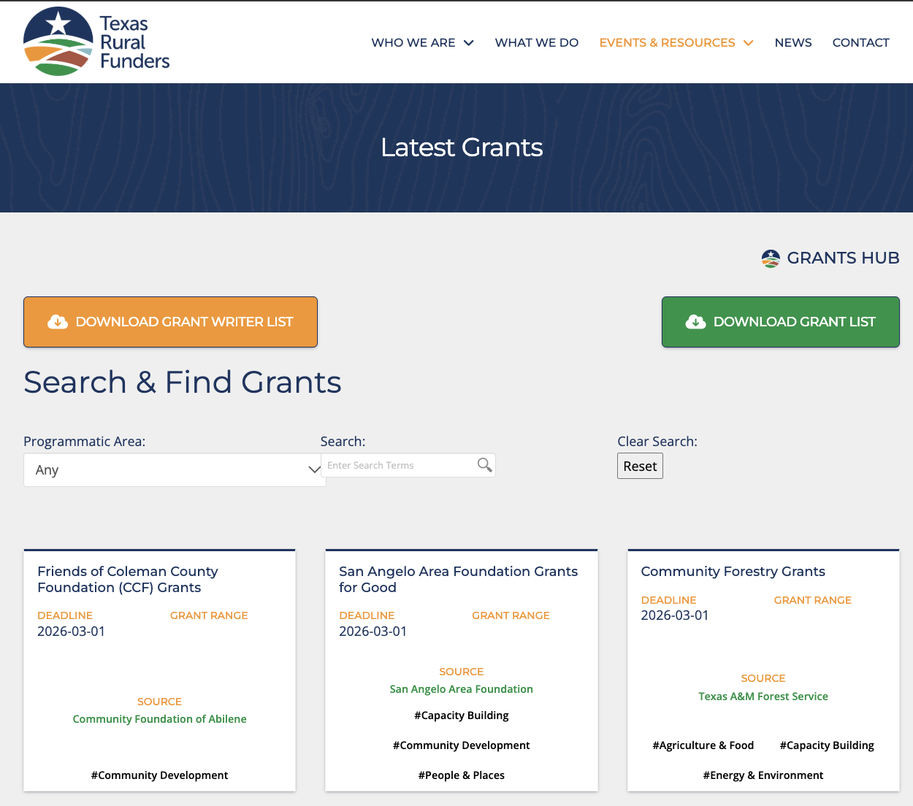
Grants Hub
Notes:
EVAN

Slide 35
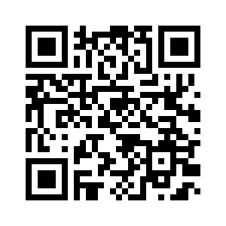
Access Rural Resources here.
Rural Resources on the Texas Rural Funders Website
Built for | Nonprofit and community leaders Funders
Key features | Resources that highlight success stories and connect users to documents, videos, and orgs dedicated to their success
Notes:
EVAN

Slide 36
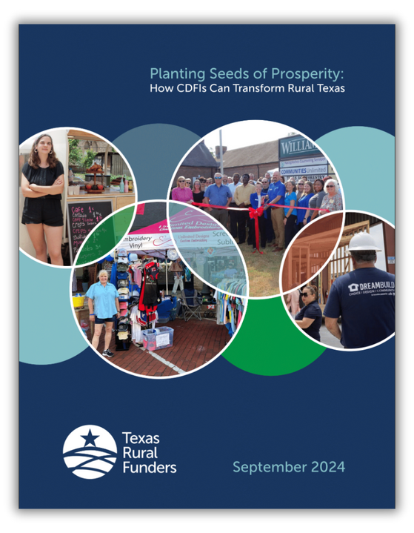
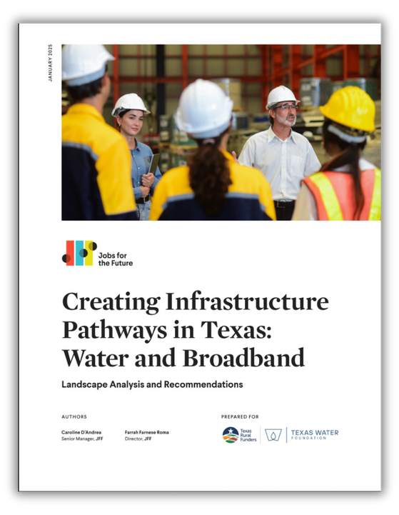
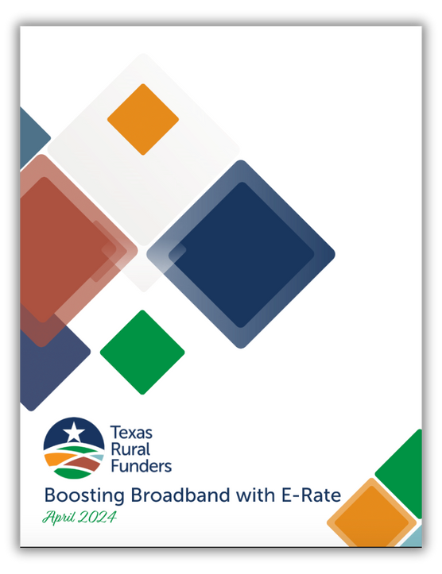
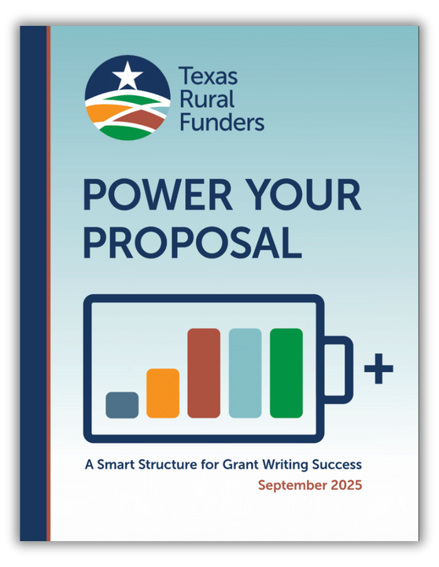




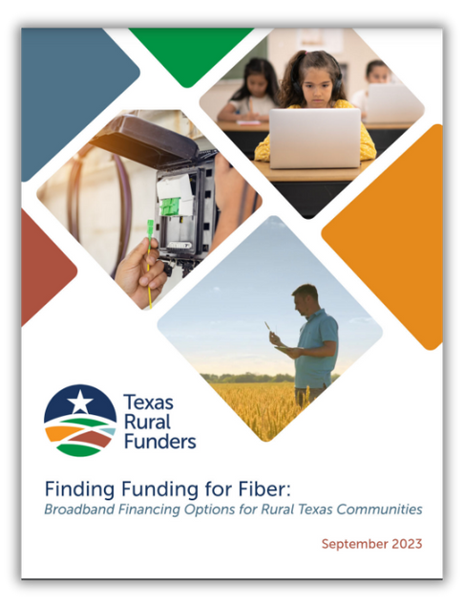

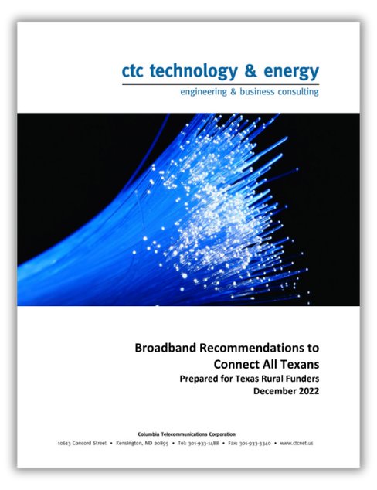
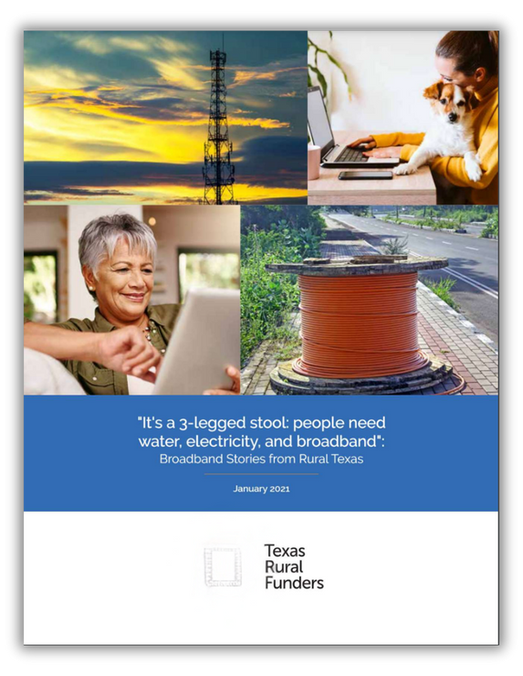



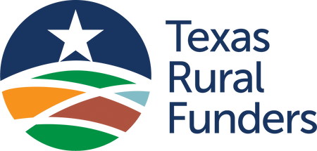

Notes:
KELTY

Slide 37
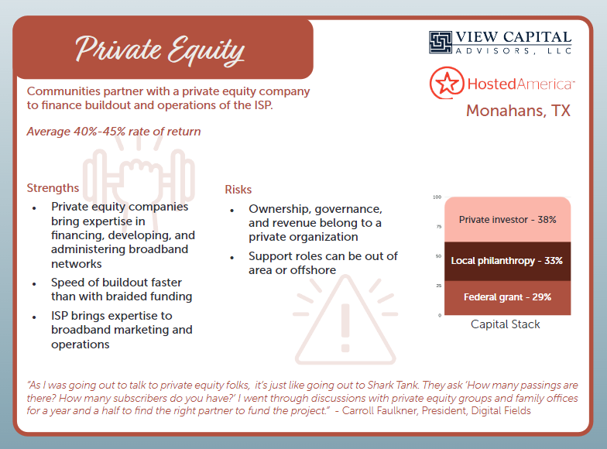
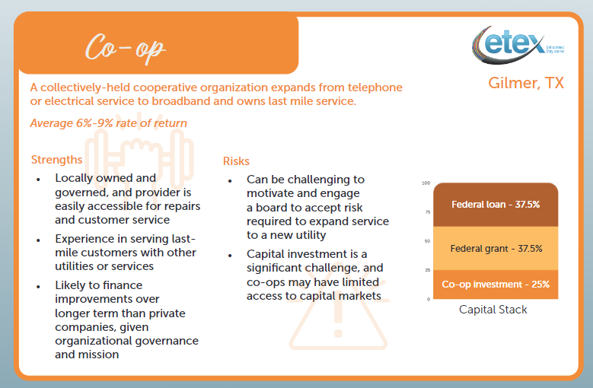
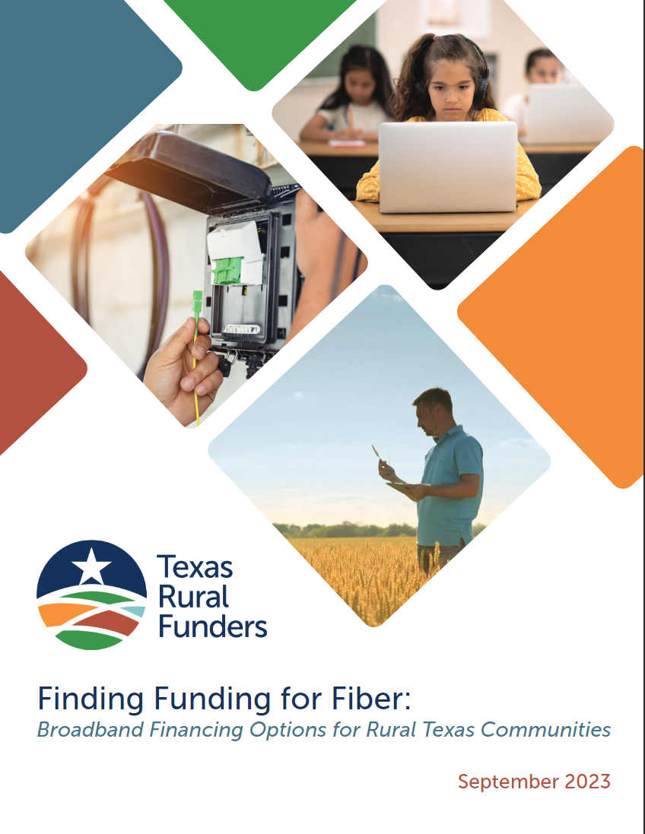
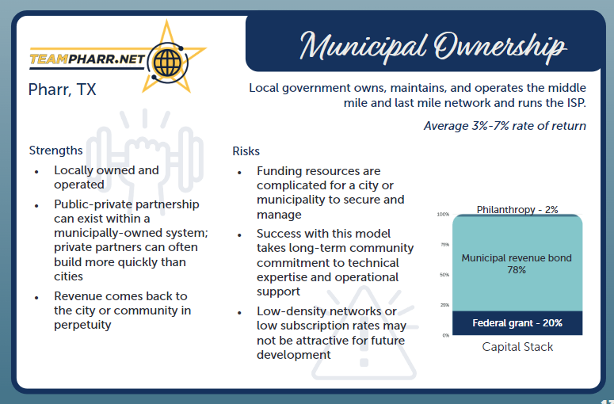
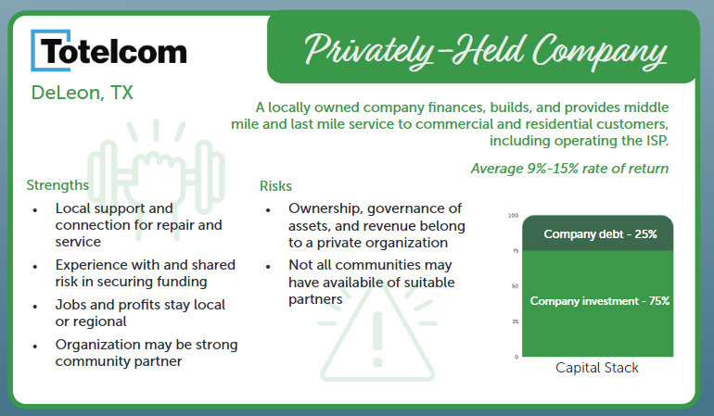
Example: Different Paths to Funding a Budget
Notes:
KELTY

Slide 38
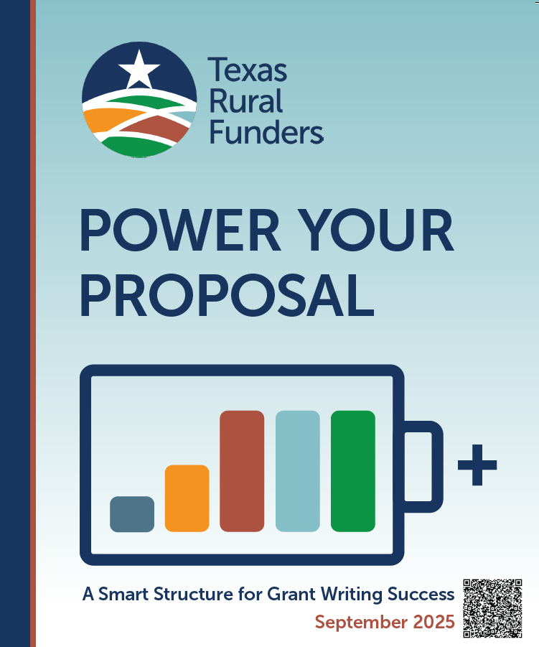
New Resource for Rural Grantseekers
Power Your Proposal: A Smart Structure for Grant Writing Success
Built for | Nonprofit staff that are new to grants Volunteer grant writers
Features | What happens at every step in the grant life cycle – and what you need to get there Easy-to-use resources you can use to put together a strong proposal
Notes:
KELTY

Slide 39

Power Your Proposal Helps Grantseekers…
Understand the kinds of grant that are available
Learn how to prepare the most commonly-needed info in a grant
Find out what funders wish grant applicants knew
Gain access to a rich catalog of grant development resources
Discover how to receive and operate grants and complete reporting
Notes:
KELTY

Slide 40
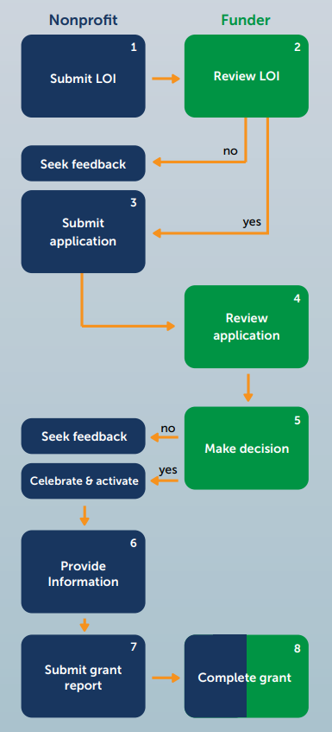
Lifecycle of a Grant
Nonprofits and funders have a role to play at every step of the grant process – from idea to implementation.
Strategies to Avoid Getting Stuck
Didn’t get the funding?
Ask for feedback and join any technical assistance offered.
“No” now doesn’t mean “no” forever.
What should I do with my grant funds?
Spend the money—all of it—on what you said you would. Unused funds may have to be returned.
Having challenges? Like hiring delays or leadership changes?
Don’t wait! Reach out to your funder before problems
grow. They can offer guidance, connections, or even
help you find new resources.
Notes:
KELTY
Reference the pages 10-11. We have advice at each step for things to think about! Like:
Step 7: Nonprofit provides grant updates
Make reporting easy on yourself.
Collect useful info along the way—like participant counts, survey results, financials, feedback, testimonials, and photos—so you’re not scrambling later.
A simple habit: every few months, document your successes, challenges, and lessons learned. It’ll make reporting easier and richer.

Slide 41
Advice from funders (hint: we want you to succeed)
We consistently fund the same categories.
Do your homework.
Are you addressing an existing need or innovating for future opportunities?
Please answer my questions within the word limits.
Your budget tells a story.
We want to know what you learned and how you achieved your goals.
No doesn’t mean no forever.
Sometimes what I can help with isn’t money.
Your organization doesn’t need to have everything figured out, but you do need a solid plan.
Relationships matter – even brief encounters can make a difference.
Notes:
EVAN
Reference page 19
Funders consistently fund the same categories.
Priorities often reflect the source of the original wealth or a cause important to the benefactor. If a funder supports “the arts,” dig deeper—is that visual arts, theater, or music? If their giving history indicates visual arts, a proposal for a summer music camp is unlikely to align.
Do your homework.
Understand why the problem exists. Who else is working on it? What solutions have been tried? Whose perspectives have you considered—especially those directly affected by the issue? Do your research to show you’ve listened and learned.
Please answer questions within the word limits.
This is not a time for creative writing. I prefer short, clear sentences that explain what you plan to do and how you will do it.
Sometimes what I can help with isn’t money.
Funders can introduce you to others who share your mission, give feedback on your proposal to another funder, invite you to professional development sessions or connect you with a coach or mentor. Building your organizational capacity can be even more valuable than a grant.

Slide 42
FINDING RESOURCES BEYOND GRANTS
Even with grant funding, you likely need partners to achieve your mission!
Grants are a crucial tool, but they’re not the only resource you have!
Think about what partners in your community can do to help accomplish your goals.
Notes:
KELTY

Slide 43
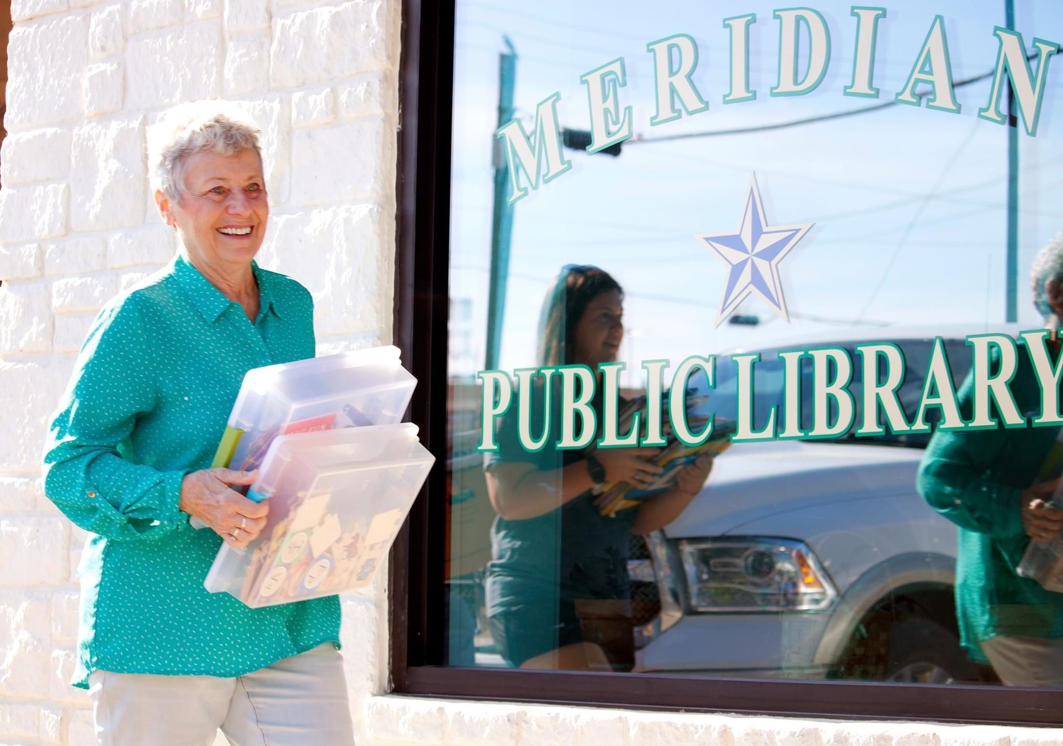
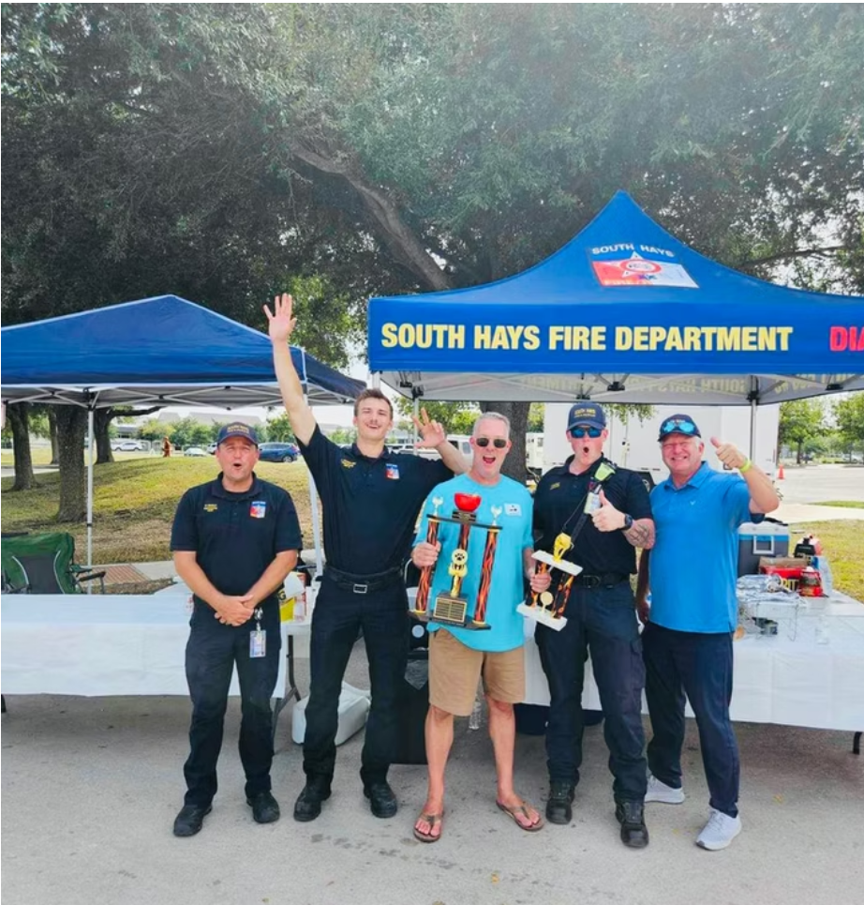
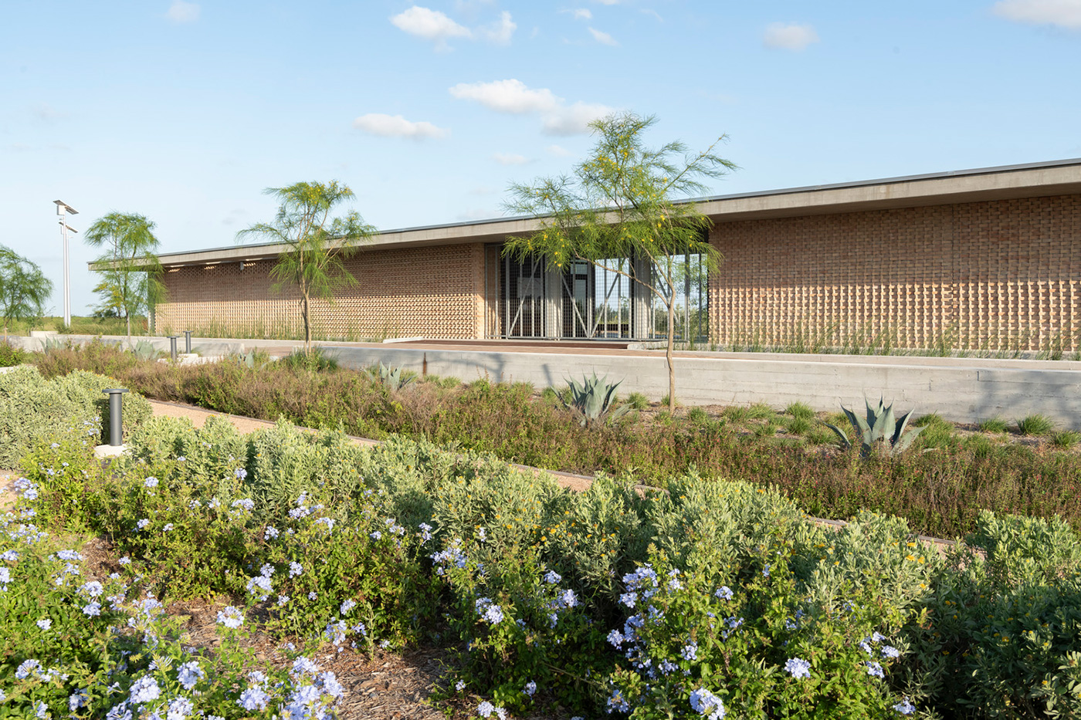
RURAL PARTNERSHIPS IN ACTION
Library
Book Brigade
Meridian
Emergency
Preparedness Fair
Kyle
South Texas
Eco-Tourism Center
Laguna Vista
Notes:
KELTY
Small – Book Brigade
Large – Emergency Preparedness Fair
EVAN
Talk about STEC

Slide 44
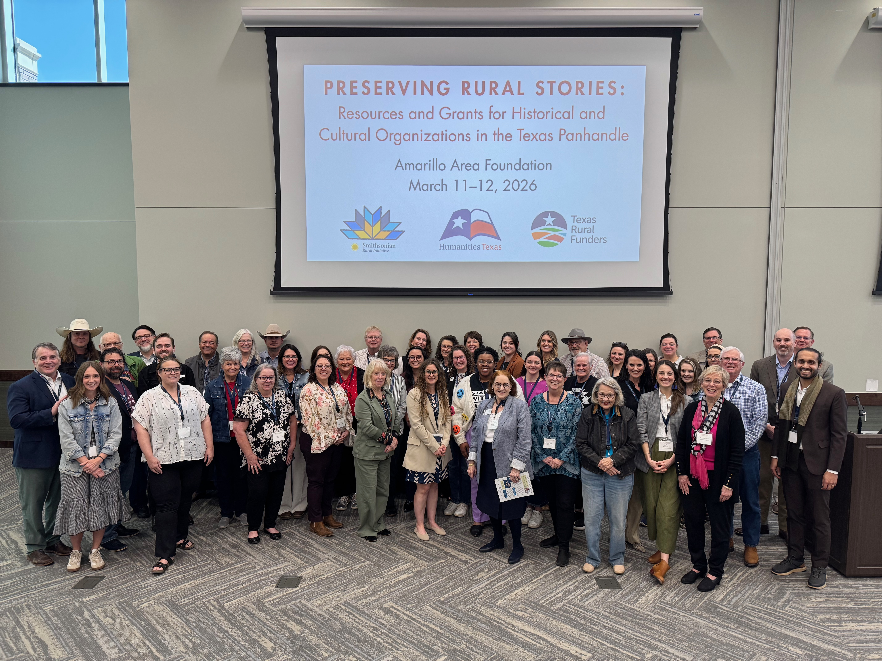
CHANGING THE WAY WE REACH
RURAL PARTNERS
Humanities Texas
Goal: increase grant applications from rural communities.
Approach: created rural-only grant with low barriers to entry
$2,500 “starter” award
Reviewed in 10 business days
Streamlined application with rolling deadline
Regional grants workshops that bring in other funders/partners
Notes:
EVAN
Humanities Texas wanted to increase the number of successful rural applications – they knew from the grants data that rural communities were under-represented among applicants
Purposefully created a grant for rural communities (counties of 60,000 or fewer which represents 207 of the 254 counties in Texas)
Grant is $2,500 and is reviewed in 10 business days. It’s a streamlined application with a rolling deadline. This is a way for a small, rural organization to get started with grants.
Paired with regional grants workshops that allow folks to meet Humanities Texas staff and other funders/partners like Texas Historical Commission, Texas Historical Foundation, Texas Commission on the Arts, local community foundations, the Smithsonian Rural Initiative, Texas Rural Funders etc.

Slide 45
TAKEAWAYS
Remember to use data for, not against, rural communities.
    Scale is the not same as impact: local population and density are poor indicators of what resources a community really needs (or has).
    Giving data highlights what parts of the map get left behind.
There’s not a one-size-fits-all strategy to connect communities with the resources they need.
    Rural communities are small but innovative.
    Check your priors and recalibrate your toolbox when
    working with rural organizations!
    Ask: are there any unintended consequences for rural?
Notes:
KELTY

Slide 46
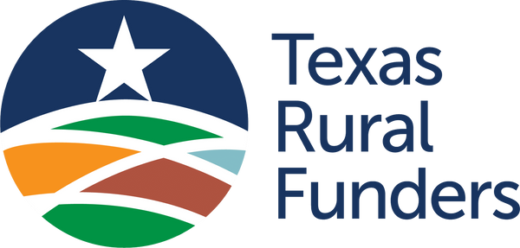
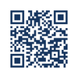
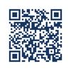
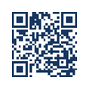
MOBILIZING THE POWER OF PHILANTHROPY
to strengthen rural Texas.
Visit our Website
Newsletter Sign Up
Grants Hub

Slide 47
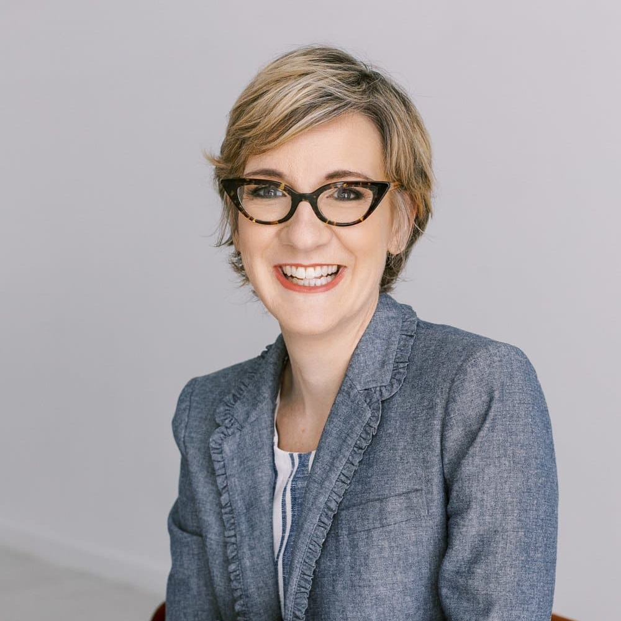
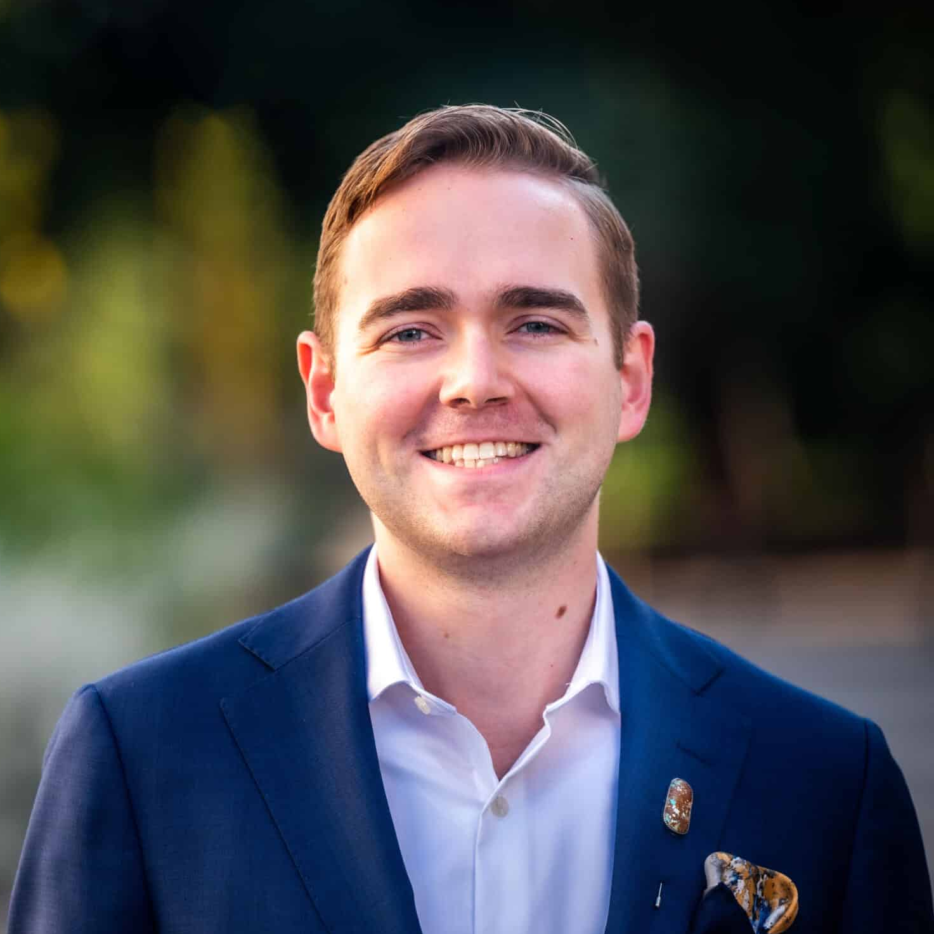
CONTACT US
Dr. Kelty Garbee
Executive Director
kelty@texasruralfunders.org
Evan Wolstencroft
Program Manager
evan@texasruralfunders.org

