Slide 1



Texas' Future in Numbers:
Population Projections and Beyond

Slide 2
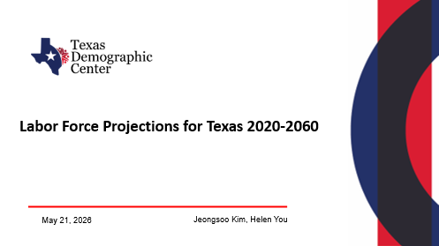
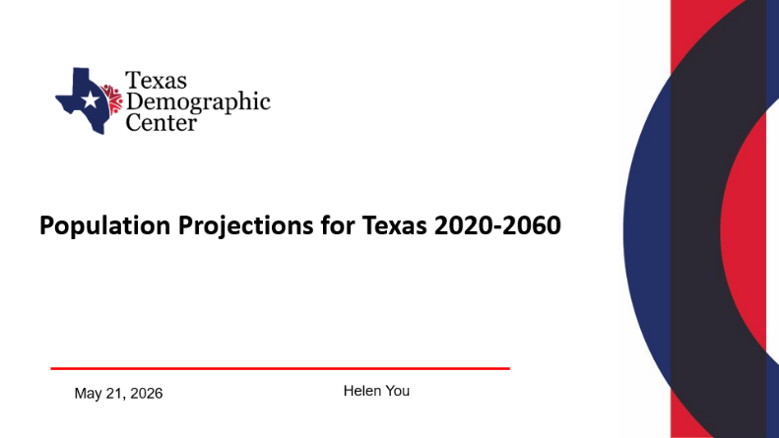

Slide 3
Population Projections for Texas 2020-2060
May 21, 2026
Helen You

Slide 4


TDC Population Projection Overview
Overview
Total population and population by age, race, and sex for Texas and all its counties:
Single year of age;
5 race/ethnic groups: Hispanic, NH White, NH Black, NH Asian, and NH Other;
From the most recent Census (2020) out to 40 years in the future (2060);
Three migration scenarios are provided – low, mid and high.

Slide 5
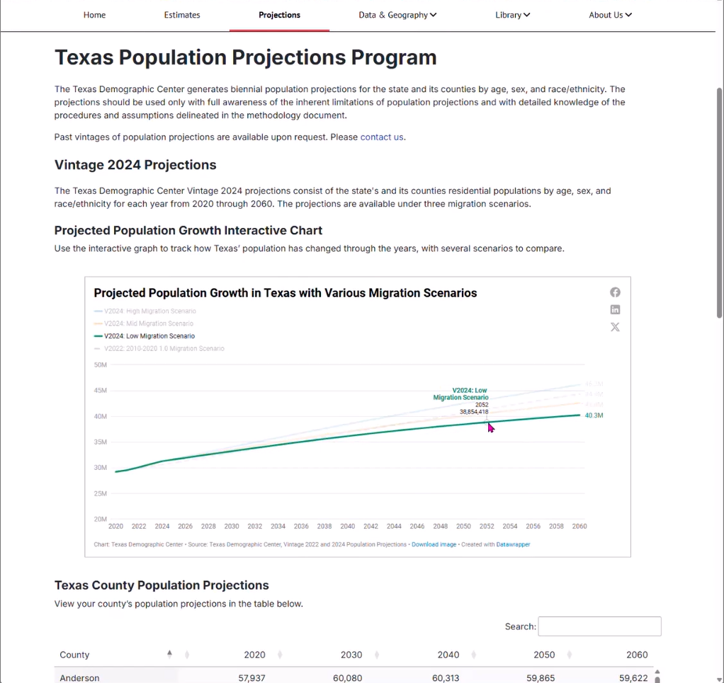
Access the
TDC Projections

Slide 6
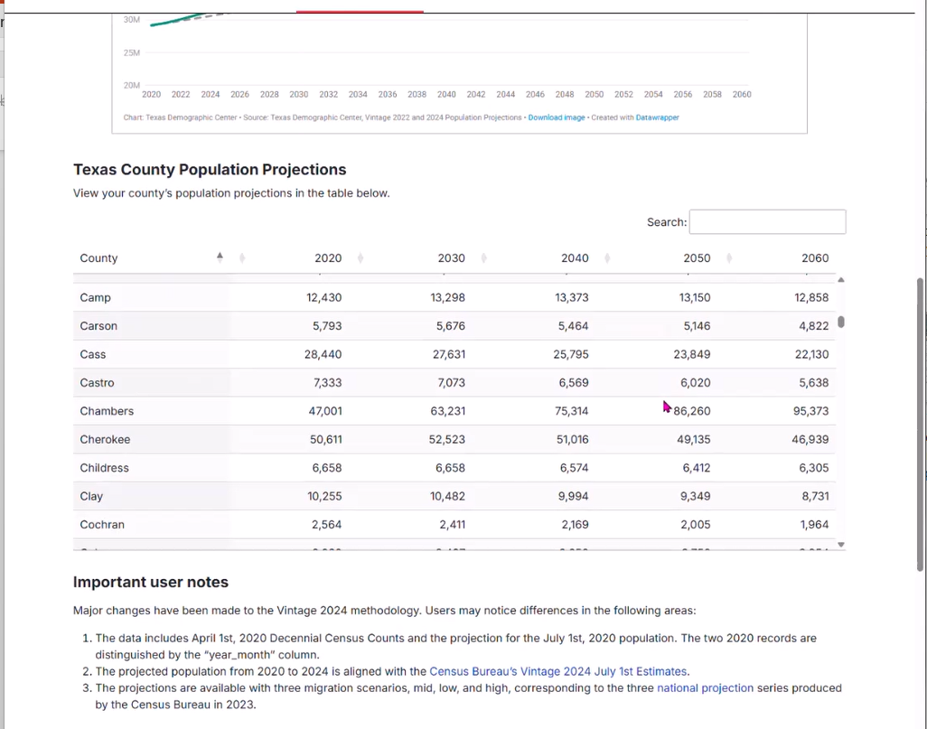
TDC Projections Table

Slide 7
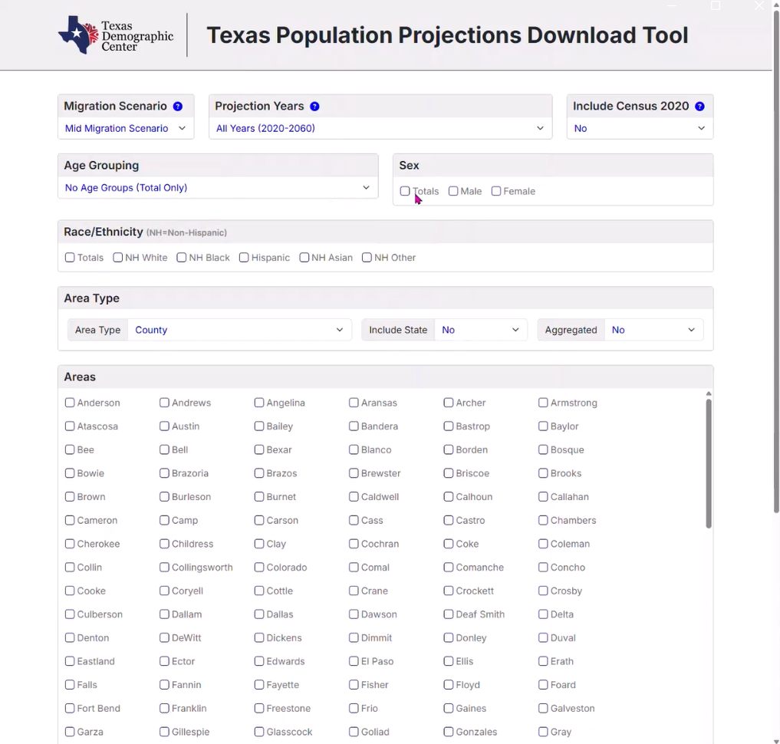
TDC Projections Data Tool

Slide 8
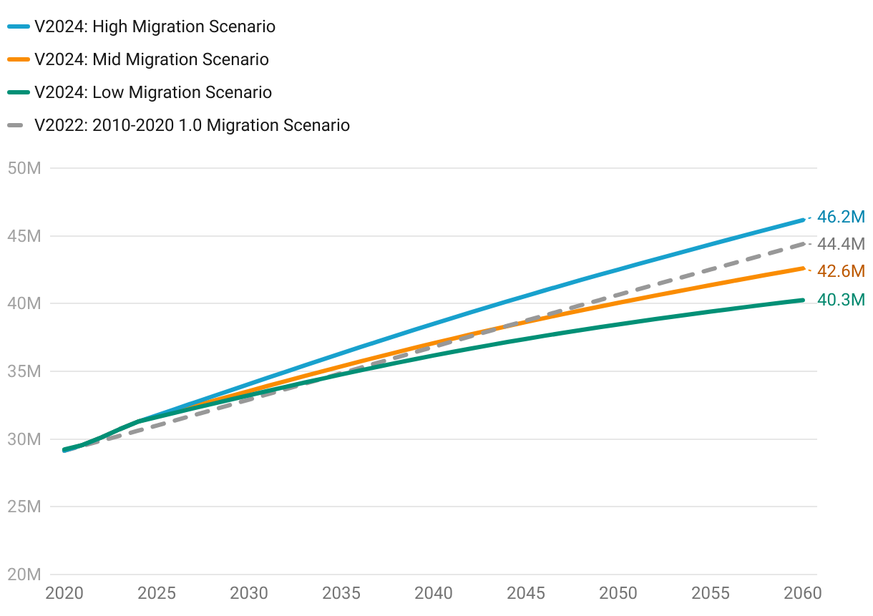
Projected Population Growth in Texas under
Various Migration Scenarios
1.9M
1.4M
7.9M
Source: Texas Demographic Center, Vintage 2022 and Vintage 2024 Population Projections

Slide 9
Projected Population by Race/Ethnicity
2020-2060
Mid Migration Scenario
All race/ethnic groups are projected to grow in size except for the non-Hispanic White.
Hispanics will gain the most population, while NH Asians will experience the fastest growth
Source: Texas Demographic Center, Vintage 2024 Population Projections, Mid Migration Scenario

Slide 10
How old will Texas be in the future?
Projected Median Age by Migration Scenario in Texas, 2020-2060
Median Age 2060
44.2
43.6
43.0
35.6
Median Age 2020
Source: Texas Demographic Center, Vintage 2024 Population Projections
Notes:
Caption: Texas had a median age of 35.6 in 2020, younger than the nation. By 2060, it is projected to rise to 43.0–44.2. Under the higher migration scenario, the median age trends lower since migrants to Texas are, on average, younger.

Slide 11
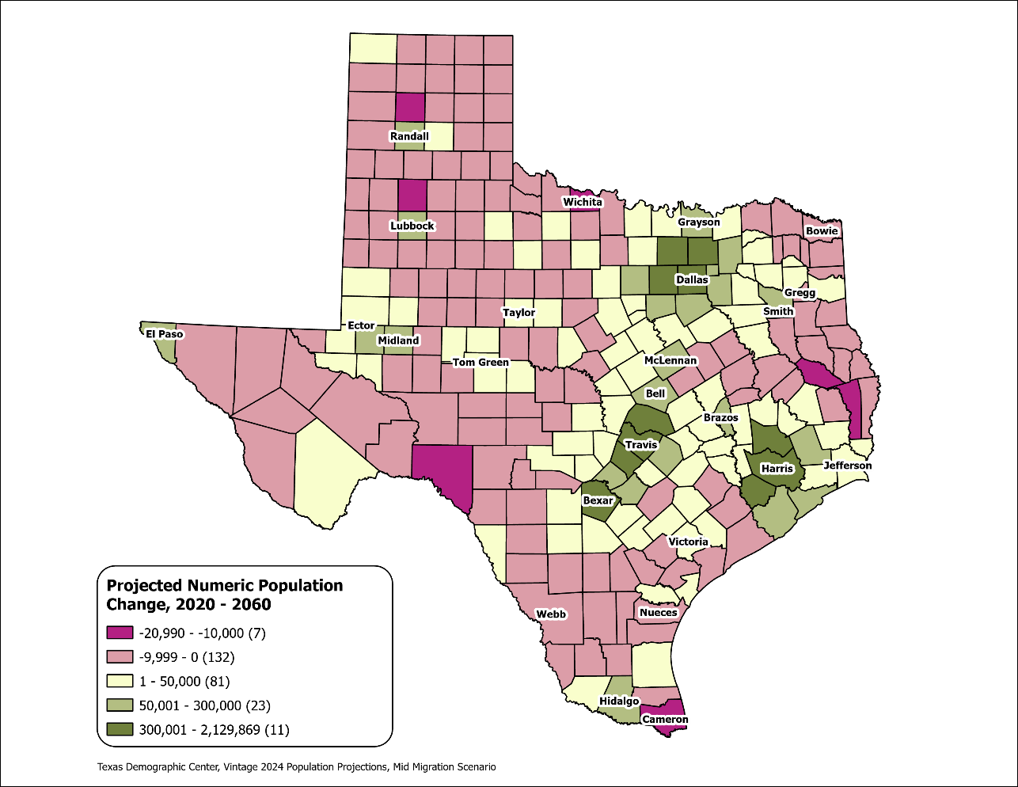
Texas Counties
Projected Population Numeric Change 2020-2060
Mid Migration Scenario
139 Counties are projected to lose population
Current MSA counties will account for 99% of the state’s growth from 2020 to 2060
The four MSAs within the TX Triangle will increase their share of population from 67% to 74%
Source: Texas Demographic Center, Vintage 2024 Population Projections, Mid Migration Scenario

Slide 12
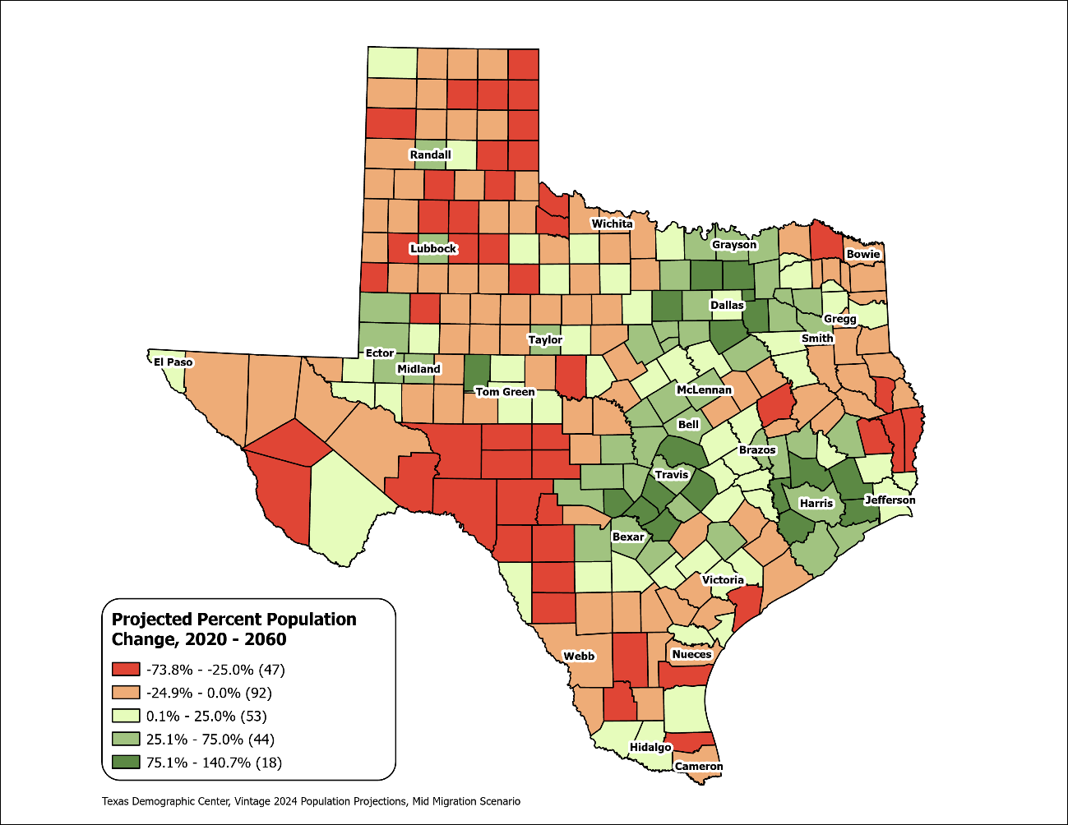
Texas Counties
Projected Population Percent Change 2020-2060
Mid Migration Scenario
Suburban ring counties in the triangle area will see the fastest growth rates.
Source: Texas Demographic Center, Vintage 2024 Population Projections, Mid Migration Scenario

Slide 13
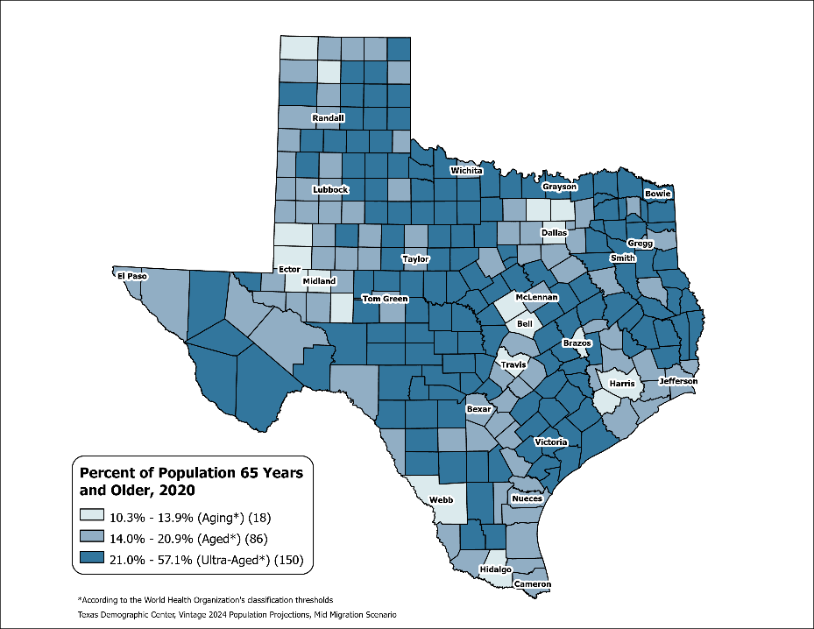
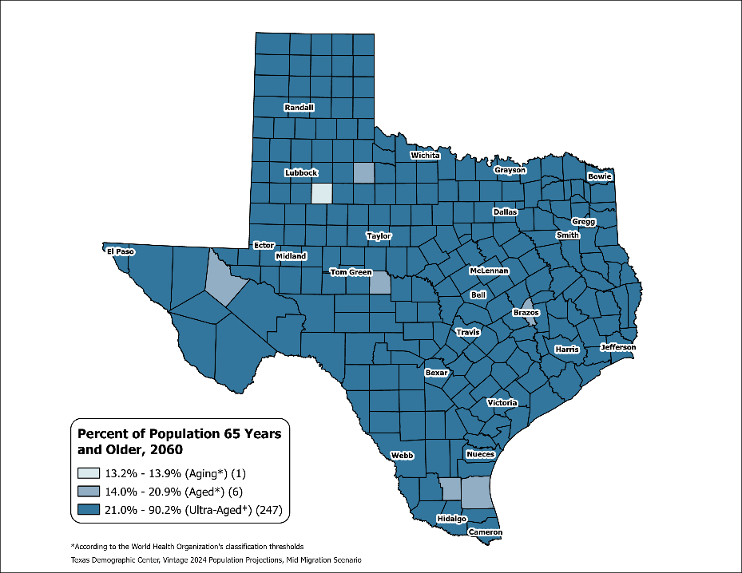
County Aging Map – Using the % of 65+ to Measure
Texas 2020: Aging (13.5%)
Texas 2060: Ultra-Aged (21.7%)
Source: Texas Demographic Center, Vintage 2024 Population Projections, Mid Migration Scenario

Slide 14

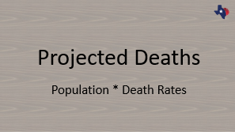
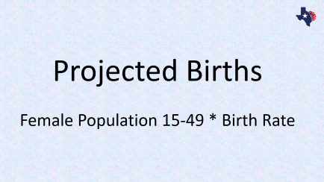
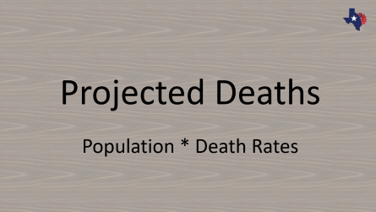

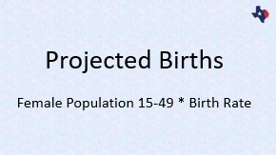
Methodology for TDC Population Projections
  The Cohort Component Model
    Components of Change: births, deaths, migration
    Cohort: Each cohort has its own pattern.
    In TDC projections, each race/ethnic group has its unique model
  Future Population Current Population
Population Change

Slide 15
Methodology for TDC Population Projections
  The Cohort Component Model
    Components of Change: births, deaths, migration
    Cohort: Each cohort has its own pattern.
    In TDC projections, each race/ethnic group has its unique model
  Future Population Current Population
Population Change

Slide 16

Projected Births
Female Population 15-49 * Birth Rate

Slide 17
Total Fertility Rate Trend
TFR
Source: National Center for Health Statistics. National Vital Statistics Reports

Slide 18
Fertility Rates Differ by Age, and Race/Ethnicity
Age Specific
Fertility Rates (ASFRs)
TFR has been on the decline, ASFRs have been moving to a delayed pattern
The area Under the curve is TFR
Source: Texas Department of State Health Services (DSHS). Vital Statistics Birth Data; U.S Census Bureau. 2020 Decennial Census

Slide 19
Projected ASFR in 2060 by Race/Ethnicity
TFR 2060
Texas Asian will “converge” to the current US NH Asian ASFRs
The rest of the groups will converge to the current US NH White ASFRs
Source: Texas Demographic Center, Vintage 2024 Population Projections

Slide 20
Group Counties for Fertility Projection by Rural/Urban Status
Source: Texas Demographic Center, Vintage 2024 Population Projections

Slide 21

Projected Deaths
Population * Death Rates

Slide 22
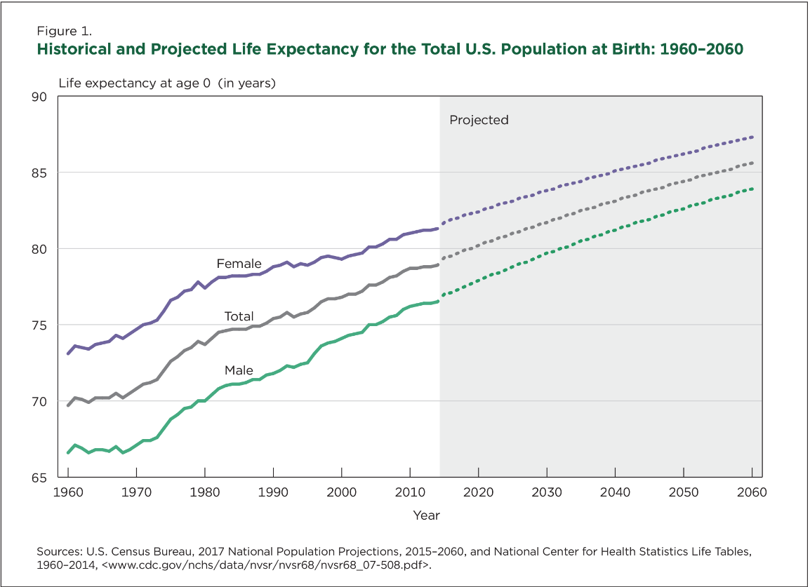
Historical and Projected Life Expectancy for the U.S.
Life Expectancy at Birth 2020
US: 77
Male: 74.2
Female: 79.9
Texas: 76.5
Male: 73.7
Female: 79.3
“Although life expectancy continues to rise, increases have slowed in recent years.”

Slide 23


County Survival Projection
State
County
Use US projected survival rates.
Apply TX/US ratio (2021)
The same as the state.
Source: Texas Demographic Center, Vintage 2024 Population Projections

Slide 24
Survival Rates by Age and Sex for the Hispanic Population,
2020 and 2060
2020 Male
2020 Female
2060 Male
2060 Female
Source: Texas Demographic Center, Vintage 2024 Population Projections

Slide 25

Projected Net Migrants

Slide 26

Net International Migration
US Net International Migrants =
  World population (region/country-specific) * Net immigration rate to the US.
Texas Net International Migrants =
  (1) US Net International Migrants * (2) Texas Share
📊 Data
U.S. NIM from CB 2023 U.S. Population Projection
ACS 2009-2019 PUMs file
Note: The calculations are done for each race/age/sex group
Source: Texas Demographic Center, Vintage 2024 Population Projections

Slide 27

Net Domestic Migration
Texas Net Domestic Migrants =
    (1) US population * (2) Net migration rate to Texas
📊 Data
CB 2023 U.S. Population Projection
ACS 2009-2019 PUMs file
Note: The calculations are done for each race/age/sex group
Source: Texas Demographic Center, Vintage 2024 Population Projections

Slide 28
County Migration
Allocate the state migrants using the Census Bureau Vintage 2020 Population Estimates
  Calculate the yearly average of the migration component of change from 2011 to 2020.
  Calculate the county share of domestic and international migrants.
Source: Texas Demographic Center, Vintage 2024 Population Projections

Slide 29
Projected Components of Change under the Mid Migration Scenario
Source: Texas Demographic Center, Vintage 2024 Population Projections

Slide 30
Key Takeaways
📈Continued Growth:
  Texas will grow under all migration scenarios, but at a slower pace over time.
🚚Migration-Driven Growth:
  Declining birth rates and aging means migration will be the main source of growth by 2060.
🧬Demographic Shifts:
  Non-Hispanic White population declines
  Hispanic population sees the largest growth
📍Regional Growth Patterns:
  Growth concentrated in the Texas Triangle and metro counties statewide.
👵Aging Population:
  Texas shifts from an Aging (13.5%) to an Ultra-Aged (21.7%) society
  150 counties were Ultra-aged in 2020
  Nearly all counties will be Ultra-aged by 2060
Source: Texas Demographic Center, Vintage 2024 Population Projections

Slide 31
❓Frequently Asked Questions
🌍 What are migration scenarios?
  Migration scenarios are assumptions about future migration patterns.
  These scenarios help model different possibilities.
  Vintage 2024 TDC projections utilize the high, medium, and low international migration scenarios from the national projections.
  For Vintage 2024, in general:
  High migration scenario – higher population projection; Low migration scenario – lower population projection.
📊 What’s the difference between population projections and population estimates?
  Estimates are calculations of the current or past population based on data of events that have already happened.
  Projections are forecasts of future population based on assumptions about fertility, mortality, and migration.
  When both are available for the same period, use the estimates.
💼 Why don’t you incorporate economic and other factors in your projections?
  We need projections of these factors, which are often not available.
Source: Texas Demographic Center, Vintage 2024 Population Projections

Slide 32
Labor Force Projections for Texas 2020-2060
May 21, 2026
Jeongsoo Kim, Helen You

Slide 33

Labor Force Projection Method
$−$ All non‑institutionalized civilians who are either employed or unemployed.
$− Labor Force participation rates$ (LFR)
$$=\frac{Civilian Labor Force }{Household Population}$$
$$− Projected Labor Force$$
$=Projected Household Population$* $Labor Force participation rates$
$−$ LFR is assumed to be the same for the projected period 2020-2060
Source: US Census Bureau, American Community Survey (ACS) 5-Year Public Use Microdata Sample (PUMS) 2024.

Slide 34
Labor Force Participation Rates in Texas, 2020-2024
Age is the primary driver of labor force participation.
Prime‑age individuals (25–54) dominate the labor force.
Population aging reduces the labor force share of non‑Hispanic Whites.
Younger Hispanic cohorts account for a growing share in projections.
Source: US Census Bureau, American Community Survey (ACS) 5-Year Public Use Microdata Sample (PUMS) 2024.

Slide 35
Historical and Projected Labor Force of Texas, 2007-2060
21.3 M
15.1 M
11.7 M
10.1 M
Labor Total
NH White Labor
NH Black Labor
5.5 M
Hispanic Labor
2.9 M
NH Asian Labor
1.9 M
NH Other Labor
1.1 M
Source: US Census Bureau, American Community Survey (ACS) 5-Year Public Use Microdata Sample (PUMS) 2024.
Texas Demographic Center, Vintage 2024 Population Projections, Mid Migration Scenario

Slide 36
Change of Projected Labor Force of Texas by Race/Ethnicity, 2022-2060
Source: US Census Bureau, American Community Survey (ACS) 5-Year Public Use Microdata Sample (PUMS) 2024.
Texas Demographic Center, Vintage 2024 Population Projections, Mid Migration Scenario
Notes:
Aging and Hispanic increase

Slide 37
Projected Labor Force, 2022-2060 – State by Age Group
13.6 M
9.7 M
3.7 M
2.3 M
2.4 M
0.7 M
1.3 M
0.1 M
0.4 M
Source: US Census Bureau, American Community Survey (ACS) 5-Year Public Use Microdata Sample (PUMS) 2024.
Texas Demographic Center, Vintage 2024 Population Projections, Mid Migration Scenario

Slide 38
Change of Projected Labor Force of Texas by Age Group, 2022-2060
Source: US Census Bureau, American Community Survey (ACS) 5-Year Public Use Microdata Sample (PUMS) 2024.
Texas Demographic Center, Vintage 2024 Population Projections, Mid Migration Scenario
Notes:
Aging and Hispanic increase

Slide 39
Projected Labor Force Rates of Texas, 2020-2060
Source: US Census Bureau, American Community Survey (ACS) 5-Year Public Use Microdata Sample (PUMS) 2024.
Texas Demographic Center, Vintage 2024 Population Projections, Mid Migration Scenario

Slide 40
Projected Labor Force, 2022-2060 - County example
Labor Total
NH Black Labor
Labor Total
NH White Labor
NH Black Labor
NH White Labor
NH Black Labor
Hispanic Labor
NH Asian Labor
NH Other Labor
Hispanic Labor
NH Asian Labor
NH Other Labor
Hispanic Labor
NH Other Labor
NH Asian Labor
NH Asian Labor
NH White Labor
Source: US Census Bureau, American Community Survey (ACS) 5-Year Public Use Microdata Sample (PUMS) 2024.
Texas Demographic Center, Vintage 2024 Population Projections, Mid Migration Scenario

Slide 41
Summary
1. The projection assumes constant LF rates, with demographic component changes serving as the primary driver of labor force growth.
2. LF expansion will be led by the prime working-age group (25–54), with increased participation among older workers compared to current rates.
3. A rising share of older adults with lower participation rates is expected to drive a decline in overall LF rates, even as the labor force continues to grow.
4. Upcoming special population projections include Household and Disabled projections.
Source: US Census Bureau, American Community Survey (ACS) 5-Year Public Use Microdata Sample (PUMS) 2024.

Slide 42

Coming up
🗺️ TDC Population Projection Story Map
  A dynamic blend of narratives, interactive maps, and visualizations that illustrate how Texas’s population is expected to change over the next 40 years
🧪 “Special” Projections
  These go beyond basic population numbers to explore how demographic changes affect other areas:
  👷 Labor Force – Who will be working?
  🏠 Household – How will living arrangements shift?
  💰 Income – What might income distributions look like?
  🧭 Other? – Population projections with different development scenarios
      We would like to hear from you!!

Slide 43
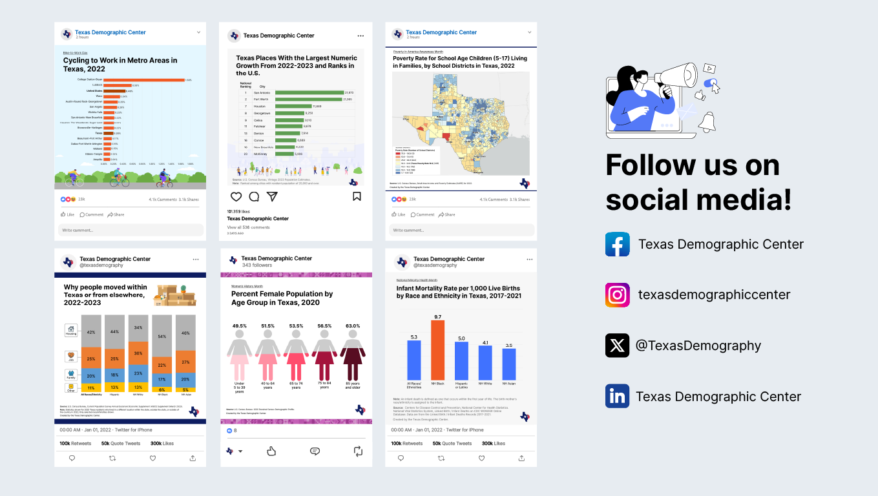

Slide 44




Visit our website
Sign up for our newsletter
Follow us on social media

Slide 45
Helen You, Ph.D.
Jeongsoo Kim, Ph.D.
(210) 458-6543
TDC@UTSA.edu
demographics.texas.gov/
@TexasDemography

