Slide 1



2030 Is Closer Than You Think:
Strengthening Census Data Starts With LUCA
Presented by:
Angela Broyles, President & CEO, Texas Census Institute
Richard Wade, Deputy Executive Administrator, Texas Geographic Information Office
May 21, 2026

Slide 2



Who We Are
Texas Census Institute (TxCI)
A nonprofit organization overcoming operational and motivational barriers to census participation in Texas to achieve a complete count in 2030.
Texas Geographic Information Office (TxGIO)
Is Texas’ official mapping and geospatial data office. We collect, manage, and share geographic data and help government and industry use mapping technology to make better decisions.
RESEARCH
EDUCATION
PARTNERSHIPS
Notes:
Angela & Richard

Slide 3
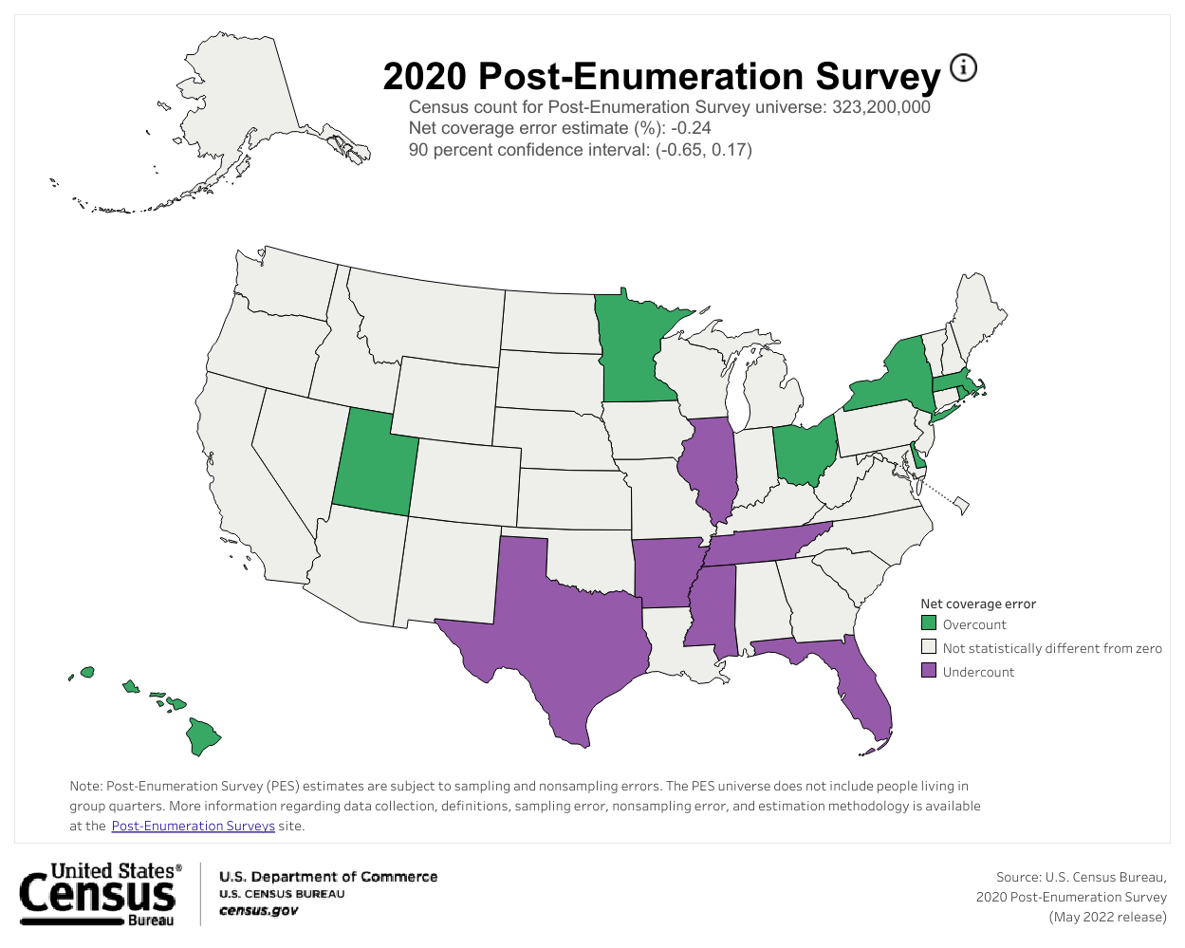
Our Motivation: 2020 Census Undercount
Estimated 2020 Undercounts
Texas
547,968
Texas Children (0-17)
153,633
Estimated Loss of Federal $$
$25 Billion
Notes:
Angela

Slide 4






Funding Implications in Texas Due
to 2020 Census Undercount
-$21.1B+
Health
-$1.2B+
Education
-$1.0B+
Infrastructure
-$840.3M+
Housing
-$647.5M+
Econ. Development
-$78.8M+
Public Safety
-$25.1B+
10-year loss in
federal programs
Notes:
Angela

Slide 5
Why Do Undercounts Exist?
Inaccurate Addresses
  Missing or "low-visibility" structures (e.g., trailers, back houses, converted garages).
  Housing units completely absent from the Census Bureau’s Master Address File.
Low Self-Response
  Lack of reliable home broadband access and difficulties completing forms on smartphones.
  Fear of the government, data privacy concerns, or worries about immigration enforcement.
Access Barriers
  Physical obstacles for field enumerators - gated communities and locked multi-unit buildings.
  Inability to easily contact highly mobile populations or people experiencing homelessness.
Complex Living
  Crowded, "doubled-up," or multi-family household arrangements.
  Confusion over census causing respondents to unintentionally leave secondary families or young children off the form
Notes:
Angela

Slide 6
Improving Census Addresses Through LUCA (Local Update of Census Addresses)
Notes:
Angela

Slide 7
What is LUCA?
LUCA (Local Update of Census Address) authorizes the Census Bureau to work with local governments to provide updates on residential housing units.
Residential addresses is what the Census Bureau will use for their Master Address File to disseminate the 2030 Census survey.
LUCA participation is the most direct method local governments can provide updated residential addresses to the Census Bureau before the 2030 Census.
Participation in LUCA is optional but highly recommended for an accurate Census count for your community in 2030.
Notes:
Richard

Slide 8
Who Can Participate in LUCA?
Highest Elected Officials from eligible governments include:
States, Counties, Cities (incorporated places), Townships (minor civil divisions)
Federally recognized Tribal Nations with a reservation and/or off-reservation trust lands
Highest elected/appointed officials can designate LUCA participants for their jurisdiction. This may include direct employees, interns, contractors, or designating alternate reviewers, such as county, state data center, or regional planning agency.
Notes:
Richard

Slide 9
LUCA Timeline 2027-2028
Spring 2027- Fall 2027 (Prep Phase)
Highest Elected Officials will receive notification from the Census Bureau about LUCA operations in the Spring 2027.
LUCA participants may access the Census Bureau’s address inventory to review the address block count list for their geographic jurisdiction.
Fall 2027- March 31, 2028 (Review and Official Submission)
LUCA participants officially submit their updates to the Census Bureau via a digital portal.
March 31, 2028 (Deadline)
*Dates subject to change upon final notice from the Census Bureau
Source: U.S. Census Bureau, Local Update of Census Addresses (LUCA) Operation
Notes:
Richard

Slide 10
How Texas Can Benefit from LUCA
Notes:
Angela

Slide 11
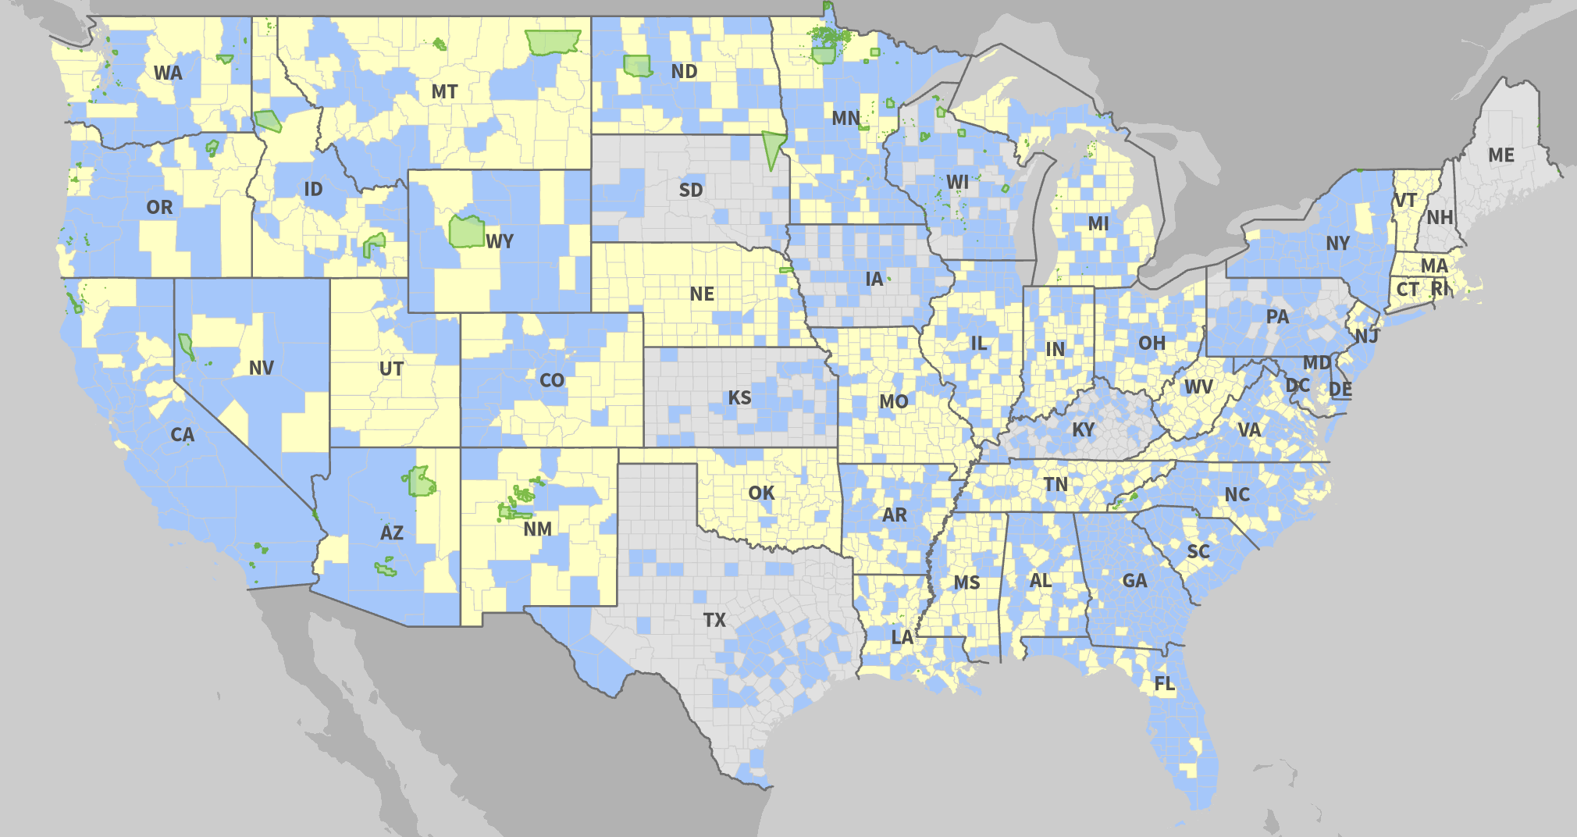
Who Participated in LUCA?
Federally recognized tribes with a reservation and/or off reservation trust lands
States
Counties and Municipios (Puerto Rico)
Incorporated Places (cities, towns, boroughs, or villages)
Townships and Towns (minor civil divisions)
Source: U.S. Census Bureau (2018)
Notes:
Angela

Slide 12
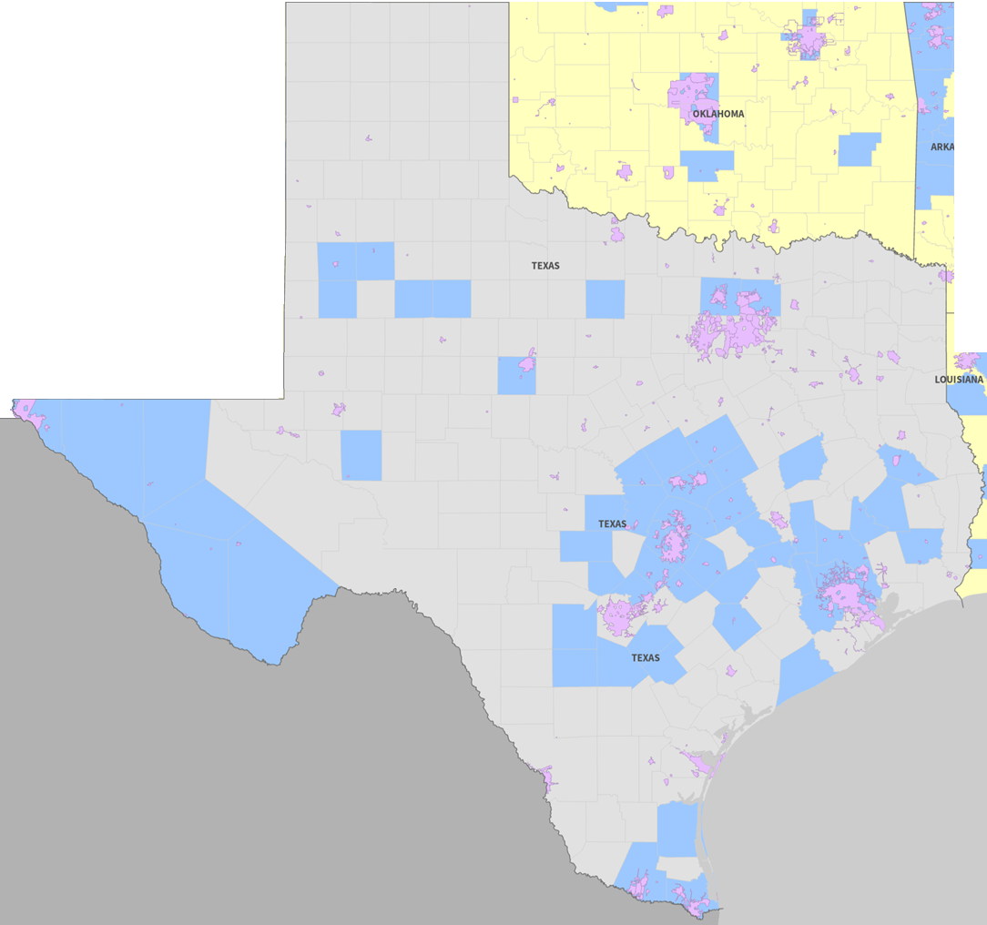
Who Participated in LUCA?
2020 LUCA Texas Respondents (Place-level view)
Source: U.S. Census Bureau (2018)
Notes:
Angela

Slide 13
Hidalgo County Example: From 911 Address
Gaps to LUCA Improvements
Community organizations reported that some neighborhoods were not being reached by 9-1-1 services.
These concerns were raised with the regional council responsible for maintaining 9-1-1 address data.
Local partners offered to help update parcel and address information for areas such as Pueblo de Palmas.
Updated address data was shared with Hidalgo County planning officials for inclusion in the county’s LUCA submission - reported 10,000 addresses added.
Field Work - Community Organization
CBOs validated and updated addresses of the 9-1-1 addresses database for the areas regional council of governments.
In-Office Work - Local COG and County Planning Dept
Hidalgo County Planning Department used updated addresses for LUCA Submission
Notes:
Angela -
Goal #1: everyone participate in LUCA
Goal #2: have good submissions. just b/c you participate in LUCA, doesn’t always mean it’s the most effective

Slide 14

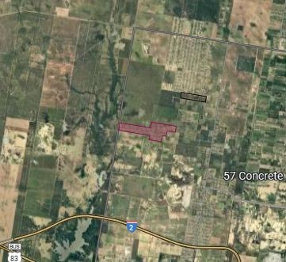
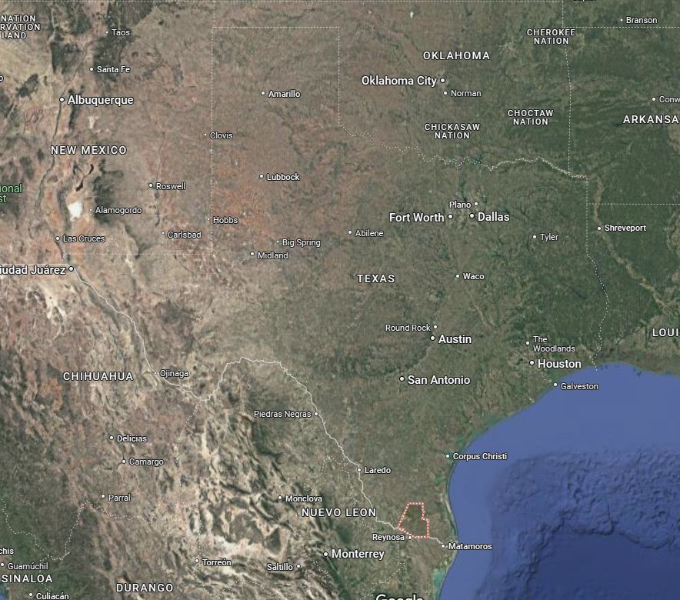
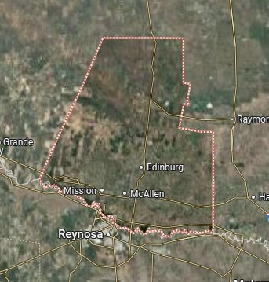
PUEBLO DE PALMAS -
HIDALGO COUNTY, TEXAS
Pueblo de Palmas
(219 Housing Units)
Hidalgo County, TX
Source: Hidalgo County (2018), and U.S. Census Bureau (2020).
Notes:
Angela- wanted to double check the success of those efforts with the census bureau

Slide 15
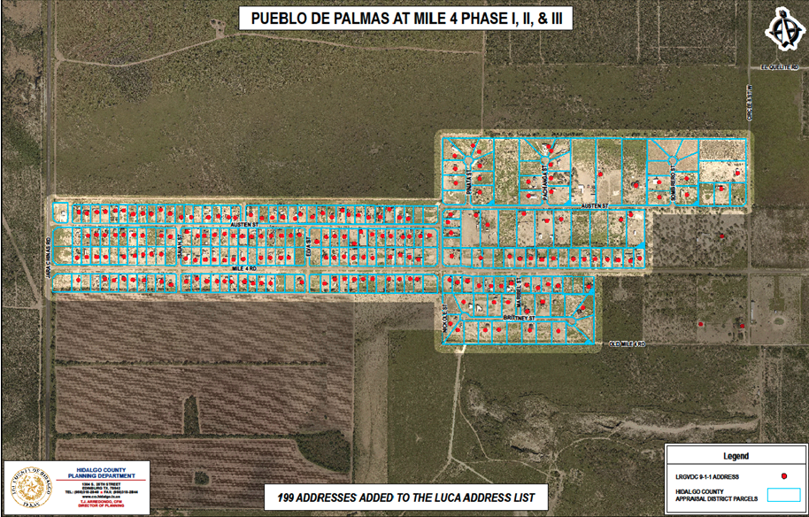
How LUCA Improved Address Accuracy in Pueblo de Palmas
Compared LUCA-added addresses in a small sample area (Pueblo de Palmas) to preexisting Census Bureau address records.
Hidalgo County added 199 new Pueblo de Palmas addresses to the county’s address file.
Over 70% of the 199 addresses were likely included in census enumeration because of the county’s LUCA submission.
Notes:
Angela

Slide 16
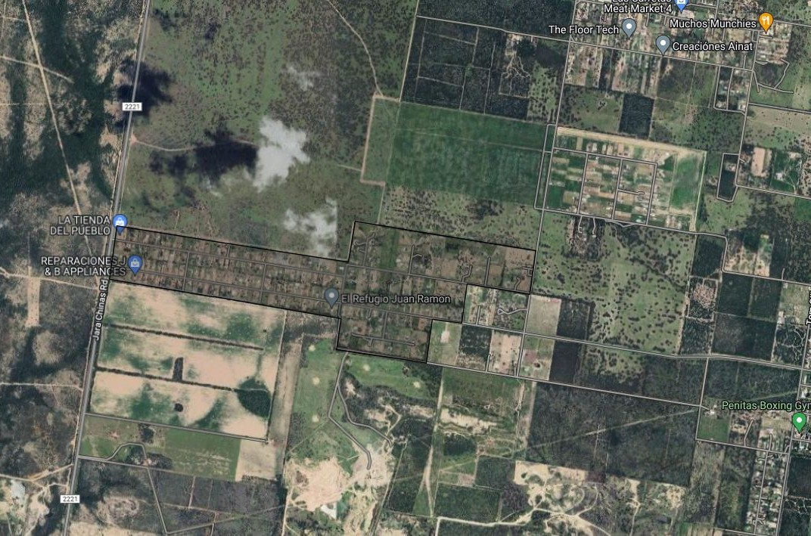
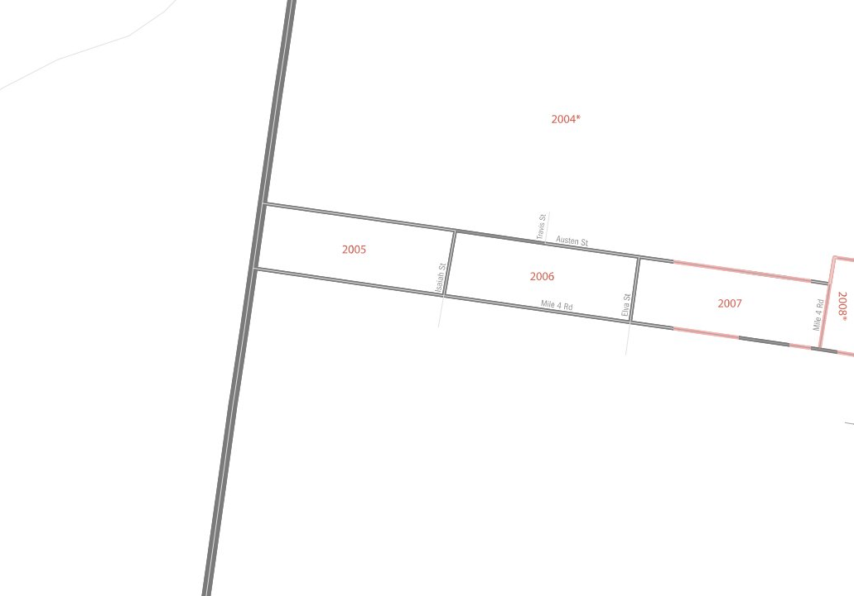
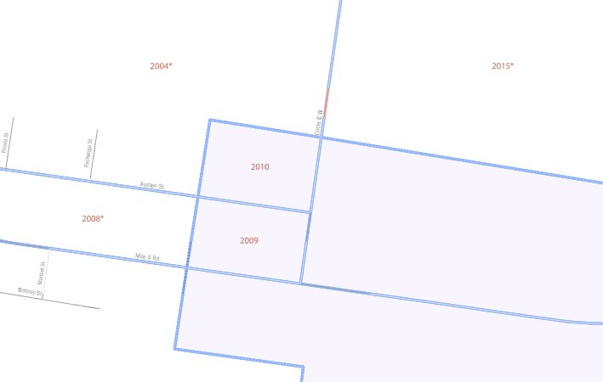
Hidalgo County - Return on Investment for Texas
Estimated average of $4,500* of census-directed funding per household for Texas.
Due to added households, LUCA efforts in Pueblo de Palmas may have received over $750,000 that it wouldn’t have otherwise been allocated, just for properly counting a 6 square mile area.
Hidalgo County estimates LUCA efforts identified about 10,000 additional households
1004*
1000
Source: Texas Census Institute (2024) and U.S. Census Bureau (2020).
These efforts are estimated to have brought approximately $45 million in census-directed funding to Texas.
Notes:
Angela

Slide 17
Newton County LUCA Pilot Overview

Slide 18
Why Newton County?
Rural Case Example: Newton County, Texas
Selected due to low Census response rates (~46.2%)
High share of inaccurate addresses with Census Bureau
No prior LUCA participation
Estimated undercount (~1,552 of ~12,000 population, based on TxCI methodology).
Strong regional E911 support through DETCOG
Engaged county leadership
Notes:
Angela

Slide 19
Texas Rural Address Challenges
Persistent address data challenges in rural and remote Texas counties contribute to census undercount risks
Common issues include:
  Nonstandard housing and long rural driveways
  Mobile home parks recorded as a single address
  Population growth that outpaces updates to the address files
Many rural counties have:
  Limited GIS capacity
  Very small staffs with many responsibilities
  Limited resources to conduct full address canvassing
Core Challenge:
How do we improve address accuracy and LUCA participation in various Texas counties using methods that are practical, scalable, and aligned with local capacity?
Notes:
Angela

Slide 20
Testing Address Improvement Efforts in
Rural Areas to Strengthen LUCA
Newton County Pilot Stages and Objectives:
Test a collaborative, cross-agency model to produce complete address set - Local, regional, and state partners (DETCOG, TxGIO, TDC, county officials, SMEs)
Identify high-discrepancy address blocks - Compare local address data with Census Bureau block-level address counts
Conduct targeted field verification only where necessary
Work to establish best practice for updating addresses and submitting for LUCA
Use these findings to more effectively support counties similar to Newton County in improving address data and preparing for LUCA participation.
Notes:
Angela

Slide 21
Proposed Statewide Plan:
A Collaborative Technical Framework
Notes:
Angela

Slide 22
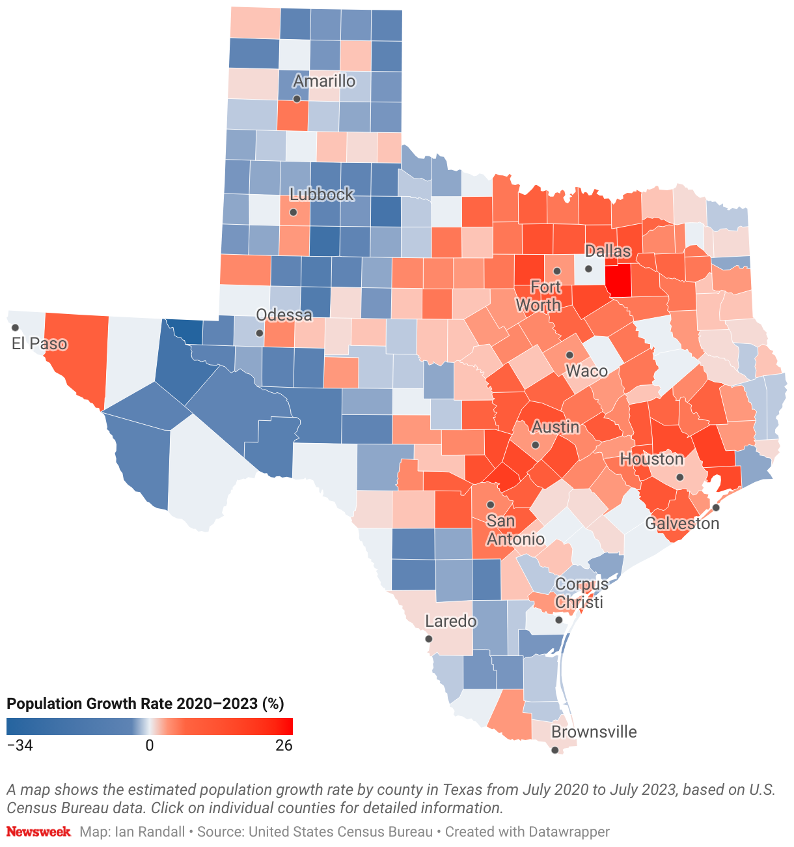
The Texas Opportunity
Texas Faces Unique Census Challenges
Challenges:
Fast population growth
Rapid suburban development
Rural addressing inconsistencies
Apartment/multi-family complexity
Colonias and informal housing
Mobile home communities
Jurisdictional fragmentation
Uneven local GIS capacity

Slide 23

Proposed State Role
How the State Can Support LUCA
            Outreach & Awareness
                Promote participation and explain the stakes.
            Geospatial Data Support
            Use statewide datasets to identify likely gaps.
            Local Assistance & Feedback
              Return actionable intelligence to participating jurisdictions.

Slide 24

State Outreach Strategy
Promote Awareness and Participation
State Support Activities:
Coordinate messaging with Texas Demographic Center and the Texas Census Institute
Help develop LUCA awareness campaign
Present at:
  County Associations
  Regional Councils of Governments
  GIS Conferences and User Groups
  Emergency Management Groups
  Planning Organizations

Slide 25

State Geospatial Support Model
Using GIS to Strengthen Local Address Review
Potential datasets:
TxGIO Statewide Aggregated Address Points
Local Authoritative Address Submissions
Third-party Address Datasets
Parcel Data
Available Building Footprints
High-resolution Imagery
Analytical Capabilities:
Cross-Validation
Gap Analysis
Anomaly Detection
Growth Detection

Slide 26
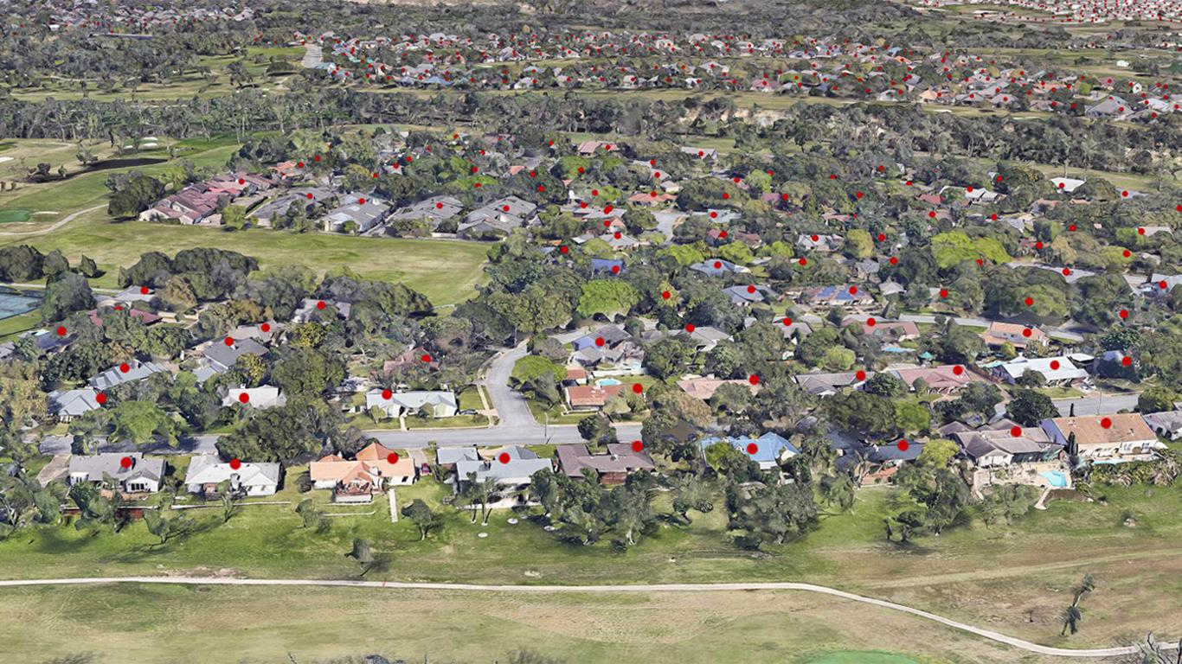
Specific Analytical Support
Potential GIS-Based LUCA Support Activities
                Residential
                Commercial
Address Classification

Slide 27
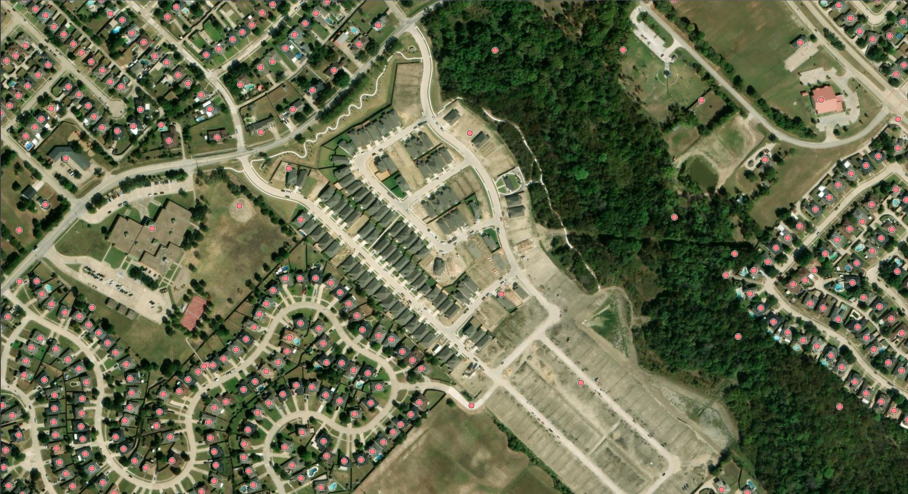
Specific Analytical Support
Potential GIS-Based LUCA Support Activities
Subdivisions under construction
Recently completed neighborhoods
New housing clusters
New development detection

Slide 28
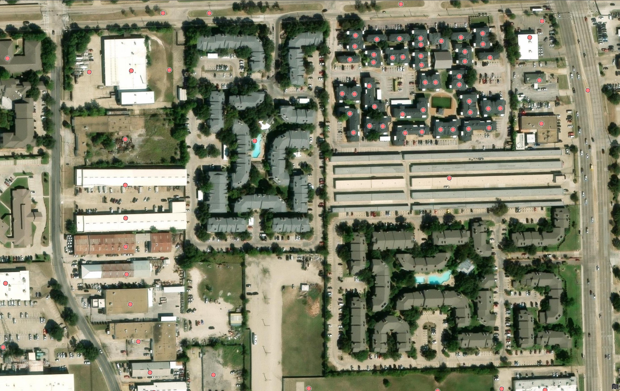
Specific Analytical Support
Potential GIS-Based LUCA Support Activities
Apartment complexes
Duplexes
Manufactured housing
Trailer parks
Condominium units
Multi-unit Housing Refinement

Slide 29
Return Value to Local Governments
Deliver Actionable Results Back to Locals
Potential deliverables:
Suspect missing address lists
Potential residential classification corrections
Multi-unit discrepancy reports
Imagery review maps
Candidate growth area maps
GIS web apps for review
Desired Workflow:
State Identifies Candidates Local Validates Local Submits through LUCA

Slide 30
What Local Governments Can Do Now:
Local Government Preparation for Statewide LUCA
Visit Census Bureau 2030 LUCA website to learn more about the operation and helpful resources.
Obtain data on residential addresses (911 addresses, residential addresses from local government sources, commercial contractors, etc.).
Identify staff members or contractors who have technical skills to utilize the Census Bureau’s Address Count Listing to review housing count units and compare with your own data.
Plan for budget allocation to ensure participation in 2027 (staff or contractors, if needed).
Notes:
Census Address List Improvement Act of 1994 (Public Law 103-430)
Title XIII Confidentiality

Slide 31

Q&A Session
Notes:
Presenter: Amy
GOALS
Who can connect us to whom?
Who will invite us to key events?
Insight on upcoming bills/priorities?
Lend Policy or Legal support?

Slide 32
THANK YOU!
Richard Wade
richard.wade@twdb.texas.gov
Angela Broyles
angela@texascensus.org
Notes:
Presenter: Amy
GOALS
Who can connect us to whom?
Who will invite us to key events?
Insight on upcoming bills/priorities?
Lend Policy or Legal support?

