Slide 1
Austin Demographic Insights:
Tools for Research and Planning
Texas Demographic Conference | May 21, 2026

Slide 2
Discussion Topics
Demographics & Data Team Intro
Core Data Products
Spotlight: DTI Population and Jobs Forecast
Spotlight: Austin Community Profile Builder Web Application

Slide 3





Who We Are
Lila Valencia
Michael Santulli
Jeff Engstrom
Sara Corby
Sarah Courtney
City Demographer
Program Manager
Senior Data Analyst, GIS Lead
Geospatial Analyst
Planner

Slide 4
What We Do
Our Work
Annual population estimates
Population projections
Mid-decade small-area population and employment forecast
Monitor demographic & socioeconomic trends, shifts in growth, demographic composition, changing disparities in health and wealth outcomes
Annual housing unit verification analysis
Maintenance of geospatial datasets and Open Data Portal assets
Tools and Products
Austin Demographics Hub (Website)
Austin Community Profile Builder
Interactive research reports
Land Database and Land Use Inventory parcel map layers
And more!

Slide 5
Data Products

Slide 6
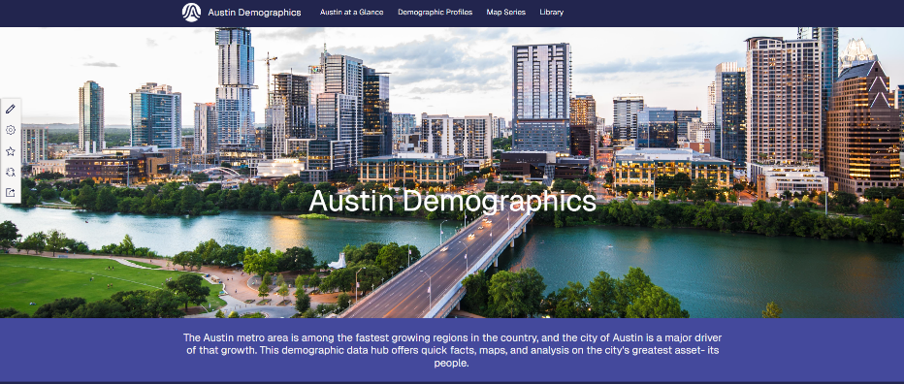
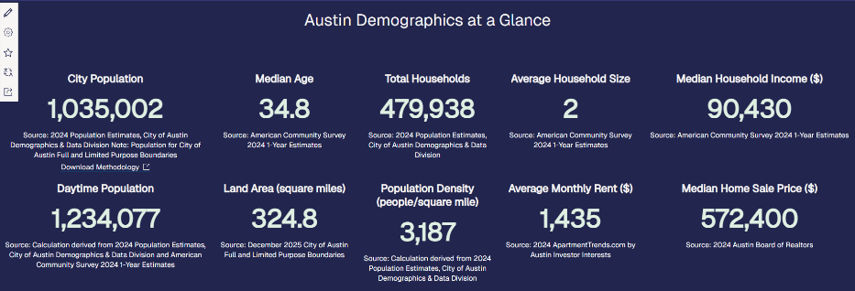

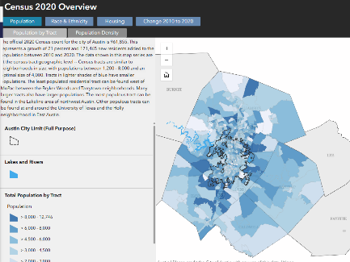
Demographics Website
Austin Demographics at a Glance
Map layers with key demographics by census tract
Storymaps (interactive research reports)
Use Cases: Researching change in Austin over the last decade; using demographic maps with other GIS data.

Slide 7
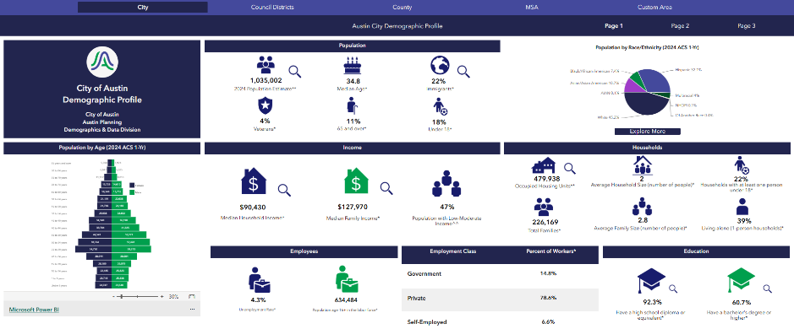
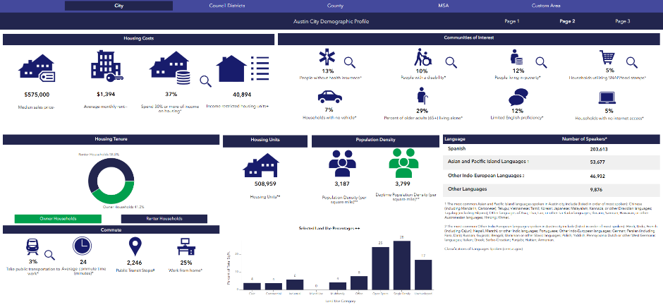
Demographic Profiles
View key demographic and socioeconomic statistics for different geographies:
  City of Austin
  Austin City Council Districts
  Austin Metropolitan Statistical Area
  Travis County
Stats include:
  Age distribution
  Household and family income
  Languages spoken
  And much more!
Use Case: Adding the latest city or metro level demographic stats to a plan.

Slide 8
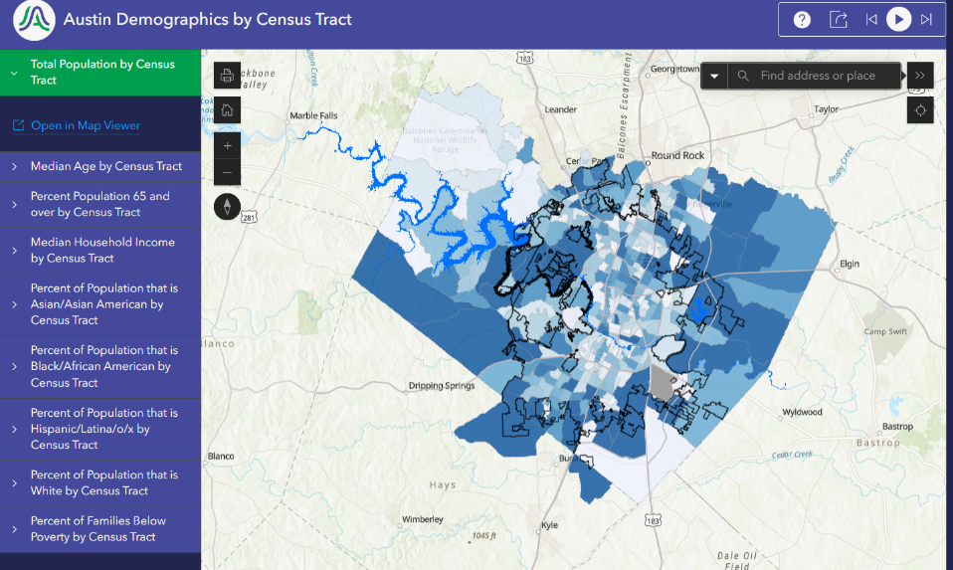
Demographic Maps
View census tract data for Austin and Travis County for key demographic variables:
  Total Population
  Percent 65 and Older
  Median Household Income
  Race and Ethnicity
  Percent of Families Below the Poverty Level

Slide 9
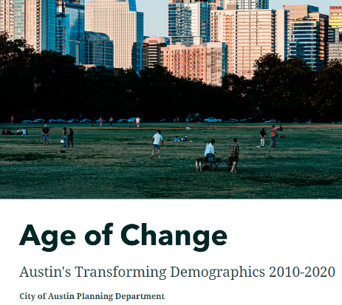


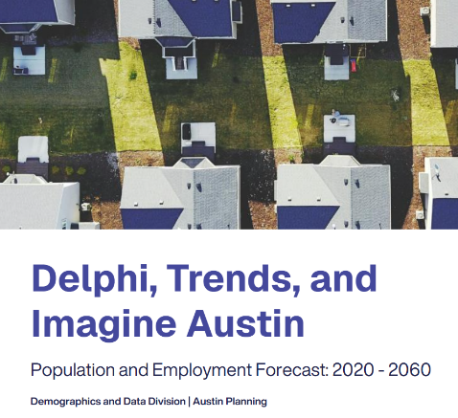

StoryMaps: Interactive Research Reports

Slide 10
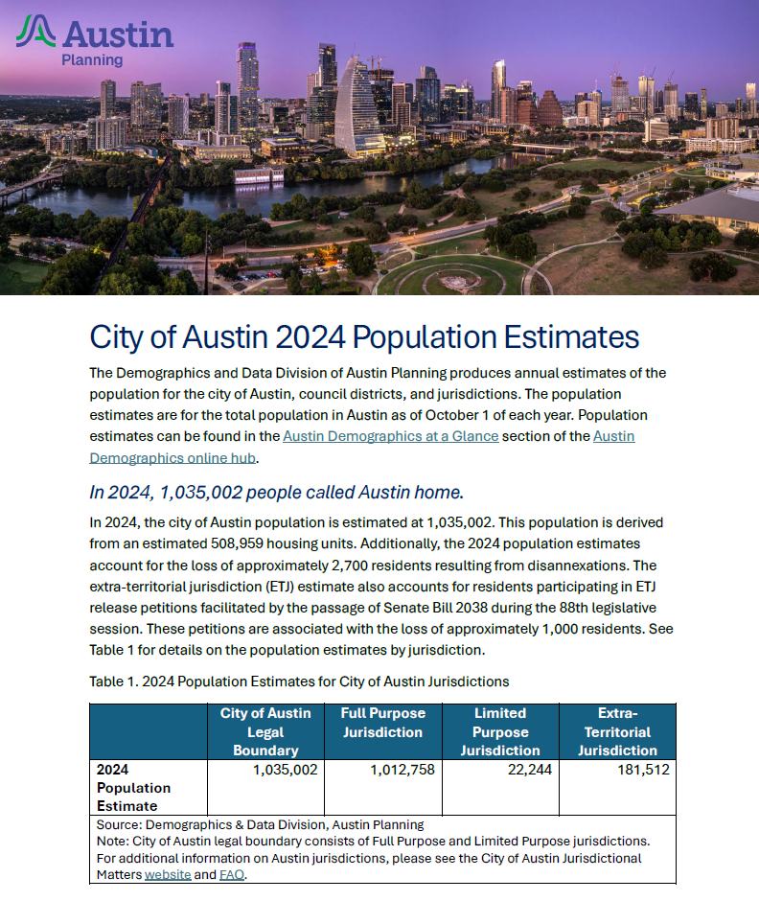
Population Estimates
2024 Estimate: 1,035,002
Population estimates for:
  City of Austin legal boundary
  Jurisdictions
  Council districts
Updated annually
Full methodology available online
Use Case: Including most up-to-date population for the city in a new or updated plan.

Slide 11
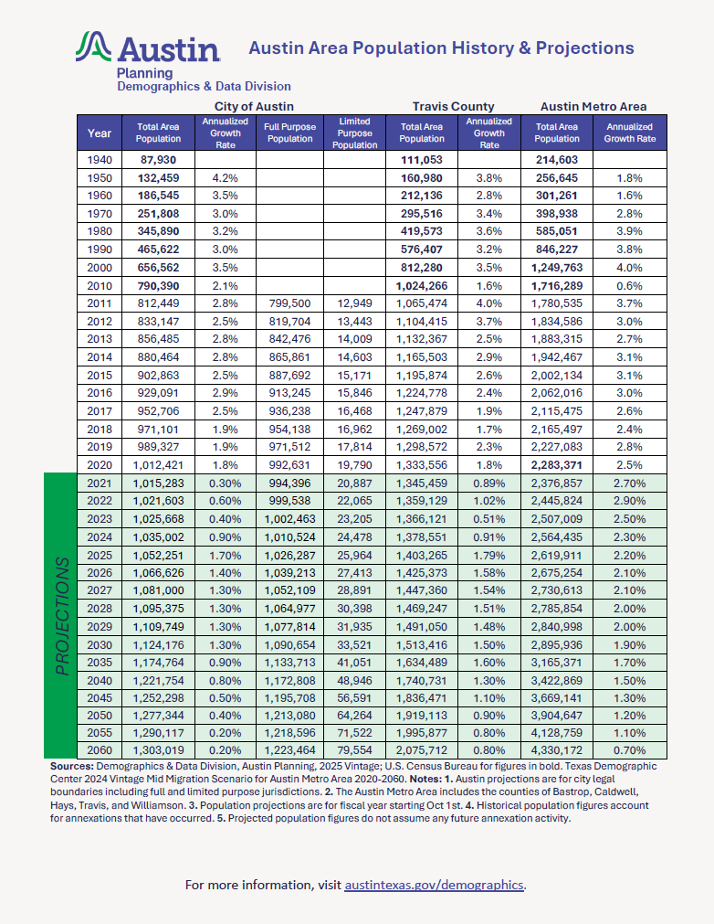
Population Projections
Projections by year from 2020-2030 and every 5 years from 2030-2060
Includes projections for:
  City of Austin & jurisdictions
  Travis County
  Austin Metro Area
Use Case: Providing context on the future growth of the city and surrounding area.

Slide 12
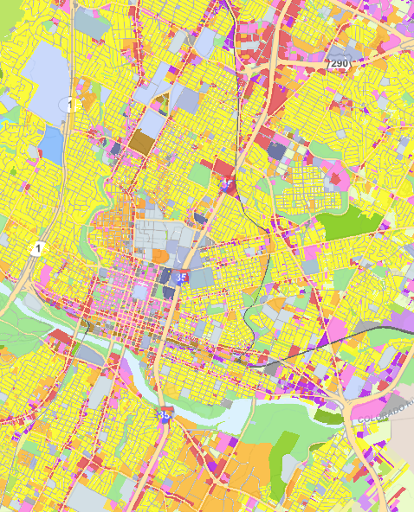
Land Database
Parcel-level geospatial dataset based on county appraisal district data, including:
  Parcel land use
  Number of housing units
  Number of employees
  Year built
  Appraised/assessed value
  Zoning and development info
Use Case: Understanding the current mix of land use in an area of interest.

Slide 13
Product Spotlight
DTI Population and Jobs Forecast

Slide 14

Delphi, Trends, and Imagine Austin (DTI) Forecast
Small area population and employment forecast for 2020-2060
Updated by interdepartmental work group in 2025
What is DTI?
  The Delphi Method
  Trends (our city-wide projections)
  Imagine Austin (our planning roadmap)

Slide 15

DTI Forecast Tools: Interactive Report
An interactive ArcGIS StoryMap presenting analysis, findings, and methodology of our DTI Forecast.
Start here for an overview before diving into the data for yourself with our other tools.

Slide 16
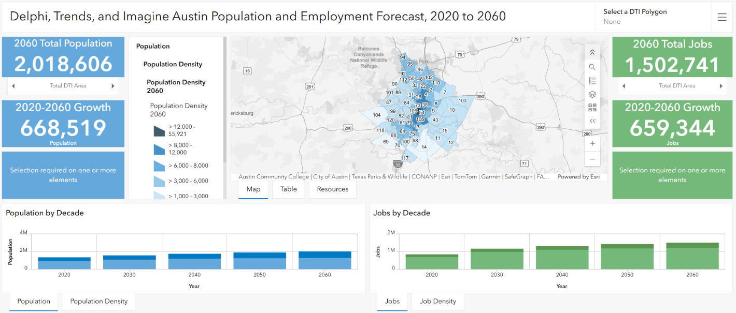
DTI Forecast Tools: Dashboard
Select a DTI Polygon to see:
Population/ Pop. Density by Decade
Jobs/Job Density by Decade
Growth rate statistics
Exportable forecast table
And more!

Slide 17
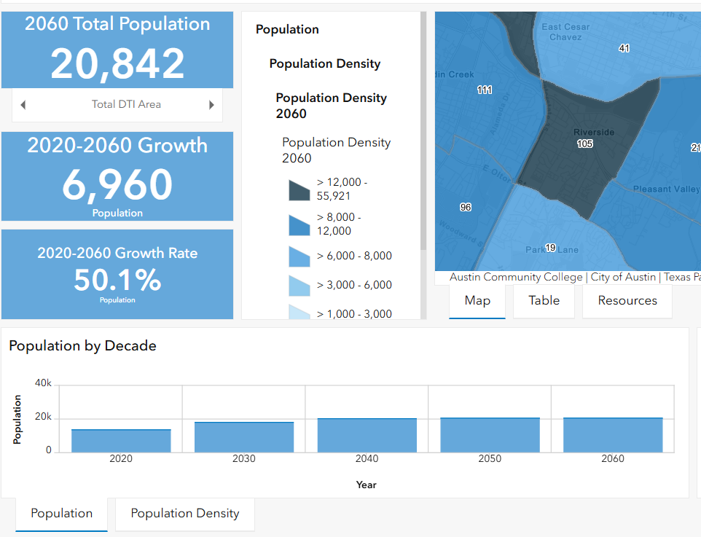
DTI Forecast Tools: Dashboard
Dashboard Population View

Slide 18
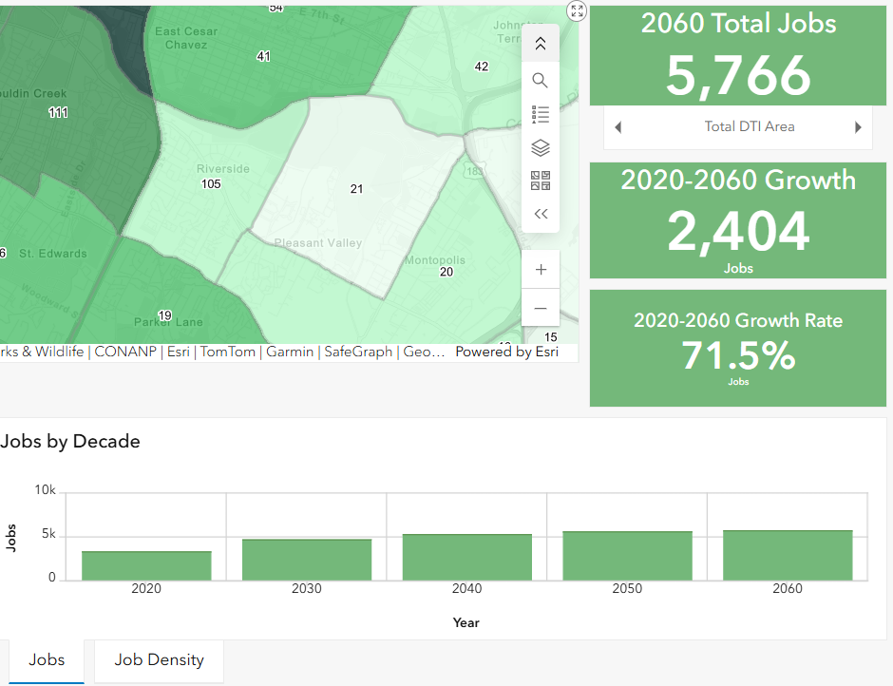
DTI Forecast Tools: Dashboard
Dashboard Employment View

Slide 19
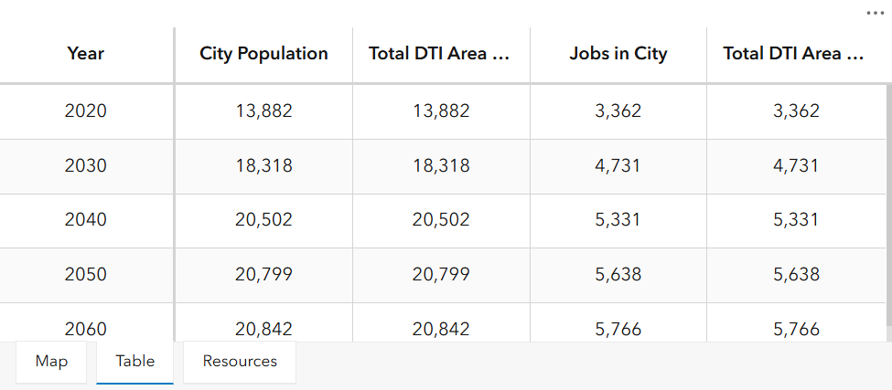
DTI Forecast Tools: Dashboard
Dashboard Table View

Slide 20
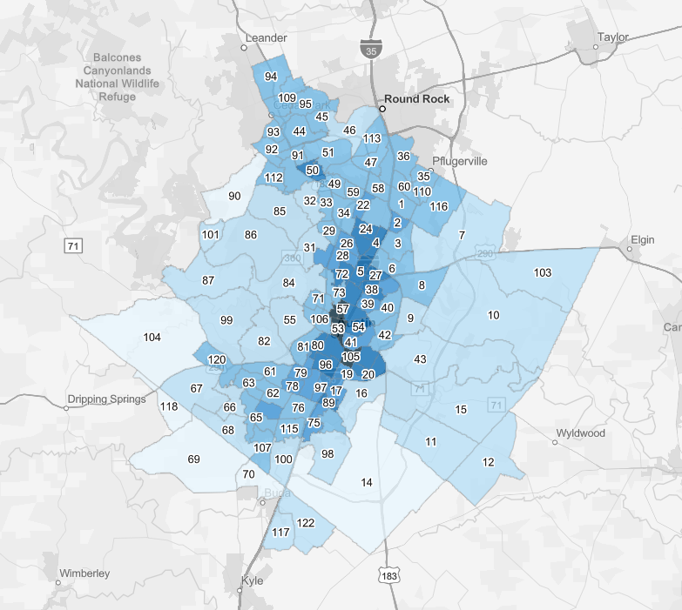
DTI Forecast Tools:
Map Layers
See forecasted population and jobs visualized by:
Forecasted total for each decade
Density (per sq. mile) for each decade
Numeric change for each decade or whole forecast range
Percent change for each decade or whole forecast range

Slide 21
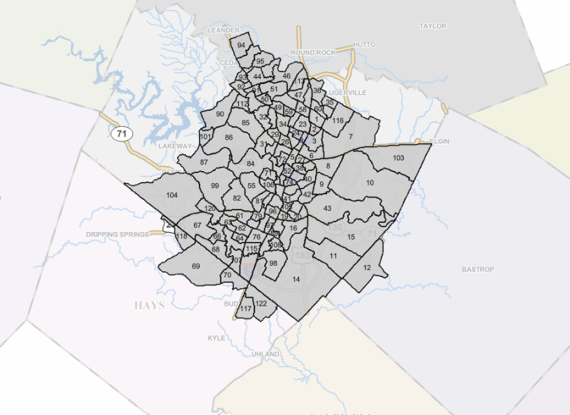
DTI Forecast Tools:
GIS Feature Layer
Raw population and employment forecast data by decade.
Not styled yet – perfect for custom analysis or maps.
Available on the City of Austin ArcGIS Online platform and the Open Data Portal.

Slide 22
Deep Dive
Austin Community Profile Builder

Slide 23
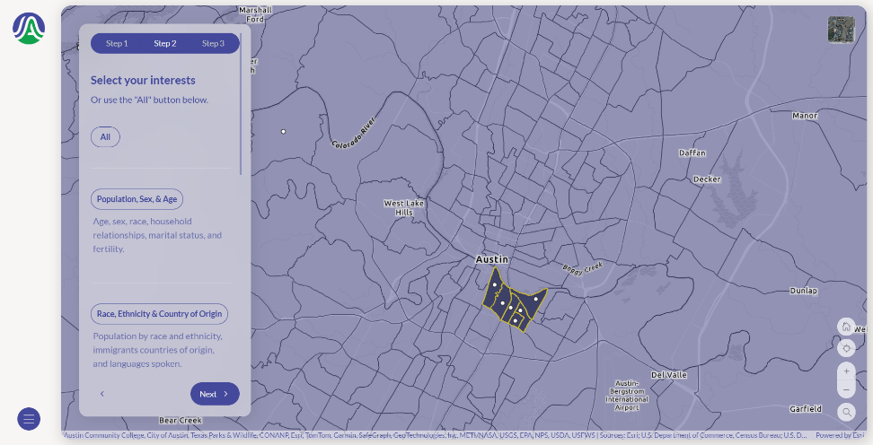
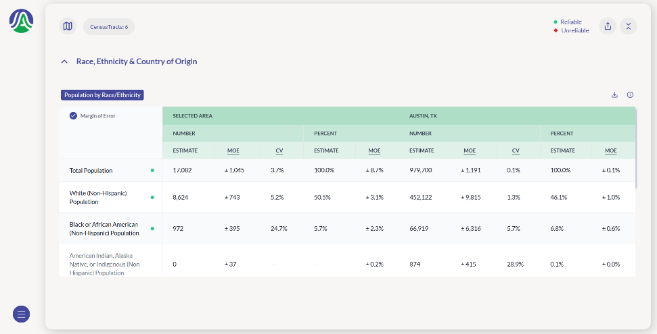
Austin Community Profile Builder
Web application to extract demographic data for custom geographies
Compares values for selected geography to citywide values
Download your selected data to Excel
Verify reliability of estimates for areas with small populations
Use Case: Accessing demographic data aggregated to approximate a neighborhood area or planning boundary, comparing with city wide values.

Slide 24
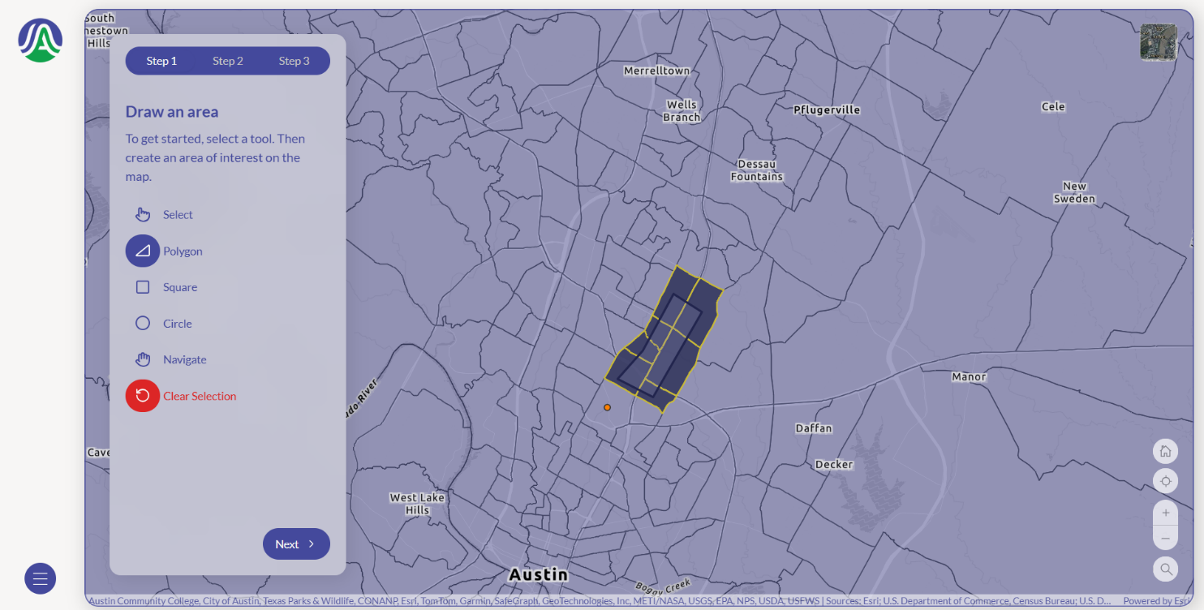
Austin Community Profile Builder
Above: Choose a custom area based on Census Tracts

Slide 25
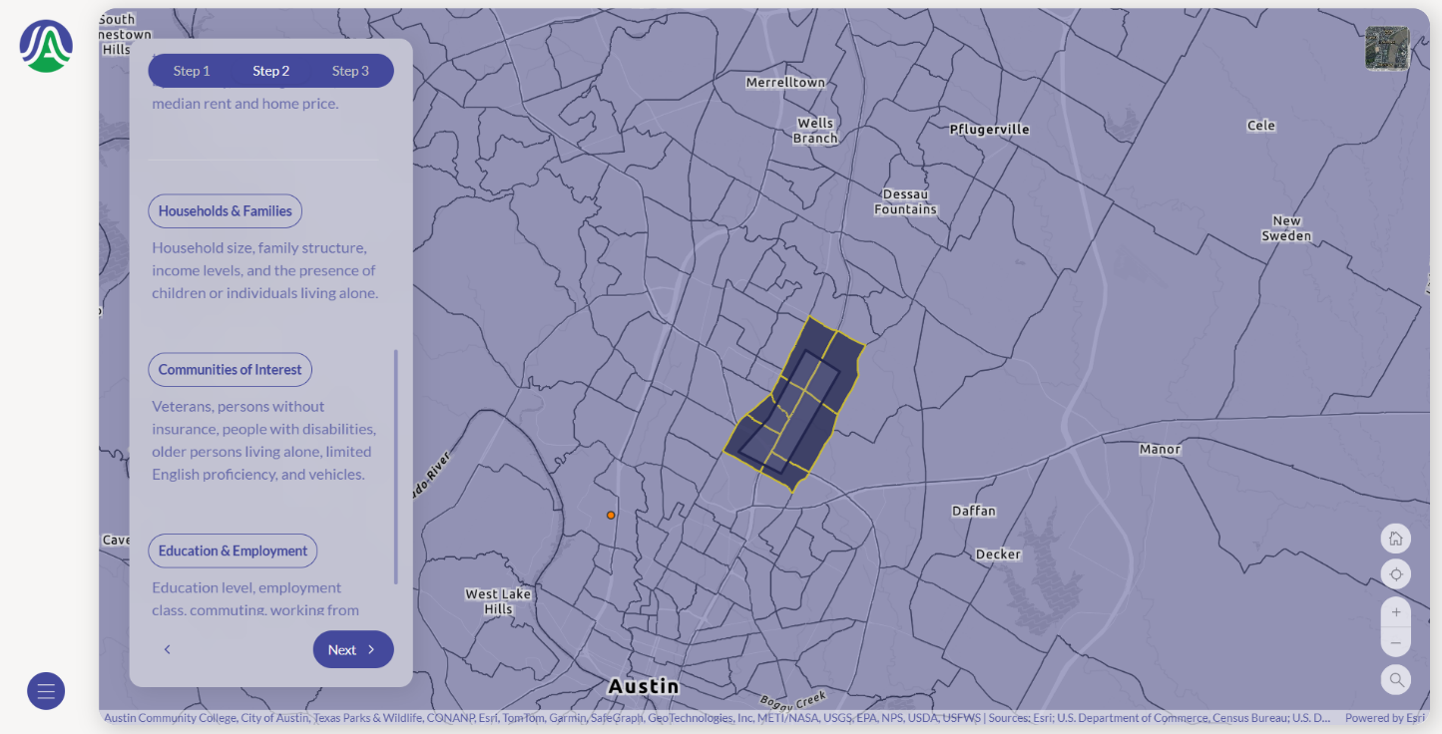
Austin Community Profile Builder
Above: Select a variable category, like Households & Families

Slide 26
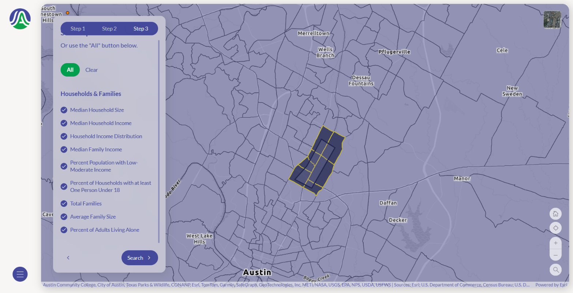
Austin Community Profile Builder
Above: Select particular variables of interest

Slide 27
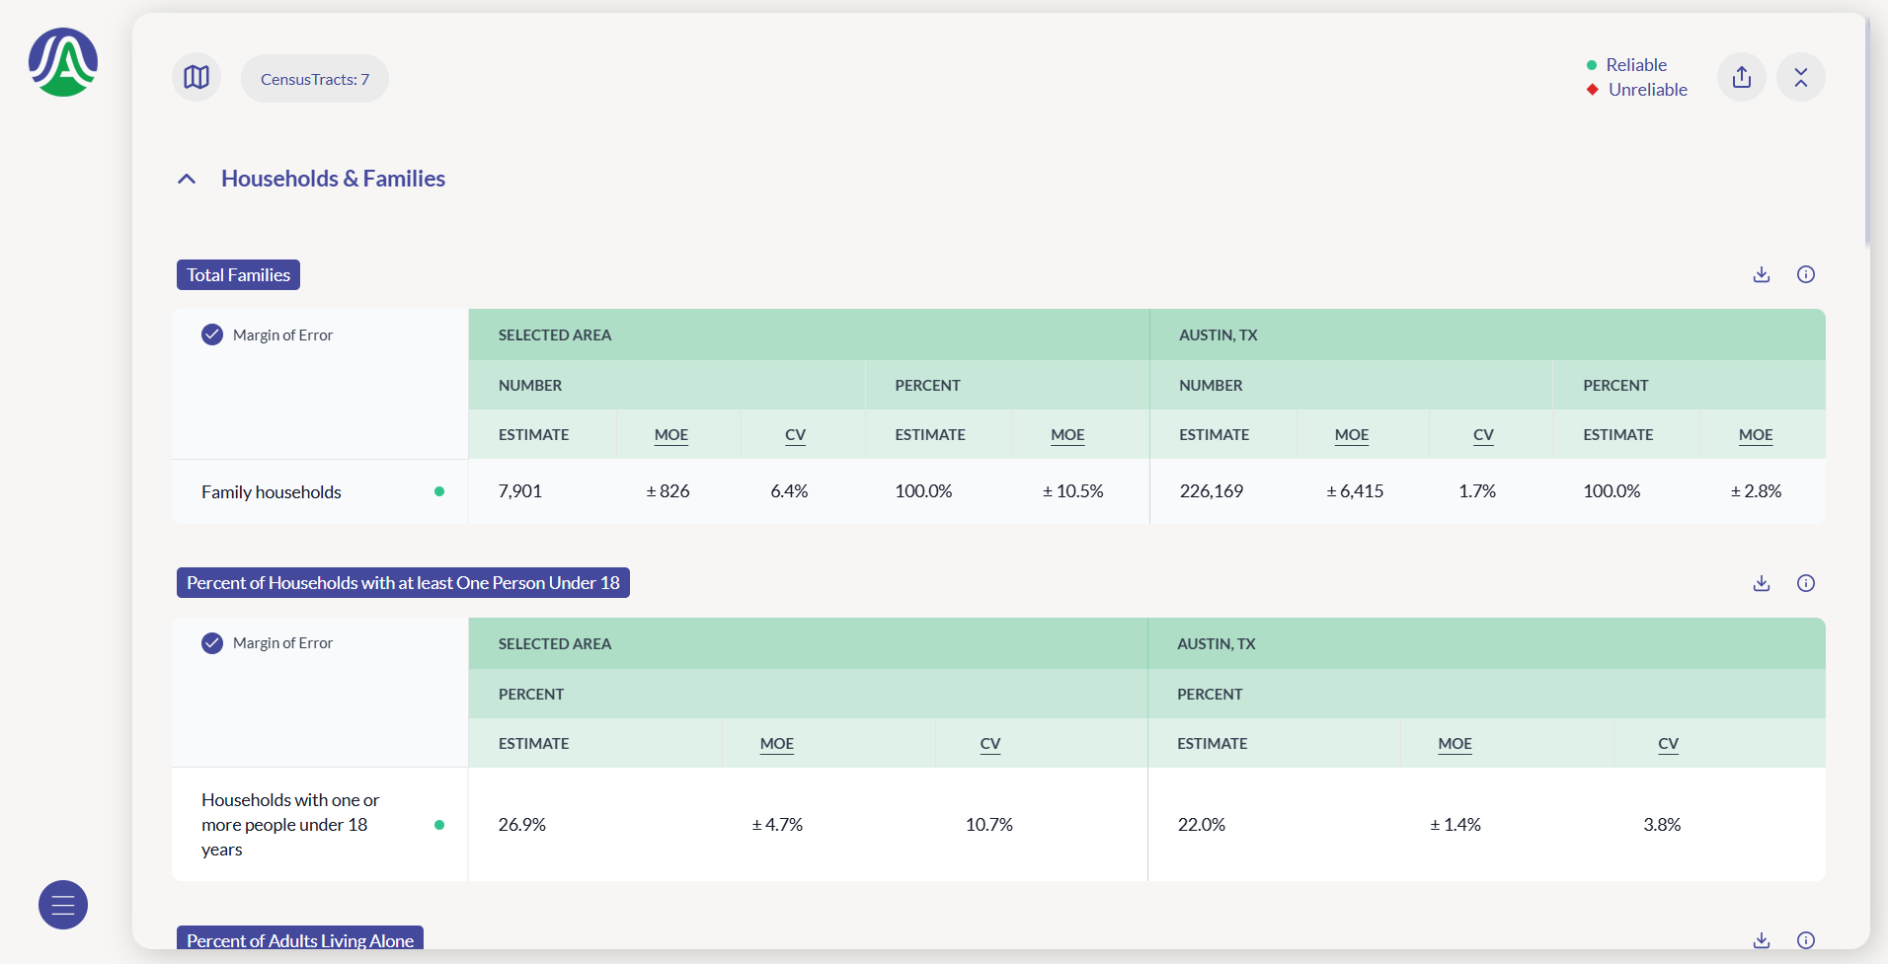
Austin Community Profile Builder
Above: View results for your area of interest and compare with the city of Austin

Slide 28
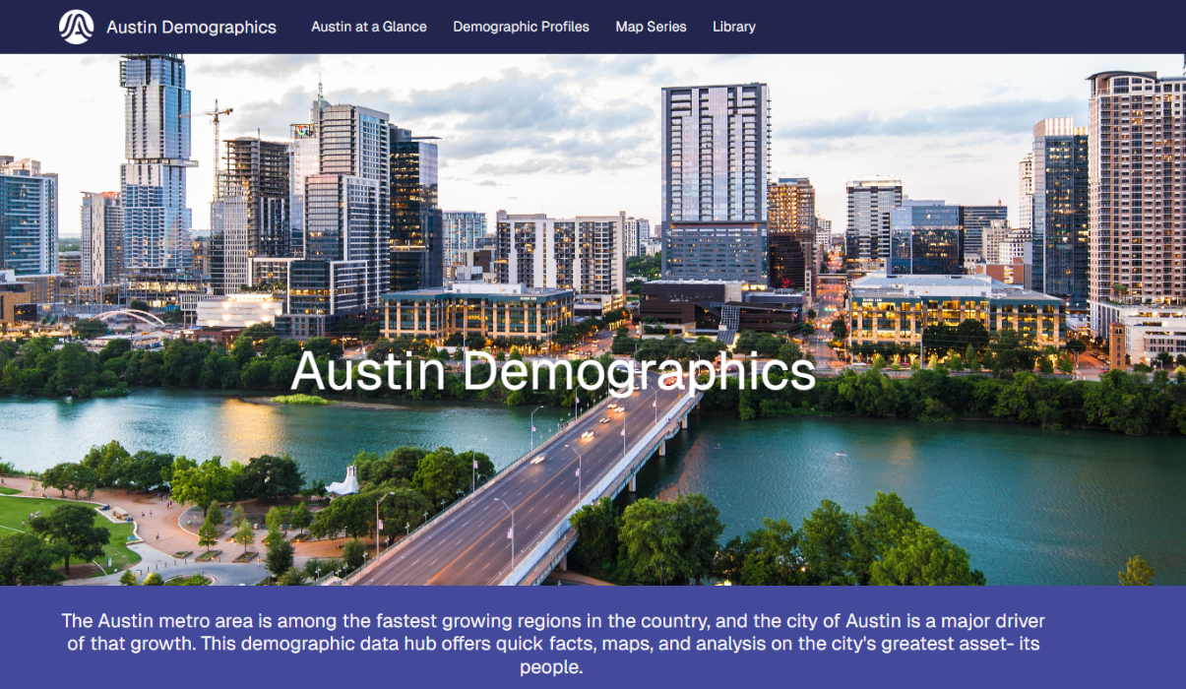
Where you can find the resources discussed today:
https://demographics-austin.hub.arcgis.com/

Slide 29
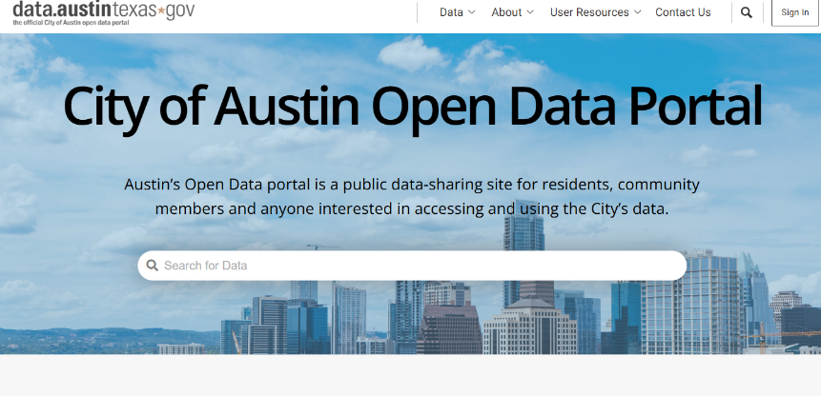
Open Data Portal
Available datasets:
Demographic Profiles
Land Use Inventory
DTI Forecast
Use Case: Exploring data in Excel, PowerBI, or other analysis tools.

Slide 30
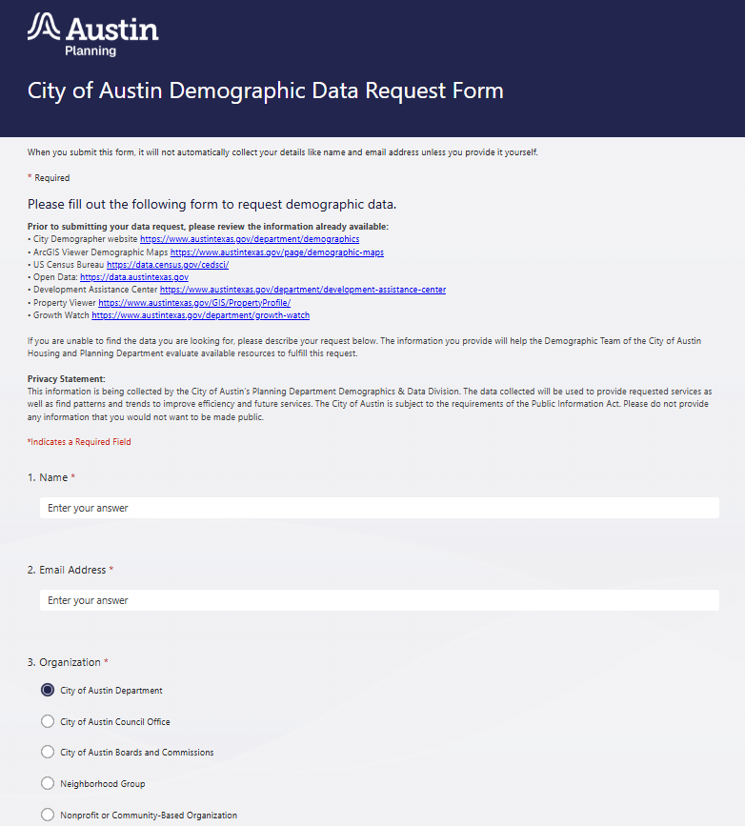
Demographic Data Requests
If you can’t find the data you need on our website, fill out our form for a consultation!
City of Austin Demographic Data Request Form
Notes:
Engage our team early!

