Slide 1



State of the State:
Texas Demographic Trends and Characteristics

Slide 2
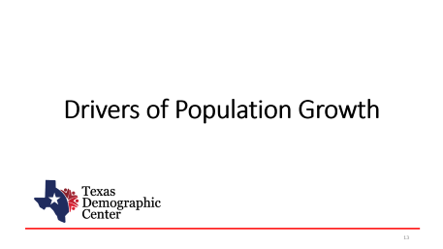
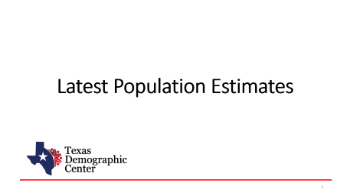

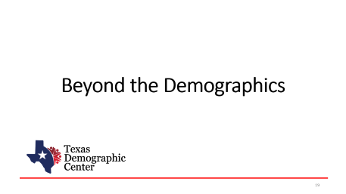
Table of Contents

Slide 3
Latest Population Estimates

Slide 4

New 2025 Estimates Show Texas Growth but at Slower Rate
Newly Released Data
Texas Total Population 2025
31.7M
391K
1.2%
Numeric increase
Percent increase
Growth from 2024
New Census Bureau data shows Texas’ population reached 31.7 million in July 2025 — a 1.2% increase from 2024 to 2025, more than 2X the 0.5% national growth rate. Though growth slowed compared to recent years, TX still led the nation in numeric gains, adding over 391K residents.

Slide 5
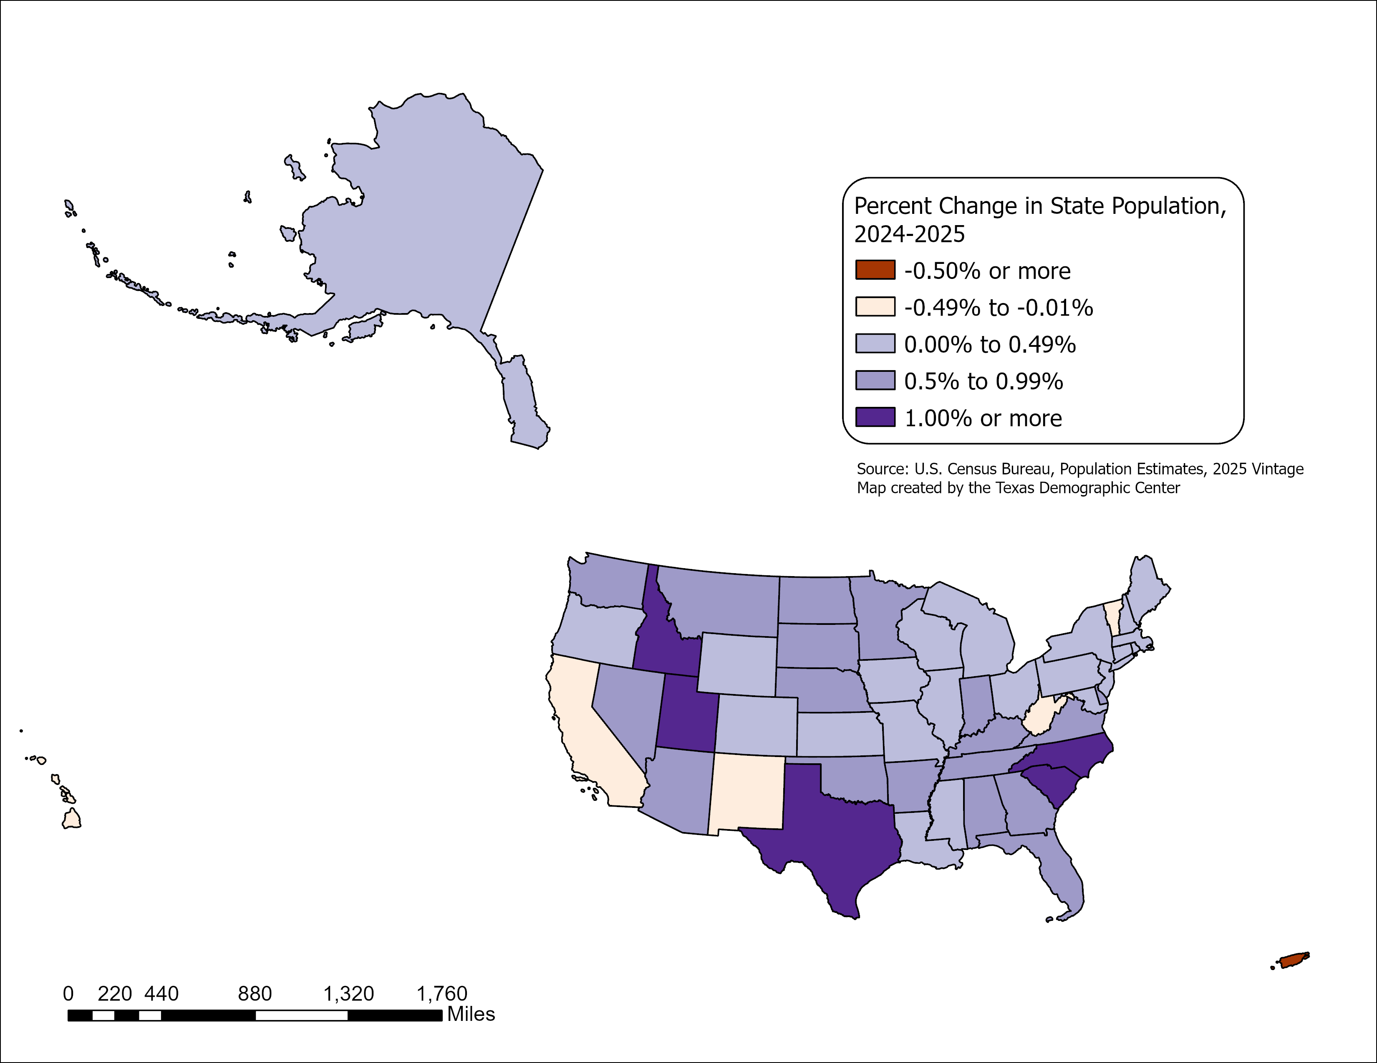
State Highlights
All but five U.S. states grew between July 2024 and July 2025
- CA, HI, NM, VT, and WV.
Top 5 States with percent change
-SC, ID, NC, TX, UT.
Top 5 States with numeric change
-TX, FL, NC, GA, SC.
Source: U.S. Census Bureau, Vintage 2025 Population Estimates

Slide 6
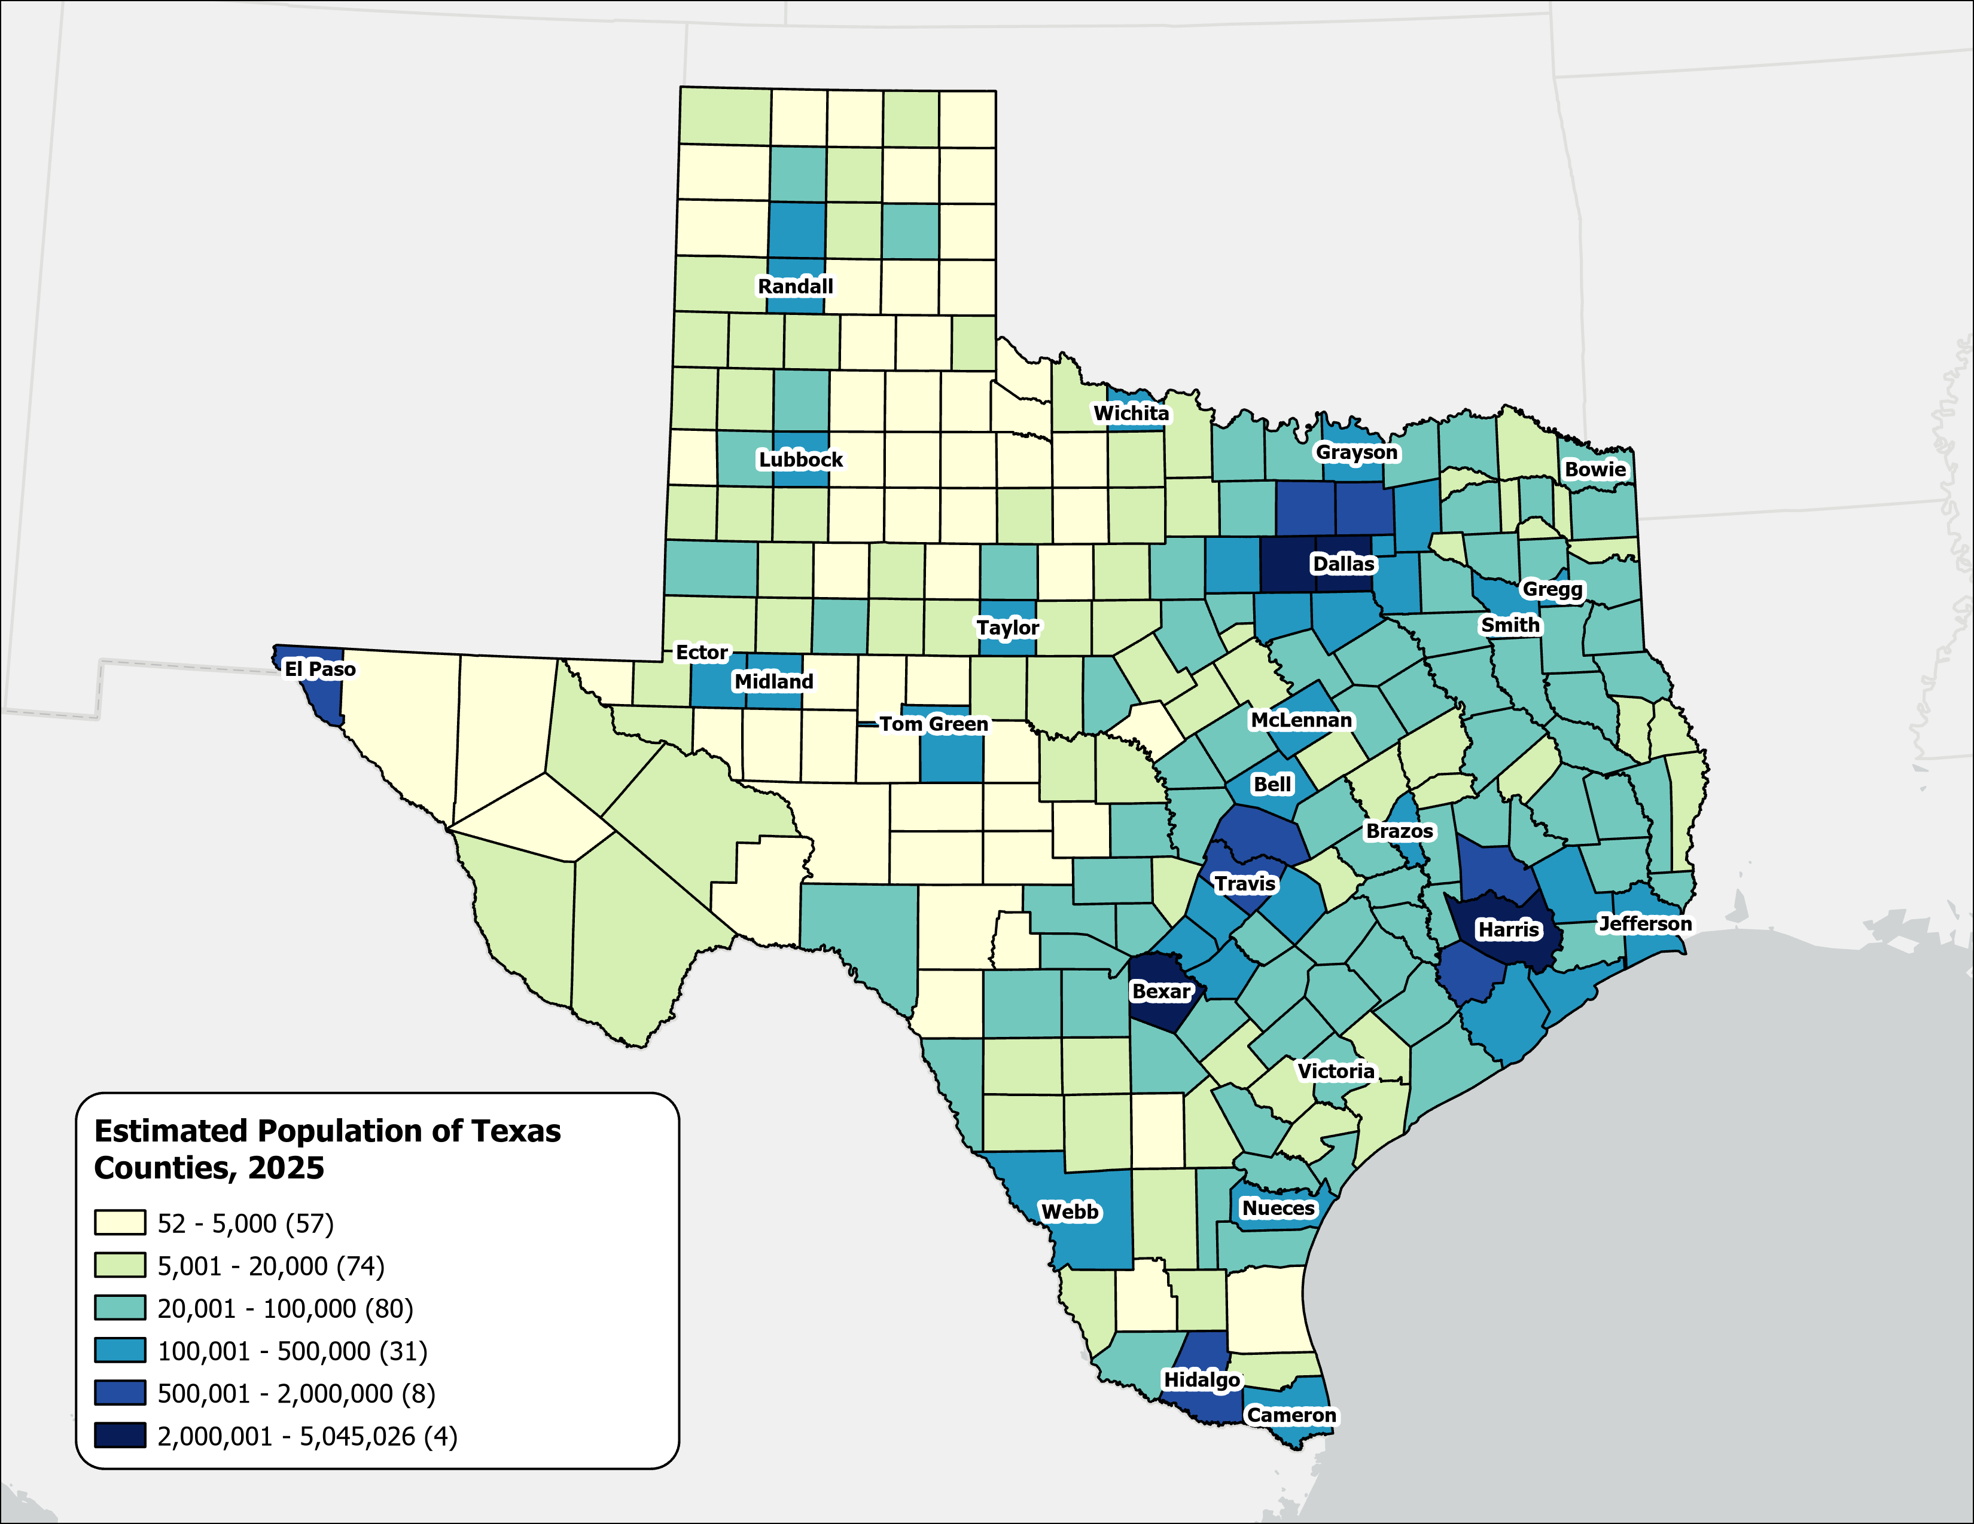
Estimated Population,
Texas Counties, 2025
Texas population is highly concentrated within the metropolitan triangle formed by Dallas–Fort Worth, Austin, San Antonio, and Houston.
The 120 counties on and east of the I‑35 corridor are home to 27.3 million residents—approximately 87.3% of the state’s total population.
87%
Source: U.S. Census Bureau, Vintage 2025 Population Estimates

Slide 7
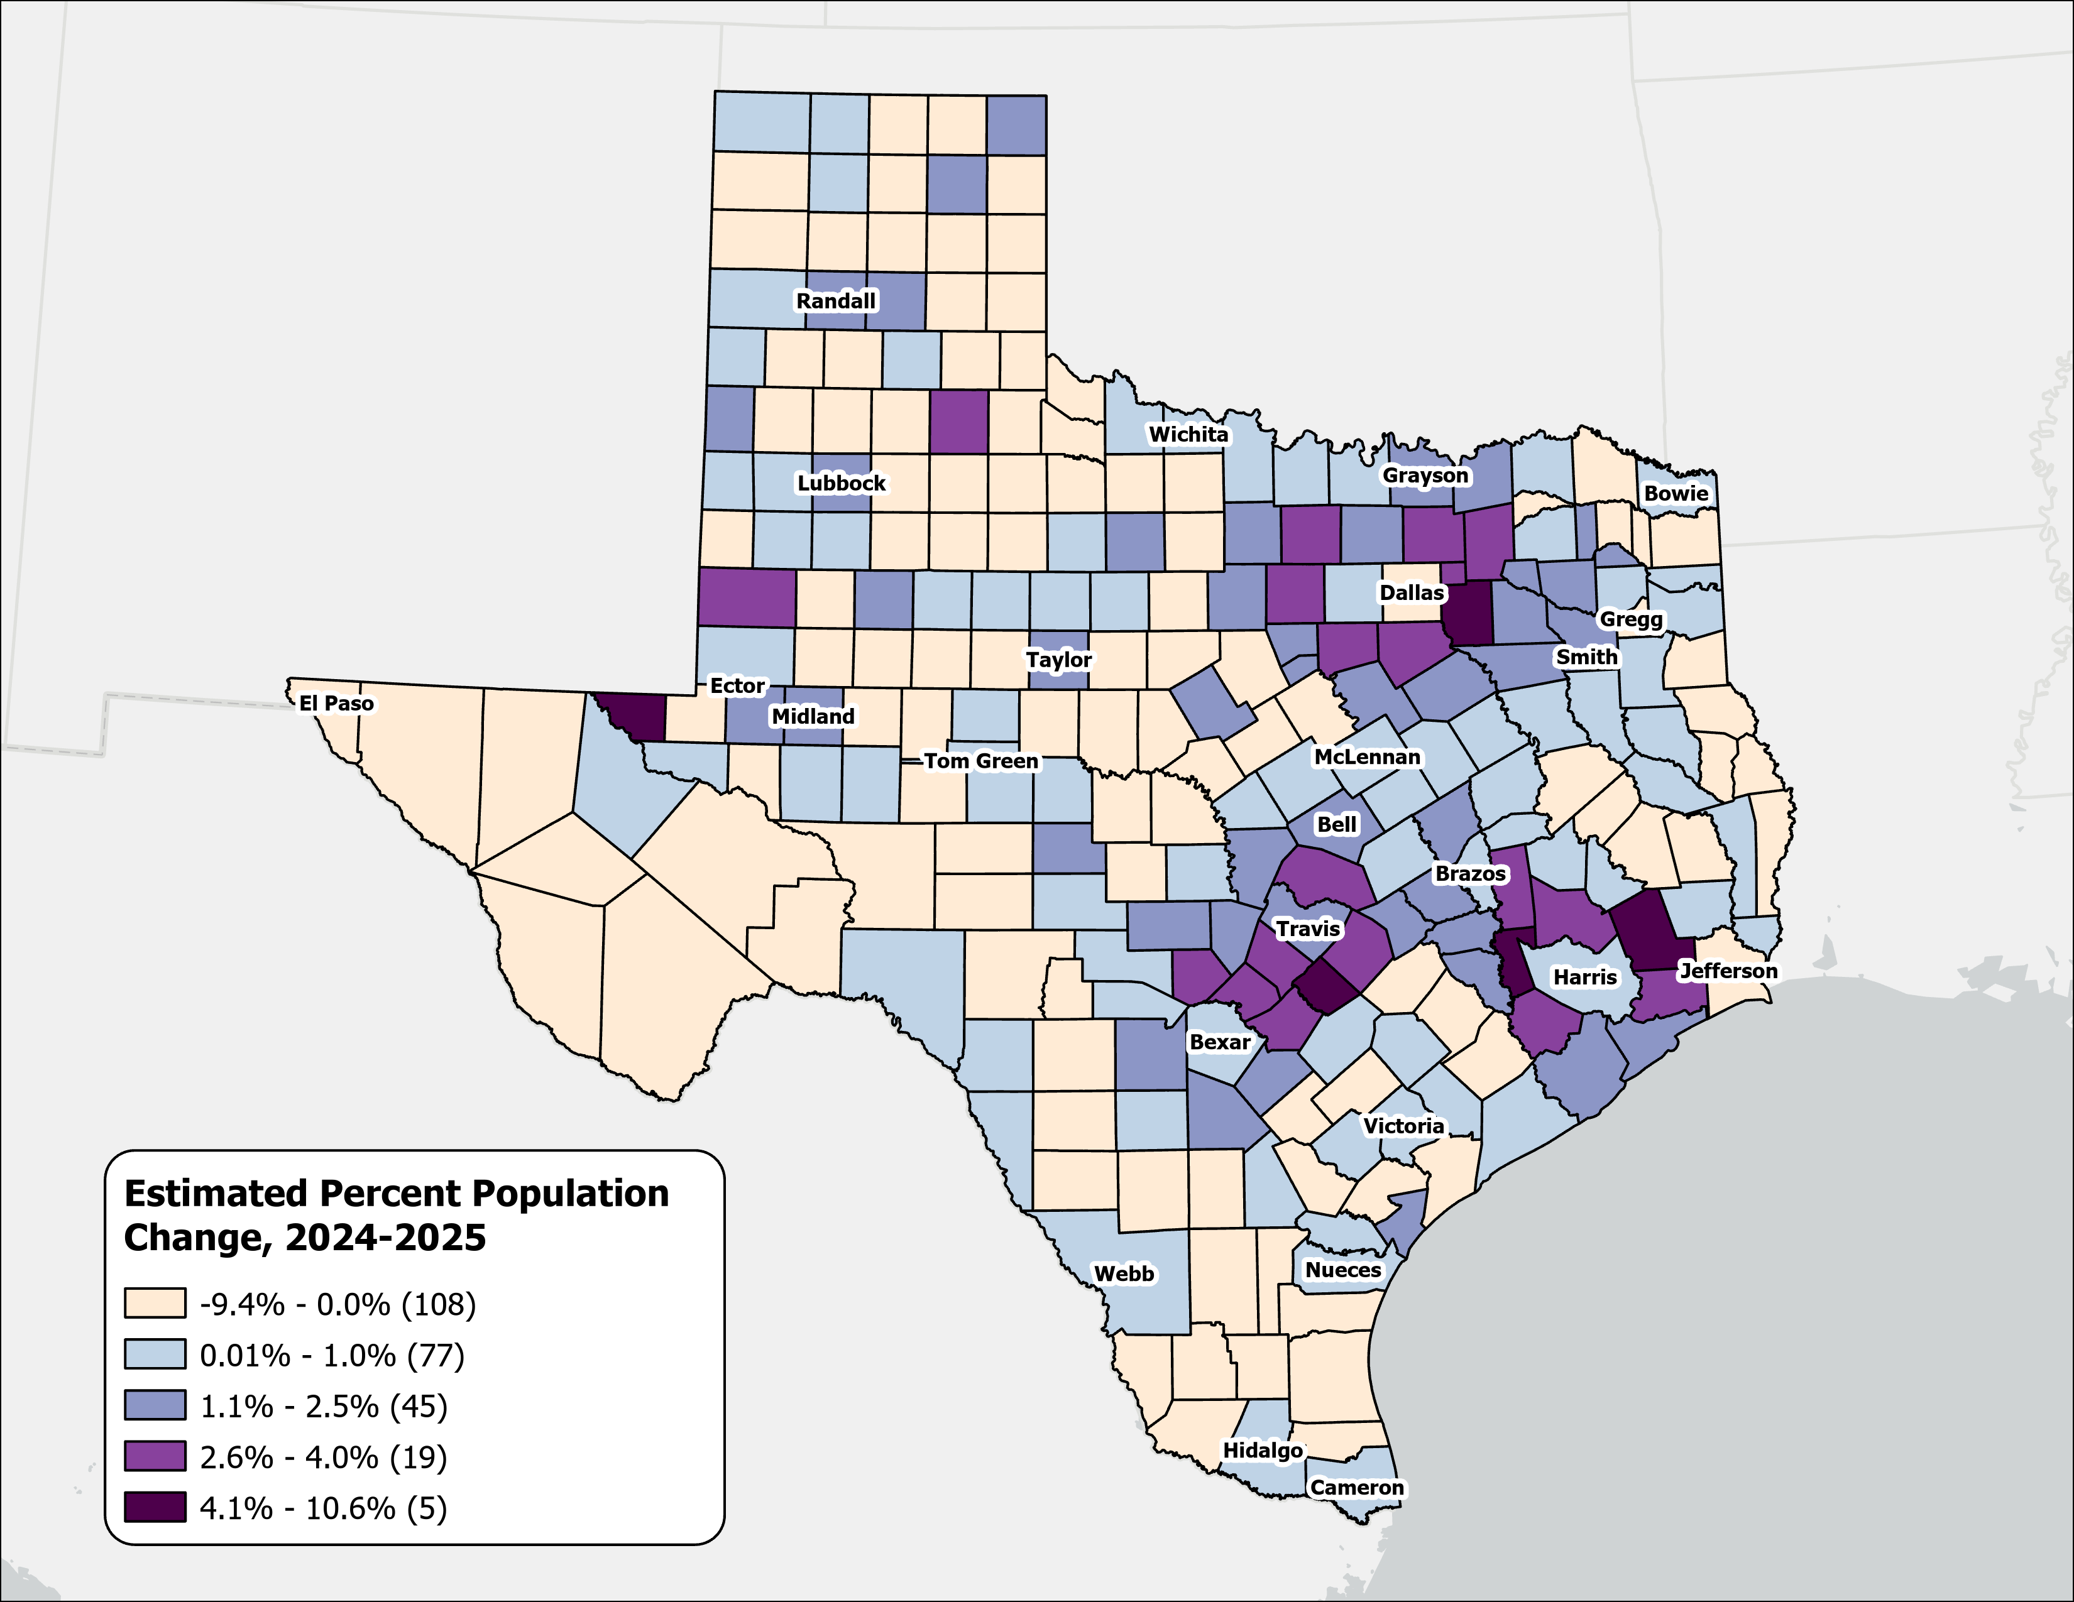
Estimated Percent Population Change, Texas Counties, 2024-2025
Rapid growth was concentrated in counties at the suburban and exurban edges of the Texas metropolitan triangle.
Source: U.S. Census Bureau, Vintage 2025 Population Estimates

Slide 8
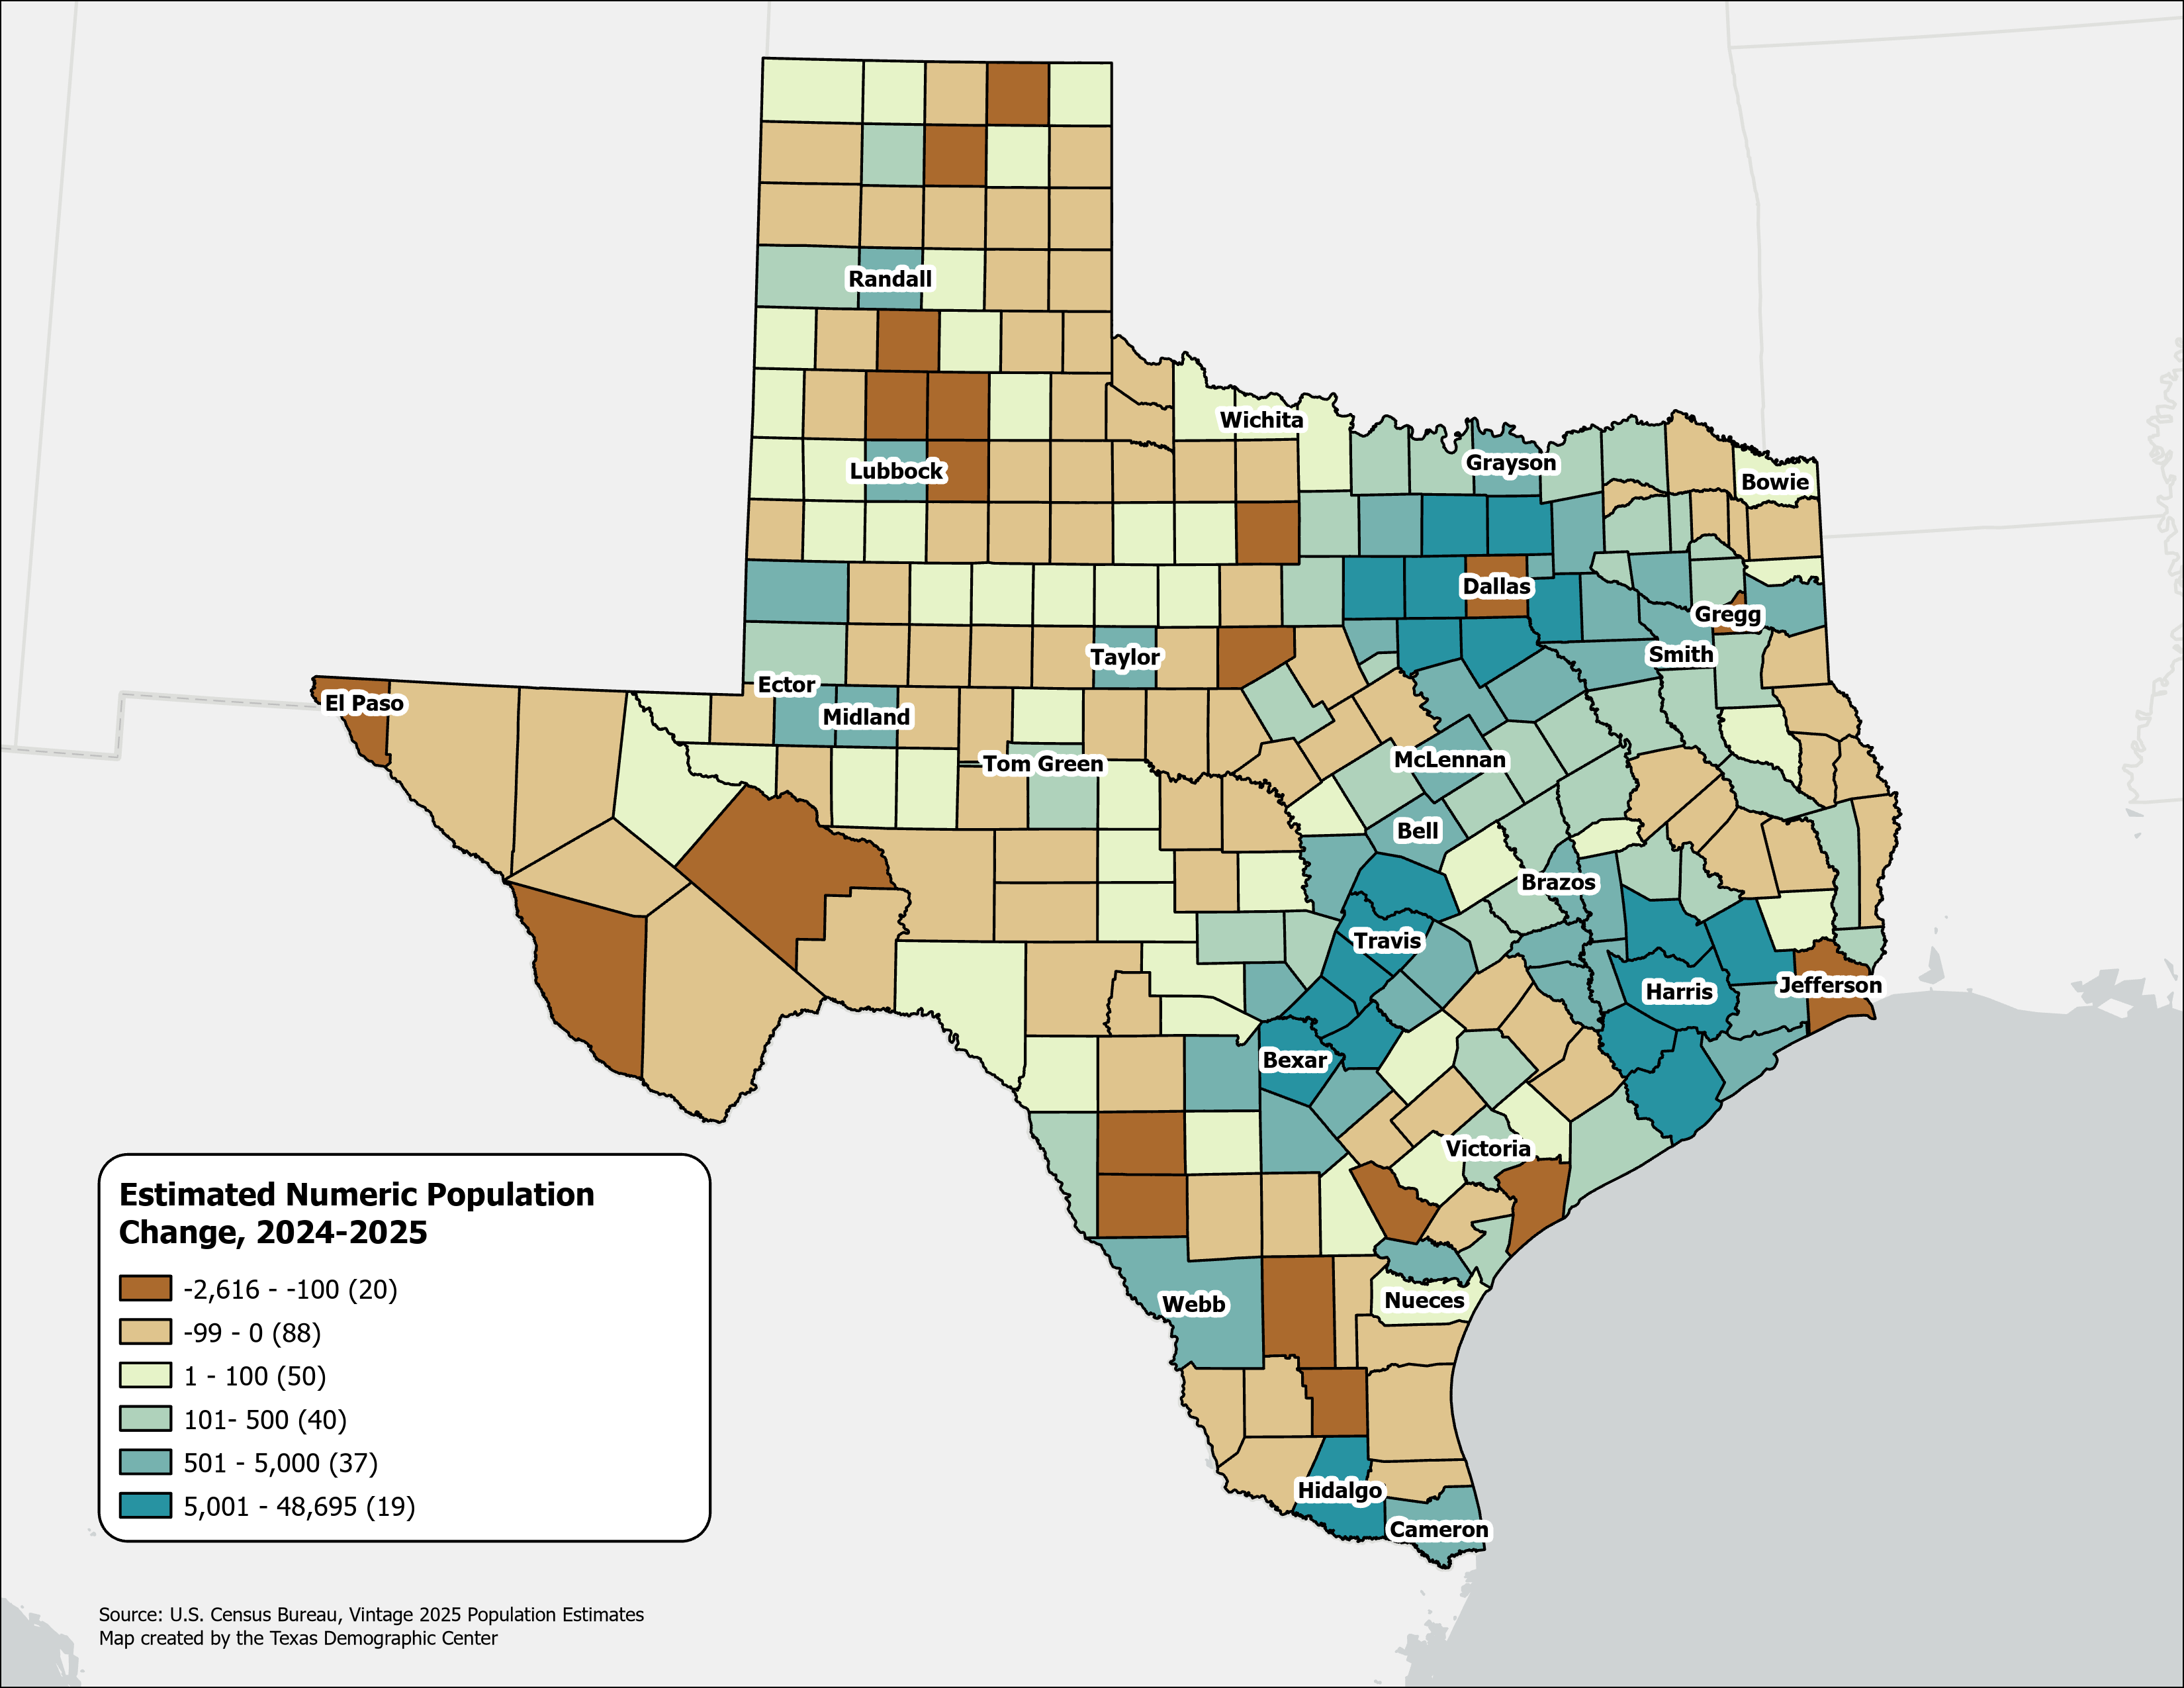
Estimated Numeric Population Change, Texas Counties, 2024-2025
Population declined in 108 Texas counties, primarily in rural areas.
Dallas experienced the largest numeric population loss, along with several border counties.
Source: U.S. Census Bureau, Vintage 2025 Population Estimates

Slide 9
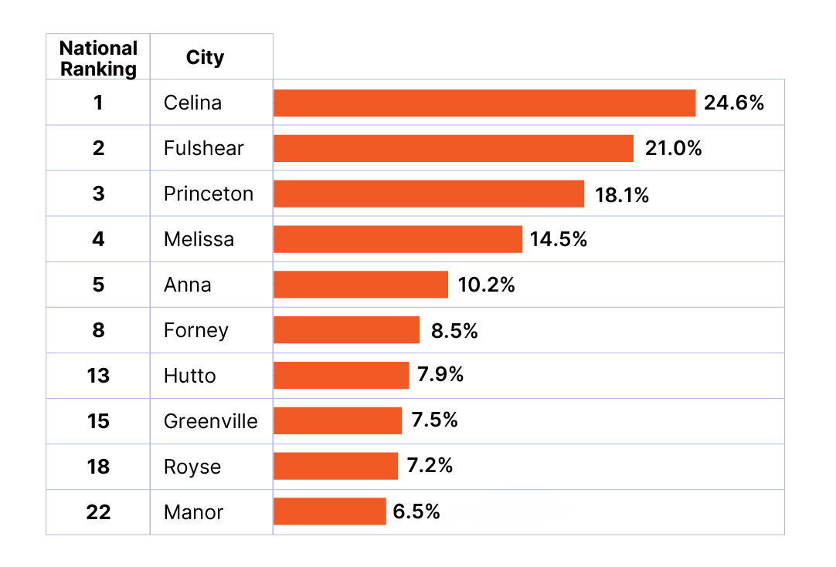
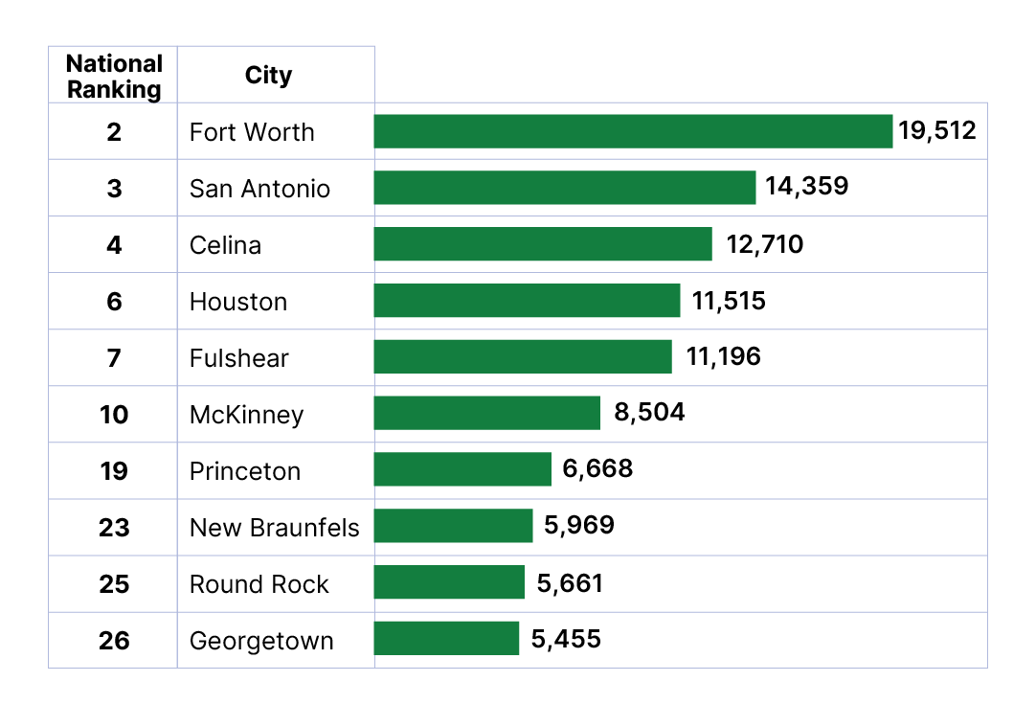
Top Growth Texas Cities and Towns
Top 10 Cities by Percent Growth in Texas
From July 1, 2024 to July 1, 2025
Top 10 Cities by Numeric Growth in Texas
From July 1, 2024 to July 1, 2025
Source: U.S. Census Bureau, Vintage 2025 Population Estimates. Ranked among incorporated places with a population of 20,000 or more.

Slide 10
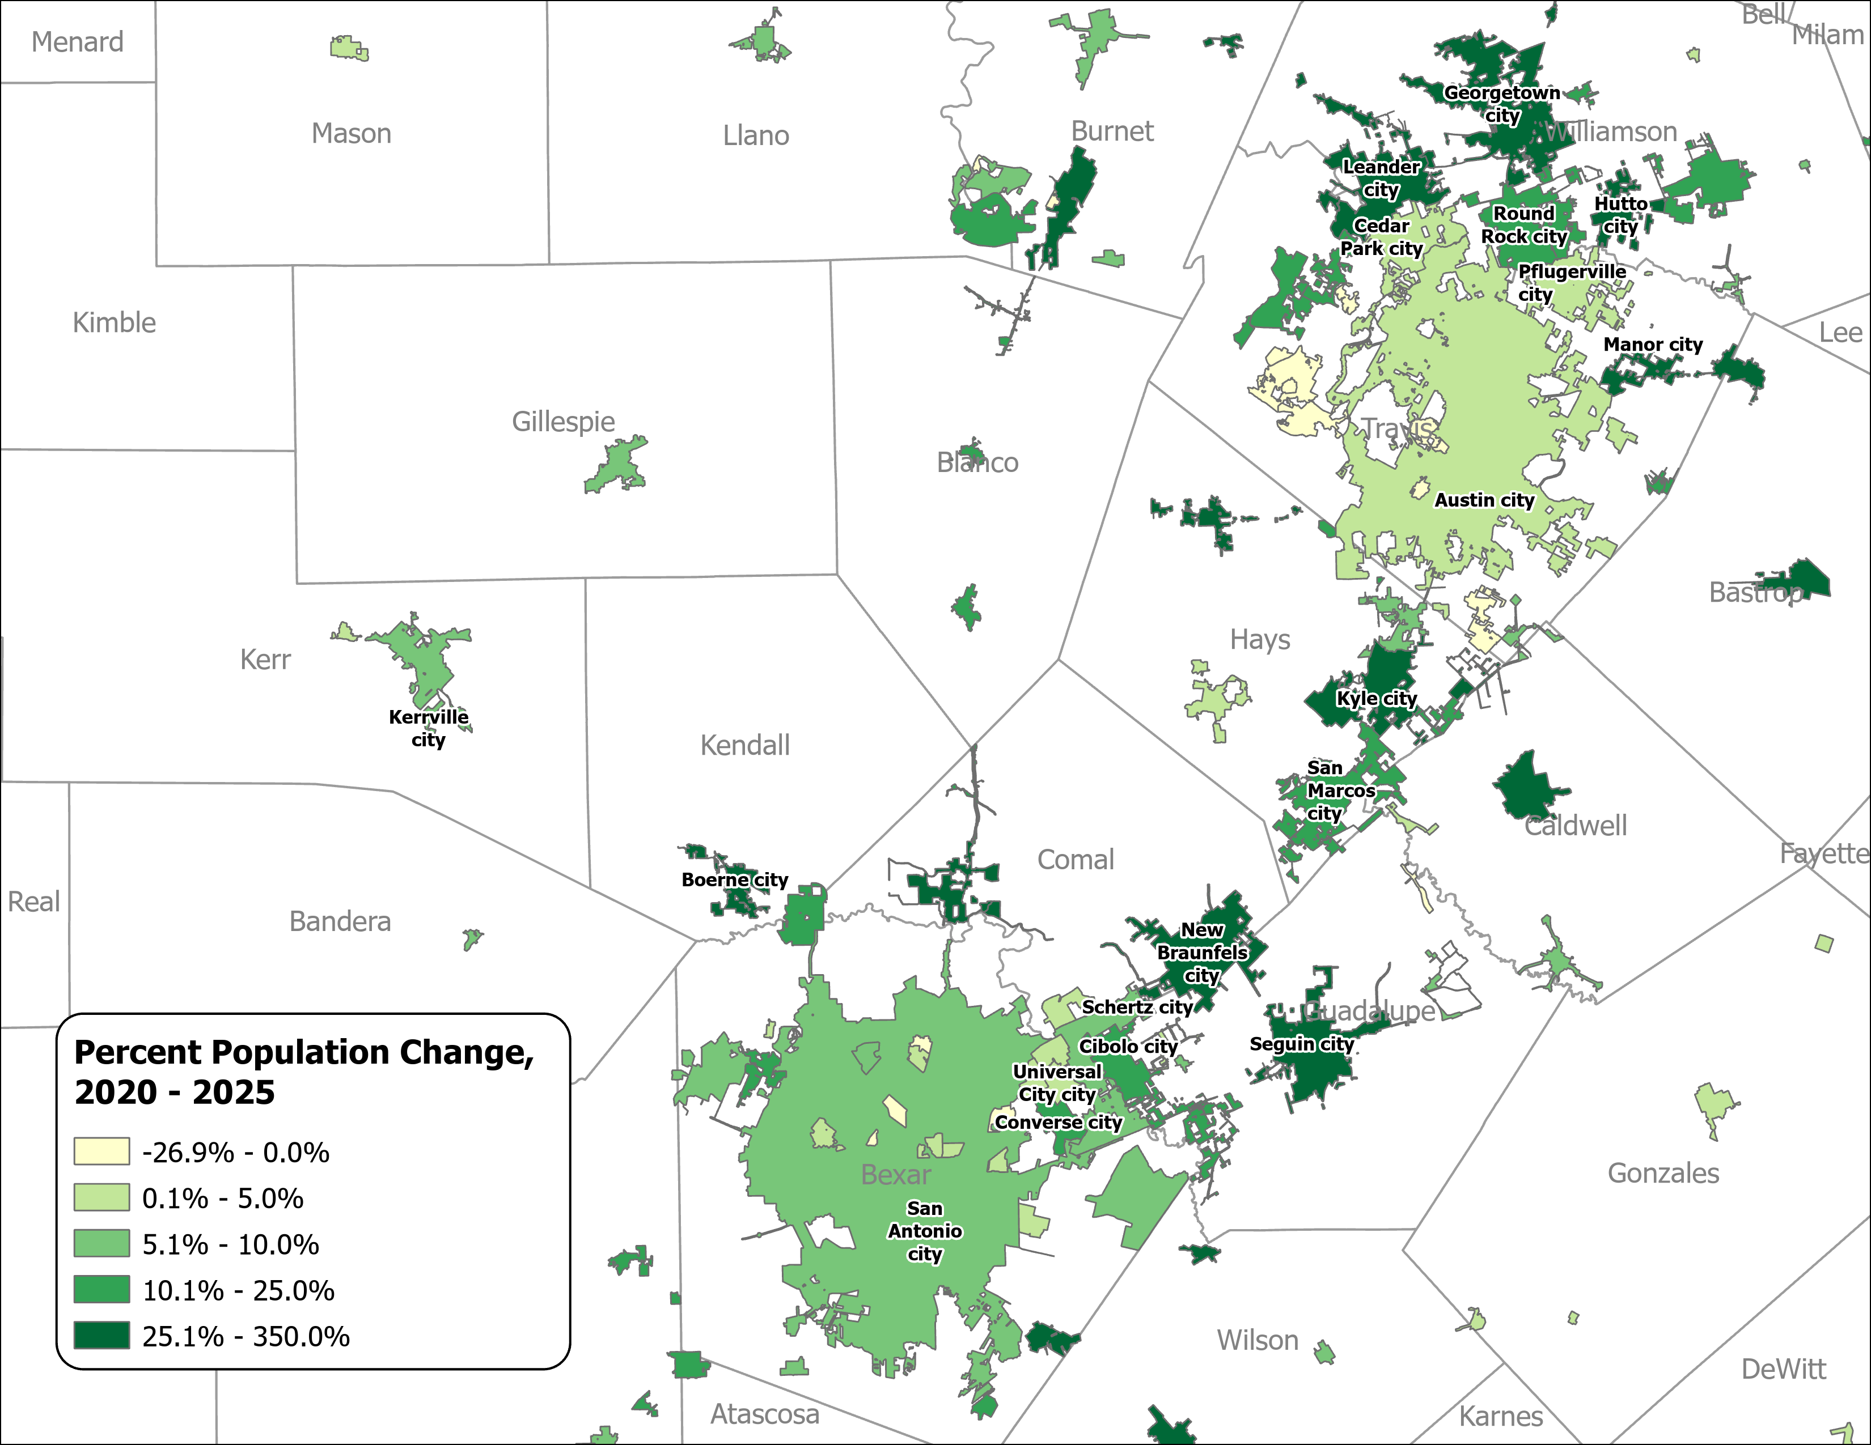
Percent Population Change for Incorporated Places, 2020-2025
Austin and San Antonio Area
Growth in major urban centers slowed considerably.
Small and midsized suburban and exurban cities within the Triangle region experienced the most rapid expansion.
Source: U.S. Census Bureau, Vintage 2025 Population Estimates

Slide 11
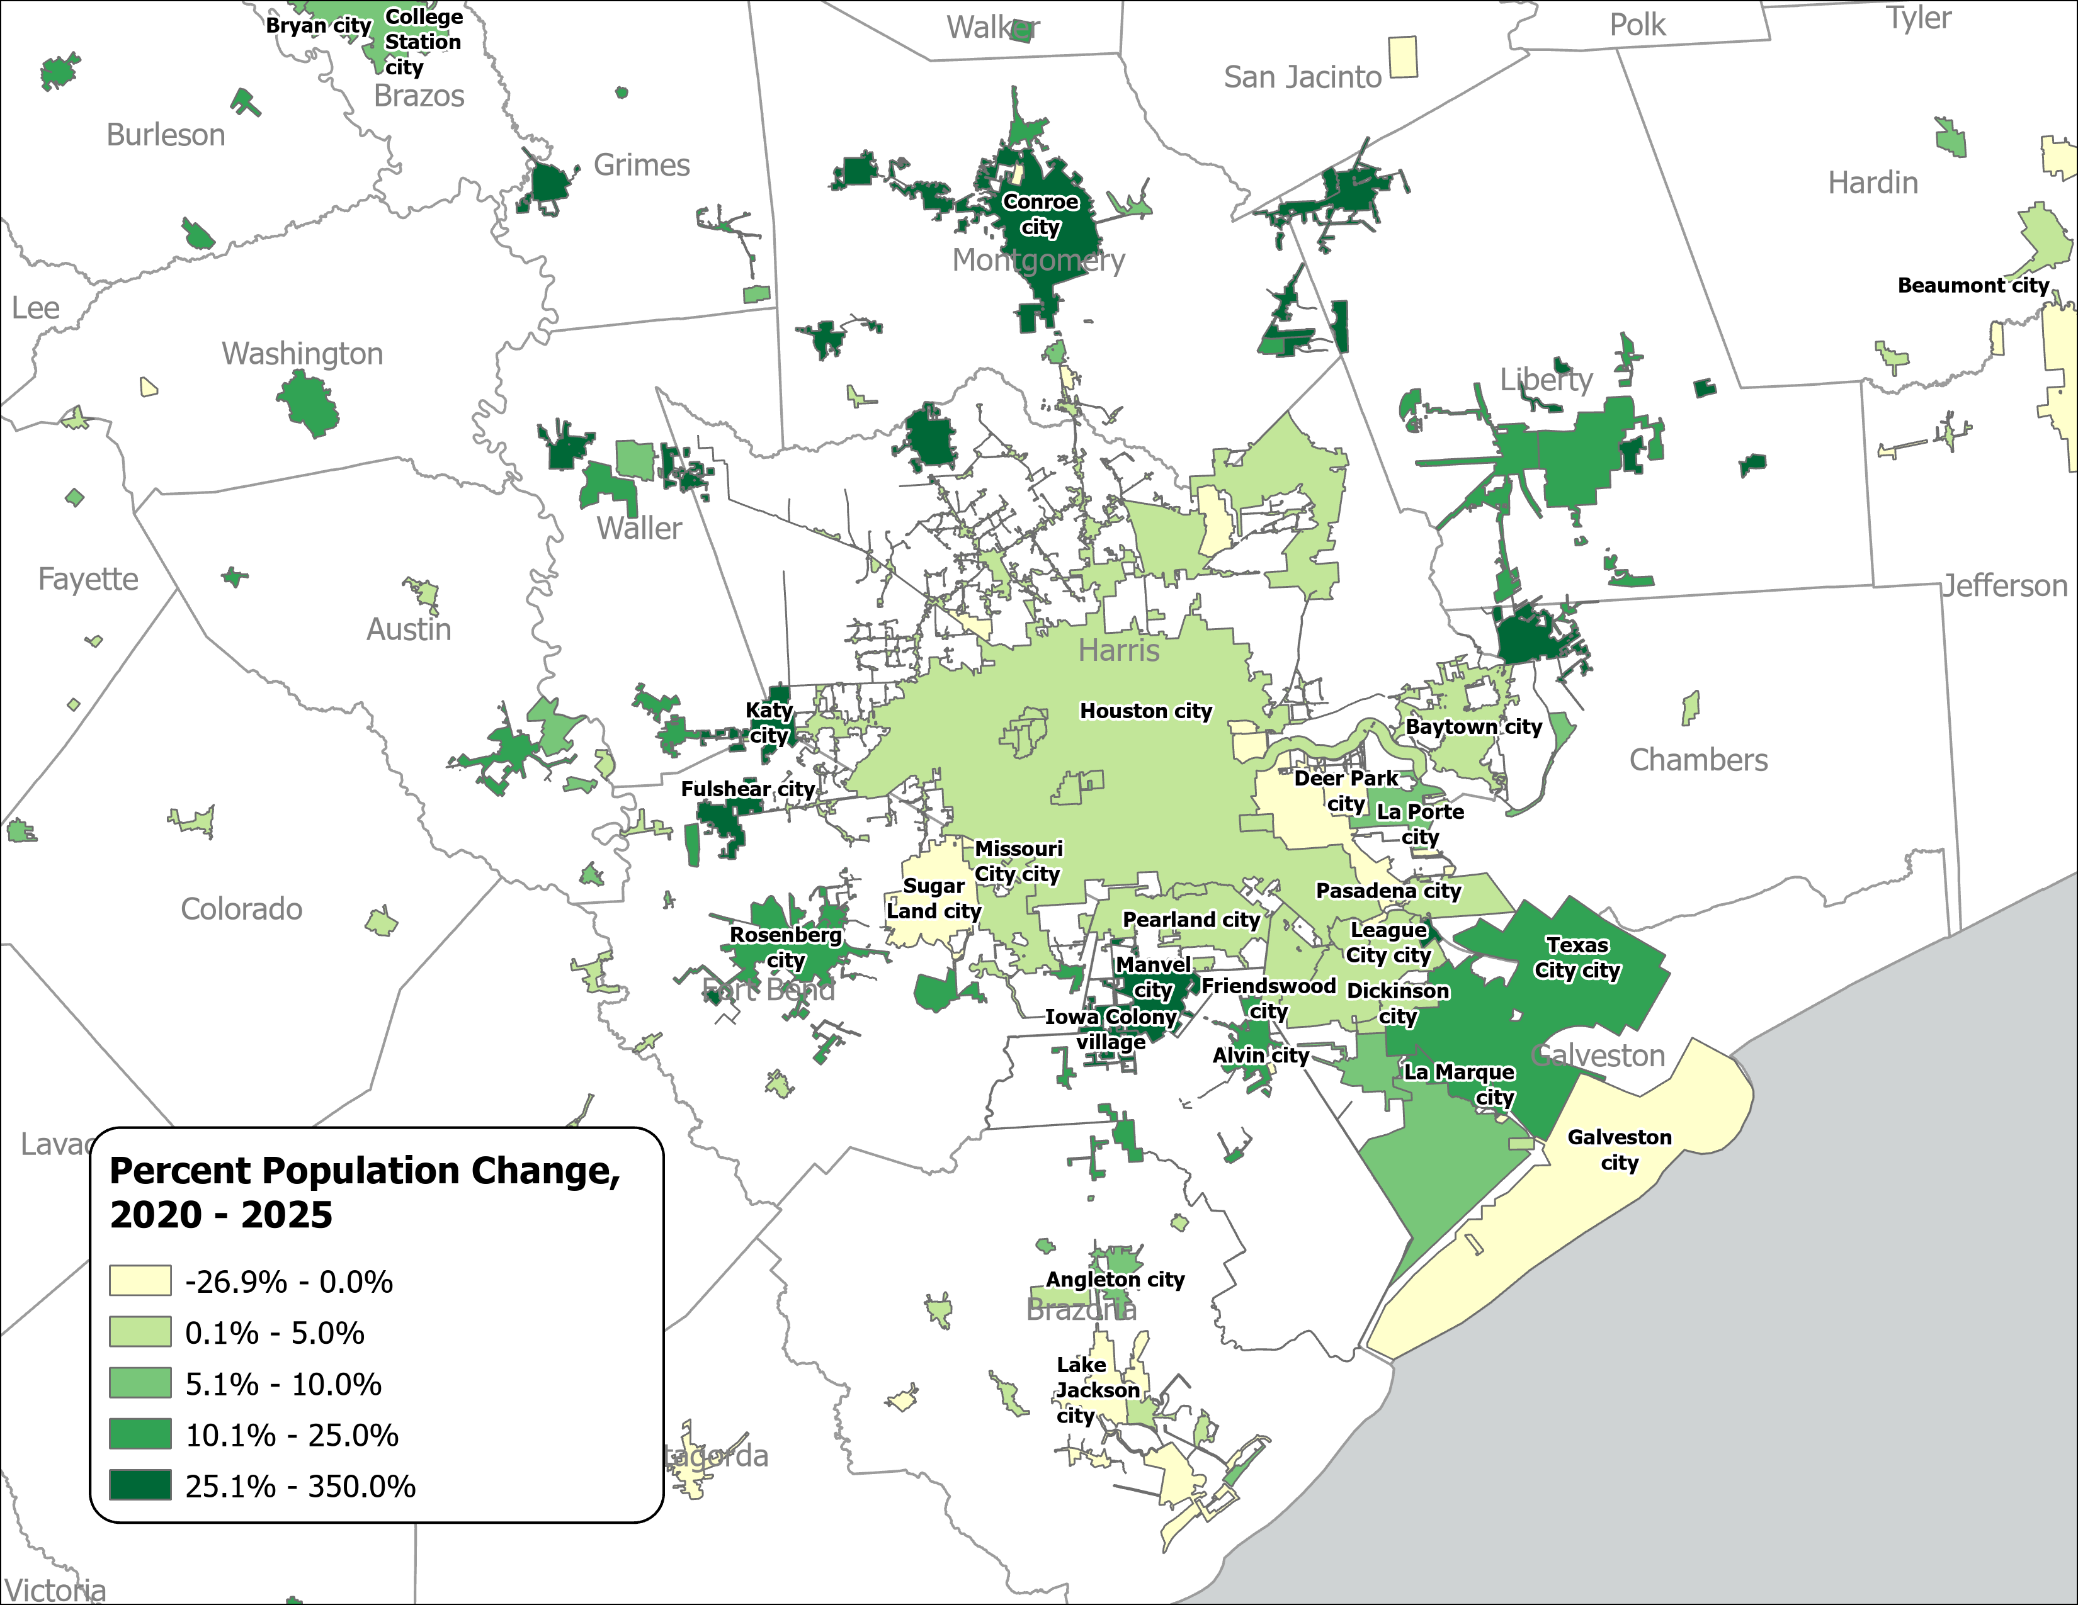
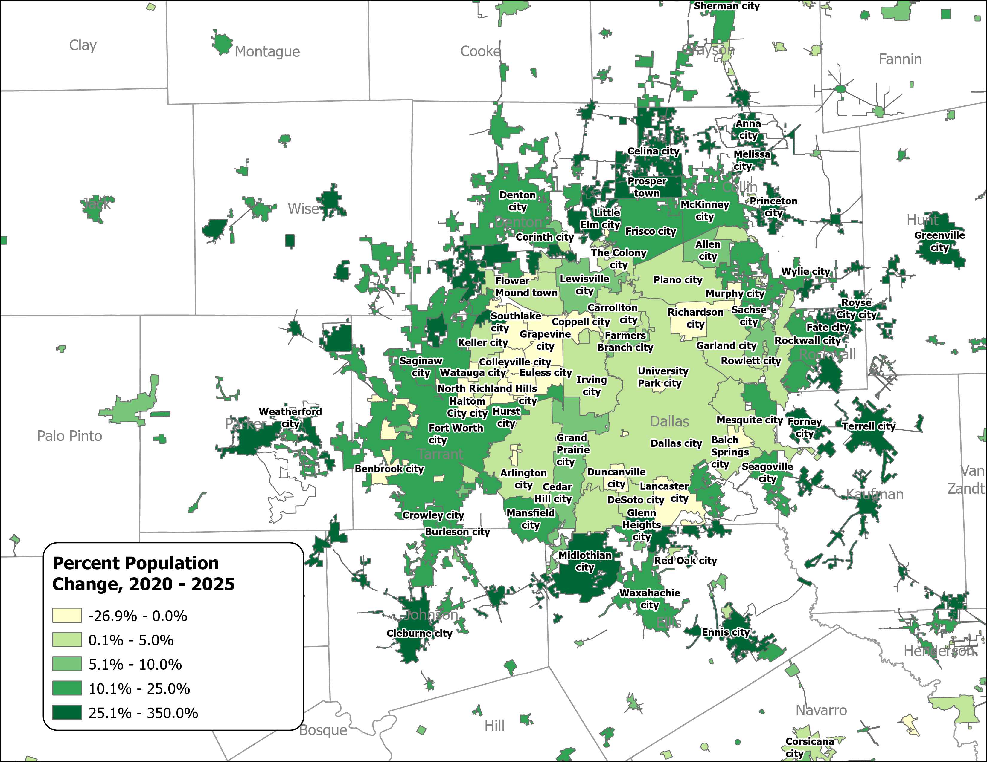
Percent Population Change for Incorporated Places, 2020-2025
Houston Area
Dallas-Fort Worth Area
Source: U.S. Census Bureau, Vintage 2025 Population Estimates

Slide 12
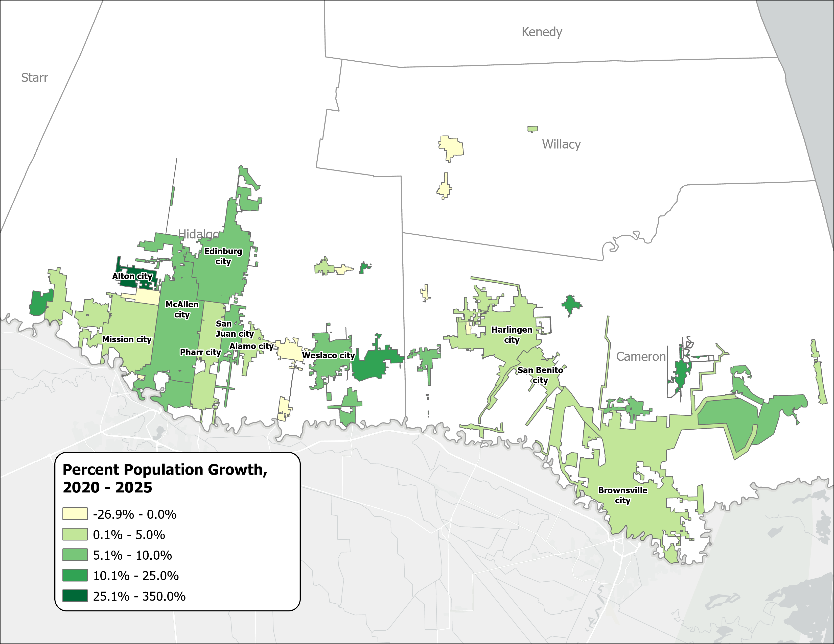
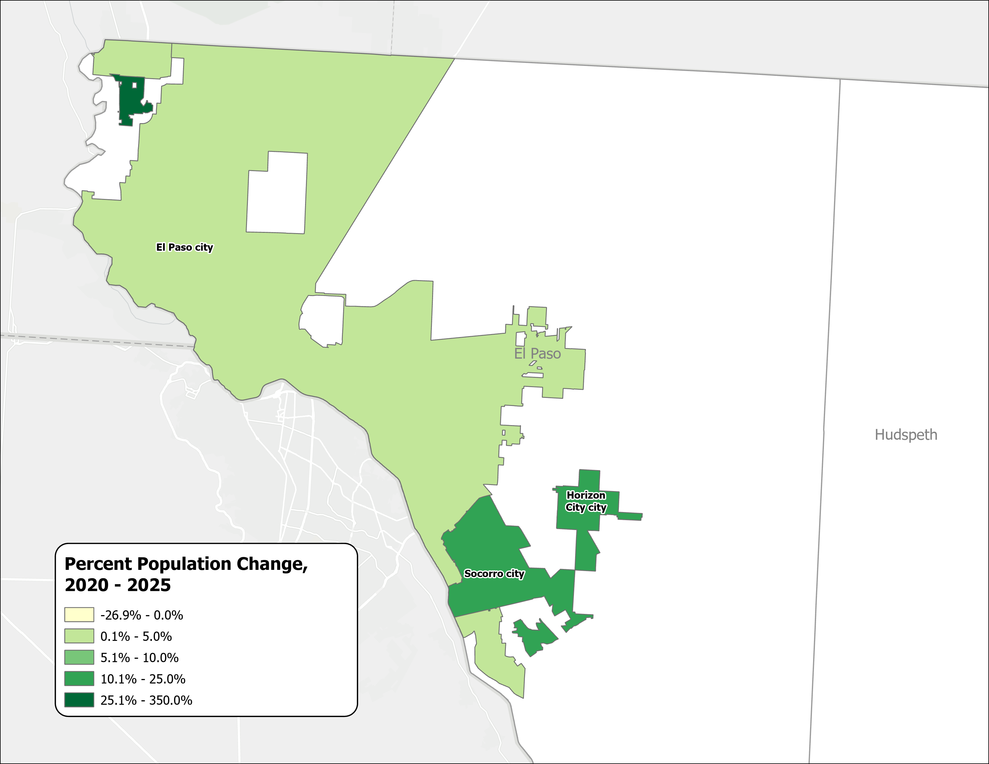
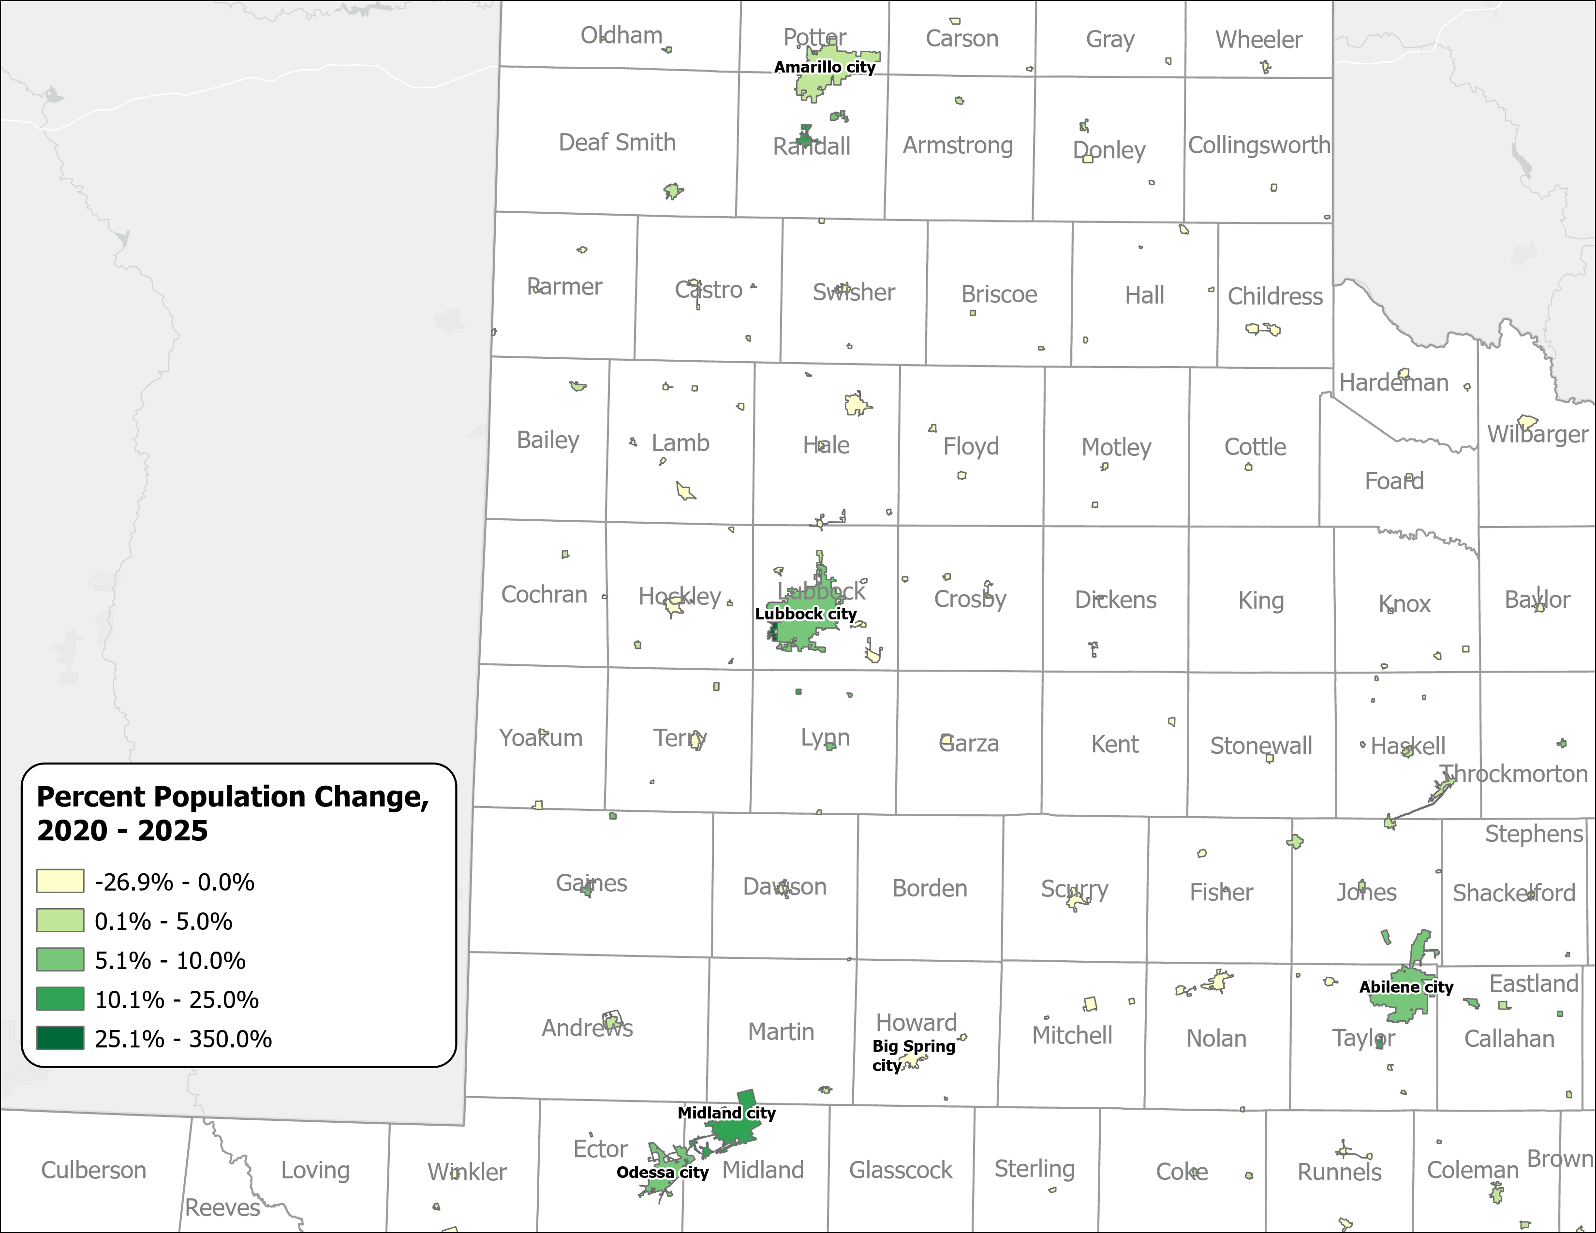
Percent Population Change for Incorporated Places, 2020-2025
El Paso Area
Panhandle and West Texas
Rio Grande Valley
Source: U.S. Census Bureau, Vintage 2025 Population Estimates

Slide 13
Drivers of Population Growth

Slide 14
Texas Daily Population Growth and Components of Change, 2020-2025
Reduced international and domestic migration drove the decline, while natural increase made up 40% of growth, up from about 25% since 2020.
917
1,494
1,647
1,642
1,072
Daily Average
Population Change
Source: U.S. Census Bureau, Vintage 2025 Population Estimates
Note: Components of change may not add to the total population change due to the minor residual components in the Census Bureau’s Population Estimates

Slide 15
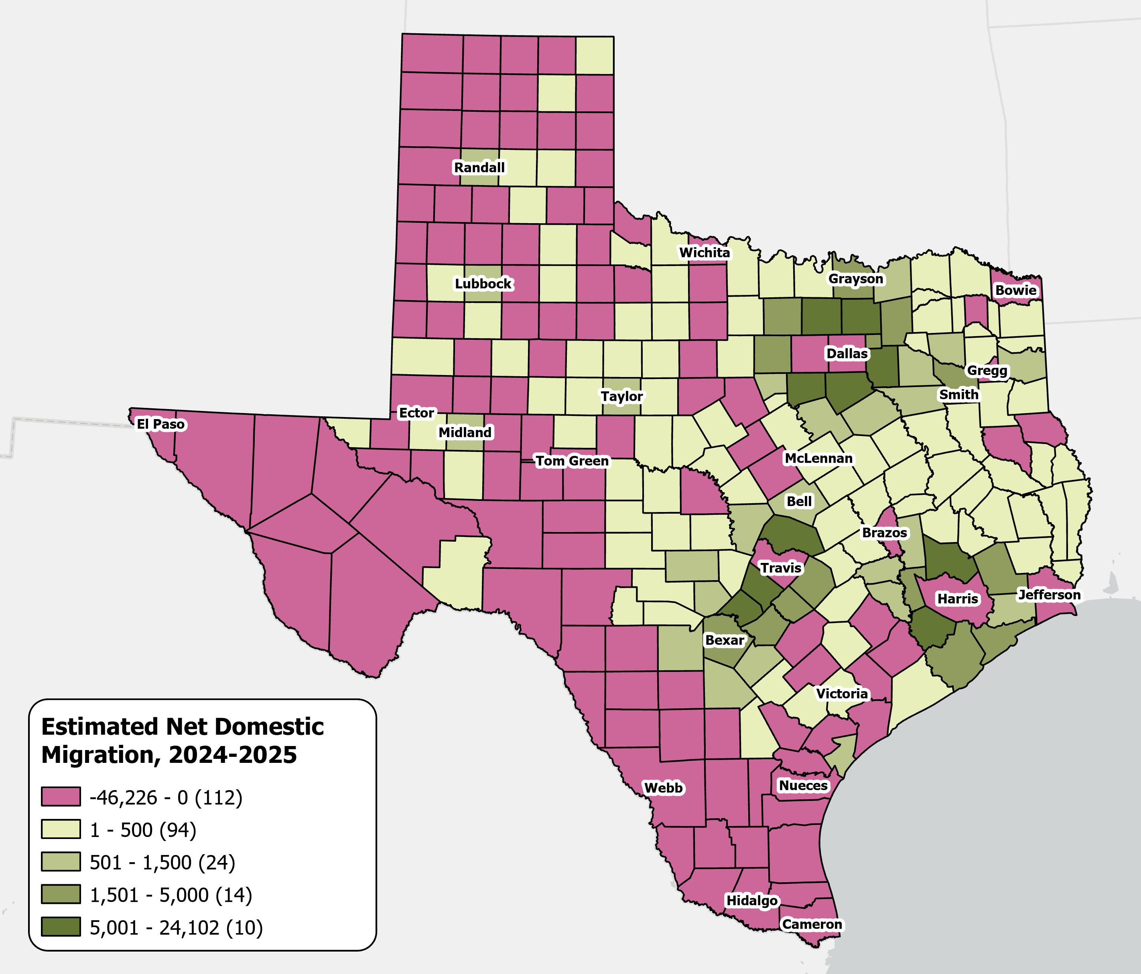
Estimates Net Domestic Migration Across Texas Counties
From July 1, 2024 to
July 1, 2025
High net domestic migration persists in suburban counties
Texas saw its
lowest domestic migration
in over a decade.
Source: U.S. Census Bureau, Vintage 2025 Population Estimates
Notes:
Caption: From July 2024 to July 2025, Texas saw its lowest level of domestic migration in more than a decade. The suburban and exurban edges of the Texas metropolitan triangle experienced the strongest net in‑migration, while central‑city counties and West Texas saw net out‑migration.

Slide 16
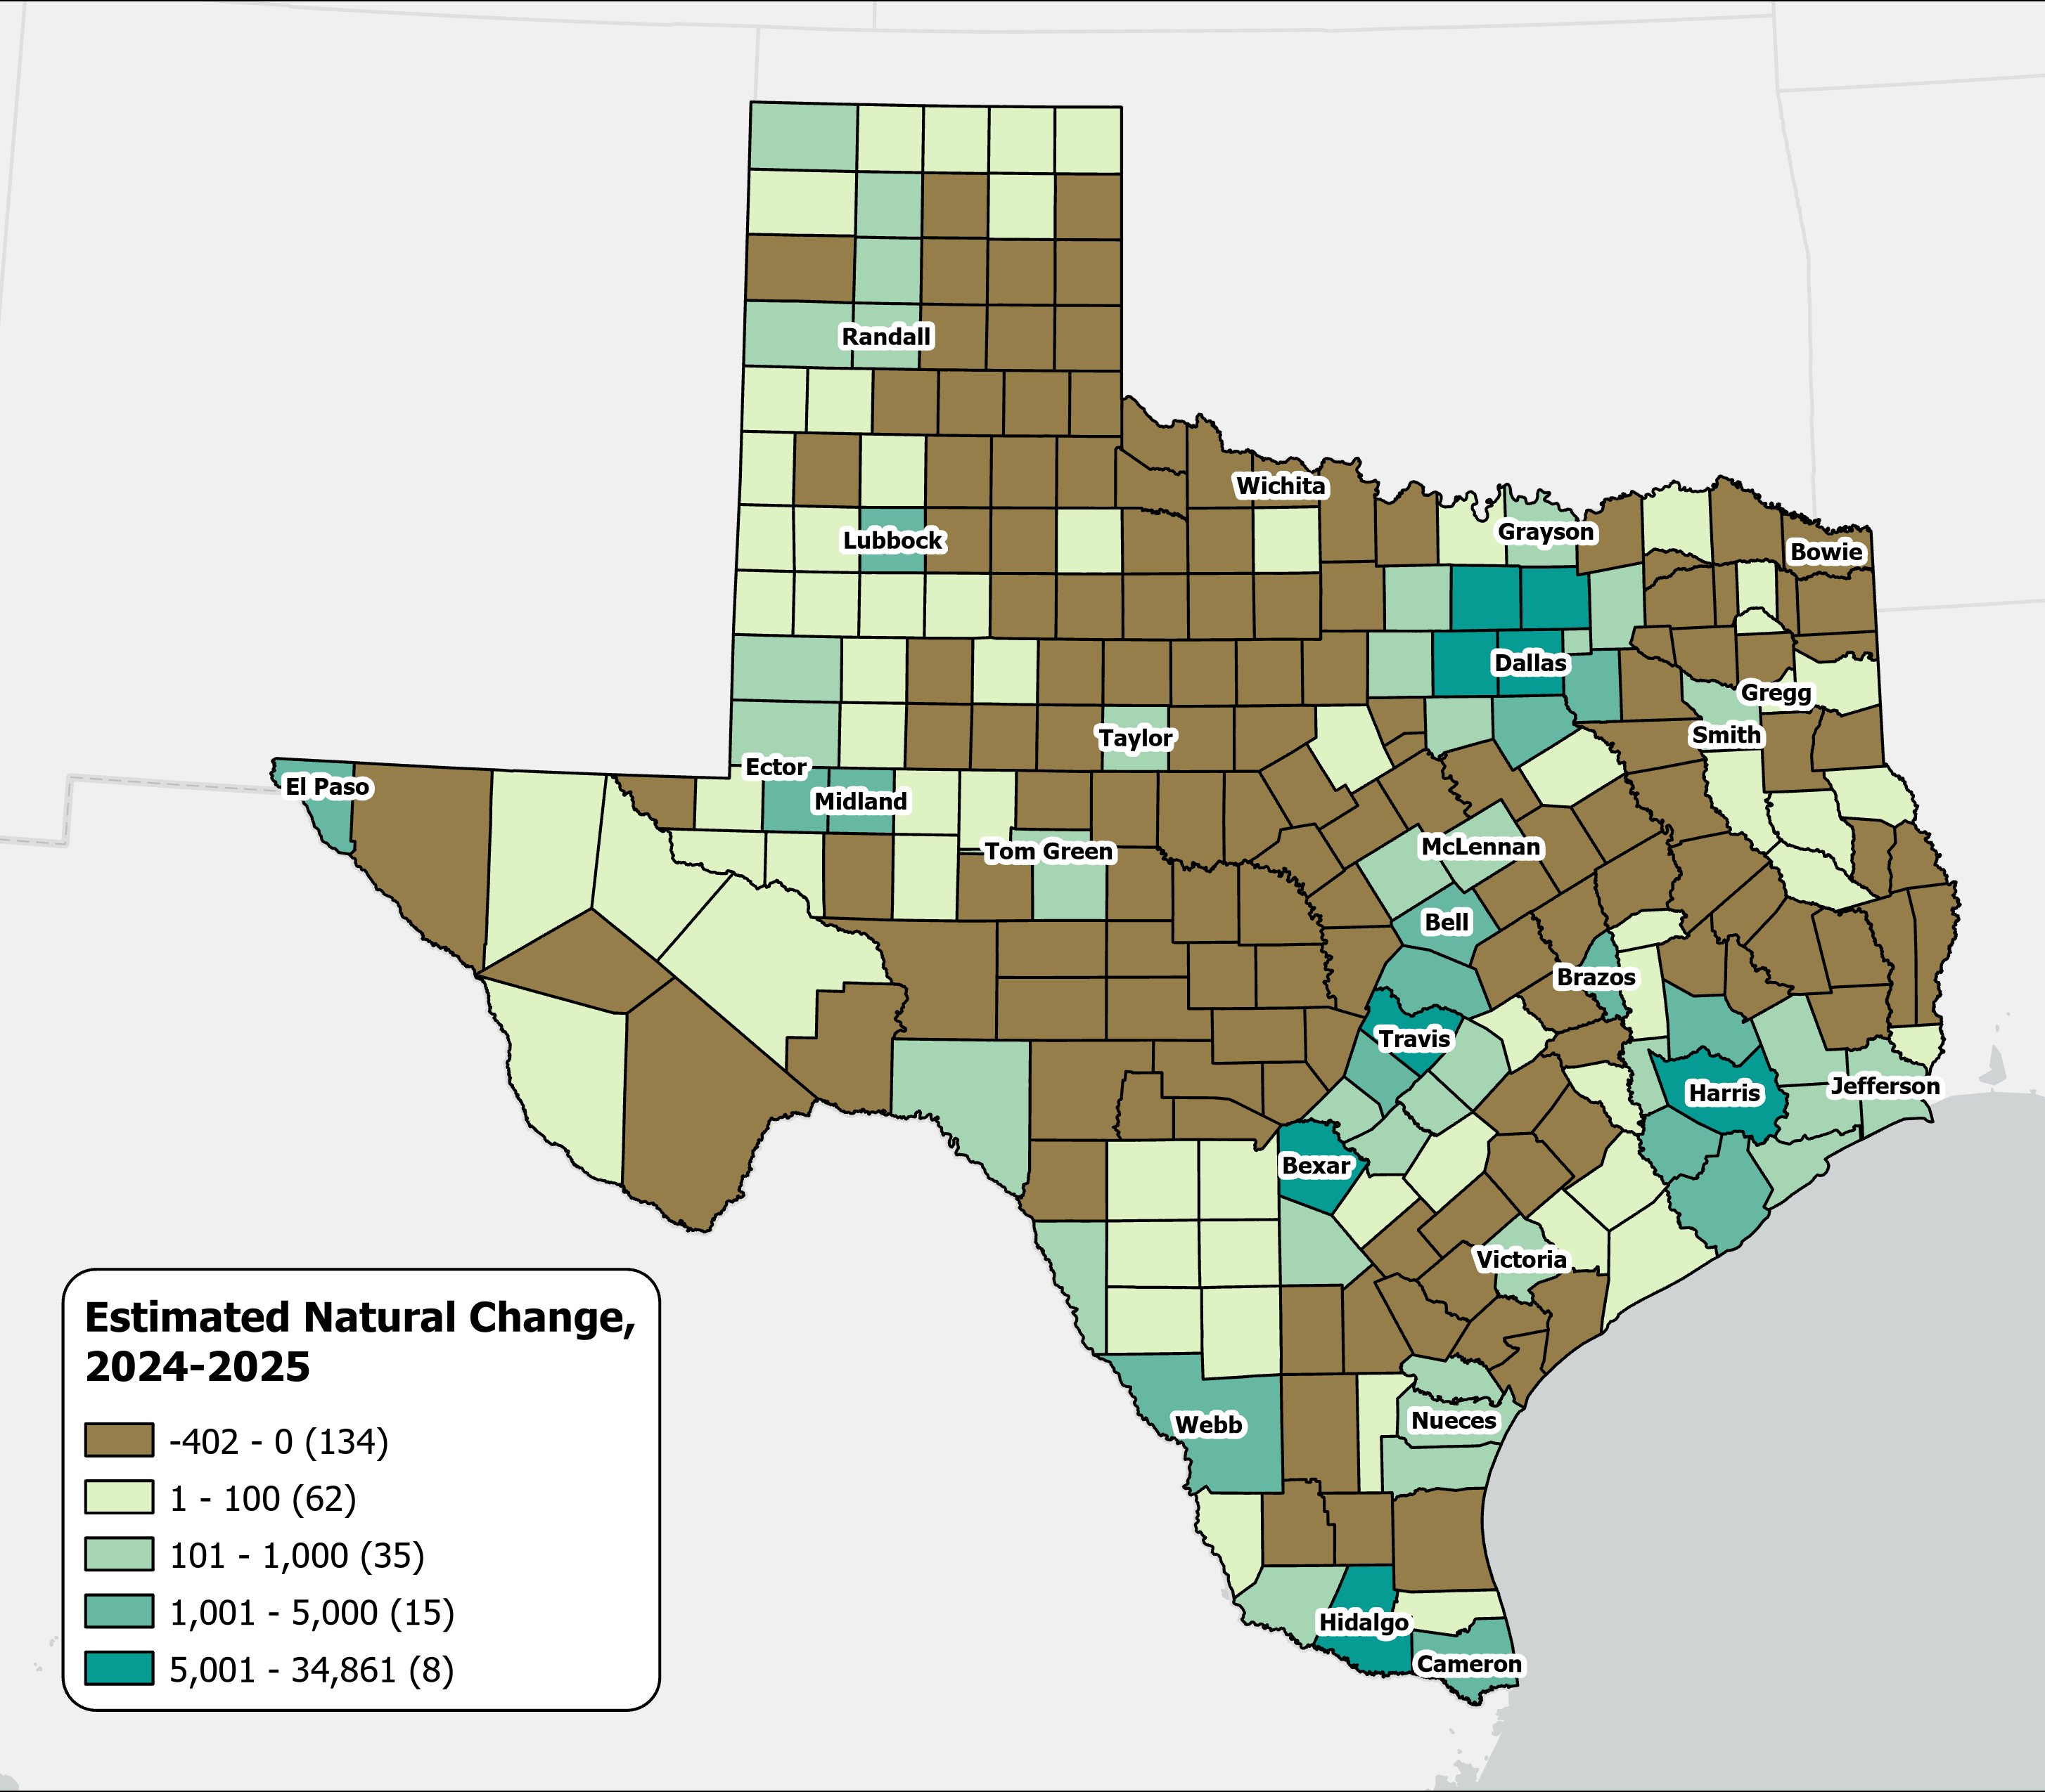
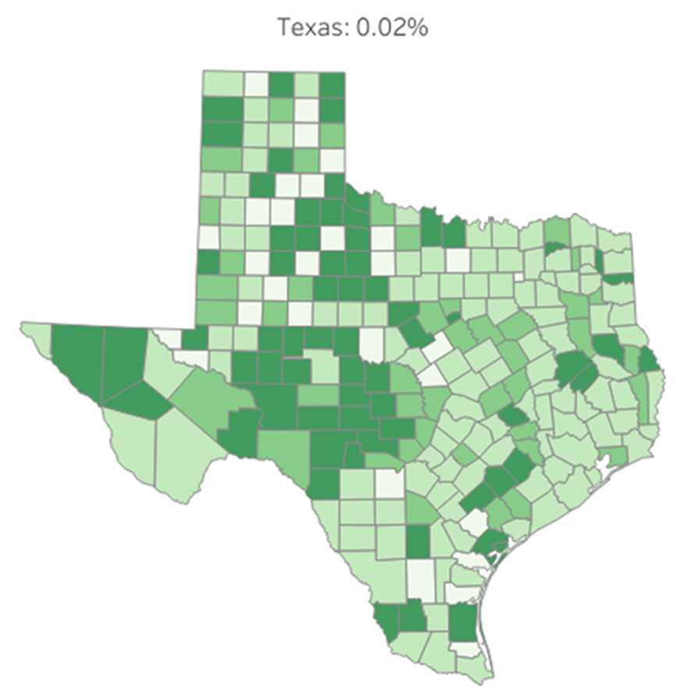
A majority of Texas counties saw more deaths than births
Estimates Natural Change Across Texas Counties
From July 2024 to July 2025
134
Percent Population
counties experienced natural population decline, with most located in rural areas.
0.05 or more
0.03 to 0.04
0.01 to 0.02
Less than 0.01
Source: U.S. Census Bureau, Vintage 2025 Population Estimates

Slide 17
Texas Fertility Rates, 2007-2024
Births per 1,000 women aged 15-44
Source: Centers for Disease Control and Prevention, National Center for Health Statistics. Natality on CDC WONDER Online Database, 2007-2024.

Slide 18
Texas Fertility Rates by Age Group of Mothers, 2009 and 2024
Note: Birth rate is expressed as births per 1,000 women ages 15–44 during the calendar year.
Source: Centers for Disease Control and Prevention, National Center for Health Statistics.

Slide 19
Beyond the Demographics

Slide 20
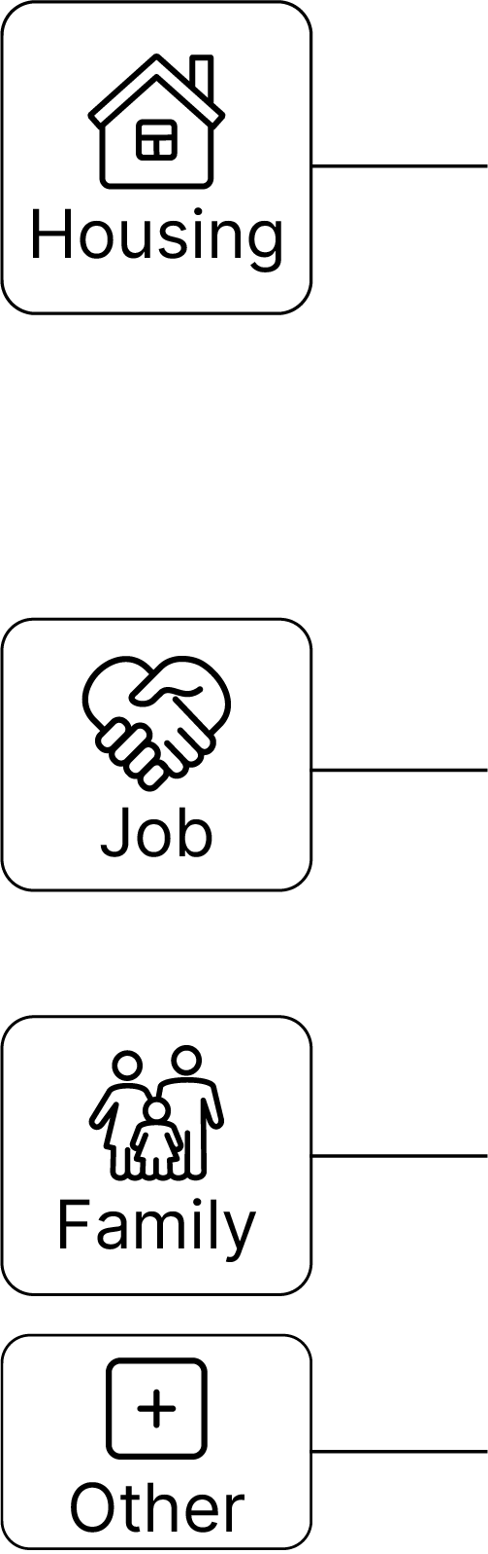
Why T4xans Move, 2022-2023
Between 2024 and 2025, people moved within Texas or from elsewhere to Texas primarily for housing reasons.
Why Texans Move?
Top Detailed Reasons ?
2020
Housing | wanted new or better house/apartment | 14%
Housing | to establish own household | 12%
Job | new job or job transfer | 11%
2025
Job | new job or job transfer | 12%
Housing | wanted new or better house/apartment | 11%
Housing | cheaper housing | 11%
Source: U.S. Census Bureau, Current Population Survey Annual Social and Economic Supplement (ASEC) Supplement (March 2023).

Slide 21

Median Household Income and Home Value Gap Widens in Texas, 2013-2023
Housing costs outpace income for many Texans
Median
Home
Value
Median
Household
Income
$
$
$
Source: U.S. Census Bureau, American Community Survey, 1-Year, 2013, 2018, and 2023.
Note: Data represented in 2023 inflation-adjusted dollars.
Notes:
The median household income has not kept up with the cost of housing in TX. Population growth, rising costs for building materials, and labor shortages have affected the supply of homes and increased their cost, making it difficult for many Texans to purchase and own a home.

Slide 22
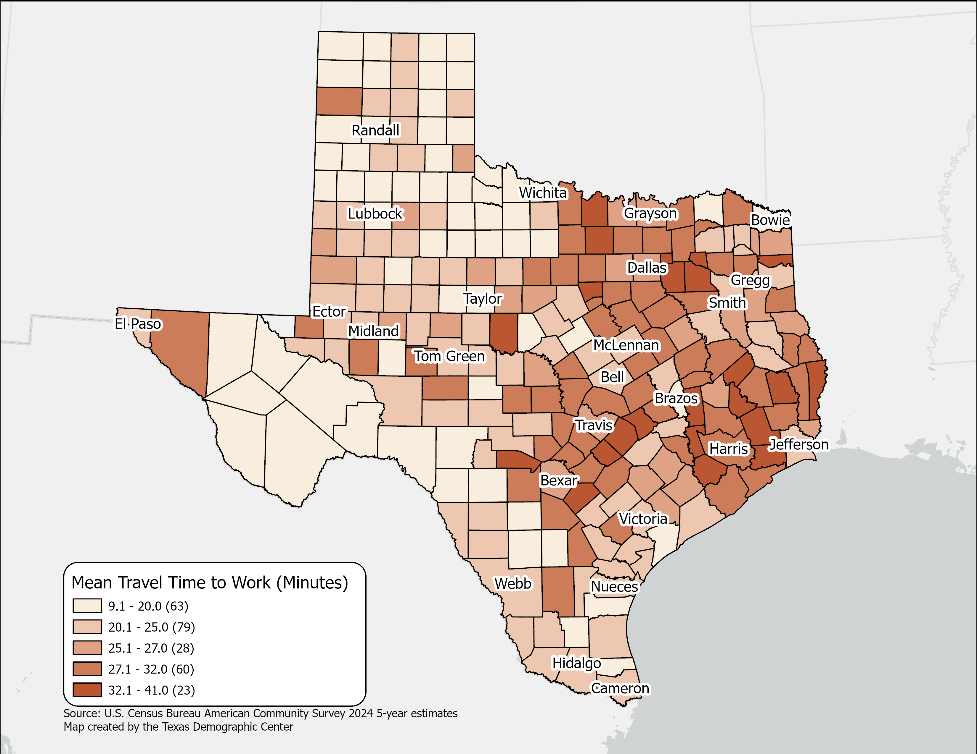
Mean Travel Time to Work(minutes),
Texas Counties, 2024
Mean Travel time for Texas:
  26.7 (2024 5-year)
  25.2 (2014 5-year)
Geographic variation across Texas counties reflects higher travel times in large metropolitan and suburban areas.
Source: U.S. Census Bureau, American Community Survey, 2024 5-year estimates

Slide 23
Estimated Municipal Water Usage, 1980-2020
Source: https://www.twdb.texas.gov/waterplanning/waterusesurvey/estimates/index.asp

Slide 24
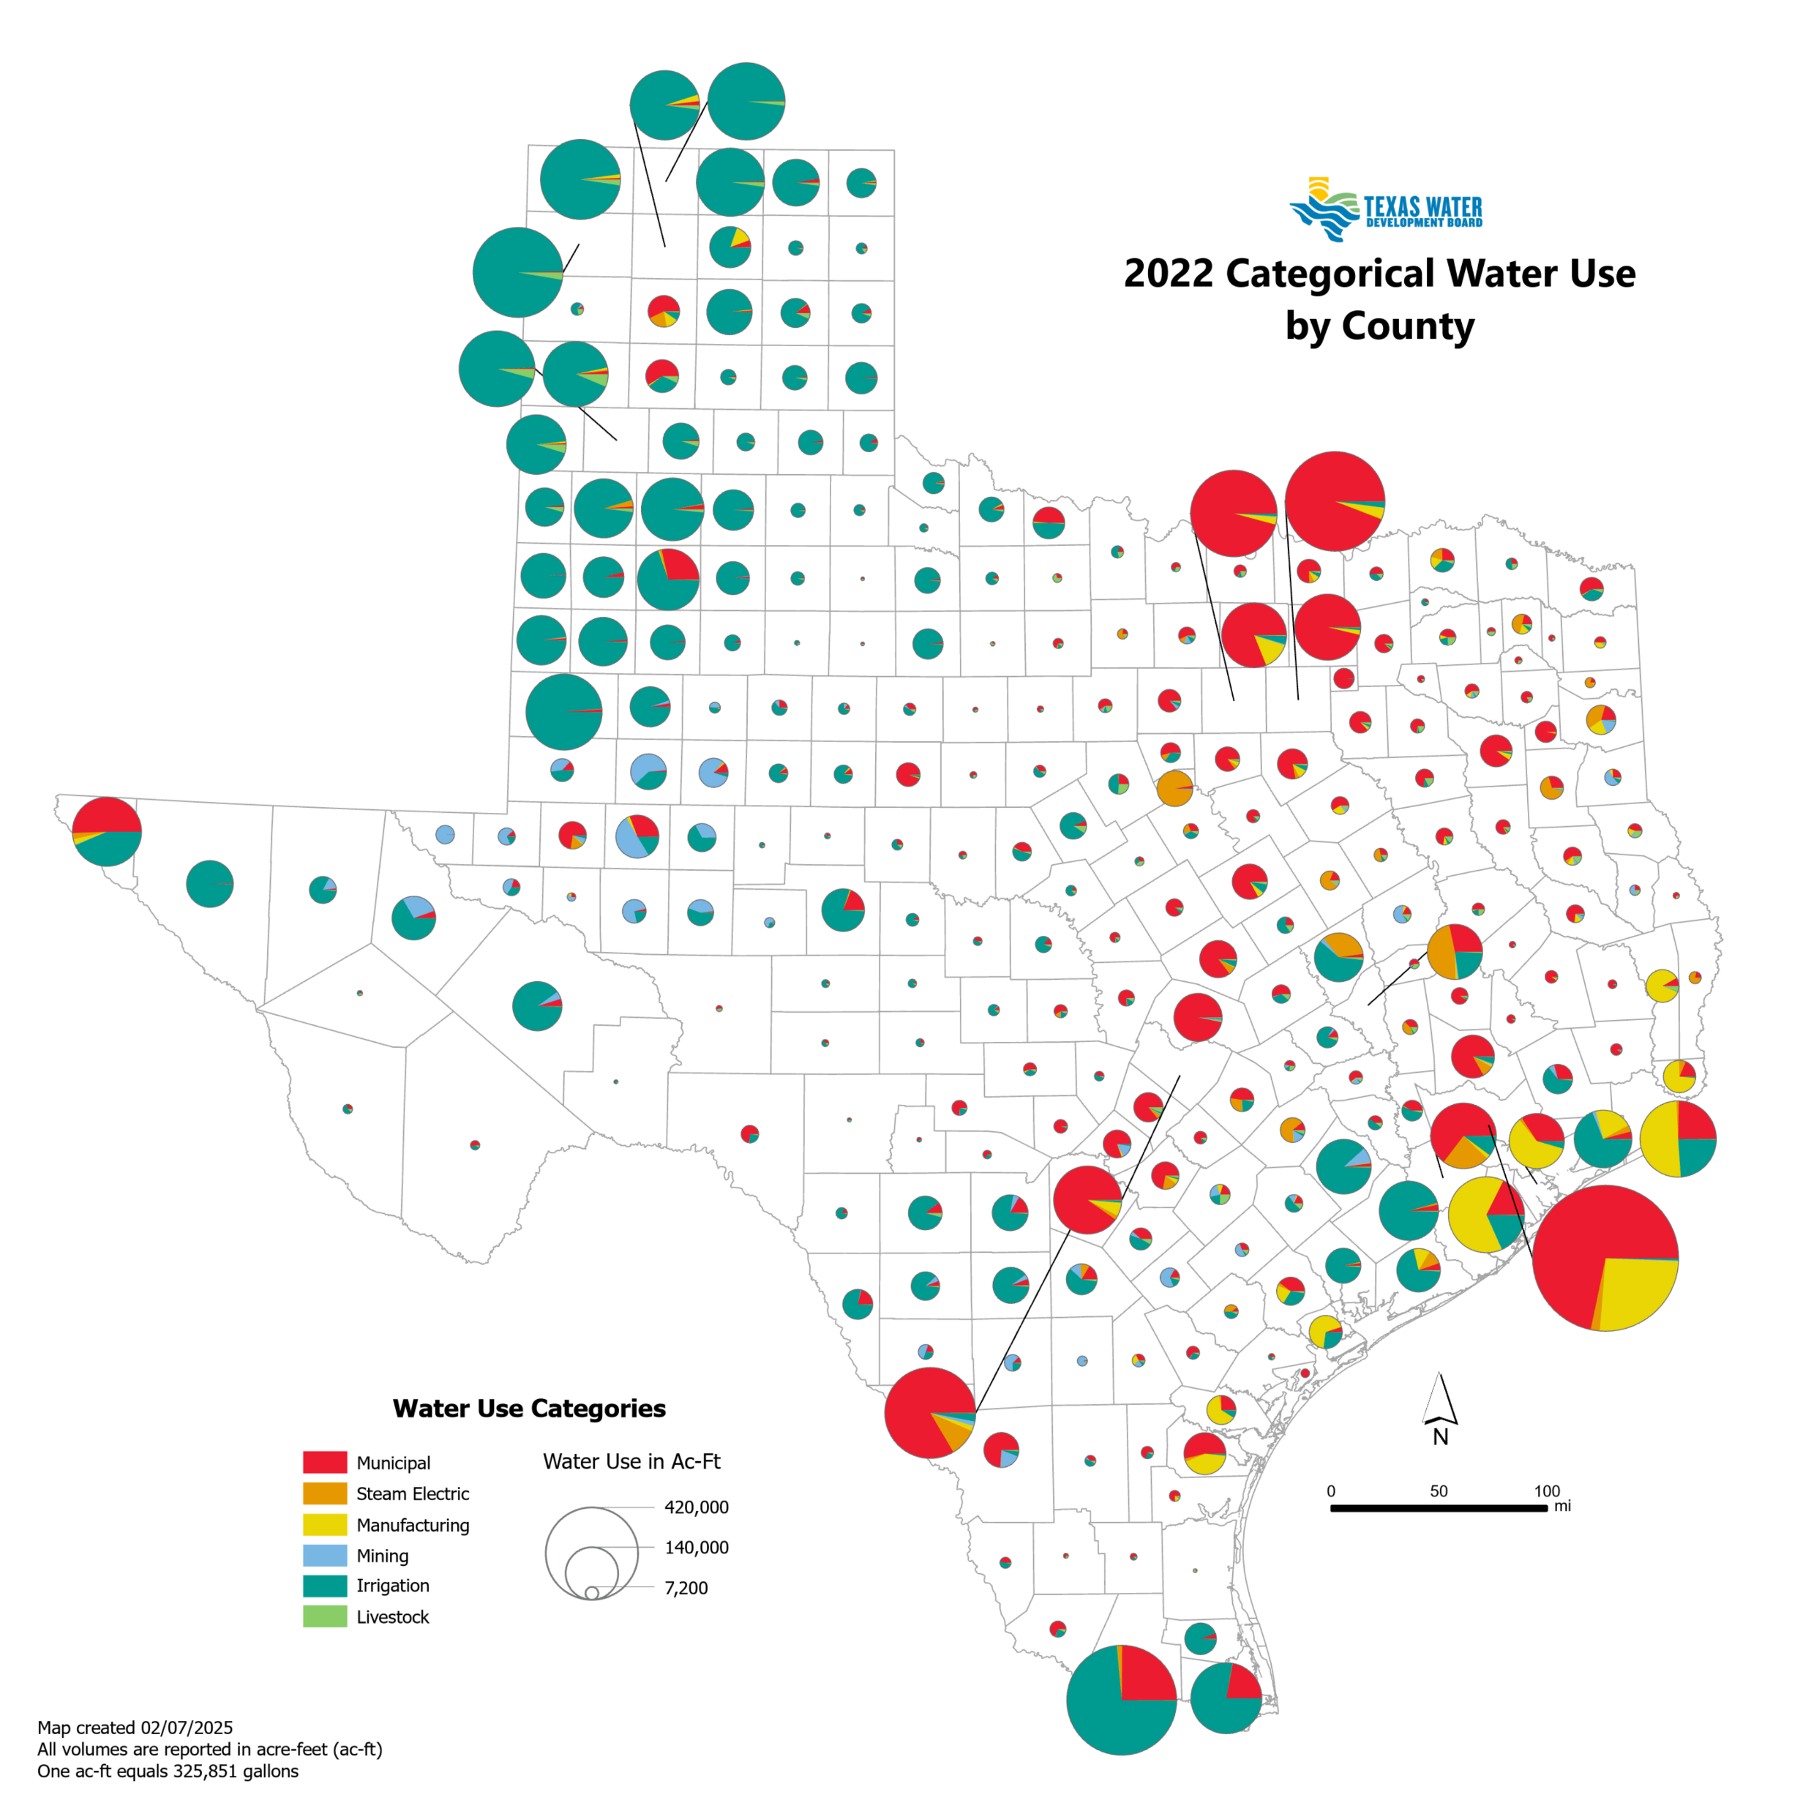
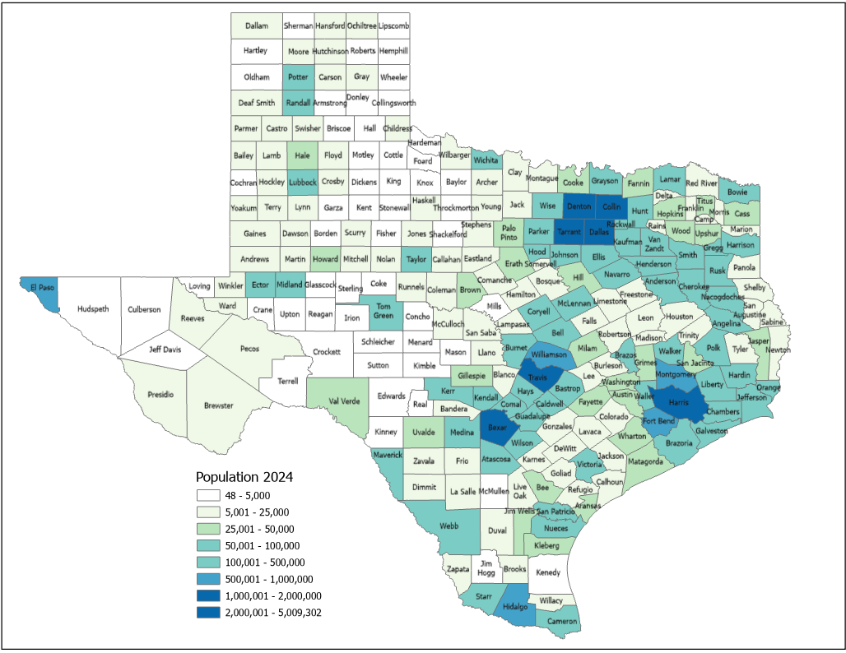
Water Use and Population
Estimated Population, Texas Counties, 2024
Source: Texas Water Development Board. Texas Water Use Summary for 2022; U.S. Census Bureau, Vintage 2024 Population Estimates.

Slide 25
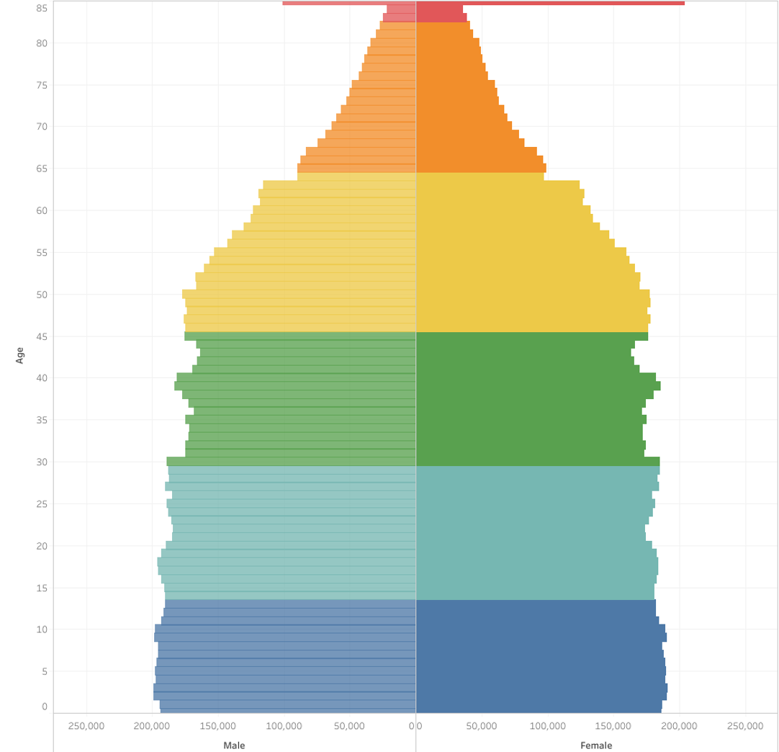
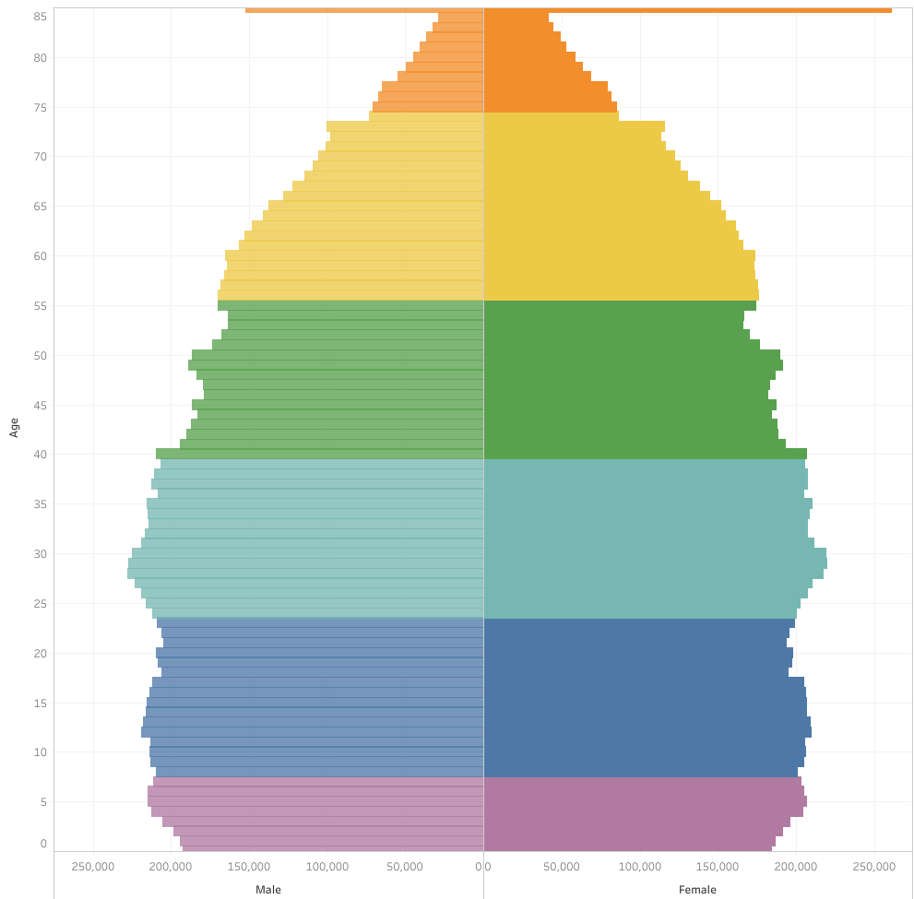
Generational Population Pyramids, Texas, 2010 and 2020
2010
2020
Generation
Greatest Generation (1901-1927)
Silent Generation (1928-1945)
Baby Boomers (1946-1964)
Generation X (1965-1980)
Millennials (1981-1996)
Generation Z (1997-2012)
Generation Alpha (2013-)
Source: U.S. Census Bureau. 2010 and 2020 Vintage Population Estimates

Slide 26
Public School Enrollment by Grade in Texas, 2014 and 2024
Source: U.S. Census Bureau. American Community Survey 1-Year sample, 2014 and 2024
Notes:
Graph: Grouped bar chart of public school enrollment by grade band, 2014 vs. 2024.
Data: Nursery/Preschool: 295K to 300K. Kindergarten: 383K to 372K. Grades 1–4: 1.51M to 1.54M. Grades 5–8: 1.49M to 1.57M. Grades 9–12: 1.44M to 1.68M.
Key Takeaway: Public school growth was concentrated in upper grades (9–12), while kindergarten actually declined—signaling the impact of smaller birth cohorts on enrollment.

Slide 27
Private School Enrollment by Grade in Texas, 2014 and 2024
% Private School
2014: 9.0%
2024: 11.7%
Source: U.S. Census Bureau. American Community Survey 1-Year sample, 2014 and 2024
Notes:
Graph: Grouped bar chart of private school enrollment by grade band, 2014 vs. 2024.
Data: Nursery/Preschool: 154K to 167K. Kindergarten: 34K to 55K. Grades 1–4: 111K to 166K. Grades 5–8: 111K to 180K. Grades 9–12: 98K to 157K. Private school share: 9.0% (2014) to 11.7% (2024).
Key Takeaway: Though still accounting for a small share of all enrollment, private school’s share increased from 9.0% to 11.7%, outpacing the growth of public school enrollment.

Slide 28
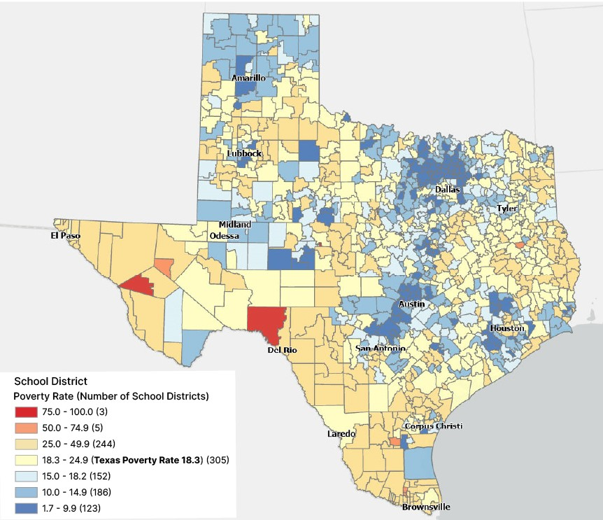
Poverty Rate for School Age Children (5-17) Living in Families, by School Districts in Texas, 2022
Many central city school districts have higher poverty rates
In Texas, nearly
1 in 5
school-age children in families live in poverty.
Source: U.S. Census Bureau, Small Area Income and Poverty Estimates (SAIPE) for 2022.

Slide 29
Labor force participation among older Texans in on the rise
Labor Force Participation Among 65+ Population, 2010 - 2024
Source: U.S. Census Bureau, American Community Survey 1-Year Estimates, 2010 and 2024

Slide 30

Disability Rate by Age in Texas, 2022
Hispanics disability rates increase faster in older age groups
Source: U.S. Census Bureau, 2022 American Community Survey 1-Year, Public Use Microdata Sample (PUMS)

Slide 31
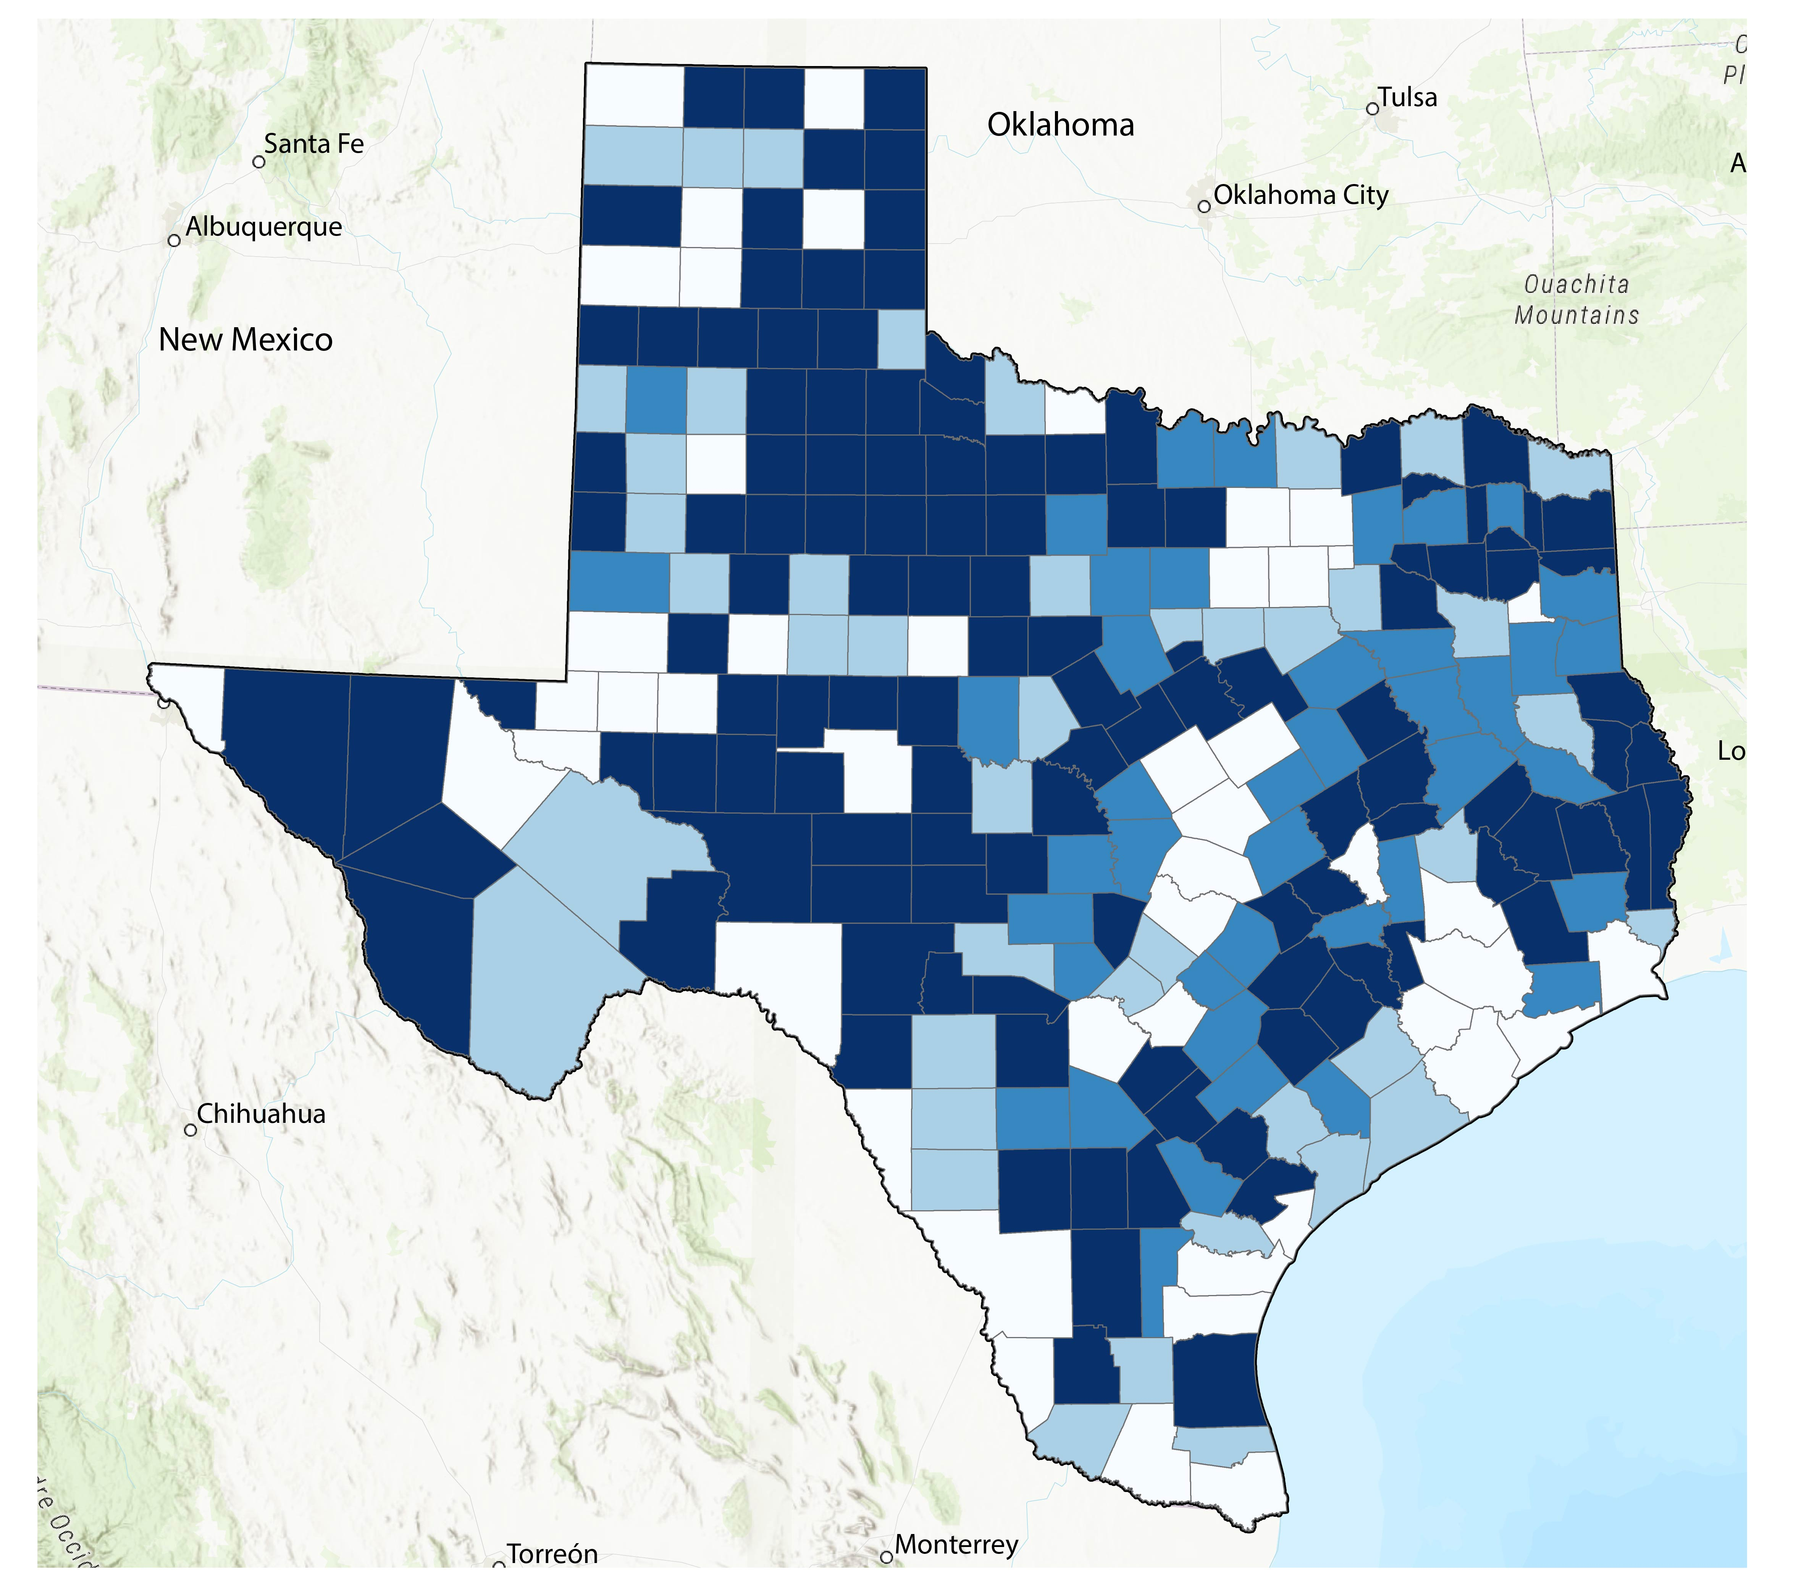
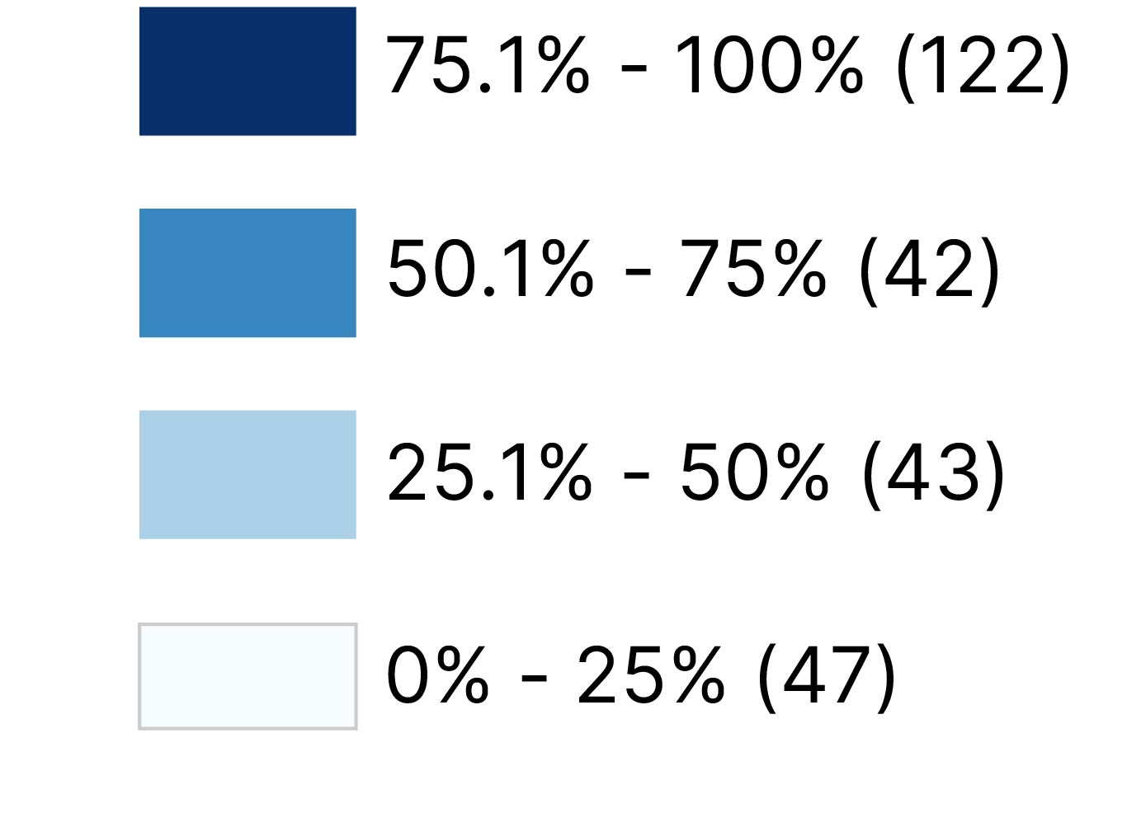
Texas is home to the largest rural population in the U.S.
Percent of Rural Population by County
4,744,808 or 16%
of Texans live outside the urban areas defined by the Census Bureau.
Source: U.S. Census Bureau, 2020 Decennial Census Demographic and Housing Characteristics (DHC) File

Slide 32
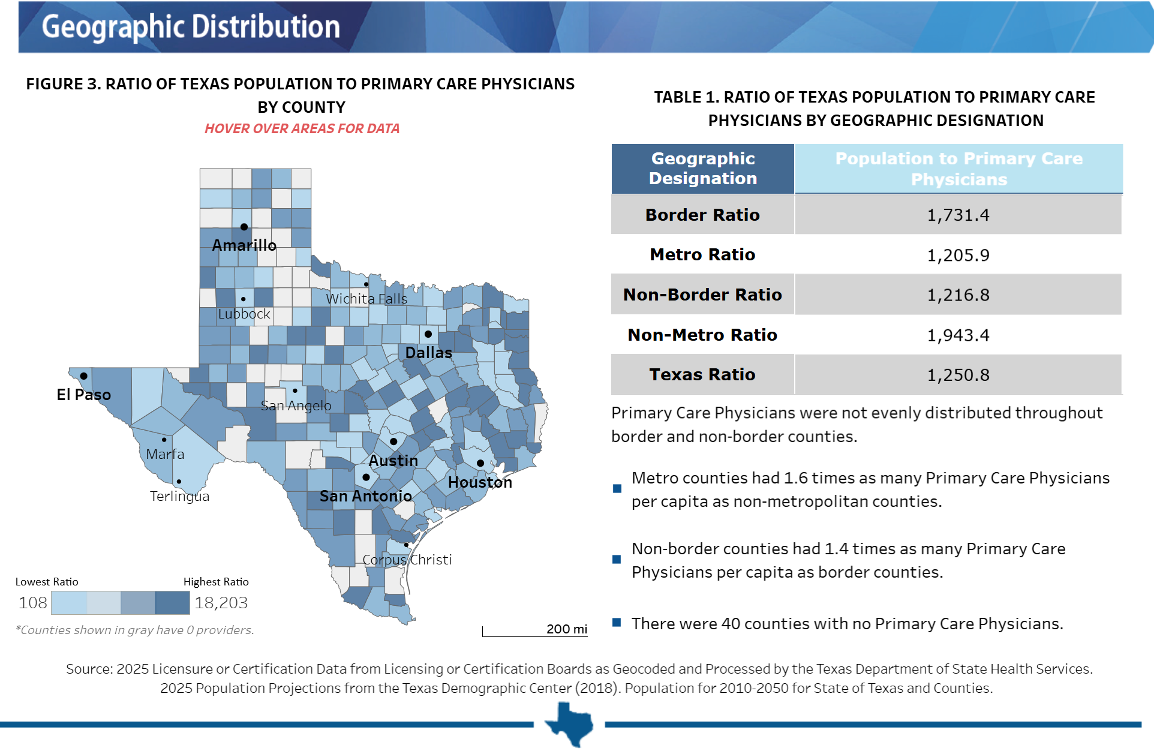
Primary Care Geographic Distribution in Texas, 2025
Source: Texas Department of State Health Services. https://healthdata.dshs.texas.gov/dashboard/health-care-workforce/hprc/health-profession-fact-sheets

Slide 33
Looking into the Future

Slide 34
Texas is expected to keep growing significantly.
Projected Population Growth in Texas with Various Migration Scenarios
42.6 million
in 2060.
(Mid-migration Scenario)
Source: Texas Demographic Center, Vintage 2024 Population Projections
Notes:
Caption: From July 2024 to July 2025, Texas saw its lowest level of domestic migration in more than a decade. The suburban and exurban edges of the Texas metropolitan triangle experienced the strongest net in‑migration, while central‑city counties and West Texas saw net out‑migration.

Slide 35
Projected Population by Race/Ethnicity
2020-2060
Mid Migration Scenario
All race/ethnic groups are projected to grow in size except for the non-Hispanic White.
Hispanics will gain the most population, while NH Asians will experience the fastest growth
Source: Texas Demographic Center, Vintage 2024 Population Projections, Mid Migration Scenario

Slide 36
Projected Population by Age
2020, 2040, and 2060
Mid Migration Scenario
22%
18%
Texas will continue to age in the next few decades.
The 65+ group will grow fastest.
Growth among those under 18 will slow and begin to decline.
The working-age population will grow and maintain a stable share of the total population.
13%
60%
60%
62%
Total Population
29.1M
37.1M
42.6M
Source: Texas Demographic Center, Vintage 2024 Population Projections, Mid Migration Scenario

Slide 37
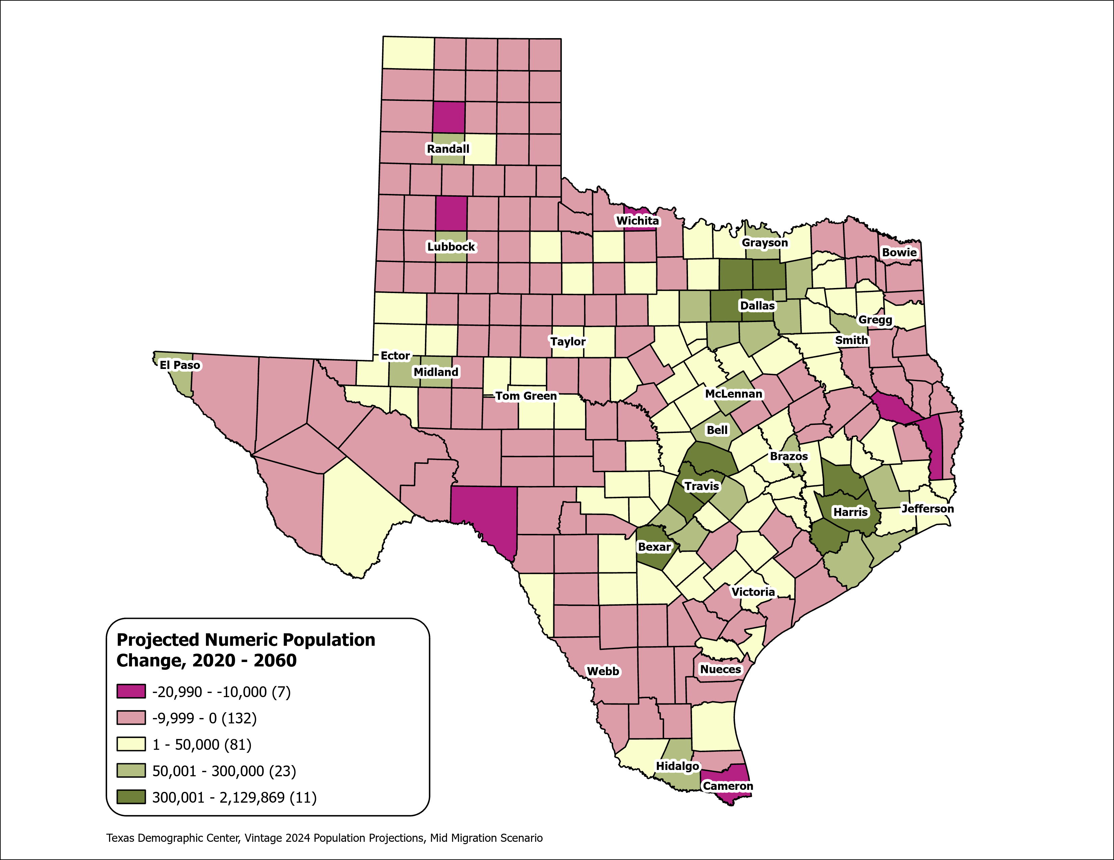
Texas Counties
Projected Population Numeric Change 2020-2060
Mid Migration Scenario
139 Counties are projected to lose population
Current MSA counties will account for 99% of the state’s growth from 2020 to 2060
The four MSAs within the TX Triangle will increase their share of population from 67% to 74%
Source: Texas Demographic Center, Vintage 2024 Population Projections, Mid Migration Scenario

Slide 38
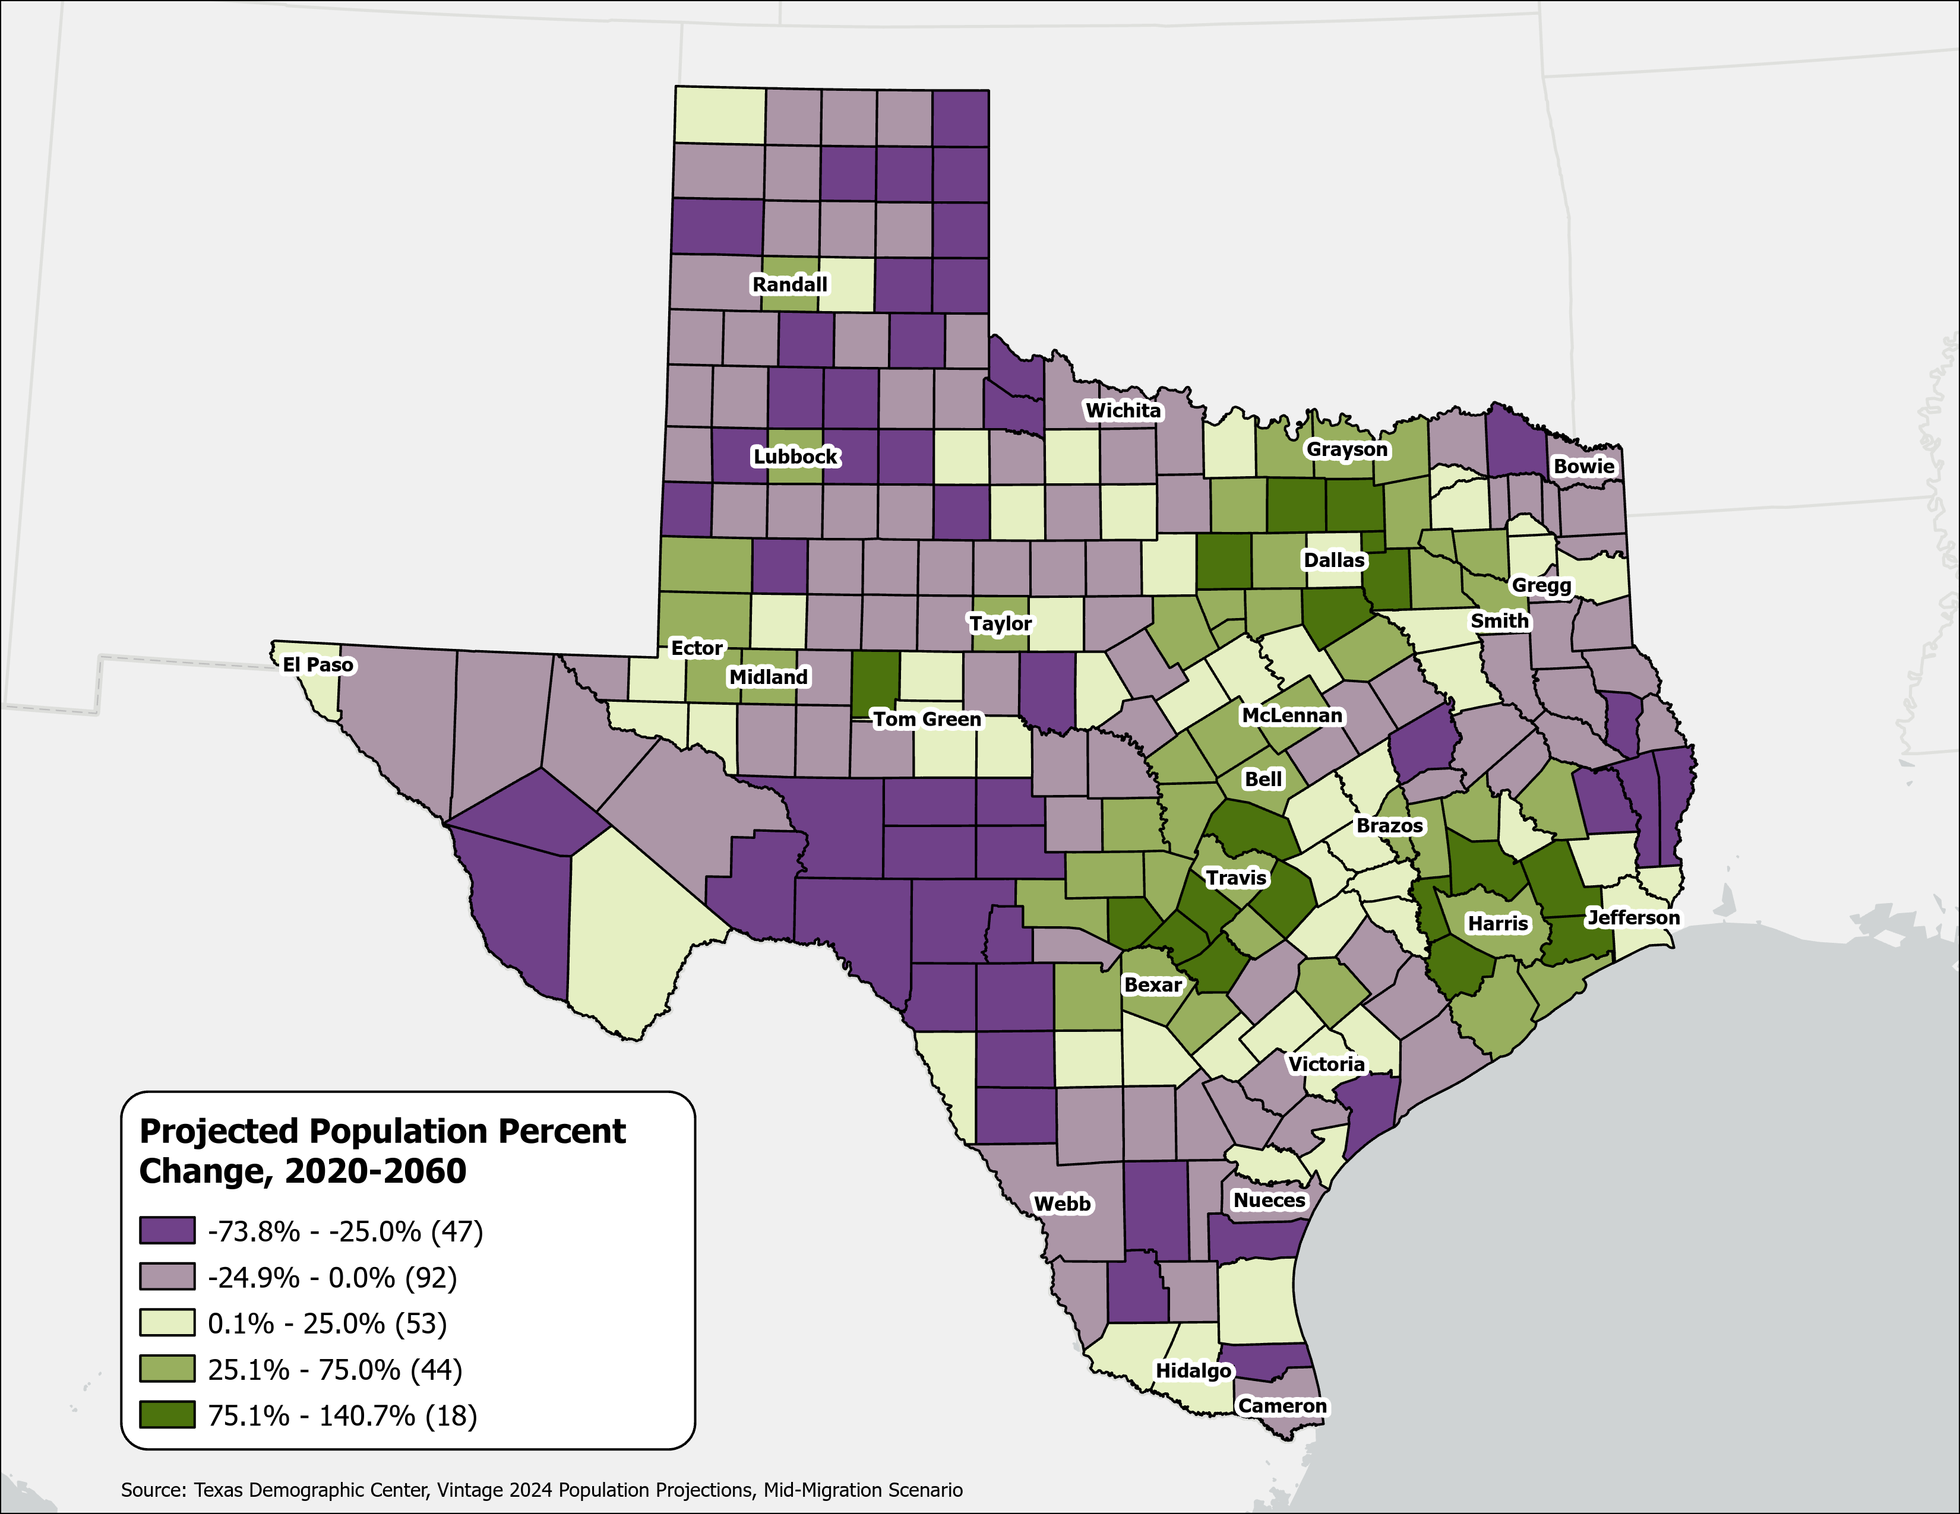
Texas Counties
Projected Population Percent Change 2020-2060
Mid Migration Scenario
Suburban ring counties in the triangle area will see the fastest growth rates.
Source: Texas Demographic Center, Vintage 2024 Population Projections, Mid Migration Scenario

Slide 39
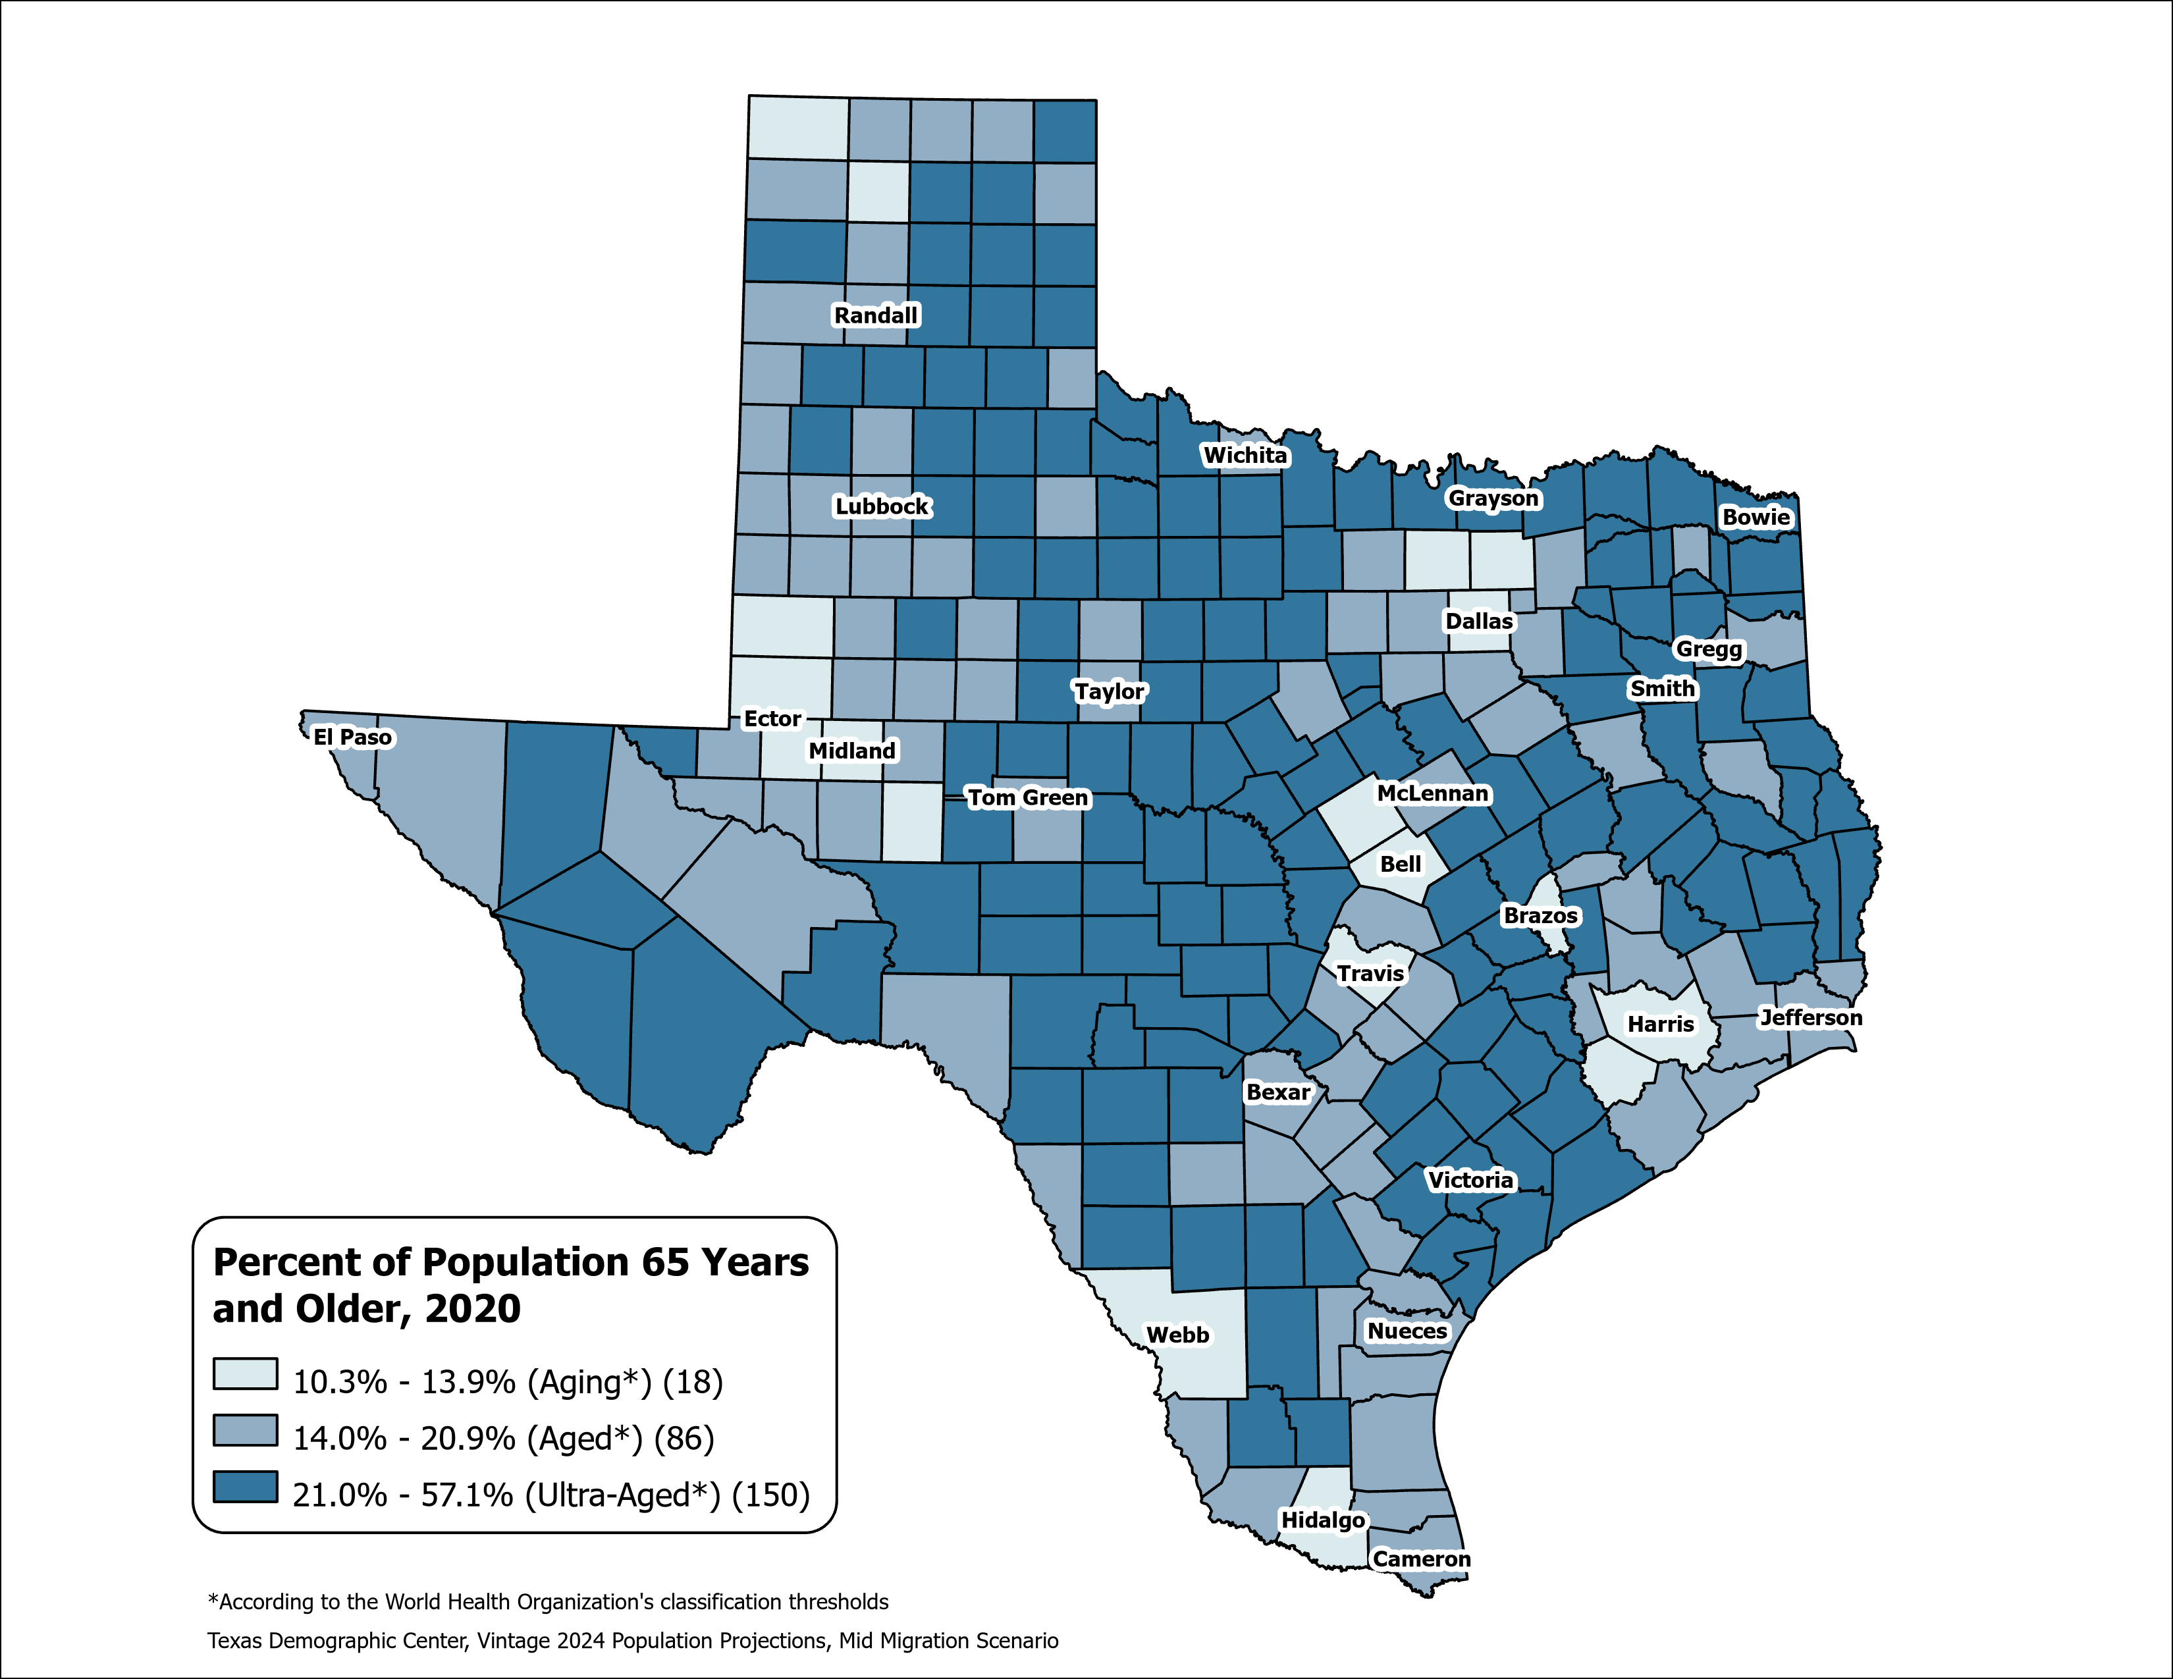
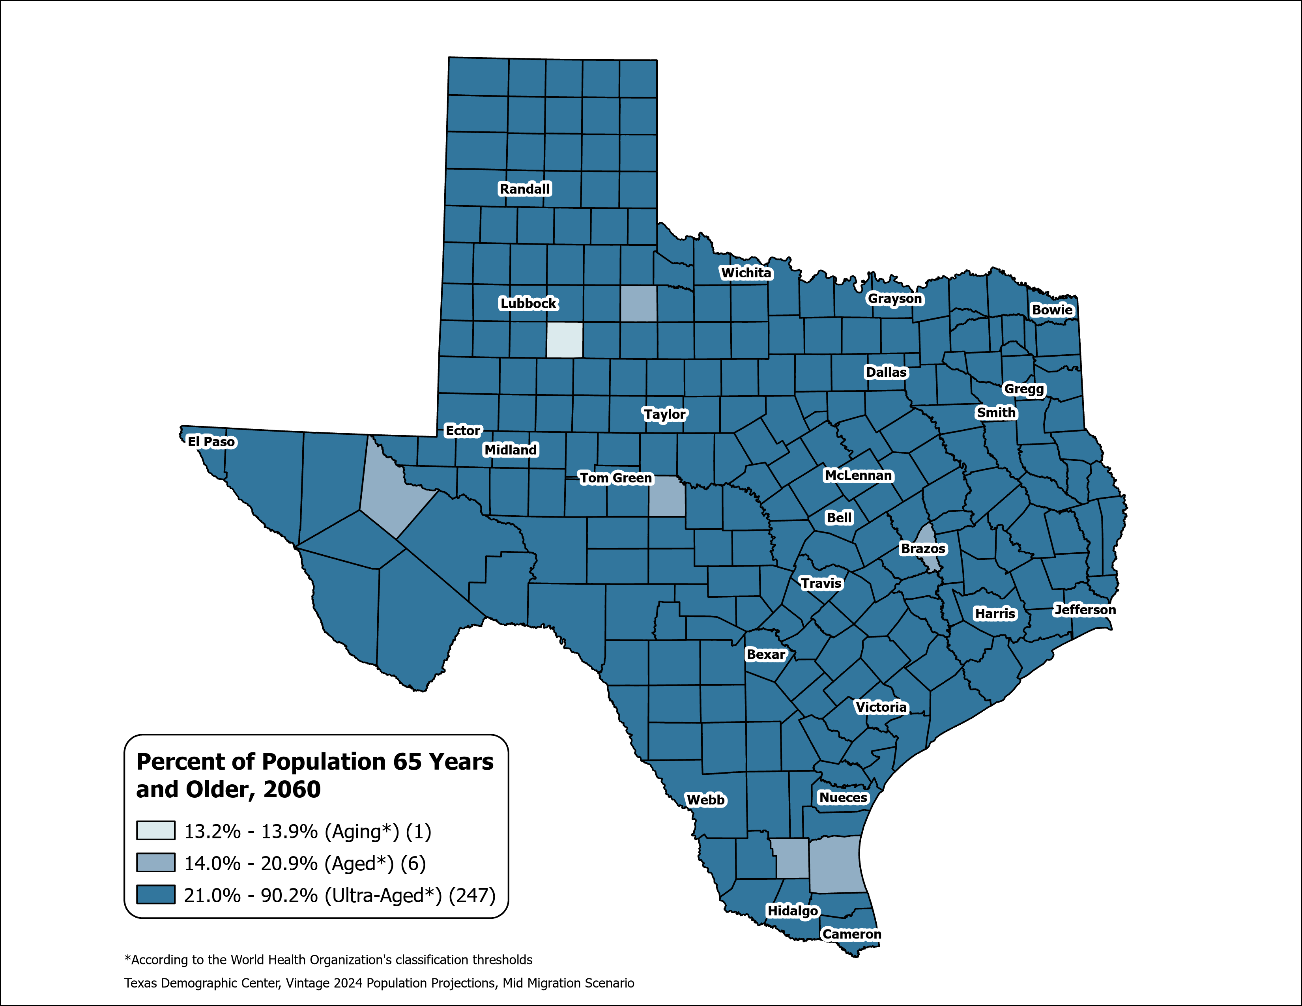
County Aging Map – Using the % of 65+ to Measure
Texas 2020: Aging (13.5%)
Texas 2060: Ultra-Aged (21.7%)
Source: Texas Demographic Center, Vintage 2024 Population Projections, Mid-Migration Scenario

Slide 40

Data at Work: Connecting People, Places, and Possibilities
Key Takeaways from Texas Demographic Data
Trends
Slower growth nationwide
Growth concentrated in the suburban and exurban areas of the Texas Triangle
Rural counties losing population and aging
Domestic migration at its lowest in a decade; natural increase now 40% of growth
Fertility rates declining; baby boomers driving rapid aging
Challenges
Growing pains: rising housing prices, water shortages, longer commutes…
Housing costs outpacing income, straining homeownership
Potential decline in school enrollment and labor force shortages
Healthcare workforce shortages in rural and border regions
Opportunities
The population is expected to reach 42.6 million by 2060, alongside ongoing economic expansion.
Increasing labor force participation among Texans aged 65 and older.
Suburban counties are set to receive significant infrastructure investments.
​
Utilizing data-driven planning to effectively support water management, housing, transportation, education, and healthcare is essential for ensuring Texas's future prosperity

Slide 41


Slide 42
About Presenter
Helen You, Ph.D.
(210) 458-6530
tdc@utsa.edu
demographics.texas.gov/

