Slide 1



From Insight to Action: How the Texas Workforce Commission is Reimagining Labor Market Data

Slide 2

What Is It?
Center for Regional Economic Competitiveness (CREC) – LMI Institute and Projections Managing Partnership (PMP)
Participants – State LMI offices & data users wanting to improve collaboration and communication
LMI offices and board team members met throughout program timeline to discuss how to improve understanding
CREC provided direction and consultation with visualization expert

Slide 3
Goals
Data Discovery: Determine the data needs of key workforce system stakeholders
Data Development: Close data gaps identified during discovery via a report, tool, or other medium.
Data Deployment: Develop and provide training resources for dashboard as well as LMI overall.
Notes:
Data Discovery – Determine needs of workforce stakeholders – board staff, EDCs, K-12. What questions are being asked? What data is available? Any knowledge gaps? What reports are workforce members using?
Data Development – Identify how to close data gaps via a report, dashboard, or some other tool. Texas chose to develop a dashboard as well as continue to improve and address outreach and training.
Data Deployment – develop dashboard for release and continue to address support through outreach and training.

Slide 4


Survey
Created an online survey to determine customer knowledge & interests
Made up of TWC staff, board team members and their contacts
Results guided development of dashboard
Wishlist
Notes:
Data used frequently, a majority respondents use LMI data weekly (57%)
Nearly tied between using data for short-term requests and special projects like business retention
In order of usage
CES (tied)
LAUS (tied)
OEWS
QCEW
Projections
Respondents wanted to see trends, comparisons, and changes over time

Slide 5
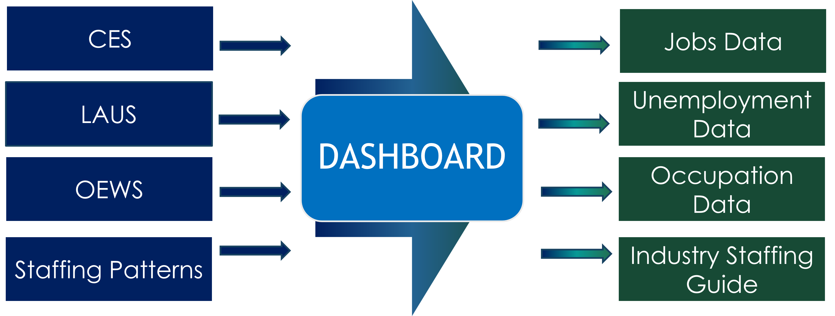
Newest Dashboard
Integrated CES, LAUS, OEWS views
Simple, intuitive charts and maps
Outcome: Self-service insights for boards

Slide 6
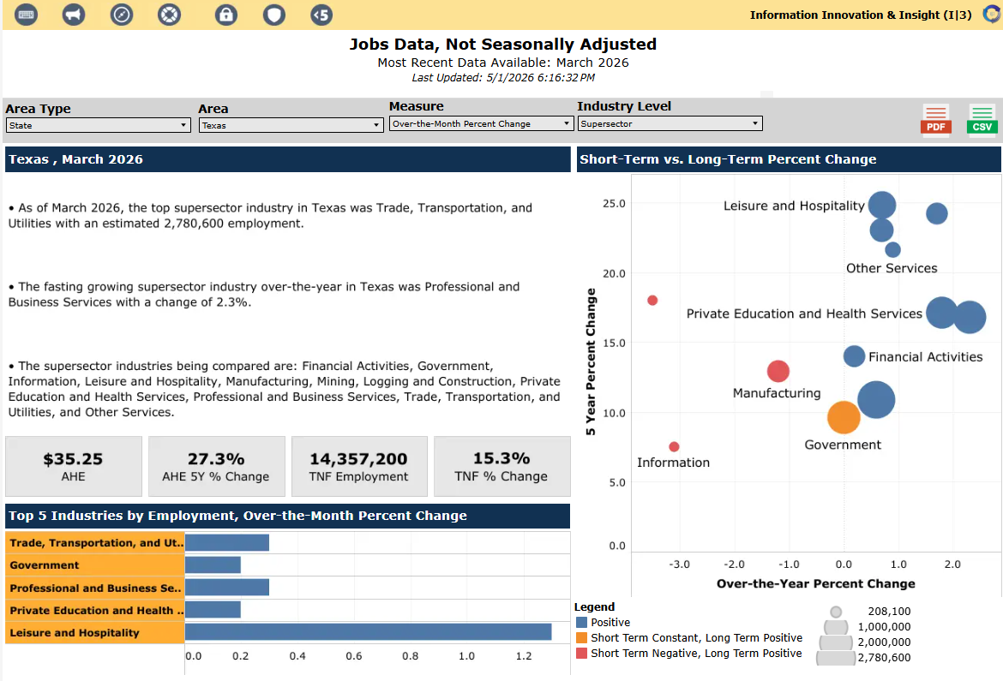

Key Features
Visuals & Functionality
    Over-the-Month/Year Change
    Custom Month/Year Change
    Drill through Geographic Areas
    Easy Data Drill Down or Up
    Time Series
    Data Comparisons at Different LOD
New Features
    Location Quotient Data
    Wage Differentials
    Employment Calculator
Notes:
Currently working on accessibility and final review to make ready for public release

Slide 7
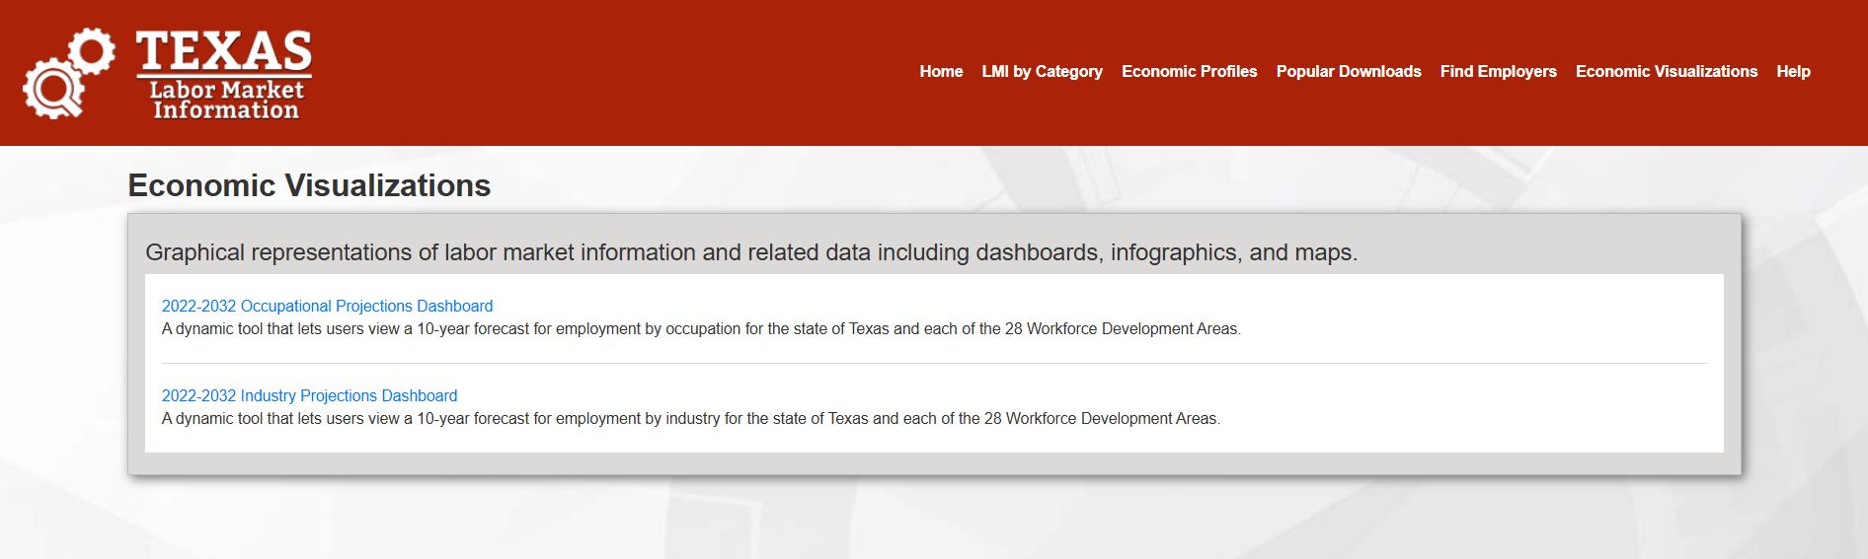
Tableau Visualizations on TexasLMI.com
Landing page is a menu that has a description of each dashboard page
Long-Term Projections and combined LMI data set dashboard available
Link to documentation at top right of menu, providing more details about
the data (including definitions, etc.)
Exportable data to PDF or .csv (Excel) file

Slide 8
Texas Workforce Commission
For more information
Contact: Gabriel Guzman
Call: 512-936-3202
Email: Gabriel.Guzman@twc.texas.gov
Labor Market Information Department

