Slide 1



The State of the Nonprofit Sector in Texas: Trends, Impact & Community Realities
May 21, 2026

Slide 2
Our Goals
Today
Understand the connection between Texas demographic and economic trends and growing community needs
Gain a clearer picture of financial hardship across Texas households through ALICE data
Recognize the size, scope, and economic impact of Texas’ nonprofit sector through Built for Texas data
Leave with actionable insights to help inform local strategies, community planning, & cross-sector collaboration
Notes:
Welcome & Opening (5 minutes) - Millicent
Why this session matters for Texas demographics, economy, & community change
Framing ALICE & Built for Texas Data: ALICE highlights household financial hardship and economic conditions (context for need) and Built for Texas → nonprofit sector size, scope, and economic impact (primary focus for Session)
NOTE: How the two datasets connect to tell a fuller story of Texas communities

Slide 3



ALICE IN
TEXAS
2025 Update on Financial Hardship
Notes:
STEPHANIE:
Understanding Financial Hardship in Texas: ALICE Framework/tool (10 minutes) - Stephanie What & why it matters; Key statewide and regional trends in household financial hardship; What ALICE reveals about working families and economic stability
NOTE: ALICE provides context on community need and economic pressure—not the system response

Slide 4
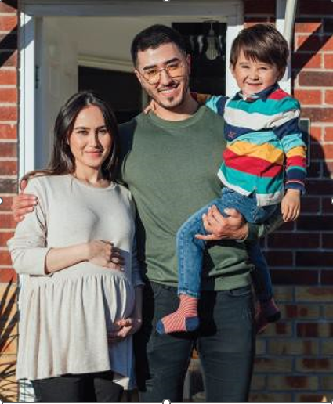
Meet ALICE
Asset Limited, Income Constrained, Employed
ALICE represents the hardworking Texans who earn above the federal poverty level but still struggle to afford the basic household budget like housing, childcare, food, and healthcare.
The ALICE in Texas Report shines a light on these households, providing credible data that helps communities, businesses, and policymakers drive solutions to improve financial stability across the state.
Notes:
STEPHANIE

Slide 5
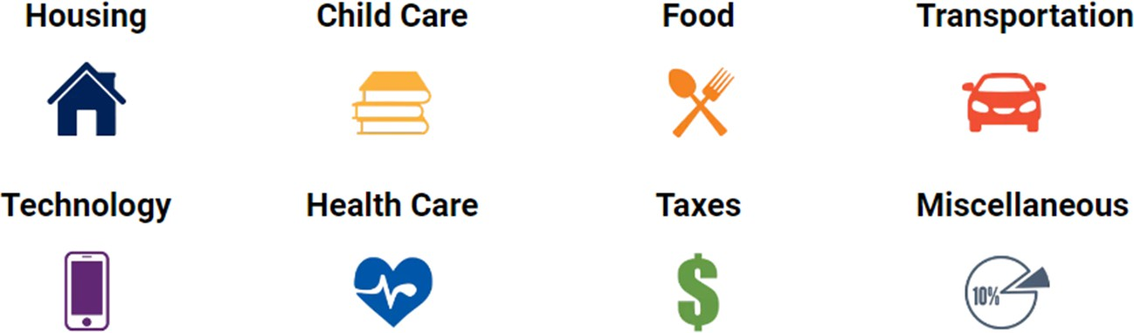
The ALICE Household Survival Budget
Reflects the minimum cost to live and work in the modern economy
Sourced from county-level, public datasets

Slide 6
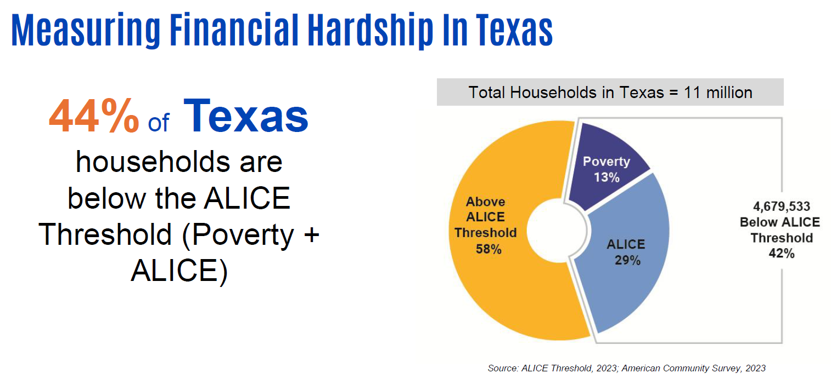

42%

Slide 7

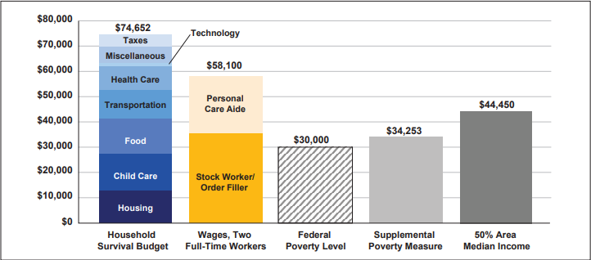
When Paychecks Don’t Add Up
Data Source: United For ALICE® (2025). The State of ALICE in Texas.
Notes:
So why is ALICE, ALICE? There are several factors that impact a household’s ability to afford basics, including systemic barriers in our communities that are keeping ALICE financially trapped, no matter how hard ALICE works. But the crux of the problem is the mismatch between the ever-increasing cost of expenses, and the wages that just aren’t keeping up. To understand this better, we need to look at the ALICE Household Survival Budget for families in our community – that is, the minimum cost of housing, child care, food, transportation, health care, and technology, plus taxes. For a family of four in (State), the Household Survival Budget was $XX,XXX in 2023. But when we combine the full-time wages of two of the most common jobs in the state – a personal care aide and a stock worker/order filler – we see that this family, with both adults working, brought in $XX,XXX – (more than/nearly) $XX,XXX short of the cost of basics.
And when we factor in the Federal Poverty Level, which was $30,000, the dilemma facing countless ALICE families becomes clearer – when the Federal Poverty Level is used to determine eligibility for assistance programs such as SNAP, it’s no wonder there are so many families locked out of the supports that are so desperately needed.

Slide 8

The Demographics of Hardship
Households most likely to struggle financially include:​
African American Households (55%)​
Under 25 years of age (69%)​
Single –Female-Headed Households with children (75%)
*Data reflects ALICE and below
Data Source: United For ALICE® (2025) Texas.
Notes:
Now let's take a closer look at some ALICE demographics. ALICE households span all ages, genders, races, and ethnicities, living in urban, suburban, and rural communities all around the country – and all across our (state/county). But some groups experience hardship at disproportionate rates because of systemic barriers. For example, in 2023, XX% of (race/ethnicity) households in (State/County) fell below the ALICE Threshold.
Others that are more likely to struggle financially than their counterparts include:
(Highest age group[s])
(Highest household composition[s] i.e. single-female-headed)

Slide 9
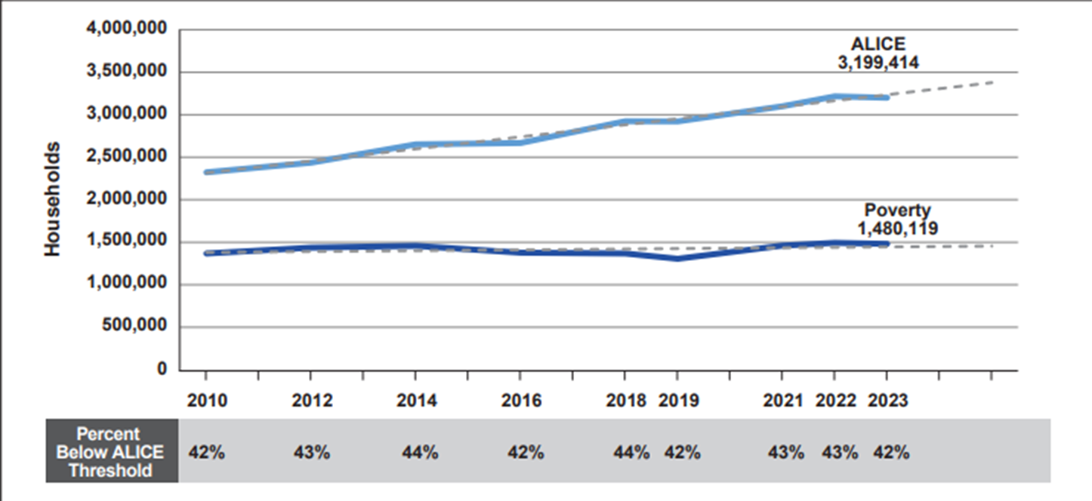
Financial Hardship Over Time
Data Source: United For ALICE® (2025). The State of ALICE in Texas
Notes:
When wages increase at a slower rate than basic expenses, purchasing power takes a hit. This is especially tough for ALICE households, who are already struggling to make ends meet without much assistance to cushion the blow.
How has this played out in the numbers? Over more than a decade, the total number of households statewide (grew by XX%/remained roughly the same/decreased by XX%).
During the same period, the number of households living in poverty in (State/County) (went up by XX%/remained roughly the same/went down by XX%), and the number of ALICE households (grew by XX%/remained roughly the same/decreased by XX%).
More recently, between 2021 and 2023, the percentage of total households struggling below the ALICE Threshold (jumped/dipped) from XX% to XX%.

Slide 10
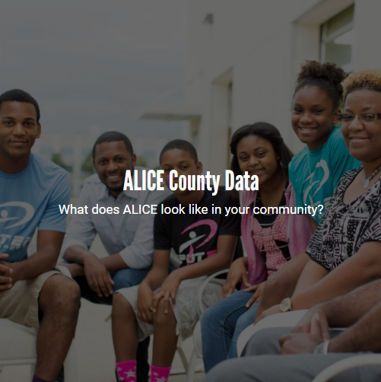
Start with the Data:
Review your ALICE data and identify:
The percentage of households that are ALICE or below
The Household Survival Budget for your county
Key cost drivers like housing, childcare, or transportation
Use this data to help explain why so many working families are still struggling.

Slide 11
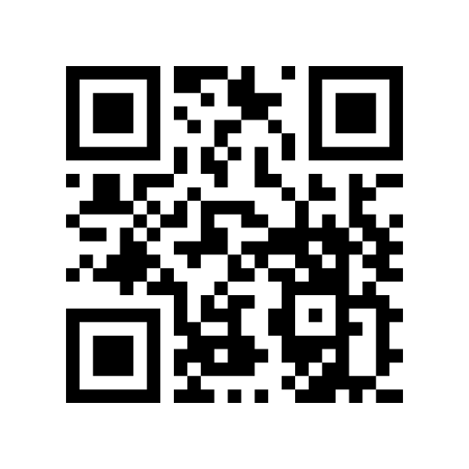

Check Out the Website!
Visit UnitedForALICEtx.org
Our Sponsors
Notes:
Join United Way of (Anytown) as a partner in the ALICE movement. Together, let’s help build ALICE’s path to financial stability.
Visit UnitedForALICE.org to dig into the data for (State/County). Use the research to drive change within your sphere of influence, and share your findings with your peers to build awareness and spark change in even larger circles.
(Donate to [insert local initiative])
(Volunteer at [insert opportunity])
(Speak Out alongside us for [insert advocacy point])
And if you know of an ALICE worker or family who would be willing to share their experiences and help amplify ALICE's voice, please encourage them to submit an audio recording at ALICEvoices.org.

Slide 12
Why the Nonprofit Sector Matters
Nonprofits are caring for communities while many of their own workers face economic insecurity
22% of nonprofit workers fall below the ALICE Threshold
Nearly 1 in 3 nonprofit workers providing social services are struggling financially themselves
Financial hardship within the nonprofit workforce is not equal across all groups
  35% of Black nonprofit workers fall below the ALICE Threshold
  34% of Hispanic nonprofit workers fall below the ALICE Threshold
Notes:
STEPHANIE: Why the Nonprofit Sector Matters (Transition for Built for Texas) (5 minutes) – Stephanie ALSO Workforce trends and staffing challenges
ALICE highlights the scale of household financial strain & That strain shows up as increased demand on community systems
Increased financial hardship drives greater demand for nonprofit and community services
Nonprofits are often the first place families turn for support and stability
Many nonprofit employees are also experiencing financial insecurity and ALICE-related challenges
Nonprofits are both a critical community support system and a major part of Texas’ workforce and economy
ALICE data highlights the growing number of Texas households struggling to afford basic needs despite working
Increased financial hardship drives greater demand for nonprofit and community services
Nonprofits are often the first place families turn for support and stability
Many nonprofit employees are also experiencing financial insecurity and ALICE-related challenges
Independent Sector research highlights workforce stress, burnout, and compensation challenges across the nonprofit sector
Nonprofits are both a critical community support system and a major part of Texas’ workforce and economy
Built for Texas helps quantify the sector’s size, workforce, and economic impact across the state

Slide 13
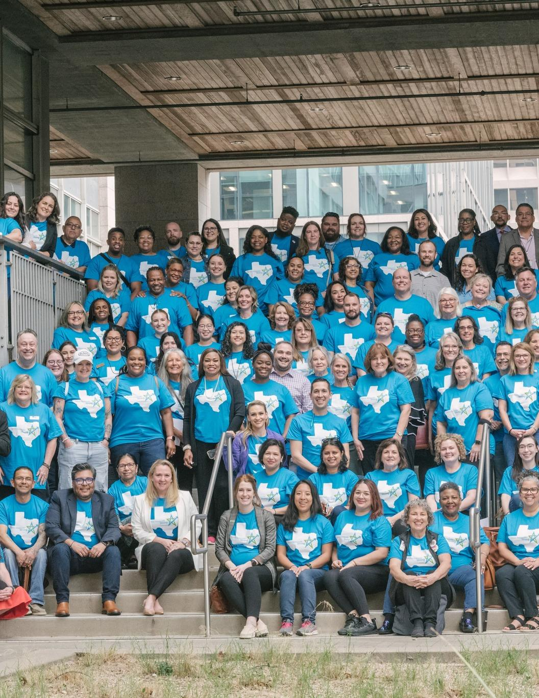


State of the Texas
Nonprofit Sector
Notes:
MILLICENT

Slide 14

Built For Texas
Texas Nonprofit Strong was created in 2020 when United Ways of Texas and OneStar joined forces to amplify voice of the Texas nonprofit sector, highlighting its contributions to local communities, its importance to the state's economy, and its vital role in civil society.
POWERED BY:
RESEARCH CONDUCTED BY
Notes:
Millicent: background and introduction
Ashley to provide any additional details and goals for these convenings and conversations #1 Empower nonprofit leaders with data on their sector to stand for their missions (and community)​; #2 Activate nonprofit voices on sector-wide advocacy – we’re all in this together for the good of those we serve​.
For today, we ask:
conversations move beyond each of our individual missions/activities/issues, to the nonprofit sector as a whole (what unites us and what we have in common)​ In other words, breaking silos that exist between us on issues, territory, funding, etc…​
Nonprofits naturally fall in to the “scarcity mindset,” but it’s time to let that go!
Together, as a sector & WITH THIS DATA, we have a lot of power, influence, and expertise that decision-makers can benefit from.

Slide 15
Nonprofit Sector Impact
About 10 million nonprofits worldwide.
1.9 million nonprofits in the U.S.
  Includes public charities, private foundations, chambers of commerce, fraternal organizations, and civic leagues.
Over $1.5 trillion contributed by nonprofits to the economy in 2024, comprising 5% of GDP.
Nonprofits employ 9% of the workforce (14 million people).
Nonprofits are the most trusted sector in America (57%).
75.7 million volunteers donating ~ 5 billion hours.
  Source: Health of the US Nonprofit Sector, 2025 | Independent Sector
Notes:
Exempt from registrations – certain types of nonprofits such as religious organizations and those with low revenue
1 in 11 people

Slide 16
Texas Nonprofit Sector Overview
130,000 nonprofits in Texas.
A typical nonprofit is very young with limited resources.
Texas nonprofits employ ~7% of the workforce (1 million people).
Nonprofits contribute more than 100 billion to the Texas economy.
6.5 million volunteers, 440.5 million hours, 1. *
  Source: Volunteering and Civic Life in America, 2024 | AmeriCorps.gov
Notes:
Millicent – first to provide overview of NONPROFIT sector in Texas (not just 2023 update data) to set the context & framing for challenges.

Slide 17
What Types of Organizations
Make Up the Sector?
105,898 Public Charities (35% growth)
6,379 Private Foundations (1.5% growth)
21,873 501 “other” Organizations (3% decrease)

Slide 18
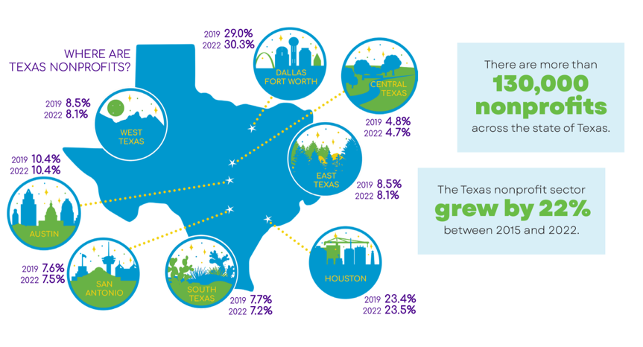
Where are Nonprofits Located?
Notes:
Millicent: Our size and geographic differences are one thing that make Texas unique. It is important understand both where Texas nonprofits are located and regional distribution of revenue. From the data we know that there are regional differences and varying concentrations of resources.​
Texas’ nonprofit sector is continuing to grow, with over 134,000 organizations in 2022
8 regions for the report
DFW: 30.3%
Houston: 23.5%
Austin: 10.4% (14,002 nonprofits))
San Antonio: 7.5%
South: 7.2%
West: 8.1%
East: 8.1%
Central: 4.7% (6.303 nonprofits)
Over ½ of all organizations are located in 30 counties of Texas’s 254 counties (DFW and Houston)
Almost ½ of all Texas private foundations are located in the DFW region (16 counties)
72% of all nonprofits are located in our “major city groups” which lines up with the proportion of the population
Austin region has 14,002 nonprofits (2022)
Central region

Slide 19
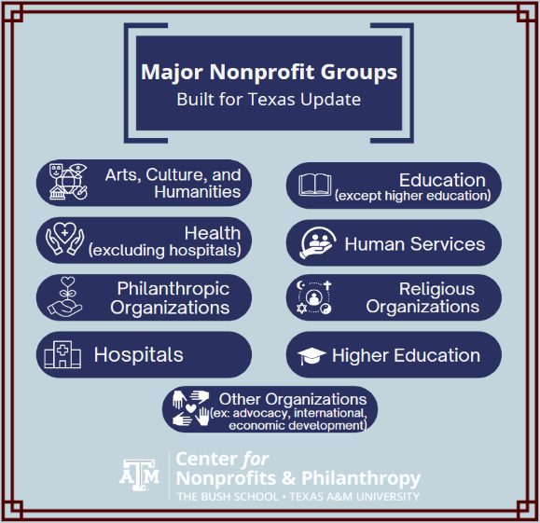
What Do Nonprofits Focus On?
Notes:
Largest: Religion with 27,299 public charities, 400 “other”, and 171 private foundations filing 990s (and that’s not all of them!)
Smallest: Higher Education with 293 public charities
The sector’s reach is wide representing a diversity of organizations who represent a cross of all industries. HOWEVER, Texas nonprofits unite around a common purpose: advance the common good for Texans.
Also,

Slide 20
Nonprofits by Focus Area
Percent of Nonprofit Organizations (all 501 types) by subsector)
Organization Type | 2015 | 2016 | 2017 | 2018 | 2019 | 2020 | 2021 | 2022
Arts, Culture, and Humanities | 17.7% | 18.0% | 18.2% | 18.1% | 16.1% | 15.8% | 15.1% | 14.7%
Education (except higher ed) | 24.9% | 24.3% | 23.9% | 23.7% | 22.1% | 21.9% | 21.3% | 20.8%
Health (not hospitals) | 4.9% | 5.8% | 5.7% | 5.7% | 5.7% | 5.5% | 5.5% | 5.4%
Human Services | 18.4% | 18.4% | 18.5% | 18.3% | 21.3% | 21.7% | 22.2% | 22.2%
Philanthropic Organizations | 5.3% | 5.3% | 5.3% | 5.2% | 5.3% | 5.3% | 5.2% | 6.1%
Religious Organizations | 21.7% | 21.0% | 21.3% | 21.8% | 20.7% | 20.8% | 21.1% | 21.1%
Other organizations | 6.6% | 6.5% | 6.6% | 6.6% | 8.2% | 8.5% | 9.1% | 9.2%
Higher Education | 0.2% | 0.2% | 0.2% | 0.2% | 0.2% | 0.2% | 0.2% | 0.2%
Hospitals | 0.3% | 0.3% | 0.3% | 0.3% | 0.3% | 0.3% | 0.3% | 0.3%
Notes:
Human Service orgs - 29,398
Religious organizations - 27,887
Education (no higher ed) - 27,515
Other orgs, includes (highlight a few below)
Educational Institutions, Environmental, Animal Related Organizations, Recreation and Sports International, Foreign Affairs, and National Security Civil Rights, Social Action & Advocacy Community Improvement, Capacity Building, Science & Technology, Social Science Public Society Benefit Mutual/Membership Benefit Organizations Other/Unknown

Slide 21
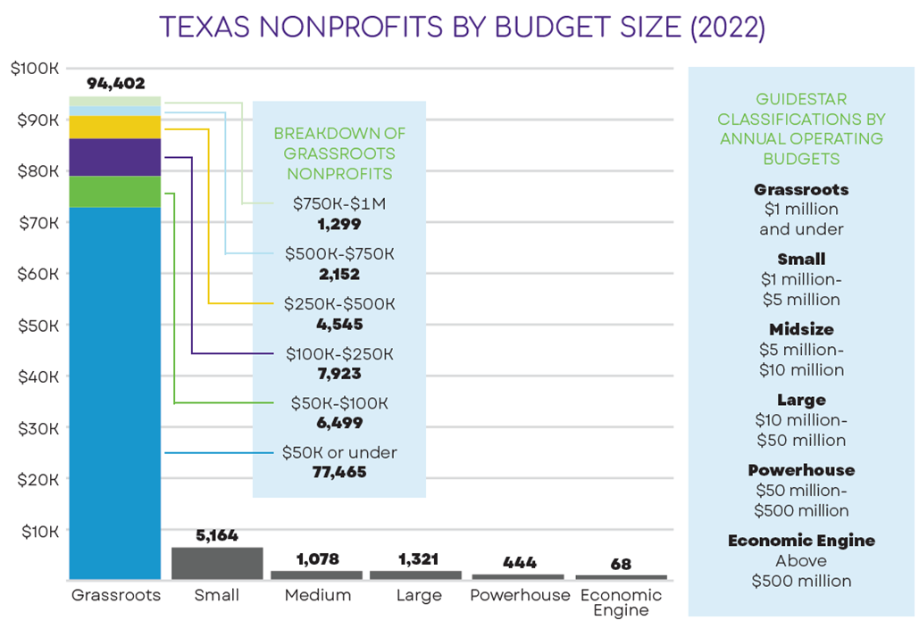
Notes:
Millicent: Houston, of 23K nps in houston, 92% are grassroots
16K nonprofits have budgets under 50K
ManyTexas nonprofits have a budget under $50,000–highlighting that relatively small number of large, complex nonprofits that have the capacity to also manage the complicated processes attached to receiving public dollars–GOVERNMENT CONTRACTS!!.

Slide 22
How Does Age Relate to Budget Size?

Slide 23
Average Age by Region (2022)
Notes:
DFW – 60 years (average age)
Houston - 27
San Antonio - 34
Austin - 55
South - 38
West - 41
East - 40
Central – 40
For the state, the average age is 44.

Slide 24
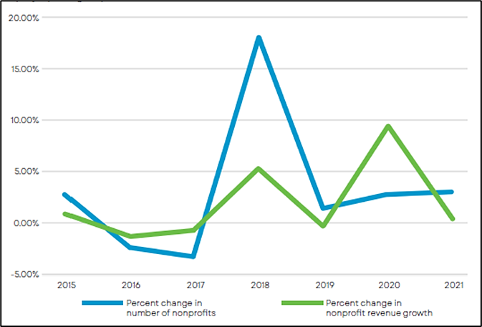
Growth of Texas Nonprofits vs. Revenue
This graph illustrates the growth of the Texas nonprofit sector, which historically has not been matched by a corresponding increase in revenue.
While support for nonprofits may surge in response to major events, such as Hurricane Harvey in 2018 or the COVID-19 pandemic in 2020, the rate of growth is insufficient to support the rapidly expanding nonprofit sector.
Notes:
Millicent: Nonprofits also have unique business models, each with a diverse mix of funding. They are able to leverage funding sources, including individual contributions to also attract corporate and government dollars.
Also, THIS IS A GOOD REMINDER, THAT NONPROFITS Contribute to the overall financial health of the Texas economy, nonprofits demonstrate and exemplify the potential to bring in money (or keep money from leaving the state), provide jobs and wages to Texans, and circulate money in the economy through their purchases of goods and services.
BIG CHALLENGES POLICYMAKERS NEED TO KEEP IN MIND: Contributions aren’t keeping pace with growth of the sector.
There are more than 130,000 nonprofits in Texas, and growth of the sector rapidly outpaced revenue between 2015 and 2022. Revenue grew by 13% since 2015, compared to 22% growth in number of nonprofits.
And Between 2017 and 2023, charitable giving in Texas dropped by 5.5%.
This gap illustrates a growing challenge: organizations are being asked to do more for their communities with relatively fewer resources. It underscores the urgent need for support—from policymakers, funders, and the public—so that Texas nonprofits can continue to thrive, sustain their missions, and meet the increasing demands
of the communities they serve.

Slide 25
% of Total Revenue by Major Nonprofit Groups
KEY FINDING
Large Nonprofits Dominate the Sector’s Financials
Notes:
Ashley: Large nonprofits have competitive power, including the ability to secure and manage government grants, secure capitol from their local financial institutions and donations from large donors, impact on smaller, grassroots/neighborhood based orgs.
Also, smaller nonprofits are often finding they can't compete for experienced fundraising talent with larger organizations. Foundations have also fall short . We know from COVID 19 surveying, that grassroots organizations more susceptible to economic downturns or changes in community support because they rely heavily on local or community-based funding can make

Slide 26
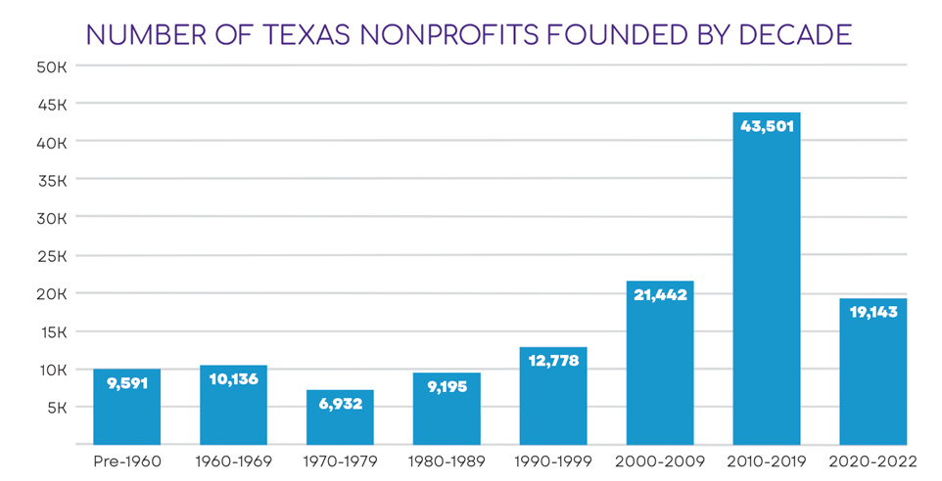
KEY FINDING
Nonprofits Keep Growing
Between the years of 2015 and 2022, the nonprofit sector grew by 22%.
The trend of more nonprofits being established each year continues, albeit now at a lessened pace.
33%
16%
15%
7%
8%
10%
7%
5%
Notes:
Millicent:
½ of houston organizations have been founded since 2011, ⅕ were founded since 2019
Between 2015 and 2022, the number of nonprofits in Texas grew by 22%, which reflects both the increasing needs in our communities and the willingness of Texans to step up and respond to those needs.
Even though the pace of growth has slowed somewhat in recent years, we are still seeing new organizations form every year. That tells us the nonprofit sector remains dynamic, entrepreneurial, and deeply connected to emerging community challenges and opportunities.
At the same time, this growth also raises important questions about sustainability, workforce capacity, funding availability, and how we ensure organizations — especially smaller and rural nonprofits — have the support they need not just to launch, but to thrive long-term.
Moreover, while more nonprofits can be a powerful solution to ever-growing community challenges, this proliferation also points to a need for thoughtful collaboration and partnership to avoid duplication of services and unnecessary competition for resources.

Slide 27
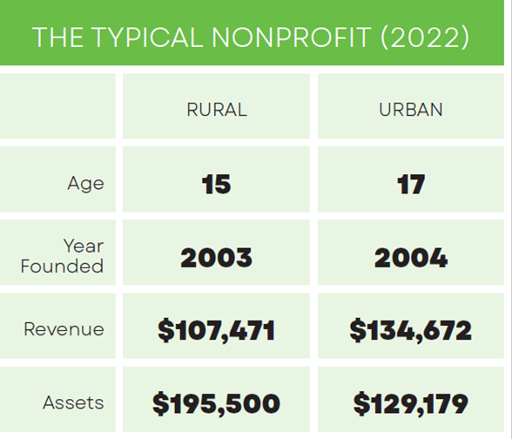
KEY FINDING
Rural Nonprofit Challenges
As of 2022, 1 in 5 nonprofits in Texas are rural-based.
The greatest number of rural nonprofits are currently located in the west region of Texas.
For every dollar in revenue, the rural nonprofit sector receives only nine cents. While the rural nonprofit may have more assets, they receive less incoming funding.
Notes:
Millicent:
One of the findings from the Built for Texas report that really stood out is the important role rural nonprofits play across our state — and the unique challenges they face.
As of 2022, about one in five nonprofits in Texas are based in rural communities. These organizations are often serving as critical lifelines, especially in areas where access to services, healthcare, transportation, or workforce supports may already be limited.
We also found that the greatest concentration of rural nonprofits is located in West Texas, where organizations are often covering vast geographic areas with fewer resources and staff capacity.
But what’s especially striking is the funding disparity. For every dollar in nonprofit revenue statewide, rural nonprofits receive only about nine cents. And while many rural organizations may hold assets — often tied to property, facilities, or infrastructure — they are operating with significantly less incoming funding and philanthropic investment.
That creates real sustainability challenges for organizations that are already doing essential work in communities that can’t afford to lose them

Slide 28
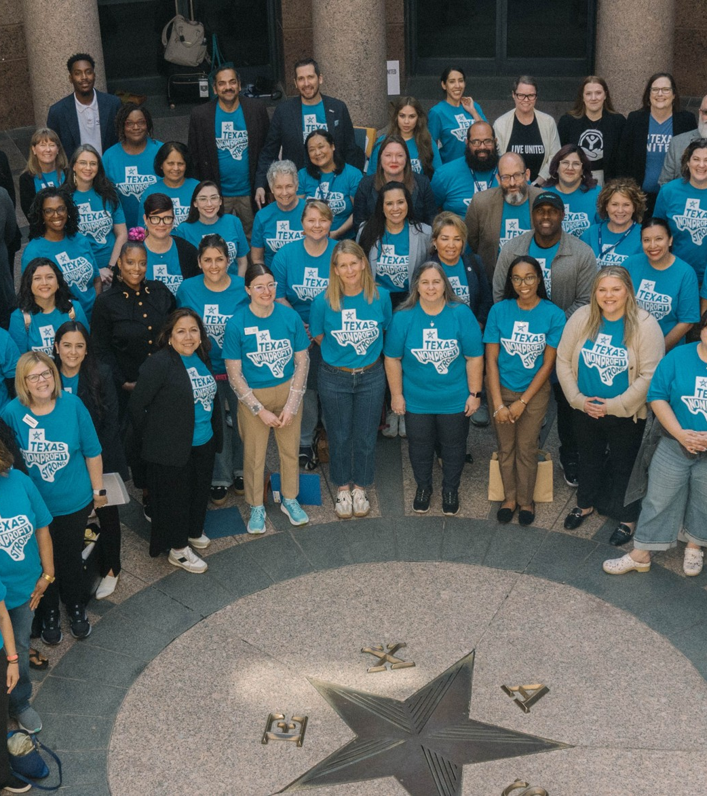
Key Messages
The nonprofit sector is essential to both improving the quality of life of all Texans and making Texas an ideal place to live and work.
The nonprofit sector is a powerful economic driver and job creator in Texas.
Texas nonprofits retain and bring outside funding to serve and build Texas communities.
Texas nonprofits support and contribute to every one of Texas’ major industries.
Together, public-private partnerships foster a healthy and prosperous state.
Notes:
Chris to reiterate key messages–especially given the power of this data for advocacy on behalf of the sector– before passing it on to Ashley to talk about the Advocacy Network and Capitol DA

Slide 29
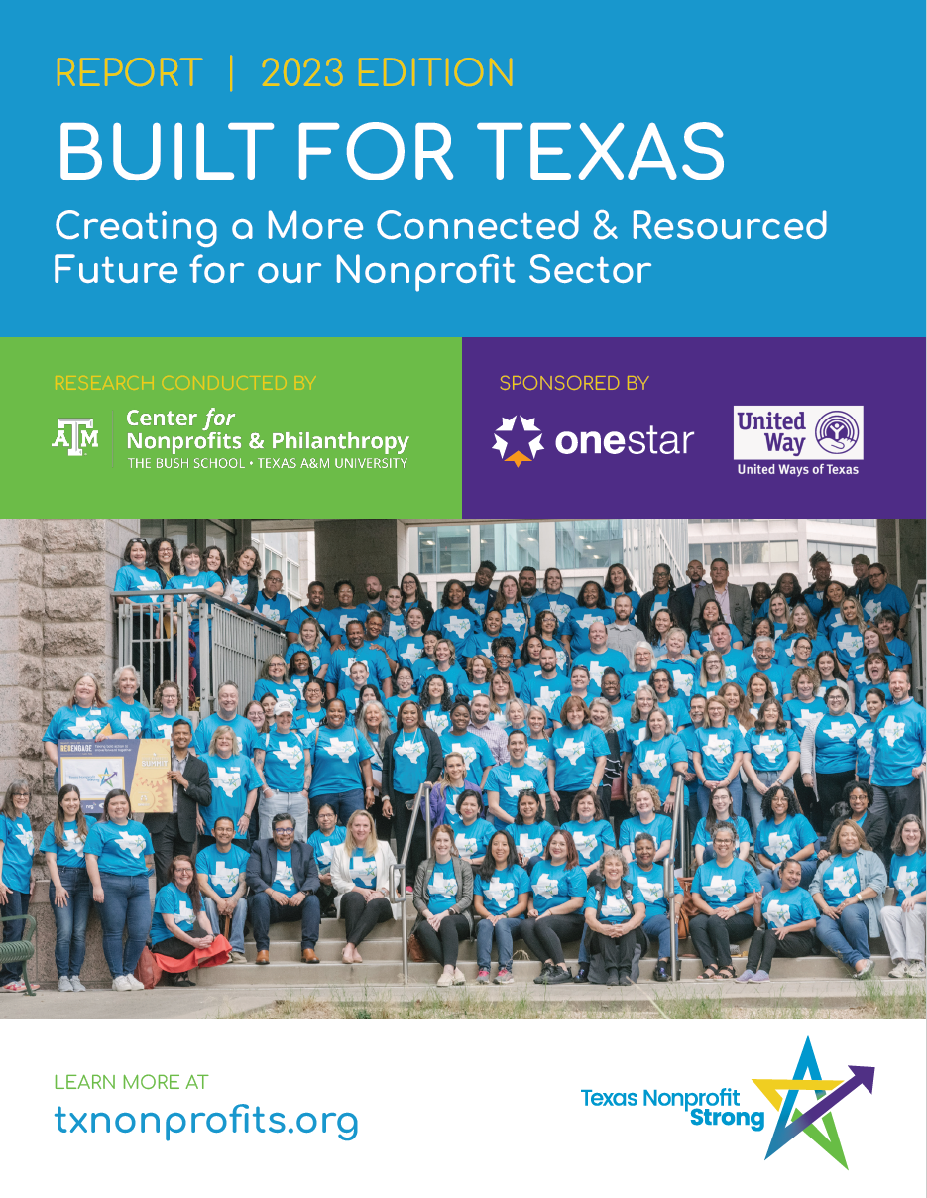
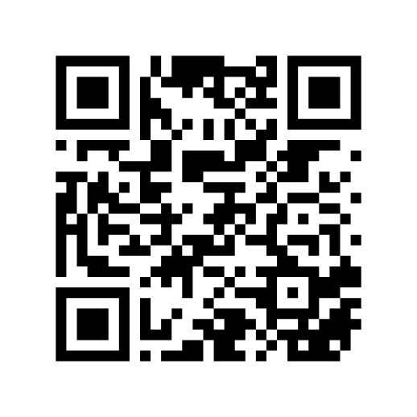
Built for Texas Toolkits
Overview flyer
Webinar & slides deck
Promotional graphics
Key messages
Targeted audience one-pagers & more!
Help build the next Built For Texas report!
Sponsorship opportunities now available
Notes:
Millicent to walk through toolkit online & how to use.

Slide 30
Understanding Need and Capacity Across Texas Communities
ALICE data identifies the level of economic need in Texas communities by highlighting households struggling to afford basic necessities despite working. It provides insight into financial instability and where support systems are most needed.
Built for Texas examines the capacity and infrastructure of the nonprofit sector, measuring the strength and reach of Texas nonprofits while identifying gaps in workforce, funding, and service capacity.
Notes:
Stephanie: (bring it all together)
ALICE data helps identify the level of economic need in our communities
Highlights households struggling to afford basic necessities despite being employed
Provides insight into financial instability affecting families and workers across Texas
Helps quantify where support systems are most needed
Built for Texas examines the capacity and infrastructure of the nonprofit sector
Measures the strength, scale, and reach of Texas nonprofits
Identifies gaps in nonprofit workforce, funding, and regional service capacity
Demonstrates the critical role nonprofits play in responding to community need

Slide 31
Take Action: ALICE & Built for Texas
Legislators & Elected Officials | Philanthropy & Funders | Nonprofit & Social Sector Professionals | Business & Civic Leaders
Use the data to better understand community need and nonprofit capacity in your district. Engage nonprofits as partners in addressing local challenges and informing policy decisions. Ensure rural and underserved communities are included in funding and policy conversations. | Invest in both direct services and the long-term strength of ALICE & nonprofit infrastructure. Use the data to identify gaps, target resources, and support underserved communities. Support advocacy and cross-sector collaboration that drives systems-level change. | Use the data to strengthen advocacy efforts and elevate community voices. Build partnerships across sectors and engage in local decision-making opportunities. Share stories and data together to demonstrate impact and community need. | Recognize nonprofits as essential partners in workforce, economic, and community wellbeing. Use the data to inform community investments and employee engagement efforts. Collaborate with nonprofits to address local challenges and strengthen Texas communities.
Notes:
Stephanie: Take Action: Funding, Advocacy, & Planning (10–15 minutes) – Stephanie
The data can strengthen advocacy for communities & can be used to improve decision-making and policy. Also, strategic planning, resource development & budget allocation
Tools, resources, etc.

Slide 32
What does the data mean to you?
Anything surprising?
How is ALICE showing up in local demand?
Where is nonprofit capacity most strained?
Why is the nonprofit sector important?
How can you use this data?

Slide 33
CLOSING
What We Learned
Financial hardship impacts working Texans in every community
ALICE data shows need beyond poverty statistics
Nonprofits are essential to Texas communities and economy
Demand is growing while nonprofit capacity is stretched
Moving Forward
Use data to drive action
Strengthen nonprofit sustainability
Build stronger cross-sector partnerships
The data is clear — investing in people and the nonprofit sector is investing in stronger Texas communities.
Notes:
Stephanie CLOSING 5 minutes:
Today’s data tells a clear story: Texas is growing, changing, and facing increasing economic pressure — and nonprofits are carrying much of the responsibility for helping communities navigate those challenges.
Through the ALICE data, we see that financial hardship extends far beyond poverty alone. Millions of working Texans are earning too much to qualify for assistance, but still not enough to afford the basics. These households are present in every region, every demographic group, and every workforce sector — including among nonprofit employees themselves.
At the same time, the Built for Texas findings remind us that the nonprofit sector is not just compassionate — it is essential infrastructure. Nonprofits are employers, economic drivers, trusted community partners, and frontline responders to growing needs across Texas. Yet many organizations are being asked to do more with limited staffing, limited funding, and increasing demand.
The opportunity moving forward is not simply to acknowledge these realities, but to act on them.
That means:
Using data to better target investments and policy solutions
Strengthening nonprofit capacity and workforce sustainability
Building stronger partnerships across business, philanthropy, government, and community organizations
Ensuring working Texans can achieve stability, not just survival
The data gives us more than statistics — it gives us direction.
And if we use these insights strategically, collaboratively, and with urgency, we can help build a Texas where communities, families, and nonprofits alike are better positioned to thrive.

Slide 34


THANK YOU!
Millicent Boykin
Stephanie O’Banion
Vice President of Strategic Partnerships
Director of Statewide Initiatives
millicent@onestarfoundation.org
stephanie.obanion@uwtexas.org
Notes:
Thank you for joining us today. For United Way members, REMEMBERS we’re here as a resource on operations, advocacy, and partnerships—don’t hesitate to reach out.
For non-members, there are ways to support our advocacy through our Built for Texas data work and Texas Nonprofit Strong initiative. Contact info for Roxanne is on the slide; if you’re ready TO SUPPORT & BE ENGAGED IN THIS WORK.

