Slide 1

Texas Economic and Revenue Trends: Current Insights & Projections
Texas Demographic Conference
May 21, 2026
Tetyana Melnyk, PhD., CGFM, CTCM
Director, Revenue Estimating Division

Slide 2
Overview
Comptroller’s role in the budget process
Texas economic and revenue forecast
Texas budget and results of the 89th legislative sessions

Slide 3
Comptroller’s Role in the Budget Process

Slide 4
Article III, Sec. 49a, Texas Constitution requires a “Financial Statements and Revenue Estimate by Comptroller of Public Accounts.”
Biennial Revenue Estimate is produced before each legislative session.
Certification Revenue Estimate is released in the fall following a legislative session, as required by Section 403.0131 (b), Texas Government Code.

Slide 5
Biennial Revenue Estimate (BRE) in Numbers
BRE provides assumptions on the growth of Texas economy and revenue for the next 2.5 years and includes:
nearly 200 estimates of various economic indicators,
more than 1,400 estimates of various revenues, and
estimates of nearly 400 balances in various funds and accounts.

Slide 6
Legislative Session
Revenue Estimating prepares on average 1,400 fiscal notes.
Revenue Estimating divisions assists Fiscal Management Division in costing and certification of the appropriations bills.

Slide 7
Certification Revenue Estimate (CRE)
Typically published in October following a legislative session.
Provides updates on revenue that were changed due to the legislative actions or based on changing economic conditions.

Slide 8
Texas Economic and Revenue Outlook

Slide 9
Recent Economic Performance in Texas and the Short-Term Outlook
  Texas employment and GSP growth rates have moderated since the unparalleled years immediately following the pandemic and are expected to exhibit a similar pattern in 2026 and 2027.
  Though the risk remains, expectations of recession have not changed. Recently inflation is showing spike due to high gasoline prices, while both the U.S. and Texas unemployment rates remain low by historical standards.
  Job growth in Texas is expected to be in the top ten among all states, and to outpace that of the nation as a whole, in both 2026 and 2027.

Slide 10
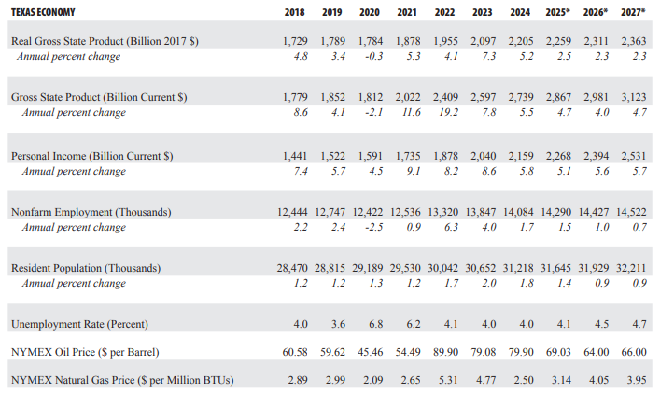
Texas Economic History and Outlook for Fiscal Years 2018 to 2027
Fall 2025 Forecast

Slide 11
Texas Gross State Product
(2010-2025)
Source: US Bureau of Economic Analysis

Slide 12
Texas Monthly Employment
(Jan. 2011 – Mar. 2026)
Source: Texas Labor Market Information, Texas Workforce Commission

Slide 13
Job Growth by State
(Mar. 2025 – Mar. 2026)
Source: US Bureau of Labor Statistics

Slide 14
Monthly Unemployment Rate, TX and US
(Jan. 2010 – Mar. 2026)
Source: Texas Labor Market Information, Texas Workforce Commission
Note: October 2025 Unemployment Rate data is missing due to the Federal Government shutdown

Slide 15
Austin MSA Nonfarm Employment by NAICS Supersector
(2010-2025)
Source: Texas Workforce Commission

Slide 16
Dallas-Fort Worth MSA Nonfarm Employment by NAICS Supersector
(2010-2025)
Source: Texas Workforce Commission

Slide 17
Houston MSA Nonfarm Employment by NAICS Supersector
(2010-2025)
Source: Texas Workforce Commission

Slide 18
San Antonio MSA Nonfarm Employment by NAICS Supersector
(2010-2025)
Source: Texas Workforce Commission

Slide 19
Source: Texas Real Estate Research Center, Texas A&M University
Total Home Sales and Median Home Prices
(1990-2025)

Slide 20
Source: Texas Real Estate Research Center, Texas A&M University
Total Listings and Months of Inventory
(1990-2025)

Slide 21
Source: Texas Real Estate Research Center, Texas A&M University
Building Permits
(1980-2024)

Slide 22
Source: Texas Real Estate Research Center, Texas A&M University
Housing Affordability Index
(2020-2025)

Slide 23
Housing Affordability Index
(2020-2025)
Source: Texas Real Estate Research Center, Texas A&M University

Slide 24
Housing Affordability Index
(2020-2025)
Source: Texas Real Estate Research Center, Texas A&M University

Slide 25
State Revenue
All Funds
General Revenue-Related Funds
  Refers to all revenue received by the state, including federal income and constitutionally-dedicated state funds.
  Excludes trust funds (and thus often described as “All Funds, Excluding Trust”).
  These funds affect the discretionary spending detailed in the General Appropriations Act.
  They include:
  General Revenue Fund
  Available School Fund
  State Technology and Instructional Materials Fund
  Foundation School Account
  Tobacco Settlement Account

Slide 26
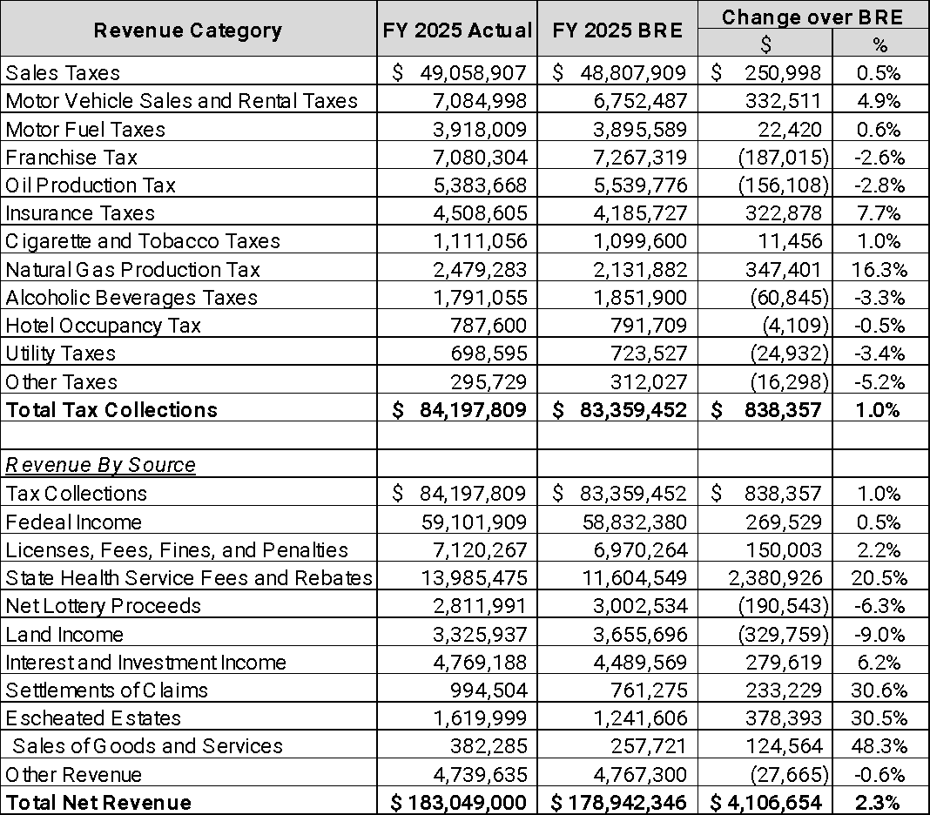
Revenue, Fiscal 2025 Actual vs. BRE
All Funds, Excluding Trust (in thousands)

Slide 27
Tax Volatility, %
Tax | FY 2024 | FY 2025 | Average FY 1996-2025
Sales Taxes | 1.2 | 4.0 | 5.4
Motor Vehicle Sales and Use Taxes | 0.2 | 3.7 | 4.6
Severance Taxes | -9.1 | -6.8 | 8.1
Total Taxes | -0.3 | 2.8 | 5.1

Slide 28
Sales Tax By Industry
Change from Prior Year and Average Growth
Industry | FY 2024 | FY 2025 | YoY Growth FY 2024-2025 | YoY Growth FY 2025-FY 2026 YTD | Compound Annual Growth Rate – Prior to Pandemic (FY 2004-2019) | Compound Annual Growth Rate – Pandemic Recovery (FY 2021-2023)
Mining | $ 1,992,754,220 | $ 1,878,344,617 | -5.7% | -1.0% | 14.2% | 71.6%
Construction | $ 2,214,797,068 | $ 2,208,949,254 | -0.3% | 5.0% | 7.4% | 19.7%
Manufacturing | $ 3,871,395,040 | $ 4,096,279,476 | 5.8% | 3.4% | 6.1% | 18.4%
Wholesale Trade | $ 4,112,427,025 | $ 4,168,514,465 | 1.4% | 6.1% | 6.0% | 19.0%
Retail Trade | $ 18,446,770,650 | $ 18,896,596,478 | 2.4% | 5.3% | 4.3% | 7.7%
Information | $ 3,128,024,208 | $ 3,311,200,123 | 5.9% | 7.8% | 4.5% | 10.7%
Services | $ 5,000,418,289 | $ 5,269,054,558 | 5.4% | 7.3% | 5.9% | 17.0%
Eating and Drinking Places | $ 5,000,357,036 | $ 5,200,499,728 | 4.0% | 4.2% | 5.9% | 13.5%

Slide 29
Insurance Premium Taxes
 | Total Texas Premium (CY) | YoY% | Premium Tax Collected (FY) | YoY% | Homeowners Average Rate Change | Private Passenger Auto Average Rate Change
2018 | 126,064,610,738
2019 | 132,435,204,169 | 5.1% | 2,445,695,824 |  | 4.2% | -1.3%
2020 | 141,774,145,843 | 7.1% | 2,567,849,428 | 5.0% | 3.8% | -1.9%
2021 | 156,843,138,561 | 10.6% | 2,576,869,691 | 0.4% | 5.9% | 2.9%
2022 | 176,927,531,650 | 12.8% | 2,975,168,971 | 15.5% | 10.8% | 23.8%
2023 | 190,386,179,922 | 7.6% | 3,899,695,138 | 31.1% | 21.1% | 25.5%
2024 | 203,120,018,061 | 6.7% | 3,992,634,000 | 2.4% | 18.7% | 4.8%
2025 | 213,932,643,781 | 5.3% | 4,366,781,851 | 9.4% | 4.3% | 0.9%
2019-2025 CAGR | 8.3% |  | 10.1% |  | 10.6% | 8.8%
Note: Premium Tax collections are based on previous calendar year premiums.

Slide 30
Oil and the Texas Economy, 1970s and Today
Feature | 1970s | 2025
Production trend | Falling | Rising strongly
Price importance | Dominant | Still important
Volume importance | Minor | Major
Revenue driver | Price | Price × production

Slide 31
Mining and the Texas Economy
Period | Mining Share of Texas GSP | What’s Happening
1970 | ~9% | Oil important but not dominant peak
1981–82 | ~14–16% (peak) | Oil boom, max dependence
1990s | ~6–8% | Post-crash diversification
2014 | ~13–14% | Shale boom peak
2022 | ~9.8% | Stabilized modern level
2025 | ~9% | Current range

Slide 32
Mining Sector Share of Texas RGSP
(Million 2017 $)
Year | TX Mining GSP | TX RGSP | Mining Sector Share
1990 | 47,465 | 627,011 | 7.6%
2000 | 51,614 | 989,905 | 5.2%
2010 | 72,041 | 1,323,059 | 5.4%
2020 | 150,671 | 1,782,738 | 8.5%
2022 | 119,523 | 1,975,164 | 6.1%
2025 | 192,949 | 2,275,881 | 8.5%

Slide 33
Natural Resource and Mining Sector Share of Texas Employment
(Thousands of Jobs)
Year | Texas Natural Resources and Mining Employment | Texas Total Nonfarm Employment | Natural Resources and Mining Sector Share
1990 | 163.79 | 7,125.41 | 2.3%
2000 | 146.17 | 9,462.08 | 1.5%
2010 | 206.47 | 10,377.13 | 2.0%
2020 | 191.48 | 12,272.72 | 1.6%
2022 | 200.53 | 13,476.58 | 1.5%
2025 | 221.84 | 14,310.21 | 1.6%

Slide 34
Gasoline and Other Fuels as a Percent of Average Annual Expenditures in Texas
(2022-2023)
Quintile | Gasoline Share
Lowest 20% | 5.45%
Second 20% | 4.99%
Third 20% | 5.76%
Fourth 20% | 4.65%
Highest 20% | 3.24%

Slide 35
Oil Price, Production, Rig Count, and Production Tax Revenue
FY 1970-2026 (select years)
Fiscal Year | Oil Price ($/bbl) (1) taxable price (2) NYMEX price | Production (mb/d) | Rigs | Oil Production Tax Revenue ($M)
1970 | na | na | 306 | 171
1973 | 3.58 (1) | 3.4 | 348 | 208
1975 | 7.39 (1) | 3.3 | 592 | 403
1978 | 8.93 (1) | 2.9 | 833 | 435
1980 | 17.93 (1) | 2.6 | 899 | 784
1981 | 30.89 (1) | 2.5 | 1160 | 1,289
1985 | 27.84 (2) | 2.3 | 778 | 1,039
1990 | 19.74 (2) | 1.7 | 320 | 515
2000 | 26.70 (2) | 1.1 | 292 | 416
2005 | 50.31 (2) | 0.9 | 562 | 681
2008 | 101.93 (2) | 0.9 | 876 | 1,436
2010 | 76.32 (2) | 1.0 | 526 | 1,008
2012 | 94.28 (2) | 1.4 | 914 | 2,102
2014 | 101.05 (2) | 2.4 | 856 | 3,872
2016 | 41.40 (2) | 2.8 | 275 | 1,703
2019 | 59.62 (2) | 4.3 | 508 | 3,887
2020 | 45.46 (2) | 4.4 | 330 | 3,229
2022 | 89.90 (2) | 4.2 | 298 | 6,362
2024 | 79.90 (2) | 4.7 | 298 | 6,304
2025 | 69.03 (2) | 4.8 | 275 | 5,384
2026 (estimated) | 64.00 | 4.7 | 264 | 4,878
YTD 2026 (thru Apr.) | 69.05 | 4.9 | 235 | 3,371

Slide 36
Natural Gas Price, Production, Rig Count, and Production Tax Revenue
FY 1970-2026 (select years)
Fiscal Year | Natural Gas Price ($/MMBtu) (1) taxable price (2) NYMEX price | Production (Tcf) | Gas Rigs | Natural Gas Production Tax Revenue ($M)
1970 | na | na | na | 96
1973 | na | na | na | 125
1975 | na | na | na | 260
1980 | 1.27 (1) | 7.2 | na | 734
1982 | 1.91 (1) | 6.5 | na | 1,057
1985 | 2.21 (1) | 5.5 | na | 1,123
1990 | 1.45 (1) | 5.4 | na | 568
2000 | 2.86 (2) | 5.3 | na | 698
2005 | 6.57 (2) | 5.8 | na | 1,657
2008 | 8.47 (2) | 7.5 | na | 2,685
2010 | 4.43 (2) | 7.4 | 327 | 726
2012 | 3.10 (2) | 7.9 | 290 | 1,535
2015 | 3.34 (2) | 8.4 | 68 | 1,280
2018 | 2.89 (2) | 8.0 | 36 | 1,431
2020 | 2.09 (2) | 10.0 | 24 | 925
2022 | 5.31 (2) | 11.0 | 28 | 4,470
2024 | 2.5 (2) | 12.3 | 31 | 2,134
2025 | 3.14 (2) | 12.7 | 29 | 2,479
2026 (estimated) | 4.05 | 12.6 | 35 | 2,803
YTD 2026 (thru Apr.) | 3.50 | 8.9 | 40 | 1,562

Slide 37
Oil and Natural Gas Production Tax Revenue
Fiscal 1970-2025

Slide 38
Crude Oil Export Growth in Texas
Year | Texas Crude Oil Exports | Export Volume
2016 | ramp-up begins | ~0.5 mb/d
2018 | rapid growth | ~2 mb/d
2019 | major exporter | ~3 mb/d
2022 | peak surge | ~3.5-4 mb/d
2025 | plateau/slight dip | ~4 mb/d

Slide 39
Liquefied Natural Gas Export Growth in Texas
Year | LNG Exports (value) | Notes
2016 | ~0 | exports just starting
2018 | $0.7B | early stage
2019 | $1.7B | scaling up
2020 | $4.3B | rapid growth
2021 | $11B | major expansion
2022 | $12B | peak surge
2023 | $9.1B | still very high
2025 | growing volumes | record capacity expanding

Slide 40
Economic Stabilization Fund Ending Balance
FY 1990-2026
* Estimated

Slide 41
Economic Stabilization Fund
Fiscal 2025 Ending Balance | $24.84 billion
Fiscal 2026 Ending Balance, Projected | $27.40 billion
Fiscal 2027 Ending Balance, Projected | $28.48 billion

Slide 42
Texas Budget and Results of the 89th Legislative Sessions

Slide 43
State Revenue
“Revenue Available for Certification”
  This is revenue available for general purpose spending.
  Beginning GR-R balance, including GR-Dedicated balances available for certification,
  Plus General Revenue-related collections during the biennium,
  Less reserves set aside for transfers to Economic Stabilization Fund and State Highway Fund.

Slide 44
2026-27 Revenue, Expenditures and Balance
From 2026-27 Certification Revenue Estimate
GR-R Available for Certification per CRE | $ 203.627 billion
Less: GR-R Appropriations | $ 198.969 billion
Unappropriated GR-R | $ 4.658 billion

Slide 45
All Funds Appropriations in 2026-27 GAA by Method of Finance (in millions)
Method of Finance | 2024-25 | 2026-27 | $ change | % change
General Revenue | $ 144,130.4 | $ 149,173.1 | $ 5,042.6 | 3.5%
General Revenue – Dedicated | 6,833.7 | 8,148.6 | 1,314.9 | 19.2
Federal Funds | 102,286.3 | 100,925.5 | (1,361.1) | (1.3)
Other | 68,087.2 | 79,770.4 | 11,683.1 | 17.2
All Funds | $ 321,337.6 | $ 338,017.2 | $ 16,679.6 | 5.2%

Slide 46
Select All Funds Appropriations, 2026-27 GAA
Appropriations for Specific Programs
Total Medicaid client services and program administration | $82.6 billion
Total Foundation School Program appropriations | $75.1 billion
Transfer from GR to Property Tax Relief Fund | $10 billion
Dementia Prevention Research Institute of Texas | $3 billion
Education Savings Accounts (ESAs) | $1 billion
Permanent Technical Institution Infrastructure Fund and Available Workforce Education Fund | $850 million
Judicial compensation and retirement, judiciary transparency and discipline | $172 million
Texas Cyber Command | $136 million
Texas Strategic Bitcoin Reserve | $10 million

Slide 47
Supplemental Appropriations by the 89th Legislature (HB 500)
Article | Program Examples | Total Appropriations (AF)
General Government | Texas Advanced Nuclear Development Fund; Texas Semiconductor Innovation Consortium; Texas Moving Industry Incentive Program; homeland security grants; Crime Victims Compensation fund; economic development grants; disaster grants; Employee Retirement System unfunded liability; facility maintenance and construction | $4.5 billion
Health and Human Services | Medicaid shortfall; state hospital construction; facility maintenance | $1.3 billion
Education | Foundation School Program updated projections; Teacher Retirement System (TRS) ActiveCare; Texas University Fund; Texas Space Commission; Texas A&M Forest Service wildfire suppression; fire department assistance; TDEM emergency response | $938 million
Public Safety and Criminal Justice | Criminal Justice operations, facility repair, and construction; TJJD facility construction; county juvenile justice reimbursement | $1.33 billion
Natural Resources | Water infrastructure and related grants; Alamo improvements; oil well plugging | $2.98 billion
Business and Economic Development | Railroad and other transportation projects; unemployment compensation fund, Vocational Rehabilitation program | $565 million
Cross-Article Appropriations | Information technology projects; vehicle replacement | $413 million

Slide 48
Tax Cuts Passed by the 89th Legislature
Bill Number | Tax Cut
SB 4 (and SJR 2) | Relating to an increase in the amount of the exemption of residence homesteads from ad valorem taxation by a school district and the protection of school districts against certain losses in local revenue
SB 2206 | Relating to a franchise tax credit for, and the application of sales and use taxes to, certain research and development expenses
HB 2517 | Relating to the applicability of premium and maintenance taxes to the Texas Windstorm Insurance Association and Texas FAIR Plan Association
HB 9 (and HJR 1) | Relating to an exemption from ad valorem taxation of a portion of the appraised value of tangible personal property that is held or used for the production of income
HB 2508 (and HJR 133) | Relating to an exemption from ad valorem taxation of the residence homestead of the surviving spouse of a veteran who died as a result of a qualifying condition or disease
HB 1399 (and HJR 99) | Relating to an exemption from ad valorem taxation of tangible personal property consisting of animal feed held by the owner of the property for sale at retail

Slide 49
Fiscal Impact of Revenue Bills of the 89th Legislature, R.S.
General Revenue-Related Funds (in thousands)
Revenue Category | FY 2026 | FY 2027
Taxes | $ (318,802) | $ (269,794)
Non-Taxes | (34,696) | (27,740)
Total | $ (353,498) | $ (297,534)

Slide 50
Fiscal Impact of Tax Revenue Bills of the 89th Legislature, R.S.
General Revenue-Related Funds (in thousands)
Tax Type | FY 2026 | FY 2027
Sales Taxes | $ (300,247) | $ (481)
Motor Vehicle Sales and Rental Taxes | (530) | (545)
Motor Fuels Taxes | (3,608) | (3,915)
Franchise Tax | (1,200) | (246,700)
Insurance Taxes | (12,697) | (17,139)
Alcoholic Beverage Taxes | (79) | (155)
Hotel Occupancy Tax | (441) | (859)

Slide 51
Revenue Estimating Division Resources
Revenue Tracking Tools
  Monthly Revenue Watch
  Sales Tax Receipts by NAICS Industry
  TexStats Statewide Dashboard
Revenue.Estimating@cpa.texas.gov
Forecasts
  2026-27 Certification Revenue Estimate
  Fall 2025 Long-Term Economic Forecast

Slide 52
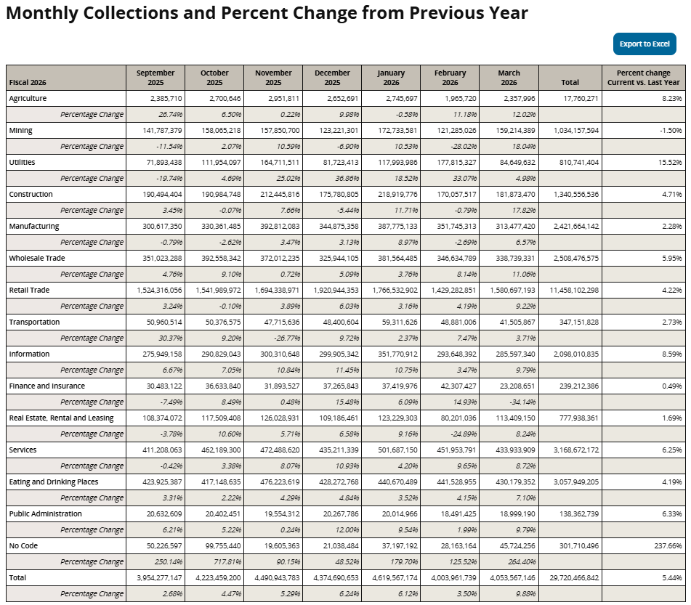
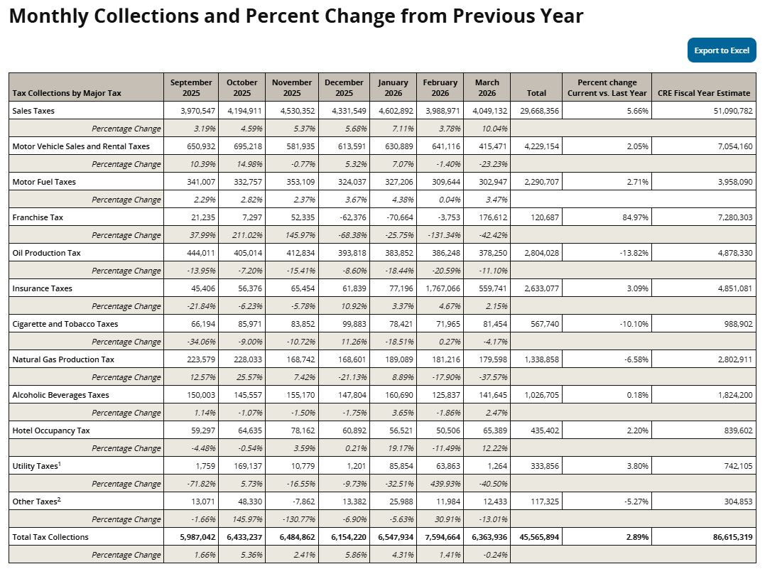
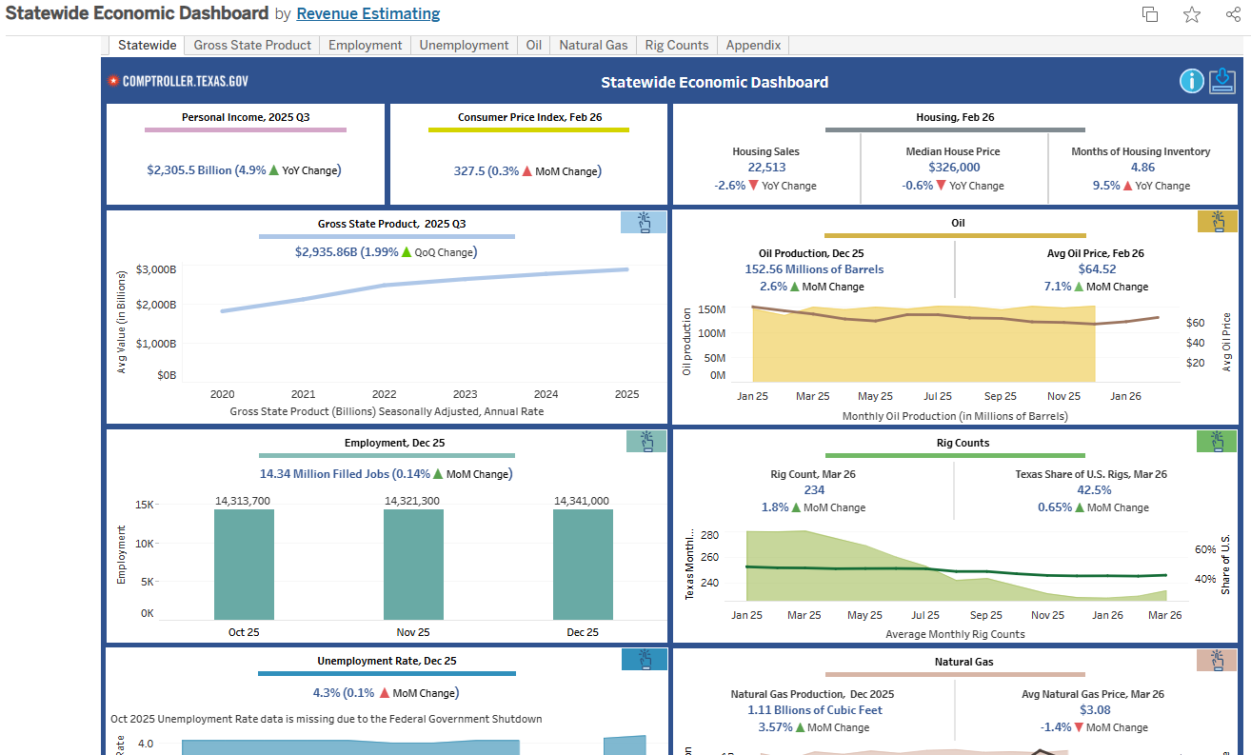
Additional Resources
Sales Tax by NAICS Report
https://comptroller.texas.gov/transparency/revenue/watch/naics/naics-industry.php
Monthly State Revenue Watch
https://comptroller.texas.gov/transparency/revenue/watch/
TexStats Statewide Economic Dashboard
https://comptroller.texas.gov/economy/economic-data/regions/2025/

Slide 53
Tetyana Melnyk, Ph.D., CGFM, CTCM
Director, Revenue Estimating Division
Texas Comptroller of Public Accounts
tetyana.melnyk@cpa.texas.gov
512-463-5202

