Slide 1
State of the State:
Texas Demographic Trends and Characteristics
June 18th, 2026
Via Zoom
Interagency Coordinating Group (ICG)

Slide 2




About our organization
Major Function
Produce annual population estimates and biennial population projections
Other Services
Disseminate demographic and socioeconomic information from the Census Bureau and other reliable sources.
Provide training and technical expertise.
Custom data analyses.
State Demographer
Lloyd B. Potter, Ph.D.
Affiliated with
The University of Texas at San Antonio
Partnerships
U.S. Census Bureau
TDC Affiliates

Slide 3
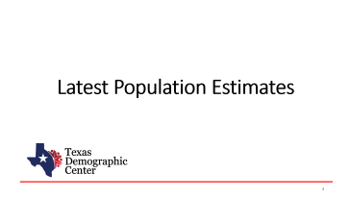

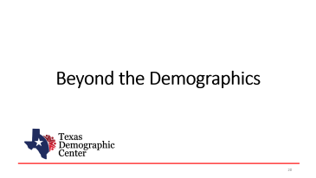
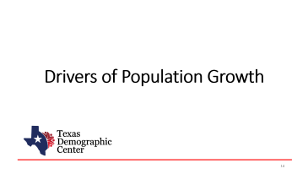
Table of Contents

Slide 4
Latest Population Estimates

Slide 5

New 2025 Estimates Show Texas Growth but at Slower Rate
Newly Released Data
Texas Total Population 2025
31.7M
391K
1.2%
Numeric increase
Percent increase
Growth from 2024
New Census Bureau data shows Texas’ population reached 31.7 million in July 2025 — a 1.2% increase from 2024 to 2025, more than 2X the 0.5% national growth rate. Though growth slowed compared to recent years, TX still led the nation in numeric gains, adding over 391K residents.

Slide 6
State Highlights
All but five U.S. states grew between July 2024 and July 2025
- CA, HI, NM, VT, and WV.
Top 5 States with percent change
-SC, ID, NC, TX, UT.
Top 5 States with numeric change
-TX, FL, NC, GA, SC.
Source: U.S. Census Bureau, Vintage 2025 Population Estimates

Slide 7
Estimated Population,
Texas Counties, 2025
Texas population is highly concentrated within the metropolitan triangle formed by Dallas–Fort Worth, Austin, San Antonio, and Houston.
The 120 counties on and east of the I‑35 corridor are home to 27.3 million residents—approximately 87.3% of the state’s total population.
87%
Source: U.S. Census Bureau, Vintage 2025 Population Estimates

Slide 8
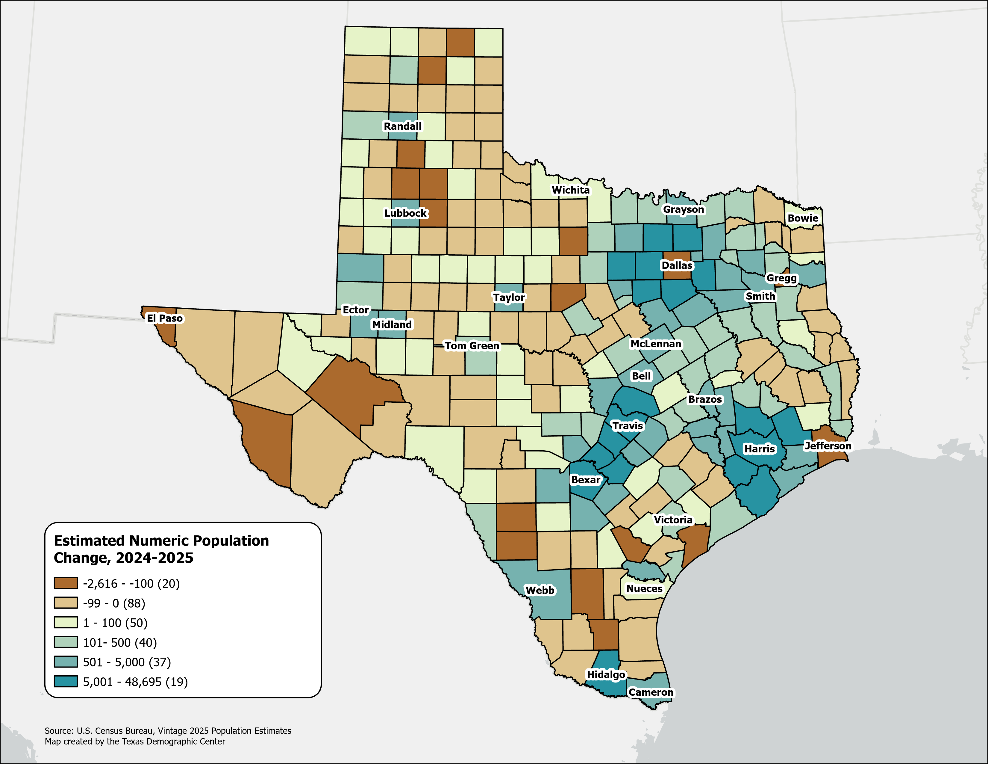
Estimated Numeric Population Change, Texas Counties, 2024-2025
Population declined in 108 Texas counties, primarily in rural areas.
Dallas experienced the largest numeric population loss, along with several border counties.
Source: U.S. Census Bureau, Vintage 2025 Population Estimates

Slide 9
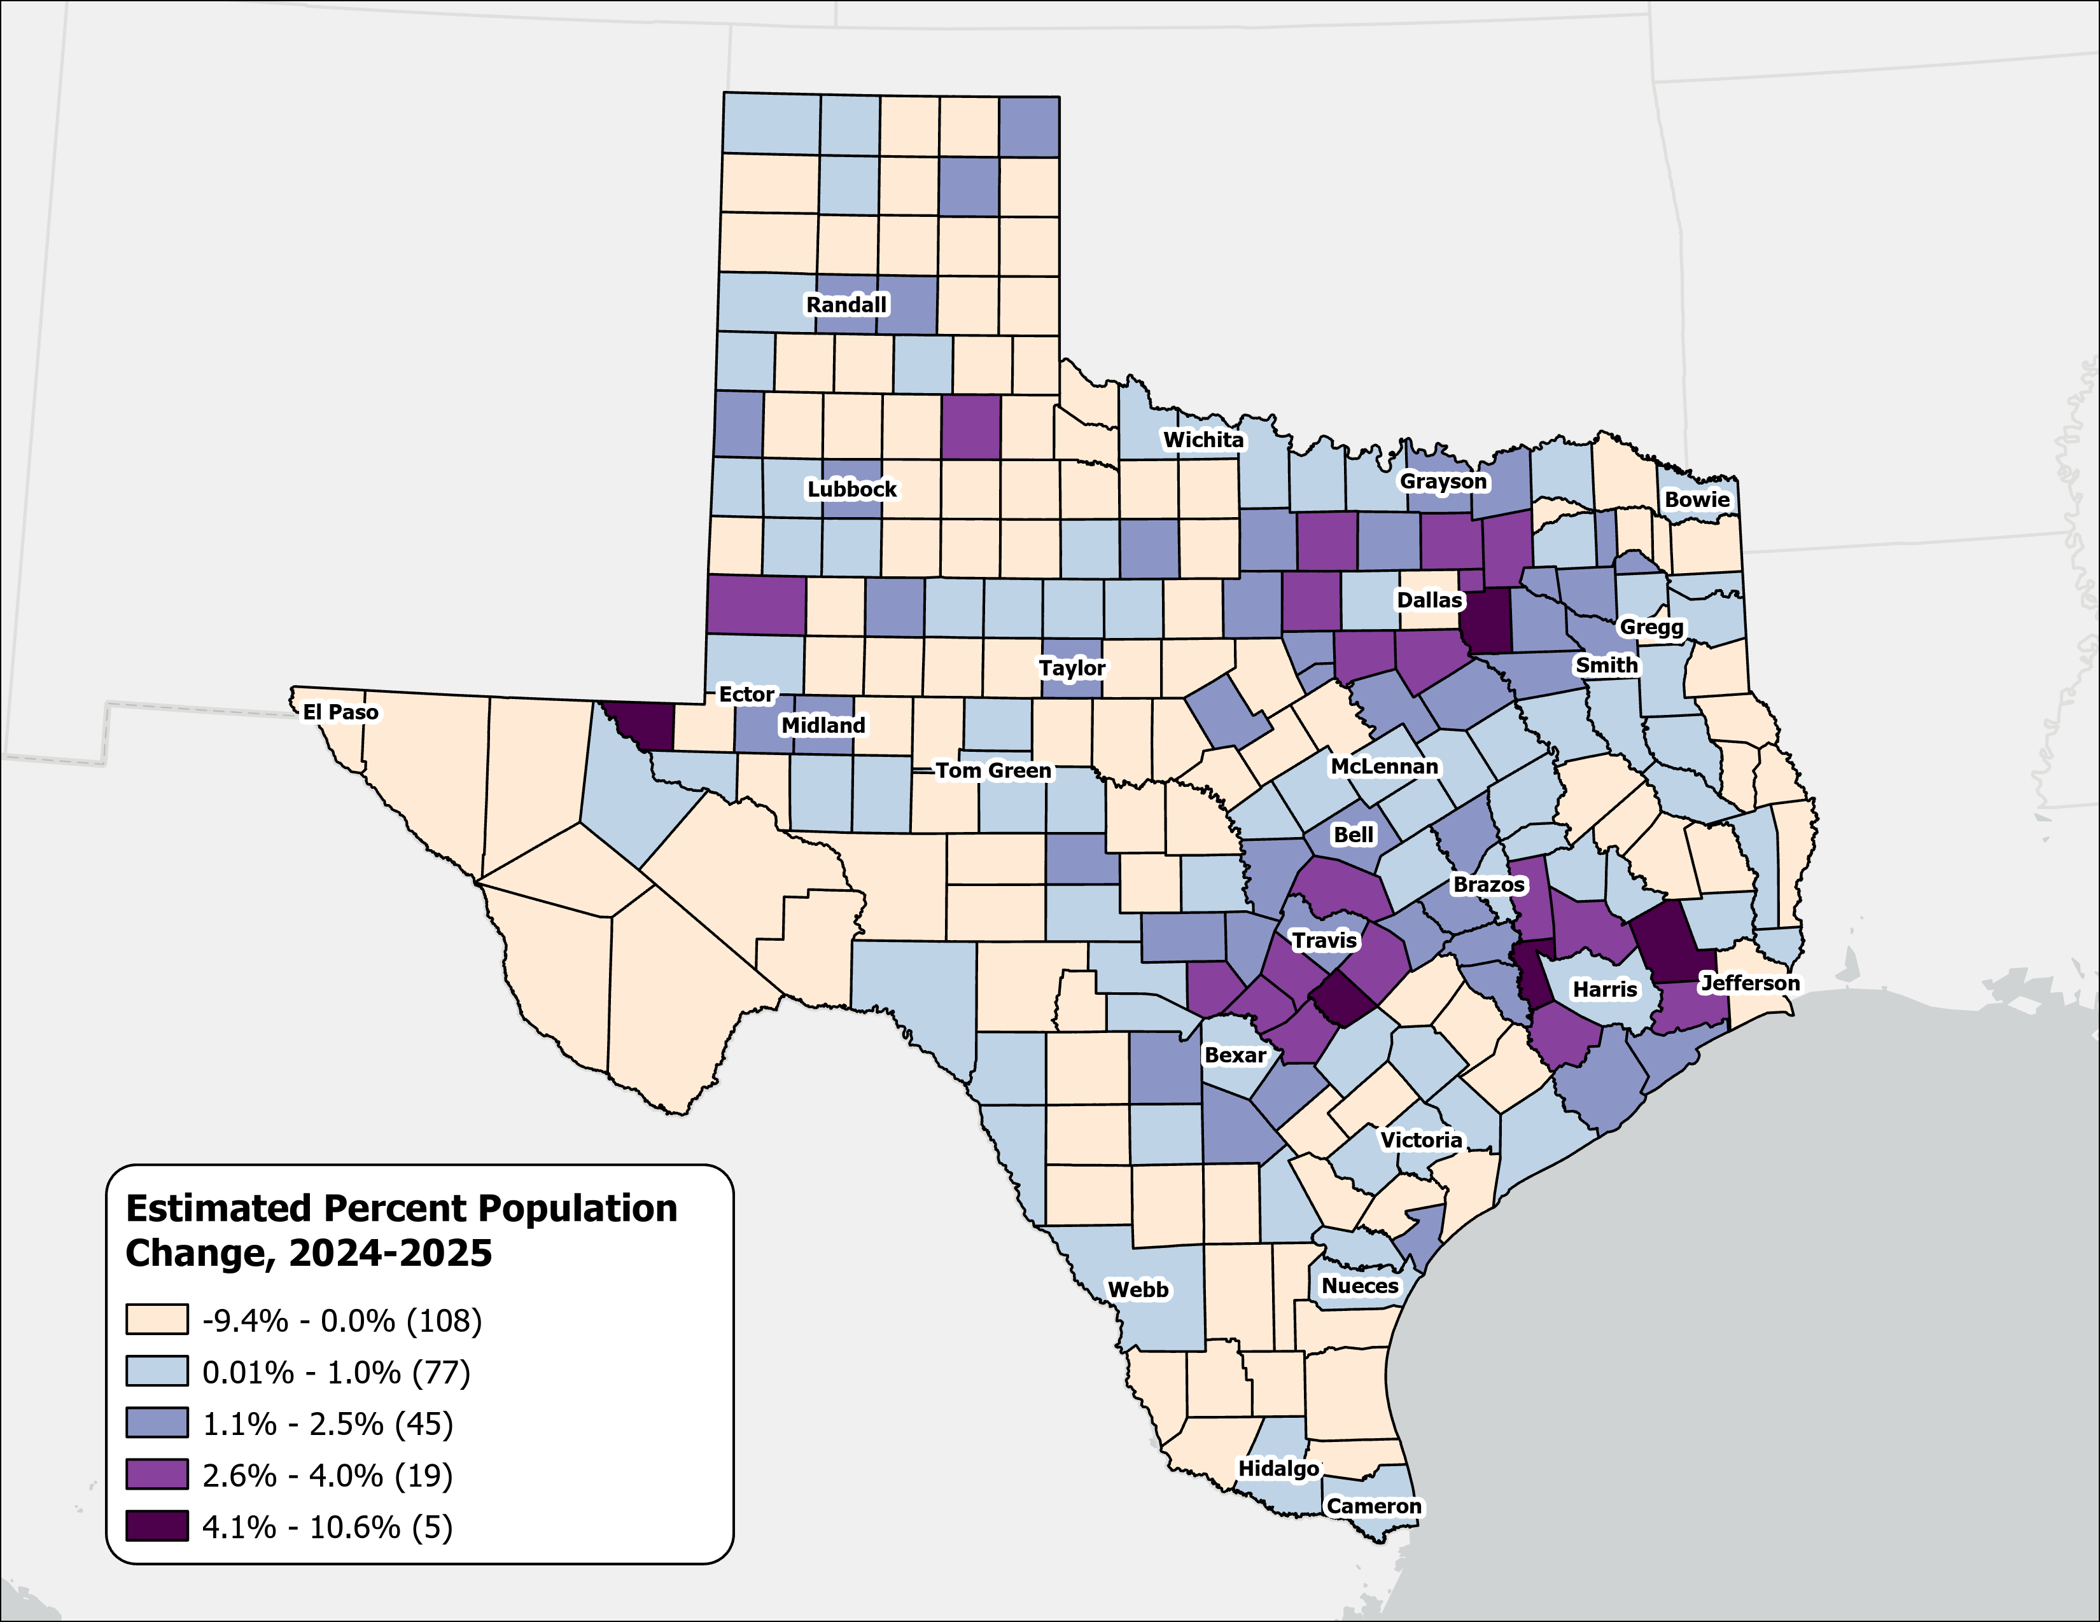
Estimated Percent Population Change, Texas Counties, 2024-2025
Rapid growth was concentrated in counties at the suburban and exurban edges of the Texas metropolitan triangle.
Source: U.S. Census Bureau, Vintage 2025 Population Estimates

Slide 10
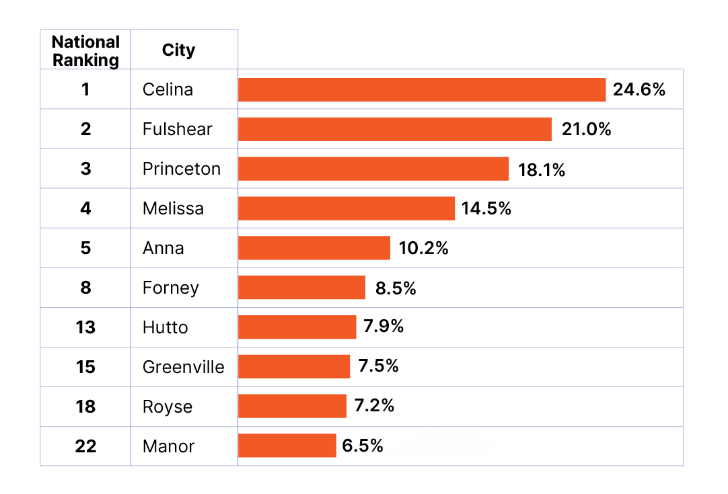
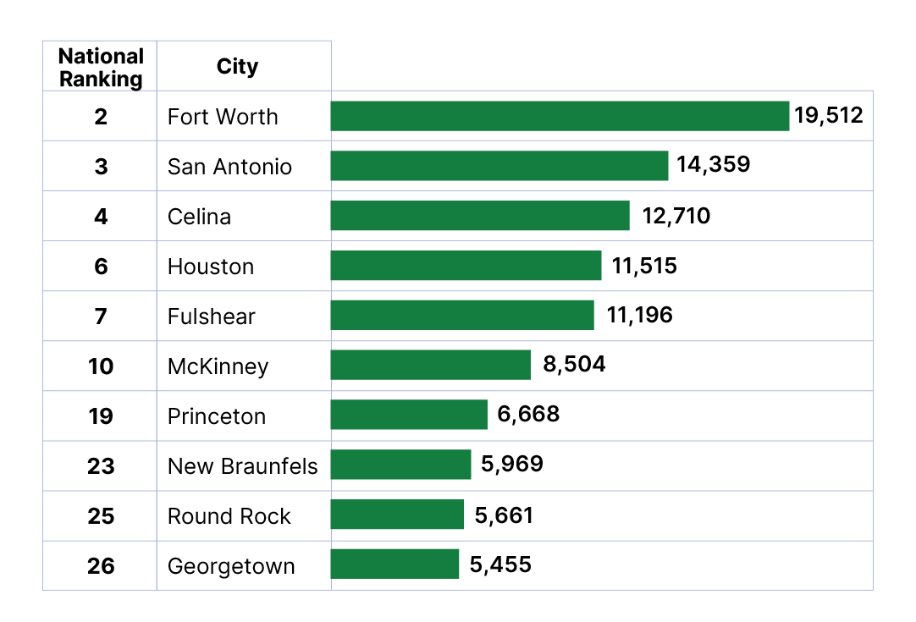
Top Growth Texas Cities and Towns
Top 10 Cities by Percent Growth in Texas
From July 1, 2024 to July 1, 2025
Top 10 Cities by Numeric Growth in Texas
From July 1, 2024 to July 1, 2025
Source: U.S. Census Bureau, Vintage 2025 Population Estimates. Ranked among incorporated places with a population of 20,000 or more.

Slide 11
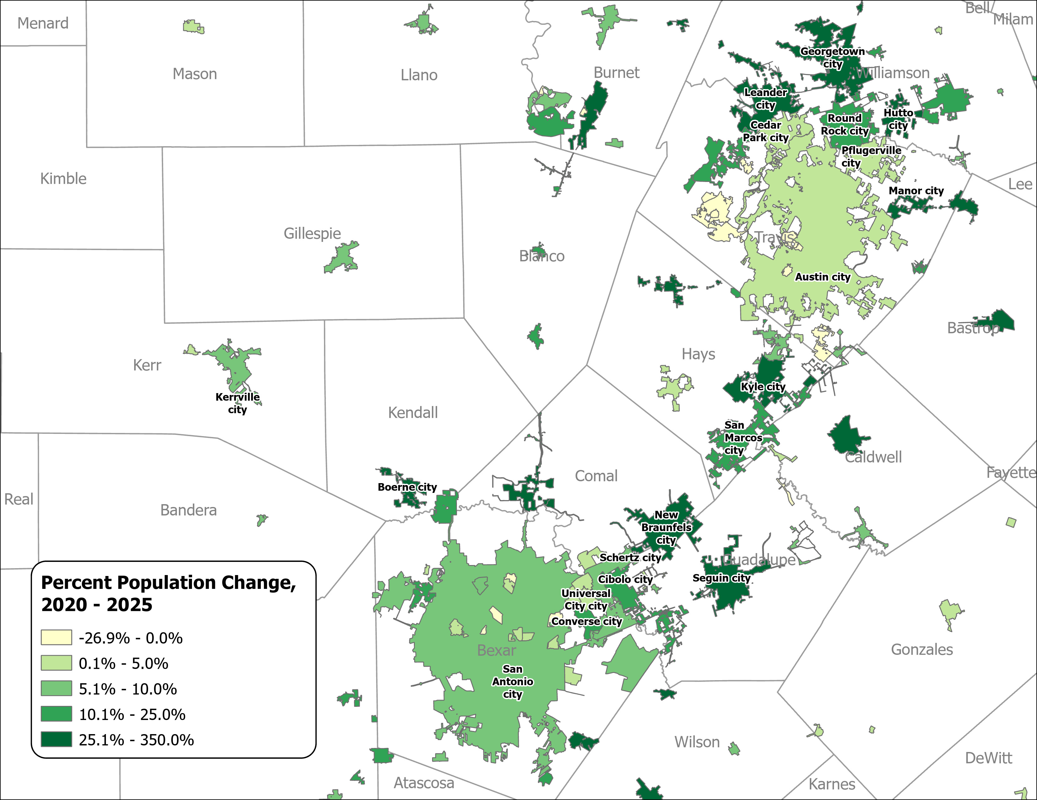
Percent Population Change for Incorporated Places, 2020-2025
Austin and San Antonio Area
Growth in major urban centers slowed considerably.
Small and midsized suburban and exurban cities within the Triangle region experienced the most rapid expansion.
Source: U.S. Census Bureau, Vintage 2025 Population Estimates

Slide 12
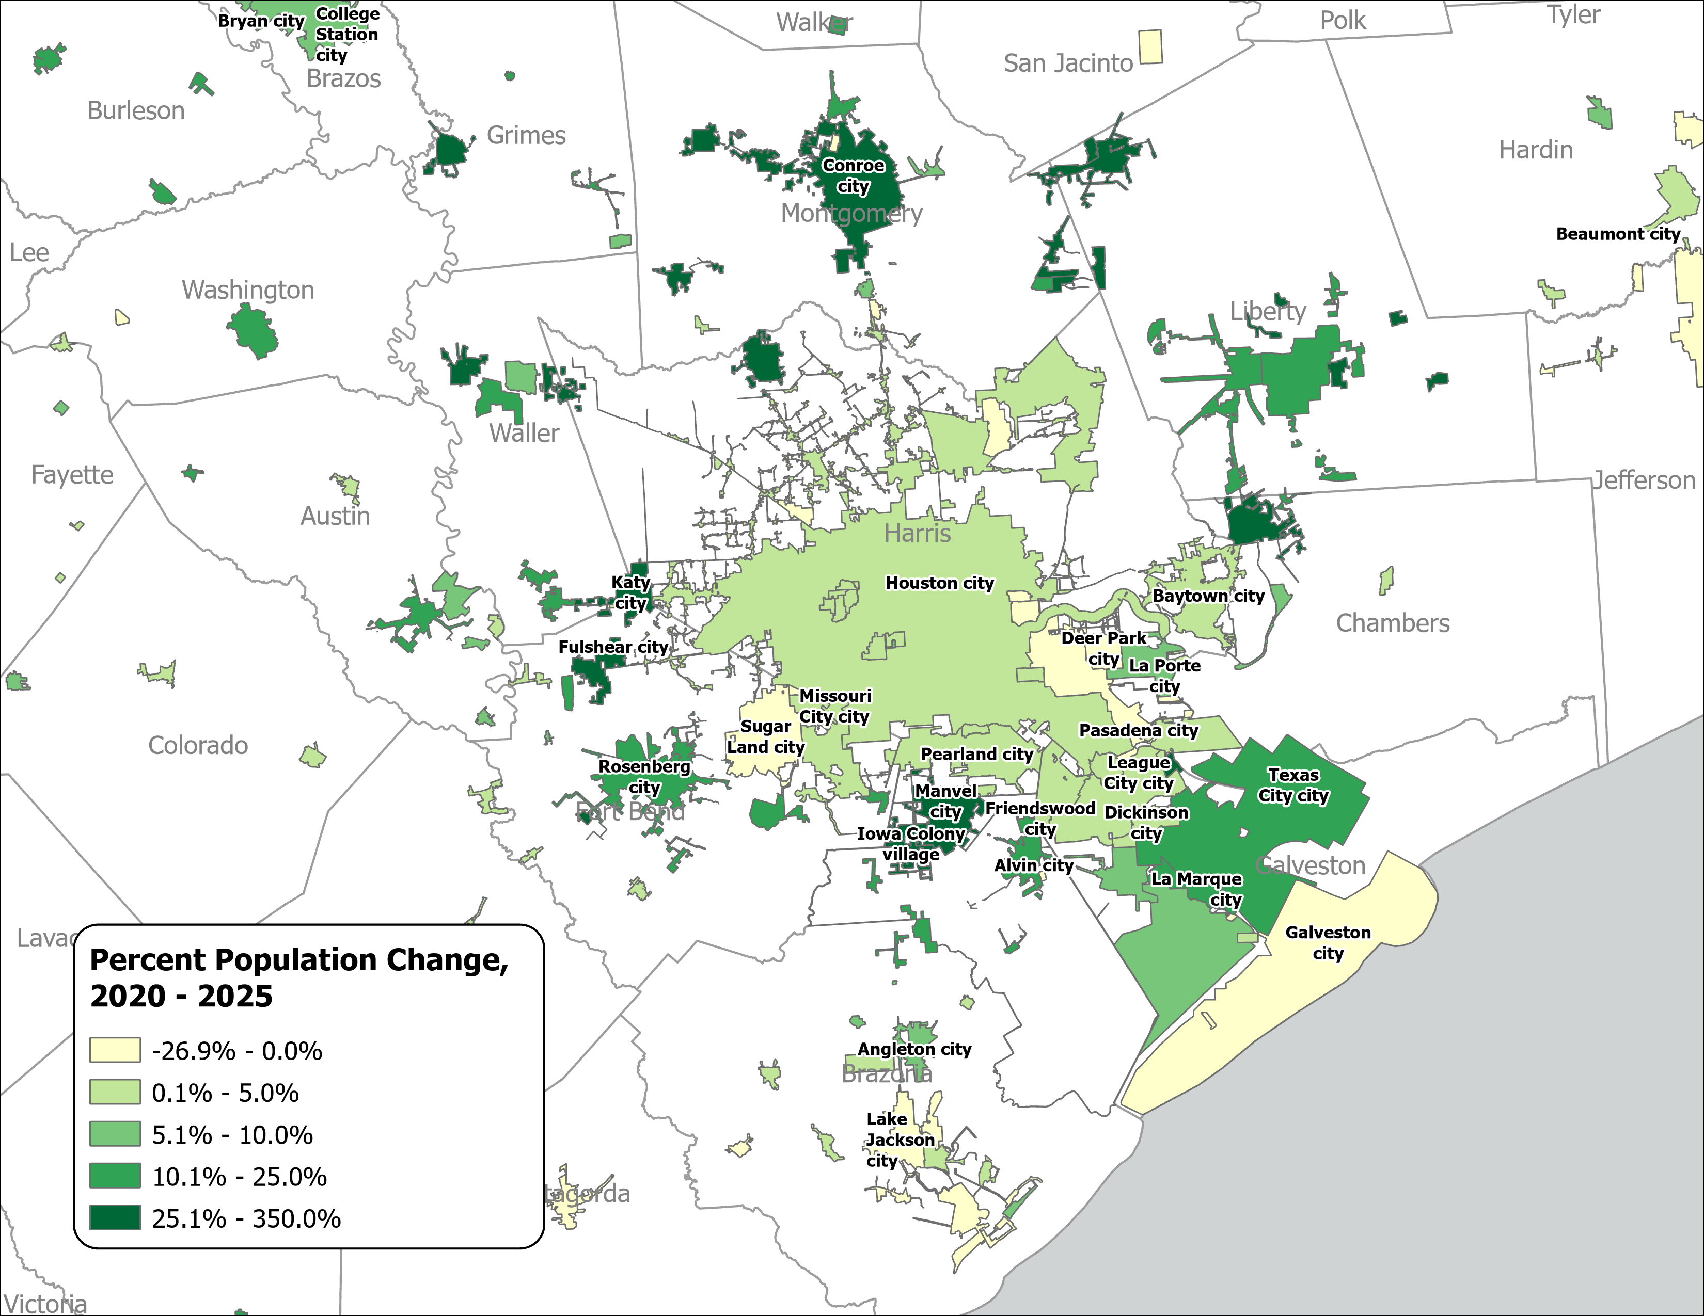
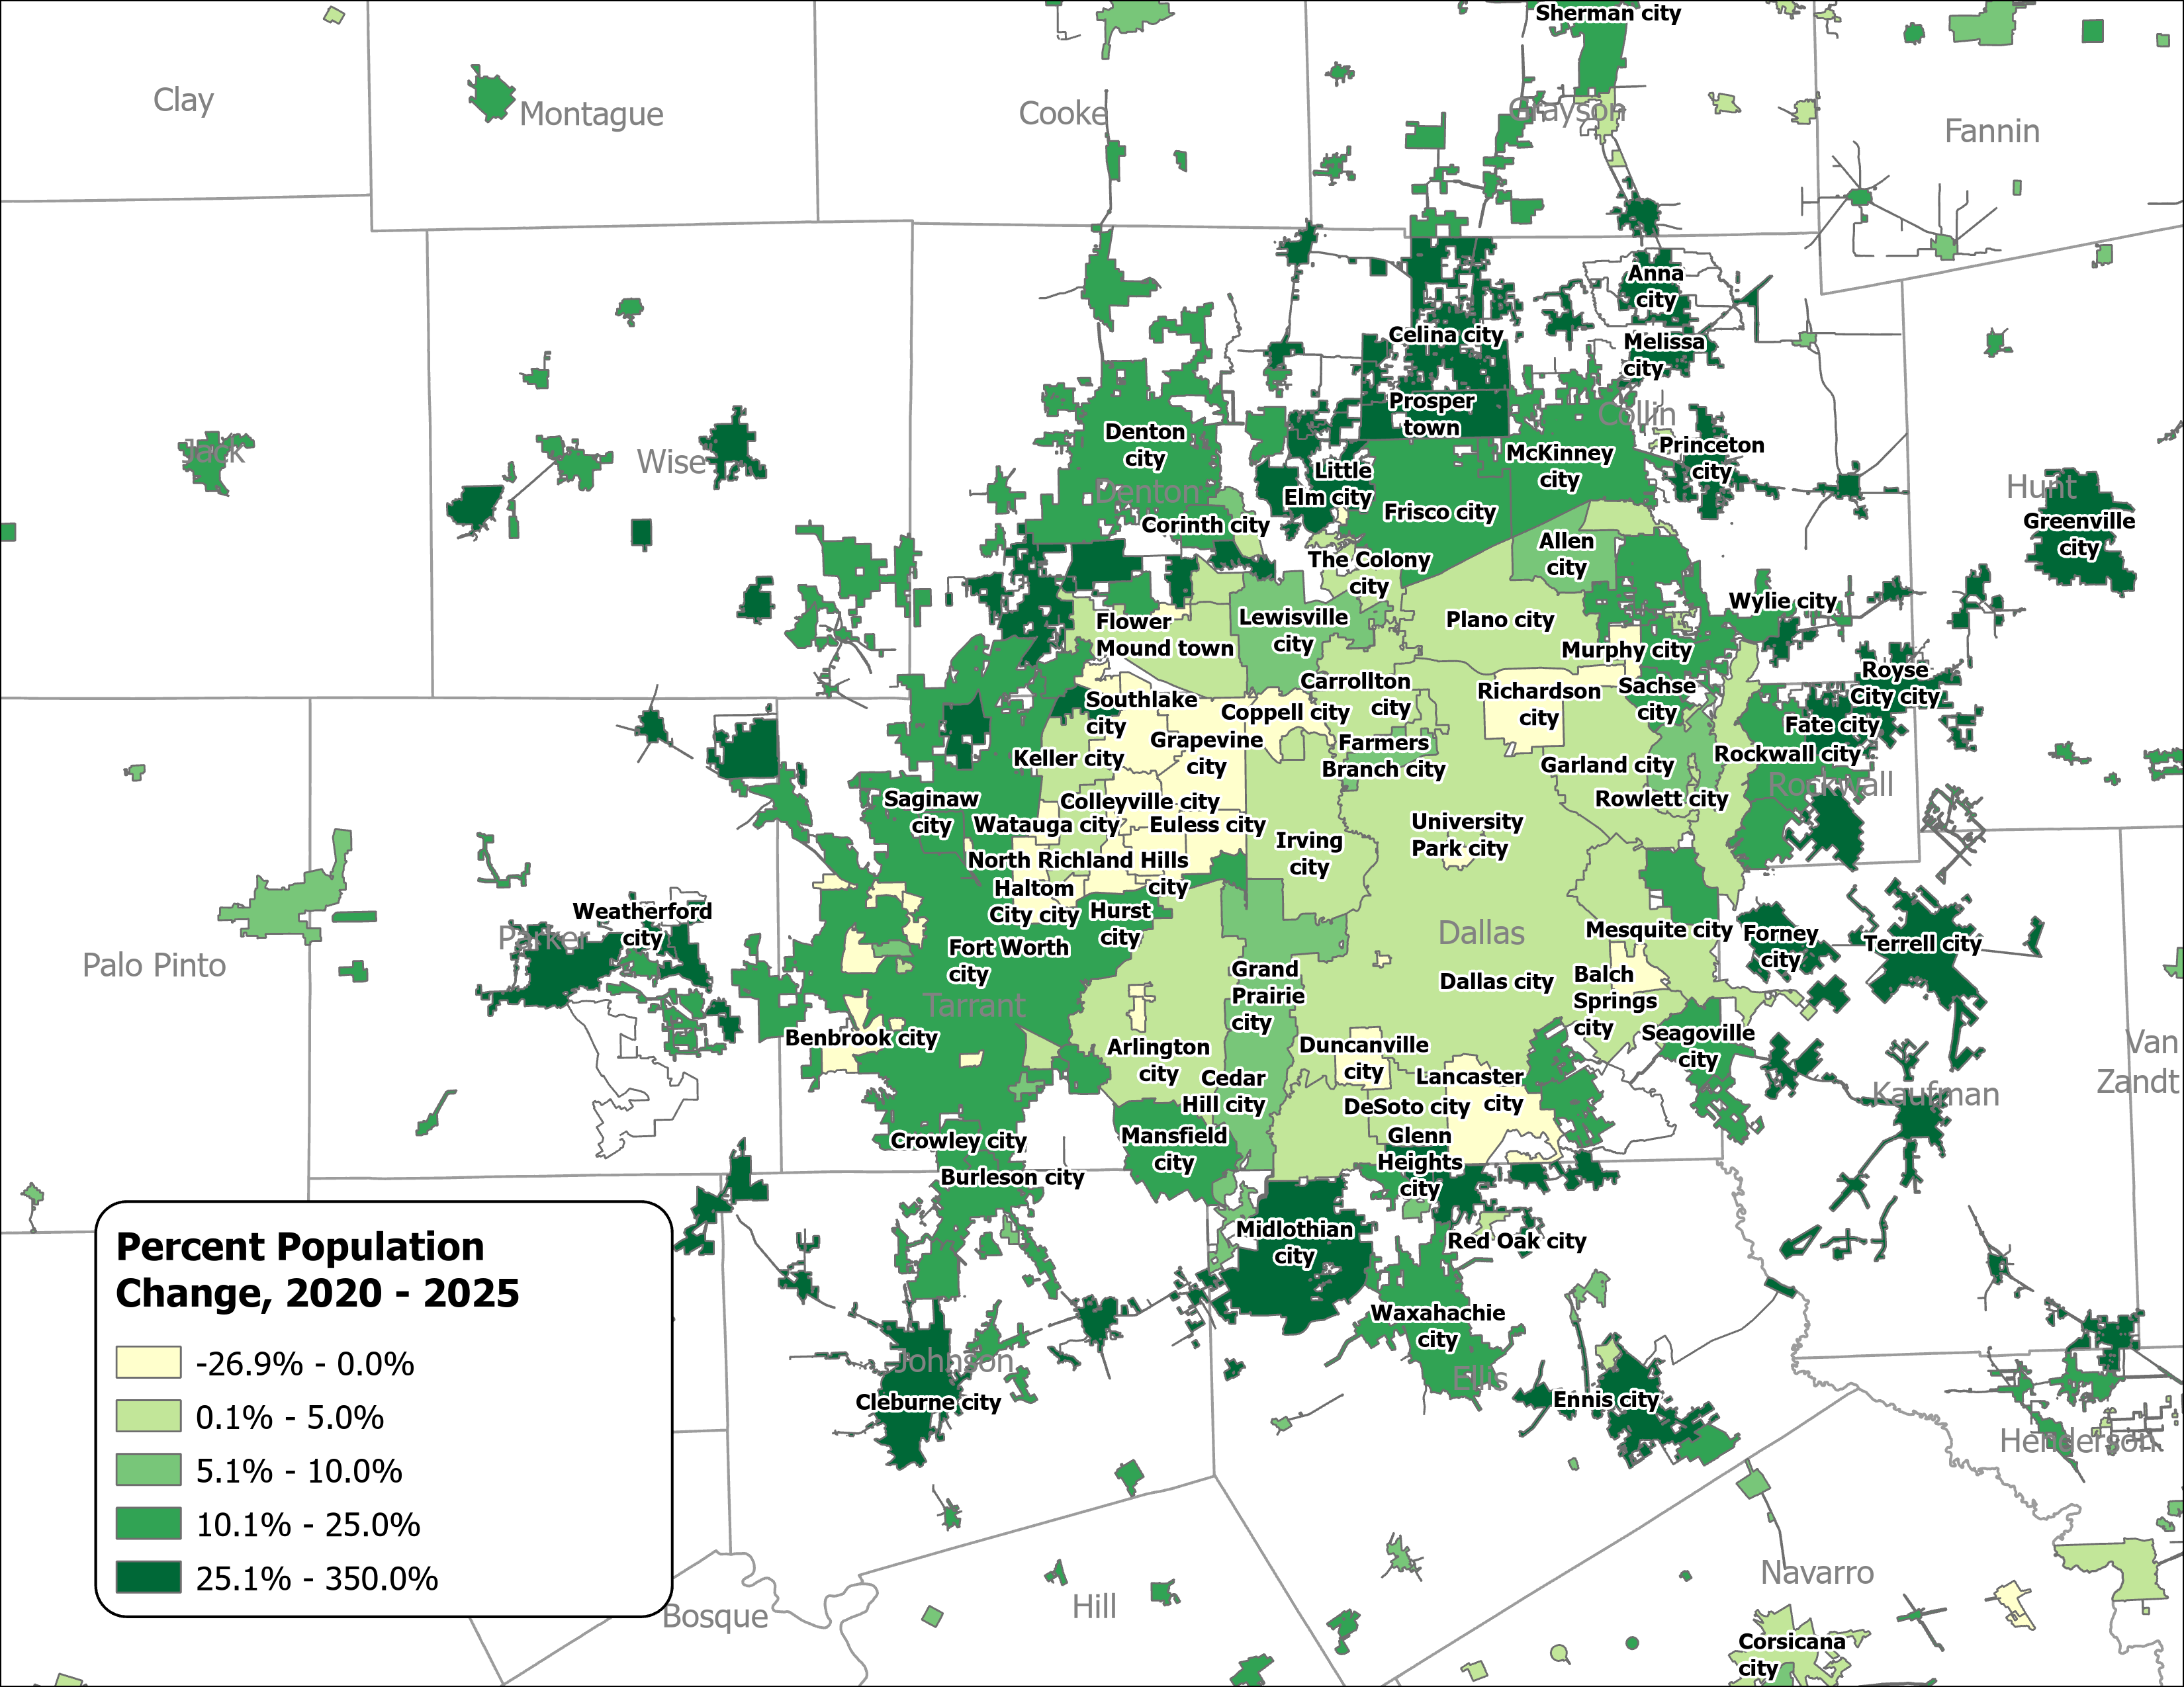
Percent Population Change for Incorporated Places, 2020-2025
(Houston and Dallas-Fort Worth)
Houston Area
Dallas-Fort Worth Area
Source: U.S. Census Bureau, Vintage 2025 Population Estimates

Slide 13
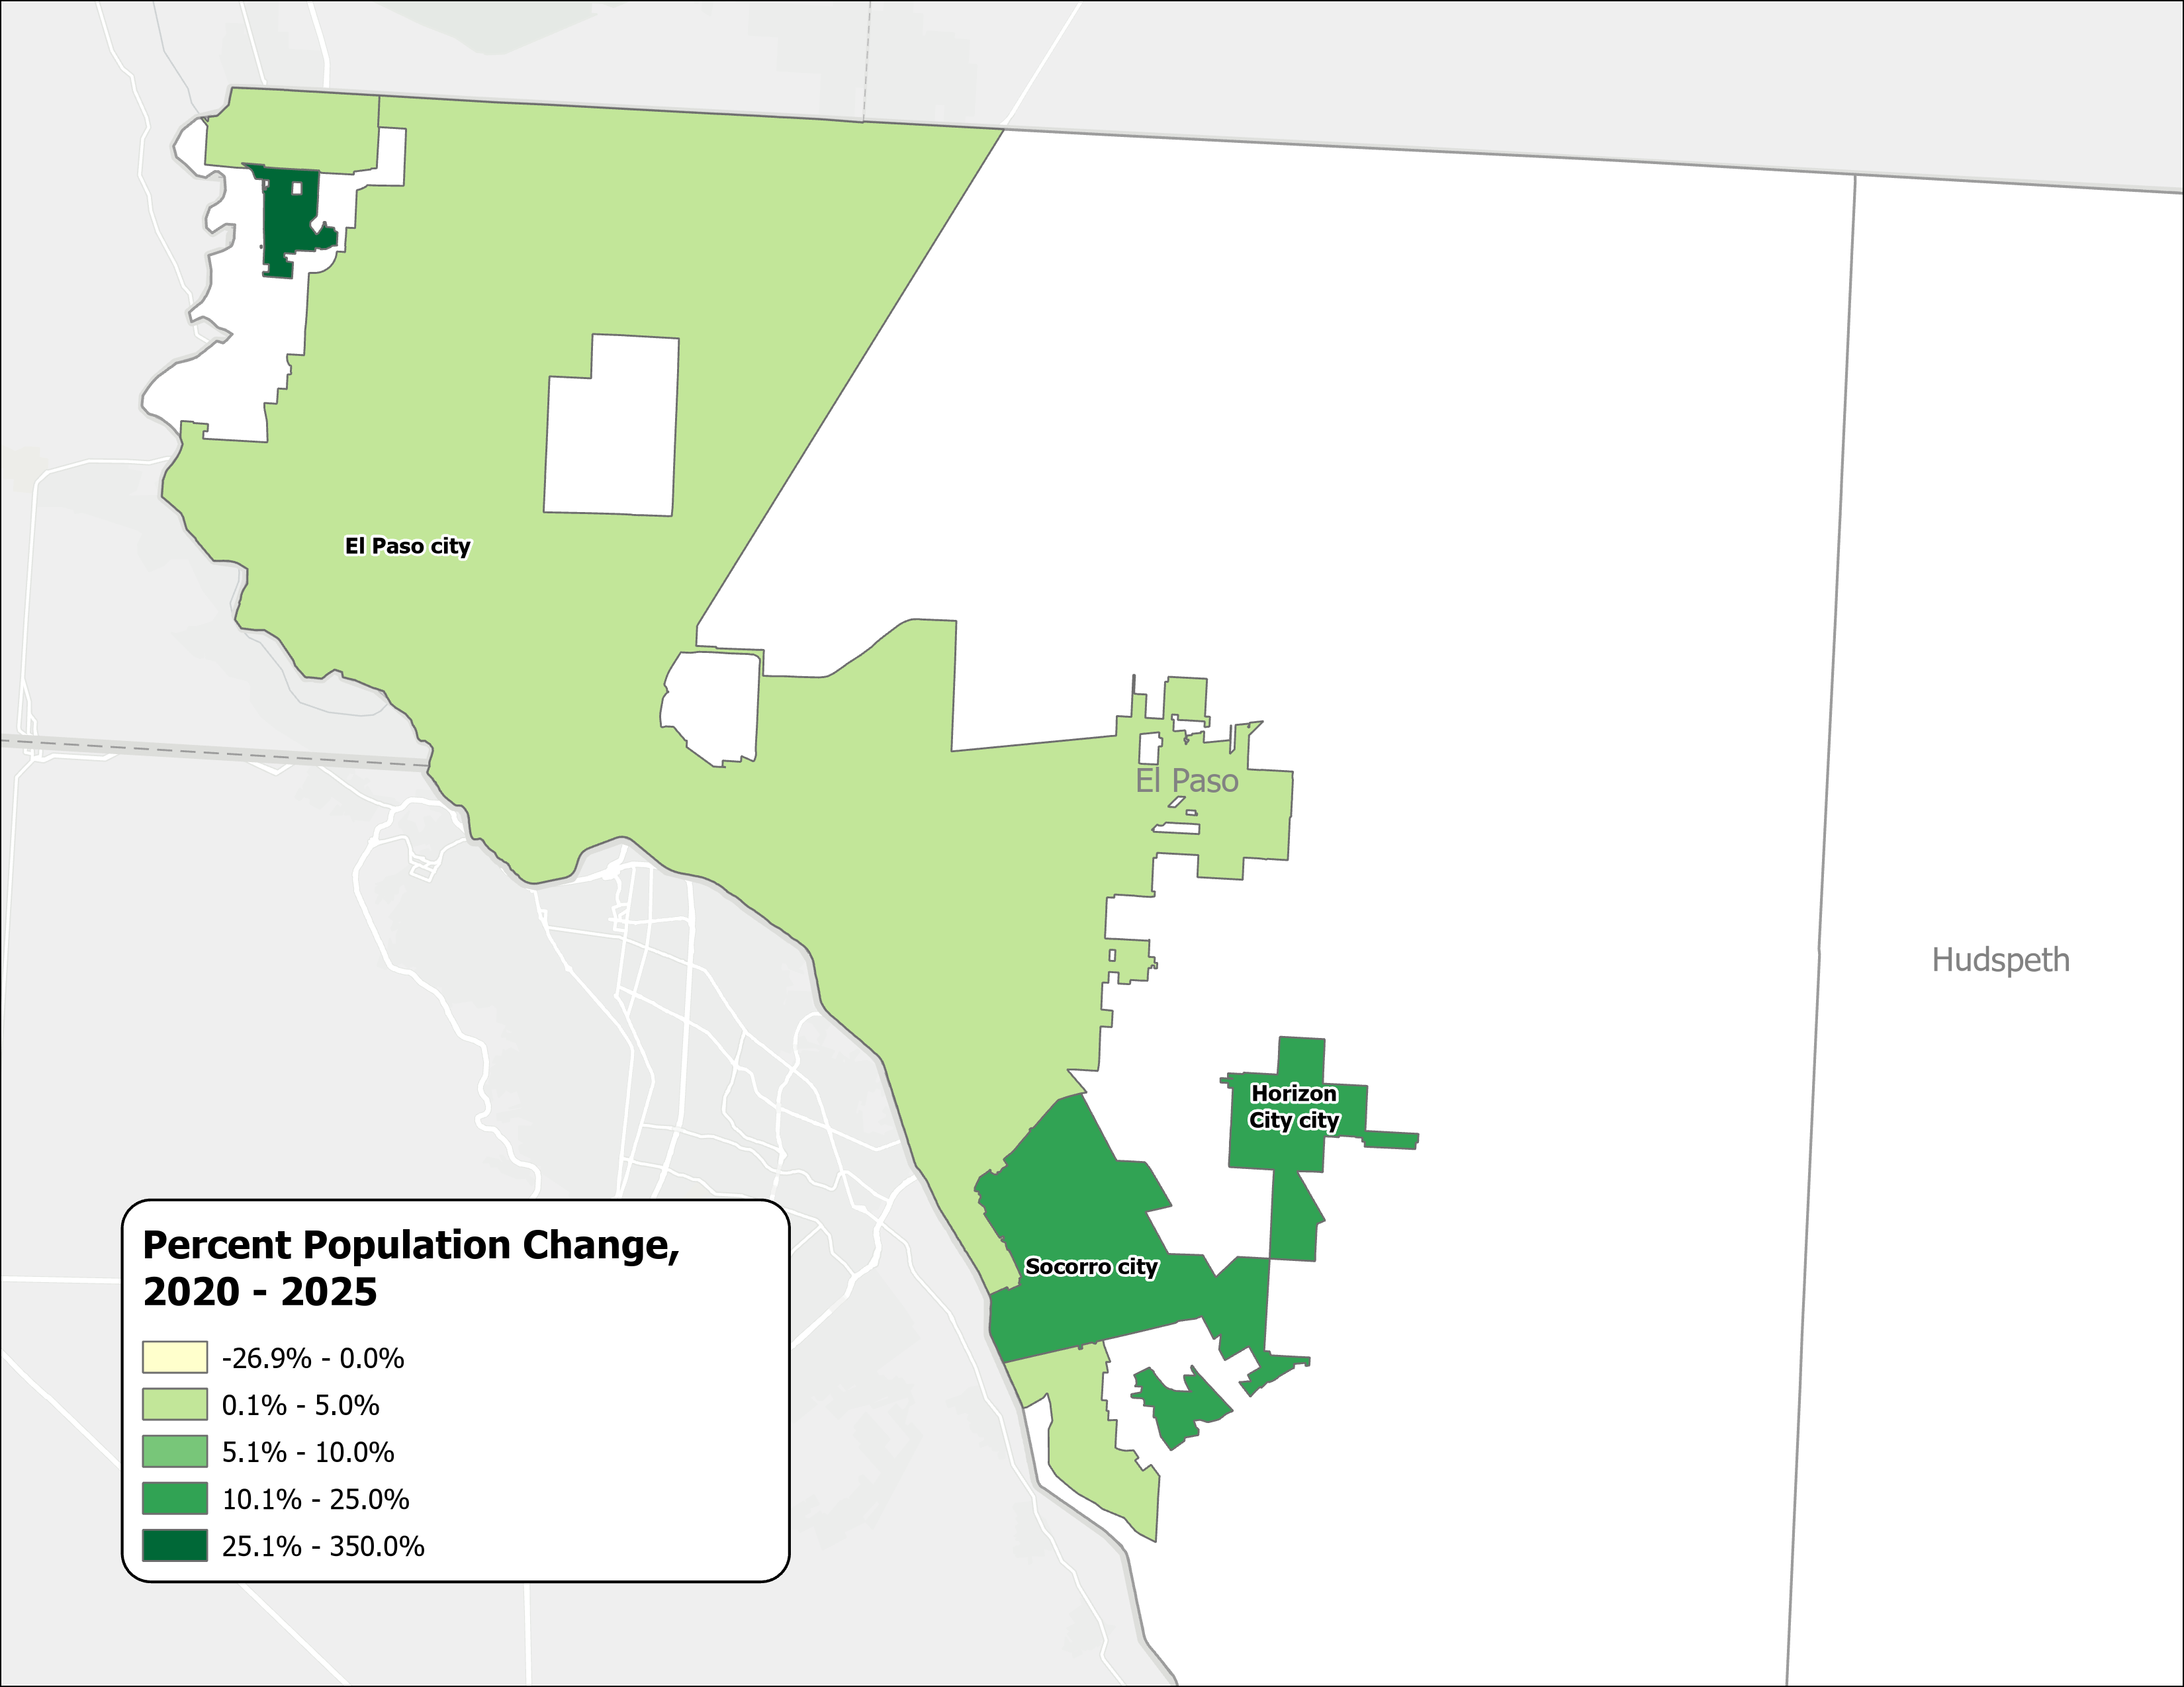
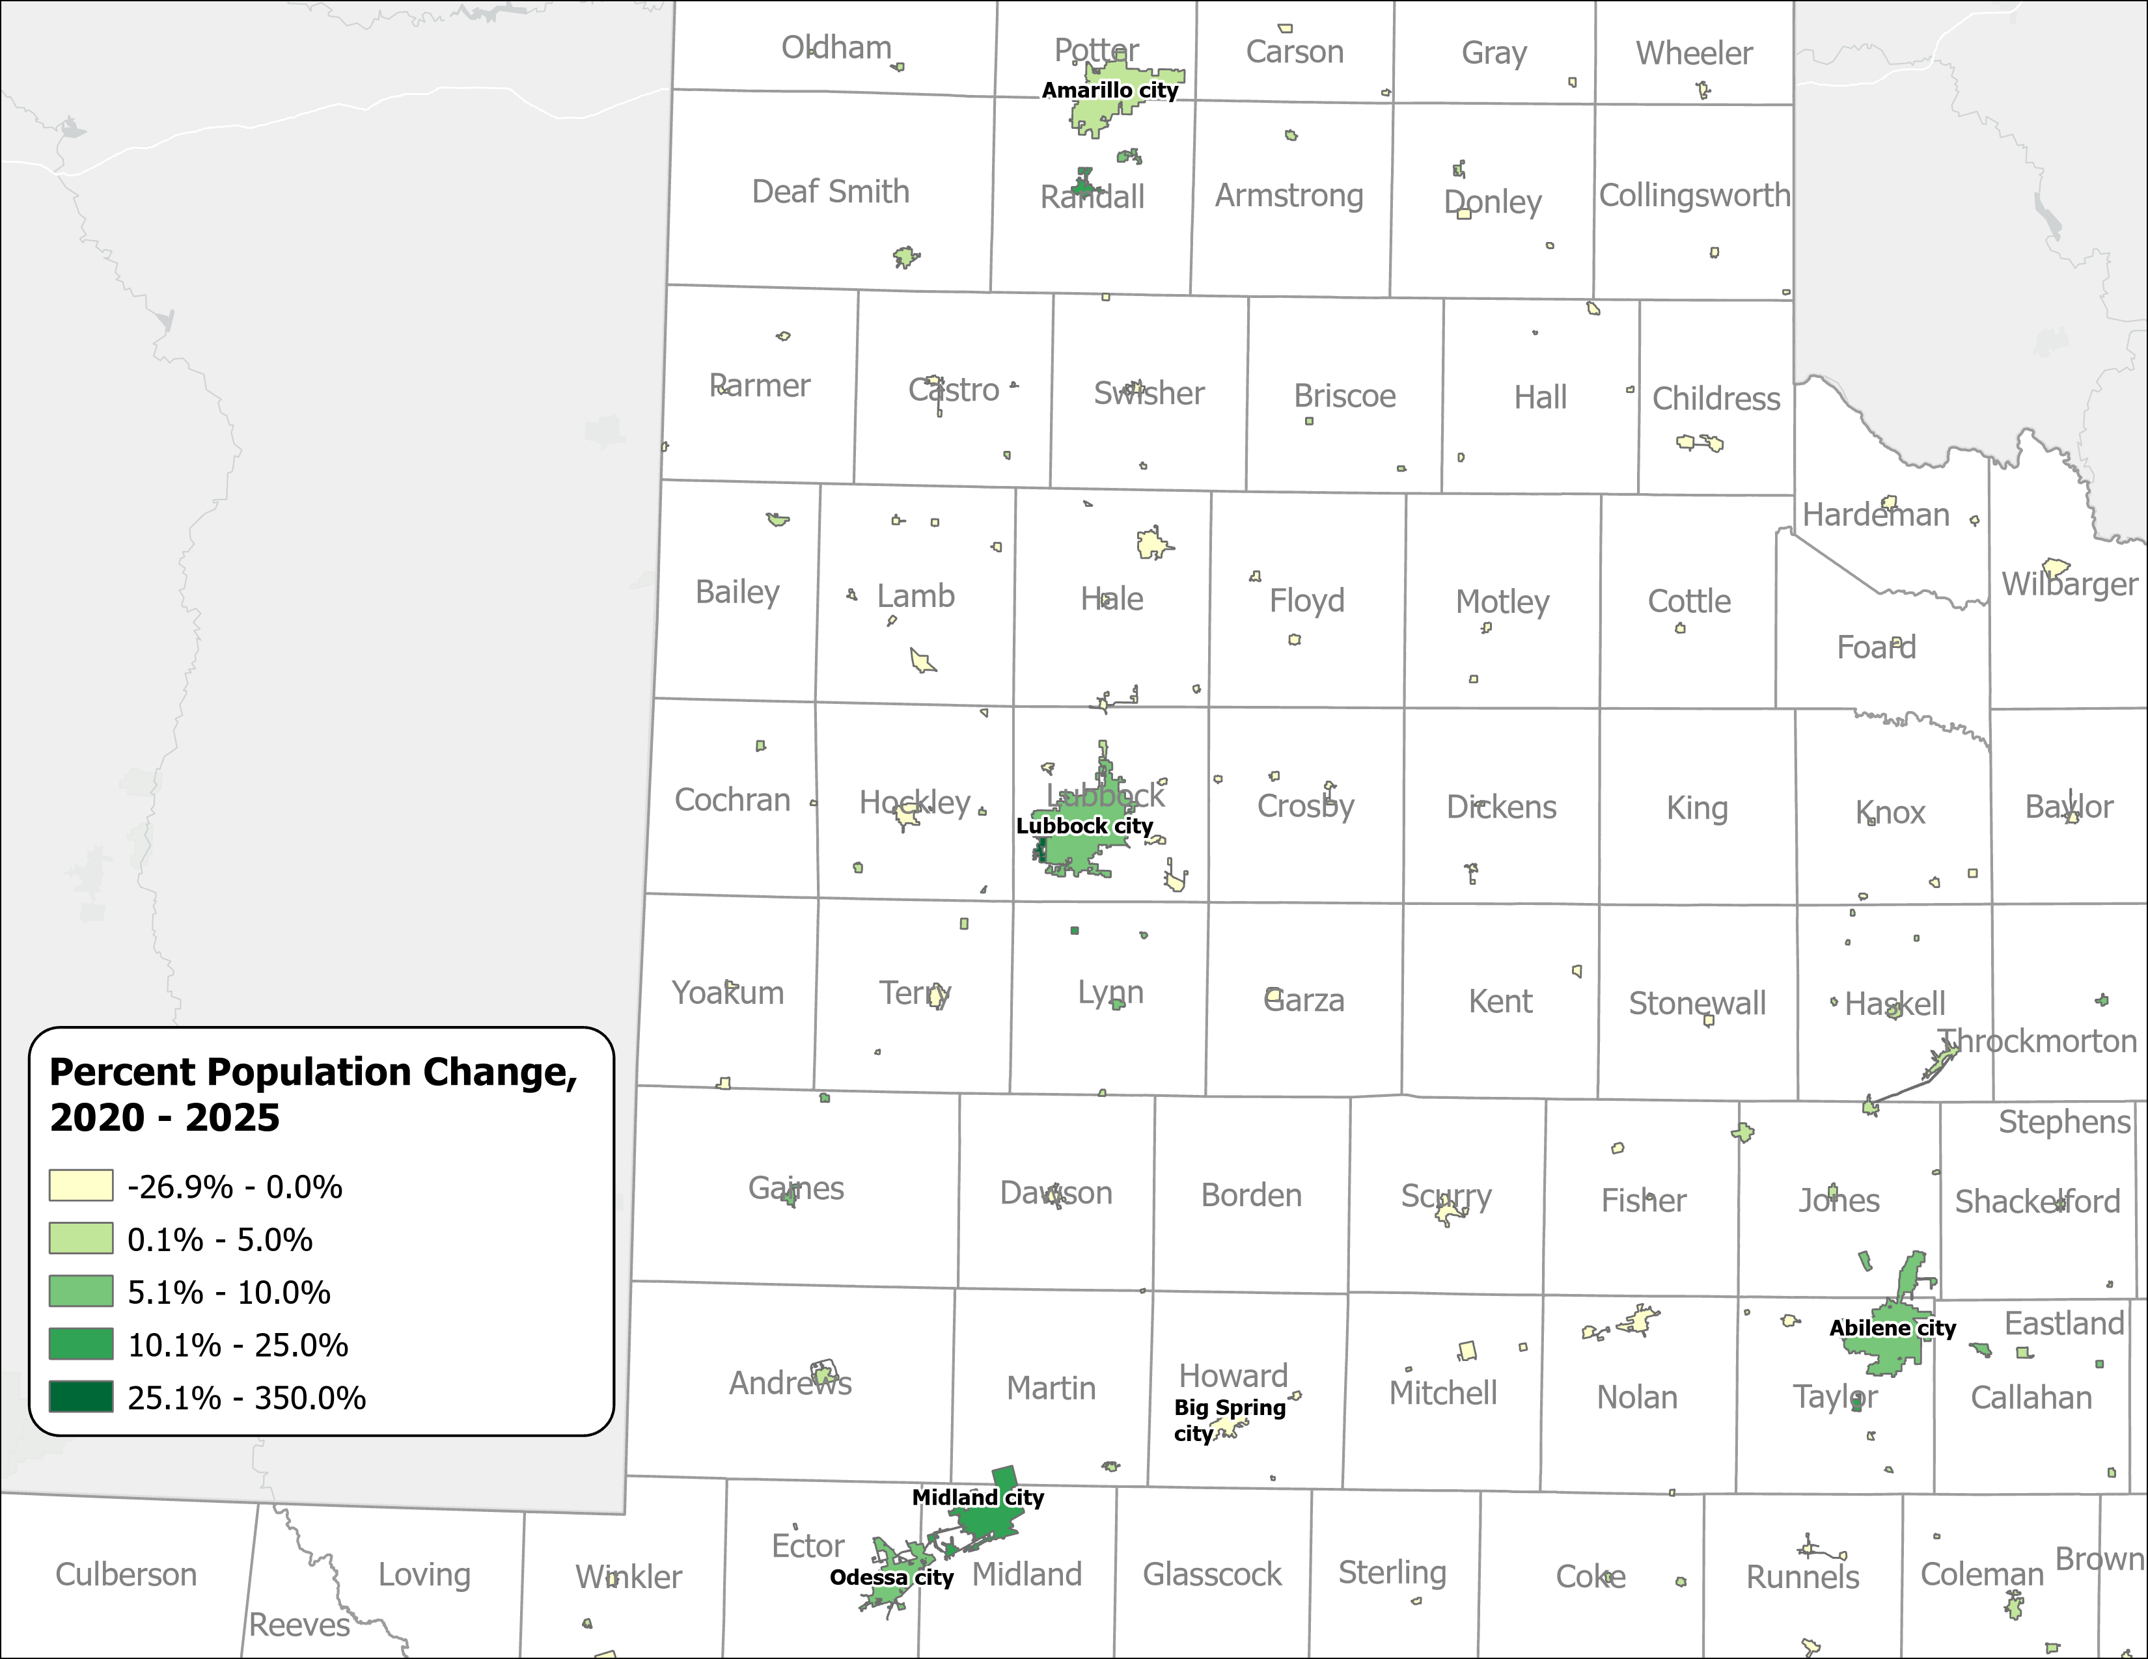
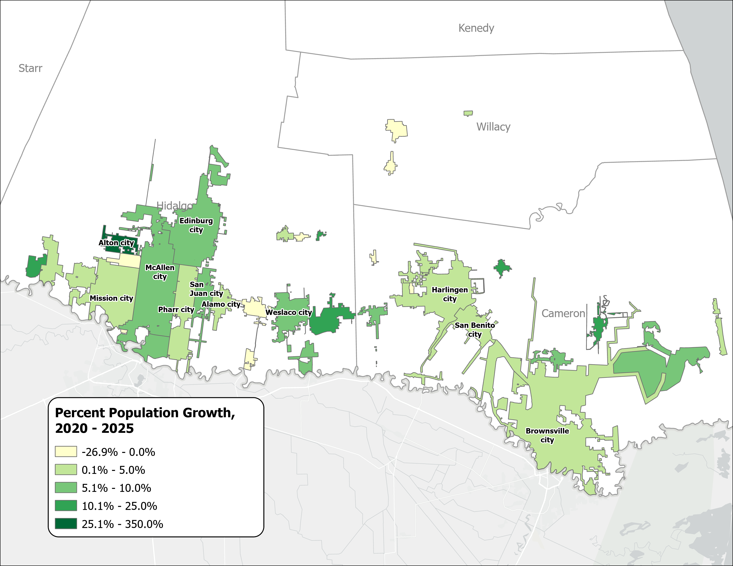
Percent Population Change for Incorporated Places, 2020-2025
(El Paso, Panhandle and West Texas, and Rio Grande Valley)
El Paso Area
Panhandle and West Texas
Rio Grande Valley
Source: U.S. Census Bureau, Vintage 2025 Population Estimates

Slide 14
Drivers of Population Growth

Slide 15
Texas Daily Population Growth and Components of Change, 2020-2025
Reduced international and domestic migration drove the decline, while natural increase made up 40% of growth, up from about 25% since 2020.
917 | 1,494 | 1,647 | 1,642 | 1,072 | Daily Average Population Change
Source: U.S. Census Bureau, Vintage 2025 Population Estimates
Note: Components of change may not add to the total population change due to the minor residual components in the Census Bureau’s Population Estimates

Slide 16
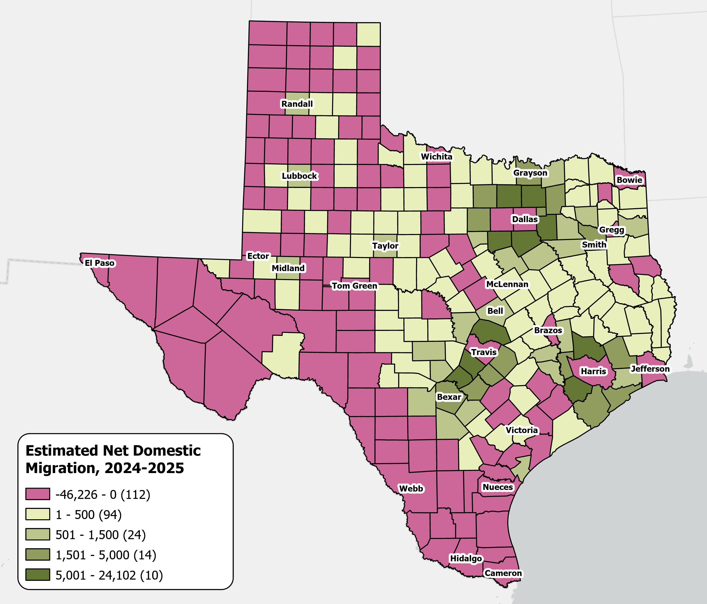
Estimates Net Domestic Migration Across Texas Counties
From July 1, 2024 to
July 1, 2025
High net domestic migration persists in suburban counties
Texas saw its
lowest domestic migration
in over a decade.
Source: U.S. Census Bureau, Vintage 2025 Population Estimates

Slide 17
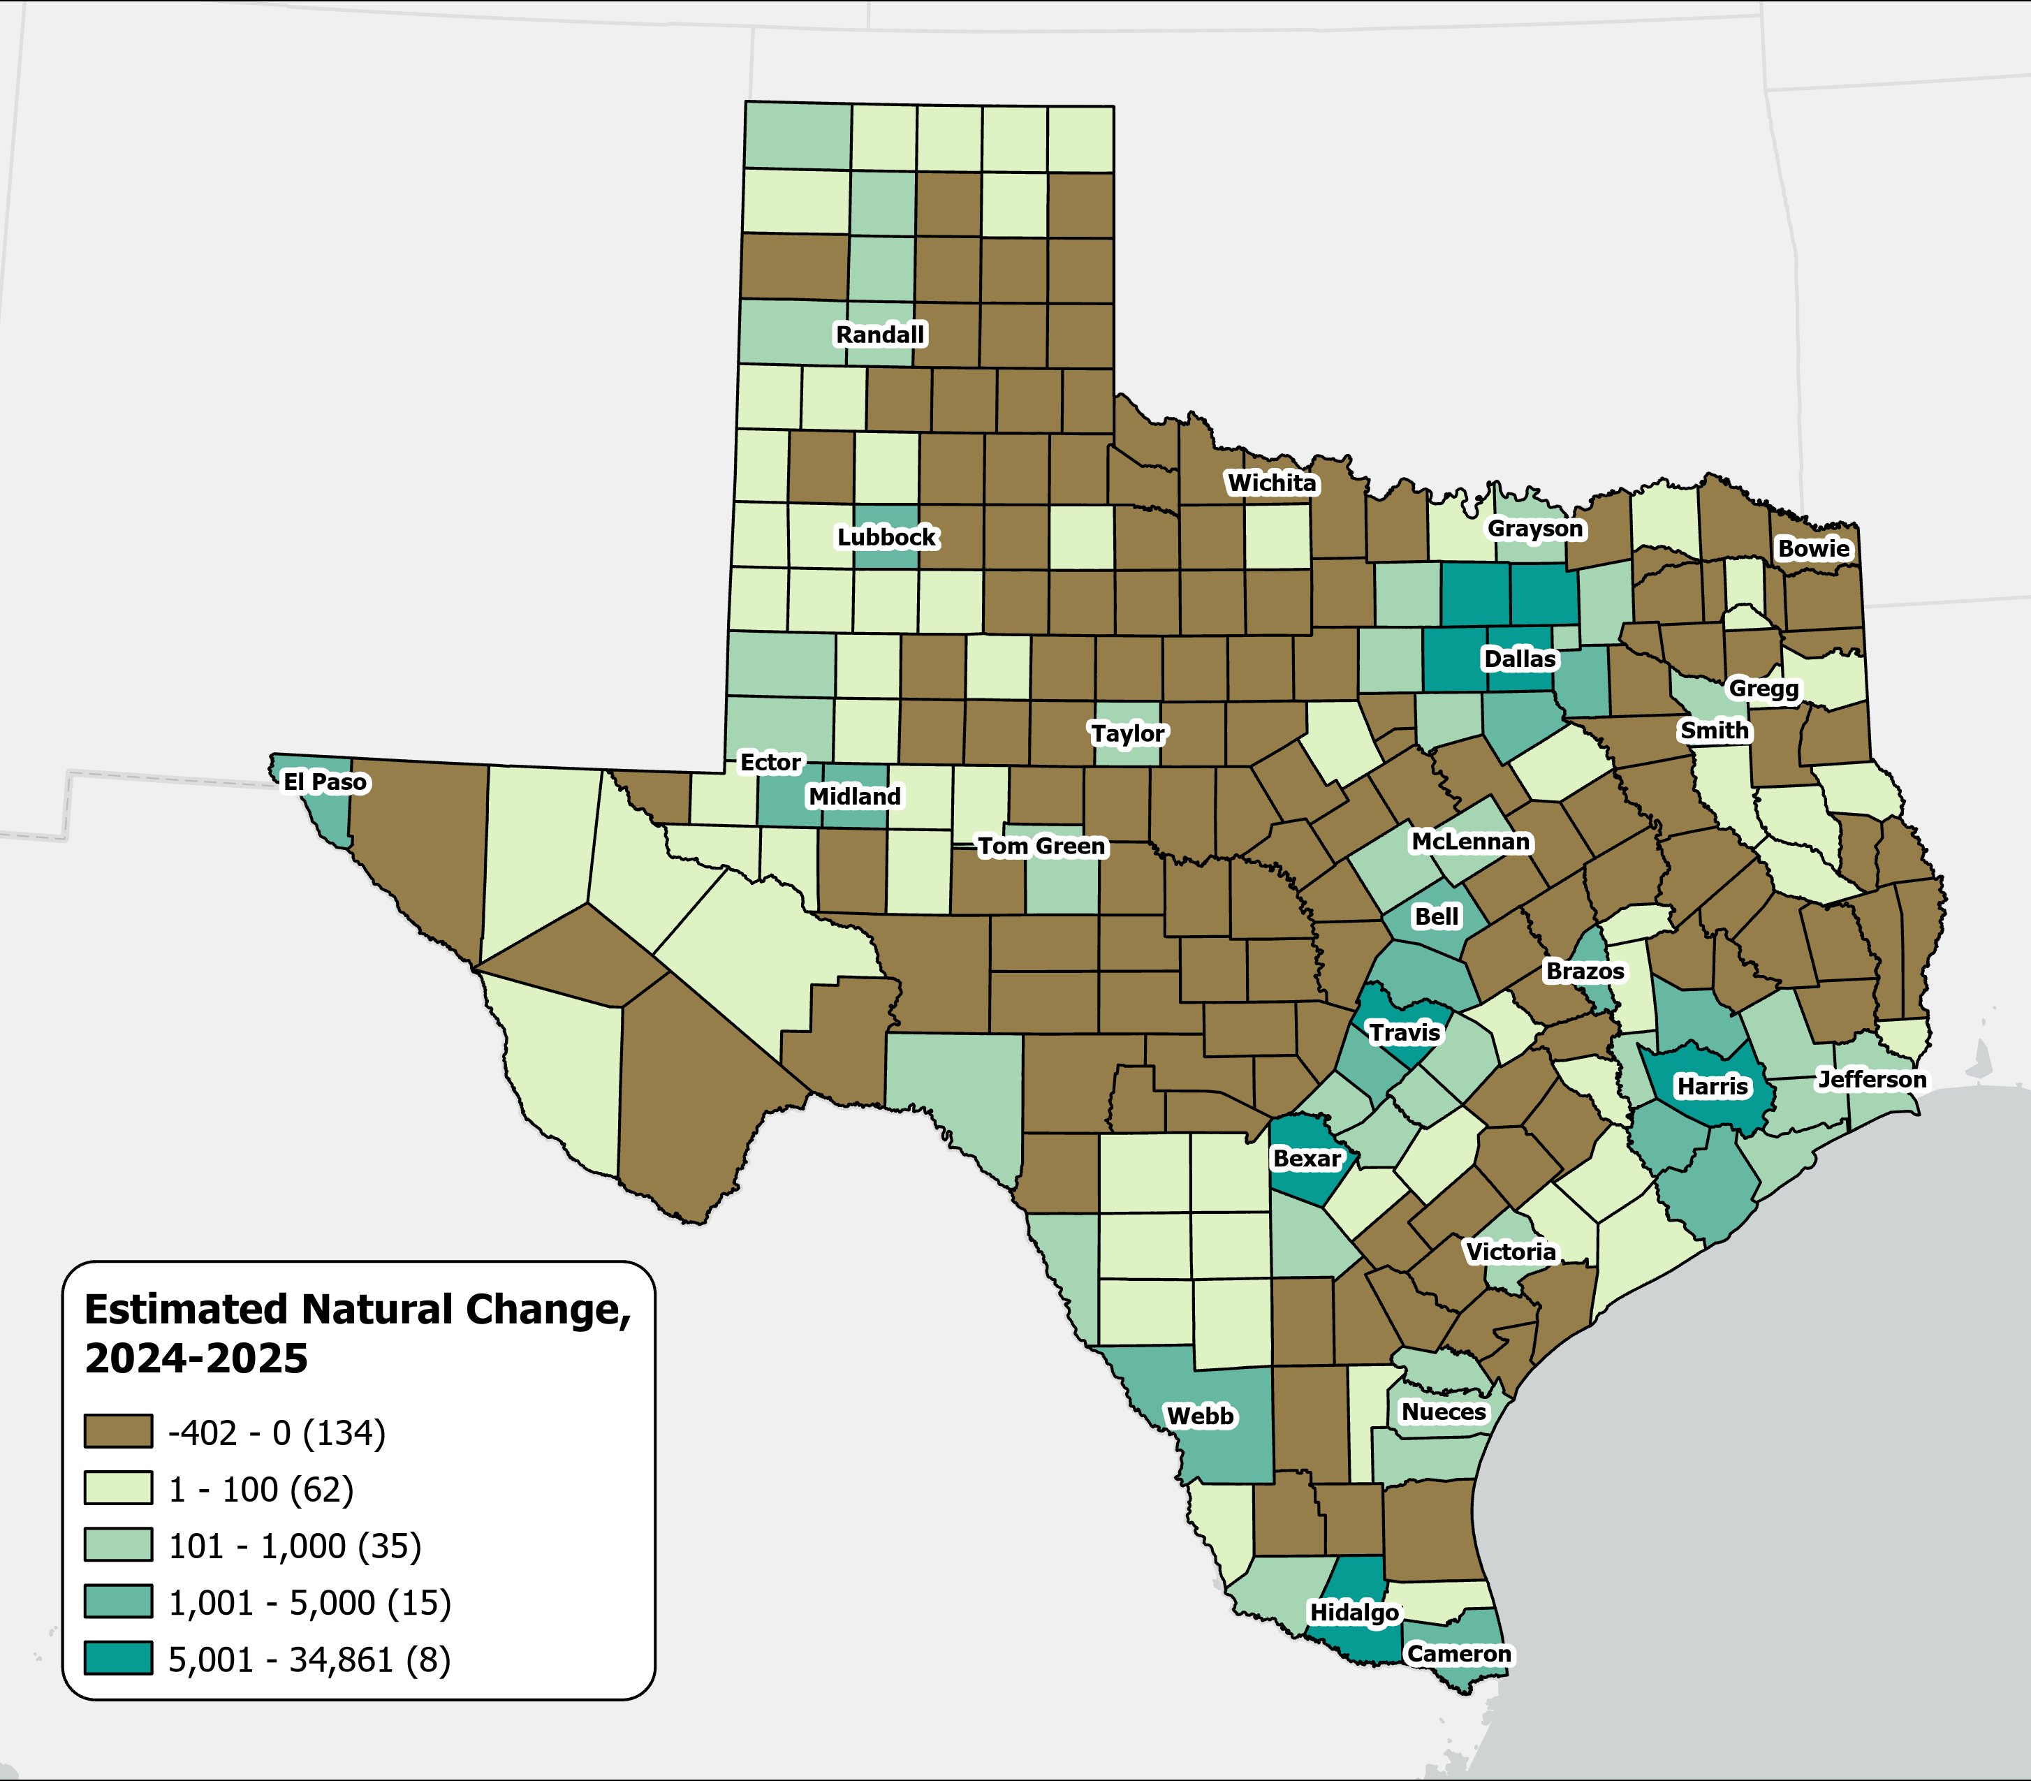
A majority of Texas counties saw more deaths than births
Estimates Natural Change Across Texas Counties
From July 2024 to July 2025
134
counties experienced natural population decline, with most located in rural areas.
Source: U.S. Census Bureau, Vintage 2025 Population Estimates

Slide 18
Texas Fertility Rates, 2007-2024
Births per 1,000 women aged 15-44
Source: Centers for Disease Control and Prevention, National Center for Health Statistics. Natality on CDC WONDER Online Database, 2007-2024.

Slide 19
Texas Fertility Rates by Age Group of Mothers, 2009 and 2024
Note: Birth rate is expressed as births per 1,000 women ages 15–44 during the calendar year.
Source: Centers for Disease Control and Prevention, National Center for Health Statistics.

Slide 20
Beyond the Demographics

Slide 21
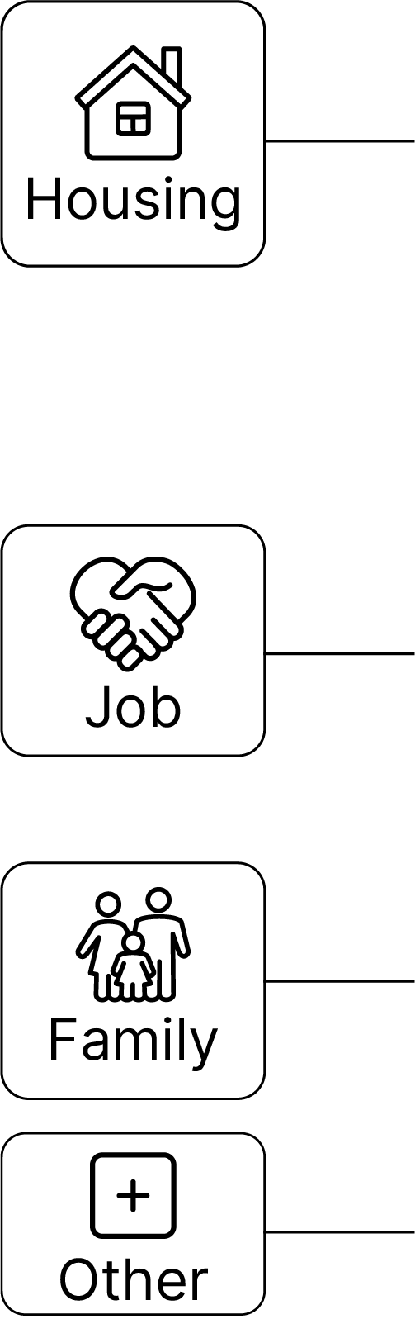
Why Texans Move, 2022-2023
Between 2024 and 2025, people moved within Texas or from elsewhere to Texas primarily for housing reasons.
Why Texans Move?
Top Detailed Reasons ?
2020
Housing | wanted new or better house/apartment | 14%
Housing | to establish own household | 12%
Job | new job or job transfer | 11%
2025
Job | new job or job transfer | 12%
Housing | wanted new or better house/apartment | 11%
Housing | cheaper housing | 11%
Source: U.S. Census Bureau, Current Population Survey Annual Social and Economic Supplement (ASEC) Supplement (March 2023).

Slide 22

Median Household Income and Home Value Gap Widens in Texas, 2013-2023
Housing costs outpace income for many Texans
Median
Home
Value
Median
Household
Income
$
$
$
Source: U.S. Census Bureau, American Community Survey, 1-Year, 2013, 2018, and 2023.
Note: Data represented in 2023 inflation-adjusted dollars.

Slide 23
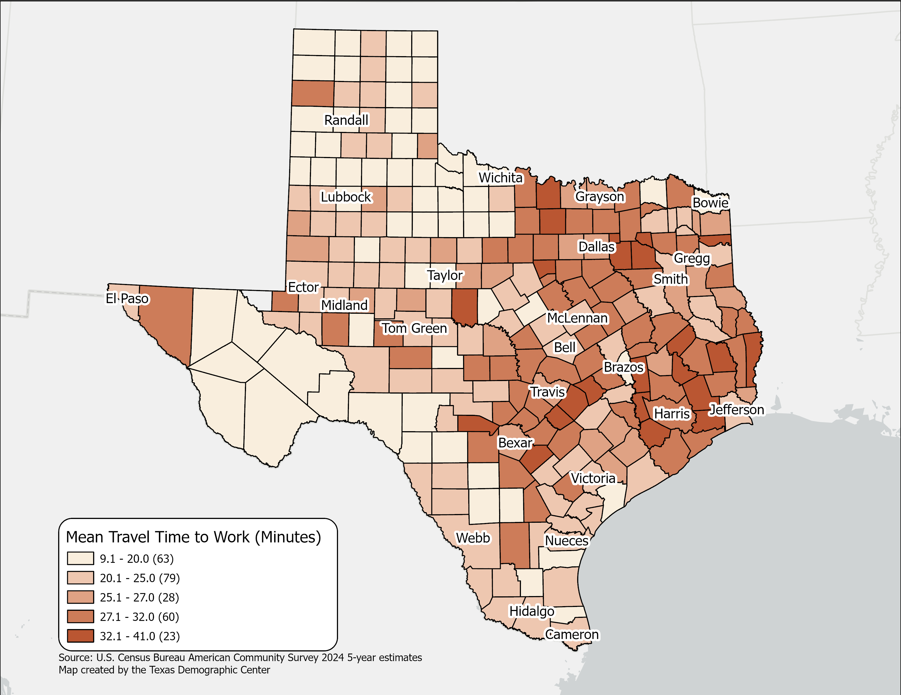
Mean Travel Time to Work(minutes),
Texas Counties, 2024
Mean Travel time for Texas:
  26.7 (2024 5-year)
  25.2 (2014 5-year)
Geographic variation across Texas counties reflects higher travel times in large metropolitan and suburban areas.
Source: U.S. Census Bureau, American Community Survey, 2024 5-year estimates

Slide 24
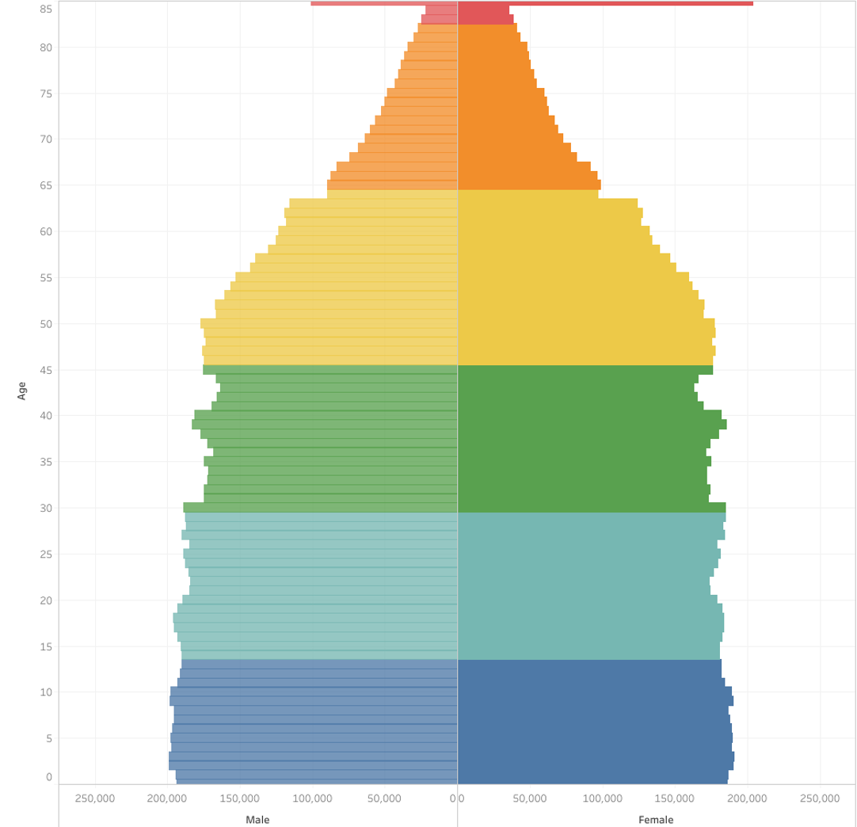
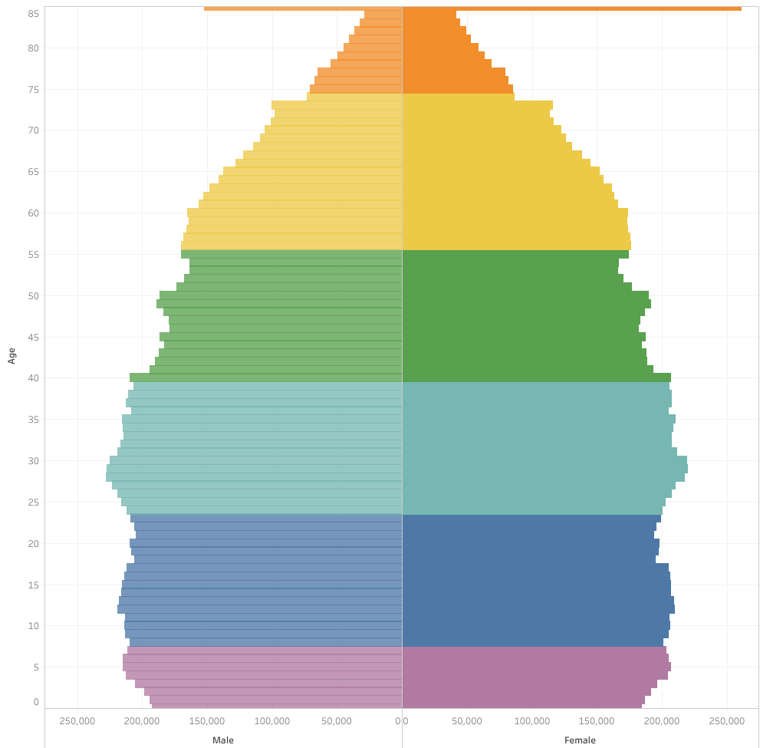
Generational Population Pyramids, Texas, 2010 and 2020
2010
2020
Generation
Greatest Generation (1901-1927)
Silent Generation (1928-1945)
Baby Boomers (1946-1964)
Generation X (1965-1980)
Millennials (1981-1996)
Generation Z (1997-2012)
Generation Alpha (2013-)
Source: U.S. Census Bureau. 2010 and 2020 Vintage Population Estimates

Slide 25
Public School Enrollment by Grade in Texas, 2014 and 2024
Source: U.S. Census Bureau. American Community Survey 1-Year sample, 2014 and 2024

Slide 26
Private School Enrollment by Grade in Texas, 2014 and 2024
% Private School
2014: 9.0%
2024: 11.7%
Source: U.S. Census Bureau. American Community Survey 1-Year sample, 2014 and 2024

Slide 27
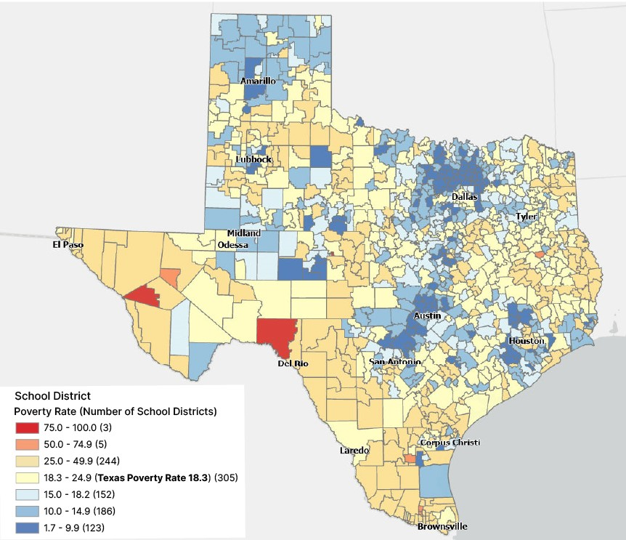
Poverty Rate for School Age Children (5-17) Living in Families, by School Districts in Texas, 2022
Many central city school districts have higher poverty rates
In Texas, nearly
1 in 5
school-age children in families live in poverty.
Source: U.S. Census Bureau, Small Area Income and Poverty Estimates (SAIPE) for 2022.

Slide 28
Labor force participation among older Texans is on the rise
Labor Force Participation Among 65+ Population, 2010 - 2024
Source: U.S. Census Bureau, American Community Survey 1-Year Estimates, 2010 and 2024

Slide 29

Disability Rate by Age in Texas, 2022
Hispanics disability rates increase faster in older age groups
Source: U.S. Census Bureau, 2022 American Community Survey 1-Year, Public Use Microdata Sample (PUMS)

Slide 30
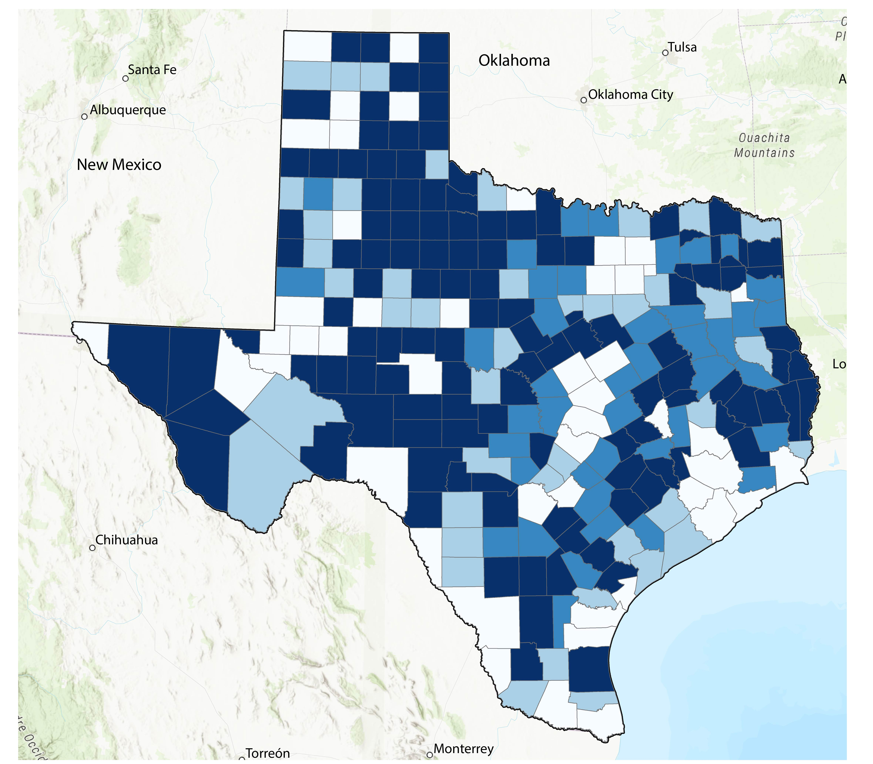
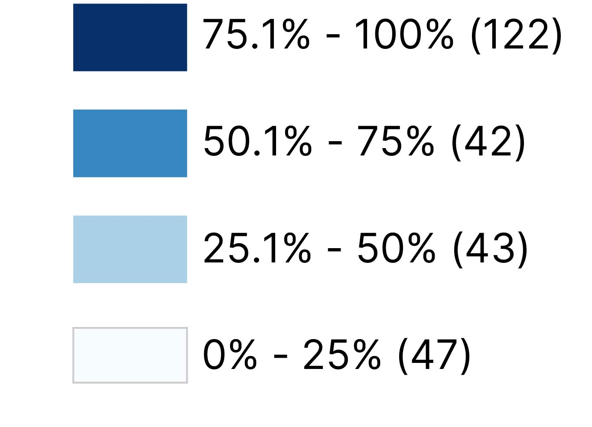
Texas is home to the largest rural population in the U.S.
Percent of Rural Population by County
4,744,808 or 16%
of Texans live outside the urban areas defined by the Census Bureau.
Source: U.S. Census Bureau, 2020 Decennial Census Demographic and Housing Characteristics (DHC) File

Slide 31
Primary Care Geographic Distribution in Texas, 2025
Source: Texas Department of State Health Services. https://healthdata.dshs.texas.gov/dashboard/health-care-workforce/hprc/health-profession-fact-sheets

Slide 32
Looking into the Future

Slide 33
Texas is expected to keep growing significantly.
Projected Population Growth in Texas with Various Migration Scenarios
42.6 million
in 2060.
(Mid-migration Scenario)
Source: Texas Demographic Center, Vintage 2024 Population Projections

Slide 34
Projected Population by Race/Ethnicity
2020-2060
Mid Migration Scenario
All race/ethnic groups are projected to grow in size except for the non-Hispanic White.
Hispanics will gain the most population, while NH Asians will experience the fastest growth
Source: Texas Demographic Center, Vintage 2024 Population Projections, Mid Migration Scenario

Slide 35
Projected Population by Age
2020, 2040, and 2060
Mid Migration Scenario
22%
18%
Texas will continue to age in the next few decades.
The 65+ group will grow fastest.
Growth among those under 18 will slow and begin to decline.
The working-age population will grow and maintain a stable share of the total population.
13%
60%
60%
62%
Total Population
29.1M
37.1M
42.6M
Source: Texas Demographic Center, Vintage 2024 Population Projections, Mid Migration Scenario

Slide 36
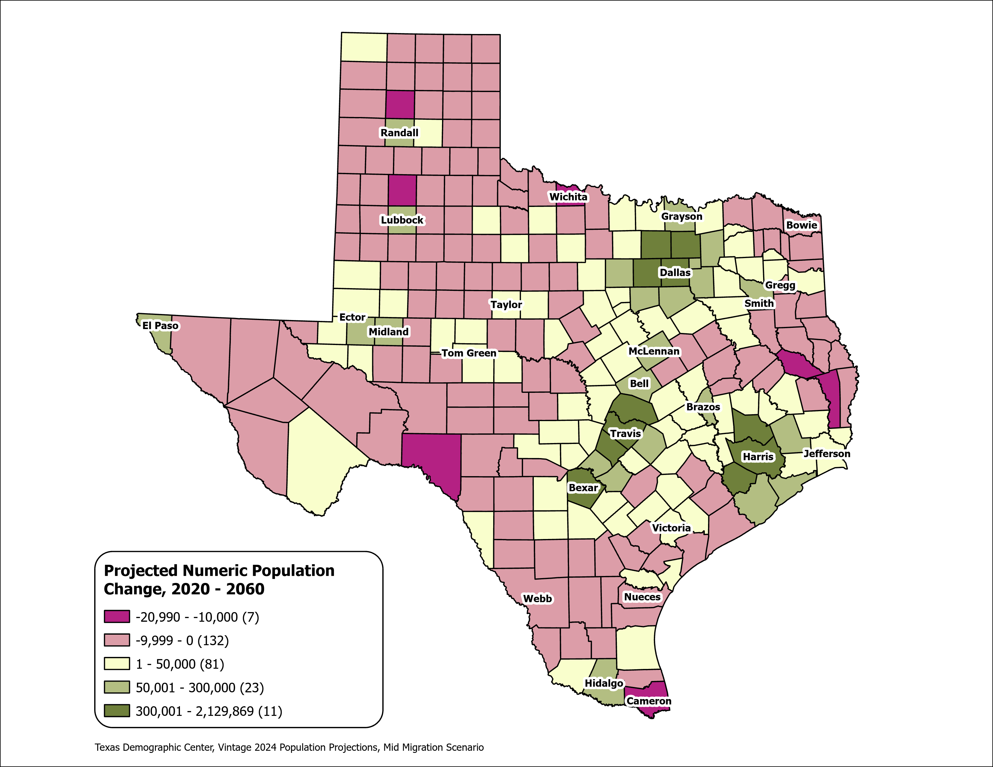
Texas Counties
Projected Population Numeric Change 2020-2060
Mid Migration Scenario
139 Counties are projected to lose population
Current MSA counties will account for 99% of the state’s growth from 2020 to 2060
The four MSAs within the TX Triangle will increase their share of population from 67% to 74%
Source: Texas Demographic Center, Vintage 2024 Population Projections, Mid Migration Scenario

Slide 37
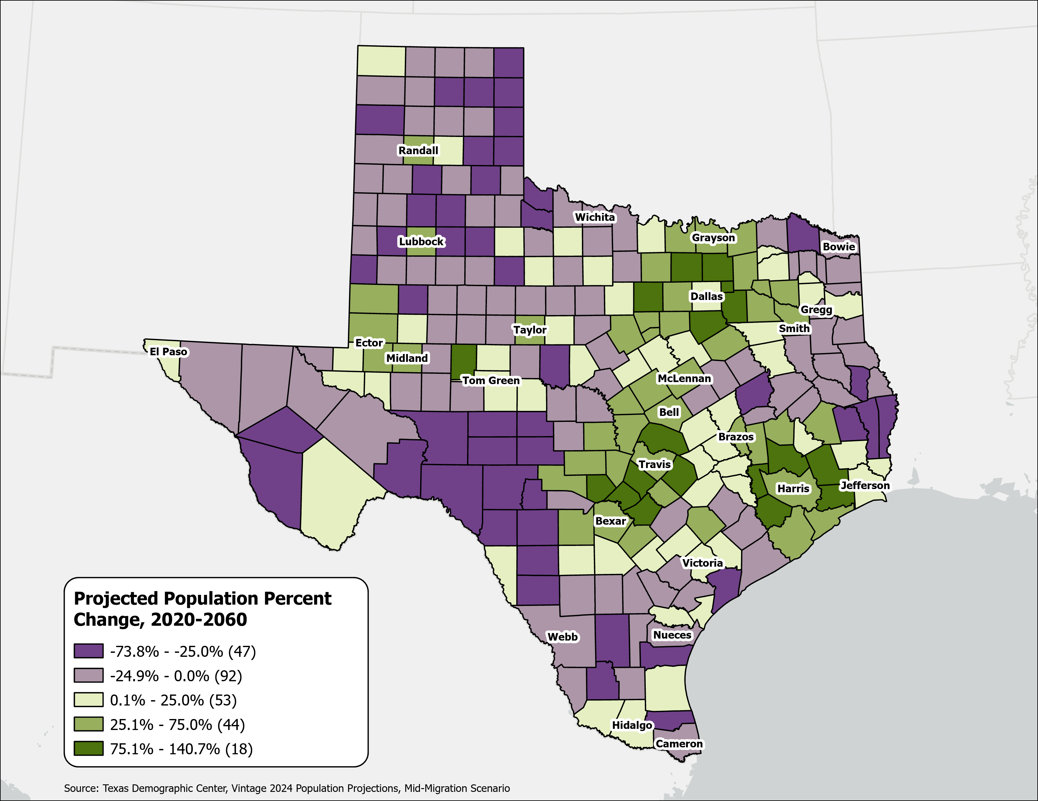
Texas Counties
Projected Population Percent Change 2020-2060
Mid Migration Scenario
Suburban ring counties in the triangle area will see the fastest growth rates.
Source: Texas Demographic Center, Vintage 2024 Population Projections, Mid Migration Scenario

Slide 38
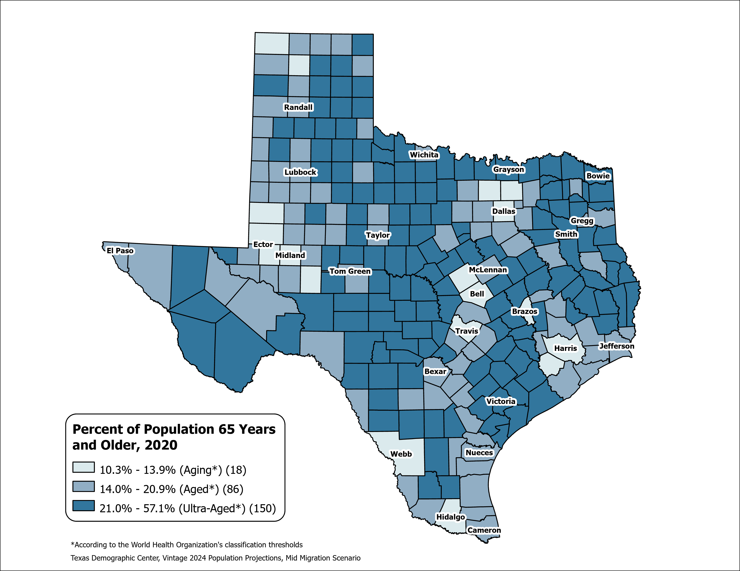
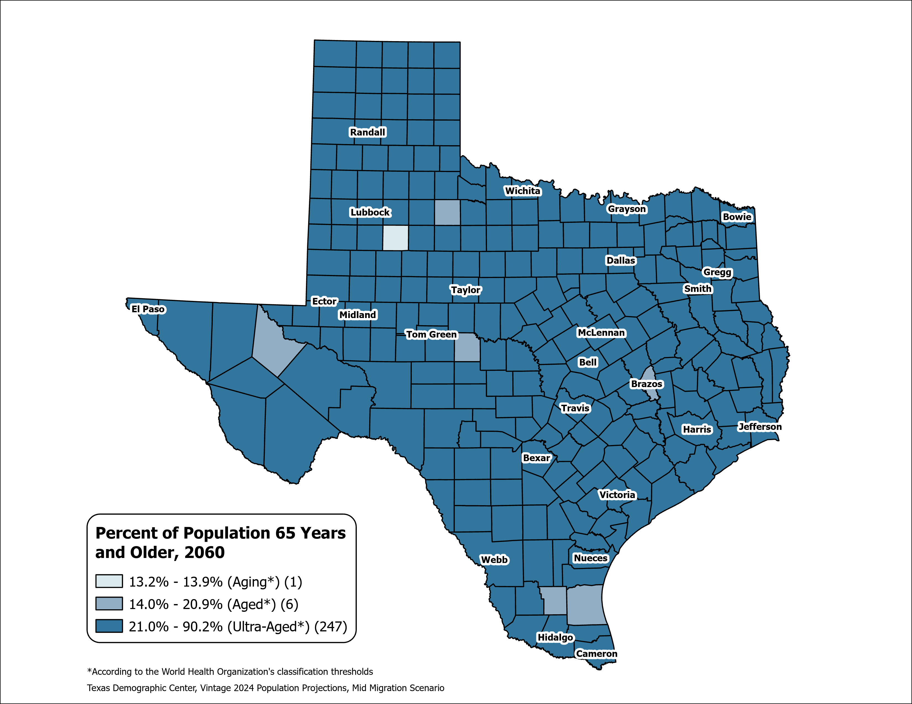
County Aging Map – Using the % of 65+ to Measure
Texas 2020: Aging (13.5%)
Texas 2060: Ultra-Aged (21.7%)
Source: Texas Demographic Center, Vintage 2024 Population Projections, Mid-Migration Scenario

Slide 39

From Data to Action
What the trends show, why they matter, and how TDC can help
The Trends
Texas keeps growing, but more slowly. Gains cluster in the suburban Texas Triangle, while rural areas shrink and the population steadily ages.
Why It Matters
These shifts reshape housing, water, transportation, schools, jobs, and healthcare in every region of the state.
How TDC Helps
The Texas Demographic Center supplies the estimates, projections, tools, and expertise to turn these trends into confident, data-driven plans.
Partner with the Texas Demographic Center to plan ahead with the data behind every decision.

Slide 40
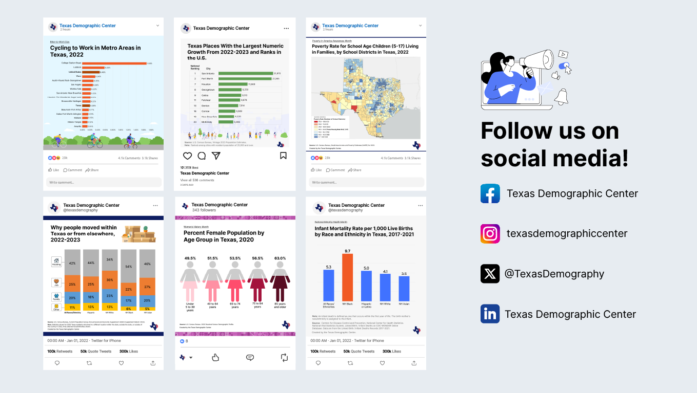
Follow us on social media

Slide 41
About Presenter
Helen You, Ph.D.
(210) 458-6530
tdc@utsa.edu
demographics.texas.gov/

