Slide 1


Slide 2


Slide 3




Major Function
Produce annual population estimates and biennial population projections
Other Services
Disseminate demographic and socioeconomic information from the Census Bureau and other reliable sources.
Provide training and technical expertise.
Custom data analyses.
State Demographer
Dr. Lloyd B. Potter
Affiliated with
The University of Texas at San Antonio
Partnerships
U.S. Census Bureau
TDC Affiliates

Slide 4
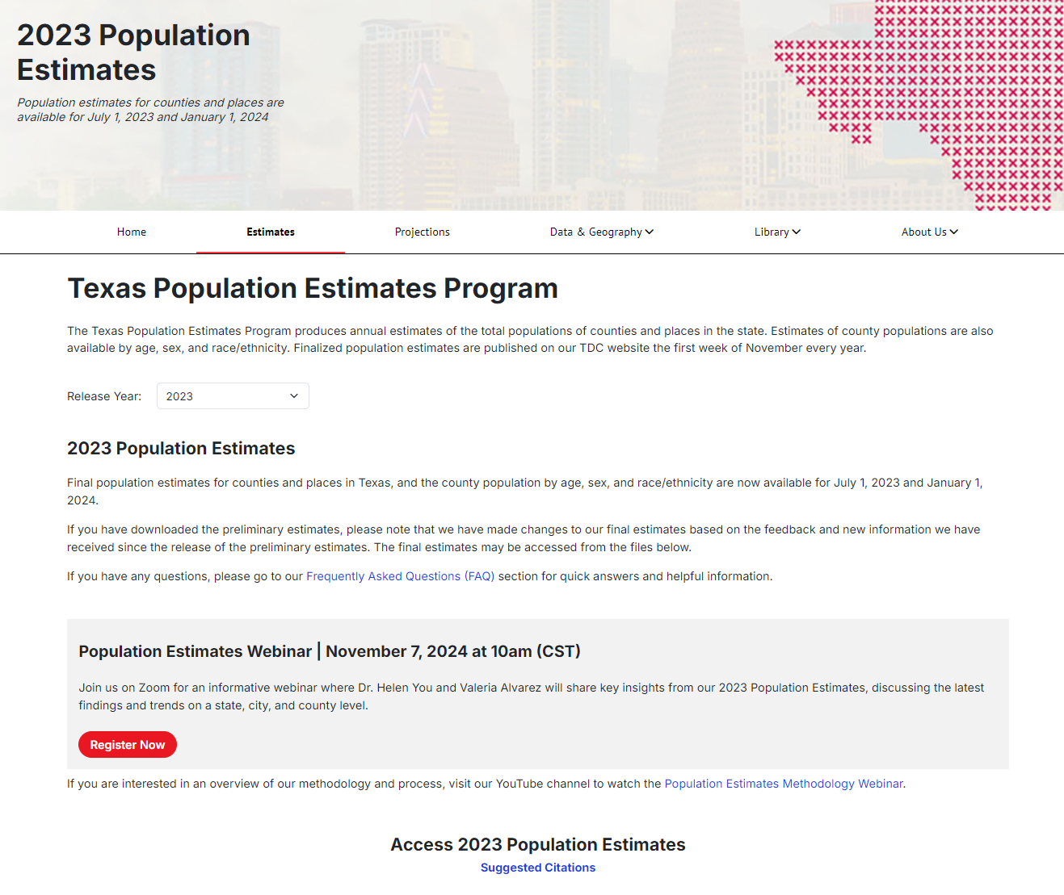

Population Estimates Methodology Webinar

Slide 5
TDC Annual Surveys
Sent in October of every year
Higher Education Survey
Sent in January of every year
Annexation & Boundary Survey
Private School Enrollment Survey
Survey of New Residential Units in Incorporated Places
Survey of New Residential Units in Unincorporated Areas
Notes:
We also collect other data sources, like administrative

Slide 6
Survey of New Residential Units in Incorporated Places Response Rates, 2013 - 2023

Slide 7
Survey of New Residential Units in Unincorporated Areas Response Rates, 2013 - 2023

Slide 8
Survey Response Methods
Online Form
Email
Mail
Want to ensure your city/county or educational institution receives our surveys every year?
Email us at tdc@utsa.edu and we can check/update your contact information.

Slide 9
County Rankings for Authorized New Residential Units
Ranking | County | New Residential Units 2020 - 2023
1 | Harris | 65,816
2 | Collin | 63,620
3 | Travis | 61,697
4 | Dallas | 60,576
5 | Tarrant | 56,238
6 | Denton | 43,116
7 | Bexar | 23,288
8 | Williamson | 19,726
9 | Hidalgo | 13,203
10 | Lubbock | 12,910
Ranking | County | New Residential Units 2023
1 | Harris | 17,207
2 | Travis | 16,590
3 | Collin | 16,280
4 | Dallas | 12,866
5 | Denton | 10,421
6 | Tarrant | 8,400
7 | Bexar | 5,054
8 | Hays | 4,189
9 | Williamson | 3,510
10 | Montgomery | 3,469
Note: Authorized new residential units are units that have been approved for development but that might not yet have completed construction
Source: Texas Demographic Center, Survey of New Residential Units in Incorporated Places, 2020 - 2023

Slide 10
City Rankings for Authorized New Residential Units, 2023
Ranking | City | New Residential Units 2023 | % Multi-family Housing Units
1 | Houston | 15,771 | 60%
2 | Austin | 14,955 | 87%
3 | Dallas | 8,974 | 80%
4 | Fort Worth | 5,576 | 54%
5 | McKinney | 5,017 | 63%
6 | San Antonio | 4,388 | 30%
7 | Celina | 3,400 | 26%
8 | Frisco | 3,399 | 70%
9 | Denton | 3,285 | 64%
10 | Conroe | 2,885 | 36%
Note: Authorized new residential units are units that have been approved for development but that might not yet have completed construction
Source: Texas Demographic Center, Survey of New Residential Units in Incorporated Places, 2023

Slide 11
Municipal Boundary Changes in Texas, 2023
In 2023, there were 372 boundary changes across Texas municipalities.
359 annexations occurred across 150 municipalities
A total of 6,119 Texas residents were living in these annexed areas
13 detachments occurred across 12 municipalities
A total of 3 Texas residents were living in these detached areas
Source: Texas Demographic Center, Annexation & Boundary Survey, 2023
Notes:
Checked Census Bureau BAS responses, they had 240 reported annexation
Terminology that the CB uses: annexations or additions / deannexations or deletions

Slide 12
Higher Education Students Residing in University-Owned Housing, Texas, 2020 - 2023
Source: Texas Demographic Center, Higher Education Survey, 2020 - 2023

Slide 13
Students Enrolled in Private School Grades 1-8 in Texas, 2020 - 2023
Source: Texas Demographic Center, Private School Enrollment Survey, 2020 - 2023
Notes:
Texas Private School Accreditation Commission

Slide 14
Students Aged 6 – 14 Enrolled in Public Schools in Texas, 2020 - 2023
From 2022 to 2023, 79 counties saw an increase in the number of students aged 6-14 enrolled in public school.
Note: Charter school enrollment numbers are included in the above data
Source: Texas Education Agency, Public Information Request, 2020 - 2023

Slide 15
Medicare Aged Beneficiaries, Texas, 2020 - 2023
From 2022 to 2023, 228 counties saw an increase in the number of Medicare aged beneficiaries
Note: Medicare aged beneficiaries are 65 years and older
Source: U.S. Centers for Medicare & Medicaid Services, Medicare Monthly Enrollment dataset, 2020 - 2023

Slide 16


Slide 17
Demographic Trends
The 2023 TDC Estimates

Slide 18
TDC Population Estimates Products Overview
Estimates released in the fall of every year
Latest: Vintage 2023 Estimates
Include:
  Total population Estimates for July 2023 and for January 2024.
    State
    County (MSA and Council of Government)
    Incorporated place (city/town)
  Demographic details for counties.
    Single year of age;
    Male/Female;
    Five race/ethnic groups: Hispanic, NH White, NH Black, NH Asian, and NH Other

Slide 19
TDC Population Estimates, 2023
MSA TOTAL
MSA (July 2023) | 2020 April Census Count | 2023 July TDC Estimates | 2023 Pop as Share of TX | 2020-2023 Growth as Share of TX
Dallas-Fort Worth-Arlington | 7,637,387 | 8,108,518 | 27% | 34%
Houston-Pasadena-The Woodlands | 7,149,642 | 7,488,332 | 25% | 25%
San Antonio-New Braunfels | 2,558,143 | 2,698,652 | 9% | 10%
Austin-Round Rock-San Marcos | 2,283,371 | 2,494,648 | 8% | 15%
McAllen-Edinburg-Mission | 870,781 | 903,213 | 3% | 2%
El Paso | 868,859 | 873,709 | 3% | 0%
Killeen-Temple | 475,367 | 495,341 | 2% | 1%
Corpus Christi | 445,763 | 447,500 | 1% | 0%
Brownsville-Harlingen | 421,017 | 426,062 | 1% | 0%
Beaumont-Port Arthur | 397,565 | 396,624 | 1% | 0%
…
Eagle Pass | 57,887 | 57,775 | 0% | 0%
All MSAs | 26,249,929 | 27,558,902 | 90.3% | 95.5%
Texas | 29,145,505 | 30,516,398
New MSA
Source: Texas Demographic Center, Vintage 2023 Population Estimates. U. S. Census Bureau, 2020 Decennial Census.

Slide 20
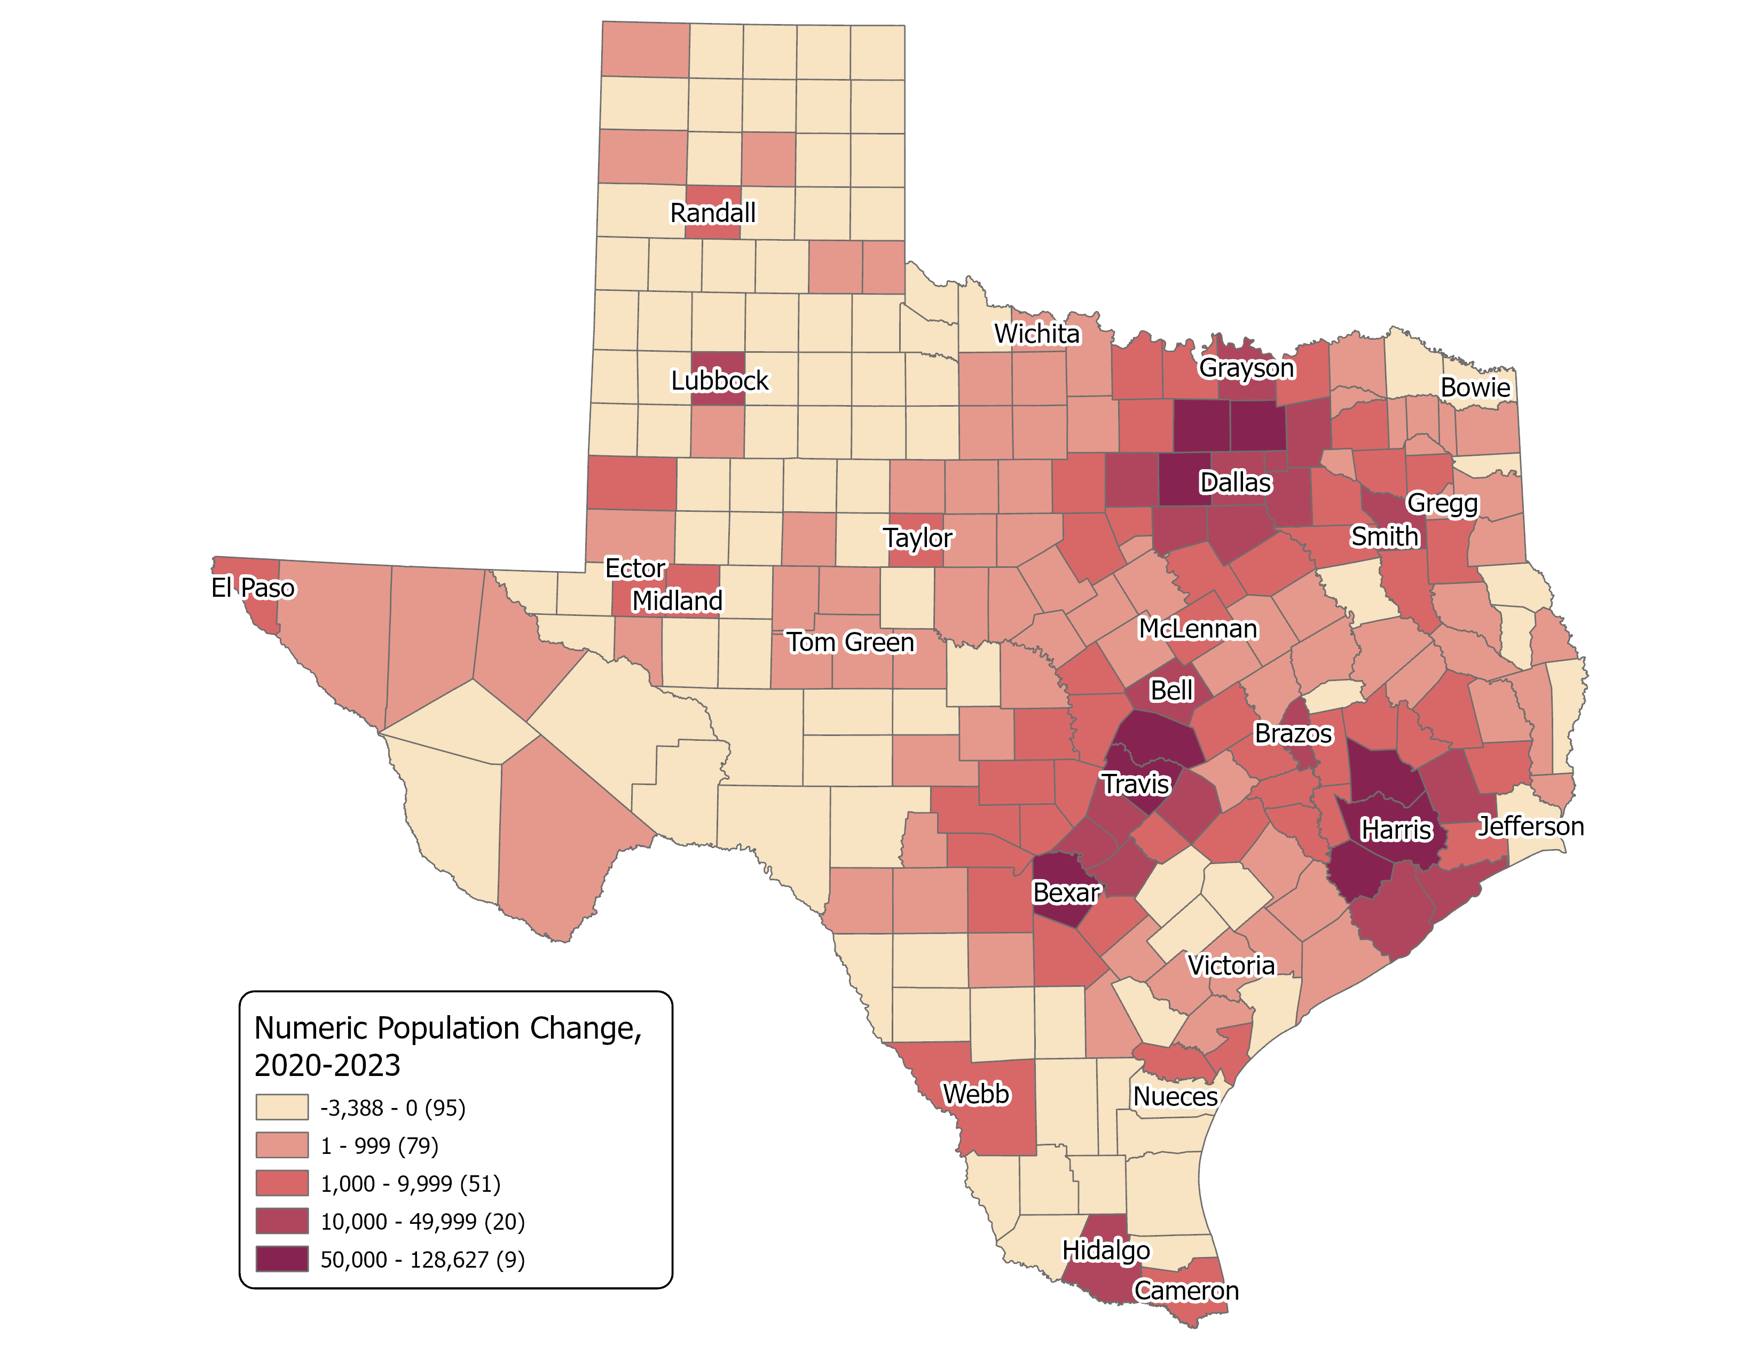
Estimated Numeric Population Change
COUNTY TOTAL
Over one-third of counties have experienced population decline.
Most population growth is observed in large metropolitan areas.
Source: Texas Demographic Center, Vintage 2023 Population Estimates, U. S. Census Bureau, 2020 Decennial Census.

Slide 21
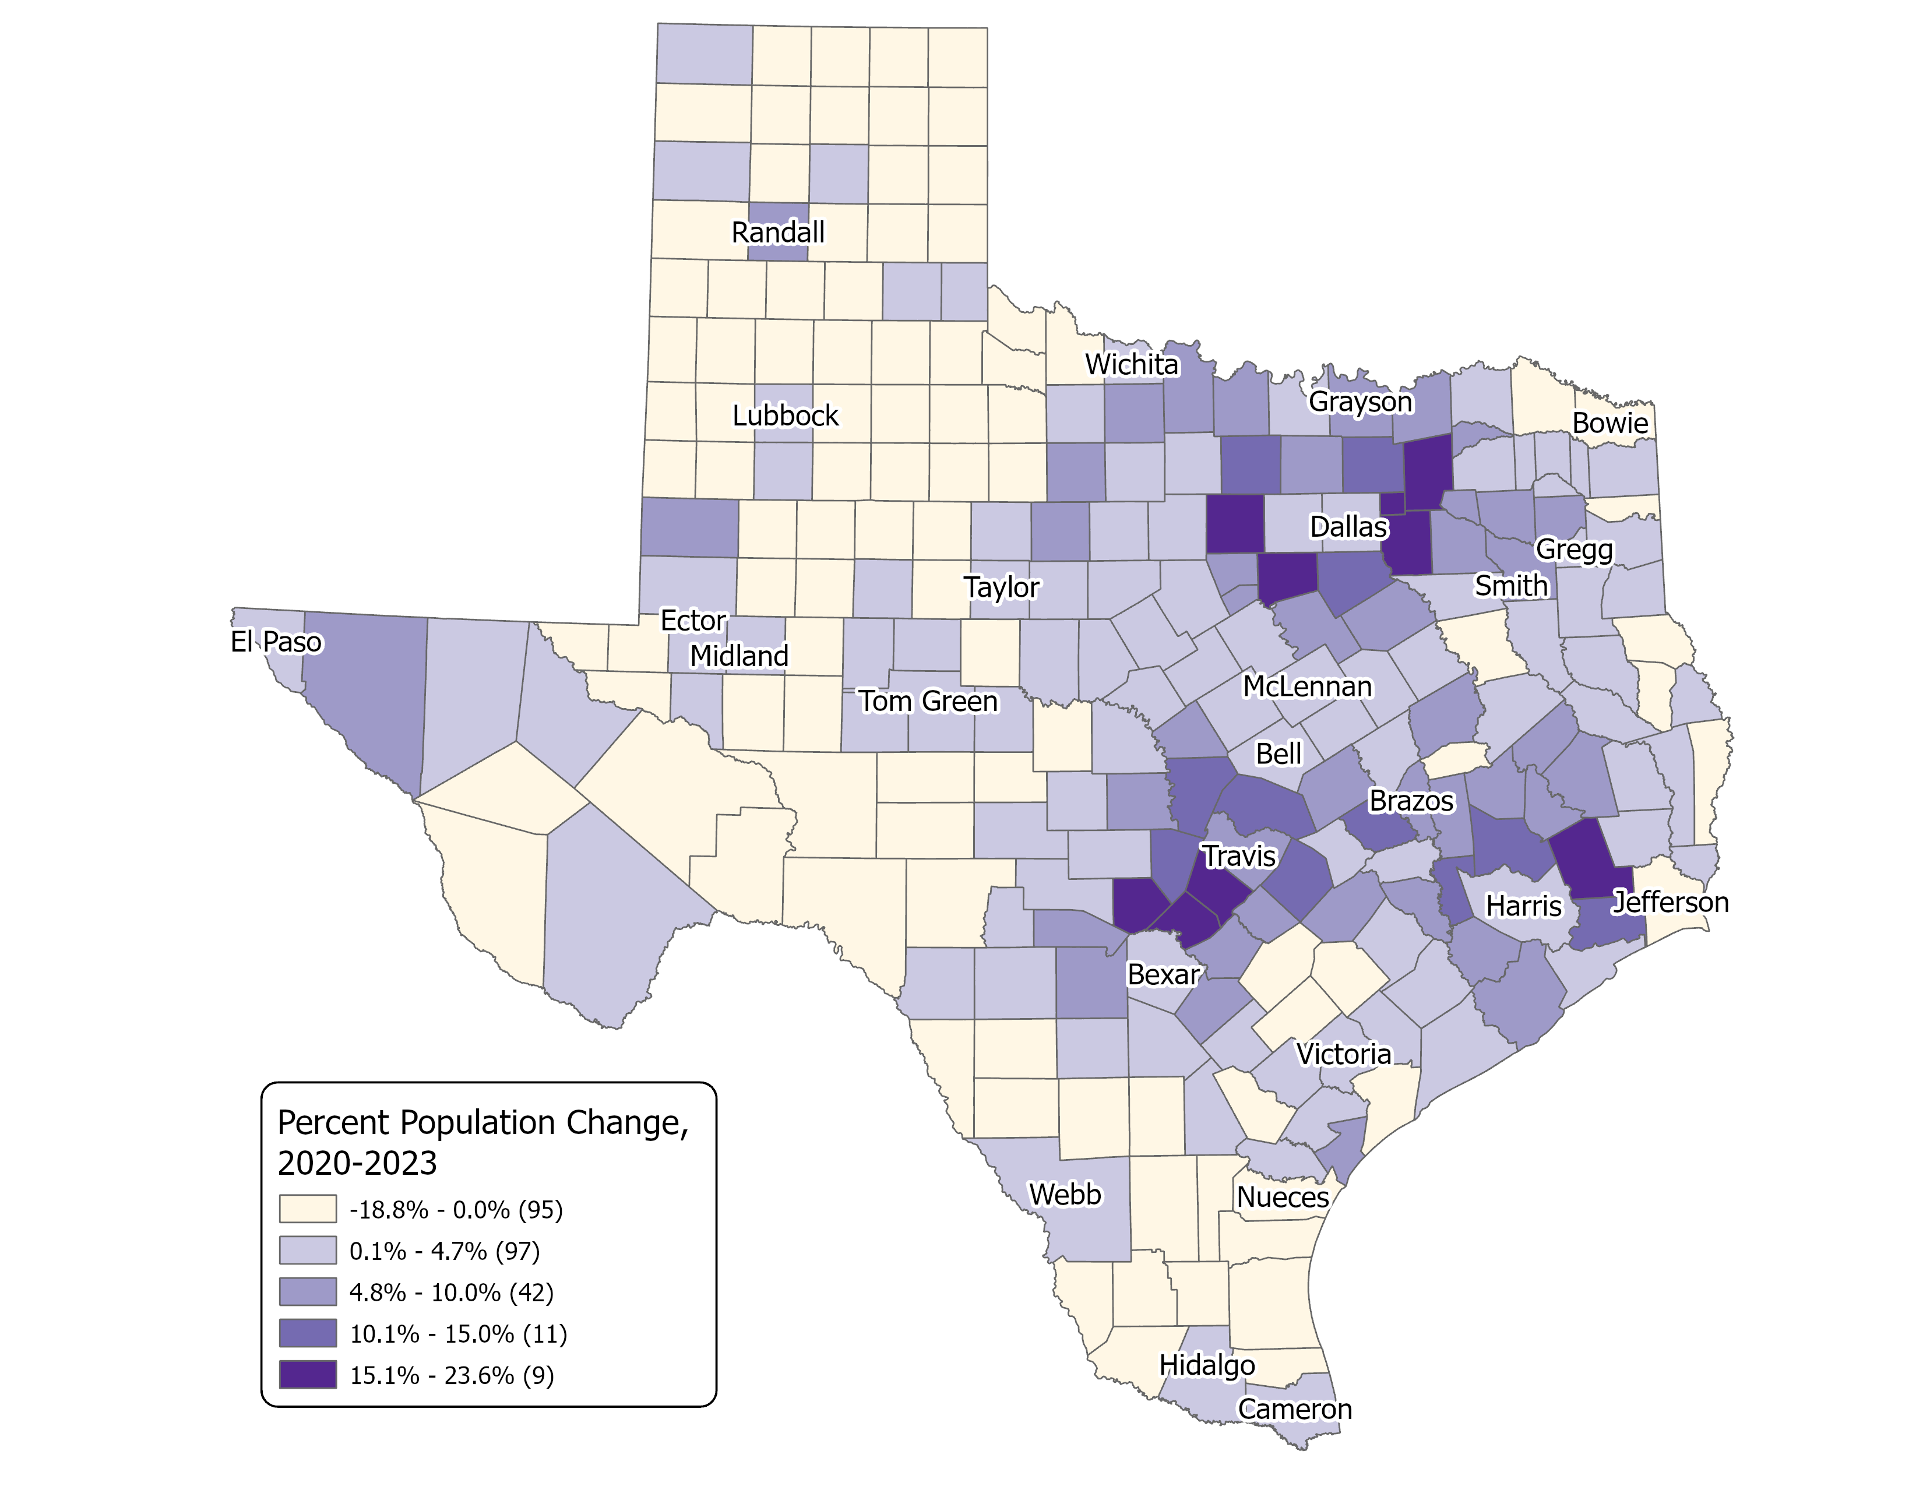
Estimated Percent Population Change,
2020-2023
COUNTY TOTAL
The fastest-growing areas continue to be the Texas triangles, especially those surrounding the central urban counties.
In other parts of Texas, the central counties drive the main growth.
Source: Texas Demographic Center, Vintage 2023 Population Estimates, U. S. Census Bureau, 2020 Decennial Census.

Slide 22
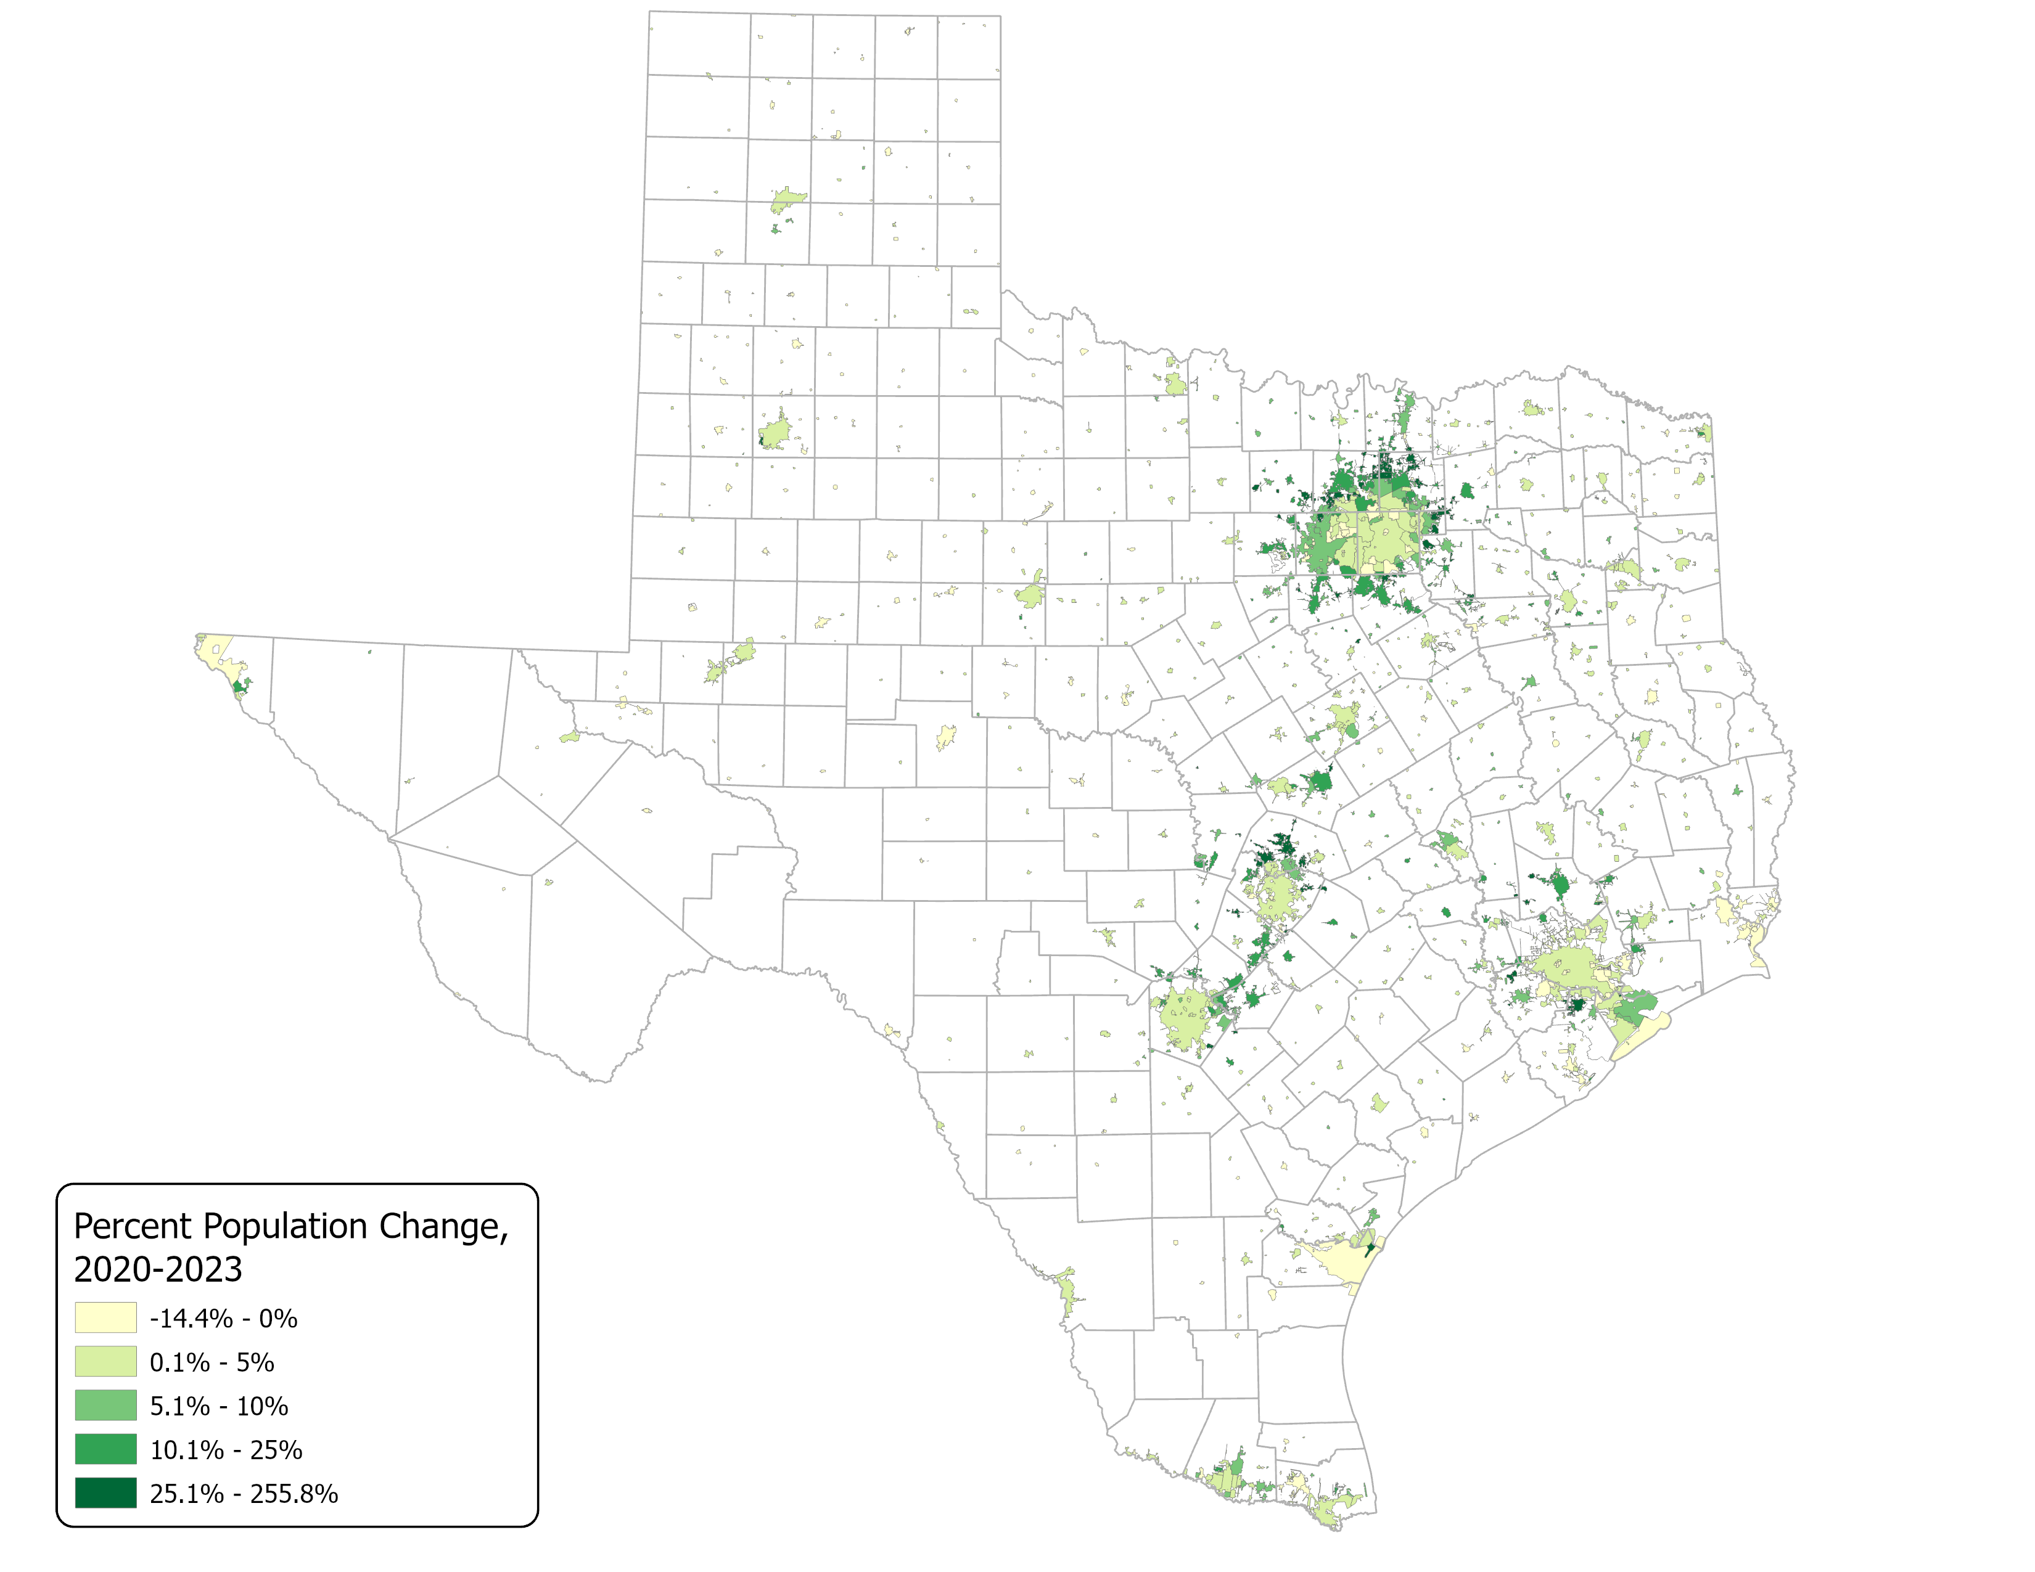
Estimated Percent Population Change,
2020-2023
PLACE TOTAL
Estimated Population for 1,228 incorporated places in Texas;
2023 Population # of Cities
<999 430
1,000 – 9,999 552
10, 000 – 19,999 97
20,000 – 99, 999 107
100,000 + 42
Source: Texas Demographic Center, Vintage 2023 Population Estimates, U. S. Census Bureau, 2020 Decennial Census,

Slide 23
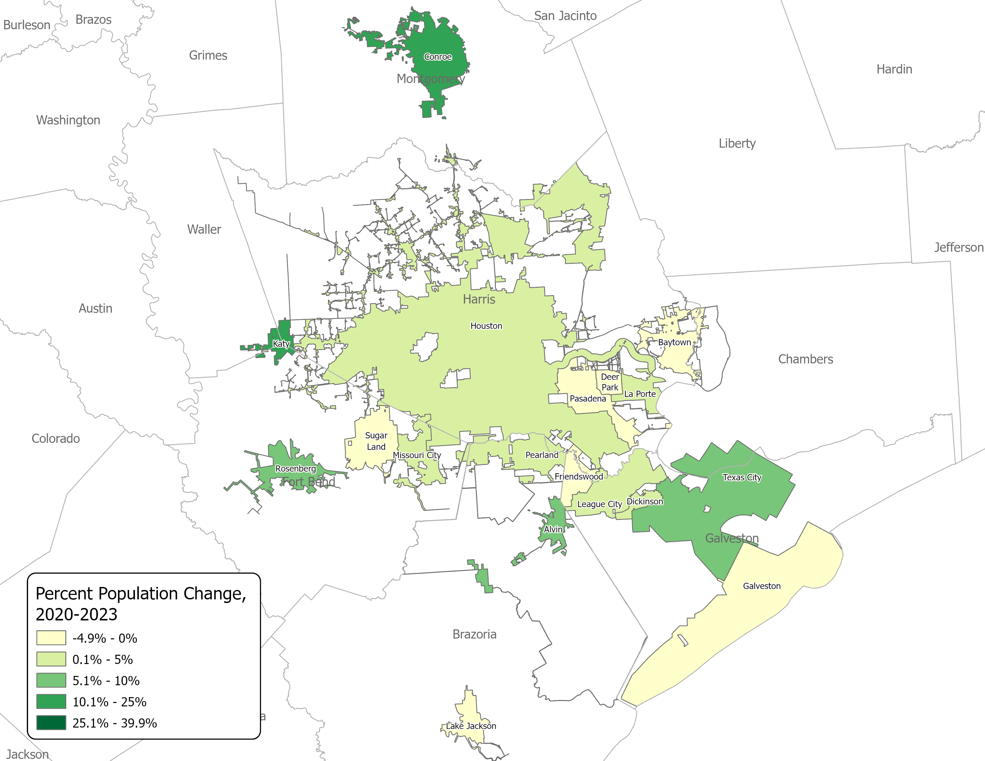
Estimated Percent Population Change,
2020-2023, Houston
PLACE TOTAL
Note: Only cities with a population over 20,000 in 2020 are displayed.
Source: Texas Demographic Center, Vintage 2023 Population Estimates, U. S. Census Bureau, 2020 Decennial Census.

Slide 24
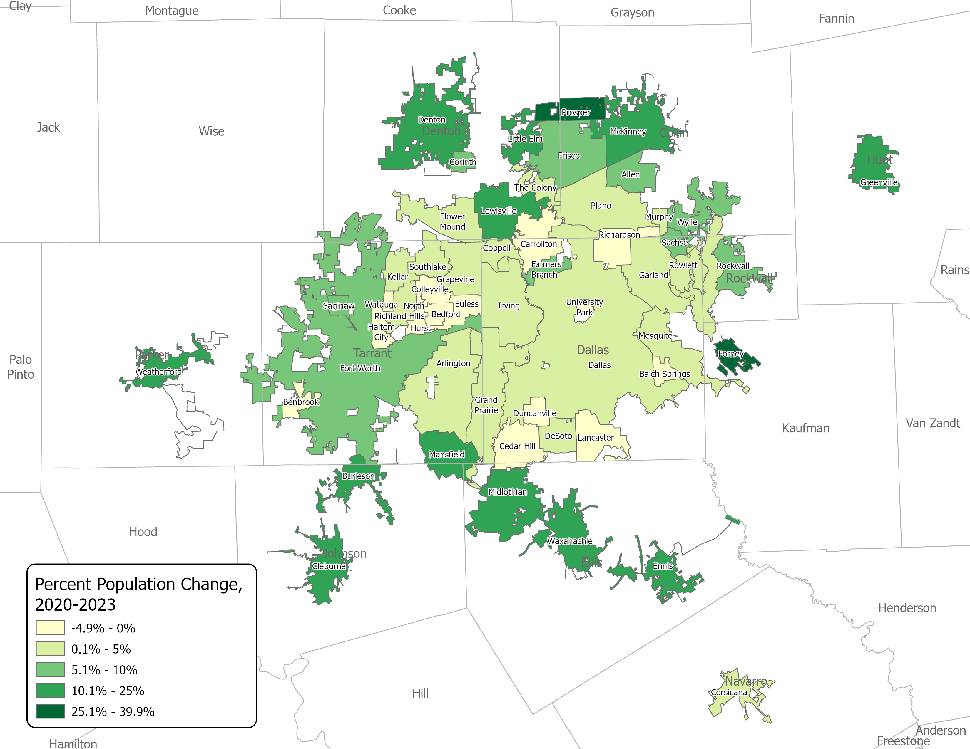
Estimated Percent Population Change,
2020-2023,
Dallas-Fort Worth
PLACE TOTAL
Note: Only cities with a population over 20,000 in 2020 are displayed.
Source: Texas Demographic Center, Vintage 2023 Population Estimates. U. S. Census Bureau, 2020 Decennial Census.

Slide 25
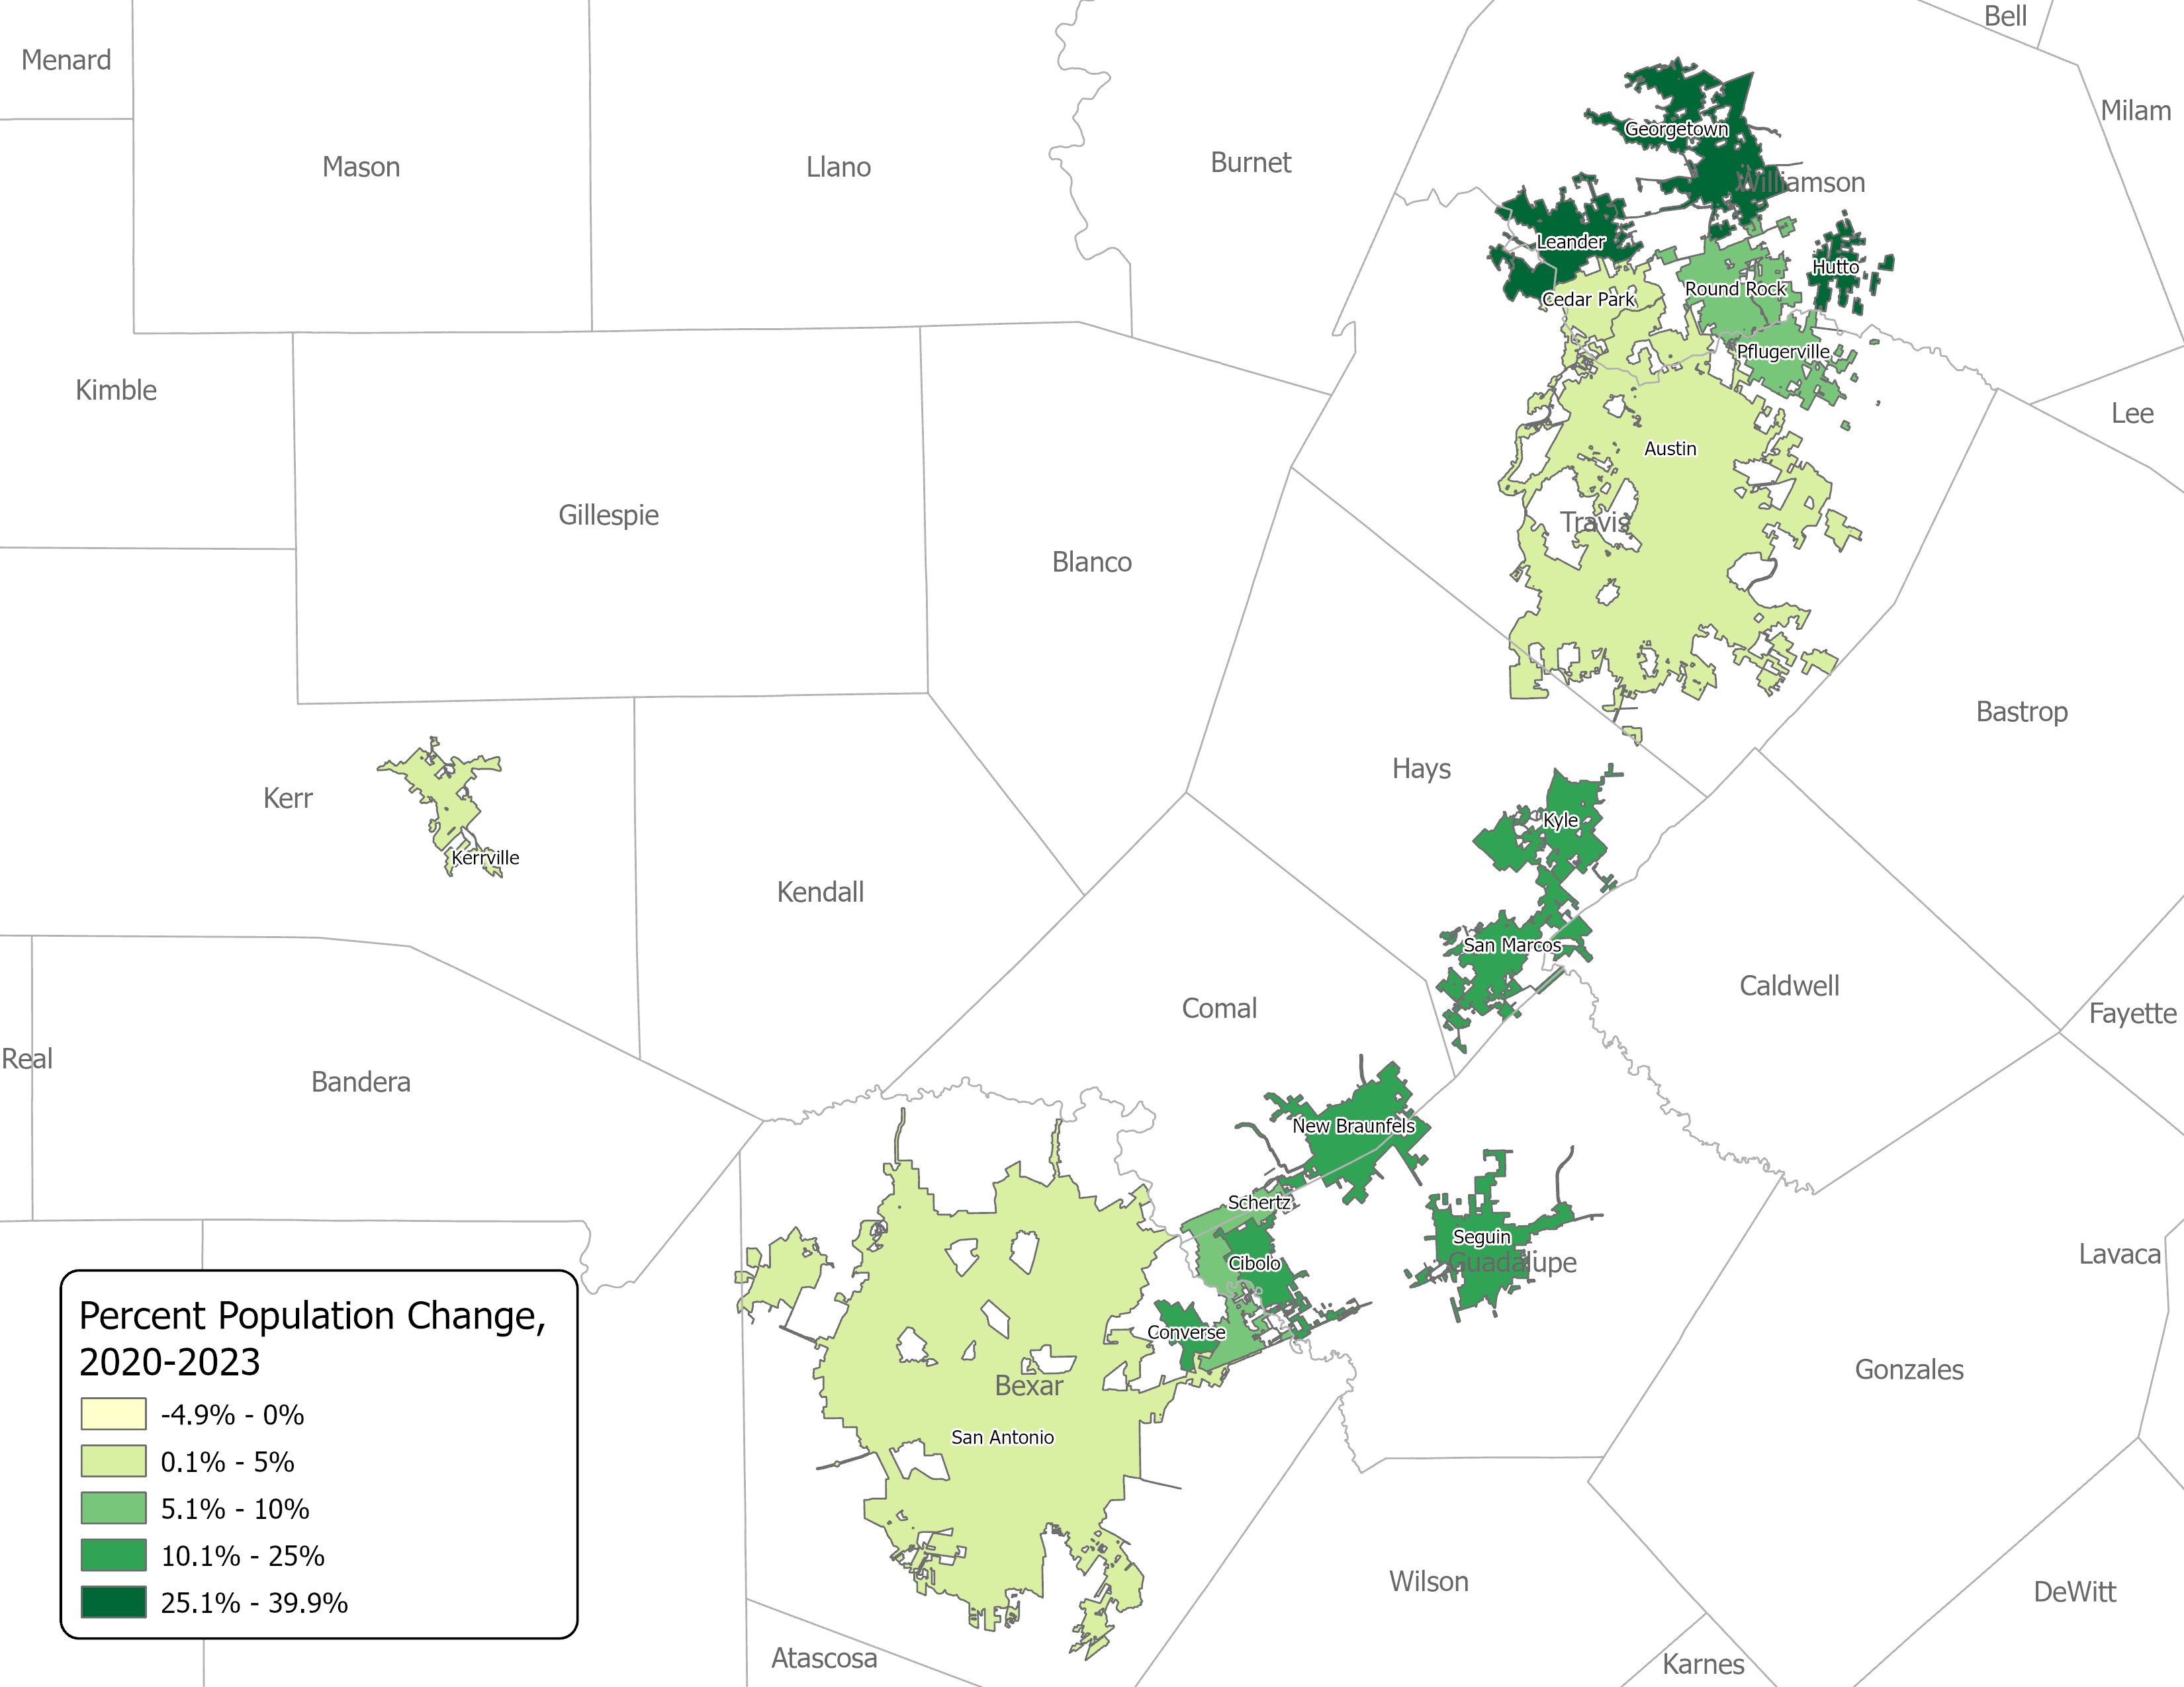
Estimated Percent Population Change,
2020-2023,
San Antonio-Austin
PLACE TOTAL
Note: Only cities with a population over 20,000 in 2020 are displayed.
Source: Texas Demographic Center, Vintage 2023 Population Estimates. U. S. Census Bureau, 2020 Decennial Census.

Slide 26
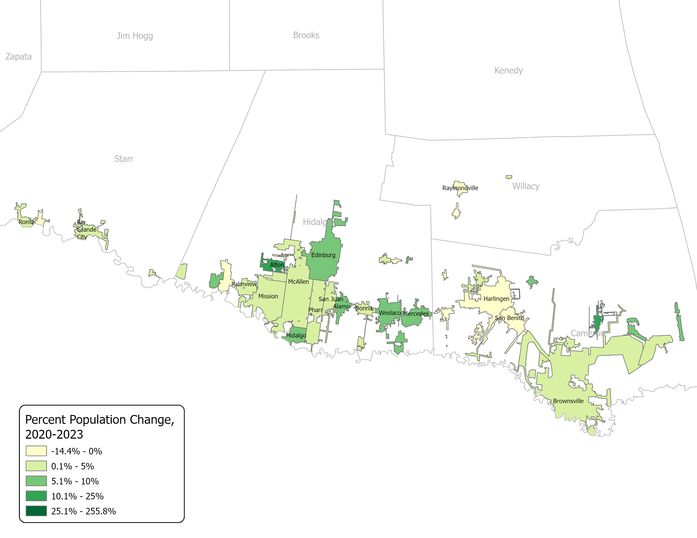
Estimated Percent Population Change,
2020-2023,
Rio Grande Valley
PLACE TOTAL
Source: Texas Demographic Center, Vintage 2023 Population Estimates. U. S. Census Bureau, 2020 Decennial Census..

Slide 27
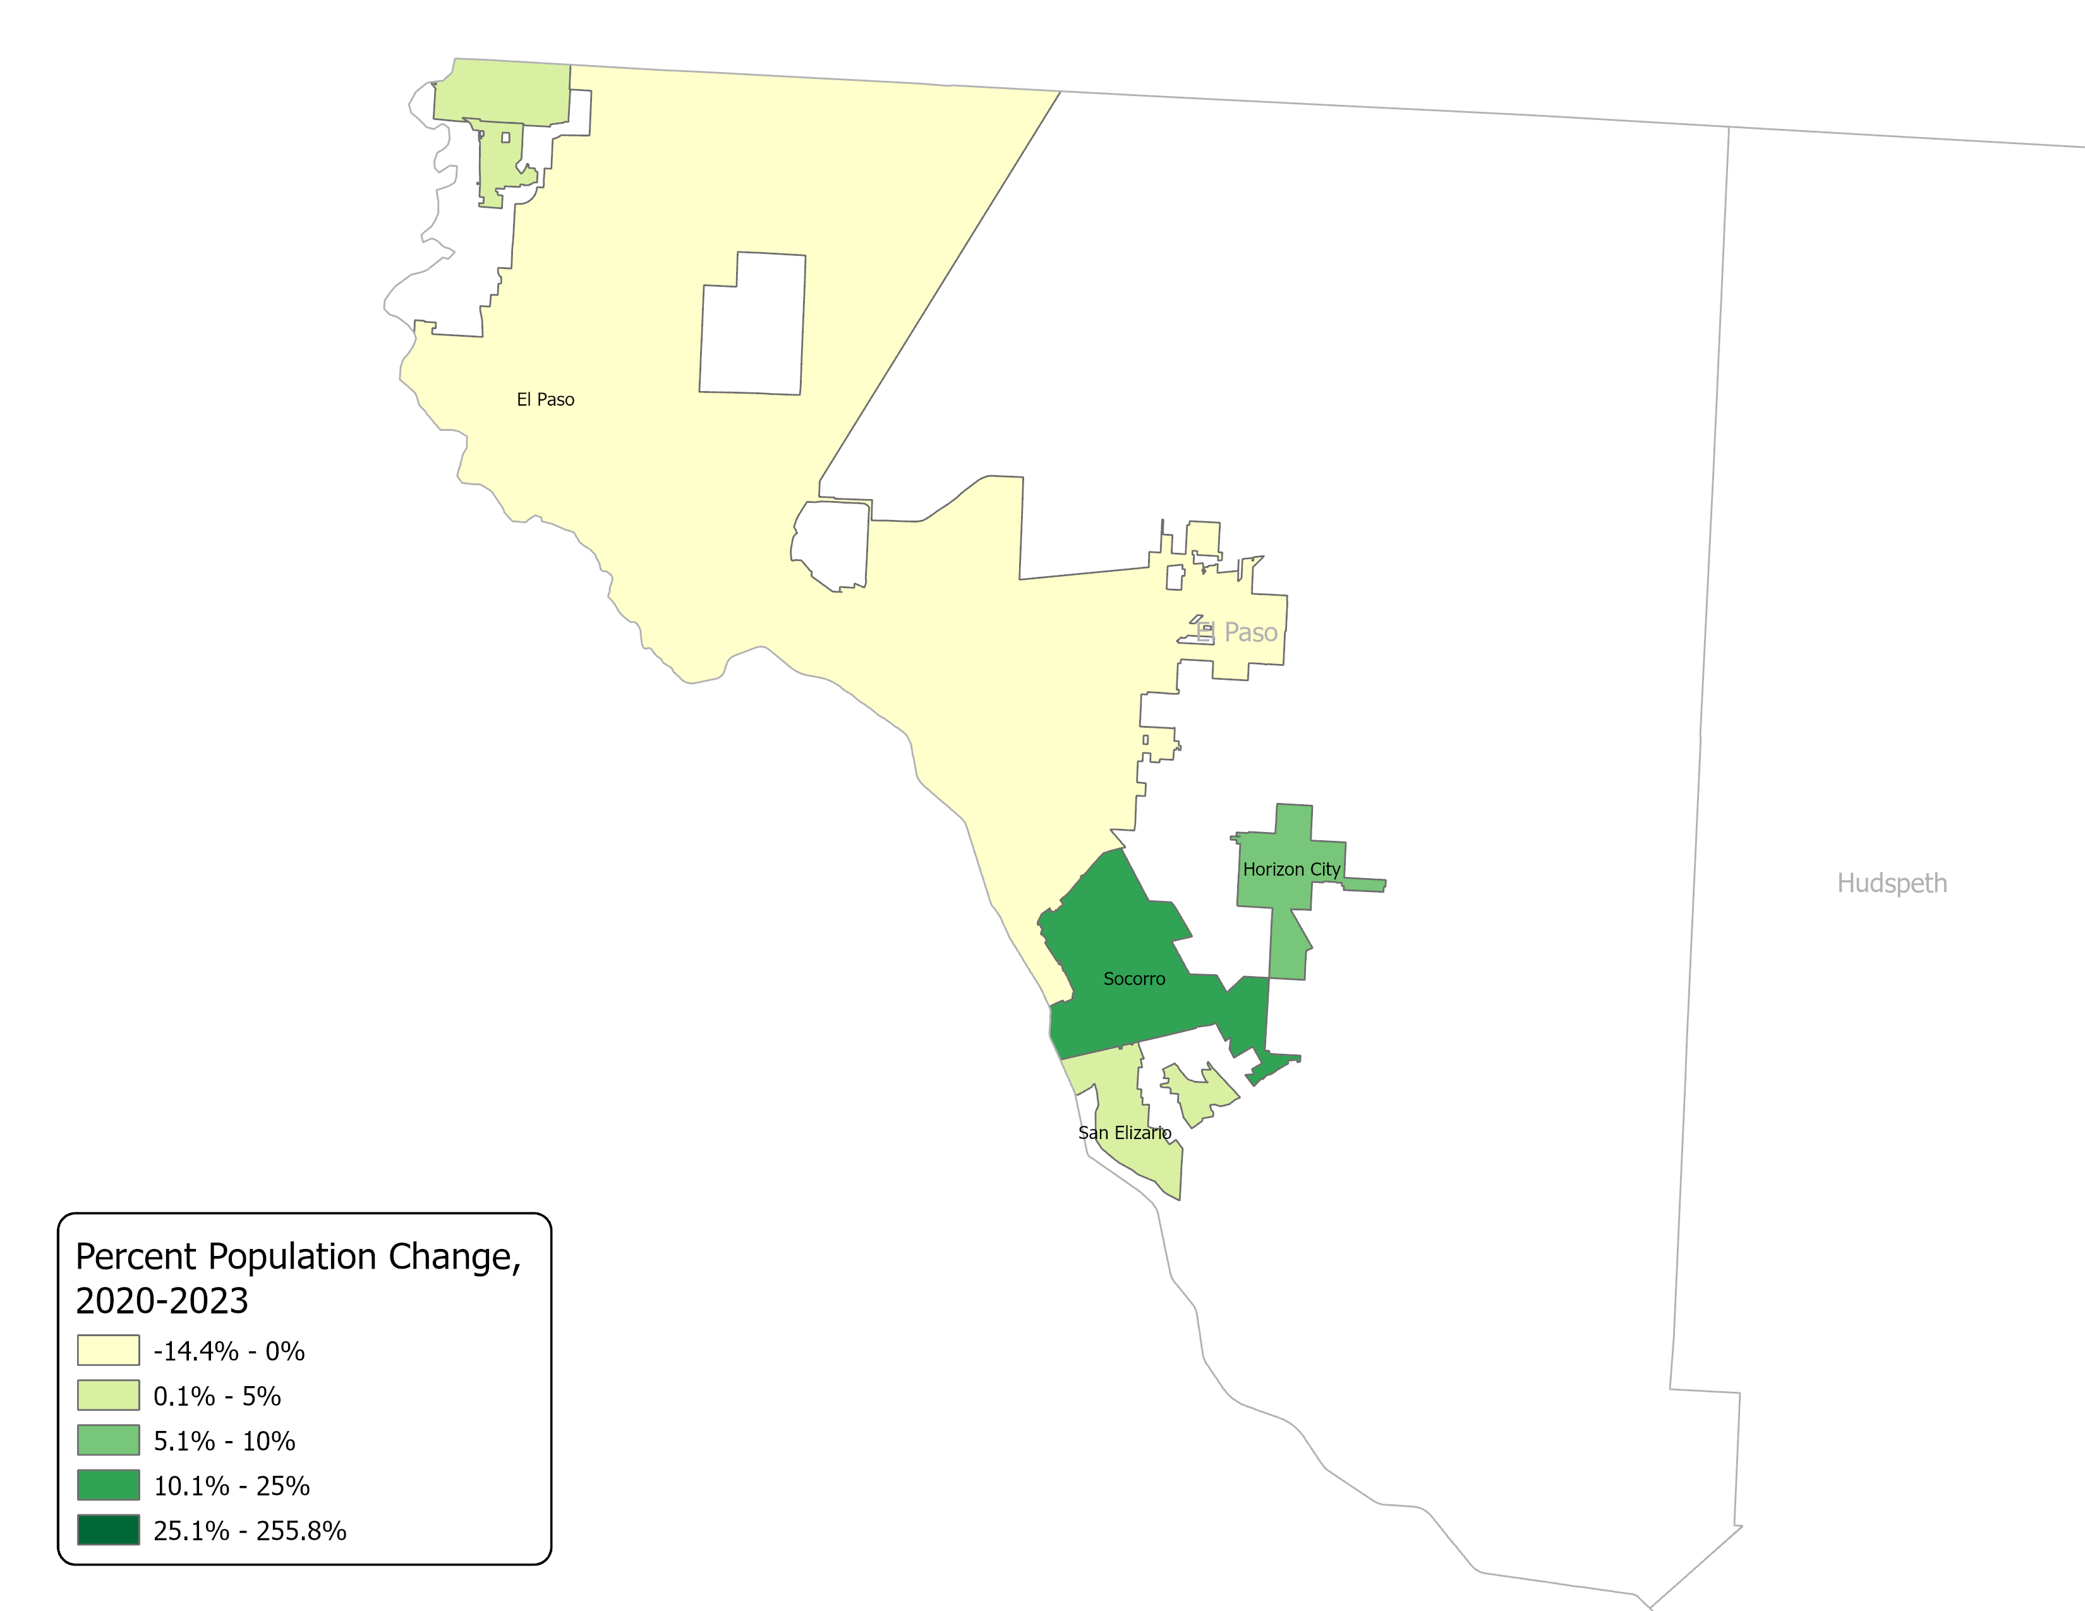
Estimated Percent Population Change,
2020-2023, El Paso
PLACE TOTAL
Source: Texas Demographic Center, Vintage 2023 Population Estimates, 2020 Decennial Census.

Slide 28
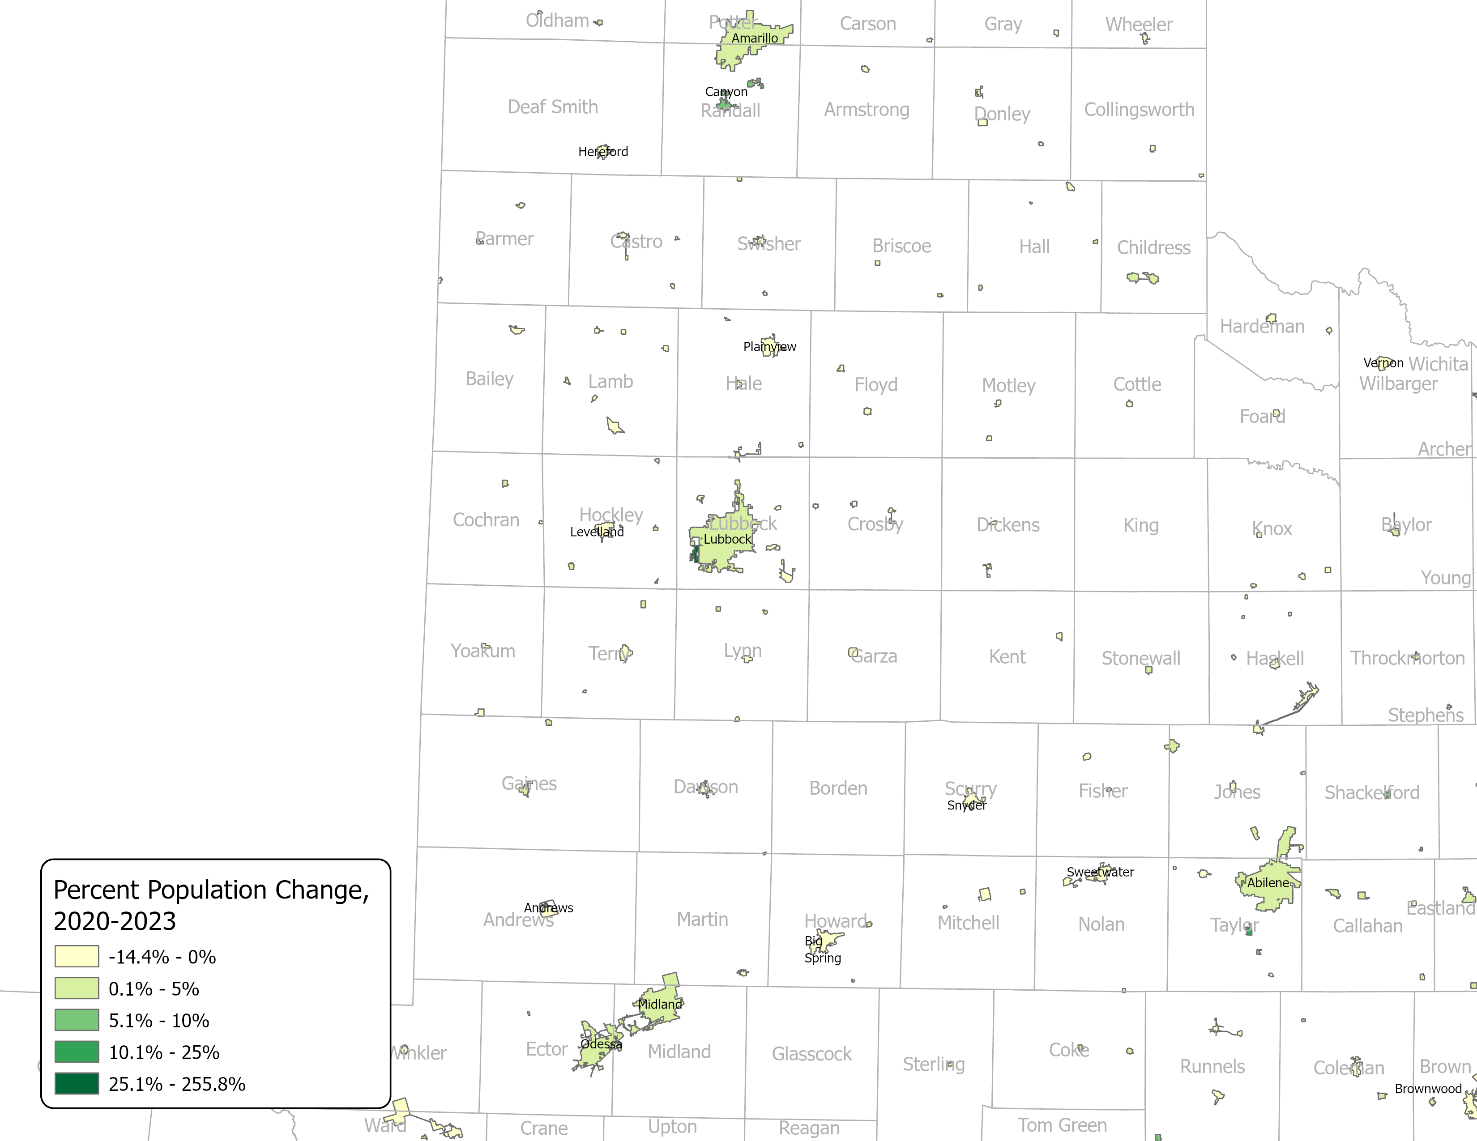
Estimated Percent Population Change,
2020-2023,
West Texas and Panhandle
PLACE TOTAL
Source: Texas Demographic Center, Vintage 2023 Population Estimates, 2020 Decennial Census.

Slide 29
Estimated Population by Age, NH White and Hispanic, Texas, 2023
AGE, SEX & RACE
Source: Texas Demographic Center, Vintage 2023 Population Estimates. U. S. Census Bureau, 2020 Decennial Census.

Slide 30
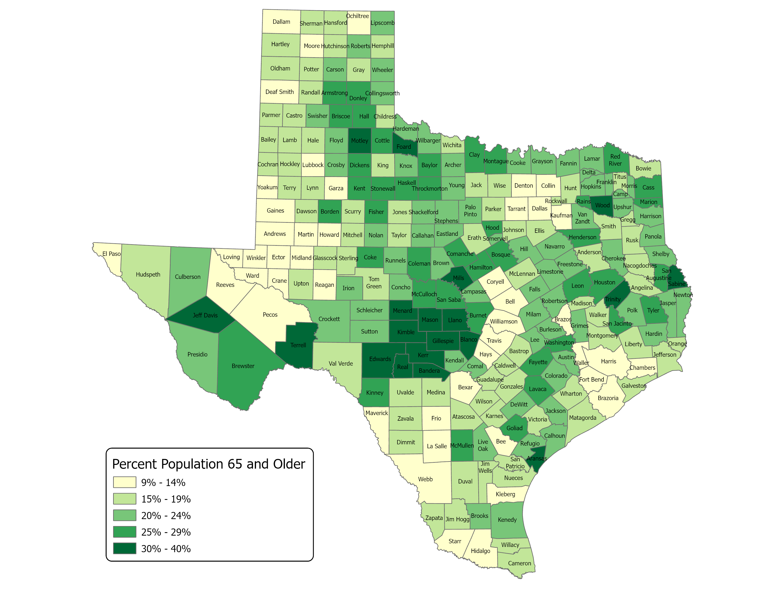
Estimated Percent of Population 65 and Older, 2023
AGE, SEX & RACE Data
Urban central counties, areas of the Permian Basin, and some border counties have the lowest rates of senior population.
In contrast, rural and certain retirement counties have a higher percentage of residents aged 65 and older.
Source: Texas Demographic Center, Vintage 2023 Population Estimates. U. S. Census Bureau, 2020 Decennial Census.

Slide 31
Demographic Trends
The population of Texas has reached 30.5 million, representing a growth of 4.7% between April 2020 and July 2023.
Population growth is concentrated in the four largest metropolitan statistical areas (MSAs) that form the Texas Triangle.
More than one-third of Texas counties have experienced a population decline.
Urban center counties have a lower percentage of senior residents, while many rural areas have higher rates of individuals aged 65 and older.
Hispanics make up a larger portion of the younger age groups, while there is a higher representation of non-Hispanic Whites among the older age groups.

Slide 32
Access the Data
The 2023 TDC Estimates

Slide 33
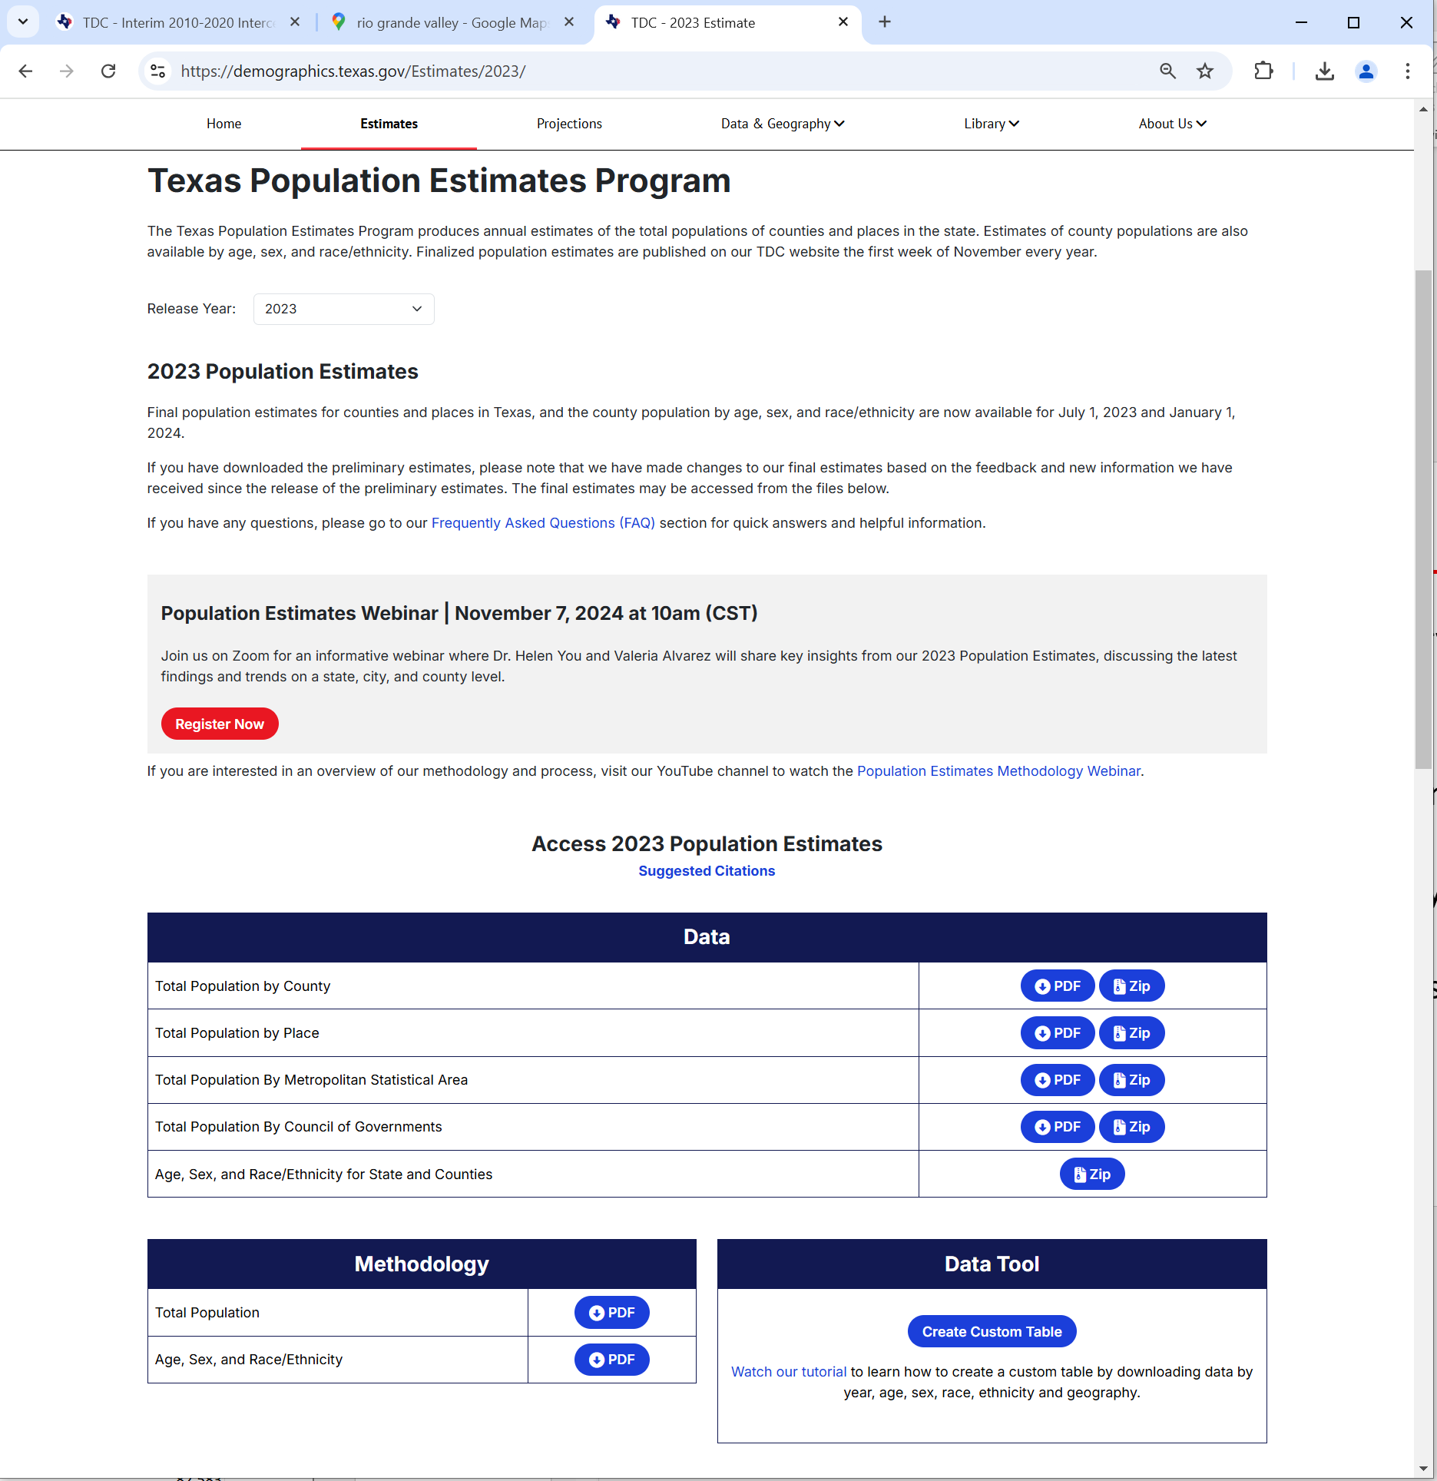
Access the Population Estimates on the TDC website
https://demographics.texas.gov/Estimates/2023/
Source: Texas Demographic Center, Vintage 2023 Population Estimates,

Slide 34
What’s New
Webinar Recordings
Suggested citations
Zipped files that include data and the methodology statement
Pop-up survey questions
FAQs
Tutorial videos
The Intercensal Estimates
  Replace the previous population estimates from the last decade to make them more comparable to the current estimates.

Slide 35
Engagement with Users and Local Communities
The 2023 TDC Estimates

Slide 36
External Review of the Preliminary Population Estimates
  The Preliminary Population Estimates were published in September to solicit feedback
  External review period -- Sept 27 to Oct 18, 2024
    2024 TML (Texas Municipal League) Annual Conference and Exhibition Oct 9-11, 2024
    Emails and phone calls since Sept 27
  Final Estimates released Nov. 4, 2024
  TDC Population Estimates Webinar

Slide 37
Feedback to the Preliminary Population Estimates (Cont.)
  New data provided
      Accept
  Alternative data
    Utility connections
    Voter registration
      Accept, if no building permit data are available
  Different methodology
    Estimates on current “housing unit stock” vs. new housing unit estimates;
      Accept, if no building permit data are available
    Use county control vs. direct estimates from the Housing Unit method.
      Accept, if other indicators are showing the same trend.
  General knowledge about the local areas
      Greatly appreciate the information
    Accept if we detect errors in our calculation
    Won’t accept if there are no quantitative data
  Challenge the base population (2020 Census count)
    Won’t accept

Slide 38

Coming up
  Three TDC surveys sent out in January
    Annexation & Boundary Survey
    Survey of New Residential Units in Incorporated Places
    Survey of New Residential Units in Unincorporated Areas
  TDC Population Projection Webinar in early 2025
  The 2024 Population Estimates
    Preliminary in September, 2025
    Feedback deadline one week after the TML conference in November
    Final release in November
  Texas Demographic Conference

Slide 39


Slide 40
Valeria Alvarez, MPP
Helen You, Ph.D.
(210) 458-6543
TDC@UTSA.edu
demographics.texas.gov
@TexasDemography

