Slide 1
Growing Healthy Texas:
A Story of People, Places, and the Future
Faculty Scientific Interest Group, UT San Antonio School of Nursing
May 29, 2026
San Antonio, TX

Slide 2




About our organization
Major Function
Produce annual population estimates and biennial population projections
Other Services
Disseminate demographic and socioeconomic information from the Census Bureau and other reliable sources.
Provide training and technical expertise.
Custom data analyses.
State Demographer
Lloyd B. Potter, Ph.D.
Affiliated with
The University of Texas at San Antonio
Partnerships
U.S. Census Bureau
TDC Affiliates

Slide 3
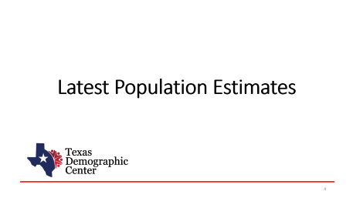
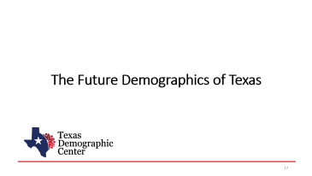

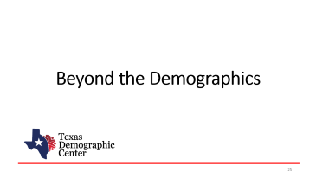
Table of Contents

Slide 4
Latest Population Estimates

Slide 5


New 2025 Estimates Show Texas Growth but at Slower Rate
Newly Released Data
Texas Total Population 2025
31.7M
391K
1.2%
Numeric increase
Percent increase
Growth from 2024
New Census Bureau data shows Texas’ population reached 31.7 million in July 2025 — a 1.2% increase from 2024 to 2025, more than 2X the 0.5% national growth rate. Though growth slowed compared to recent years, TX still led the nation in numeric gains, adding over 391K residents.

Slide 6
Texas Daily Population Growth and Components of Change, 2020-2025
Reduced international and domestic migration drove the decline, while natural increase made up 40% of growth, up from about 25% since 2020.
917 | 1,494 | 1,647 | 1,642 | 1,072 | Daily Average Population Change
Source: U.S. Census Bureau, Vintage 2025 Population Estimates
Note: Components of change may not add to the total population change due to the minor residual components in the Census Bureau’s Population Estimates

Slide 7
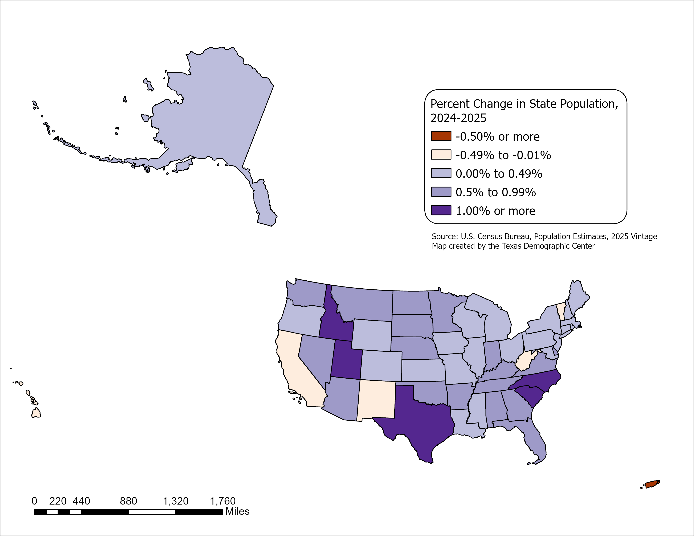
State Highlights
All but five U.S. states grew between July 2024 and July 2025
- CA, HI, NM, VT, and WV.
Top 5 States with percent change
-SC, ID, NC, TX, UT.
Top 5 States with numeric change
-TX, FL, NC, GA, SC.
Source: U.S. Census Bureau, Vintage 2025 Population Estimates

Slide 8
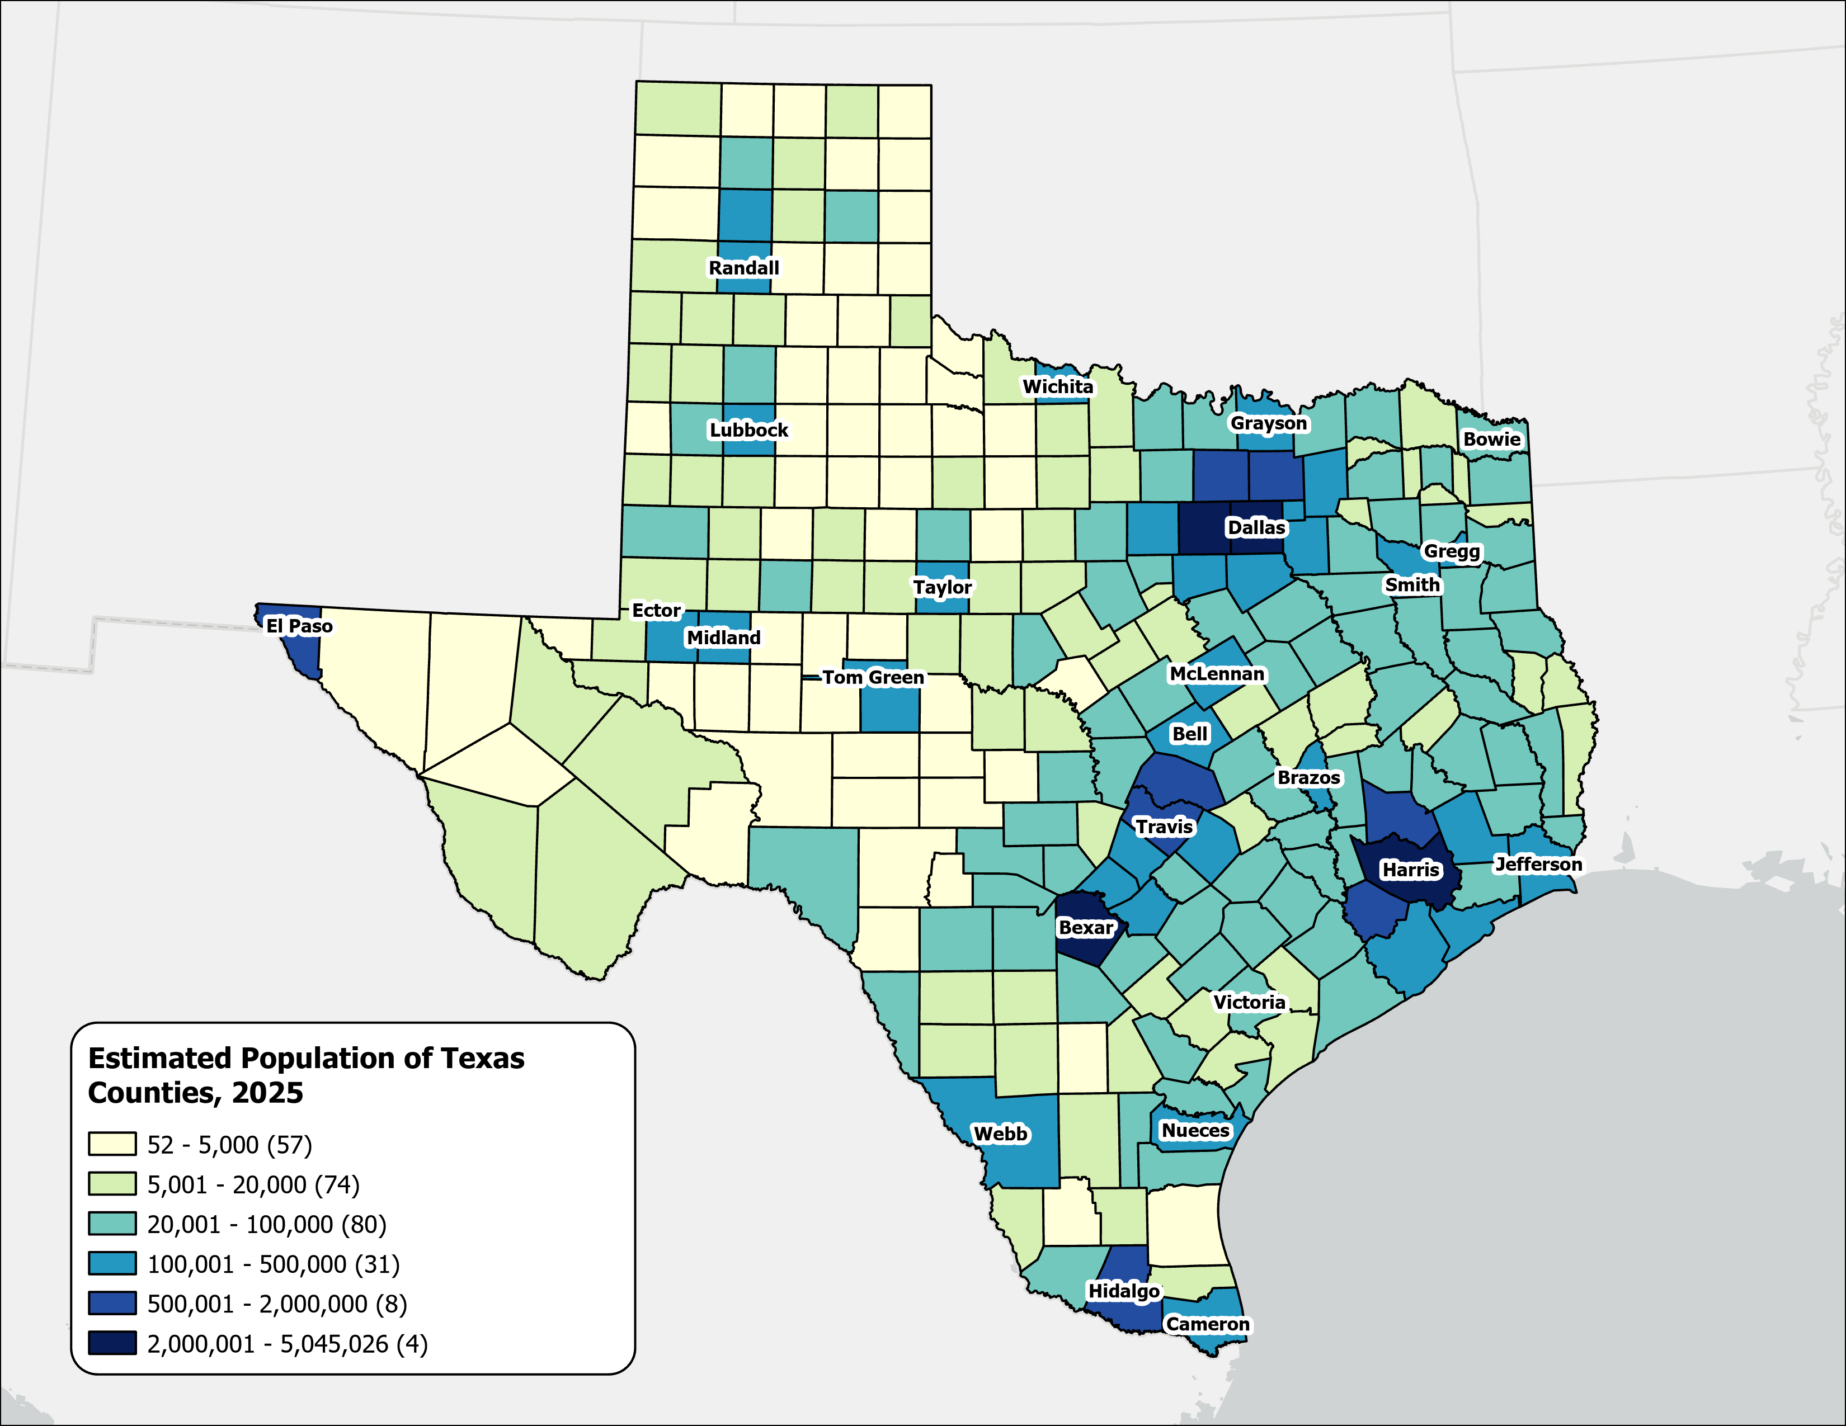
Estimated Population,
Texas Counties, 2025
Texas population is highly concentrated within the metropolitan triangle formed by Dallas–Fort Worth, Austin, San Antonio, and Houston.
The 120 counties on and east of the I‑35 corridor are home to 27.3 million residents—approximately 87.3% of the state’s total population.
87%
Source: U.S. Census Bureau, Vintage 2025 Population Estimates

Slide 9
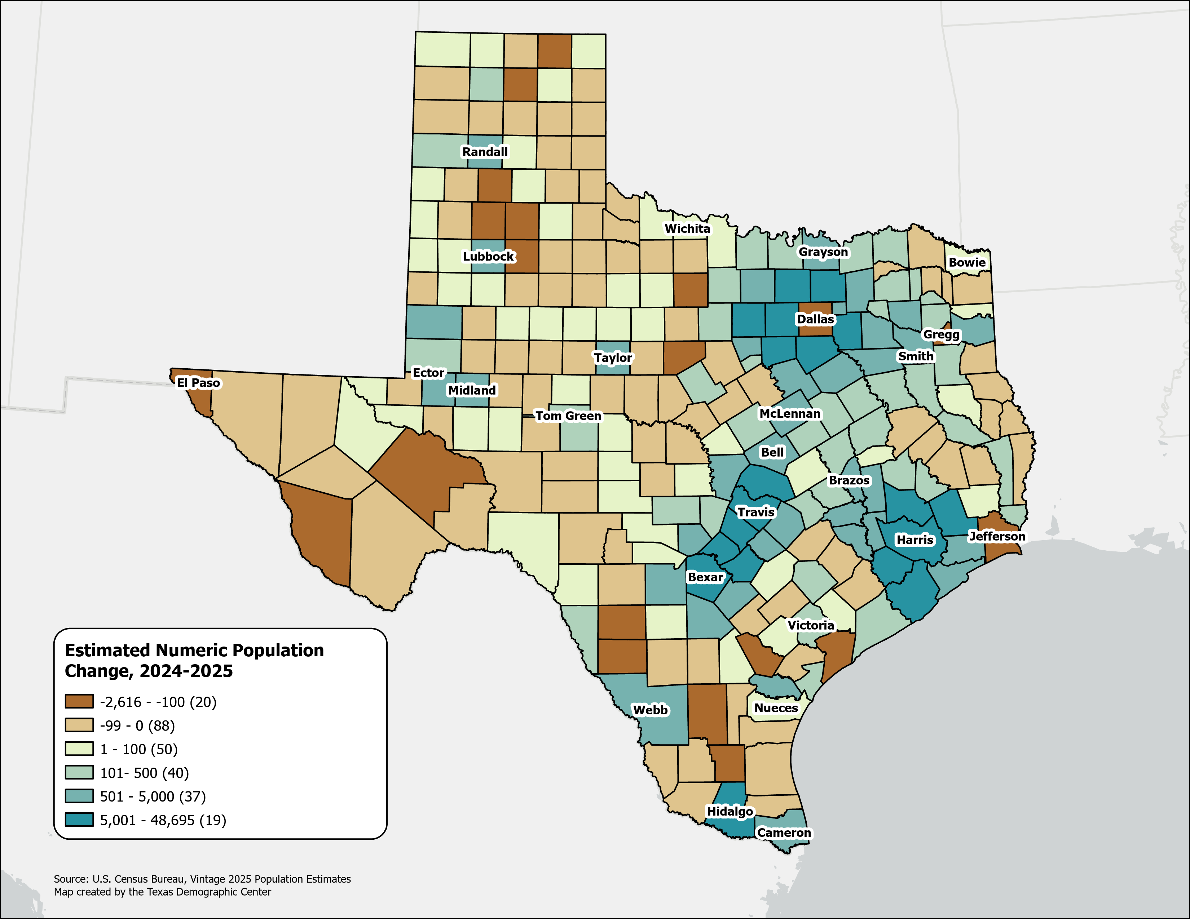
Estimated Numeric Population Change, Texas Counties, 2024-2025
Population declined in 108 Texas counties, primarily in rural areas.
Dallas experienced the largest numeric population loss, along with several border counties.
Source: U.S. Census Bureau, Vintage 2025 Population Estimates

Slide 10
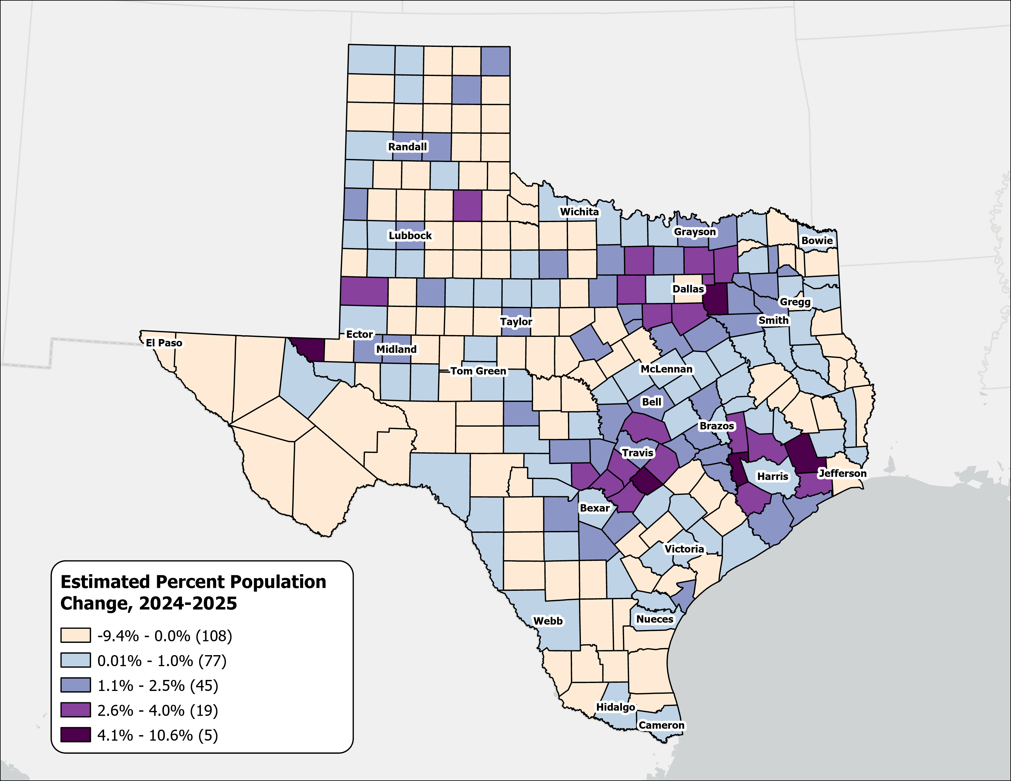
Estimated Percent Population Change, Texas Counties, 2024-2025
Rapid growth was concentrated in counties at the suburban and exurban edges of the Texas metropolitan triangle.
Source: U.S. Census Bureau, Vintage 2025 Population Estimates

Slide 11
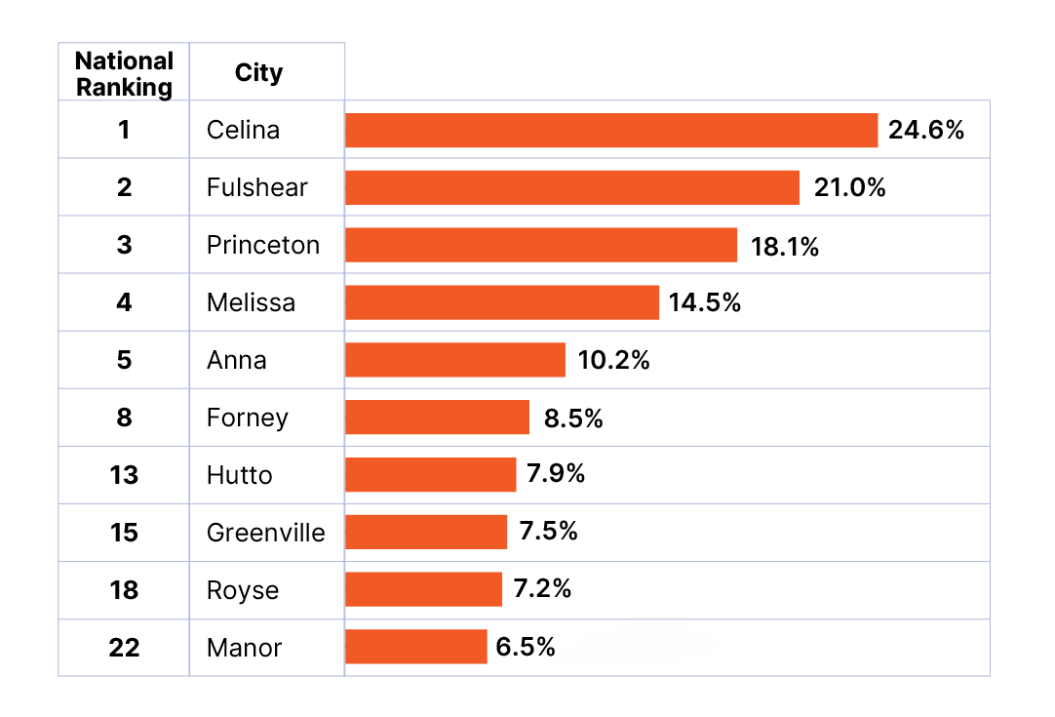
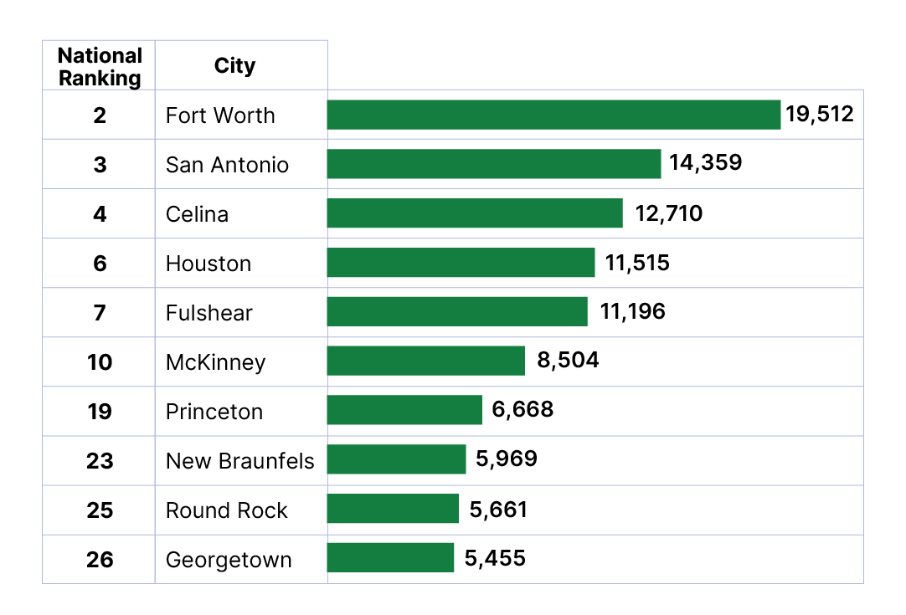
Top Growth Texas Cities and Towns
Top 10 Cities by Percent Growth in Texas
From July 1, 2024 to July 1, 2025
Top 10 Cities by Numeric Growth in Texas
From July 1, 2024 to July 1, 2025
Source: U.S. Census Bureau, Vintage 2025 Population Estimates. Ranked among incorporated places with a population of 20,000 or more.

Slide 12
Percent Population Change for Incorporated Places, 2020-2025
Austin and San Antonio Area
Growth in major urban centers slowed considerably.
Small and midsized suburban and exurban cities within the Triangle region experienced the most rapid expansion.
Source: U.S. Census Bureau, Vintage 2025 Population Estimates

Slide 13
Percent Population Change for Incorporated Places, 2020-2025
(Houston and Dallas-Fort Worth)
Houston Area
Dallas-Fort Worth Area
Source: U.S. Census Bureau, Vintage 2025 Population Estimates

Slide 14
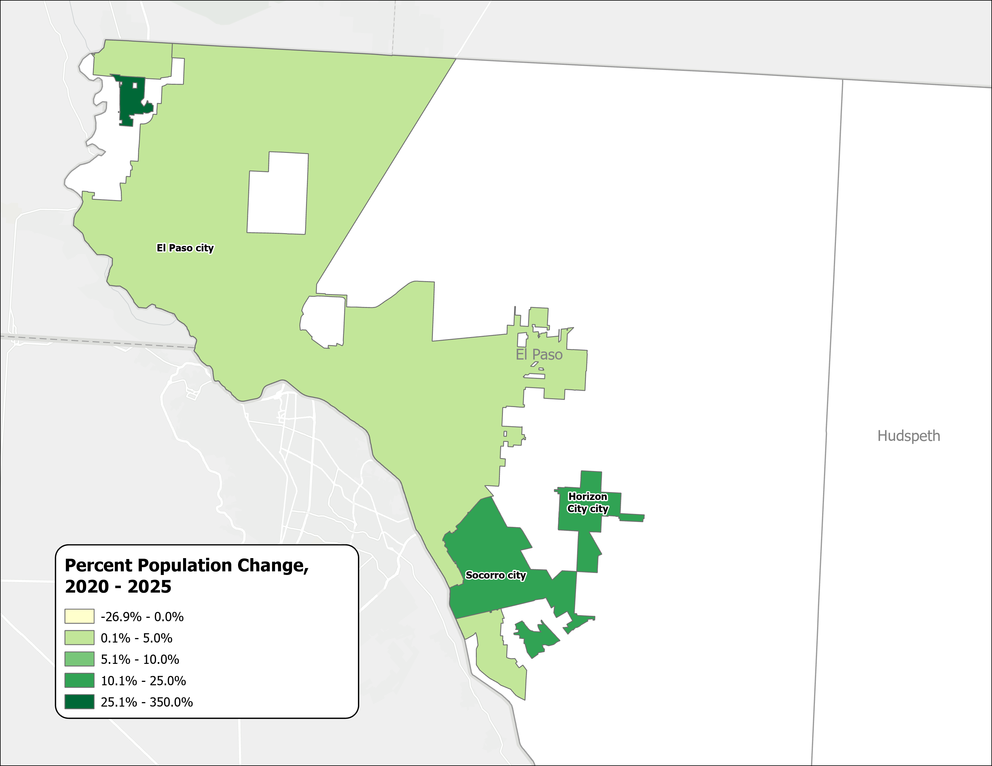
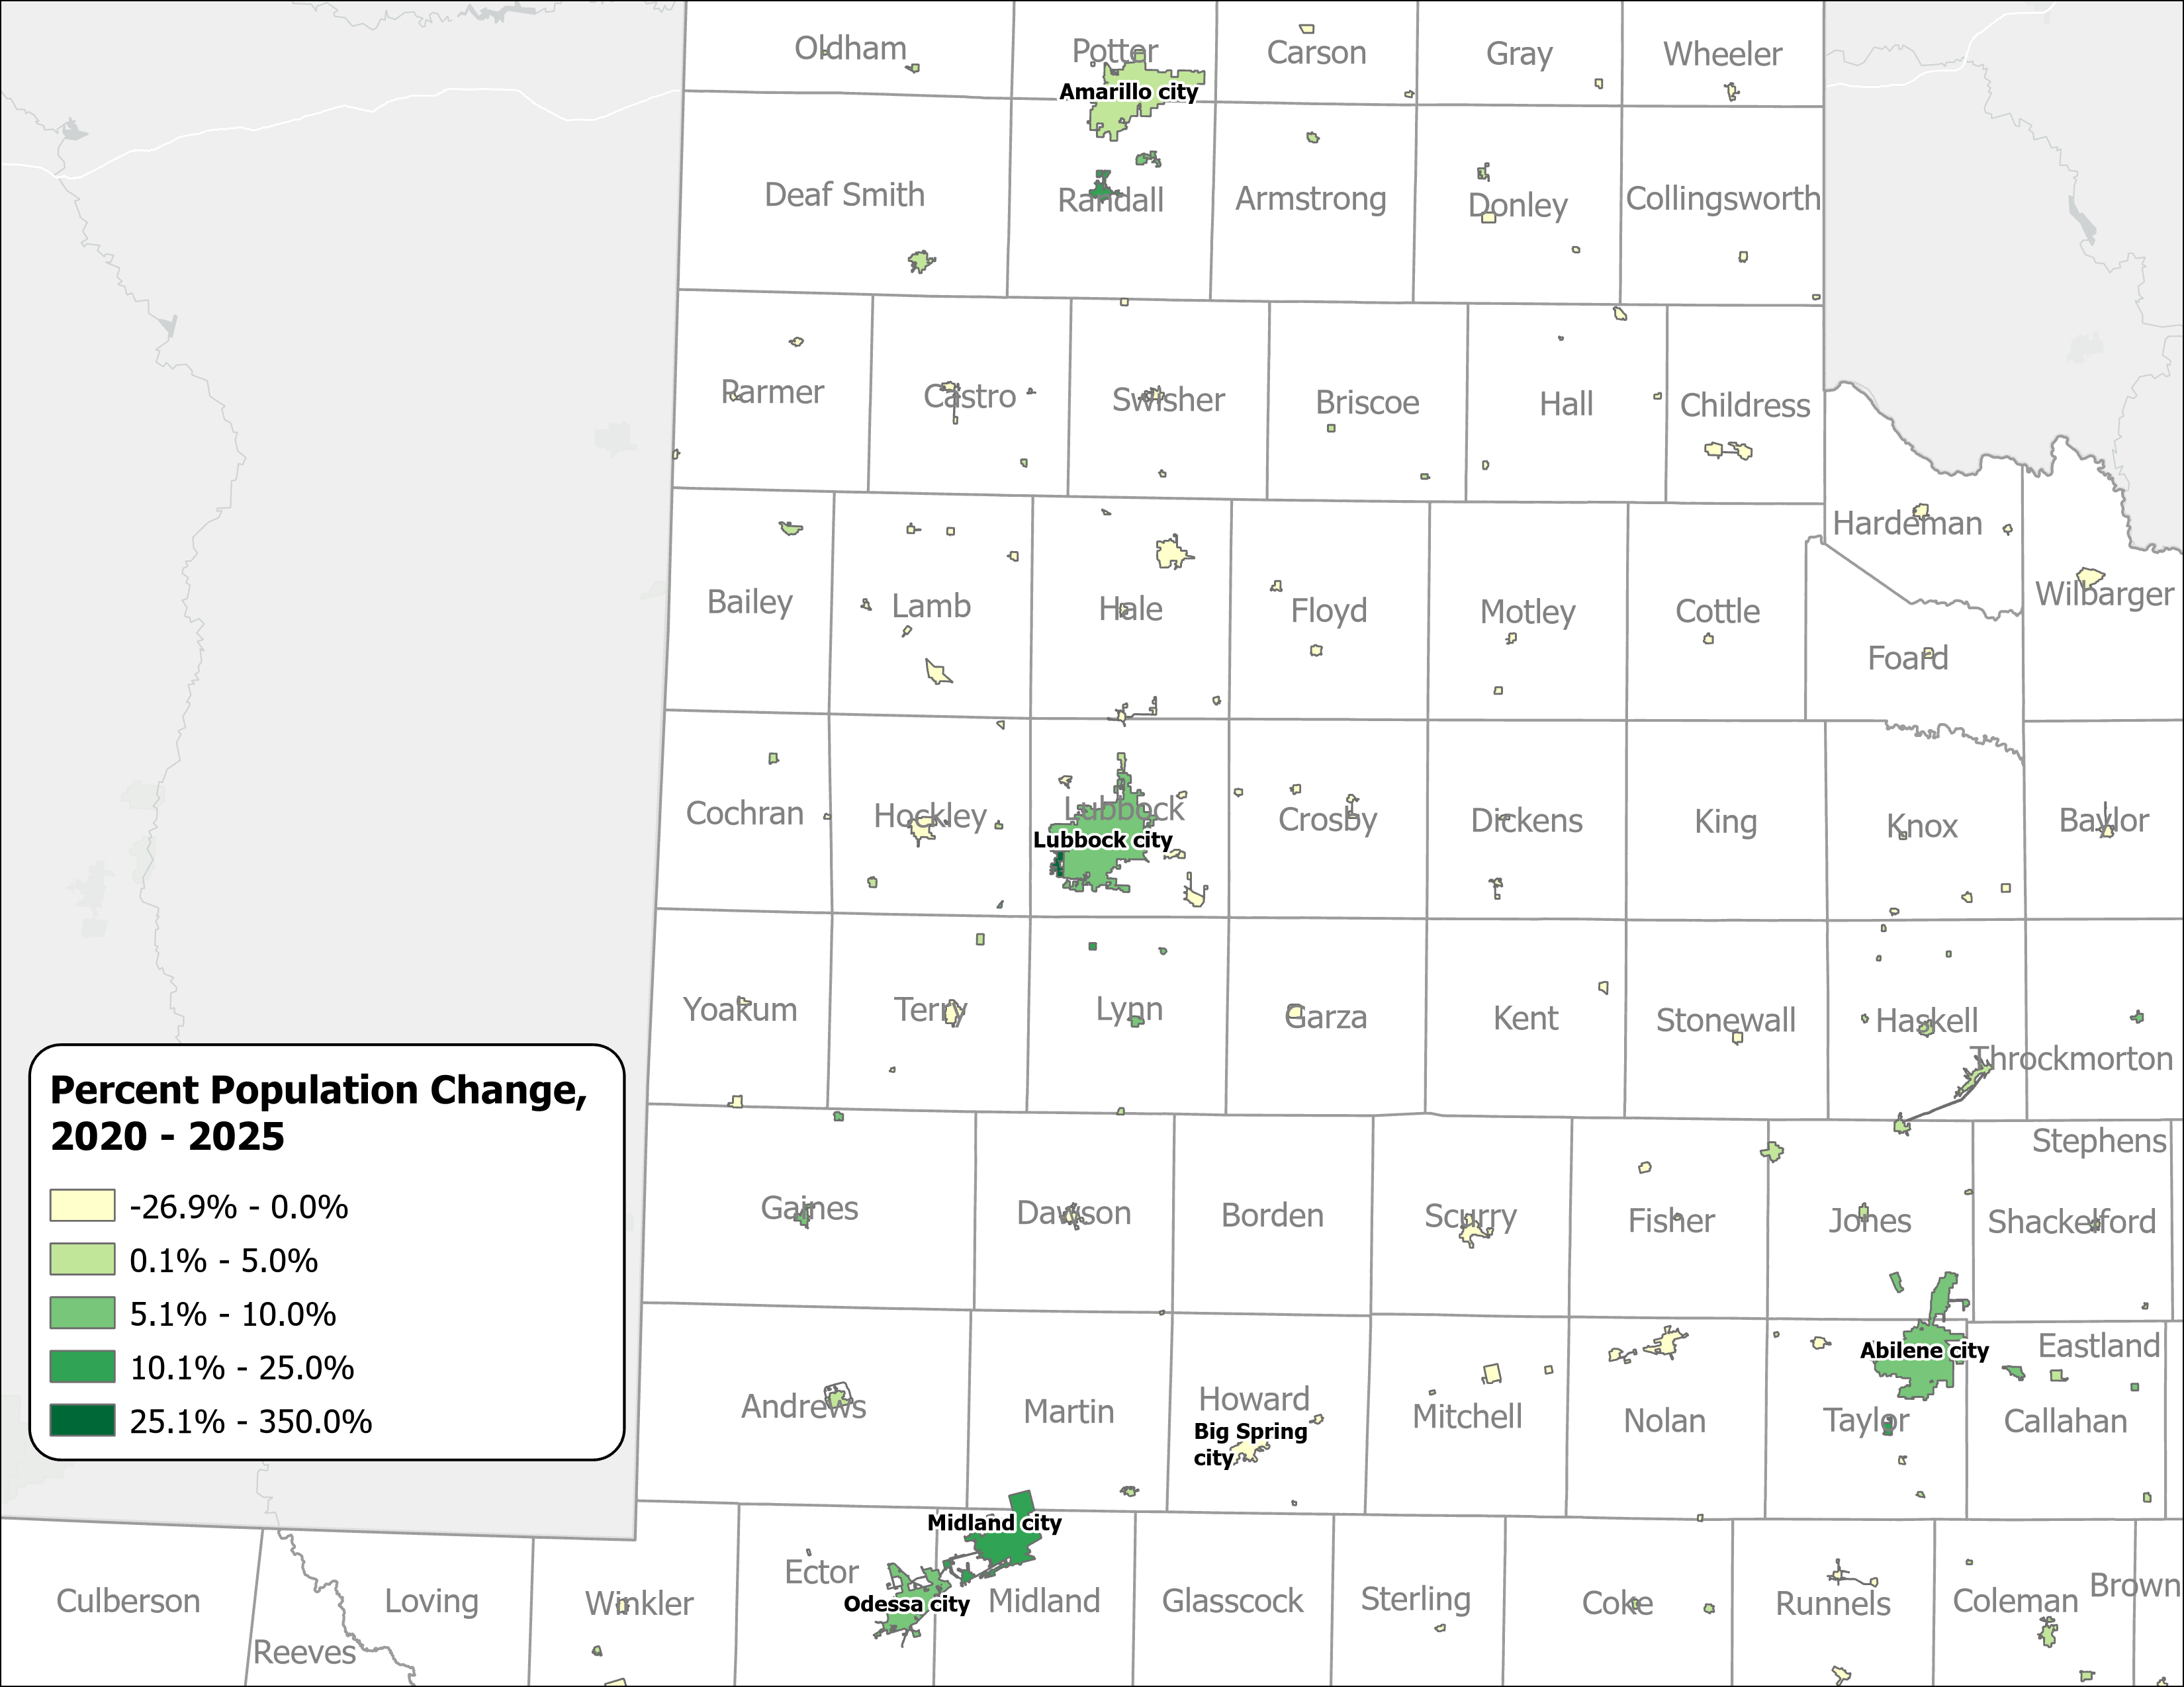
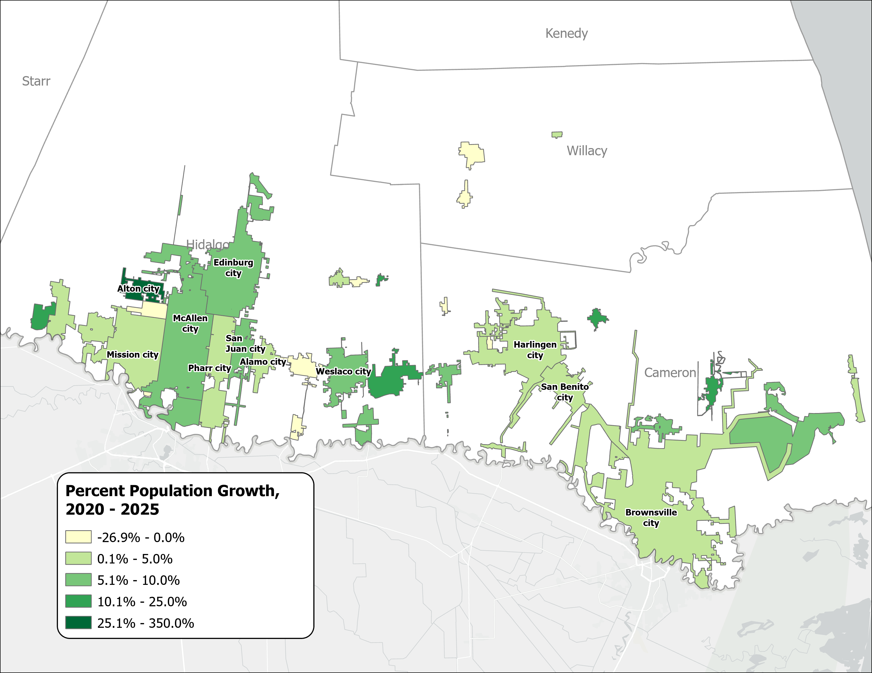
Percent Population Change for Incorporated Places, 2020-2025
(El Paso, Panhandle and West Texas, and Rio Grande Valley)
El Paso Area
Panhandle and West Texas
Rio Grande Valley
Source: U.S. Census Bureau, Vintage 2025 Population Estimates

Slide 15
Texas Fertility Rates, 2007-2024
Births per 1,000 women aged 15-44
Source: Centers for Disease Control and Prevention, National Center for Health Statistics. Natality on CDC WONDER Online Database, 2007-2024.

Slide 16
Texas Fertility Rates by Age Group of Mothers, 2009 and 2024
Note: Birth rate is expressed as births per 1,000 women ages 15–44 during the calendar year.
Source: Centers for Disease Control and Prevention, National Center for Health Statistics.

Slide 17
The Future Demographics of Texas

Slide 18
Projected Components of Population Change in Texas, 2024-2054
Source: Texas Demographic Center. Vintage 2024 Population Projections for Texas

Slide 19
Texas is expected to keep growing significantly.
Projected Population Growth in Texas with Various Migration Scenarios
42.6 million
in 2060.
(Mid-migration Scenario)
Source: Texas Demographic Center, Vintage 2024 Population Projections

Slide 20
Projected Population by Race/Ethnicity
2020-2060
Mid Migration Scenario
All race/ethnic groups are projected to grow in size except for the non-Hispanic White.
Hispanics will gain the most population, while NH Asians will experience the fastest growth
Source: Texas Demographic Center, Vintage 2024 Population Projections, Mid Migration Scenario

Slide 21
Projected Population by Age
2020, 2040, and 2060
Mid Migration Scenario
22%
18%
Texas will continue to age in the next few decades.
The 65+ group will grow fastest.
Growth among those under 18 will slow and begin to decline.
The working-age population will grow and maintain a stable share of the total population.
13%
60%
60%
62%
Total Population
29.1M
37.1M
42.6M
Source: Texas Demographic Center, Vintage 2024 Population Projections, Mid Migration Scenario

Slide 22
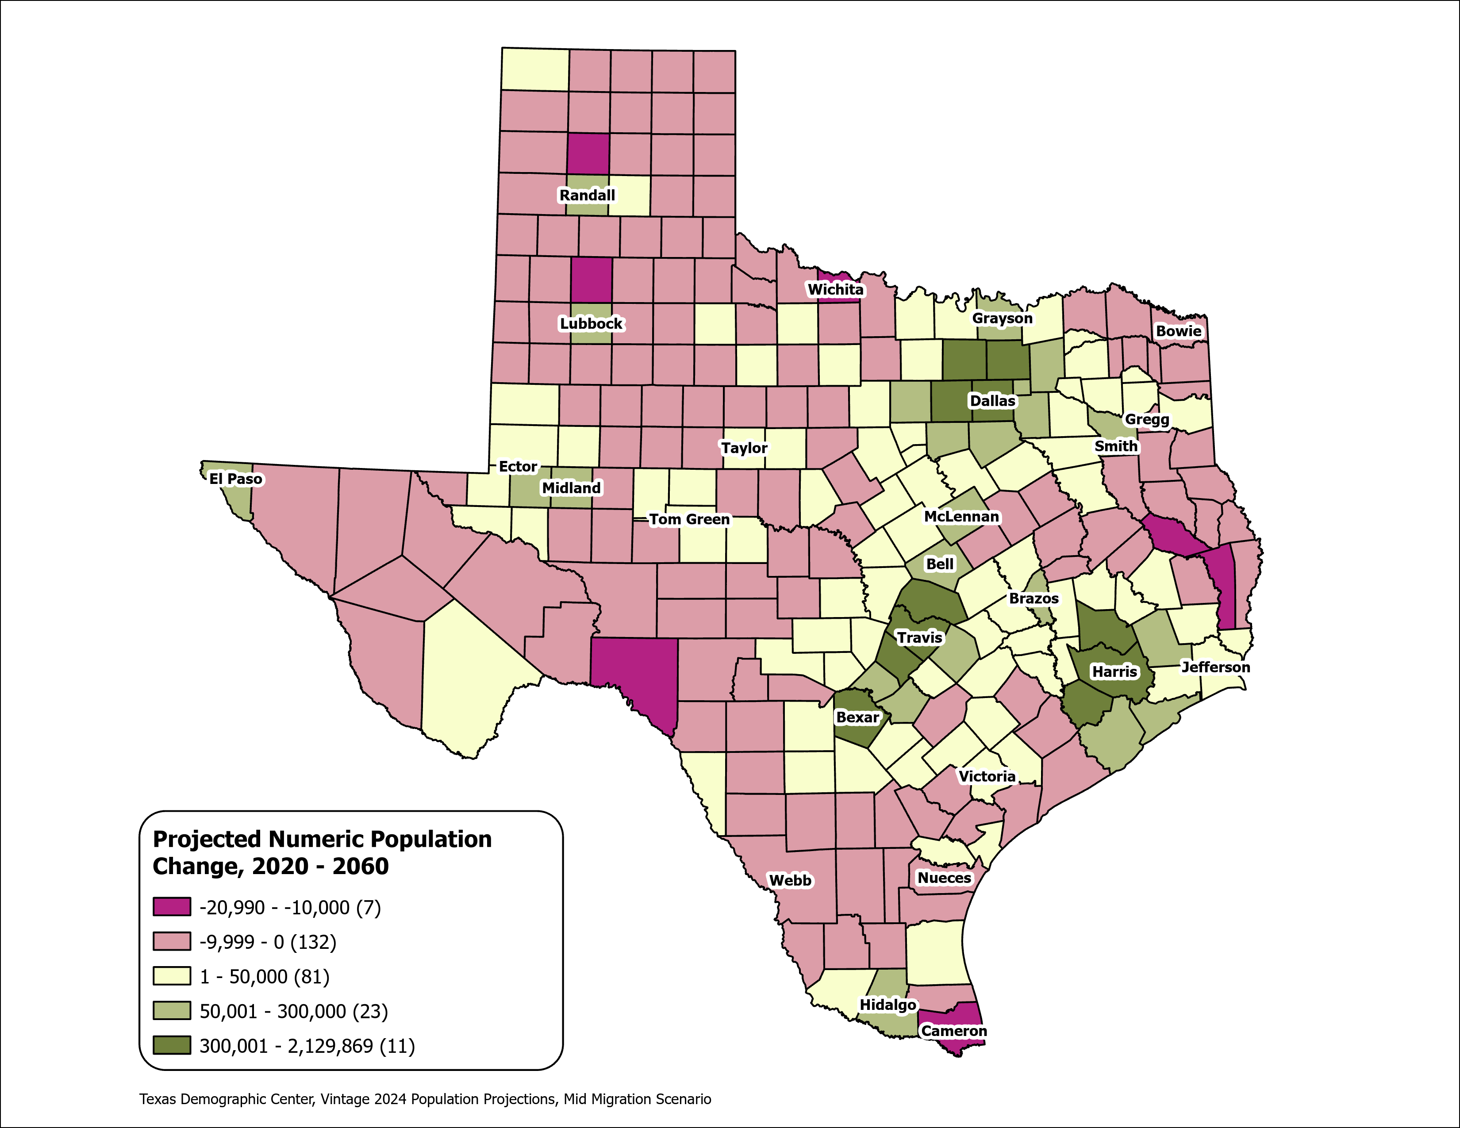
Texas Counties
Projected Population Numeric Change 2020-2060
Mid Migration Scenario
139 Counties are projected to lose population
Current MSA counties will account for 99% of the state’s growth from 2020 to 2060
The four MSAs within the TX Triangle will increase their share of population from 67% to 74%
Source: Texas Demographic Center, Vintage 2024 Population Projections, Mid Migration Scenario

Slide 23
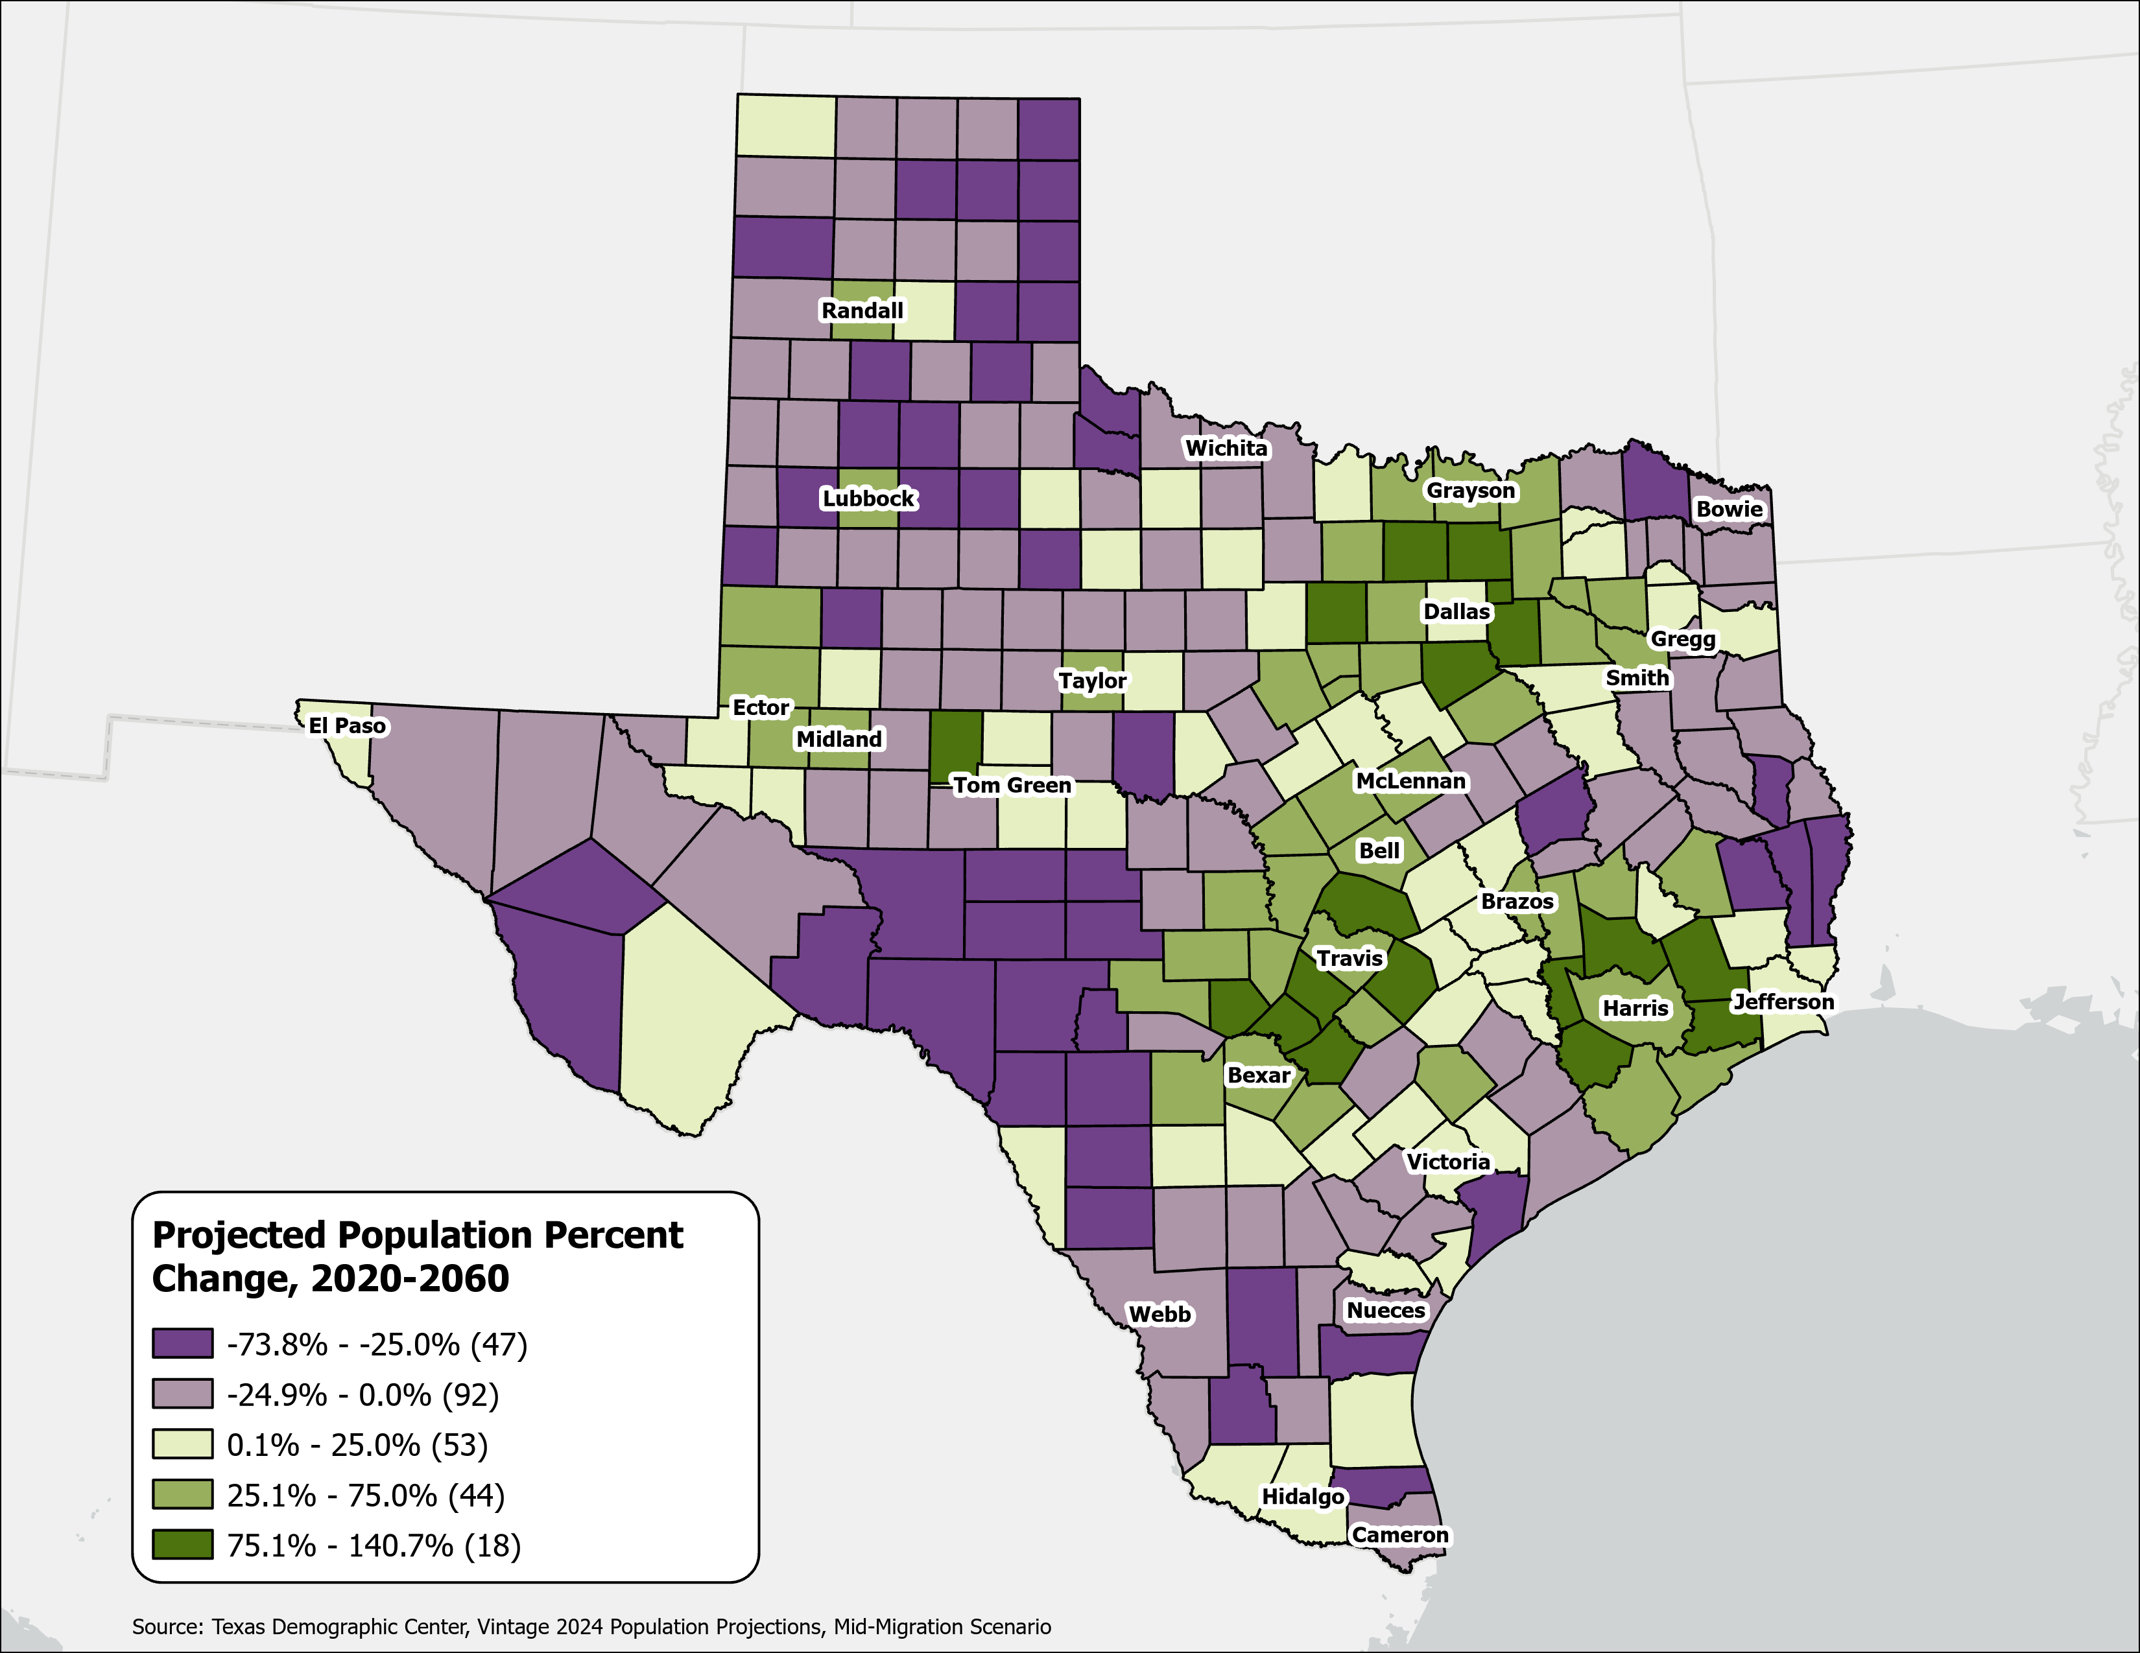
Texas Counties
Projected Population Percent Change 2020-2060
Mid Migration Scenario
Suburban ring counties in the triangle area will see the fastest growth rates.
Source: Texas Demographic Center, Vintage 2024 Population Projections, Mid Migration Scenario

Slide 24
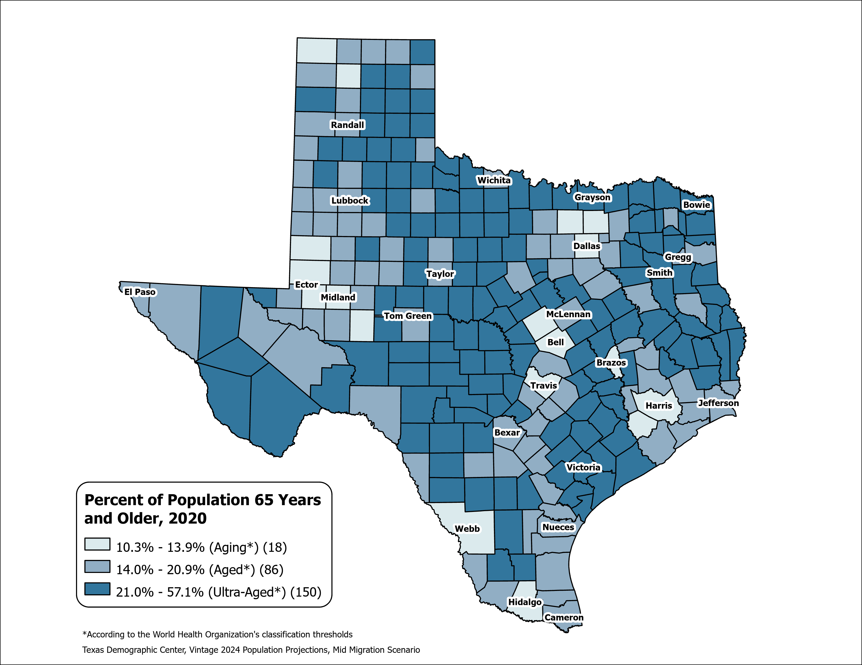
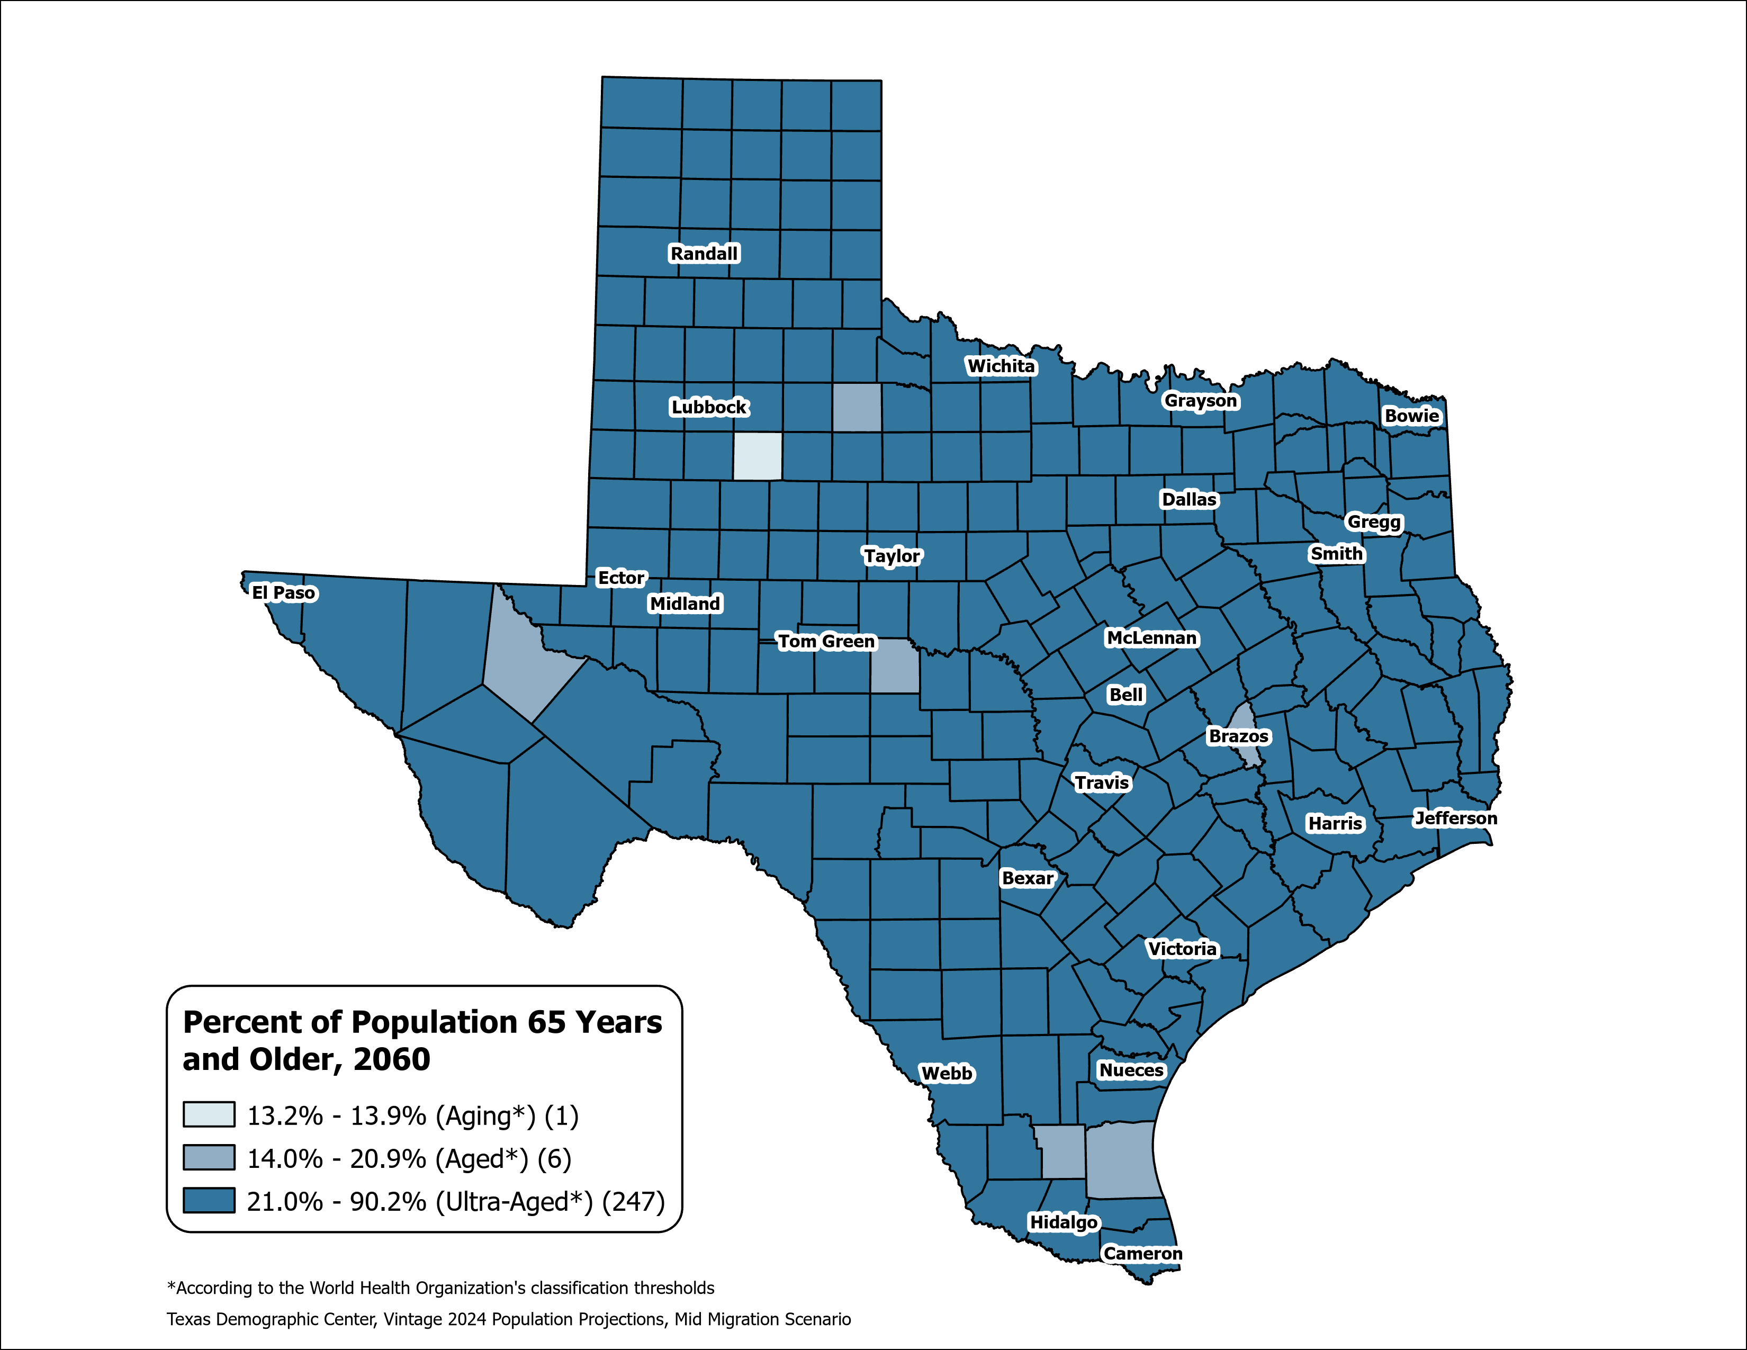
County Aging Map – Using the % of 65+ to Measure
Texas 2020: Aging (13.5%)
Texas 2060: Ultra-Aged (21.7%)
Source: Texas Demographic Center, Vintage 2024 Population Projections, Mid-Migration Scenario

Slide 25
Beyond the Demographics

Slide 26
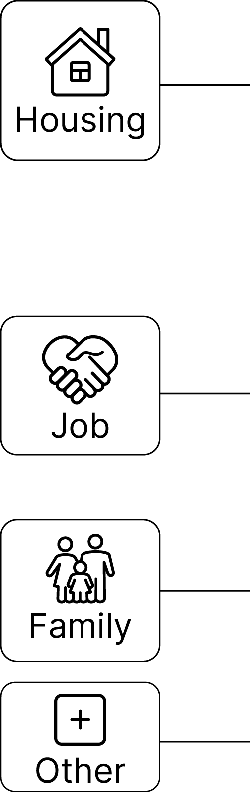
Why Texans Move, 2022-2023
Between 2024 and 2025, people moved within Texas or from elsewhere to Texas primarily for housing reasons.
Why Texans Move?
Top Detailed Reasons ?
2020
Housing | wanted new or better house/apartment | 14%
Housing | to establish own household | 12%
Job | new job or job transfer | 11%
2025
Job | new job or job transfer | 12%
Housing | wanted new or better house/apartment | 11%
Housing | cheaper housing | 11%
Source: U.S. Census Bureau, Current Population Survey Annual Social and Economic Supplement (ASEC) Supplement (March 2023).

Slide 27

Median Household Income and Home Value Gap Widens in Texas, 2013-2023
Housing costs outpace income for many Texans
Median
Home
Value
Median
Household
Income
$
$
$
Source: U.S. Census Bureau, American Community Survey, 1-Year, 2013, 2018, and 2023.
Note: Data represented in 2023 inflation-adjusted dollars.

Slide 28
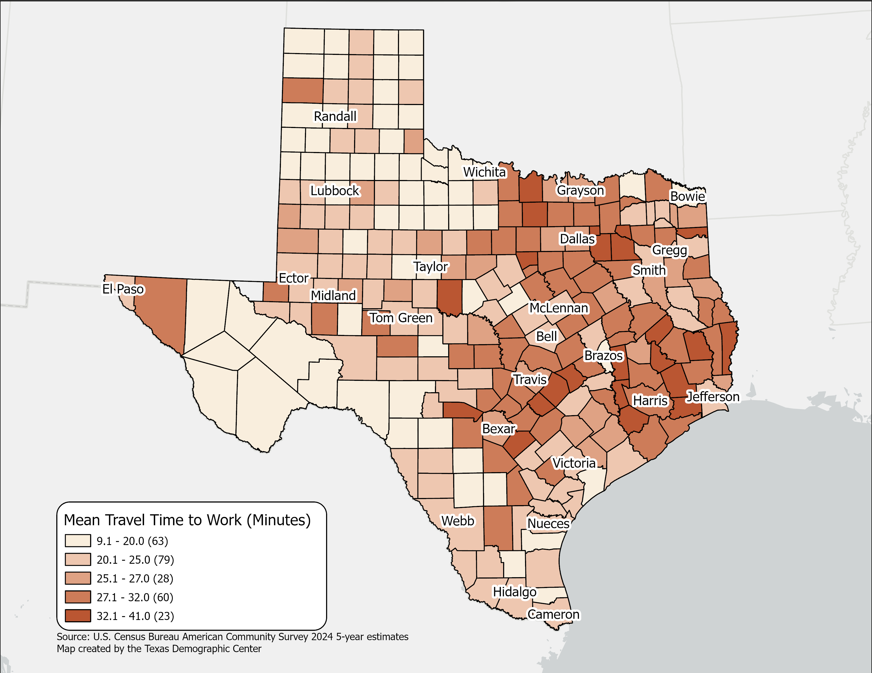
Mean Travel Time to Work(minutes),
Texas Counties, 2024
Mean Travel time for Texas:
  26.7 (2024 5-year)
  25.2 (2014 5-year)
Geographic variation across Texas counties reflects higher travel times in large metropolitan and suburban areas.
Source: U.S. Census Bureau, American Community Survey, 2024 5-year estimates

Slide 29
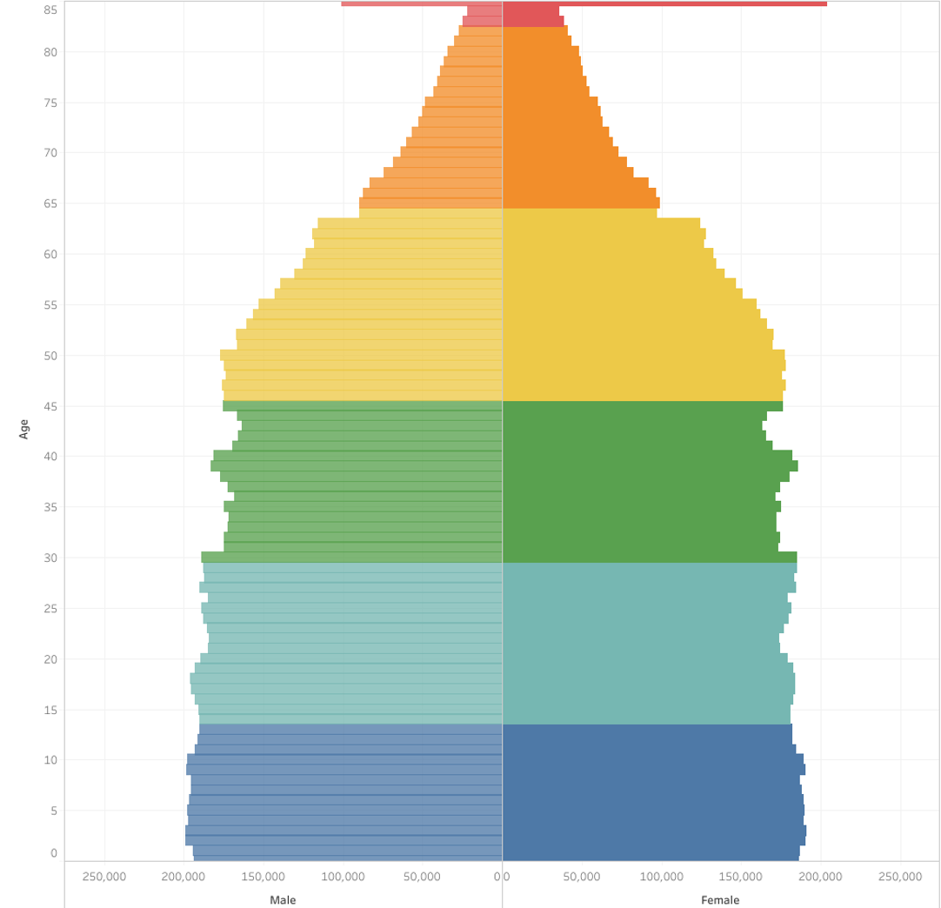
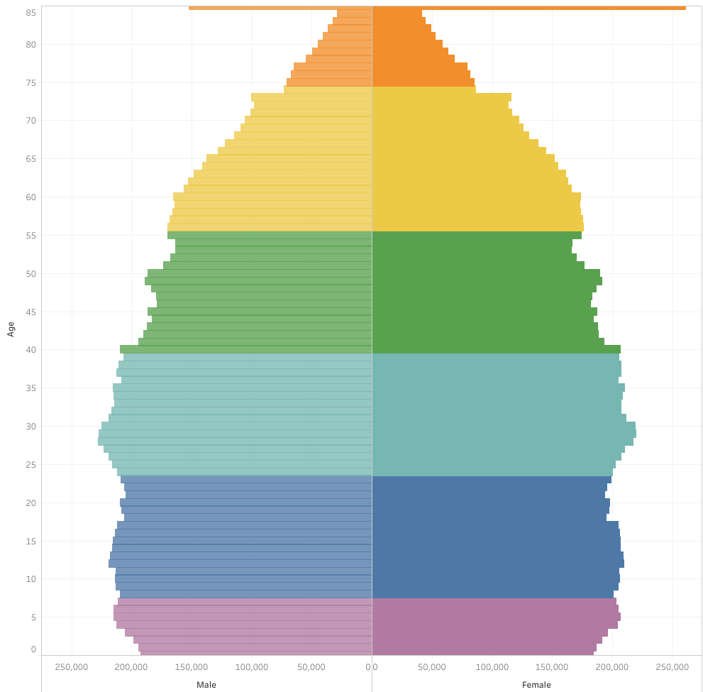
Generational Population Pyramids, Texas, 2010 and 2020
2010
2020
Generation
Greatest Generation (1901-1927)
Silent Generation (1928-1945)
Baby Boomers (1946-1964)
Generation X (1965-1980)
Millennials (1981-1996)
Generation Z (1997-2012)
Generation Alpha (2013-)
Source: U.S. Census Bureau. 2010 and 2020 Vintage Population Estimates

Slide 30
Public School Enrollment by Grade in Texas, 2014 and 2024
Source: U.S. Census Bureau. American Community Survey 1-Year sample, 2014 and 2024

Slide 31
Private School Enrollment by Grade in Texas, 2014 and 2024
% Private School
2014: 9.0%
2024: 11.7%
Source: U.S. Census Bureau. American Community Survey 1-Year sample, 2014 and 2024

Slide 32
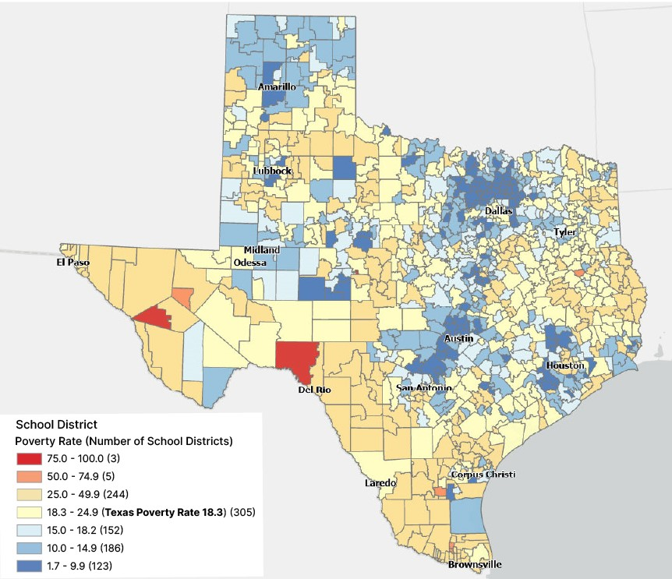
Poverty Rate for School Age Children (5-17) Living in Families, by School Districts in Texas, 2022
Many central city school districts have higher poverty rates
In Texas, nearly
1 in 5
school-age children in families live in poverty.
Source: U.S. Census Bureau, Small Area Income and Poverty Estimates (SAIPE) for 2022.

Slide 33
Labor force participation among older Texans is on the rise
Labor Force Participation Among 65+ Population, 2010 - 2024
Source: U.S. Census Bureau, American Community Survey 1-Year Estimates, 2010 and 2024

Slide 34
Health and Health Care in Texas

Slide 35

Disability Rate by Age in Texas, 2022
Hispanics disability rates increase faster in older age groups
Source: U.S. Census Bureau, 2022 American Community Survey 1-Year, Public Use Microdata Sample (PUMS)

Slide 36
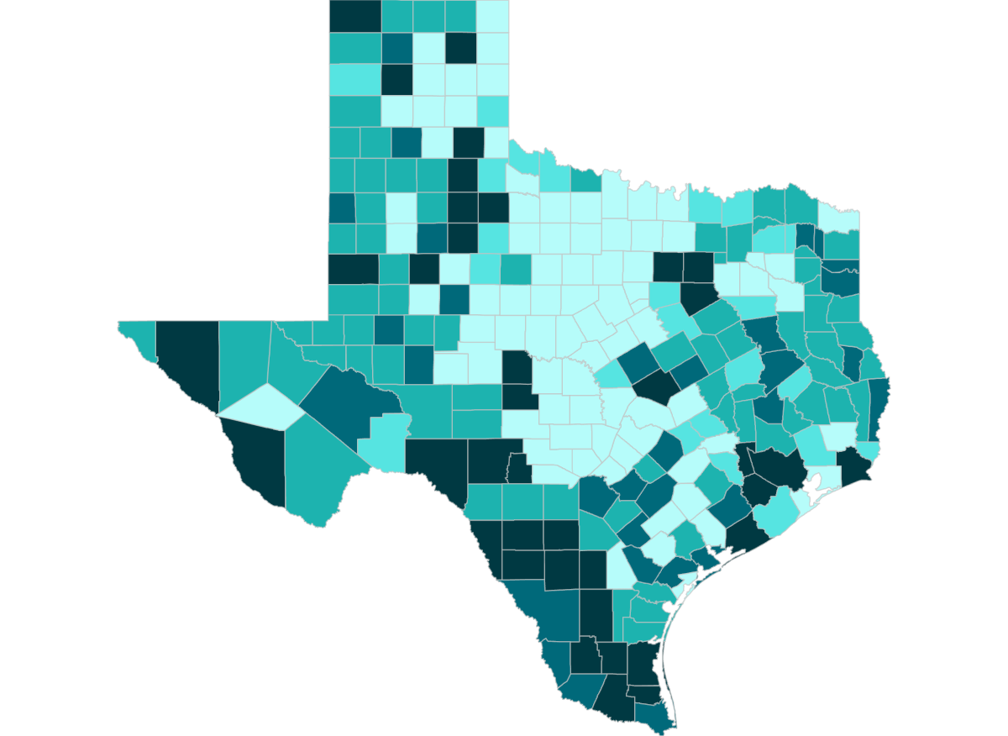


Diabetes Diagnoses Rates
Texas Adults 20+, 2024
8.9 - 9.6
9.7 - 9.7
9.8 - 10
10.1 - 10.2
10.3 - 11.1
No Data
Suppressed
Source: Centers for Disease Control and Prevention, National Center for Health Statistics. Surveillance - United States Diabetes Surveillance System

Slide 37
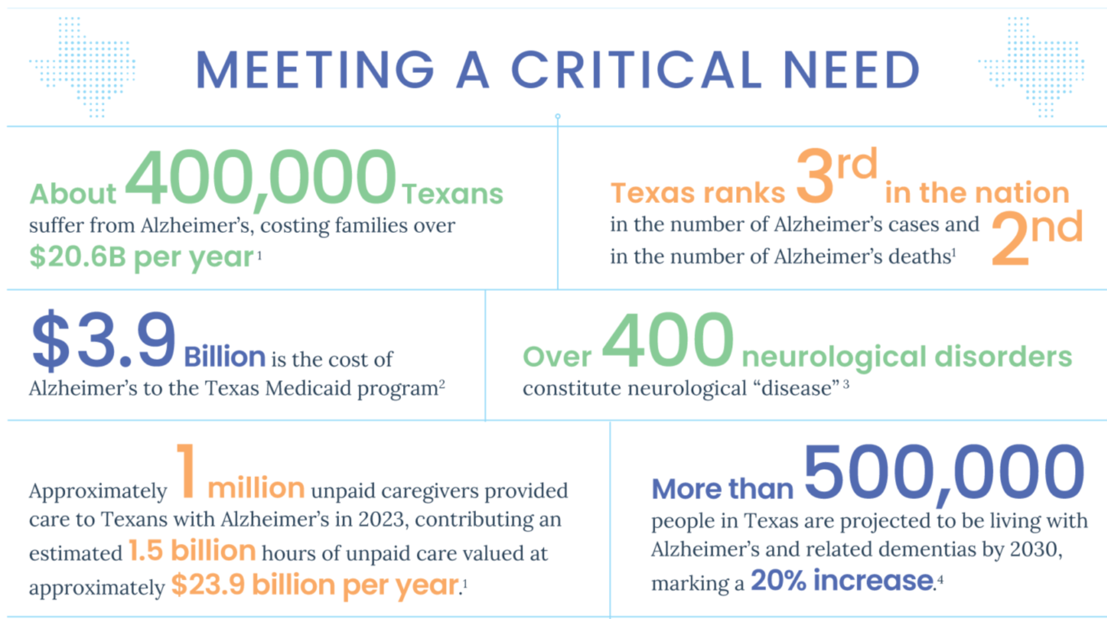
The Creation of the
Dementia Prevention and Research Institute of Texas (DPRIT)
Source: Texas Medical Center. Dementia Prevention Research Institute of Texas (DPRIT) - Texas Medical Center

Slide 38
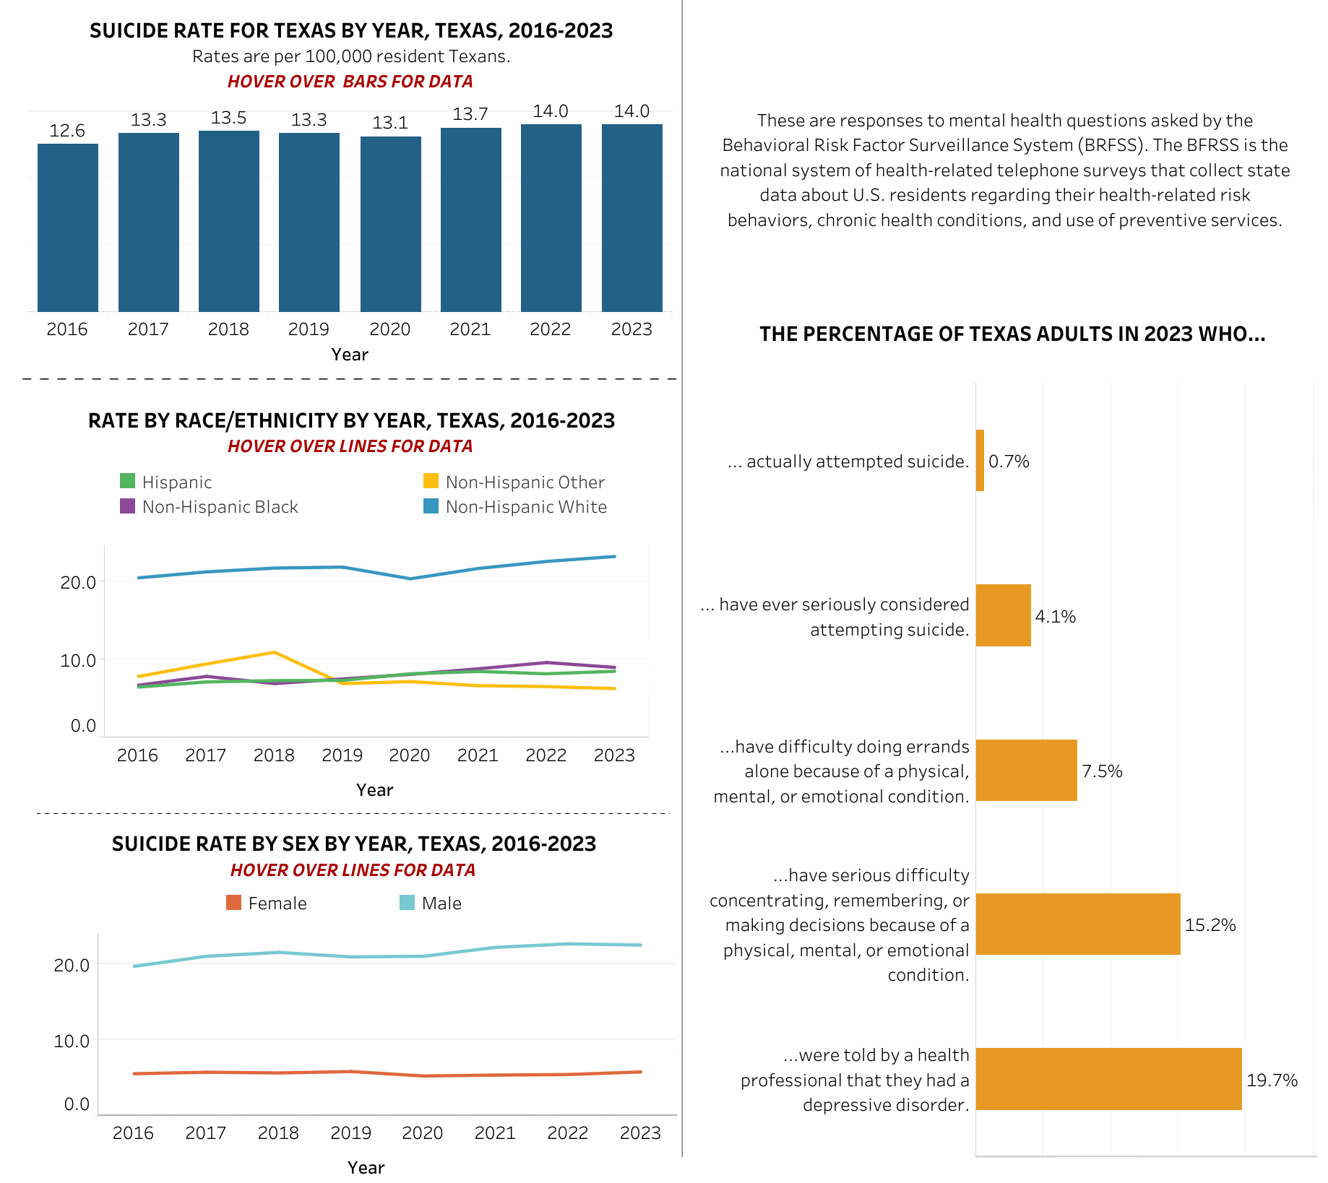


Mental Health in Texas
2016-2023
Source: Texas Department of Health Services. Texas Health Data - Mental Health

Slide 39
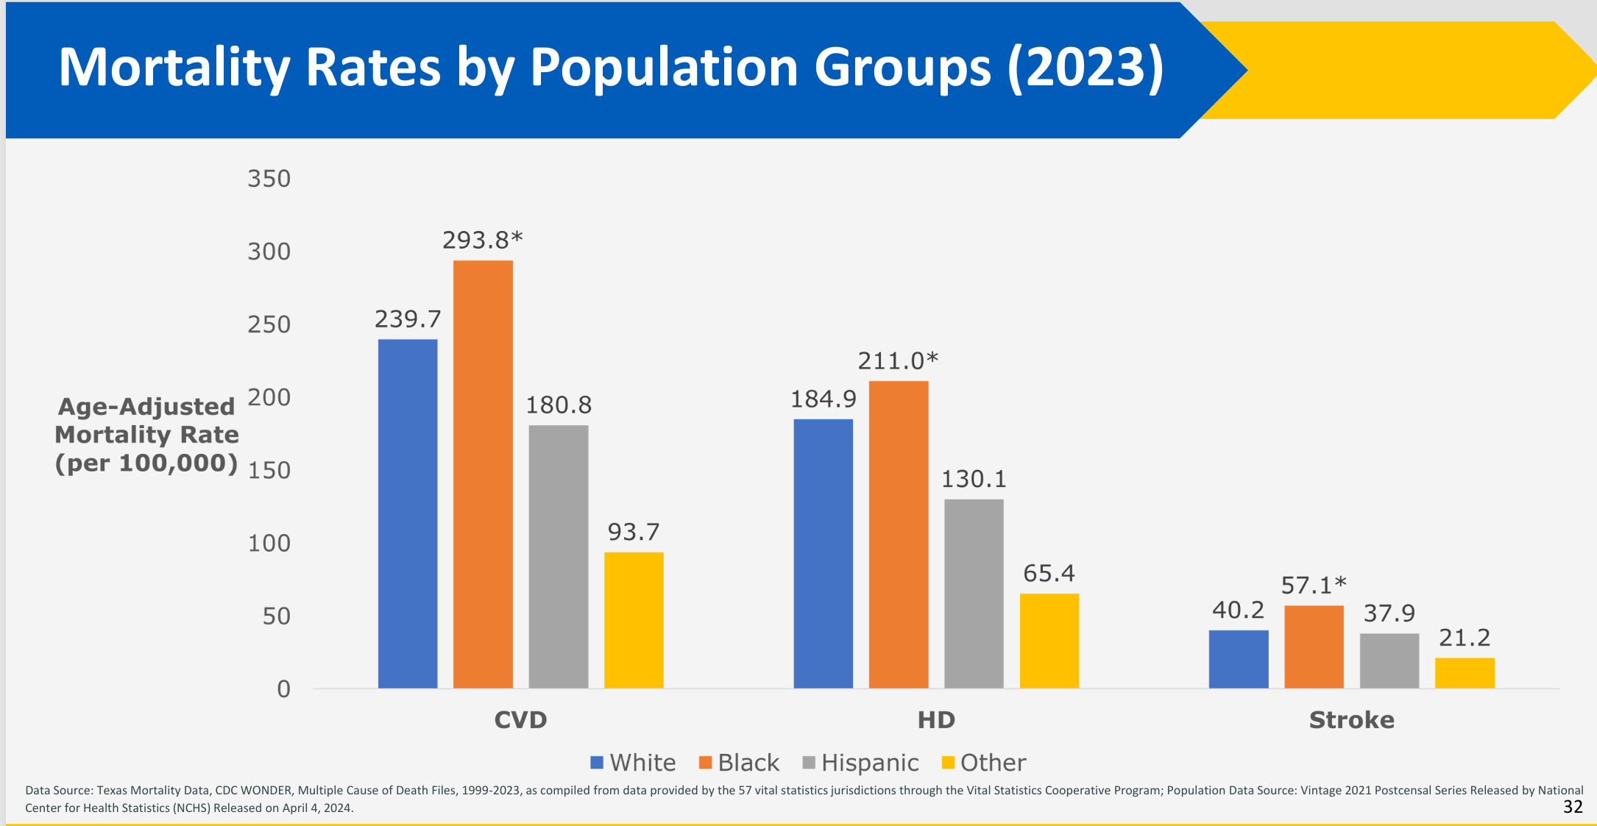
Cardiovascular Disease and Stroke Deaths in Texas
Heart disease is the number one cause of death (U.S. and Texas)
About 1 in 5 people died of HD in the U.S. in 2022
CVD is a group of heart and blood vessel disorders like heart disease, heart attack, stroke, and arrhythmia.
HD refers to several heart conditions, i.e., heart attack, arrhythmia, and heart failure
Stroke is a disruption of blood flow to the brain by blockage or loss of blood
Source: Texas Department of State Health Services. Overview of Cardiovascular Disease and Stroke Prevalence in Texas

Slide 40
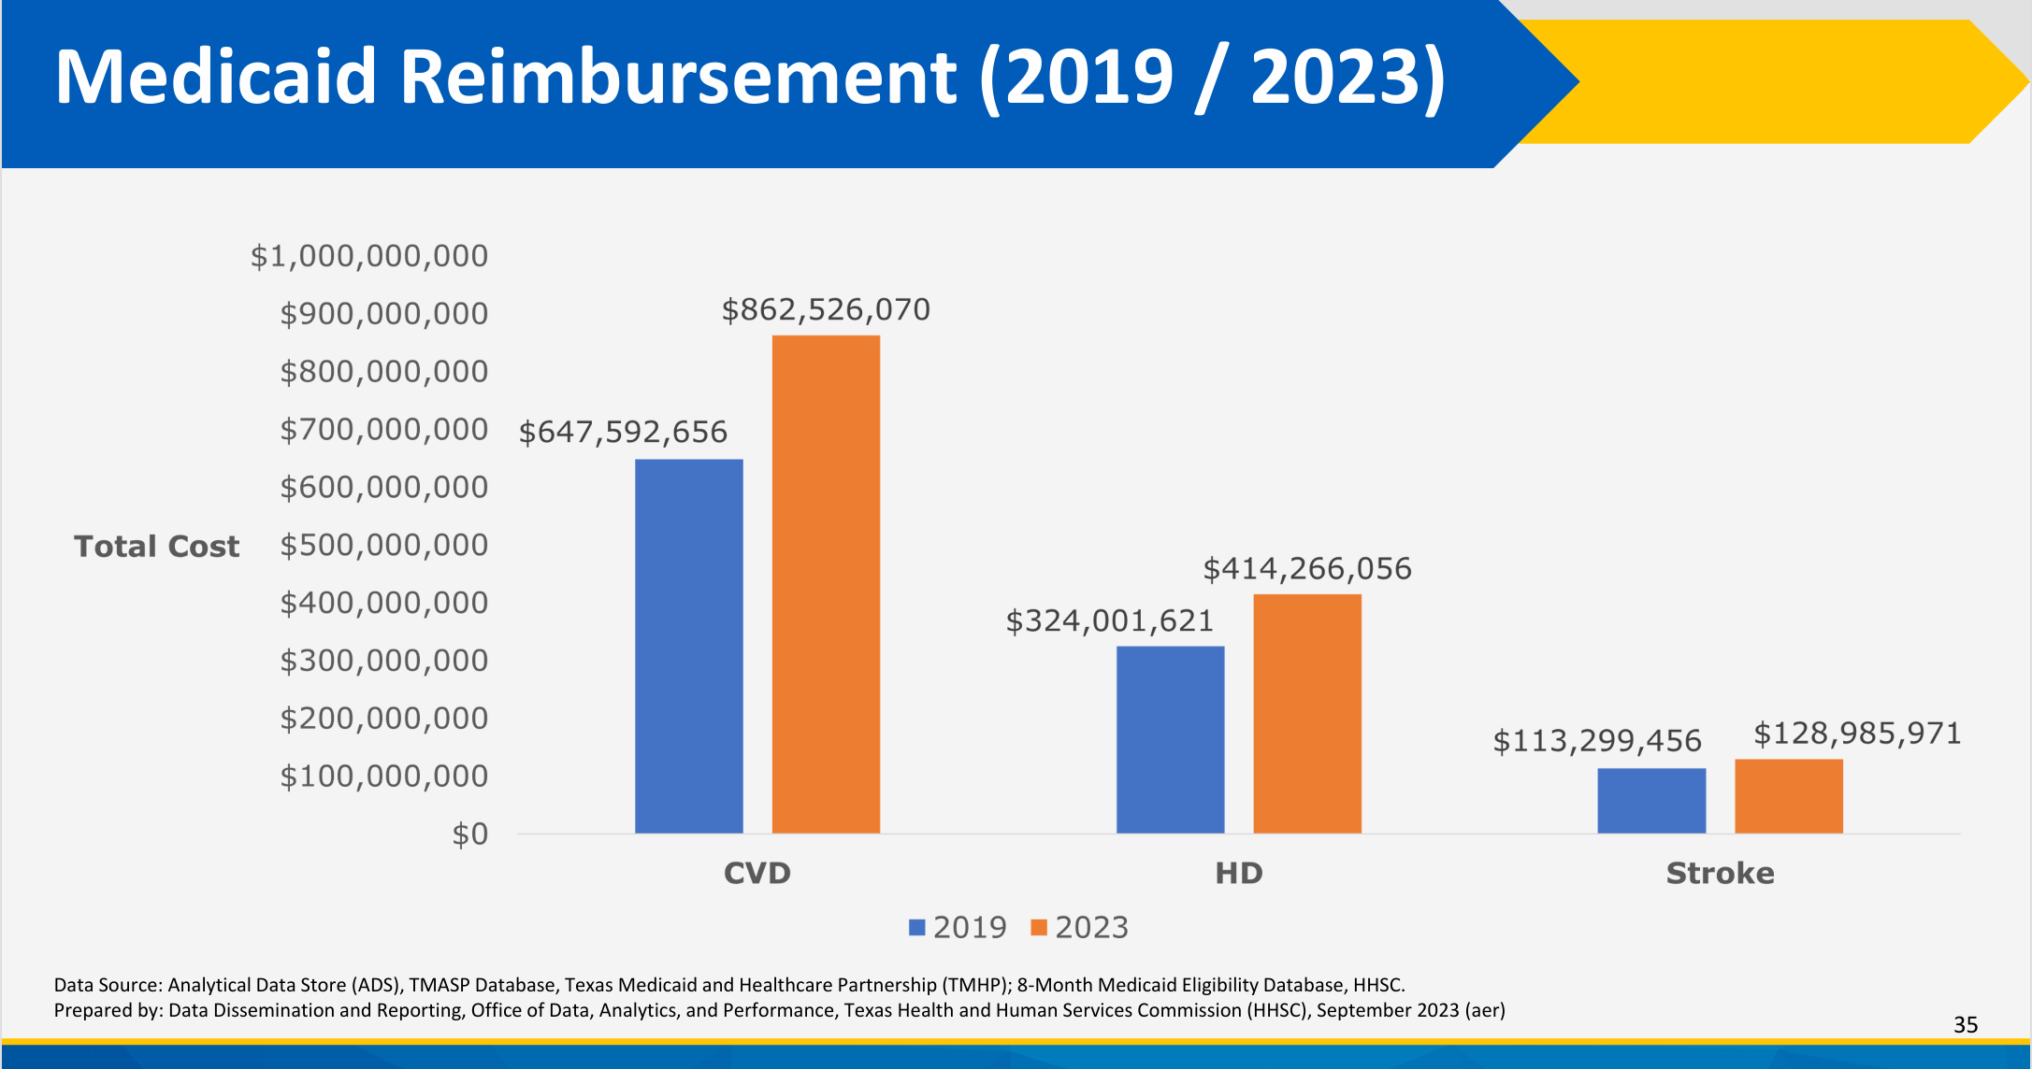
Rising Cost of Cardiovascular Diseases
Source: Texas Department of State Health Services. Overview of Cardiovascular Disease and Stroke Prevalence in Texas

Slide 41
Percent Uninsured by Race/Ethnicity, Texas 2024
16.7% of Texans are uninsured with differences among race/ethnic groups
Source: U.S. Census Bureau, American Community Survey, 2022 1-year estimates

Slide 42
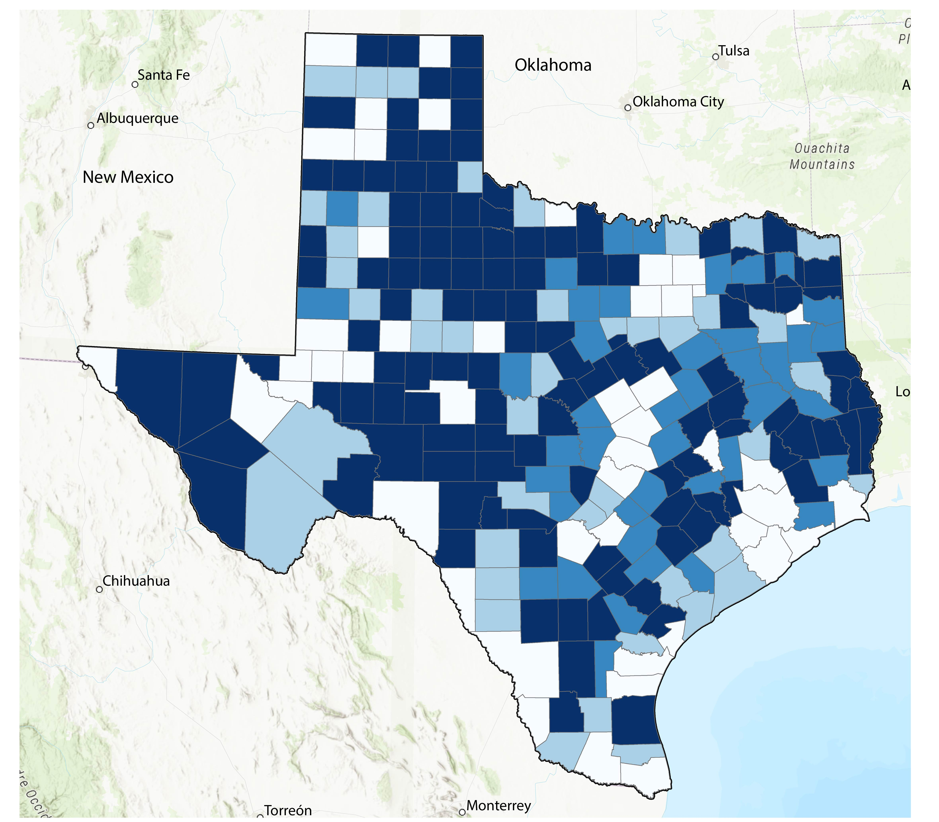
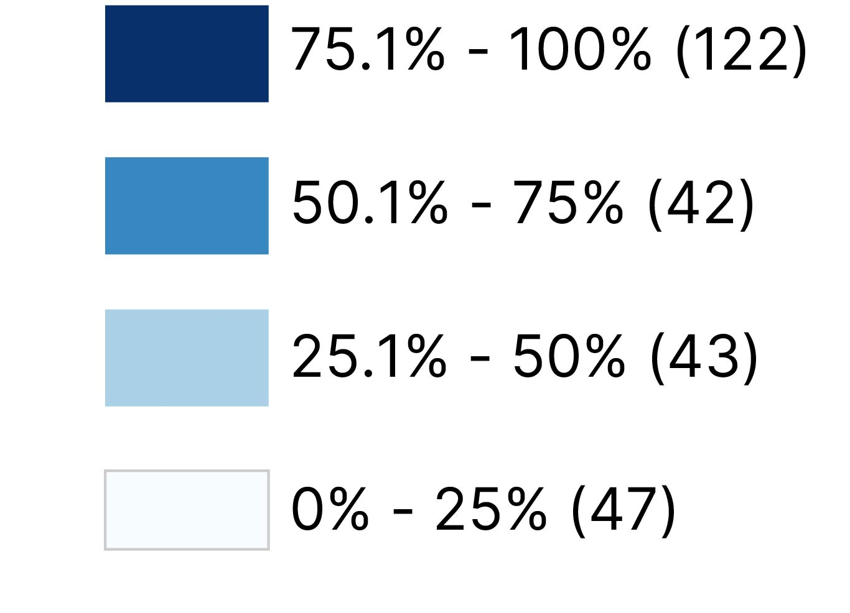
Texas is home to the largest rural population in the U.S.
Percent of Rural Population by County
4,744,808 or 16%
of Texans live outside the urban areas defined by the Census Bureau.
Source: U.S. Census Bureau, 2020 Decennial Census Demographic and Housing Characteristics (DHC) File

Slide 43
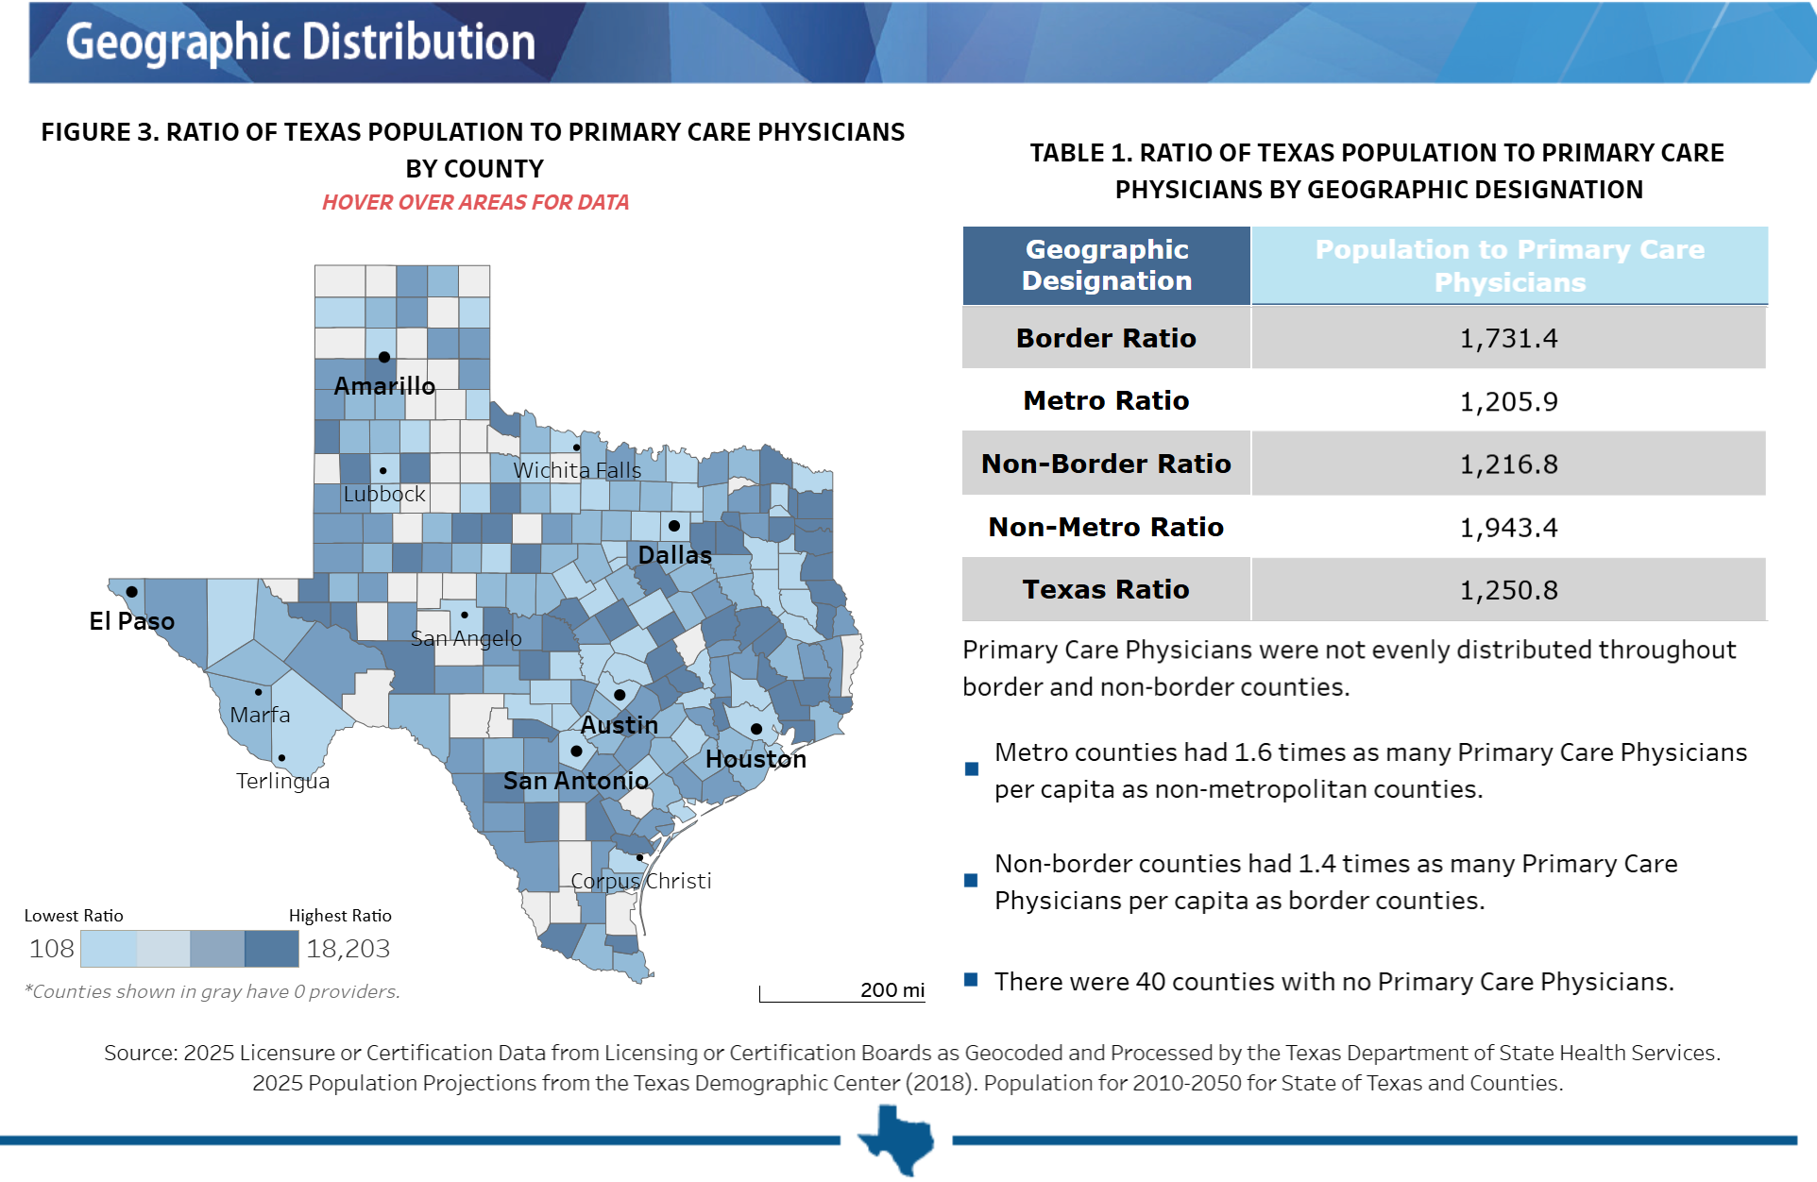
Primary Care Geographic Distribution in Texas, 2025
Source: Texas Department of State Health Services. https://healthdata.dshs.texas.gov/dashboard/health-care-workforce/hprc/health-profession-fact-sheets

Slide 44
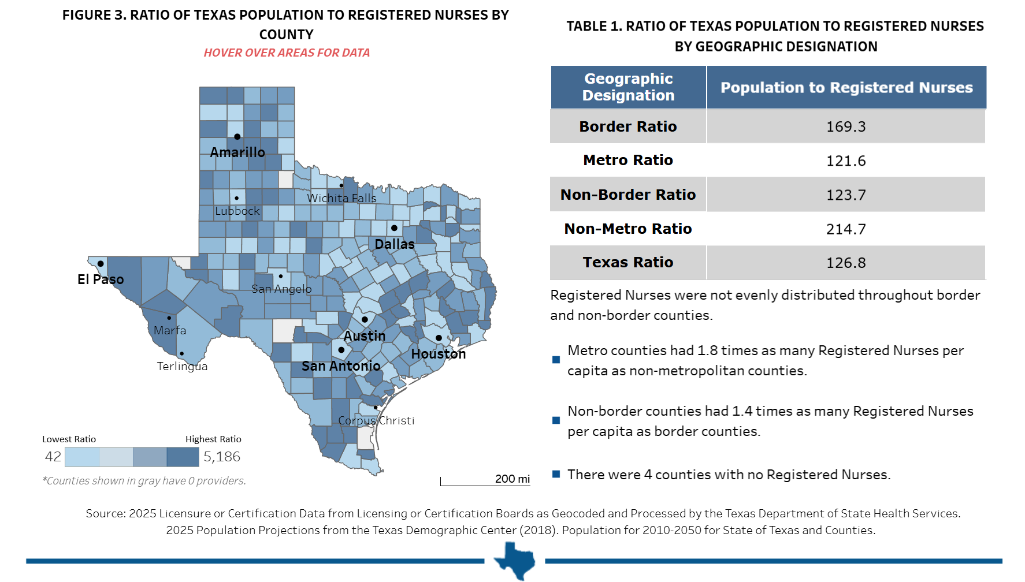
Registered Nurses Geographic Distribution in Texas, 2025
Source: Texas Department of State Health Services. https://healthdata.dshs.texas.gov/dashboard/health-care-workforce/hprc/health-profession-fact-sheets

Slide 45
Growing Healthy Texas: What It Will Take
A Story of People, Places, and the Future
The People
The Places
The Future
31.7 million residents and growing — but fertility is declining, the population is aging, and 16.7% remain uninsured with stark disparities by race and ethnicity
Metro areas are booming while 139 rural counties face population loss, widening gaps in housing affordability, healthcare workforce, and access to primary care
Projections through 2060 show a more diverse, older Texas — growing healthy will require closing coverage gaps, expanding the care workforce, and investing in prevention

Slide 46




Visit our website
Sign up for our newsletter
Follow us on social media

Slide 47
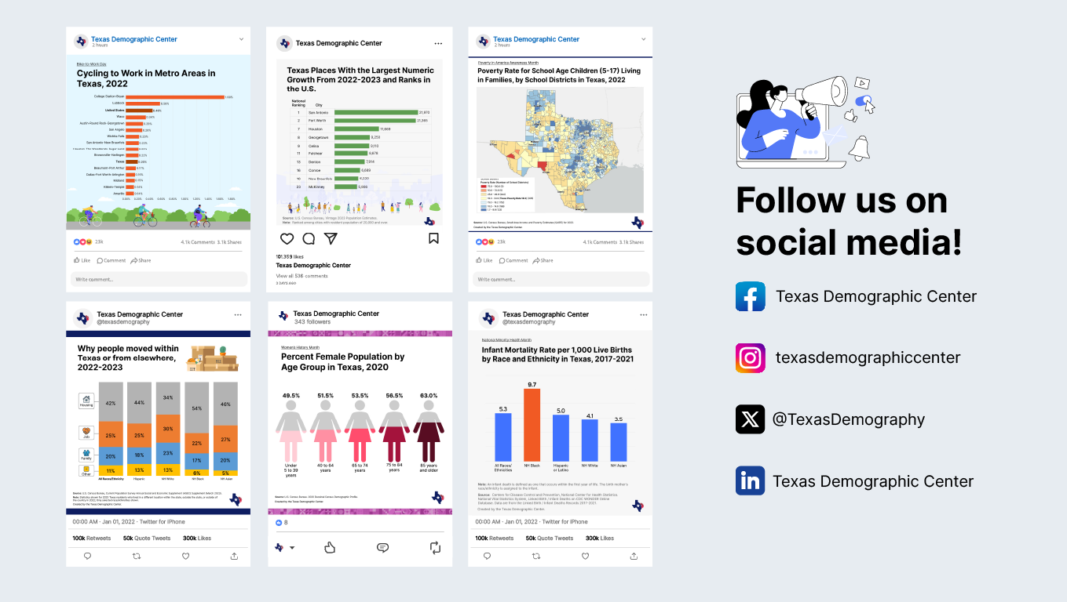
Follow us on social media

Slide 48
About Presenter
Helen You, Ph.D.
(210) 458-6530
tdc@utsa.edu
demographics.texas.gov/

