Slide 1
Texas by the Numbers:
Demographic Trends Driving Elder Justice
Presented at
Texas Elder Justice Coalition Summit
June 18, 2026

Slide 2
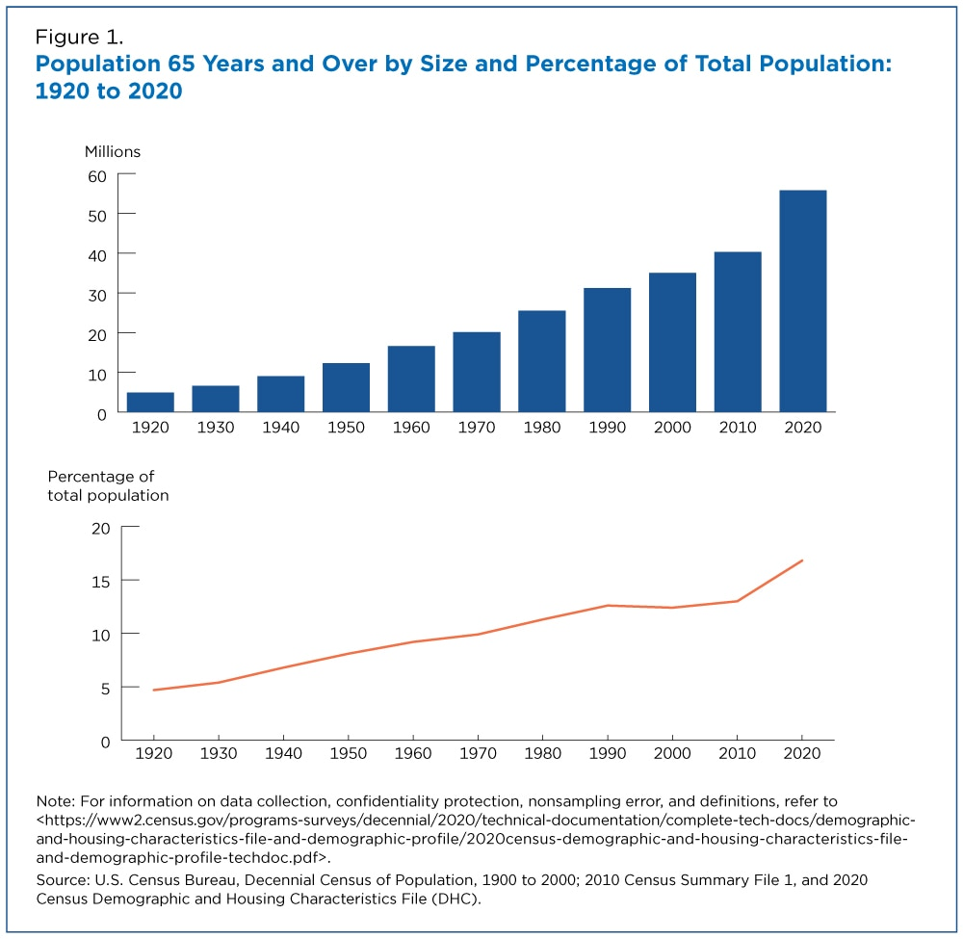

The Aging Population
The U.S. population aged 65 and over grew nearly five times faster than the total population;
Growth spike 2010-2020:
  Largest 10-year numerical growth
  Largest growth in share
  Fastest growth rates
https://www.census.gov/content/dam/Census/library/stories/2023/05/2020-census-united-states-older-population-grew-figure-1.jpg

Slide 3
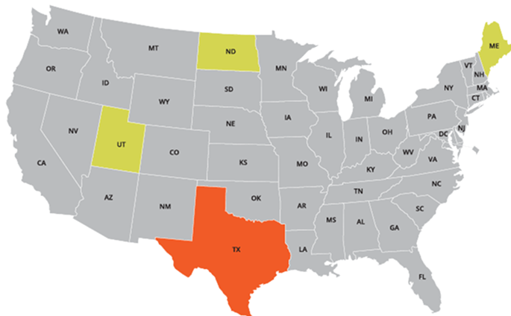
Texas was the second youngest state in the nation in 2024.
National Ranking | U.S. State | Median Age
#1 | Maine | 44.8
…
#48 | North Dakota | 36.0
#49 | Texas | 35.8
#50 | Utah | 32.4
Source: U.S. Census Bureau, Vintage 2024 Population Estimates.

Slide 4
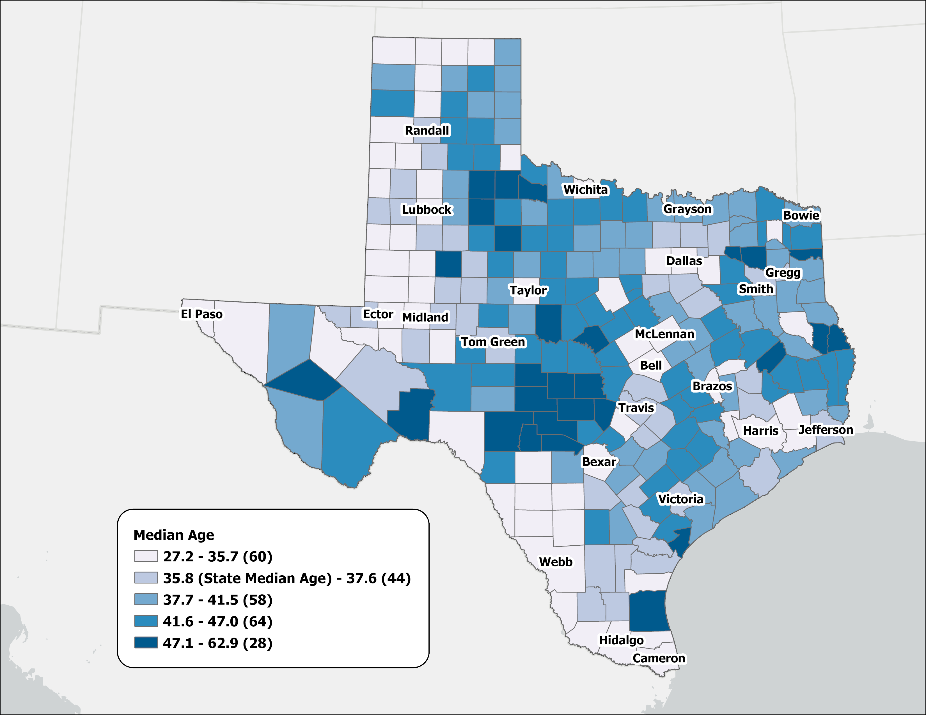
Population Median Age in Texas Counties, 2024
Source: U.S. Census Bureau, Vintage 2024 Population Estimates

Slide 5
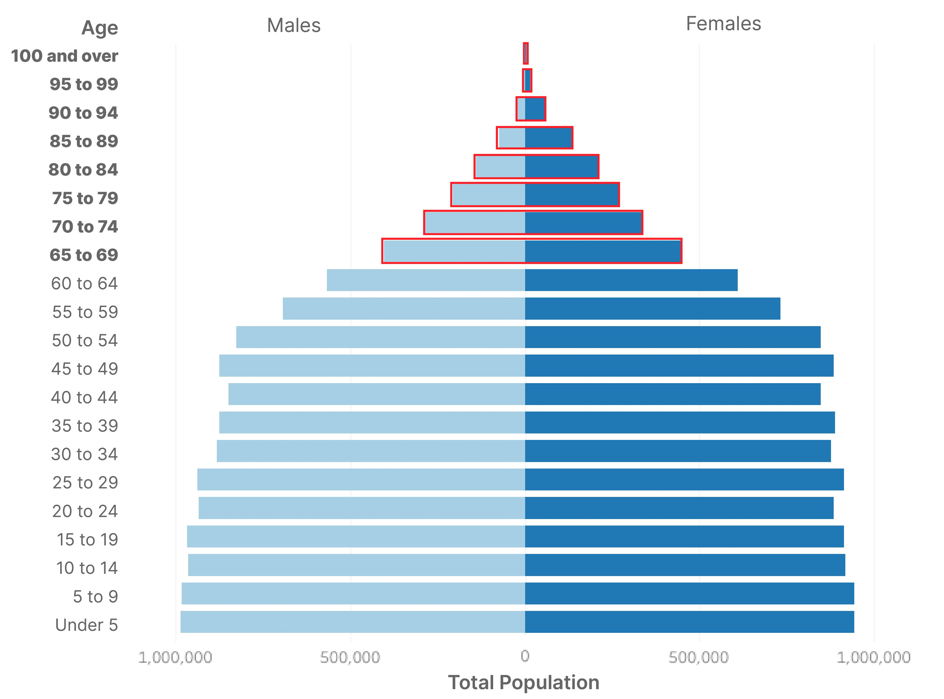
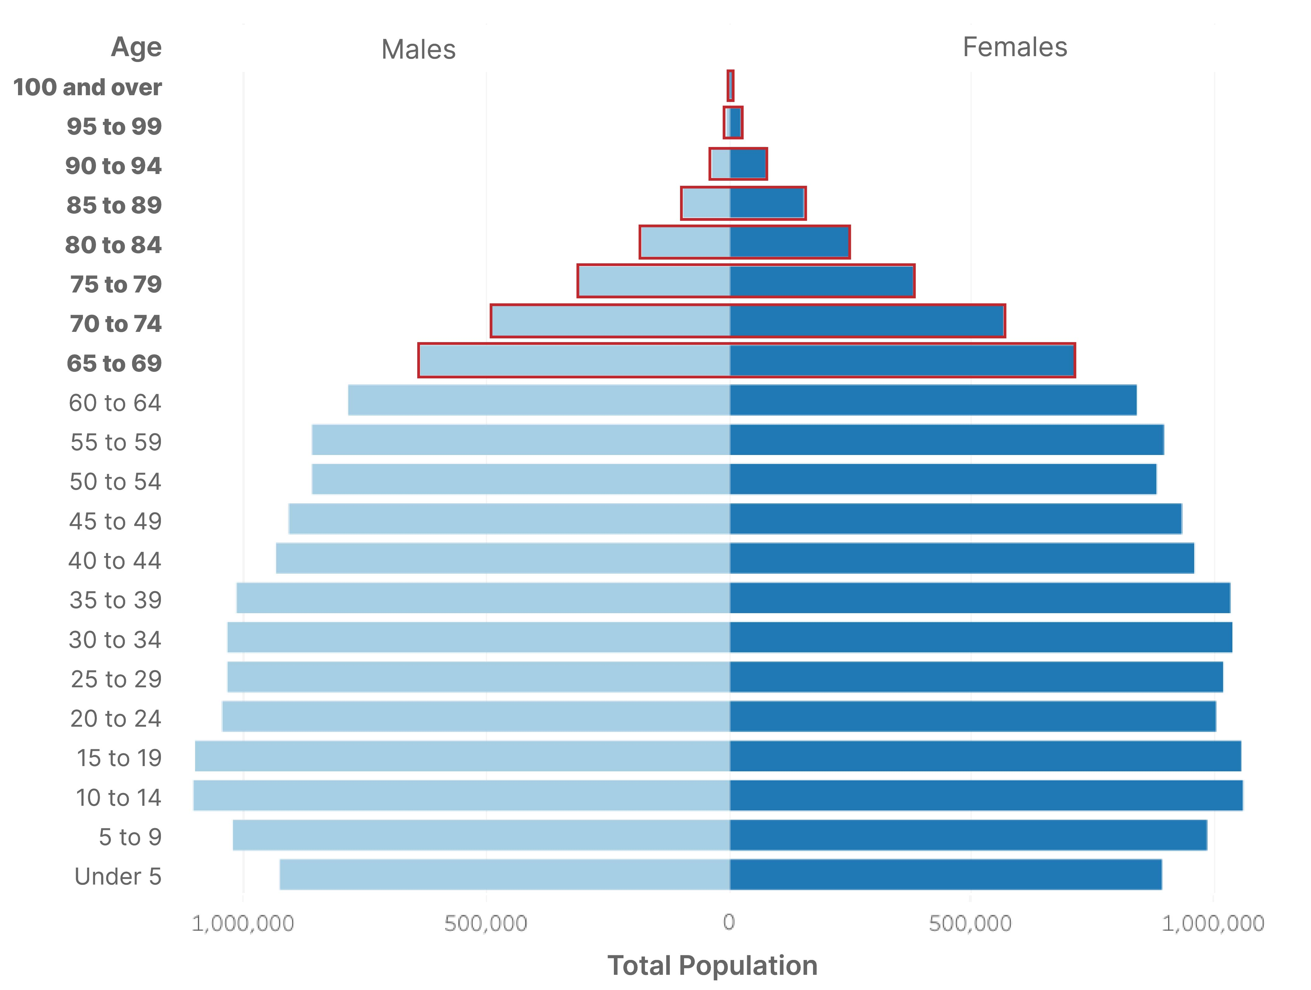
Texas Population Pyramid
2010
2020
% Population 65+:
10.3%
Population 65+:
2.6M
% Population 65+:
13.5%
Population 65+:
3.9M
Population: 25,145,561 | Median Age: 33.6 | % under 18 years: 27.3
Population: 29,145,505 | Median Age: 35.6 | % under 18 years: 25.0
Source: U.S. Census Bureau, Census 2000 Summary File 1 (SF1), 2010 Census Summary File 1 (SF1), 2020 Census Demographic and Housing Characteristics File (DHC)

Slide 6
Texas Fertility Rates, 2007-2024
Births per 1,000 women aged 15-44
Source: Centers for Disease Control and Prevention, National Center for Health Statistics. Natality on CDC WONDER Online Database, 2007-2024.

Slide 7
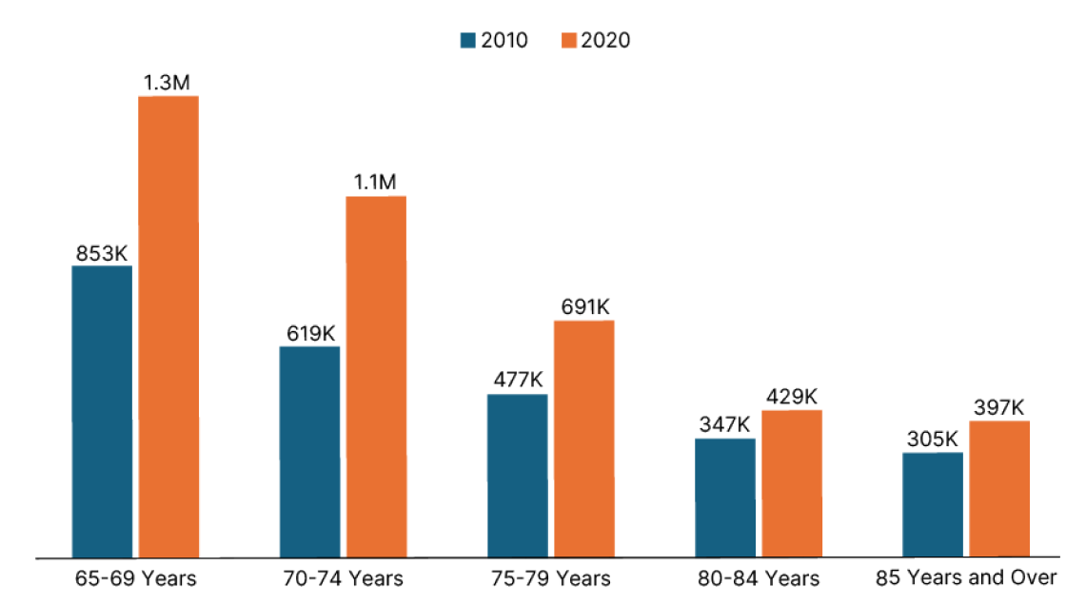
Population Size of Older 65 and Older Age Groups: 2010 and 2020
Source: U.S. Census Bureau, 2010 Decennial Census; 2020 Decennial Census.

Slide 8
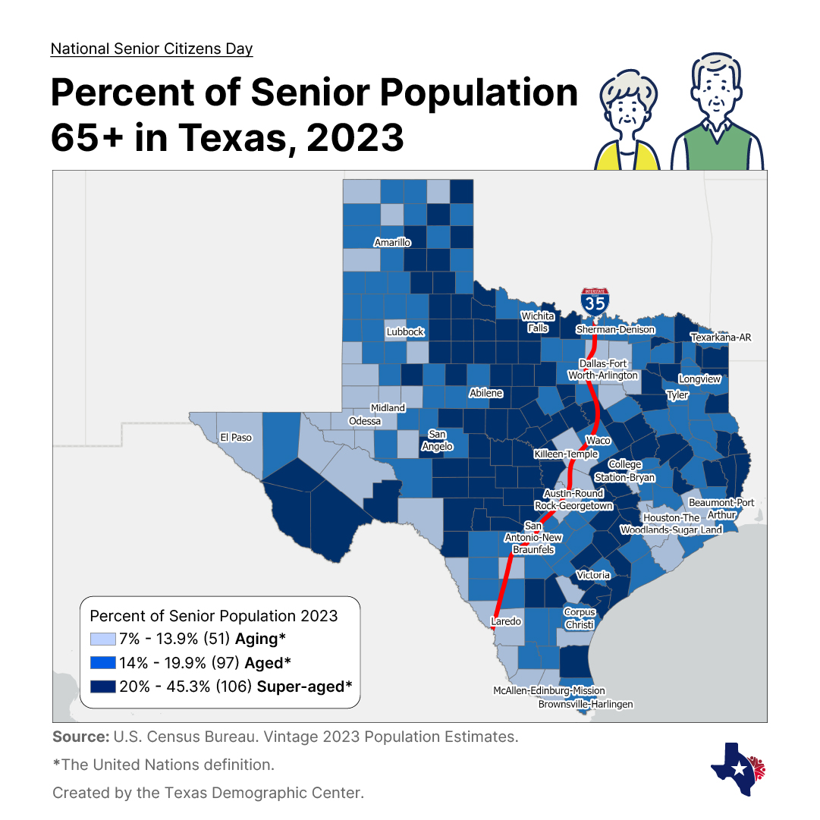
Estimated Percent of Population 65 and Older, 2023
Urban central counties, areas of the Permian Basin, and some border counties have the lowest rates of senior population.
In contrast, rural and certain retirement counties have a higher percentage of residents aged 65 and older.

Slide 9
Poverty Rates by Age Groups in Texas, 2014 and 2024
Change: -3.8%
Change: -6.7%
Change: -3.2%
Change: +1.4%
Source: U.S. Census Bureau, American Community Survey Estimates, 1-Year, 2014 and 2024

Slide 10
Labor Force Participation Among Texans 65+, 2010-2024
Source: U.S. Census Bureau, American Community Survey Estimates, 1-Year, 2010 – 2024.

Slide 11

Age Dependency Ratios in Texas, 2010 and 2024
Texas’s Workforce is Carrying More Seniors than Ever
Source: U.S. Census Bureau, 2010 Decennial Census and Vintage 2024 Population Estimates

Slide 12
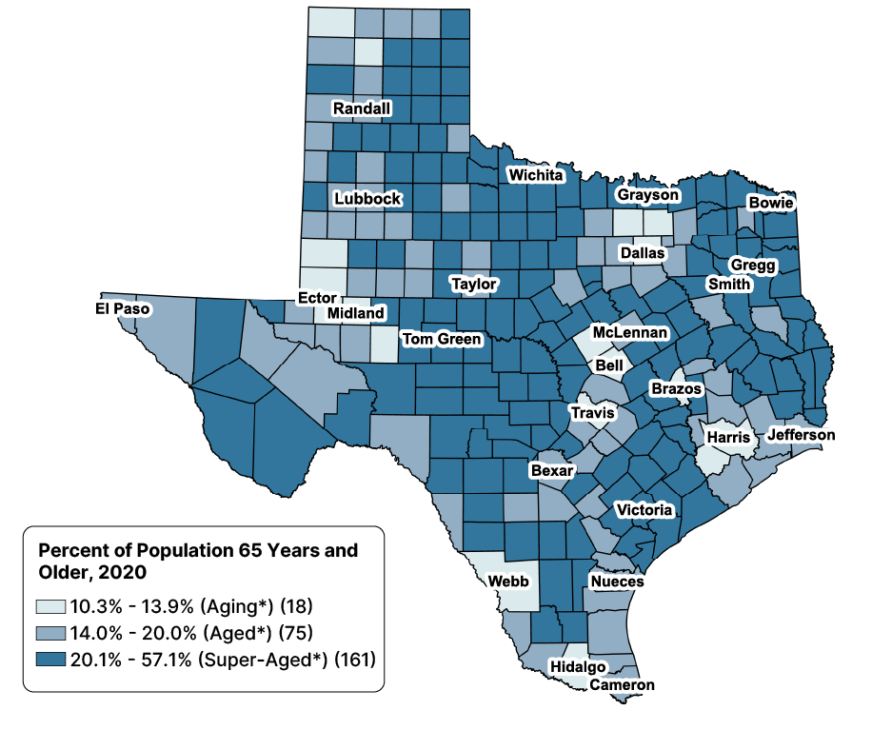
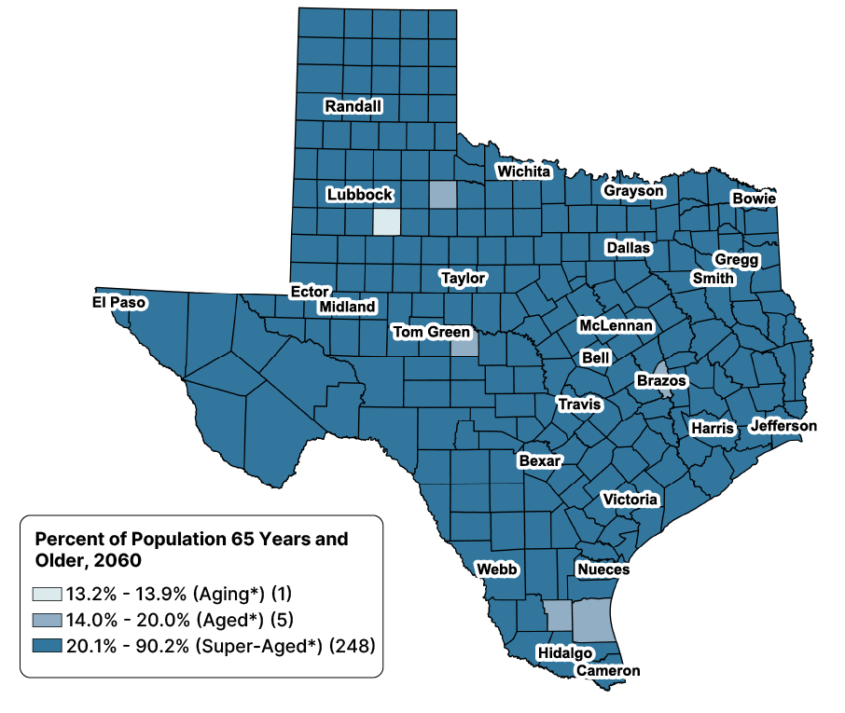
Population 65 Years and Older in Texas
2020
2060
Source: Texas Demographic Center, Vintage 2024 Population Projections, Mid-Migration Scenario.

Slide 13
Texas Projected Population by Age, 2020-2060
Share of population 65+ will continue to increase
22%
18%
13%
60%
60%
62%
25%
21%
18%
Total Population | 29.1M | 37.1M | 42.6M
Source: Texas Demographic Center, Vintage 2024 Population Projections, Mid-Migration Scenario.

Slide 14
Projected Median Age by Migration Scenario in Texas, 2020-2060
Median Age 2060
44.2
43.6
43.6
43.0
Median Age 2020
35.6
Source: Texas Demographic Center, Vintage 2024 Population Projections

Slide 15
Stay in Touch
Monica Cruz, Ph.D.
(210) 458-6543
tdc@utsa.edu
demographics.texas.gov/

