Slide 1
Demographic Trends in Texas and the San Antonio and
Central Texas Region
May 11, 2026
Leadership San Antonio
San Antonio, Texas

Slide 2




About our organization
Major Function
Produce annual population estimates and biennial population projections
Other Services
Disseminate demographic and socioeconomic information from the Census Bureau and other reliable sources.
Provide training and technical expertise.
Custom data analyses.
State Demographer
Lloyd B. Potter, Ph.D.
Affiliated with
The University of Texas at San Antonio
Partnerships
U.S. Census Bureau
TDC Affiliates

Slide 3
Population Growth

Slide 4


Texas Numeric Growth
Texas’s population surpassed
31.7 million
and ranked #1
in the U.S. on numeric growth
between 2024-2025.
Source: U.S. Census Bureau, Vintage 2024 Population Estimates

Slide 5

New 2025 Estimates Show Texas Growth but at Slower Rate
Newly Released Data
Texas Total Population 2025
31.7M
391K
1.2%
Numeric increase
Percent increase
Growth from 2024

Slide 6
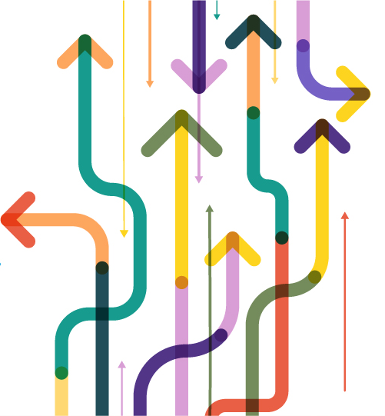
Population increased by
1,072 new Texans daily
between 2024 and 2025.
Source: U.S. Census Bureau, Population Estimates, 2022 and 2023

Slide 7
Texas Components of Population Change 2024-2025
1,072 New Texans Daily
Source: U.S. Census Bureau, Vintage 2025 Population Estimates

Slide 8
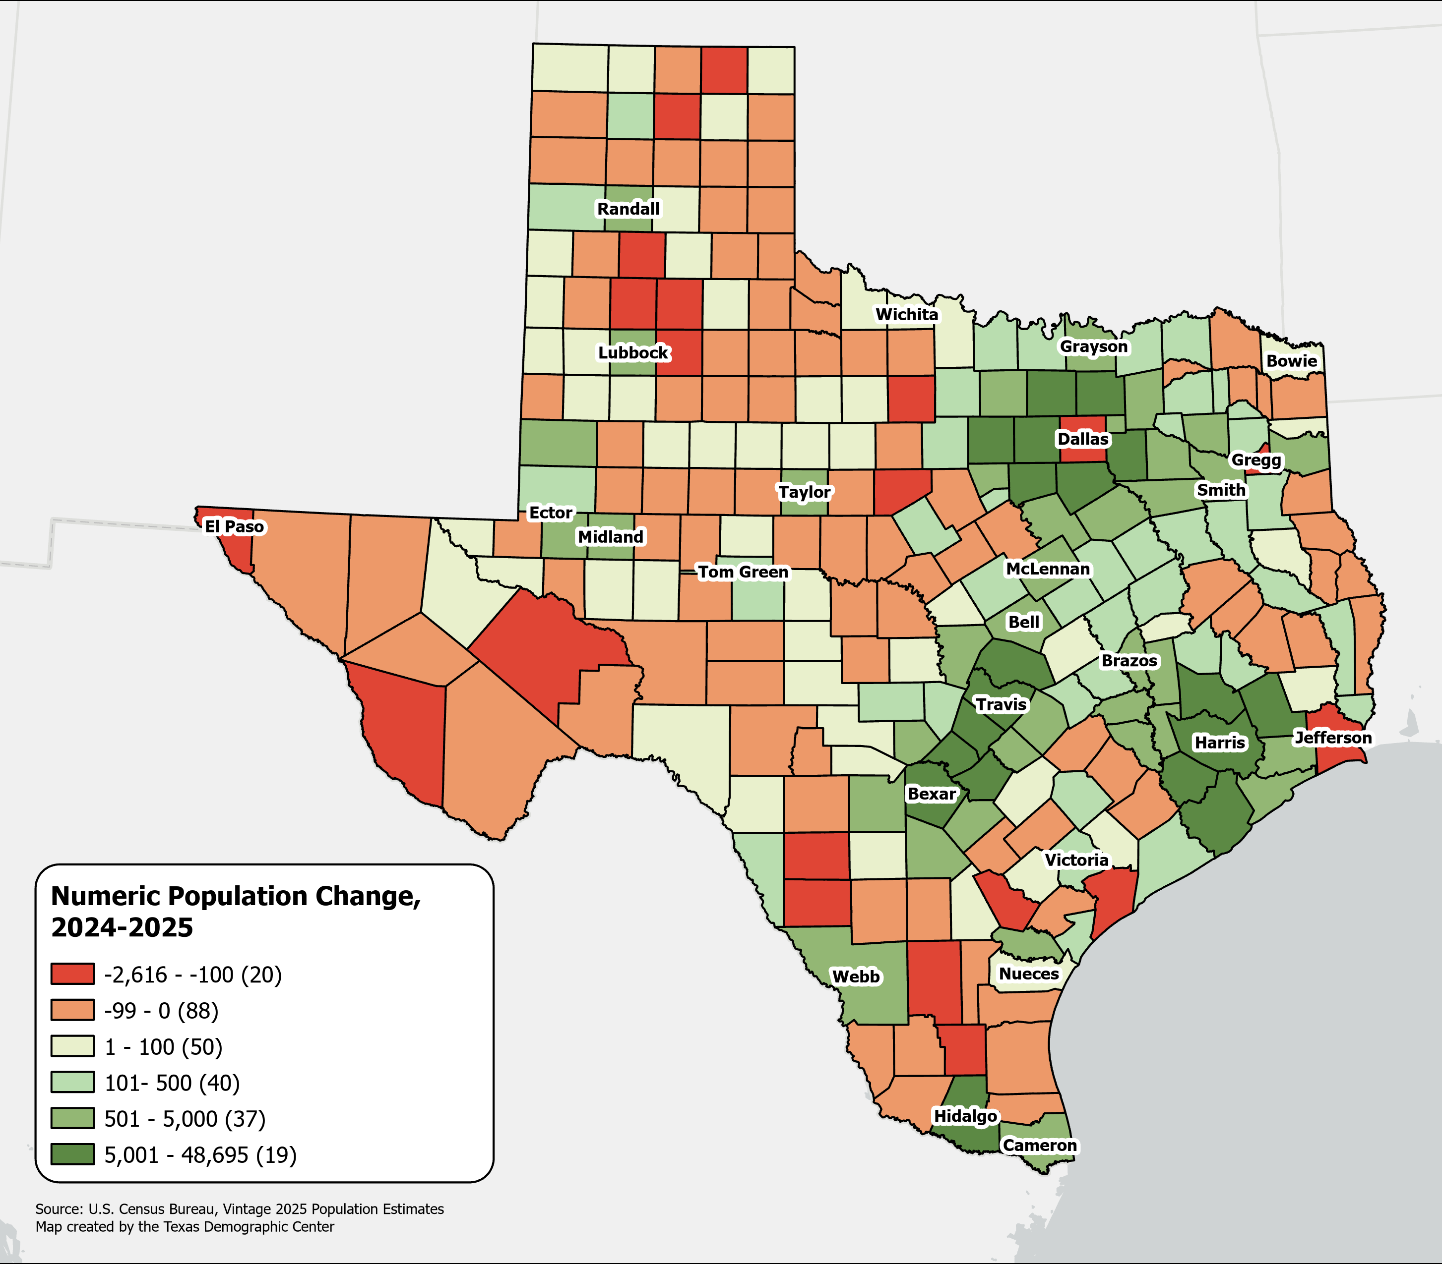
Numeric Change in Texas Counties, 2024-2025
108 counties (42%) lost population
Source: U.S. Census Bureau, Vintage 2025 Population Estimates
Notes:
Caption: Latest data from Census Bureau show that Texas is still growing, but slower than in previous years. A majority of counties (58%) experienced population growth within the TX triangle, while 108 counties (42%) concentrated in west and south TX lost population in the past year.

Slide 9
Texas Daily Population Growth and Components of Change 2020-2025
Drop in Net Migration Slows Texas Population Growth
917
1,494
1,647
1,642
1,072
Daily Average Population Change
Source: U.S. Census Bureau, Vintage 2025 Population Estimates

Slide 10
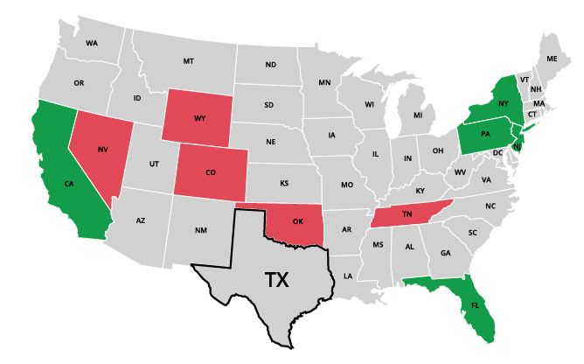
Top Net Migration To and From Texas: Leading States in 2024
Moving to Texas
California | 31,714
2. New York | 11,909
3. New Jersey | 8,148
4. Florida | 6,960
5. Pennsylvania | 5,730
Leaving Texas
1. Oklahoma | -9,495
2. Tennessee | -5,210
3. Colorado | -4,588
4. Wyoming | -2,342
5. Nevada | -2,180
Source: U.S. Census Bureau, 2024 State-to-State Migration Flows Statistics.
Notes:
Note: Data displayed are estimates based on a sample survey and are subject to error.
Caption: Latest U.S. Census Bureau Data: Around 550K domestic migrants moved to Texas in 2024, while 480K left for other states. Texas saw the largest net inflows of migrants from California, New York, and New Jersey and net outflows to Oklahoma, Tennessee, and Colorado.

Slide 11
Total Fertility Rate Trends of the U.S. and Texas, 2000-2022
Source: National Vital Statistics Reports, Centers for Disease Control and Prevention
Note: The total fertility rate is a demographic indicator that estimates the average number of children a woman will have during her childbearing years..

Slide 12
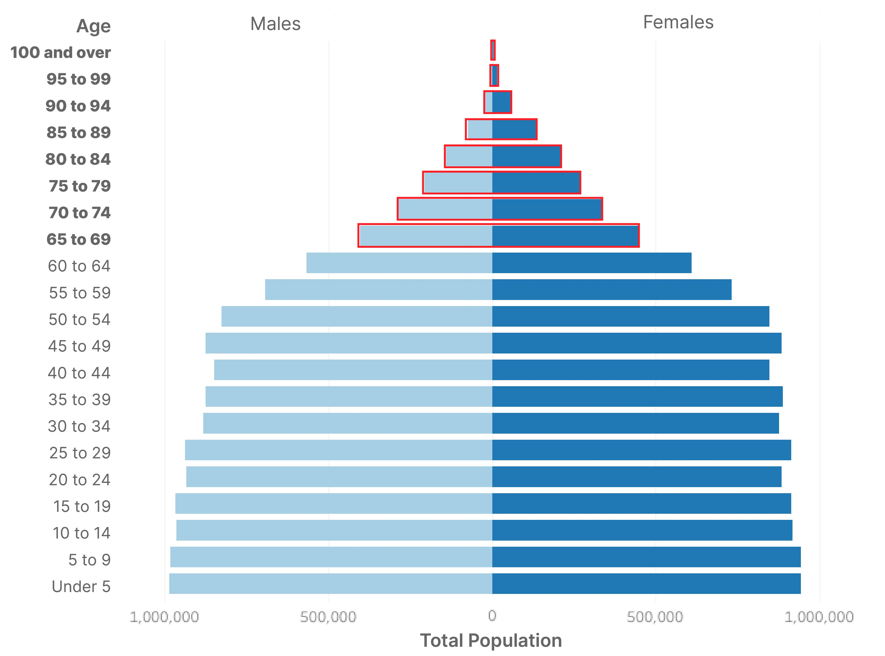
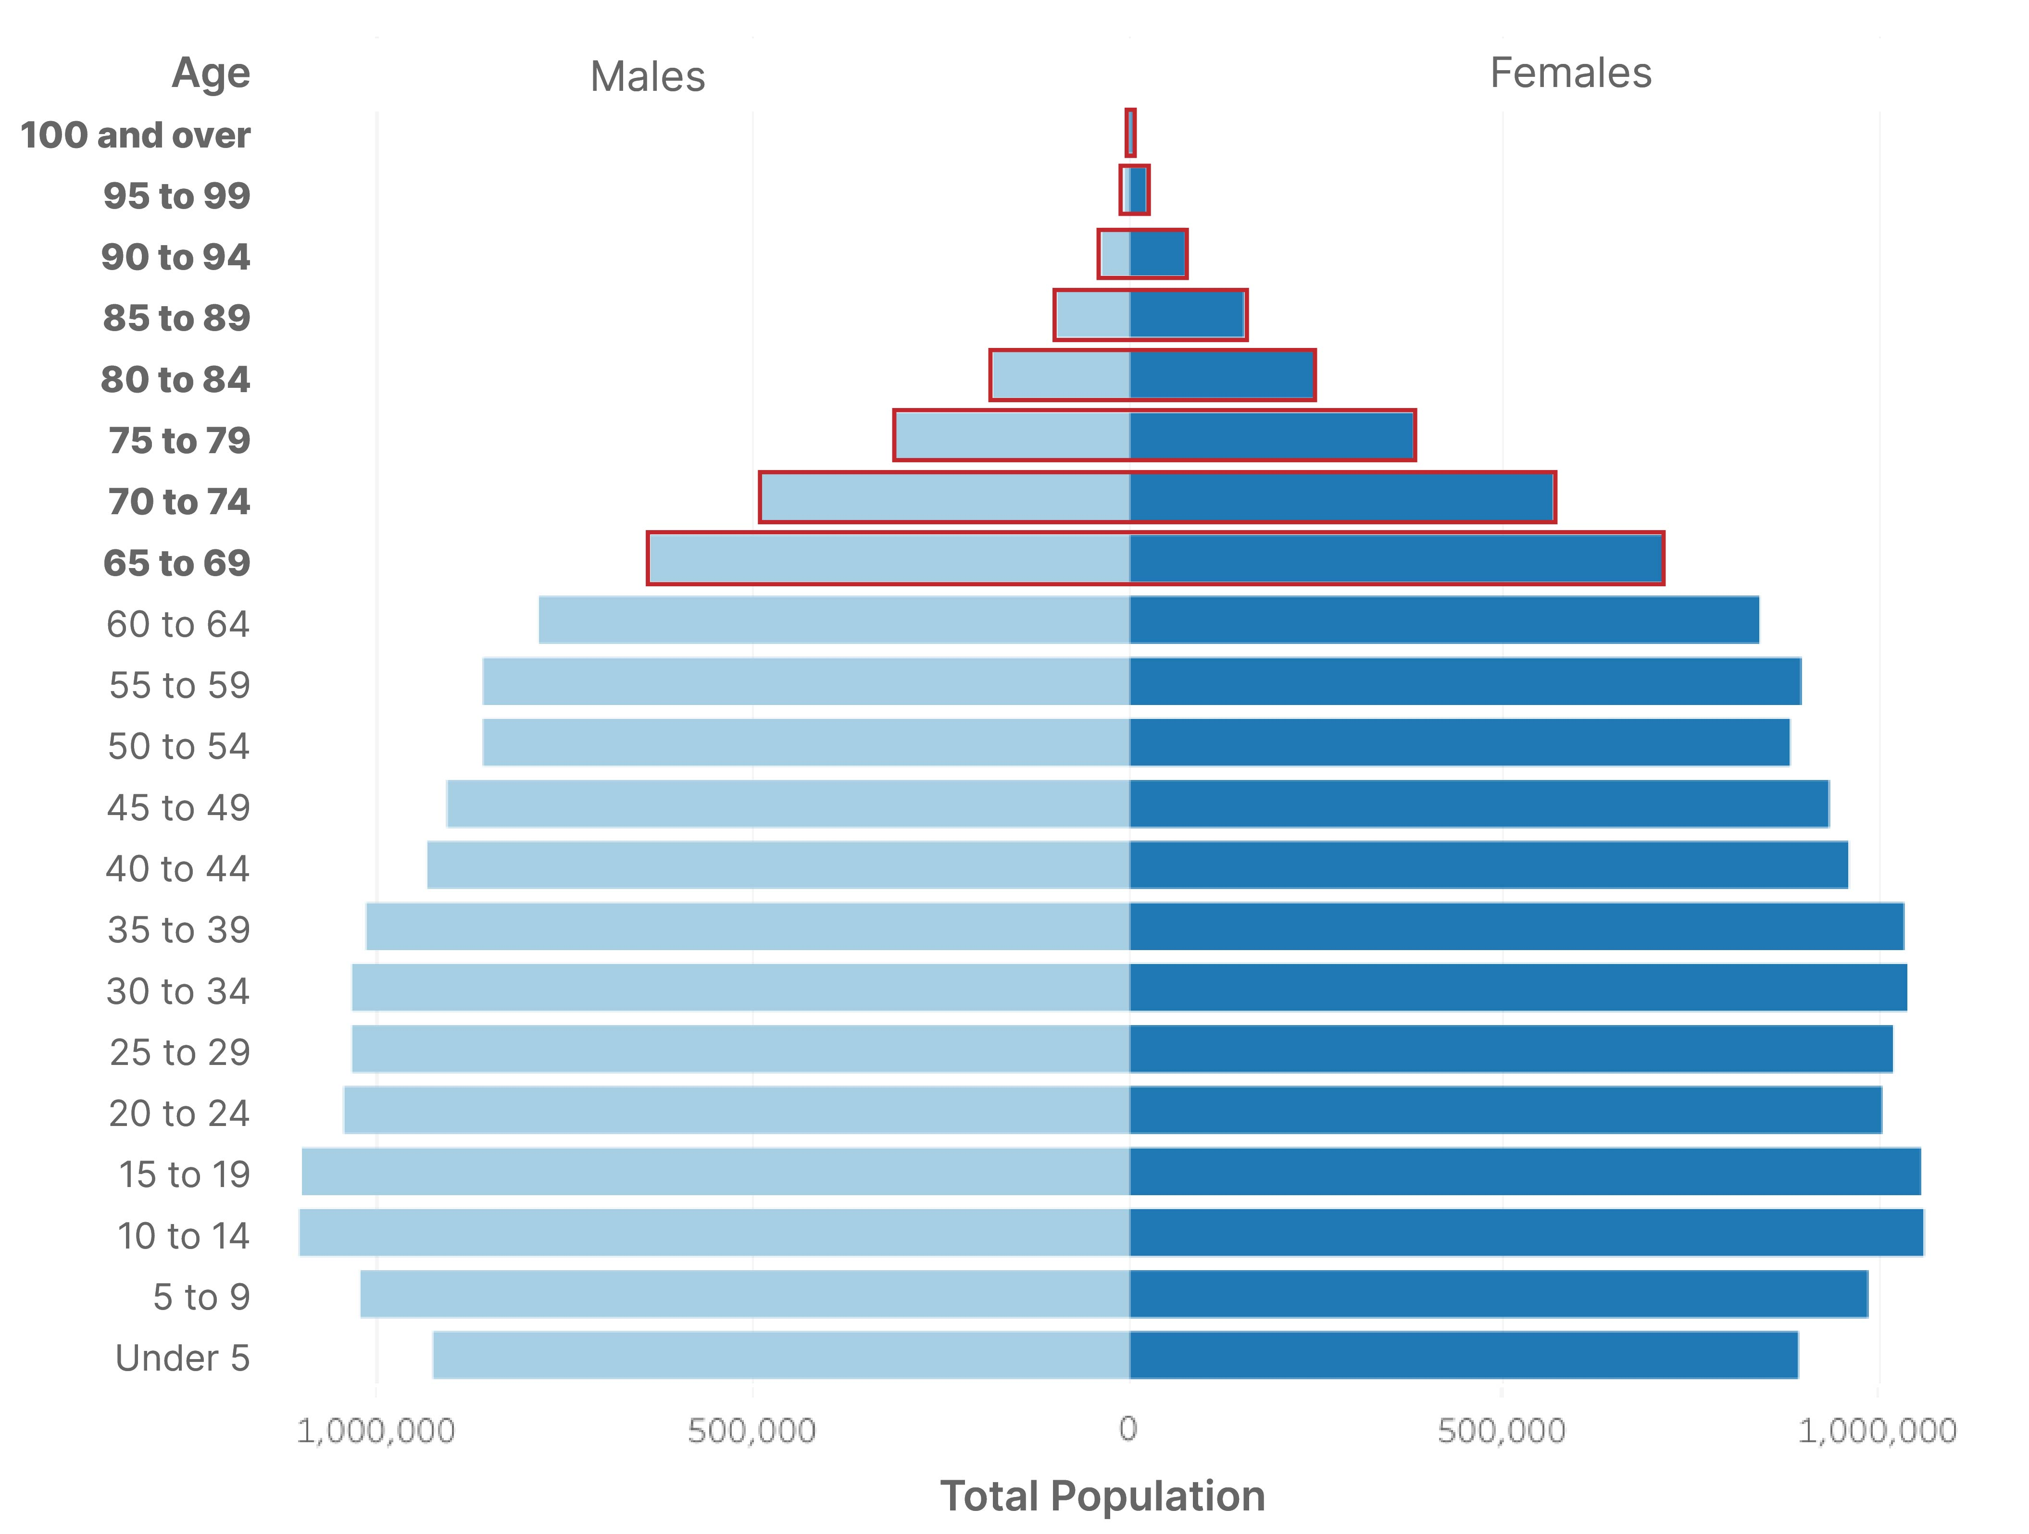
Texas Population Pyramid
2010
2020
% Population 65+:
10.3%
Population 65+:
2.6M
% Population 65+:
13.5%
Population 65+:
3.9M
Population: 25,145,561 | Median Age: 33.6 | % under 18 years: 27.3
Population: 29,145,505 | Median Age: 35.6 | % under 18 years: 25.0
Source: U.S. Census Bureau, Census 2000 Summary File 1 (SF1), 2010 Census Summary File 1 (SF1), 2020 Census Demographic and Housing Characteristics File (DHC)

Slide 13
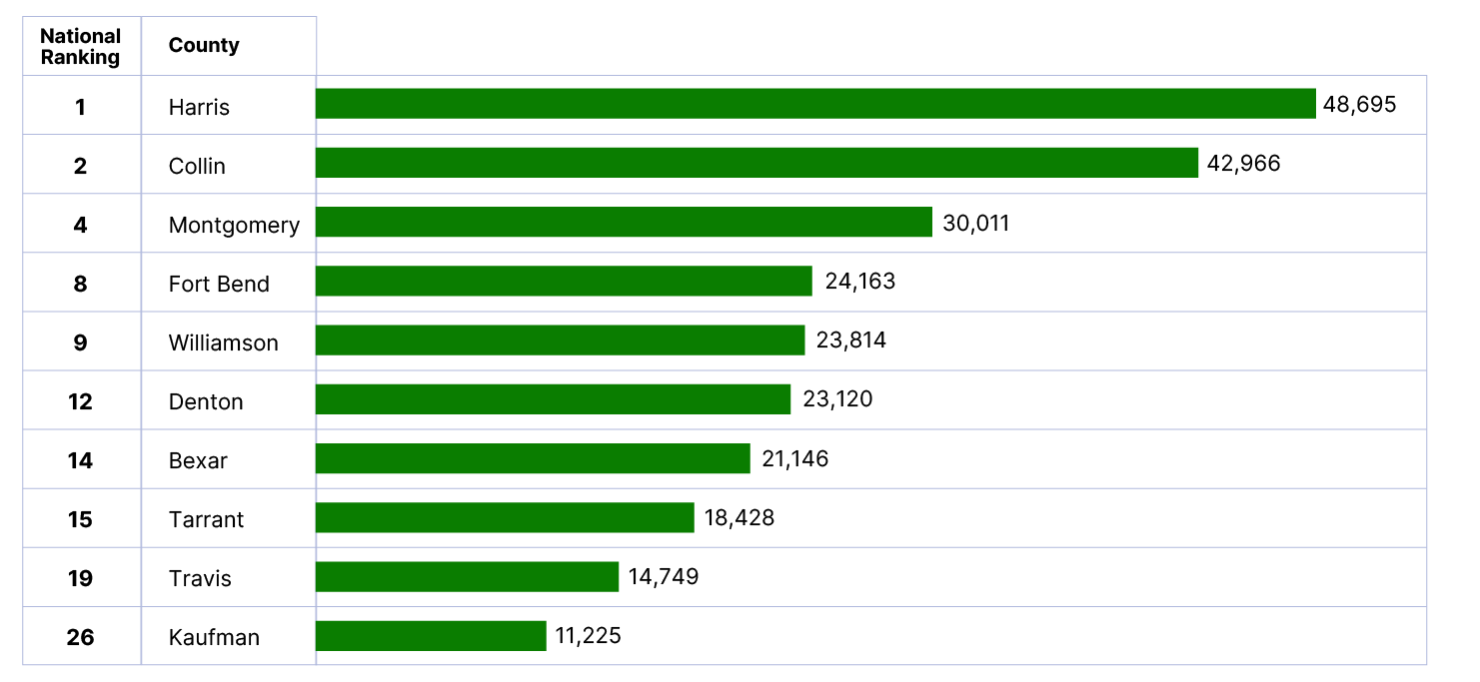
Top 10 Counties by Numeric Growth in Texas and their U.S. Ranking
From July 1, 2024 to July 1, 2025
Source: U.S. Census Bureau, Vintage 2025 Population Estimates
Notes:
Caption: Five of the nation’s top 10 counties for numeric growth are right here in Texas. Harris County leads the state, adding more than 48,000 new residents from 2024 to 2025. Texas continues to be one of the country’s most sought after places to call home.

Slide 14
Texas Cities by Largest Numeric Growth from 2023 to 2024 and National Ranking
National
Ranking
City
1
2
3
4
8
9
10
11
18
21
Source: U.S. Census Bureau, Vintage 2024 Population Estimates

Slide 15
Demographic Change and Demand for Services

Slide 16

Median Household Income and Home Value
Gap Widens in Texas, 2013-2023
Median
Home
Value
Median
Household
Income
$
$
$
Source: U.S. Census Bureau, American Community Survey, 1-Year, 2013, 2018, and 2023.
Note: 2023 Inflation-Adjusted Dollars.
Notes:
The median household income has not kept up with the cost of housing in TX. Population growth, rising costs for building materials, and labor shortages have affected the supply of homes and increased their cost, making it difficult for many Texans to purchase and own a home.

Slide 17
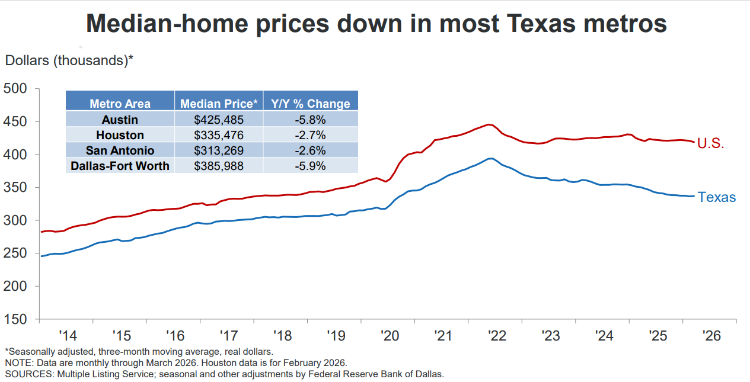

Slide 18








Housing Tenure and Costs in Texas, 2024
11.4 million occupied housing units
Homeowners
Renters
62.3% homeowners in Texas
37.7% renters in Texas
Median mortgage: $2,211/month
Median rent: $1,475/month
Cost burden: 31%
Cost burden: 53%
Source: U.S. Census Bureau, 2024 American Community Survey, 1-Year Estimates

Slide 19
Percent Uninsured by Race/Ethnicity, Texas 2024
16.7% of Texans are without health insurance
TX has the highest uninsured rate in the US
Source: U.S. Census Bureau, American Community Survey, 2024 1-year estimates

Slide 20
Mean Commuting Time in Texas and Major Cities (2014-2024)
minutes
Source: U.S. Census Bureau, American Community Survey Estimates, 1-Year, 2014 – 2024.
Notes:
NOTE: Commute times reflected are for residents who live within city boundaries and not for individuals who work in these cities but reside elsewhere.
Caption: Average commute times in Texas rose before the pandemic, dipped after, and are climbing again. Houston and Fort Worth still have the longest one‑way trips, while Austin and San Antonio remain the shortest. By 2024, most major cities are back to (or above) pre‑pandemic levels.

Slide 21
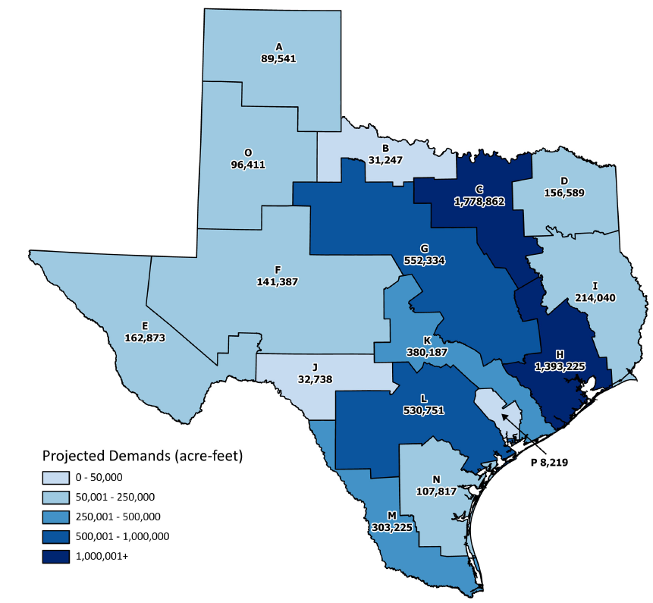
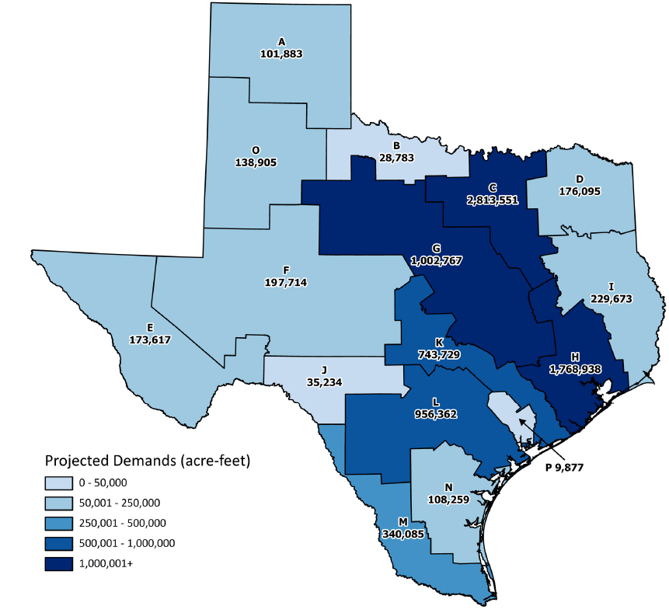
Projected Municipal Water Demands
2030
2080
Source: 2022 State Water Plan, Texas Water Development Board

Slide 22
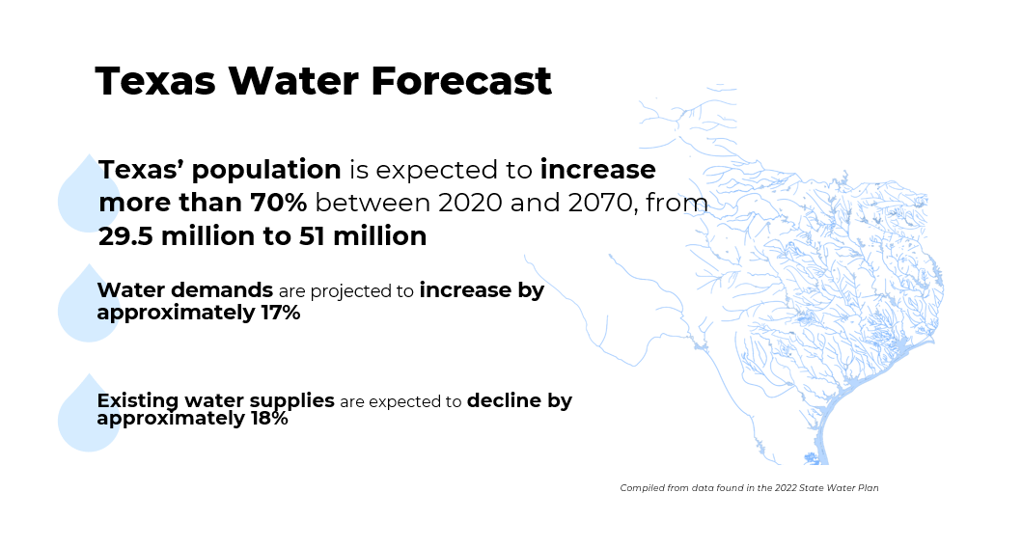
Texas Water Forecast
Source: 2022 State Water Plan, Texas Water Development Board

Slide 23
A Look at San Antonio and Region

Slide 24
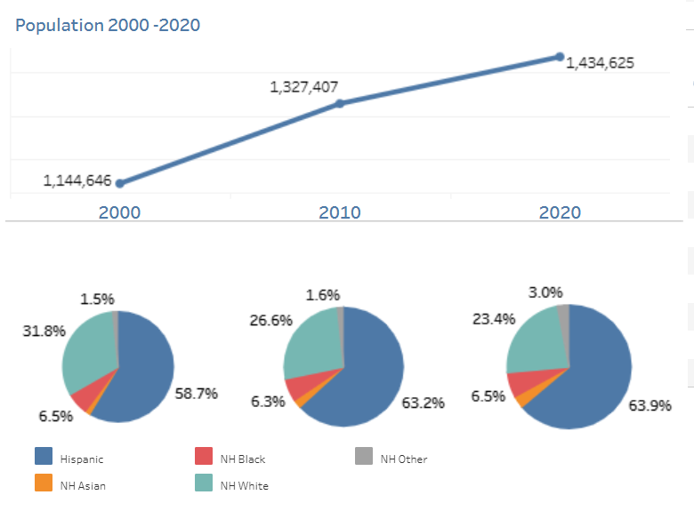
San Antonio, Texas 2000-2020
Population and Demographic Characteristics
Current
Population 1.5 M
Source: U.S. Census Bureau, Decennial Census, 2000, 2010, 2020, Population Estimates, 2024

Slide 25
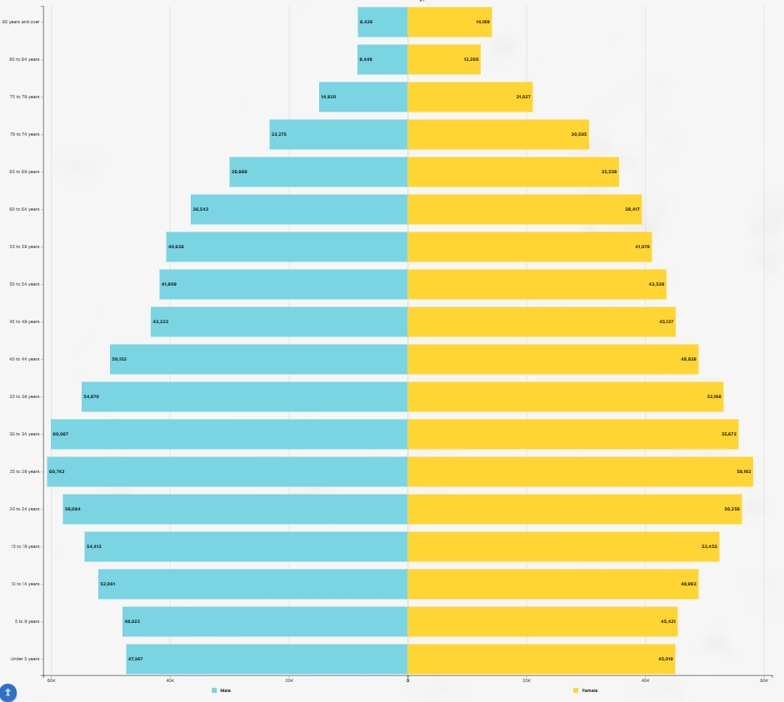
San Antonio, Texas
Population Pyramid
Median Age in SA= 34.9
Median Age in TX= 35.9
Source: U.S. Census Bureau, 2024 ACS 1-year Estimates

Slide 26
Percent of the Population with a BA or Higher, San Antonio
Population 25 years and older
Source: U.S. Census Bureau, 2024 ACS 1-Year Estimates

Slide 27
Median Household Income by Race/Ethnicity
San Antonio, Texas
Median Household Income in Texas: $79,721
U.S. Census Bureau, ACS 2024 1-year estimates

Slide 28
Housing Characteristics
Texas, Bexar County, San Antonio
Median Monthly Costs (SA) Homeowner: $1,824
Renter: $1,389
 | Texas | Bexar County | San Antonio
Percent of Owner-occupied households | 62.6% | 58.4% | 51.9%
Percent of Renter-occupied households | 37.4% | 41.6% | 48.1%
Percent of Owner-occupied households that pay 30% or more of their monthly income on housing | 31% | 30.6% | 31.9%
Percent of Renter-occupied households that pay 30% or more of their monthly income on housing | 53% | 55.2% | 55.1%
*Cost Burden: When a household spends more than 1/3 of its income on housing costs.
Source: U.S. Census Bureau. "Selected Housing Characteristics." American Community Survey, 2024 ACS 1-Year Estimates Data Profiles, Table DP04

Slide 29
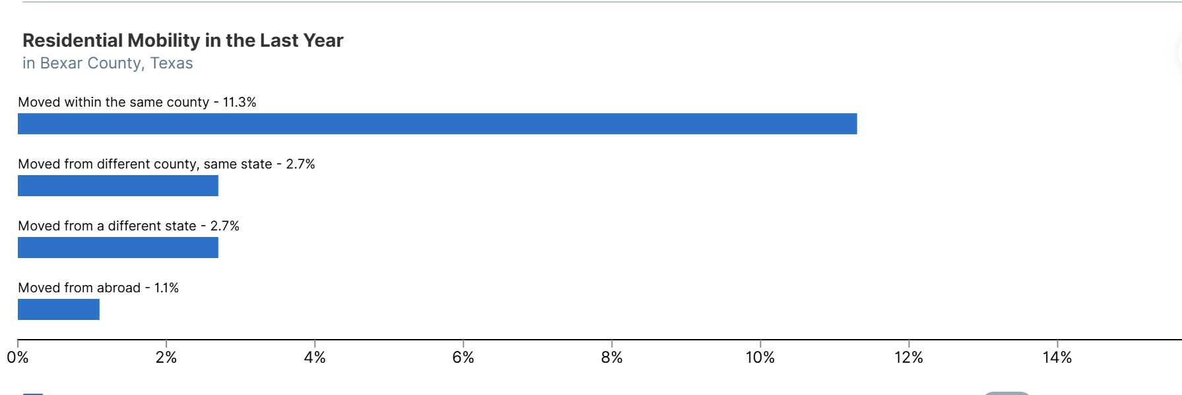
Residential Mobility, Bexar County
Source: U.S. Census Bureau, 2024 ACS 1-year estimates

Slide 30
Source: U.S. Census Bureau, ACS 1-year estimatesource: U.S. Census Bureau, 2014-2024 American Community Survey, 1-year estimates

Slide 31
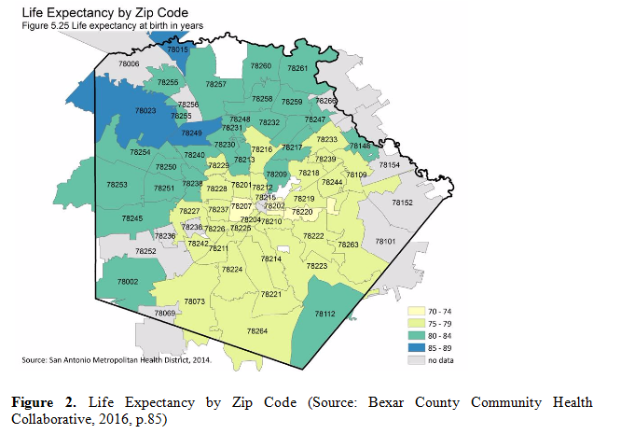
Life Expectancy by Zip Code, Bexar County
On average, Northside residents in Bexar County live 20 years longer than Southside residents.

Slide 32
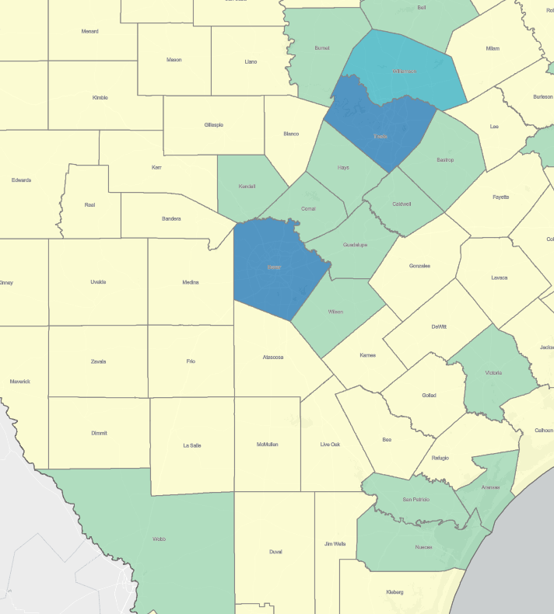
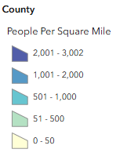
Population Density, South Texas Region
County | Population
Williamson | 752,827
Travis | 1,389,670
Hays | 304,390
Comal | 209,166
Kendall | 53,289
Guadalupe | 201,111
Bexar | 2,160,088
Medina | 56,881
Webb | 281,224
Source: Texas Demographic Center, Population Density Map, 2025
U.S. Census Bureau, Vintage 2024 Population Estimates

Slide 33
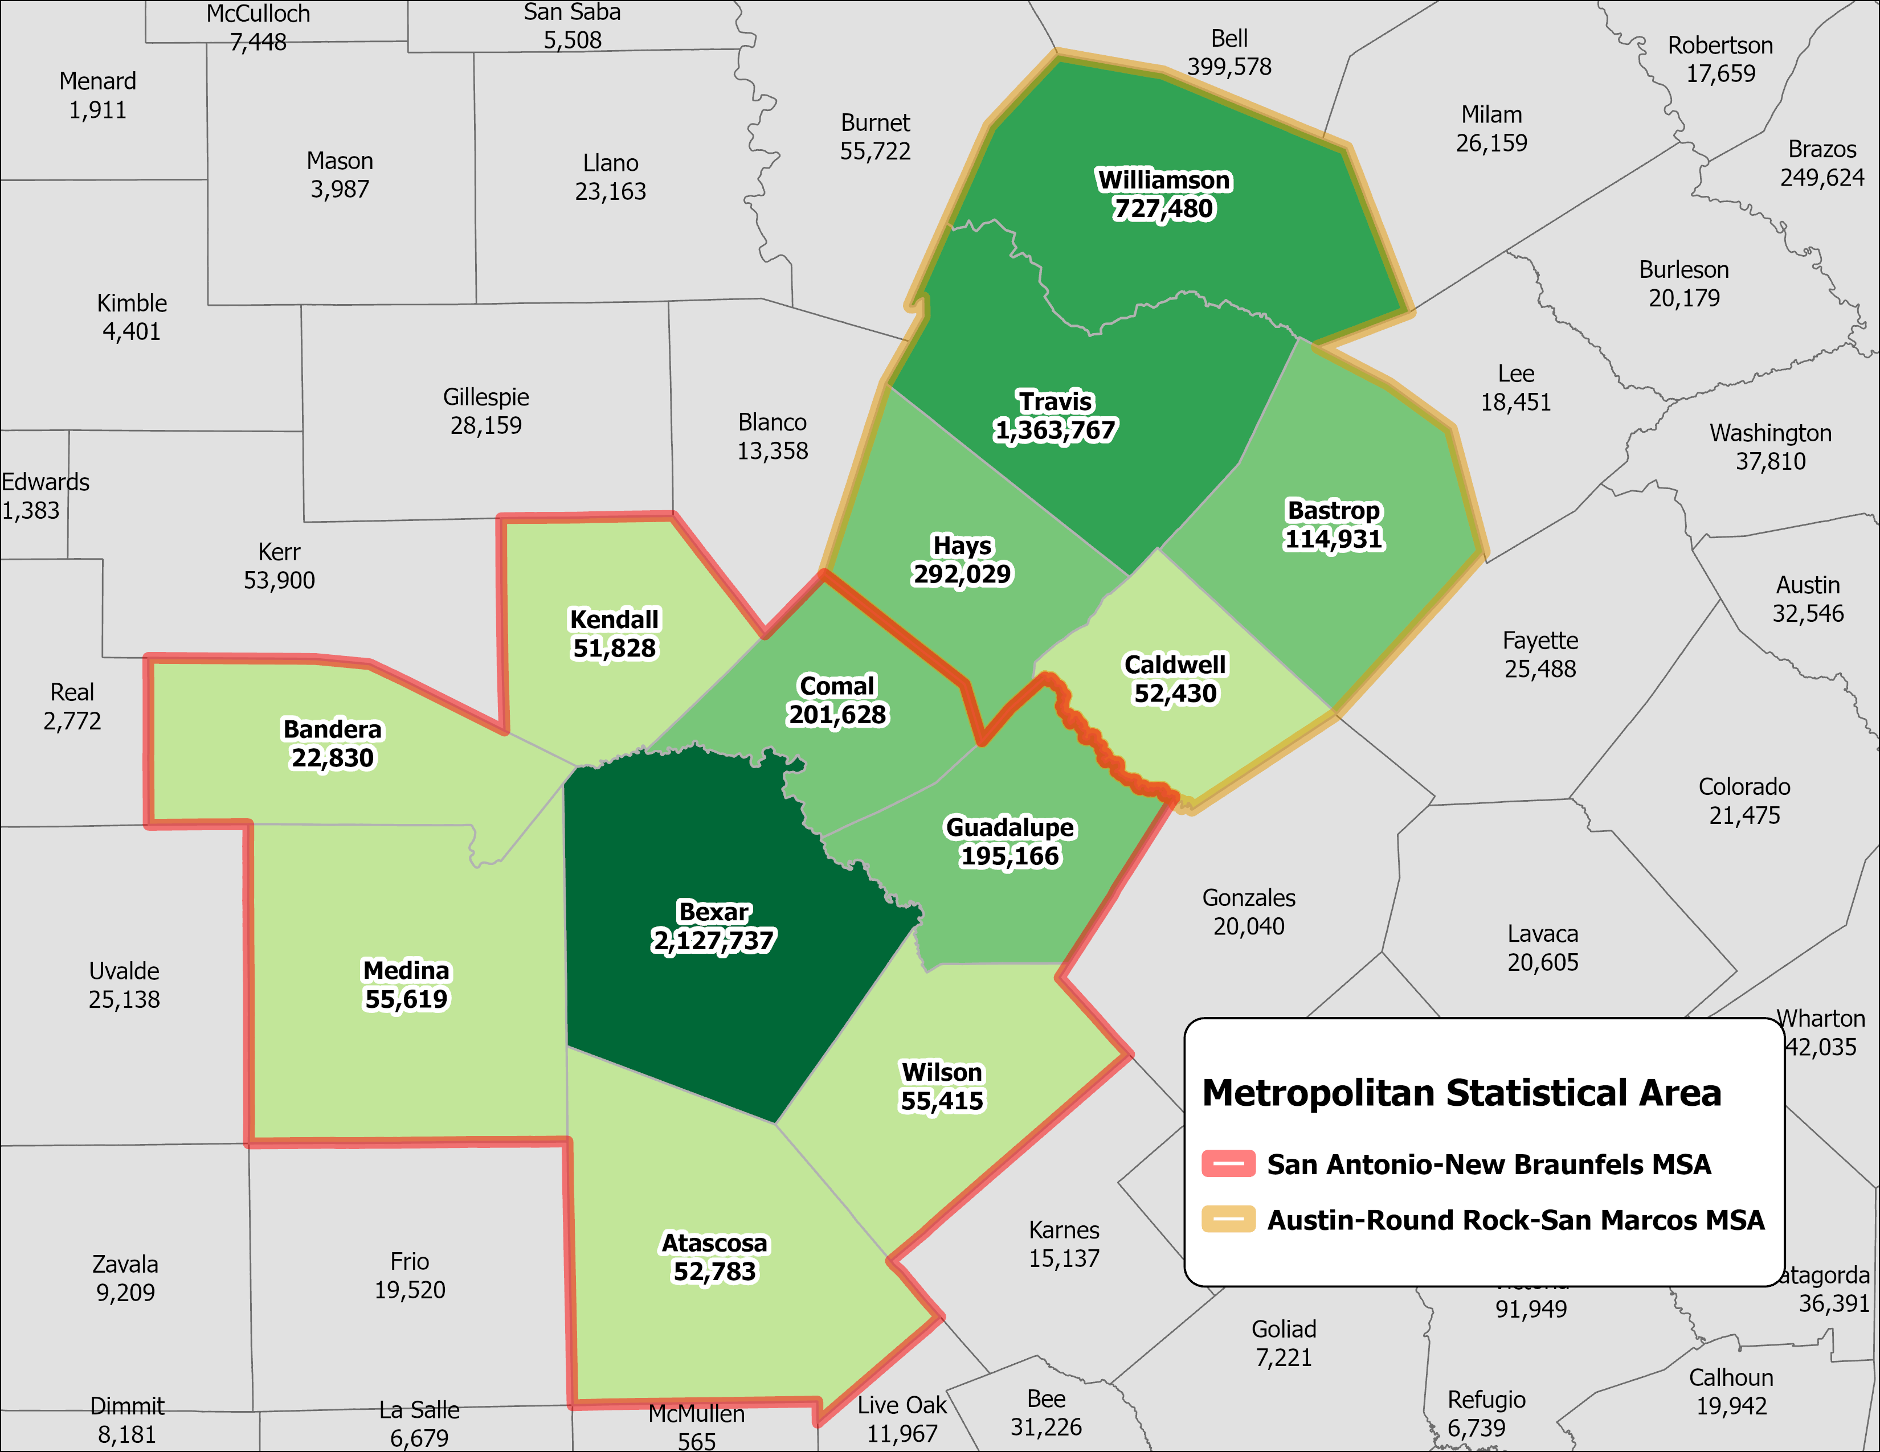
Source: U.S. Census Bureau, American Community Survey, 2024 5-year Sample
Notes:
.

Slide 34
Top Five Industries, 2014 and 2024
Source: U.S. Census Bureau, American Community Survey 1-Year Estimates, 2014 and 2024

Slide 35
Business Dynamics Statistics
San Antonio- New Braunfels MSA
Source: U.S. Census Bureau, Economic Survey, 2013, 2018, 2023 Business Dynamics Statistics

Slide 36
Business Dynamics Statistics
Austin-Round Rock-San Marcos MSA
Source: U.S. Census Bureau, Economic Survey, 2013.2018, 2023 Business Dynamics Statistics

Slide 37
A Look into the Future

Slide 38
Projected Population Growth in Texas with Various Migration Scenarios
2020-2060
42.6 million by 2060
Source: Texas Demographic Center, Vintage 2022 and 2024 Population Projections

Slide 39
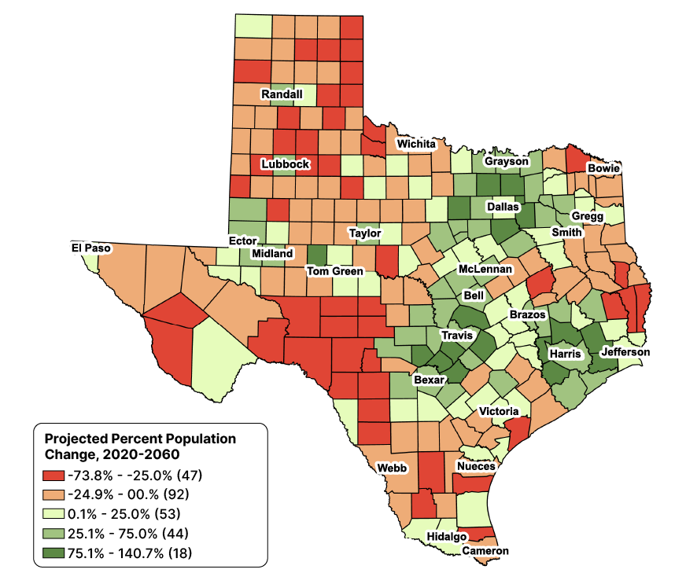
Projected Percent Population Change for Texas Counties, 2020-2060
Source: Texas Demographic Center, Vintage 2024 Population Projections, Mid-Migration Scenario.
Notes:
Caption: Our Vintage 2024 population projections show continued growth in major metro areas, while rural and selected border counties experience moderate growth or declining population. With migration as a major driver, TDC will monitor and highlight these patterns in future projections.

Slide 40
Projected Population Growth, Selected Counties
2020-2060
Source: Texas Demographic Center, 2024 Vintage Population Projections

Slide 41
Texas Projected Population by Age, 2020-2060
Share of population 65+ will continue to increase
22%
18%
13%
60%
60%
62%
25%
21%
18%
Total Population
29.1M
37.1M
42.6M
Source: Texas Demographic Center, Vintage 2024 Population Projections, Mid-Migration Scenario.
Notes:
Caption: New TDC Vintage 2024 projections show Texas will continue to age in the next few decades. The 65+ group will grow fastest. Growth among those under18 will slow and begin to decline. The working-age population will grow and maintain a stable share of the total population.

Slide 42
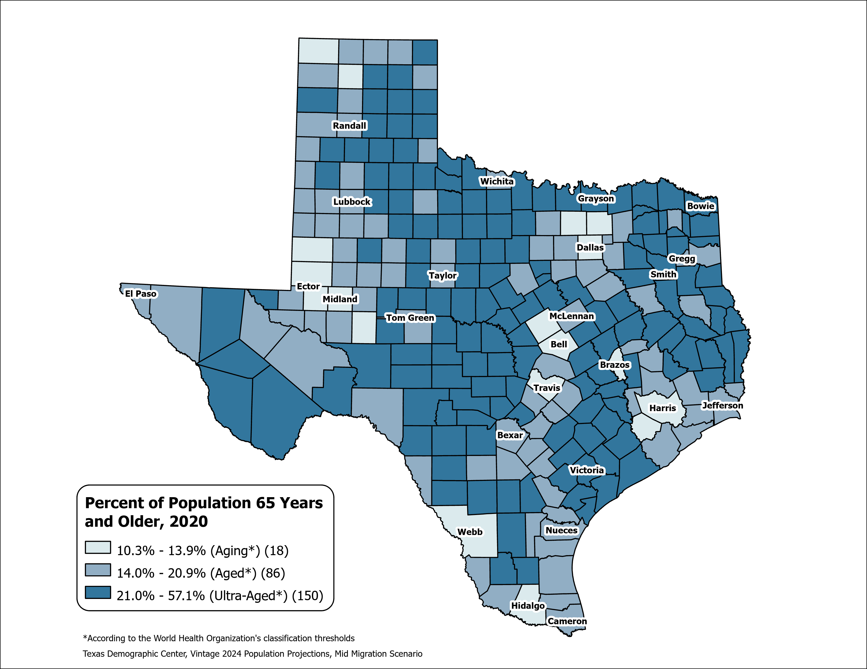
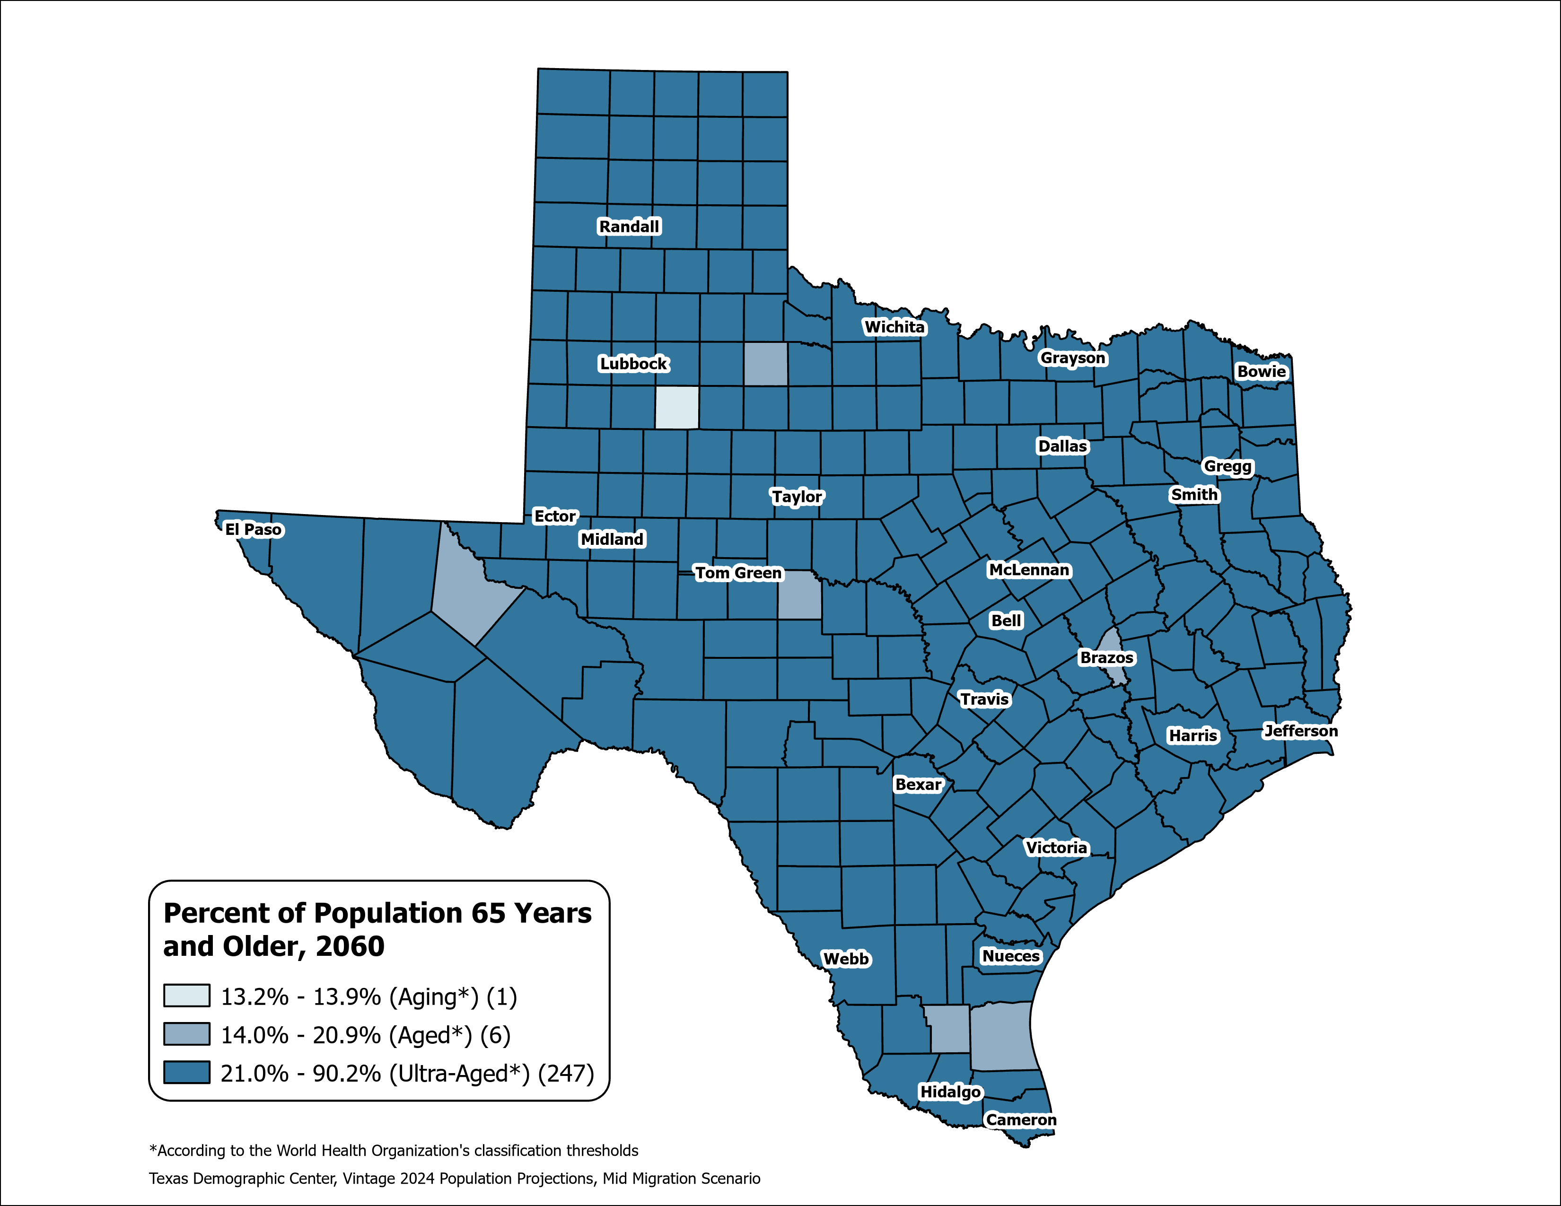
County Aging Map – Using the % of 65+ to Measure
Texas 2020: Aging (13.5%)
Texas 2060: Ultra-Aged (21.7%)
Source: Texas Demographic Center, Vintage 2024 Population Projections, Mid-Migration Scenario

Slide 43
Projected Population by Race/Ethnicity in Texas
Share of Hispanic population will continue to increase
42.6 million by 2060
Source: Texas Demographic Center, Vintage 2024 Population Projections, Mid-Migration Scenario

Slide 44
Preparing for the 2030 Census
Between 2010- 2020 Texas ranked #1 in numeric growth adding 3.9 million new Texans
YET 2020 Census: Texas was one of 6 states with an undercount (approximately 500K people)
Undercounting the population costs us billions in lost funding for infrastructure, health care, social services
Participate in the 2027 Local Update Census Addresses (LUCA) to ensure the Census Bureau has every address in your city or county.

Slide 45
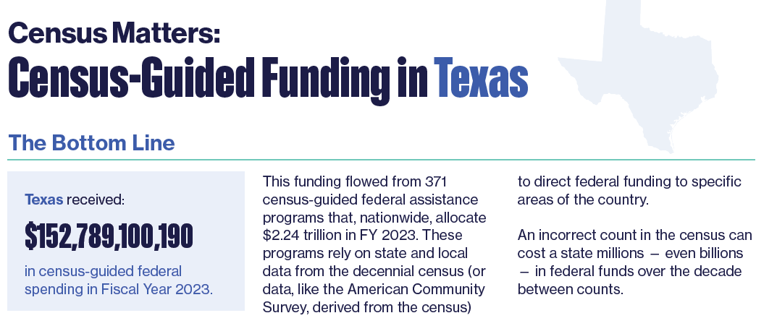
Why Good Population Data Matters
Texas received over
$152 Billion
in Census-guided federal assistance in 2023
Project on Government Oversight report
Source: Census Matters: Why an Accurate Count is Essential to Funding Our Communities | Project On Government Oversight

Slide 46
In summary:
Since the 2020 Decennial Census, Texas has consistently ranked #1 in the country in numeric growth.
Population growth has been driven by migration (international and domestic).
The Texas population is getting older, but at a slower rate than other states in the U.S.
Hispanics make up the greatest share of the population.
Monitoring demographic growth and trends will help us:
  Manage our natural resources;
  Develop infrastructure to support the economy;
  Expand vital services for the well-being of all Texans.

Slide 47



Slide 48




Visit our website
Sign up for our newsletter
Follow us on social media

Slide 49
Monica Cruz, Ph.D.
(210) 458-6543
tdc@utsa.edu
demographics.texas.gov/

